Slide 1

Copernicus
J.S Peirce
Edward Sayers
Portland State Univ.
ECE478
Fall 2015

Slide 2

Copernicus Robot
Tasks:
-Implement Kinect control mechanisms.
-Install robot body onto roving base.
-Assess motor driver “black-box.”
-Locate and assess any motor driver software.
-Attempt control of base motors.
-Create presentation related to Copernicus robot and our findings.
Introduction
Methods
Results
Discussion

Slide 3

Work:
-Implement Kinect control software.
-Leverage software provided by J.R. Kerr website.
-Repair and Port J.R.Kerr software for Visual Studio 2003 to functional state in VS2015.
-Recompile J.R. Kerr motor control libraries, DLLs and example projects from source.
-Merge it directly with our Kinect program and thereby control the robot via the Kinect.
-The NMC test utility program does work on current versions of Windows, as it is a *.exe Windows executable file.
-Motors, serial communication and motor driver boards all tested functional with NMC test utility.
Introduction
Methods
Results
Discussion

Slide 4
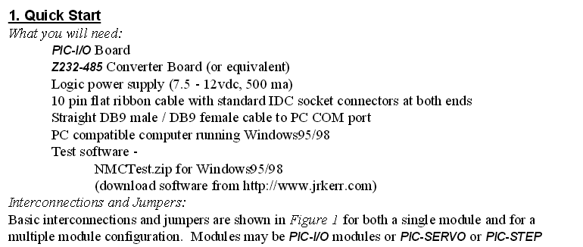
Work:
-Verification of motors/driver boards first priority.
-Leverage NMC Test Utility.
-Find necessary cables, power supply, determine polarity, etc.
-Once motors are verified, continue porting J.R.Kerr software.
Introduction
Methods
Results
Discussion

Slide 5

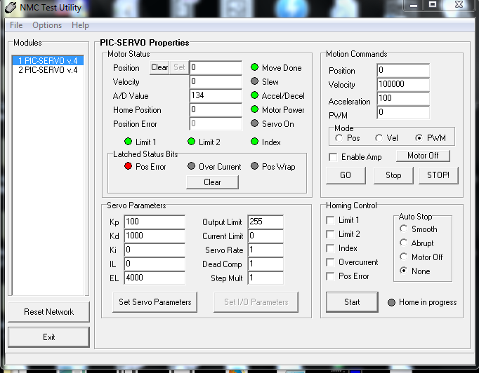
Motor Verification:
Screenshot of NMC Test Utility:
Introduction
Allows user to enable amplifiers and send PWM signals to motors via the USB to Serial cable.
Methods
Results
Discussion

Slide 6
Work:
-To aid in verification and testing, use USBPcap can sniff USB traffic.
-USBPcap packet capture program produces .pcap files.
-Files are readable with Wireshark, tcpdump, etc.
Introduction
Methods
Results
Discussion

Slide 7
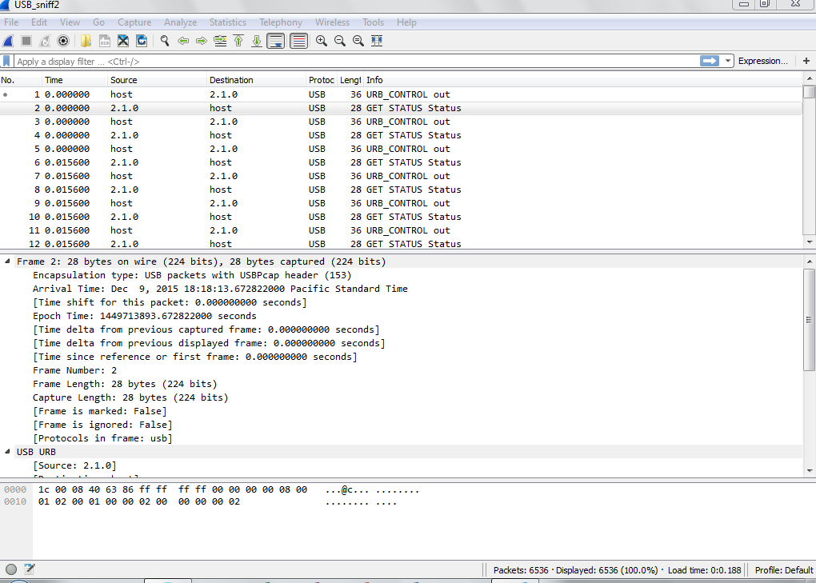
Protocol Pirating:
Analyzing USB packets captured with USBPcap in Wireshark:
Introduction
Methods
Results
Discussion

Slide 8
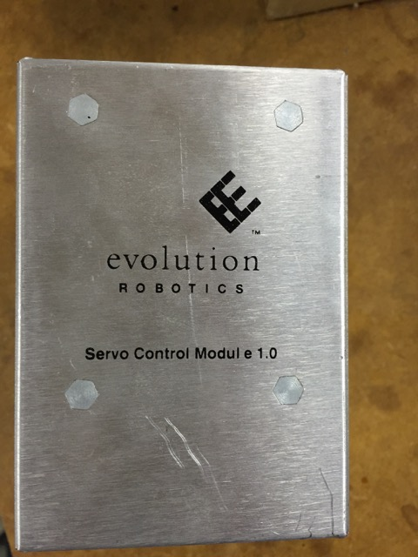
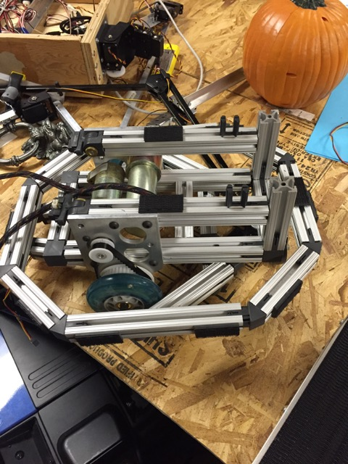
Work:
-Given this newly assembled information, toolset and workflow,the task of writing a new interpreter is feasible should it be deemed necessary for the next team.
-This would not include attempting to repair the existing software.
Introduction
Methods
Results
Discussion

Slide 9

Necessary Software:
J.R Kerr LLC: http://www.jrkerr.com/software.html
3rd party Linux: http://www.praecogito.com/~brudy/blue_cube/code/blue_move/
FTDI Drivers: http://www.ftdichip.com/Drivers/D2XX.htm
Visual Studio 2015 Enterprise→ Install VC++ tools through Setup
Wireshark USB sniffing: (via USBPcap)
https://wiki.wireshark.org/CaptureSetup/USB
USBPcap:
http://desowin.org/usbpcap/
RealTerm:
http://sourceforge.net/projects/realterm/
Introduction
Methods
Results
Discussion

Slide 10
Hardware:
Hardware platform: Evolution Robotics servo controller.
(3 total) Internal boards:
(1) RS-232 → Serial comm board
(2) PIC-SERVO v.4, PIC_ENC v.1 boards
(2) Motors, mounted on base chassis
Power for servo control unit:
9V, 3-4 Amp.connector polarity GND -> - ( + ), center high.
-Saelig RS-232 → USB Serial cable
Introduction
Methods
Results
Discussion

Slide 11
Assessment:
-The current tools are not available to immediately use this base for the robot with the standard controller.
-An overhaul of the software is possible with now assembled tools and documentation.
-If valid software existed, would be ideal platform for Intel NUC or similar.
Introduction
Methods
Results
Discussion

Slide 12

References
J.R Kerr LLC
Software: http://www.jrkerr.com/software.html
Documentation:
http://www.jrkerr.com/picsrvsc.pdf http://www.jrkerr.com/pioboard.pdf http://www.jrkerr.com/piodata.pdf http://www.jrkerr.com/boards.html
3rd party Linux: Bryan Rudy: http://www.praecogito.com/~brudy/blue_cube/code/blue_move/
Wireshark:
https://wiki.wireshark.org/CaptureSetup/USB
USBPcap:
http://desowin.org/usbpcap/
FTDI Drivers:
http://www.ftdichip.com/Drivers/D2XX.htm
Microsoft:
Visual Studio 2015 Enterprise

