Slide 1
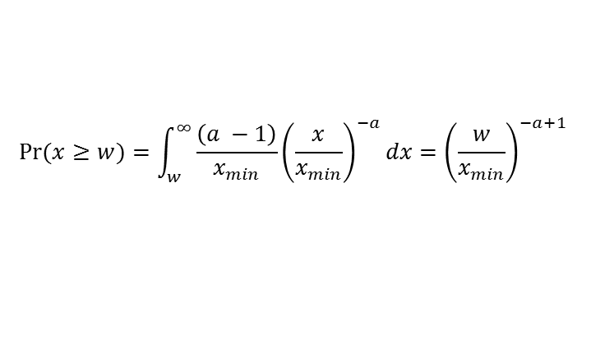
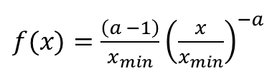
$f(x)=\frac{\left(a −1\right)}{x_{min}}{\left(\frac{x}{x_{min}}\right)}^{−a}$
$$Pr⁡(x≥w)=\int_{w}^{∞}{\frac{\left(a −1\right)}{x_{min}}{\left(\frac{x}{x_{min}}\right)}^{−a}dx={\left(\frac{w}{x_{min}}\right)}^{−a+1}}$$

