Slide 1
LoadTGA / WriteTGA 설명
2021. 3. 23

Slide 2
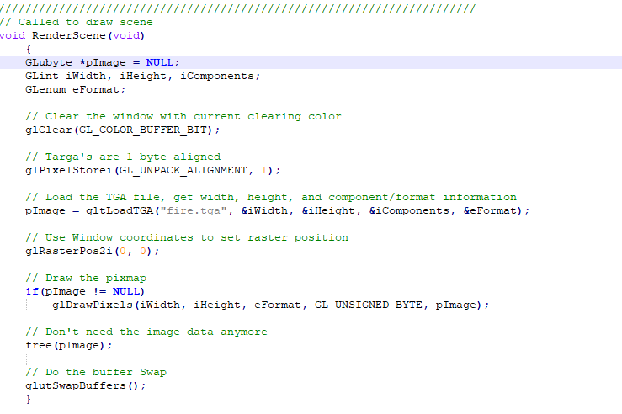

Slide 3
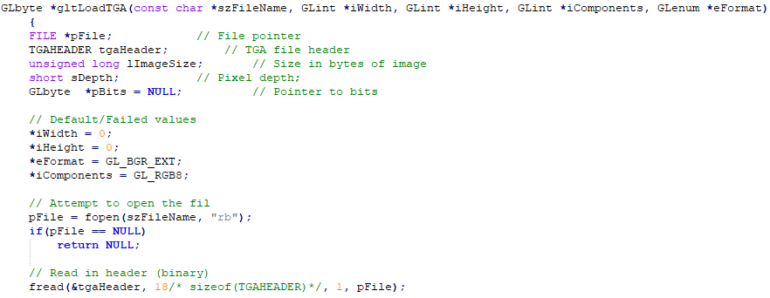

Slide 4
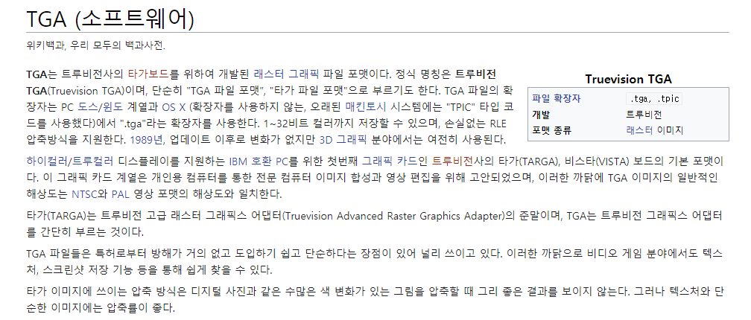
https://ko.wikipedia.org/wiki/TGA_(%EC%86%8C%ED%94%84%ED%8A%B8%EC%9B%A8%EC%96%B4)

Slide 5
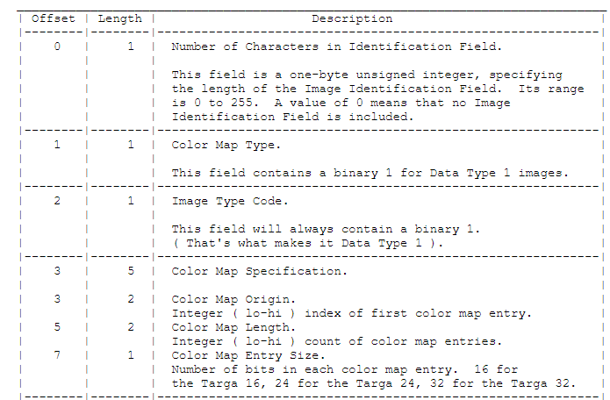
http://www.paulbourke.net/dataformats/tga/

Slide 6
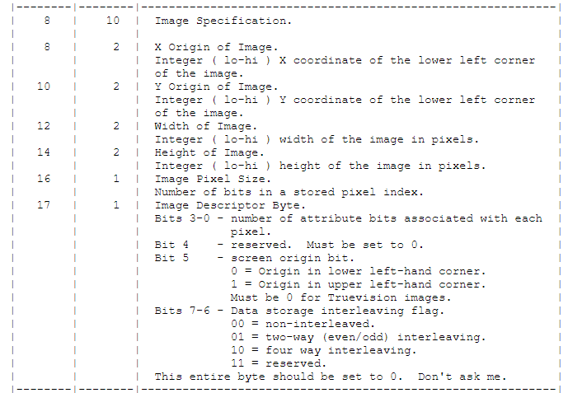
http://www.paulbourke.net/dataformats/tga/

Slide 7
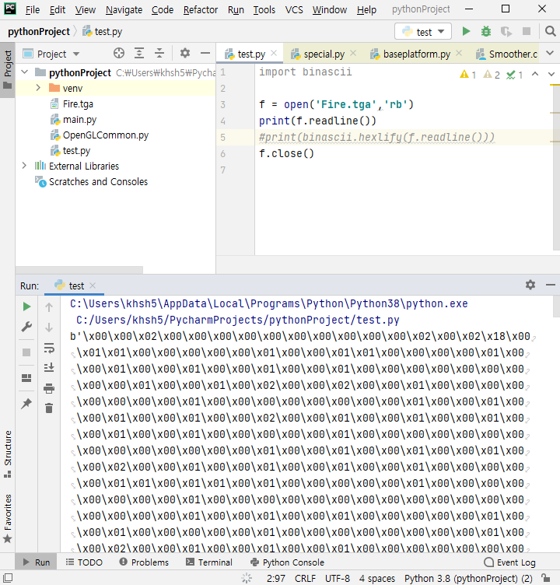

Slide 8
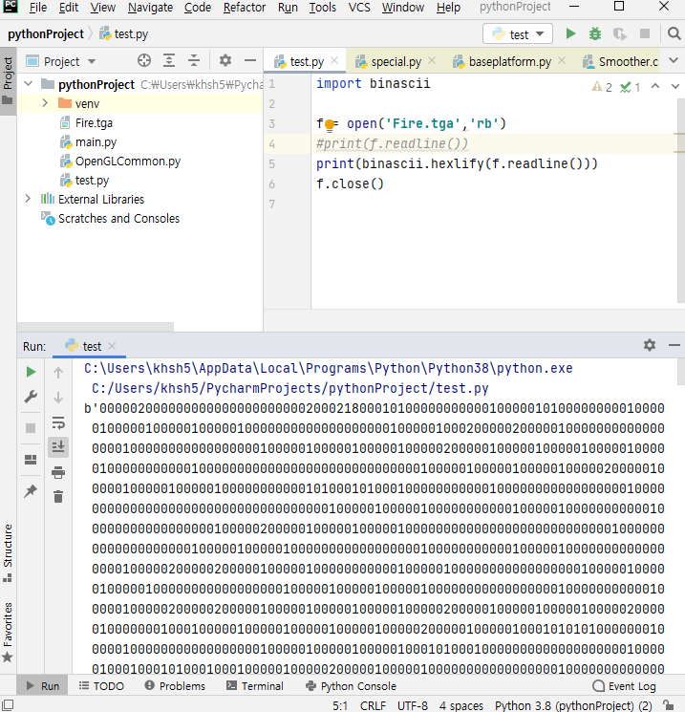

Slide 9
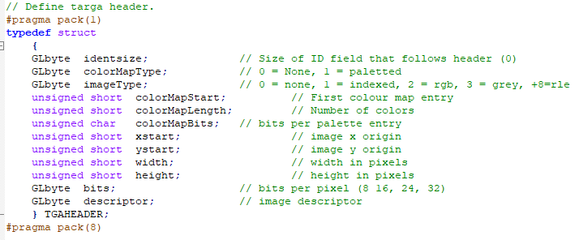
\x00
\x00
\x02
\x00\x00
\x00\x00
\x00
\x00\x00
\x00\x00
\x00\x02
\x00\x02
\x18
\x00

Slide 10
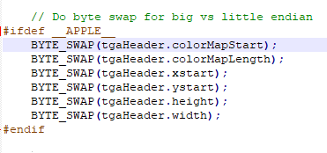

Slide 11
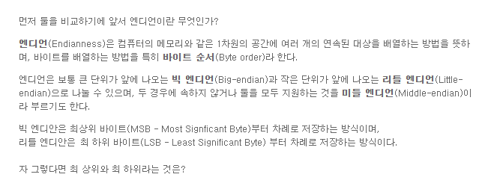

Slide 12
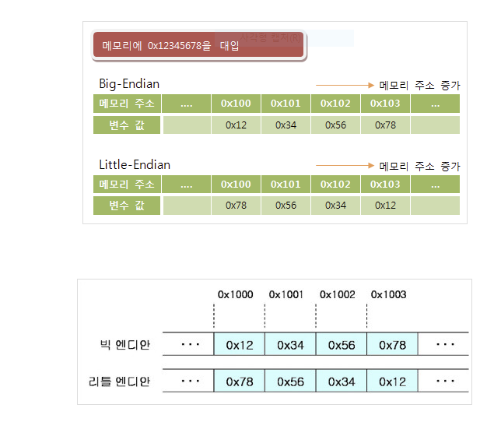

Slide 13
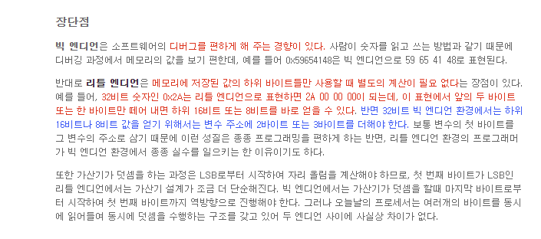

Slide 14
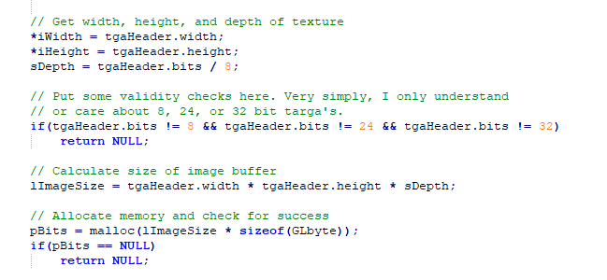

Slide 15
