Slide 1
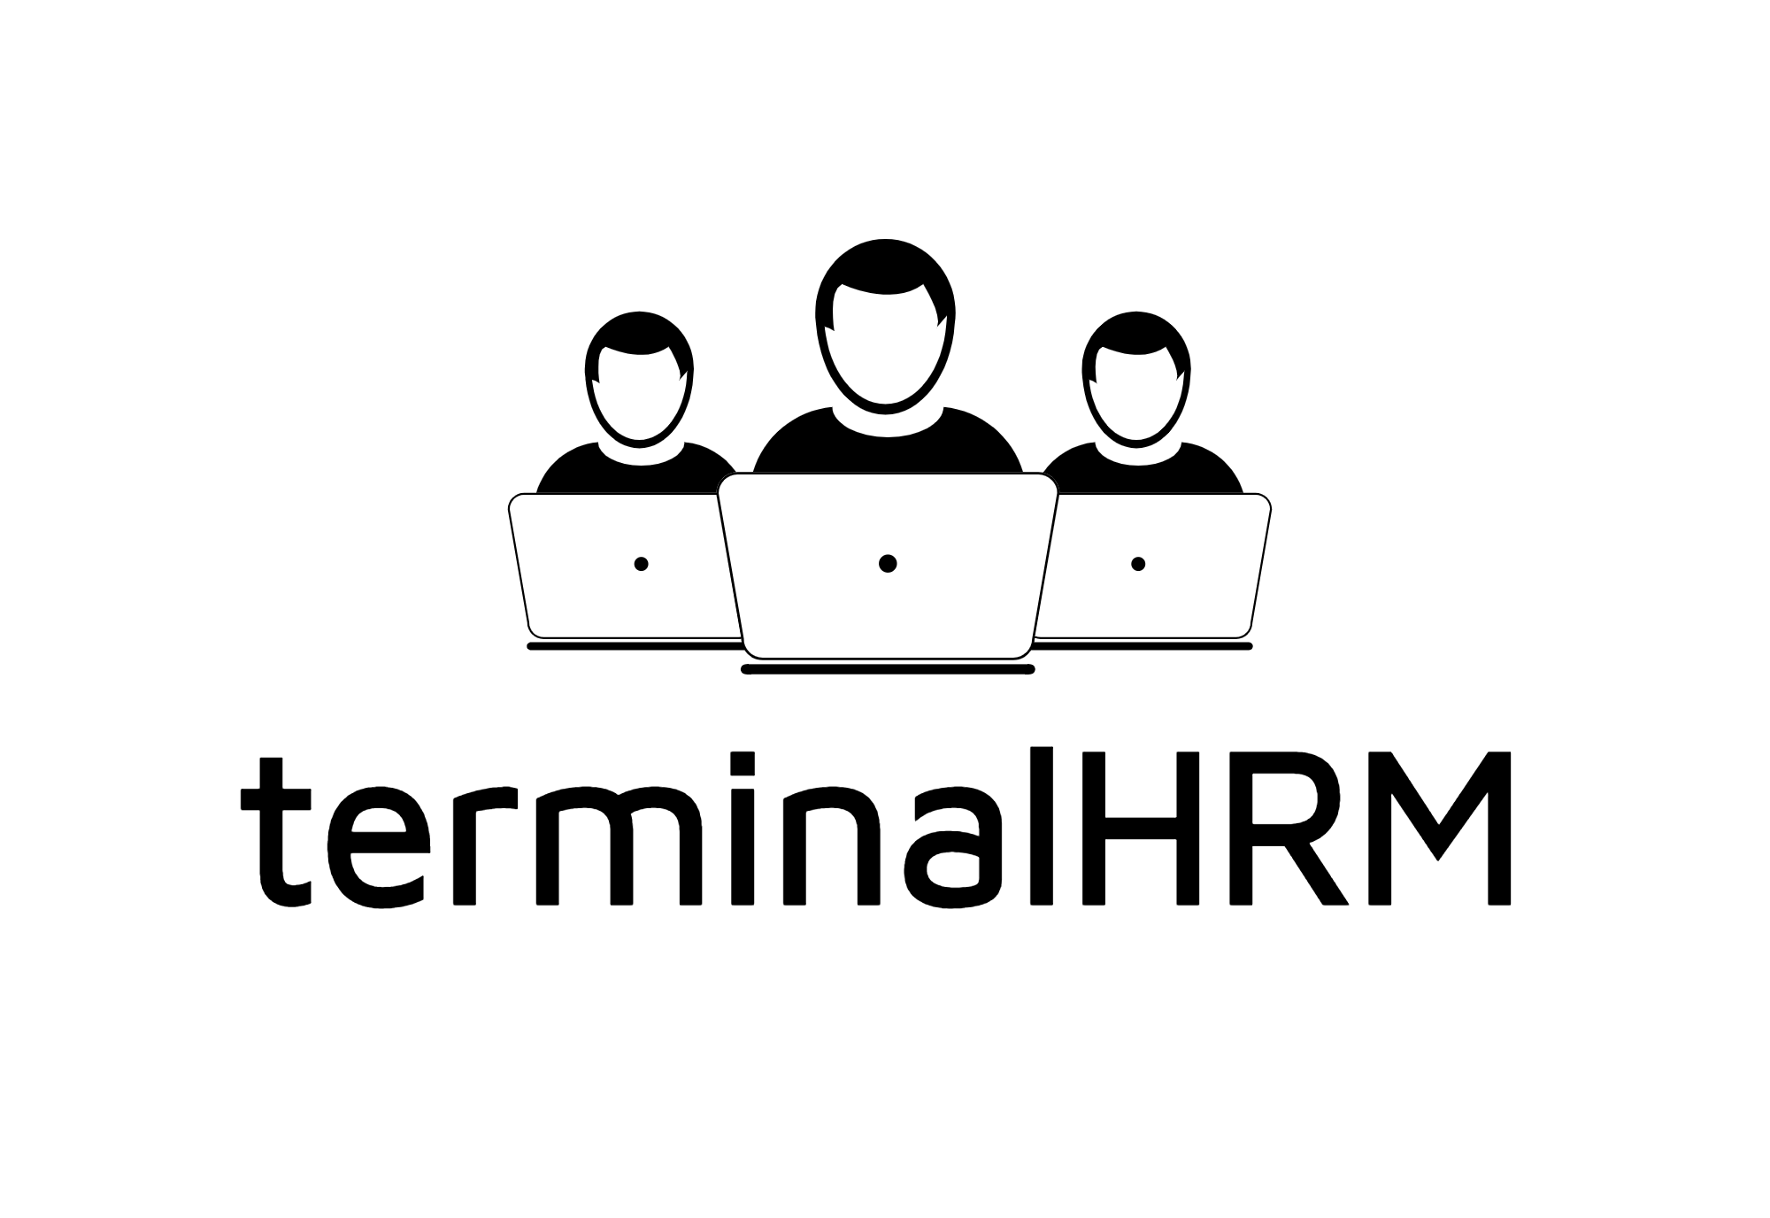

Slide 2
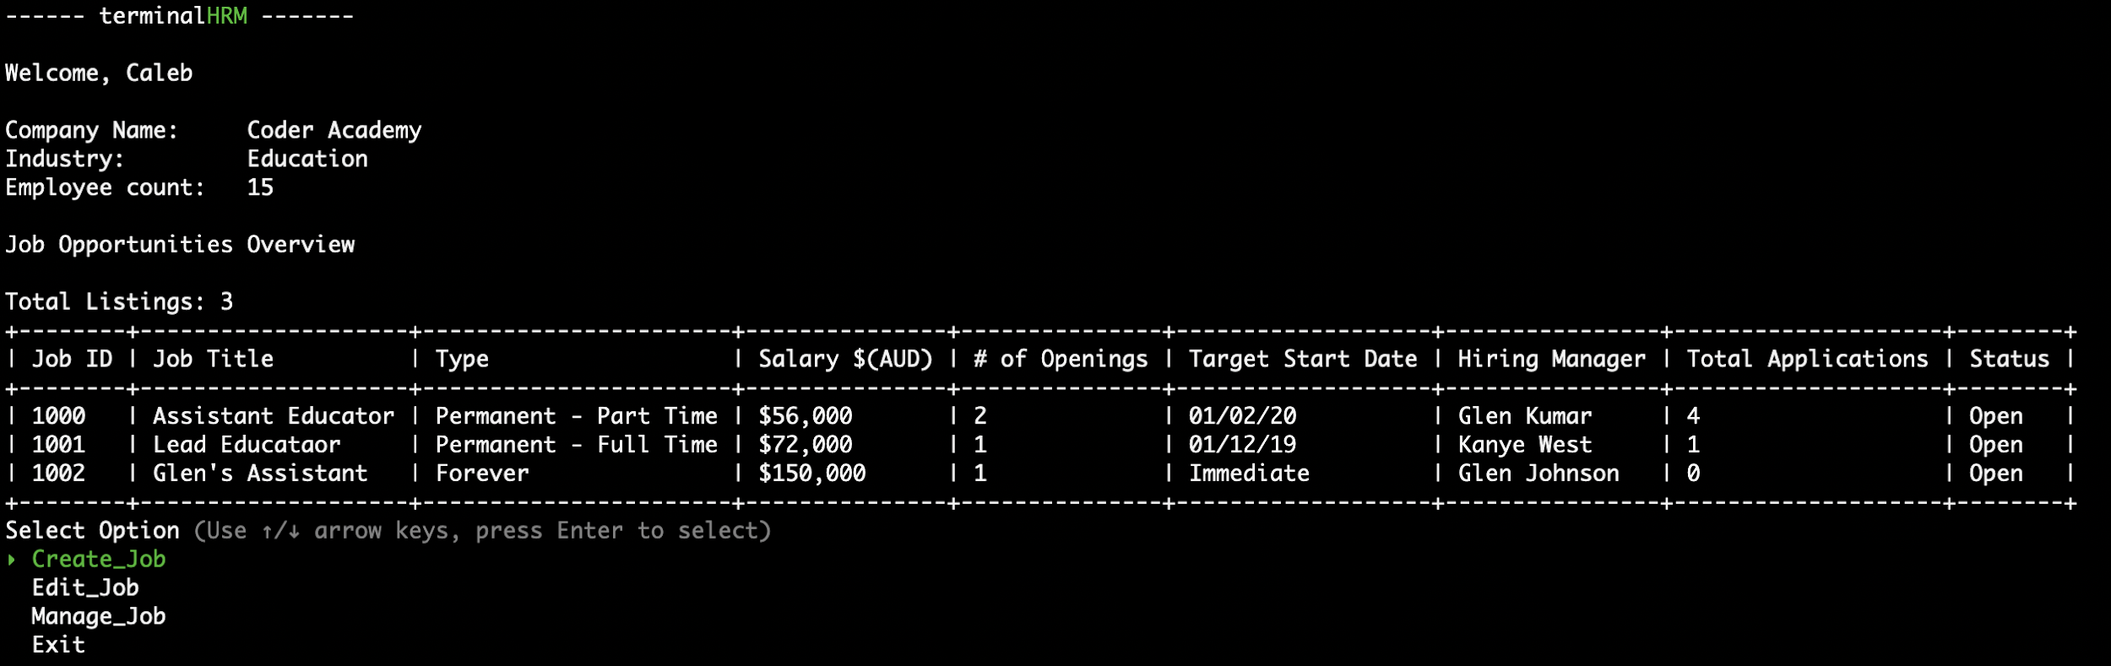
Human Resource Management Software
HRM Software lets you manage people stuff in your company.

Slide 3
Purpose
Human Resource Management is very important for business
terminalHRM provides a simple solution (because everyone uses ruby on terminal to do their business management)
Target Audience: Small / Medium Businesses

Slide 4
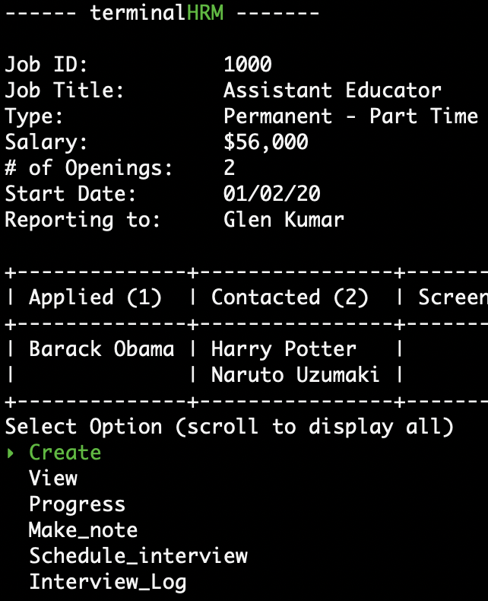
Features
Manage multiple job opportunities
Manage candidates across all openings
Flexible editing features
Lets you save your work.

Slide 5
Walkthrough
$ ./terminal-hrm.sh

Slide 6
Questions?

