Slide 1
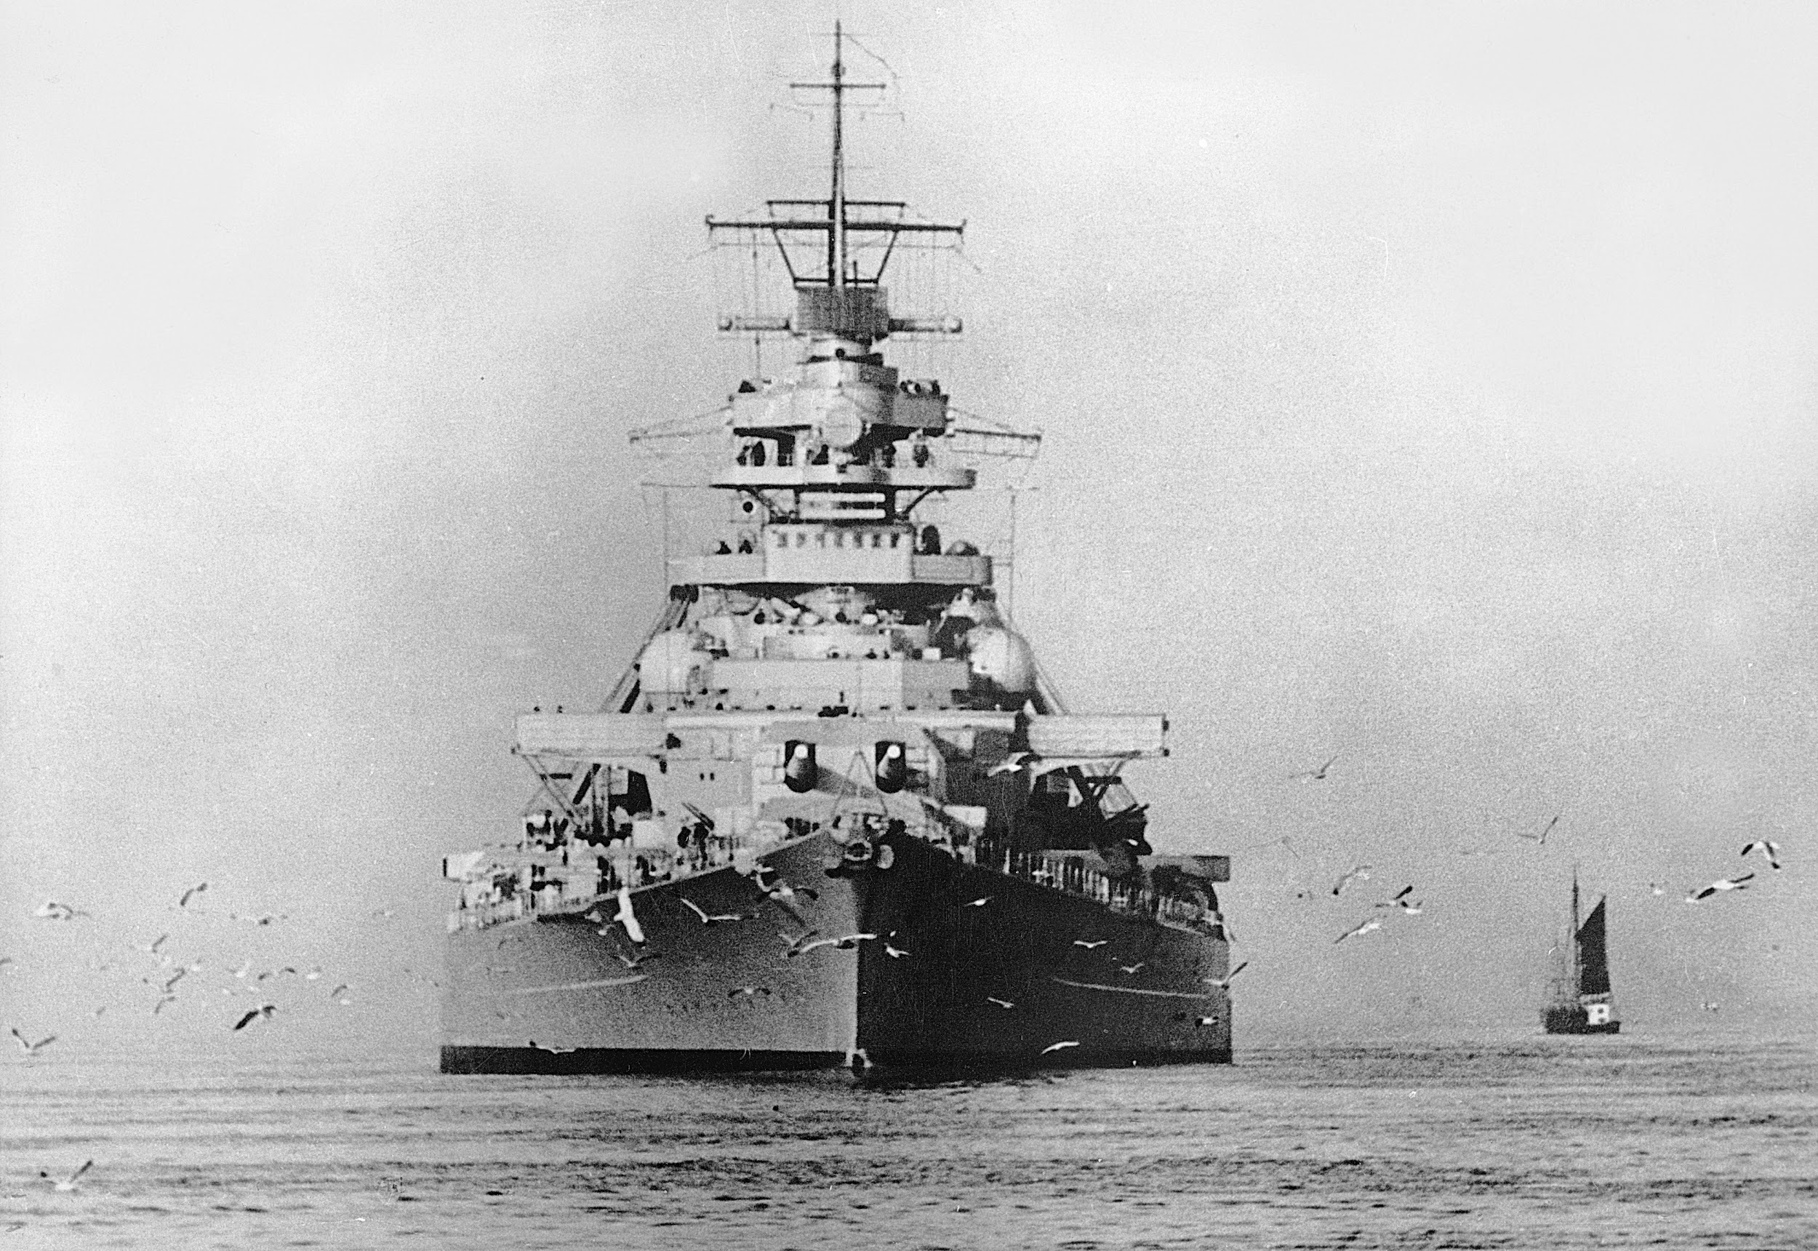
Battle
Battleships RB

Slide 2
Purpose
Entertainment
Universally accessible
Safety

Slide 3
Features
Character Names
Personalised Game Board Grids
5 Ships for each player
View current ship status and previous attacks
Launch Attacks

Slide 4
Walkthrough

Slide 5
Problems, Challenges, Bugs
Hash as game board proved difficult
Ensuring ships did not clash
Incorrect coordinates crash the application

Slide 6
Additional Features
‘Bomb’ attack feature
Ability to select number of ships
Ability to select location of ships

