Slide 1
RISC-V
multi-cycle, APB_bus
4조
윤수민, 곽은찬, 서어진, 여인석

Slide 2
Contents
1
2
3
4
5
Introduction
Multi-cycle CPU
APB bus
Peripherals
Conclusion
1) Introduction 2) Project Overview
1) B/D, FSM Chart 2) State Behavior
3) Simulation
1) Concept
2) Memory Map
3) Simulation
1) GPIO
2) BRAM
3) FND
4) UART
1) Board Test 2) Trouble Shooting

Slide 3
Introduction
1
1) Introduction 2) Project Overview

Slide 4
Introduction
프로젝트 목표:
multi-cycle로 동작하는 RISC-V CPU와 APB bus, 메모리 및 주변장치(GPIO, FND, UART)를 설계하여 구동한다.

Slide 5
Project Overview
System Architecture
CPU
APB_BUS
instruction
memory
32x256
slave0
BRAM
control_unit
APB
master
slave1
GPO
register file
32x32
slave2
GPI
ALU
slave3
GPIO
slave4
FND
PC
slave5
UART

Slide 6
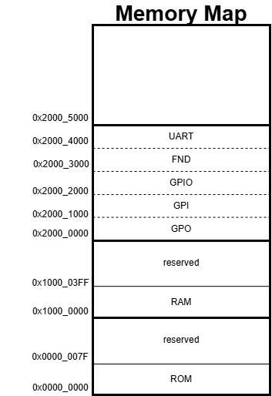
Project Overview
Memory Map

Slide 7
Multi-cycle CPU
2
1) B/D, FSM Chart 2) State Behavior
3) Simulation

Slide 8
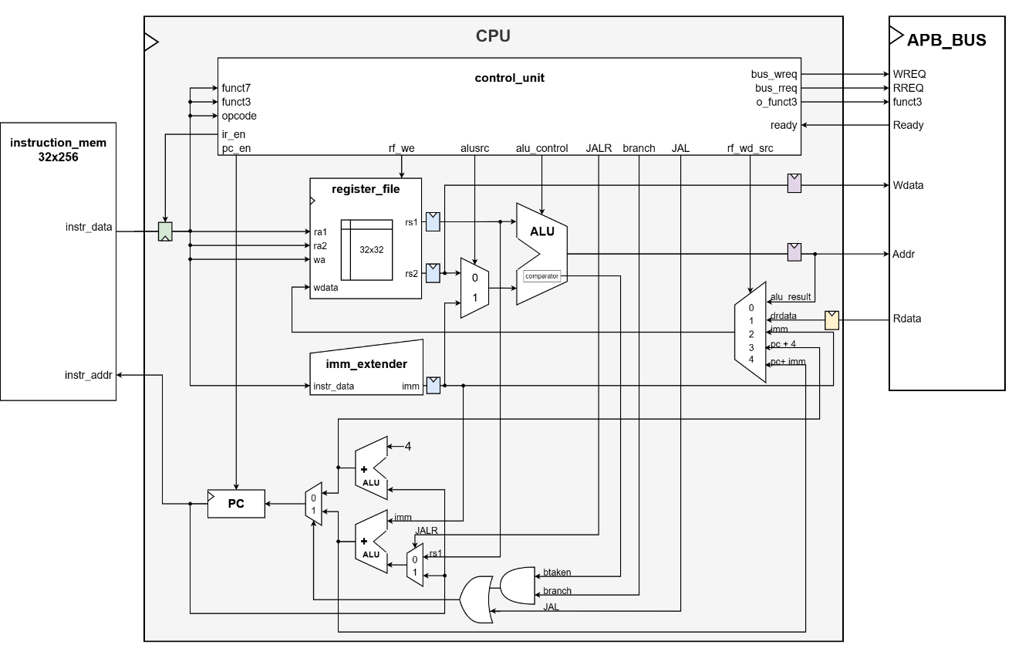
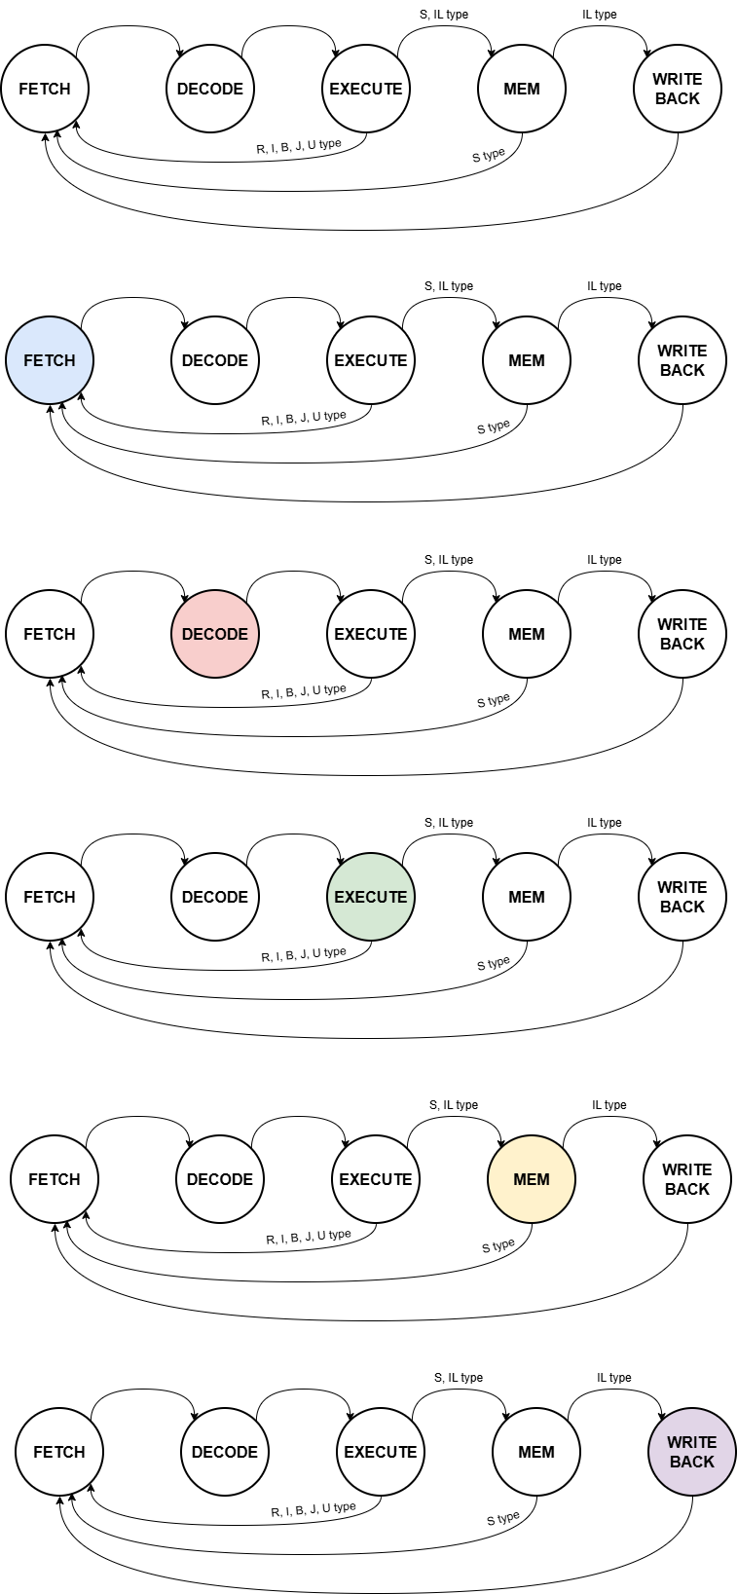
Block Diagram

Slide 9
FSM Chart

Slide 10
Fetch

Slide 11
Decode

Slide 12
Execute

Slide 13
Memory

Slide 14
Write Back

Slide 15
Simulation
Scenario
idx. | hex | type | assembly | expected result
0 | 004182b3 | R-type | add, x5, x3, x4 | x3(3) + x4(4) = x5(7)
4 | 405201b3 | R-type | sub, x3, x4, x5 | x4(4) - x5(7) = x3(-3)
8 | 10001537 | U-type | lui x10, 65536 | x10(65536 = 0x’1000_0’000)
12 | 00352023 | S-type | sw x3, 0(x10) | mem[x10(1000_0000)+0] = x3(-3)
16 | 00118293 | I-type | addi x5, x3, 1 | x3(-3) + 1 = x5(-2)
20 | 00108463 | B-type | beq, x1, x1 | x1(1) = x1(1) -> next PC = 20+8
24 | 00450513 | I-type | addi, x10, x10, 4 | x10(1000_0000) + 4 = x10(1000_0004)
28 | 008002ef | J-type | jal, x5, 8 | x5(28+4), next PC = 28+8
32 | 00450513 | I-type | addi, x10, x10, 4 | x10(1000_0000) + 4 = x10(1000_0004)
36 | 00052283 | IL-type | lw, x5, 0 | mem[x10(1000_0000)+0]

Slide 16
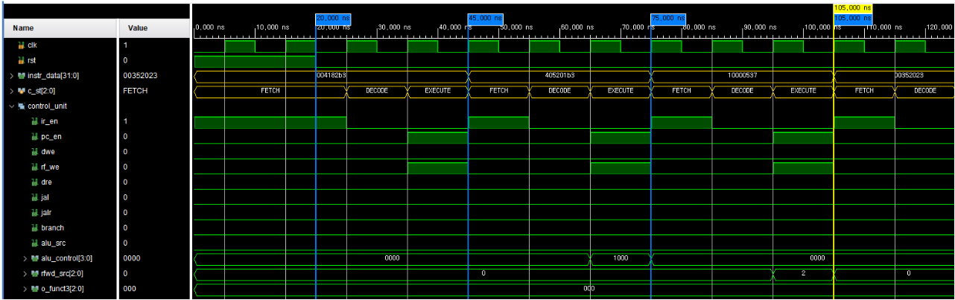
Simulation
idx. | hex | type | assembly | expected result
0 | 004182b3 | R-type | add, x5, x3, x4 | x3(3) + x4(4) = x5(7)
4 | 405201b3 | R-type | sub, x3, x4, x5 | x4(4) - x5(7) = x3(-3)
8 | 10001537 | U-type | lui x10, 65536 | x10(65536 = 0x’1000_0’000)
➀
➁
Result 1: control signal
➂
➀
➁
➂

Slide 17
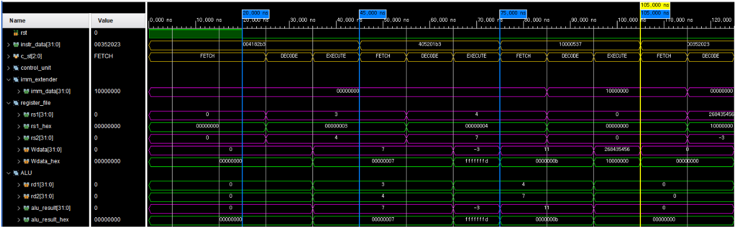
Simulation
idx. | hex | type | assembly | expected result
0 | 004182b3 | R-type | add, x5, x3, x4 | x3(3) + x4(4) = x5(7)
4 | 405201b3 | R-type | sub, x3, x4, x5 | x4(4) - x5(7) = x3(-3)
8 | 10001537 | U-type | lui x10, 65536 | x10(65536 = 0x’1000_0’000)
➀
➁
Result 1: register load
➂
➀
➁
➂

Slide 18
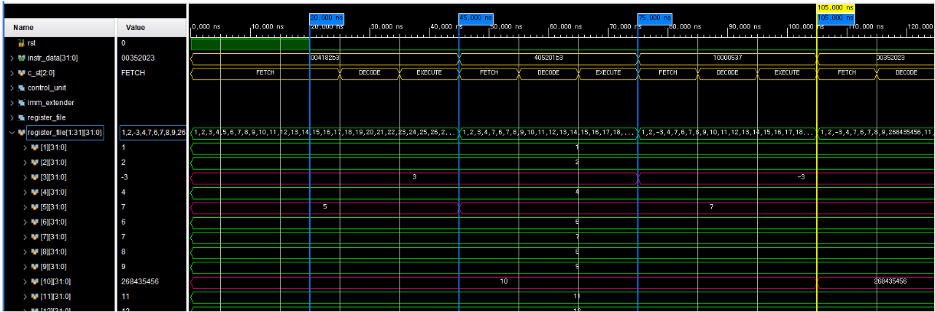
Simulation
idx. | hex | type | assembly | expected result
0 | 004182b3 | R-type | add, x5, x3, x4 | x3(3) + x4(4) = x5(7)
4 | 405201b3 | R-type | sub, x3, x4, x5 | x4(4) - x5(7) = x3(-3)
8 | 10001537 | U-type | lui x10, 65536 | x10(65536 = 0x’1000_0’000)
➀
➁
Result 1: register update
➂
➀
➁
➂

Slide 19
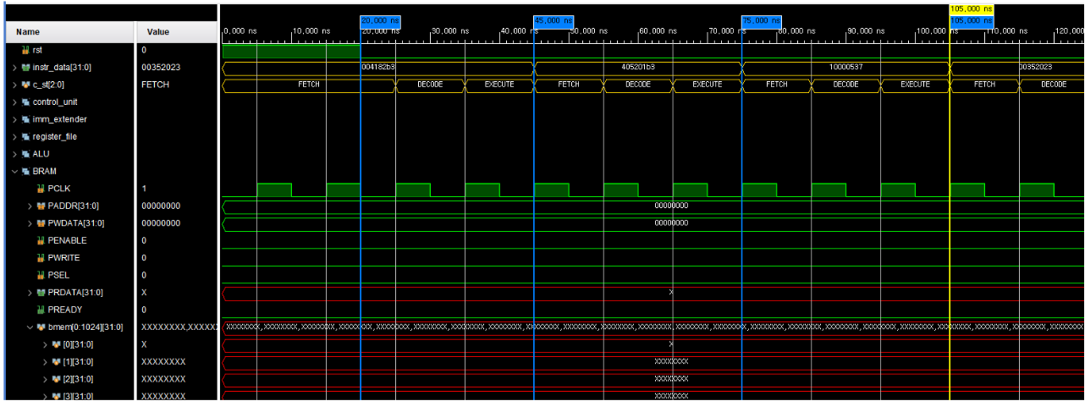
Simulation
idx. | hex | type | assembly | expected result
0 | 004182b3 | R-type | add, x5, x3, x4 | x3(3) + x4(4) = x5(7)
4 | 405201b3 | R-type | sub, x3, x4, x5 | x4(4) - x5(7) = x3(-3)
8 | 10001537 | U-type | lui x10, 65536 | x10(65536 = 0x’1000_0’000)
➀
➁
Result 1: memory update
➂
➀
➁
➂

Slide 20
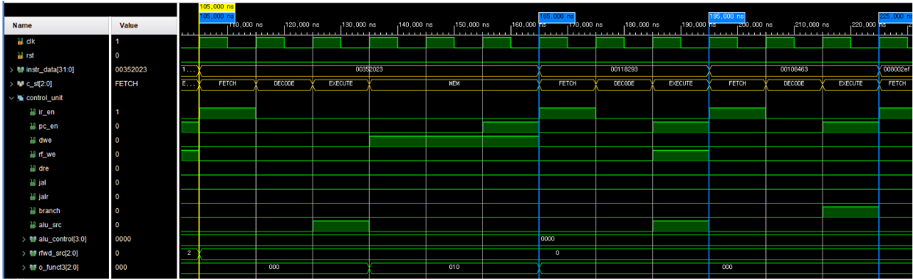
Simulation
idx. | hex | type | assembly | expected result
12 | 00352023 | S-type | sw x3, 0(x10) | mem[x10(1000_0000)+0] = x3(-3)
16 | 00118293 | I-type | addi x5, x3, 1 | x3(-3) + 1 = x5(-2)
20 | 00108463 | B-type | beq, x1, x1 | x1(1) = x1(1) -> next PC = 20+8
➃
➄
Result 2: control signal
➅
➃
➄
➅

Slide 21
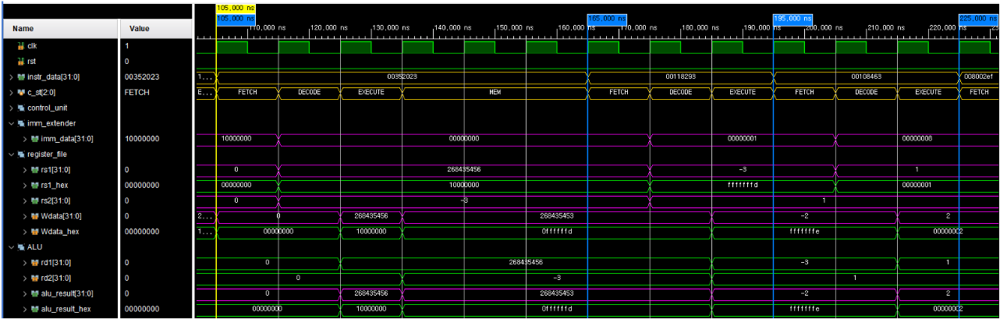
Simulation
idx. | hex | type | assembly | expected result
12 | 00352023 | S-type | sw x3, 0(x10) | mem[x10(1000_0000)+0] = x3(-3)
16 | 00118293 | I-type | addi x5, x3, 1 | x3(-3) + 1 = x5(-2)
20 | 00108463 | B-type | beq, x1, x1 | x1(1) = x1(1) -> next PC = 20+8
➃
➄
Result 2: register load
➅
➃
➄
➅

Slide 22
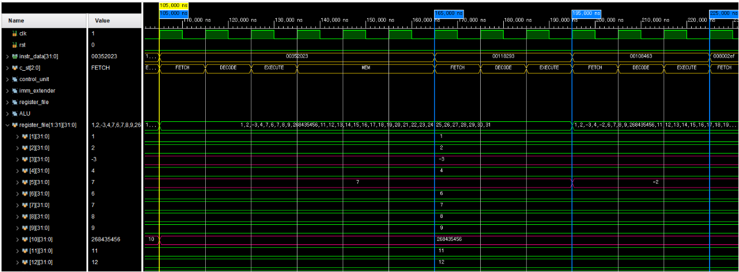
Simulation
idx. | hex | type | assembly | expected result
12 | 00352023 | S-type | sw x3, 0(x10) | mem[x10(1000_0000)+0] = x3(-3)
16 | 00118293 | I-type | addi x5, x3, 1 | x3(-3) + 1 = x5(-2)
20 | 00108463 | B-type | beq, x1, x1 | x1(1) = x1(1) -> next PC = 20+8
➃
➄
Result 2: register update
➅
➃
➄
➅

Slide 23
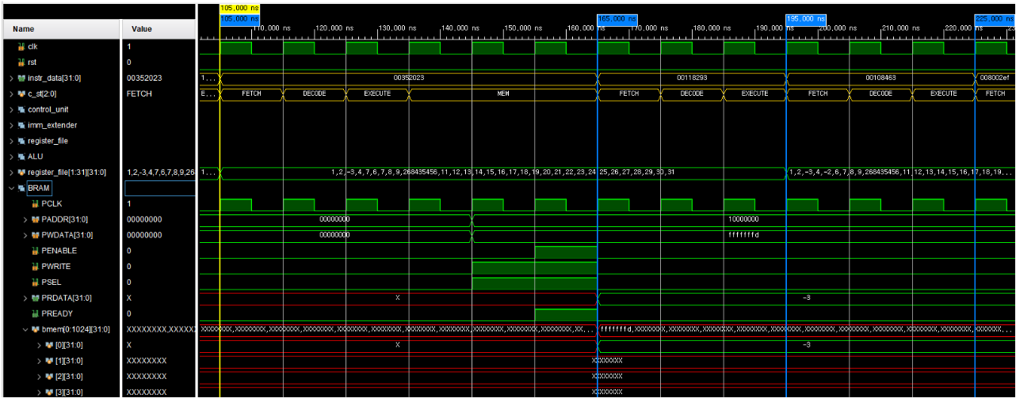
Simulation
idx. | hex | type | assembly | expected result
12 | 00352023 | S-type | sw x3, 0(x10) | mem[x10(1000_0000)+0] = x3(-3)
16 | 00118293 | I-type | addi x5, x3, 1 | x3(-3) + 1 = x5(-2)
20 | 00108463 | B-type | beq, x1, x1 | x1(1) = x1(1) -> next PC = 20+8
➃
➄
Result 2: memory update
➅
➃
➄
➅

Slide 24
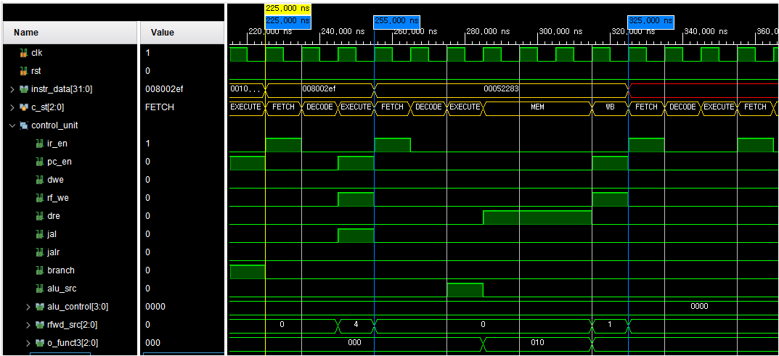
Simulation
idx. | hex | type | assembly | expected result
24 | 00450513 | I-type | addi, x10, x10, 4 | x10(1000_0000) + 4 = x10(1000_0004)
28 | 008002ef | J-type | jal, x5, 8 | x5(28+4), next PC = 28+8
32 | 00450513 | I-type | addi, x10, x10, 4 | x10(1000_0000) + 4 = x10(1000_0004)
36 | 00052283 | IL-type | lw, x5, 0 | mem[x10(1000_0000)+0]
➆
Result 3: control signal
➇
➆
➇

Slide 25
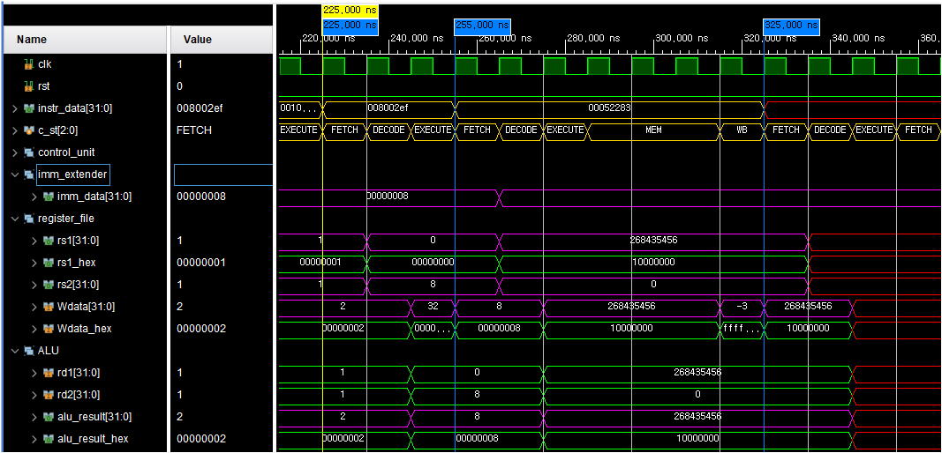
Simulation
idx. | hex | type | assembly | expected result
24 | 00450513 | I-type | addi, x10, x10, 4 | x10(1000_0000) + 4 = x10(1000_0004)
28 | 008002ef | J-type | jal, x5, 8 | x5(28+4), next PC = 28+8
32 | 00450513 | I-type | addi, x10, x10, 4 | x10(1000_0000) + 4 = x10(1000_0004)
36 | 00052283 | IL-type | lw, x5, 0 | mem[x10(1000_0000)+0]
➆
Result 3: register load
➇
➆
➇

Slide 26
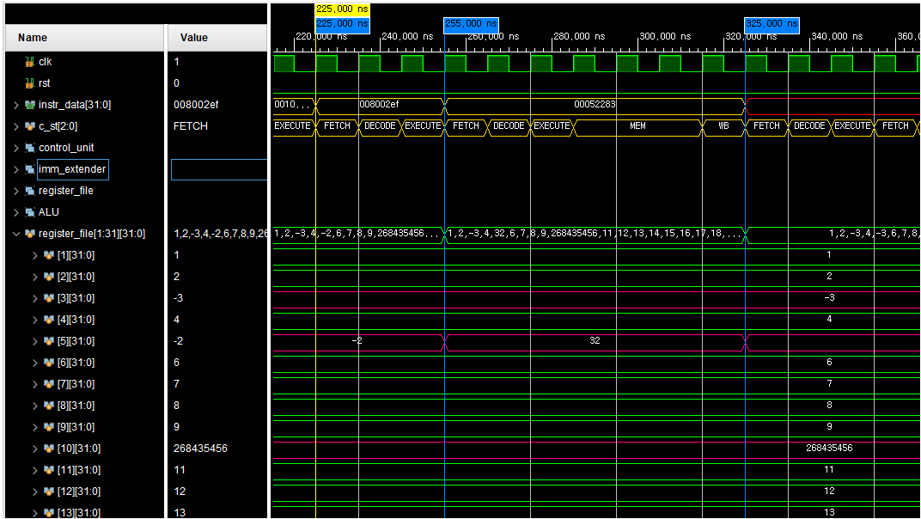
Simulation
idx. | hex | type | assembly | expected result
24 | 00450513 | I-type | addi, x10, x10, 4 | x10(1000_0000) + 4 = x10(1000_0004)
28 | 008002ef | J-type | jal, x5, 8 | x5(28+4), next PC = 28+8
32 | 00450513 | I-type | addi, x10, x10, 4 | x10(1000_0000) + 4 = x10(1000_0004)
36 | 00052283 | IL-type | lw, x5, 0 | mem[x10(1000_0000)+0]
➆
Result 3: register update
➇
➆
➇

Slide 27
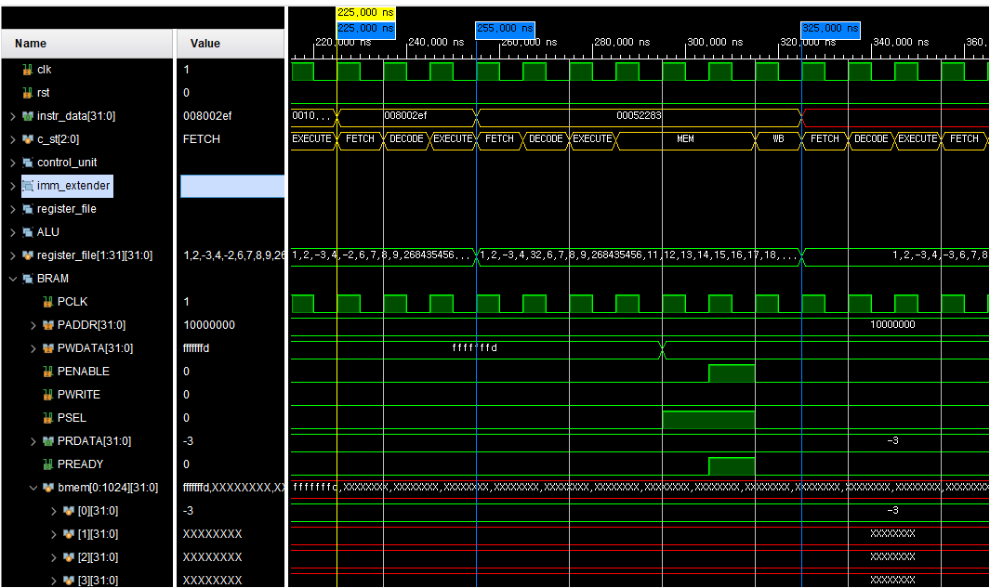
Simulation
idx. | hex | type | assembly | expected result
24 | 00450513 | I-type | addi, x10, x10, 4 | x10(1000_0000) + 4 = x10(1000_0004)
28 | 008002ef | J-type | jal, x5, 8 | x5(28+4), next PC = 28+8
32 | 00450513 | I-type | addi, x10, x10, 4 | x10(1000_0000) + 4 = x10(1000_0004)
36 | 00052283 | IL-type | lw, x5, 0 | mem[x10(1000_0000)+0]
➆
Result 3: memory update
➇
➆
➇

Slide 28
APB bus
3
1) Concept
2) Memory Map
3) Simulation

Slide 29
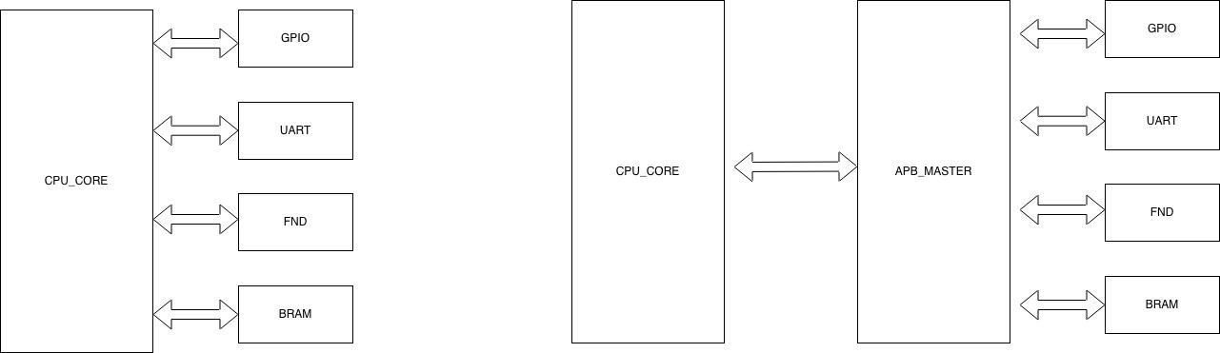
BUS 사용이유
direct 배선 방식
BUS 도입
장치 추가 될때 마다, cpu logic 수정 발생.
새로운 장치 추가시, 버스 규격에 맞춰 슬레이브로 연결하면 됨. 시스템 확장성과 재사용성 극대화.

Slide 30
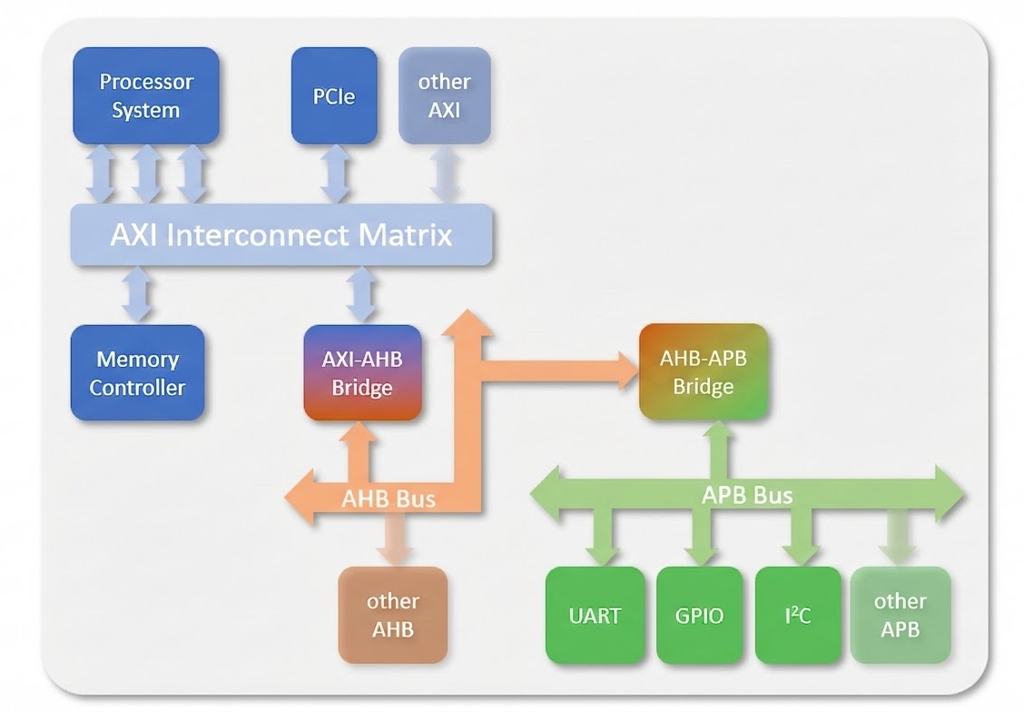
AMBA(Advanced Microcontroller bus architecture) protocol
ARM이 개발한 SoC 내부 통신 표준 버스 규격.
목적: 다양한 IP 연결 표준화로 설계 재사용성
및 확장성 극대화.
AXI/AHB: 고속, 고대역폭
(CPU, Memory, DMA 등)
APB: 저속, 저전력
(GPIO, UART, I2C 등 주변장치)

Slide 31
MMIO 및 메모리 맵
4KBYTE
Boundary address | Peripheral
0x_2000_5000 ~ | reserved
0x_2000_4000 ~ 0x_2000_4FFF | UART
0x_2000_3000 ~ 0x_2000_3FFF | FND
0x_2000_2000 ~ 0x_2000_2FFF | GPIO
0x_2000_1000 ~ 0x_2000_1FFF | GPI
0x_2000_0000 ~ 0x_2000_0FFF | GPO
0x_1000_1000 ~0x_1FFF_FFFF | reserved
0x1000_0000 ~ 0x_1000_0FFF | RAM
0x_0000_1000 ~0x_0FFF_FFFF | reserved
0x0000_0000 ~ 0x_0000_0FFF | ROM
MMIO(memory mapped I/O)
정의: CPU가 I/O 장치를 메모리 주소 공간으로 인식하여 제어하는 방식.
주변장치(UART, GPIO 등) 레지스터에 특정 메모리 주소를 할당.
작동 원리
전용 I/O 명령어(IN/OUT) 없이, 일반 메모리 접근 명령어(Load/Store) 사용.
CPU가 특정 주소에 접근하면, APB master 모듈이 감지하여 해당 장치의 PSEL 신호 활성화.
장점
복잡한 I/O 프로토콜 없이 C언어 포인터 연산으로 하드웨어 제어 가능.
주소 공간이 충분하면 새로운 주변장치 추가 용이.

Slide 32
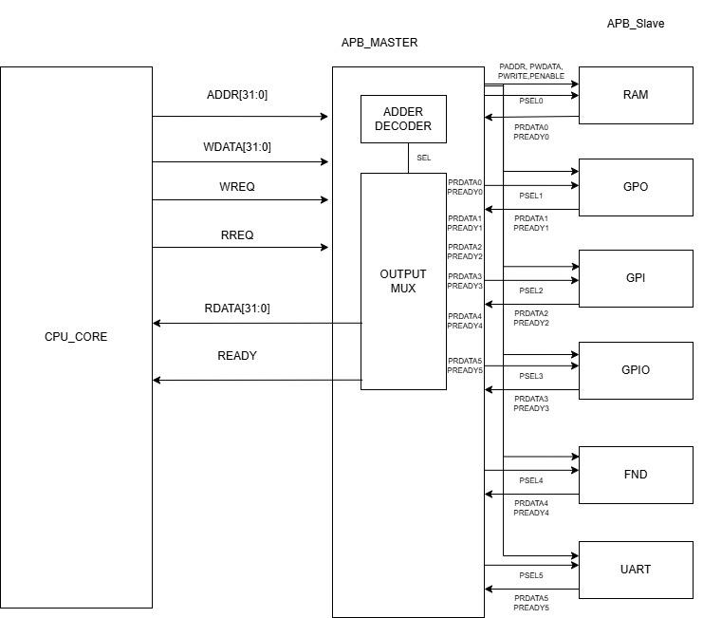
Block Diagram

Slide 33
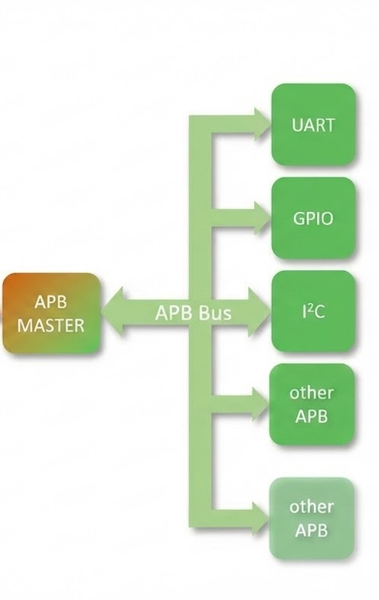
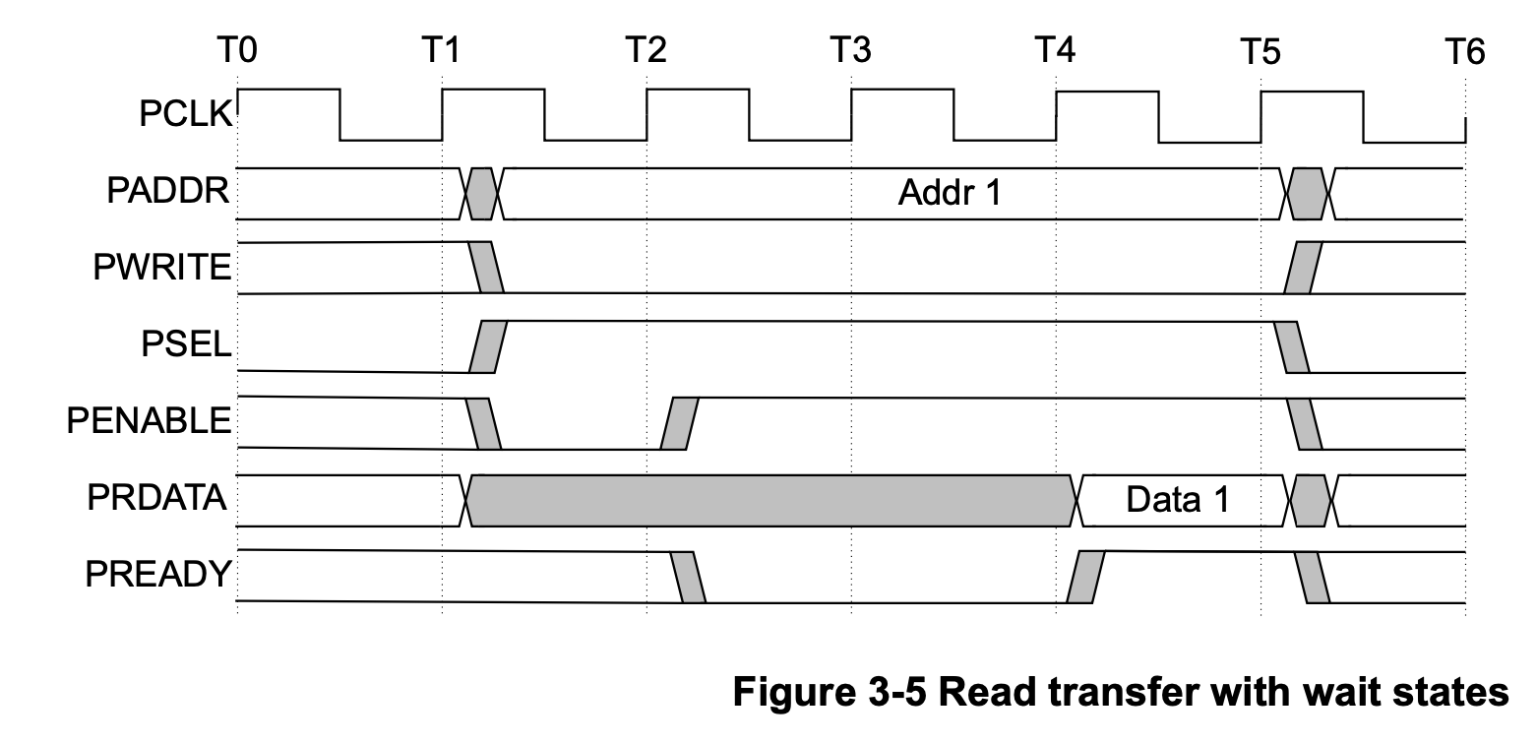
APB protocol 특징
Master-slave 구조
2. 최소 2-Clock(setup,access) 기반 통신
3. wait state 지원
IDLE
SETUP
ACCESS
ACCESS
ACCESS
WAIT

Slide 34
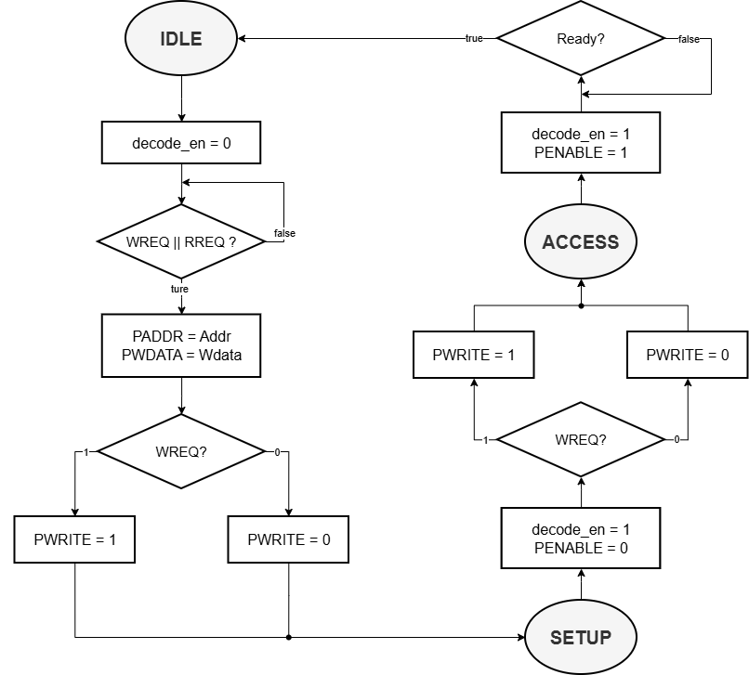
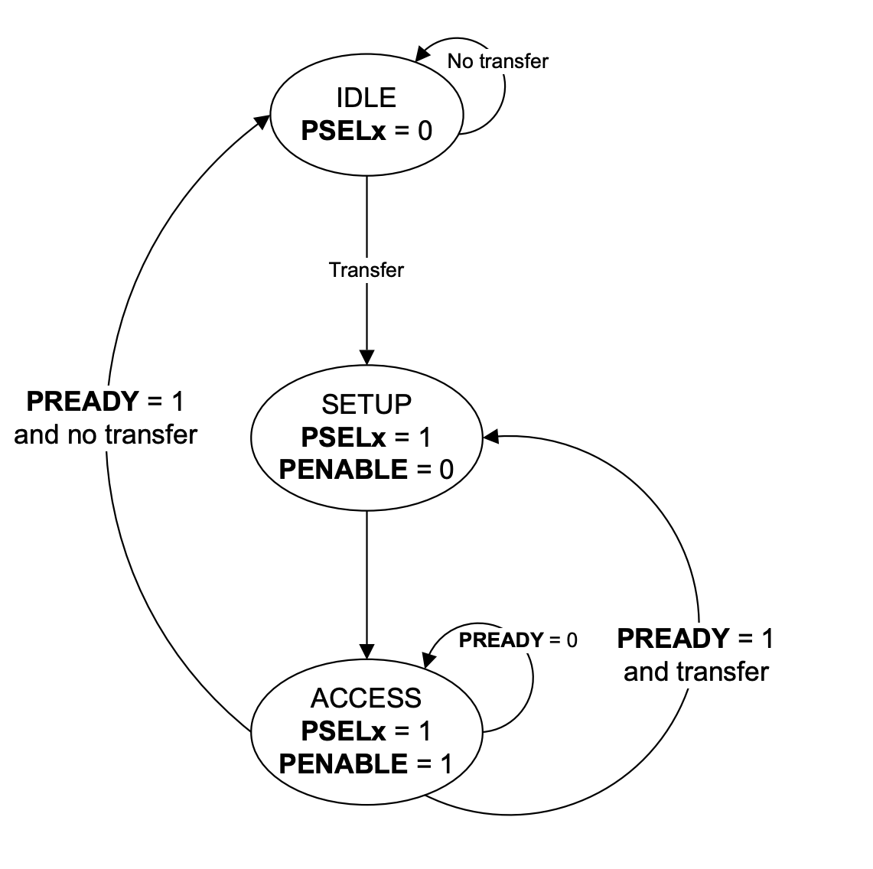
APB master - state diagram
write
read

Slide 35
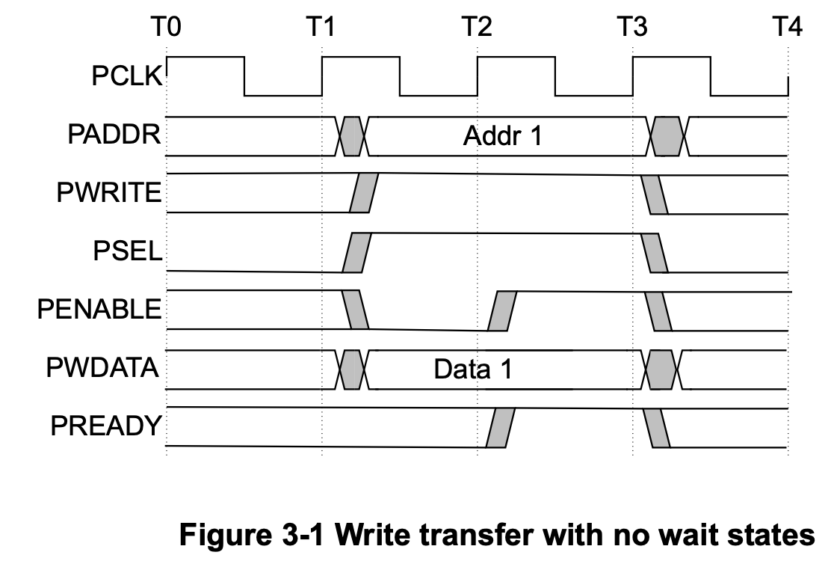
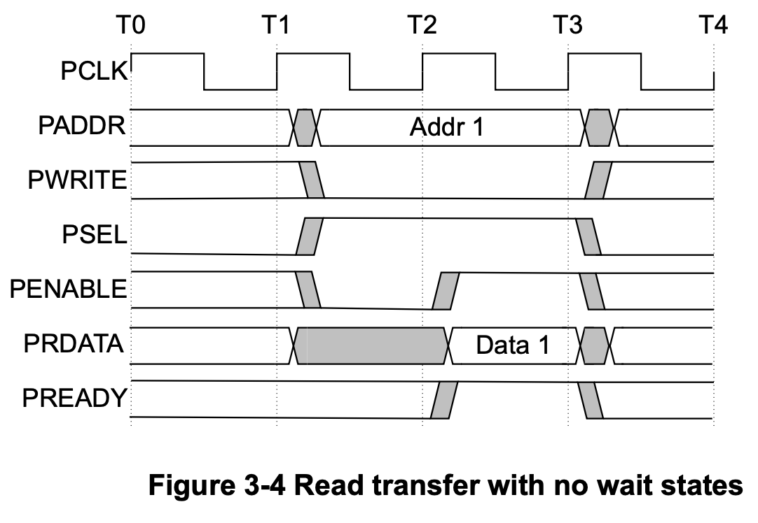
APB protocol 통신 과정
IDLE
SETUP
ACCESS
IDLE
SETUP
ACCESS
1
0

Slide 36
GPIO
4
1) Concept
2) Memory Map
3) Simulation

Slide 37
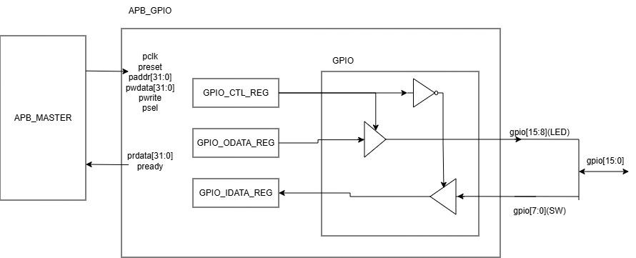
GPIO-slave
GPIO: 하나의 선으로 입출력을 모두 처리하는 inout 포트.

Slide 38
GPIO-slave memory register map
offset address | Peripheral
0x_2000_2000 | GPIO
address | register
offset+8 | gpio_idata_reg[15:0] | gpio의 input data register
offset+4 | gpio_odata_reg[15:0] | gpio의 output data register
offset+0 | gpio_ctl_reg[15:0] | bit data 1: gpio data값을 해당 bit 위치의 register에 write bit data 0: z값을 해당 bit 위치의 register에 write
GPIO[15:0]
8
0
LED[7] | LED[6] | LED[5] | LED[4] | LED[3] | LED[2] | LED[1] | LED[0] | SW[7] | SW[6] | SW[5] | SW[4] | SW[3] | SW[2] | SW[1] | SW[0]

Slide 39
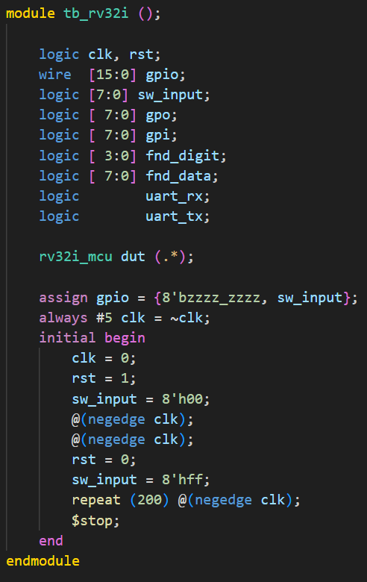
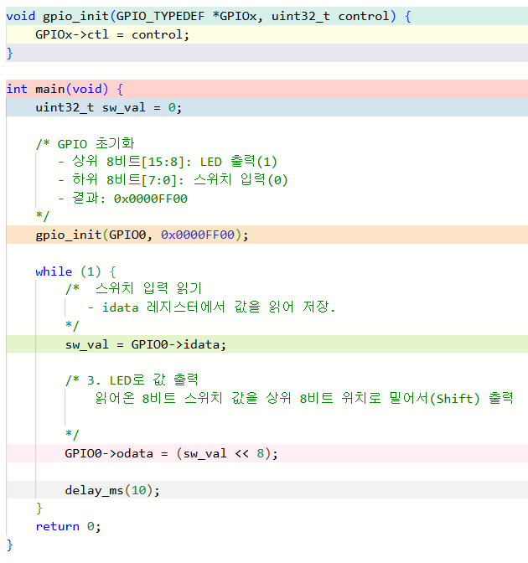
GPIO 동작검증-c code 시나리오

Slide 40
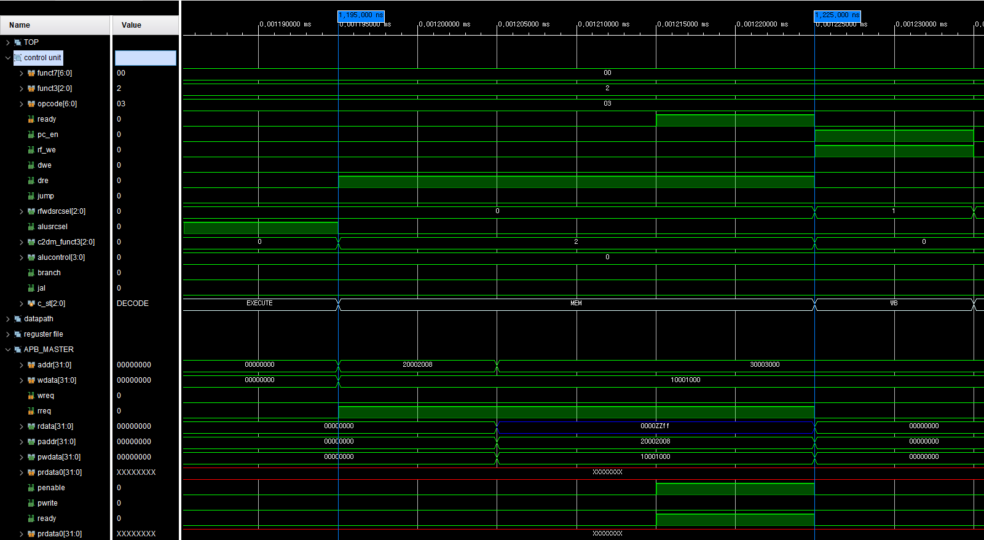
GPIO-c code- read(gpio_idata_reg)
1(read)
0(read)

Slide 41
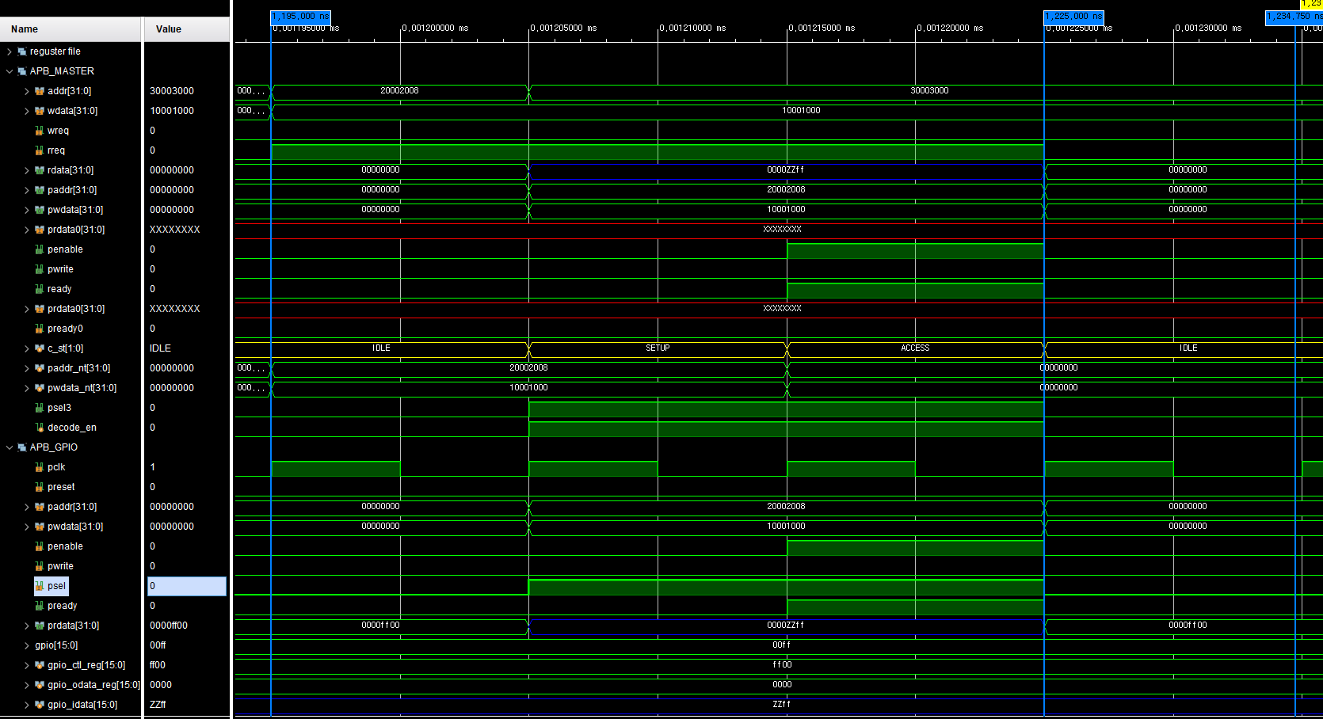
GPIO-c code- read(gpio_idata_reg)
1
0(read)
1
1(GPIO)
1

Slide 42
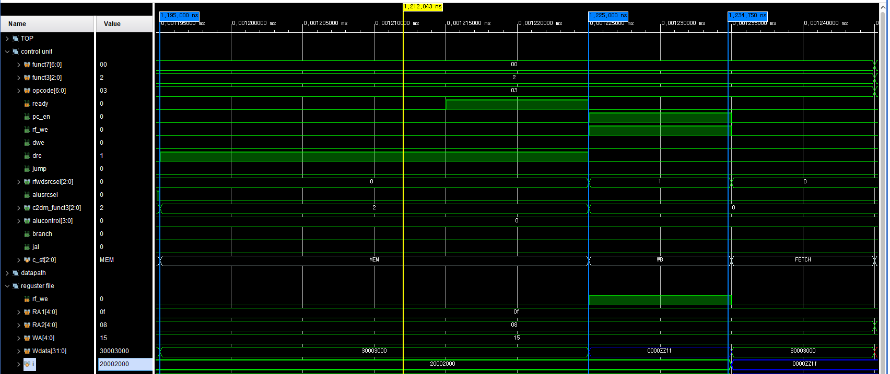
GPIO-c code- read(gpio_idata_reg)
1

Slide 43
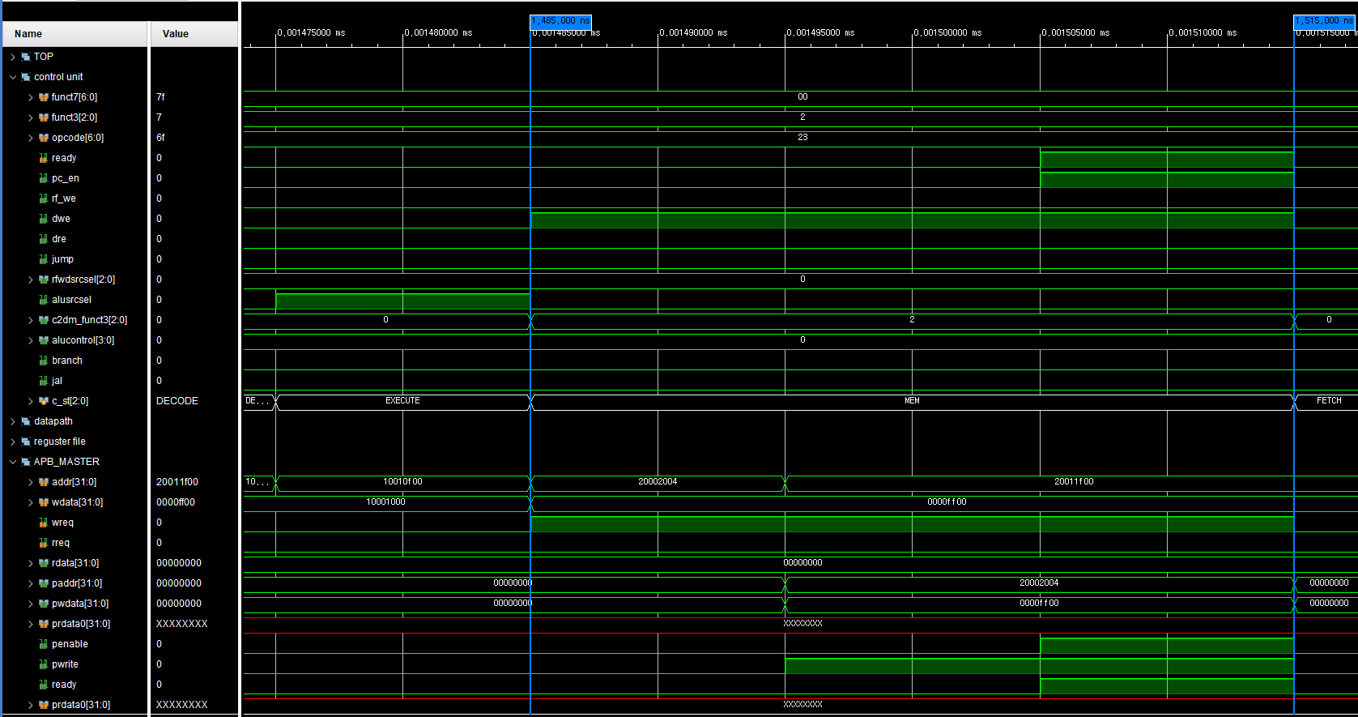
GPIO-c code- write(gpio_odata_reg)
1(write)
1(write)

Slide 44
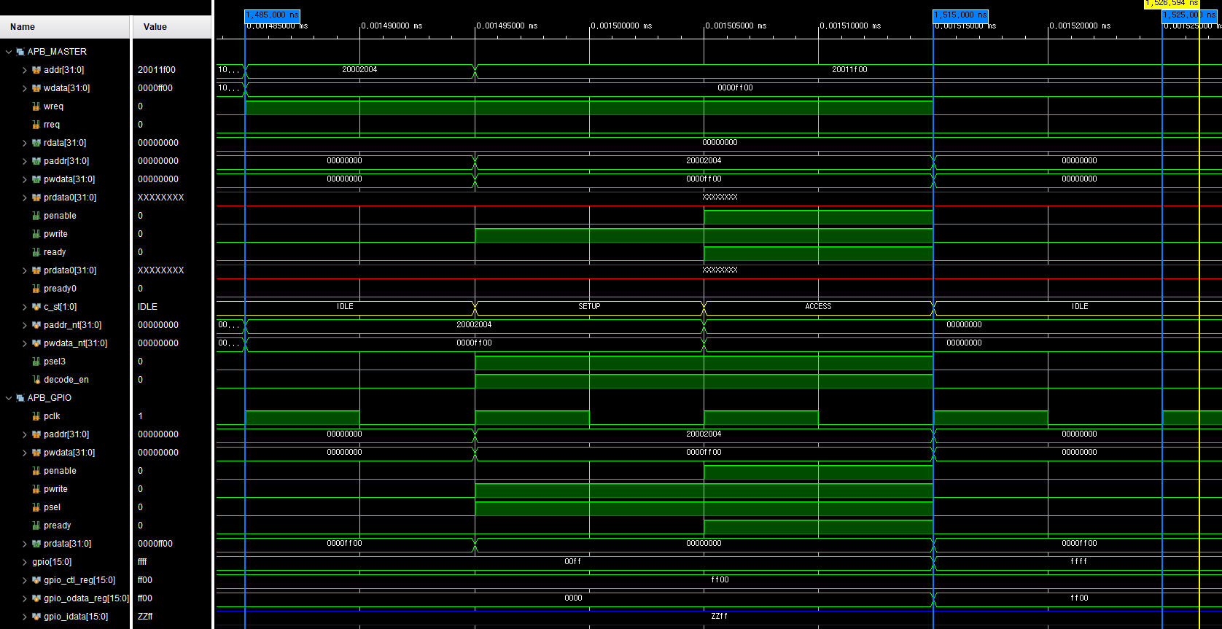
GPIO-c code- write(gpio_odata_reg)
1
1(write)
1
1

Slide 45
RAM
4
1) Concept
2) Memory Map
3) Simulation

Slide 46
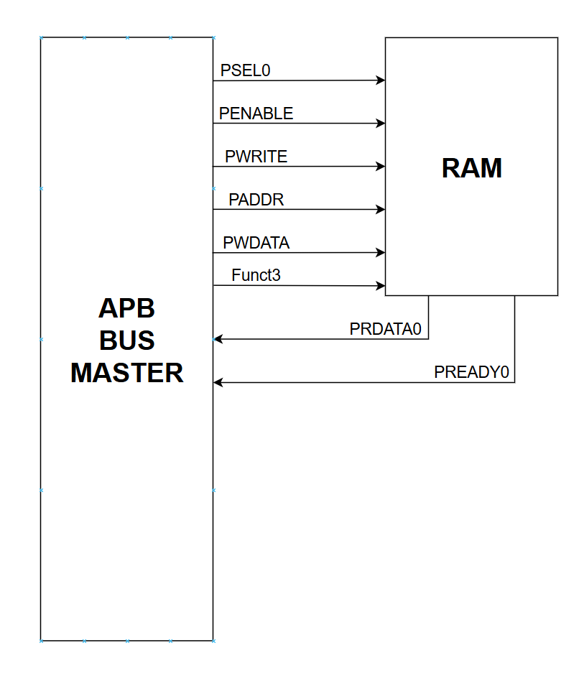
Block Diagram
Trig signal
● 기능 정의 - SW (Store World)
- SH (Store Half)
- SB (Store Byte)
- LW (Load World)
- LH (Load Half)
- LB (Load Byte)
Data signal
End signal

Slide 47
Memory map
address | I/O
0x_2000_5000 | reserve
0x_2000_4000 | UART
0x_2000_3000 | FND
0x_2000_2000 | GPIO
0x_2000_1000 | GPI
0x_2000_0000 | GPO
0x_1000_0FFF | reserve
0x1000_0000 | RAM
0x_0000_0FFF | reserve
0x0000_0000 | ROM
0x1000_0000 ~ 0x1000_0FFF

Slide 48
기능 및 신호정의
● 기능
- SW (Store World)
- SH (Store Half)
- SB (Store Byte)
- LW (Load World)
- LH (Load Half)
- LB (Load Byte)
PWRITE, PADDR[1:0]으로 구분
STORE → PWRITE = 1
LOAD → PWRITE = 0
PADDR : 32Bit (0x1000_0000 ~ 0x1000_0FFF)
BYTE8 | BYTE7 | BYTE6 | BYTE5 | BYTE4 | BYTE3 | BYTE2 | BYTE1
PADDR [11:2] - 0x1000_0000 ~ 0x1000_0FFF
안에서 주소 접근을 위해 사용
PADDR [1:0] - 하위 2bit는 W/H/B 구분을 위해 사용

Slide 49

SIMULATION (sw)
ADDI
x1 = x0 + 1 = 1 x2 = x0 + 2 = 2 x3 = x0 + 3 = 3
：
x10 = x0 + 10 = 10
reg file[1] ~ reg file[10] Addi를 이용해서 1~10 저장
SW
mem[1] = x1 + 0 = 1
mem[2] = x2 + 0 = 2
mem[3] = x3 + 0 = 3
：
mem[10] = x10 + 0 = 10
mem[1] ~ mem[10]
reg file[1~10] 값 저장
LW
mem[1] = x1 + 0 = 1
mem[2] = x2 + 0 = 2
mem[3] = x3 + 0 = 3
：
mem[10] = x10 + 0 = 10
reg file[1] ~ reg file[10]에 mem[1] ~ mem[10] 들어있는 값 저장

Slide 50
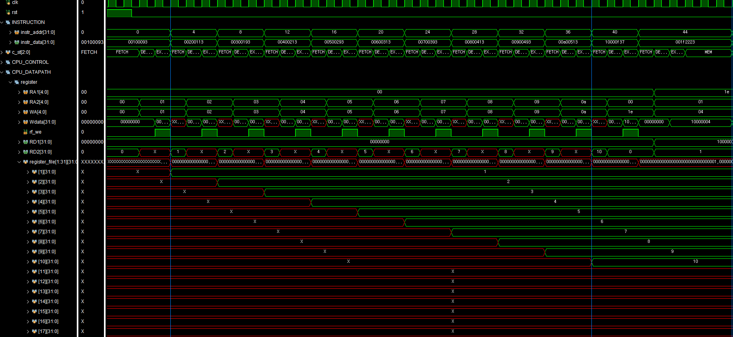
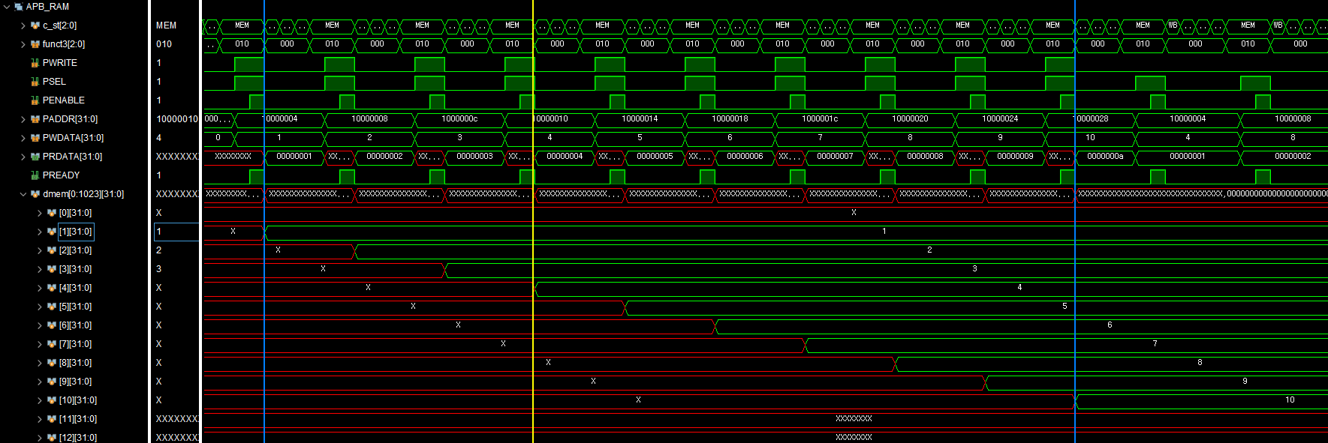
ADDR : 1000_0004 WDATA : 1
SW 명령어 결과

Slide 51
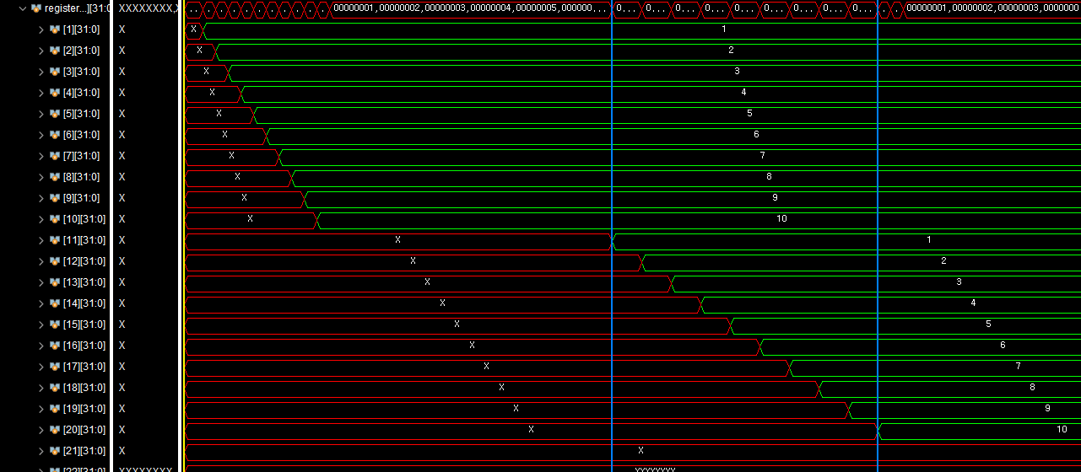
SIMULATION (LW)
LW 명령어 결과

Slide 52
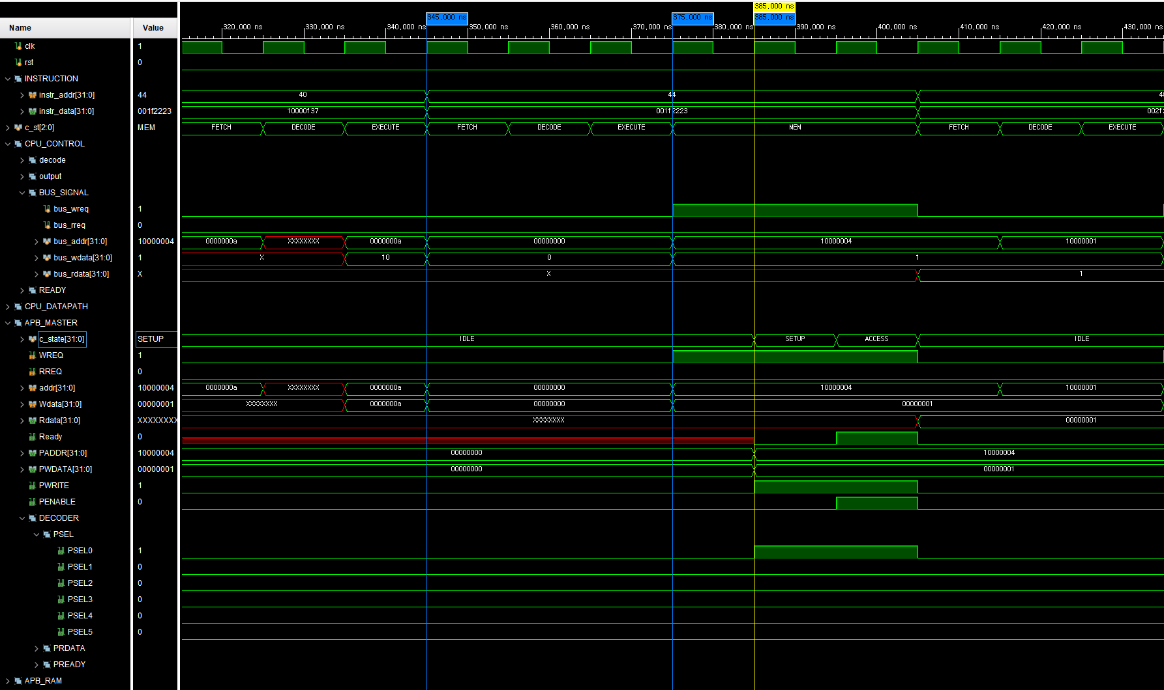
SIMULATION (sw)
ROM CODE : 001f2223
0000_0000_0001_1111_0010_0010_0010_0011
assembly → sw rs2, 4(rs1)
CPU → MASTER
WREQ
1
RREQ
1000_0004
ADDR
1
WDATA
RDATA
MASTER → SLAVE
IDLE
SETUP
ACCESS
WREQ
1
RREQ
ADDR
1000_0004
WDATA
1
RDATA
PWRITE
1
PENABLE
0
1
PSEL
PSEL0

Slide 53
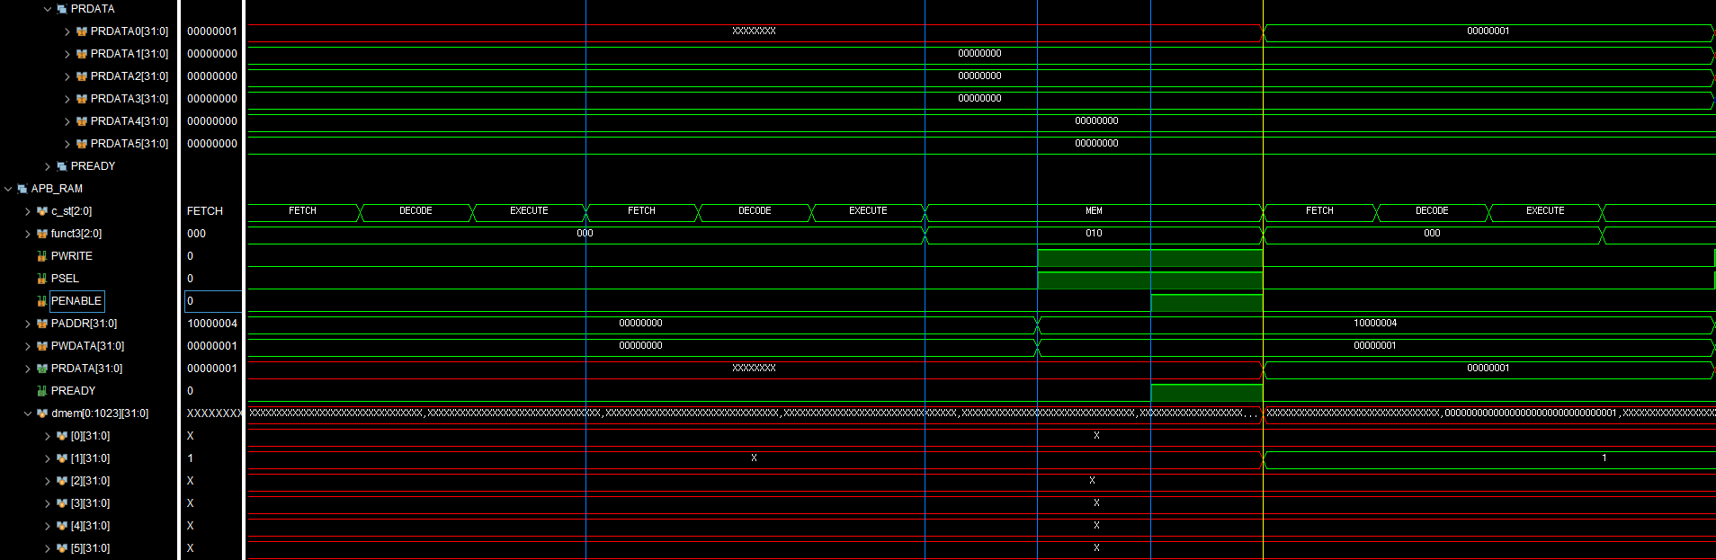
SIMULATION (sw)
APB SLAVE
IDLE
SETUP
ACCESS
PWRITE
1
PSEL
1
PENABLE
1
PADDR
PADDR
1000_0004
MEM[0] : 1000_0000
MEM[1] : 1000_0004
MEM[2] : 1000_0008 ：
PWDATA
1
1
MEM[1]
1

Slide 54
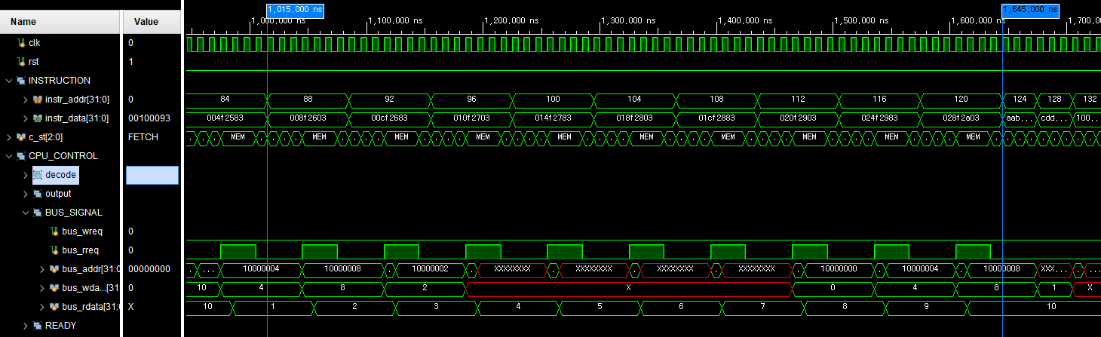
SIMULATION (LW)
WREQ
0
RREQ
1
ADDR

Slide 55
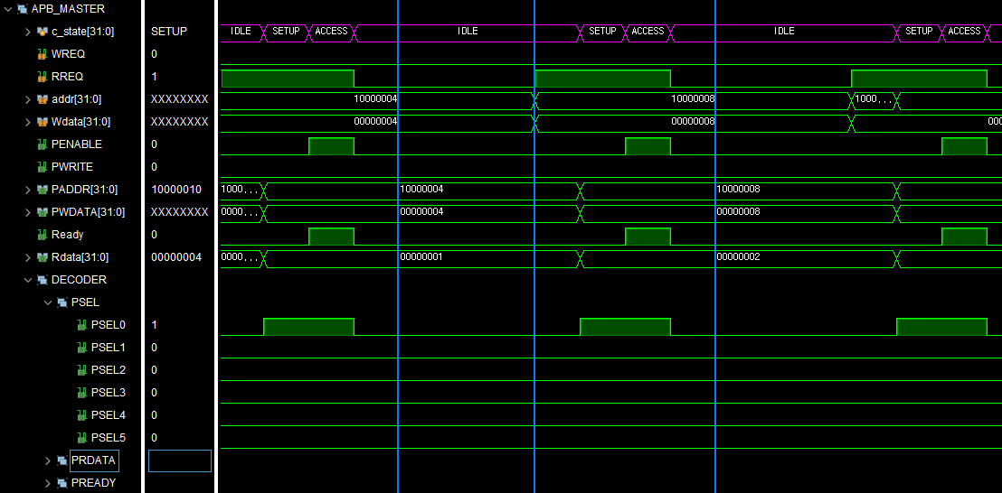
SIMULATION (LW, APB-Master)
WREQ
0
RREQ
1
PENABLE
0
1
ADDR
PSEL0
1

Slide 56
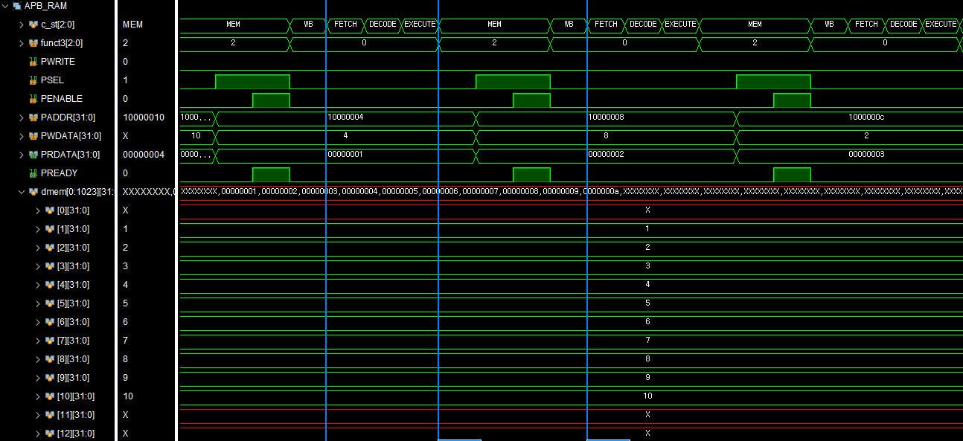
SIMULATION (LW, MASTER - RAM)
= mem[2]

Slide 57
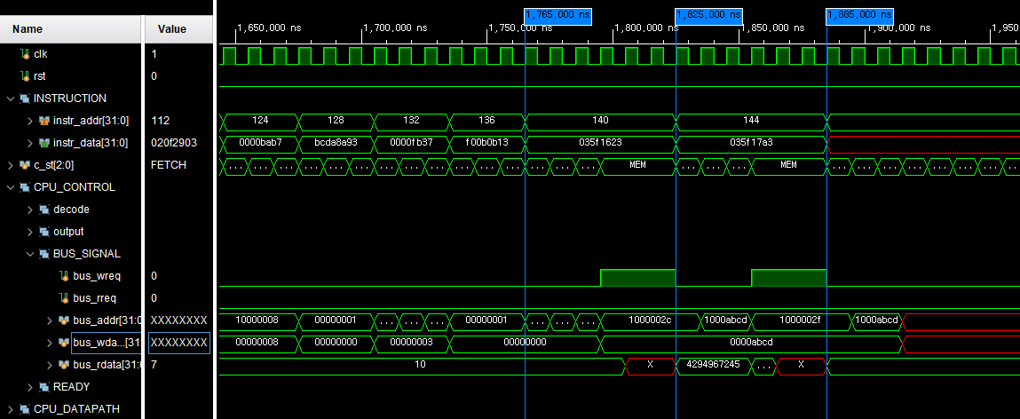
SIMULATION (SH)
reg file[21] = 0000abcd
MEM[11]
1000002C+3
WREQ
RREQ
ADDR

Slide 58
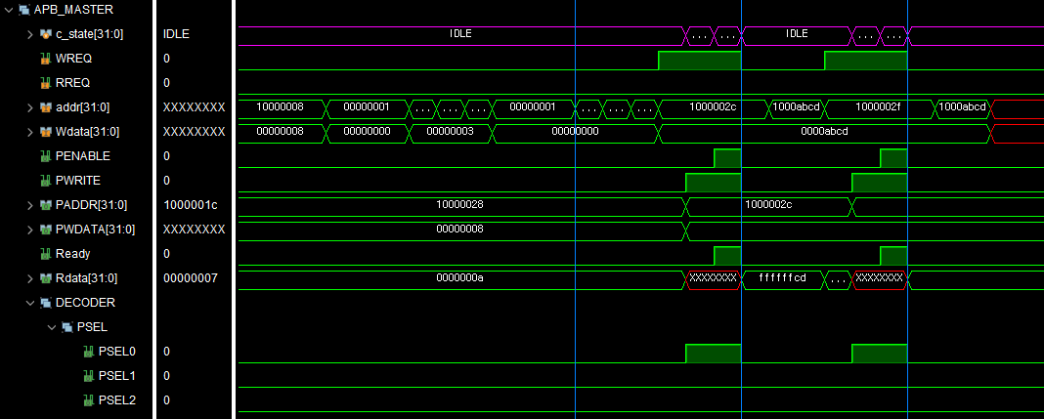
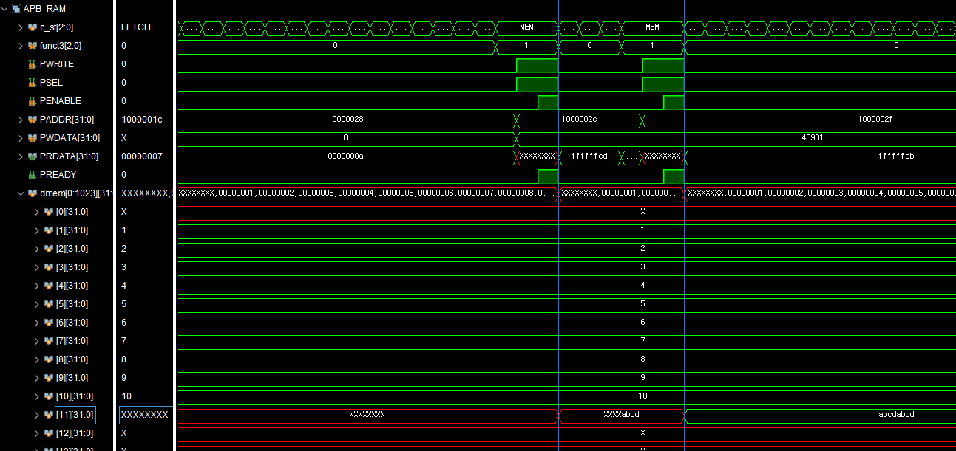
PWRITE
PSEL
PENABLE

Slide 59
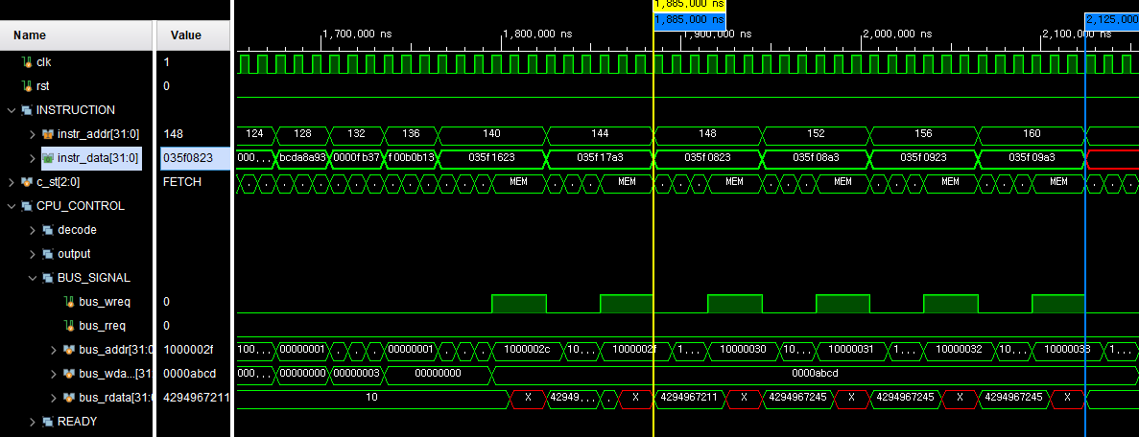
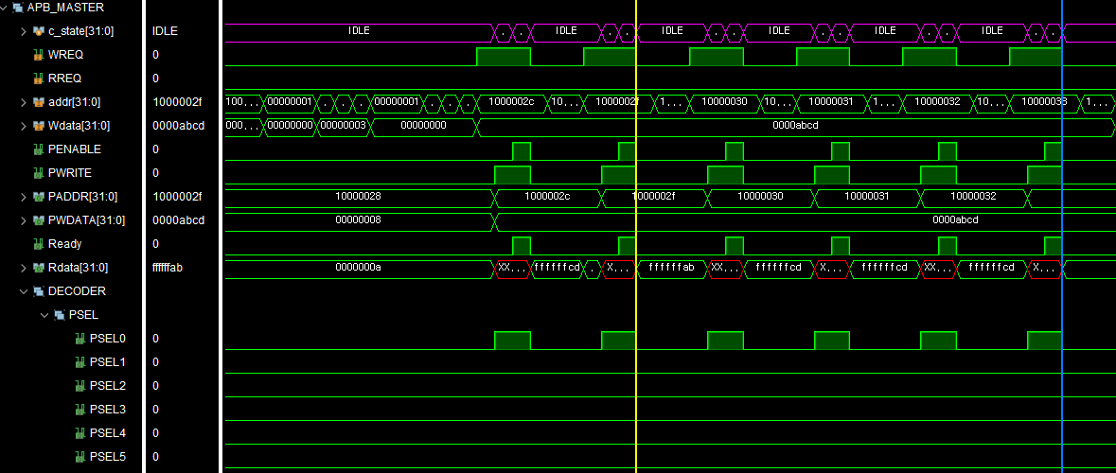
SIMULATION (SB)
PENABLE
PWRITE
+1
+1
+1
PSEL

Slide 60
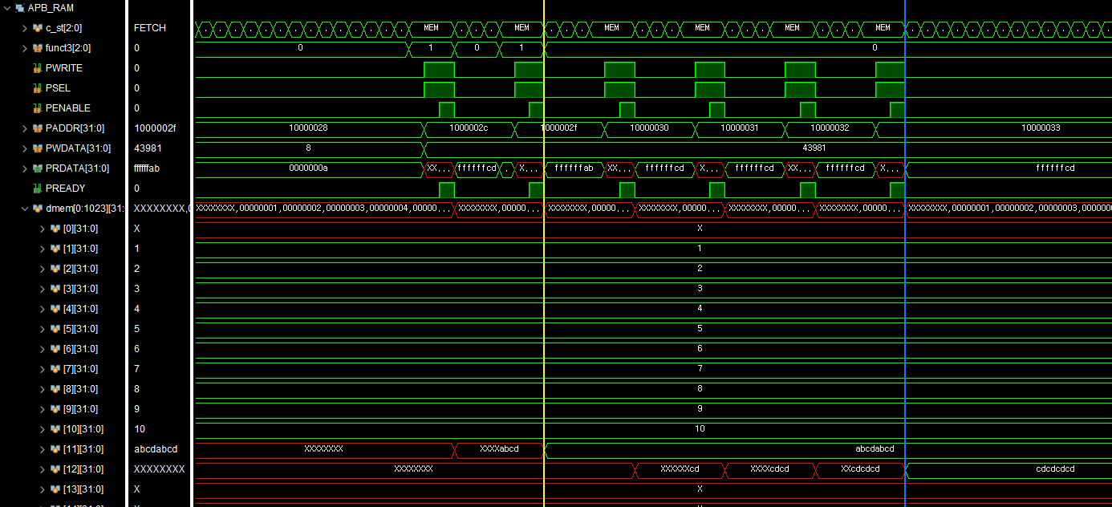
SIMULATION (SB)

Slide 61
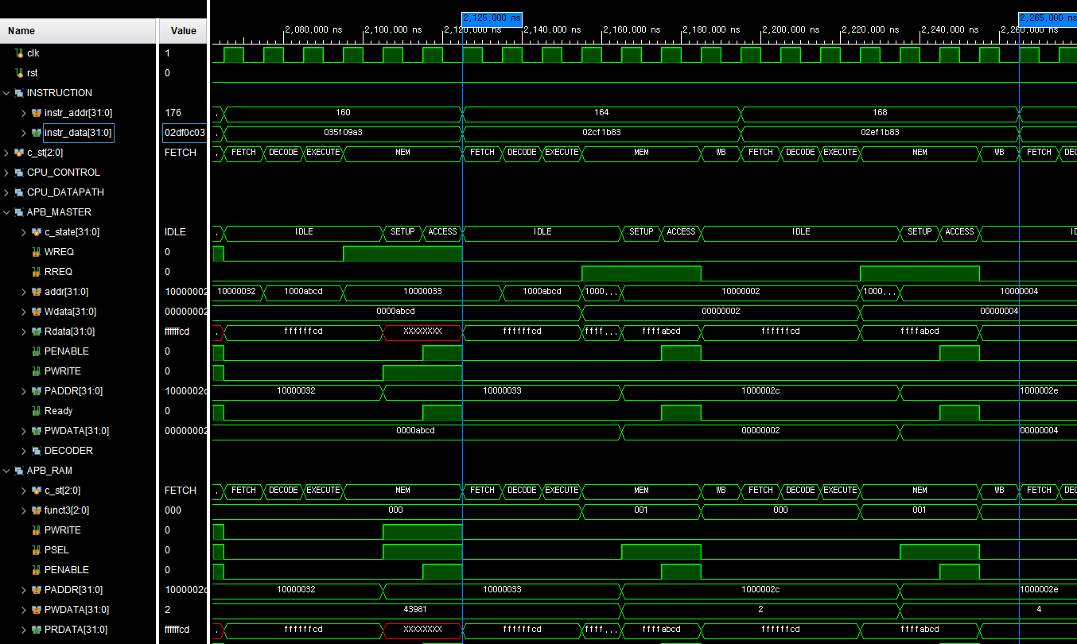
SIMULATION (LH)
PWRITE
0
PENABLE

Slide 62
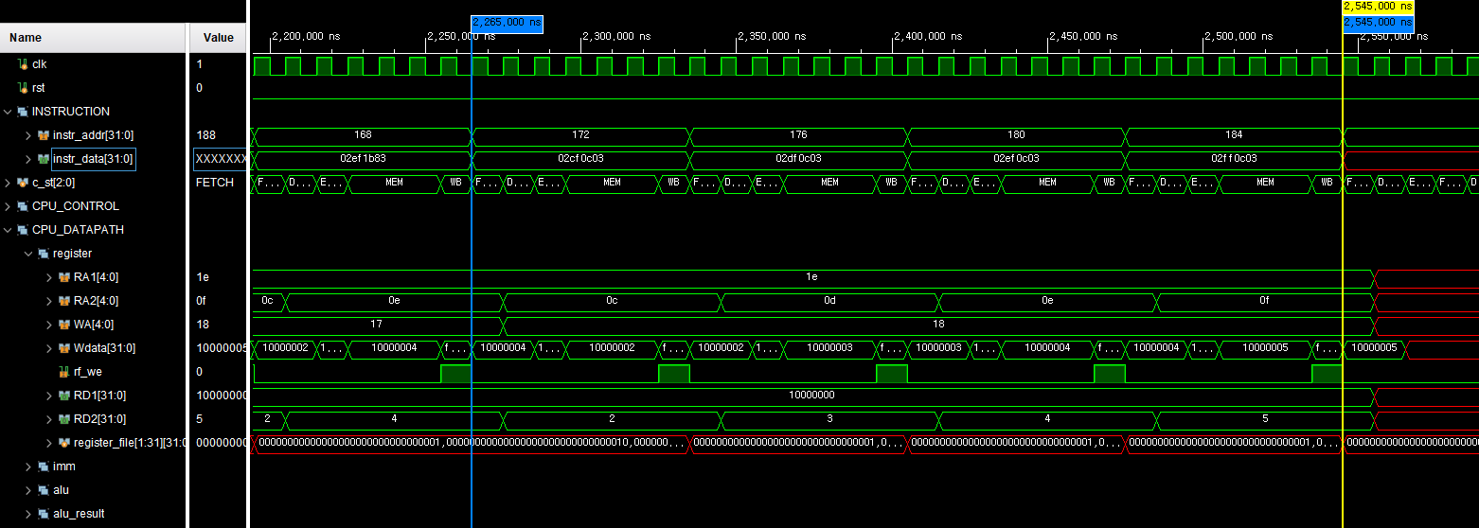
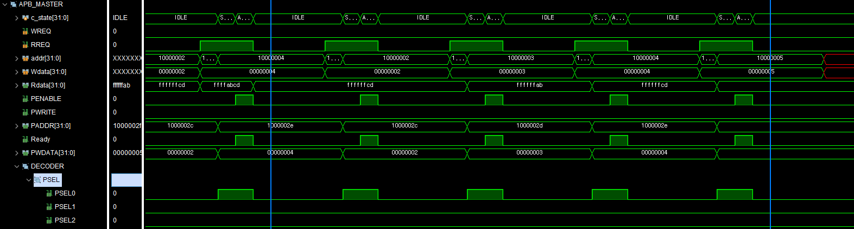
SIMULATION (LB)
PENABLE
1
PWRITE
0
+1
+1
+1
PSEL0
1

Slide 63


SIMULATION (LB)

Slide 64
FND,UART
4
1) Concept
2) Memory Map
3) Simulation

Slide 65
FND,UART

Slide 66

APB FND

Slide 67

APB UART

Slide 68


UART RX ASM

Slide 69


UART TX ASM

Slide 70


C code
1. STATUS_REG에서 rx_done 확인
2. 수신문자를 0~15로 변환
(범위 밖이면 무시)
하위 8비트 GPIO LED 출력 상위 8비트 GPO LED 출력
3.fnd value 0초기화
0~15까지 확인해서 켜진 비트 +1 결과 FND에 출력

Slide 71

C code

Slide 72




C code
1.수신문자 숫자로 변환
2.TX 완료 확인 후 데이터 저장하고 CTL 펄스로 전송 시작
3.전달받은주소 ODATA 저장

Slide 73


Slide 74


Slide 75

Simulation
19200bps: 1060us-532.90us=527.1us
19200 bps
1/19200 = 0.000052083

Slide 76

Simulation
19200bps: 1060us-532.90us=527.1us
115200bps: 204us-119us=85us
19200 bps
1/19200 = 0.000052083
115200bps
1/115200=0.00000868

Slide 77

Simulation
2.07ms-1.03ms = 약 1.04ms
9600 bps
1/9600 = 0.000104166

Slide 78

Simulation

Slide 79

Simulation
RX_DATA
TX_DATA, echo

Slide 80

Simulation
LED 15번 ON
LED 15번 OFF
LED 14번 ON
LED 14번 OFF
LED 13번 ON
LED 13번 OFF
LED 12번 ON
LED 12번 OFF
LED 11번 ON
LED 11번 OFF
LED 10번 ON
LED 10번 OFF
LED 9번 ON
LED 9번 OFF
LED 8번 ON
LED 8번 OFF
LED 7번 ON
LED 7번 OFF
LED 6번 ON
LED 6번 OFF
LED 5번 ON
LED 5번 OFF
LED 4번 ON
LED 4번 OFF
LED 3번 ON
LED 3번 OFF
LED 2번 ON
LED 2번 OFF
LED 1번 ON
LED 1번 OFF
LED 0번 ON
LED 0번 OFF

Slide 81
Simulation
VALUE 16
LED 15번 ON
LED 15번 OFF
VALUE 15
LED 14번 ON
LED 14번 OFF
VALUE 14
LED 13번 ON
LED 13번 OFF
VALUE 13
LED 12번 ON
LED 12번 OFF
VALUE 12
LED 11번 ON
LED 11번 OFF
VALUE 11
LED 10번 ON
LED 10번 OFF
VALUE 10
LED 9번 ON
LED 9번 OFF
VALUE 9
LED 8번 ON
LED 8번 OFF
FND VALUE 8
LED 7번 OFF
LED 7번 ON
FND VALUE 7
LED 6번 OFF
LED 6번 ON
FND VALUE 6
LED 5번 OFF
LED 5번 ON
FND VALUE 5
LED 4번 OFF
LED 4번 ON
FND VALUE 4
LED 3번 OFF
LED 3번 ON
LED 2번 ON
LED 2번 OFF
FND VALUE 3
LED 1번 ON
LED 1번 OFF
FND VALUE 2
LED 0번 ON
LED 0번 OFF
FND VALUE 1

Slide 82
Board Test
5

Slide 83

Board Test

Slide 84
Trouble shooting
5

Slide 85



Trouble shooting

Slide 86



Troubleshooting
ir_en

Slide 87
감사합니다

