Slide 1
LLM-assisted pharmacovigilance pipeline for
prioritizing potentially unlabeled adverse drug reactions from FAERS
Hackathon Project for the 2nd AI Workshop NYC
Presenter
Step 0: FAERS reports
Eunchong Kang
Challenge: Disproportionality analysis generates many drug–event signals, but reviewers need a prioritized set of plausible unlabeled ADRs.
→
Step 1: Statistical EBGM signals
Ph.D. Candidate, Department of Biostatistics
→
The University of North Carolina at Chapel Hill
Step 2: LLM PT triage
→
Step 3: LLM label comparison
LLM-assisted post-statistical analysis
→
Step 4: Prioritized novel ADRs

Slide 2
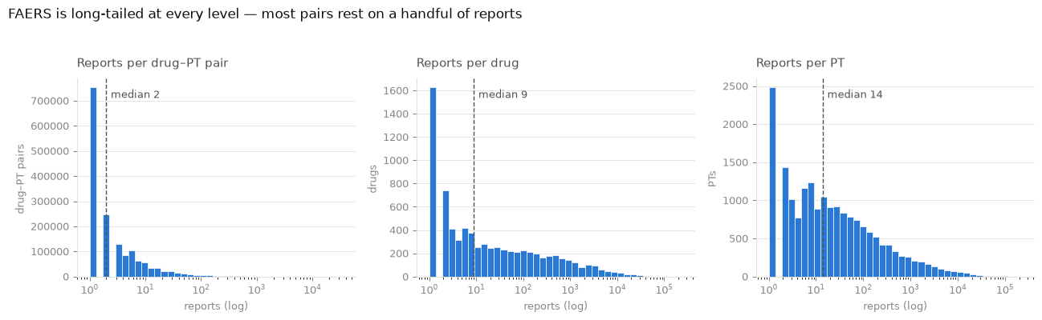
Background, Dataset, and Unit of analysis
Source Data: The FDA Adverse Event Reporting System (FAERS) quarterly data in 2024Q1–2026Q1
3.15M
14.76M
1.62M
- Each FAERS report lists suspect active ingredients (drugs) and adverse event as MedDRA Preferred Terms (PTs.)
- The unit of analysis: one drug-PT pair.
- Disproportionality analysis tests whether a drug–PT pair is reported more often than expected.
unique FAERS reports
report–drug–PT rows
unique drug–PT pairs
7,655
18,838
drugs
PTs
Right-skewed counts motivate shrinkage.
AIWSNYC Hackathon | FAERS signal detection

Slide 3
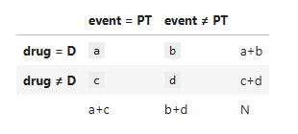
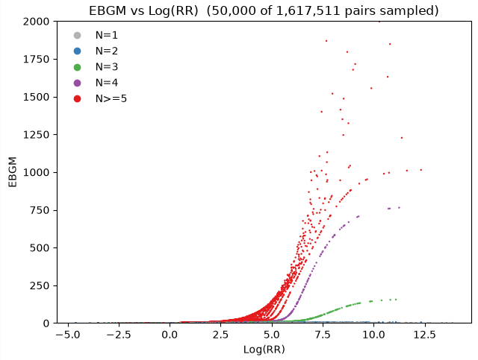
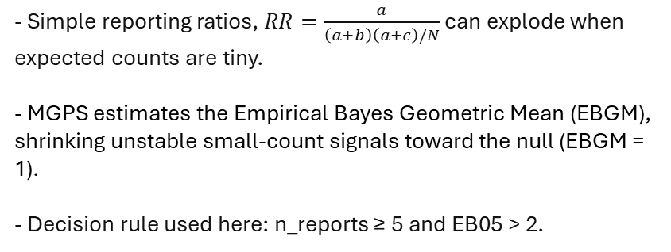
Stage 1: statistical? signal detection with MGPS / EBGM
Screening output
Goal: Quantify disproportionality signals for each drug–PT pair using EBGM
177,823
9,032
3,523
10.99%
drug–PT pairs passed threshold
unique PTs
unique drugs
survival rate from all pairs
- Simple reporting ratios, $RR=\frac{a}{\left(a+b\right)\left(a+c\right)/N}$ can explode when expected counts are tiny.
- MGPS estimates the Empirical Bayes Geometric Mean (EBGM), shrinking unstable small-count signals toward the null (EBGM = 1).
- Decision rule used here: n_reports ≥ 5 and EB05 > 2.
Stage 1 narrows the candidate ADR search space, but the remaining signals still include non-ADR terms,
such as treatment failure and product issues, as well as events already listed in FDA labels.
AIWSNYC Hackathon | FAERS signal detection
Notes:
MGPS: Multi-Item Gamma Poisson Shrinker
EB05: 5th percentile of the posterior distribution of the EBGM

Slide 4
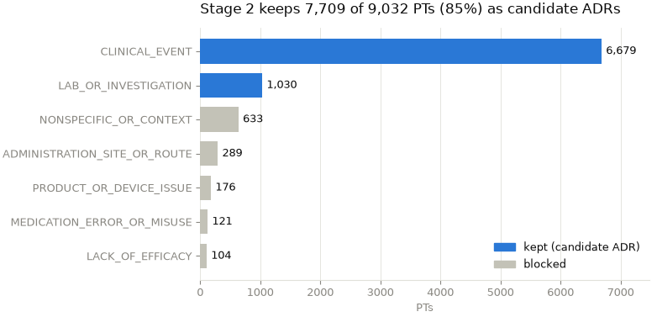
Stage 2: LLM triage of MedDRA PTs
Goal: retain PTs that could plausibly be adverse drug reactions
- FAERS records adverse events (AE), not adverse reactions (ADR).
- PTs are classified drug-agnostically into 7 categories using LLM. Then, keep PTs that belong to ADR related categories.
- Kept categories: CLINICAL_EVENT (e.g. rash) and LAB_OR_INVESTIGATION (blood glucose increased.)
- Blocked: LACK_OF_EFFICACY (drug ineffective), MEDICATION_ERROR_OR_MISUSE (off label use), PRODUCT_OR_DEVICE_ISSUE (device malfunction), ADMINISTRATION_SITE_OR_ROUTE (infusion site pain), NONSPECIFIC_OR_CONTEXT.
Prompt Exert:
“You are a senior pharmacovigilance analyst and MedDRA expert. Definitions: - Adverse Event (AE): any unwanted … Background: I have a list of PTs obtained from FAERS reports … I created the following categories to help determine which PTs could plausibly represent ADRs. Use only these categories: - CLINICAL_EVENT: A genuine sign … Goal:
Classify each PT into exactly one … Classification rules: 1. Make the classification drug-agnostic. Classify the following 50 PTs: 1. Drug ineffective 2. Toxicity to various agents …”
Output schema:
{pt, pt_type, keep, reasoning}
e.g.
{'pt': 'Anaemia', 'pt_type': 'CLINICAL_EVENT’}
{'pt': 'Drug ineffective', 'pt_type': 'LACK_OF_EFFICACY’}
…
After retaining 7,881 clinical PTs, 154,041 of 177,823 EBGM signals (drug–PT pairs) remained as candidate drug–ADR pairs.
AIWSNYC Hackathon | FAERS signal detection

Slide 5
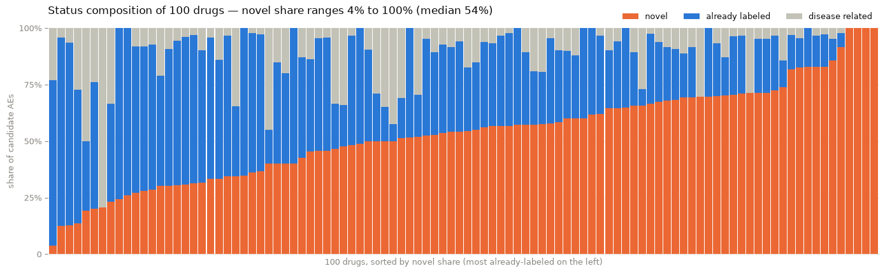
Stage 3: LLM comparison against FDA label
Question: is the signal already known (labeled) for this product?
- Fetch FDA SPL label via openFDA drug/label endpoint.
- Compare candidate AEs against label sections: indications, boxed warning, adverse reactions, etc. to classify each PTs into ‘NOVEL’, ‘ALREADY_LABELED’, and ‘DISEASE_RELATED.’
- Drug can be pinned to one curated brand/product because labels differ by route, form, and manufacturer.
- For the test analysis, I randomly selected 100 drug-brand pairs
Across 100 sampled drugs, status composition varied.
Prompt Exert:
“You are a pharmacovigilance expert comparing candidate PTs for one drug against that drug's official FDA label. … Background: The label text is provided as reference material … Treat the ENTIRE label as the source of truth … Classification rules: For each candidate PT, make a hierarchical decision and assign exactly ONE status … 1. If the AE is really the drug's INDICATION … 2. Else if the label describes the AE as something the drug can cause … 3. Else -> novel (a potential unlabeled ADR) … === FDA LABEL ===
## INDICATIONS AND USAGE 1 INDICATIONS AND USAGE ULORIC … === CANDIDATE ADVERSE EVENTS === 1. Cerebral artery thrombosis 2. Gouty arthritis …
Output schema:
{"pt": "<verbatim>", "status": "<one status>", "reasoning": "<one short sentence>"}
e.g.
{‘pt’: ‘Cerebral artery thrombosis’, ‘status’:’novel’, ‘reasoning’: ‘The label does not mention cerebral artery thr...’}
{‘pt’: ‘Dyslipidaemia’, ‘status’: ‘already_labeled’, ‘reasoning’: ‘Dyslipidaemia is covered under 'hyperlipid…’}
AIWSNYC Hackathon | FAERS signal detection
Notes:
SPL: Structured Product Labeling

Slide 6
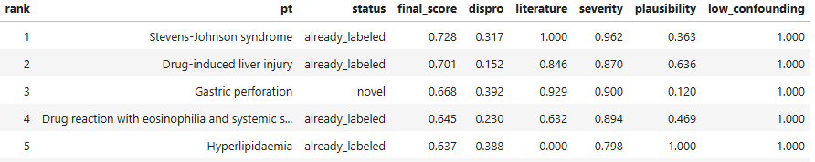
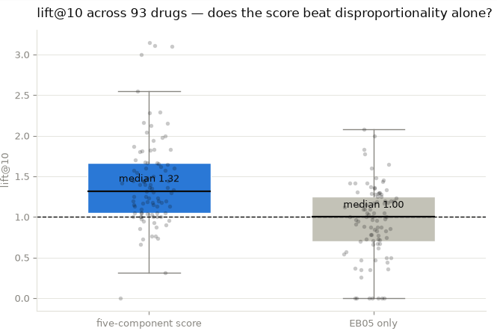
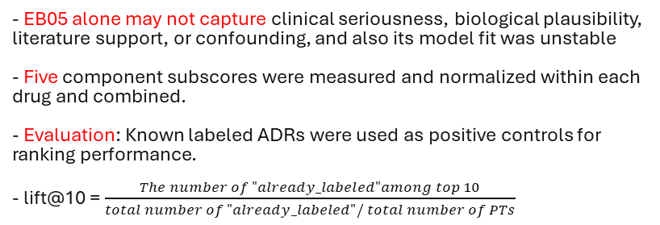
Stage 4: Priority score and internal validation
Goal: Prioritize novel signals that rank near known ADRs
- EB05 alone may not capture clinical seriousness, biological plausibility, literature support, or confounding, and also its model fit was unstable
- Five component subscores were measured and normalized within each drug and combined.
- Evaluation: Known labeled ADRs were used as positive controls for ranking performance.
- lift@10 = $\frac{The number of "already_labeled"among top 10}{total number of "already_labeled"/ total number of PTs}$
Component
Operational definition
dispro
log(EB05)
- For example, use an LLM embedding model to calculate the cosine similarity between “rash” and “death.”
literature
Semantic embedding similarity to FAERS-cited papers
severity
Semantic embedding similarity to severe outcomes
plausibility
similarity to drug’s labeled ADR profile
low confounding
fewer co-suspect drugs
Validation summary: 93 drugs evaluated. Median lift@10 was 1.32 for the five-component score vs 1.00 for EB05 alone; lift > 1 in 78% vs 46% of drugs.
AIWSNYC Hackathon | FAERS signal detection

Slide 7
Conclusions & Limitations
Conclusion
Limitations
- Built an automatic, LLM-assisted pipeline from FAERS reports to ranked candidates for potentially unlabeled ADRs.
- LLM stages transform noisy PTs and long product labels into structured, reviewable decisions using its semantic understanding.
- The final score appears more useful than EB05 alone for ranking known ADRs near the top.
- LLM-based PT triage and label comparison were not closely validated. In fact, the threshold for considering two terms equivalent needs further investigation,
- e.g. Acute kidney injury (novel) vs Renal failure (labeled) for febuxostat.
- Accounting for brand, route, and formulation requires more complete product-level data.
- EBGM hyperparameter fitting was unstable; therefore, EB05 should be used only for screening and approximate ranking.
- Equal score weights are untuned, and it can be learned from data and evaluated by each component (ablation study).
- Literature, plausibility, and severity scores currently rely only on information within FAERS reports, but could be extended through automated PubMed searches for supporting evidence.
Reference:
ICH E2A guideline
openEBGM: Canida T, Ihrie J (2017) The R Journal
Data Mining at FDA -- White Paper
AIWSNYC Hackathon | FAERS signal detection

