Slide 1
Heart Disease Data Analysis
BIOS 735 Group 2 - Mingwei, Di, Wanting, Eunchong, & Andrew
Github repository
Notes:
Andrew

Slide 2
Introduction
Notes:
Andrew

Slide 3
Introduction - Background
In 2020, heart disease was the leading cause of death in the United States with 696,962 deaths attributed (followed by cancer & COVID-19) according to the final 2020 U.S. mortality data from the CDC.
https://ourworldindata.org/does-the-news-reflect-what-we-die-from
Many health status indicators are found related to heart disease such as high blood pressure, high cholesterol, smoking, diabetes, obesity (BMI > 30.0), insufficient physical activity, & excessive alcohol consumption.
Understanding and detecting the factors that have the greatest impact on heart disease occurrence in populations is crucial in healthcare to improve the length and quality of life.
Notes:
Andrew - Sherry L Murphy, Kenneth D Kochanek, Jiaquan Xu, and Elizabeth Arias. Mortality in the united states, 2020. 2021.18

Slide 4
Introduction - dataset
Personal key indicators of heart disease (kaggle)
https://www.kaggle.com/datasets/kamilpytlak/personal-key-indicators-of-heart-disease
319795 observations of 18 variables (1 outcome & 17 covariates)
Primary Outcome of interest: Heart disease occurrence
Subject experienced either coronary heart disease or myocardial infarction (binary)
Other factors:
BMI, Smoking status, alcohol consumption, stroke occurrence, poor physical health, poor mental health, walking difficulty, sex, age, race, diabetes, physical activity, general health status, average sleep time, asthma, kidney disease occurrence, skin cancer occurrence
Notes:
Andrew

Slide 5
Introduction - project aims/research questions
Aim 1: determine relationship between heart disease prevalence and all other factors
Aim 2: determine relationship between BMI & heart disease
Aim 3: determine relationship between risky behaviors (smoking & drinking) with heart disease or stroke (poor health outcomes)
Aim 4: Compare the model fitting performance between logistic regression model and other machine learning methods. And propose predictions for occurrence of heart disease given health condition indicators
Notes:
Andrew

Slide 6
Exploratory figures
Notes:
Andrew

Slide 7
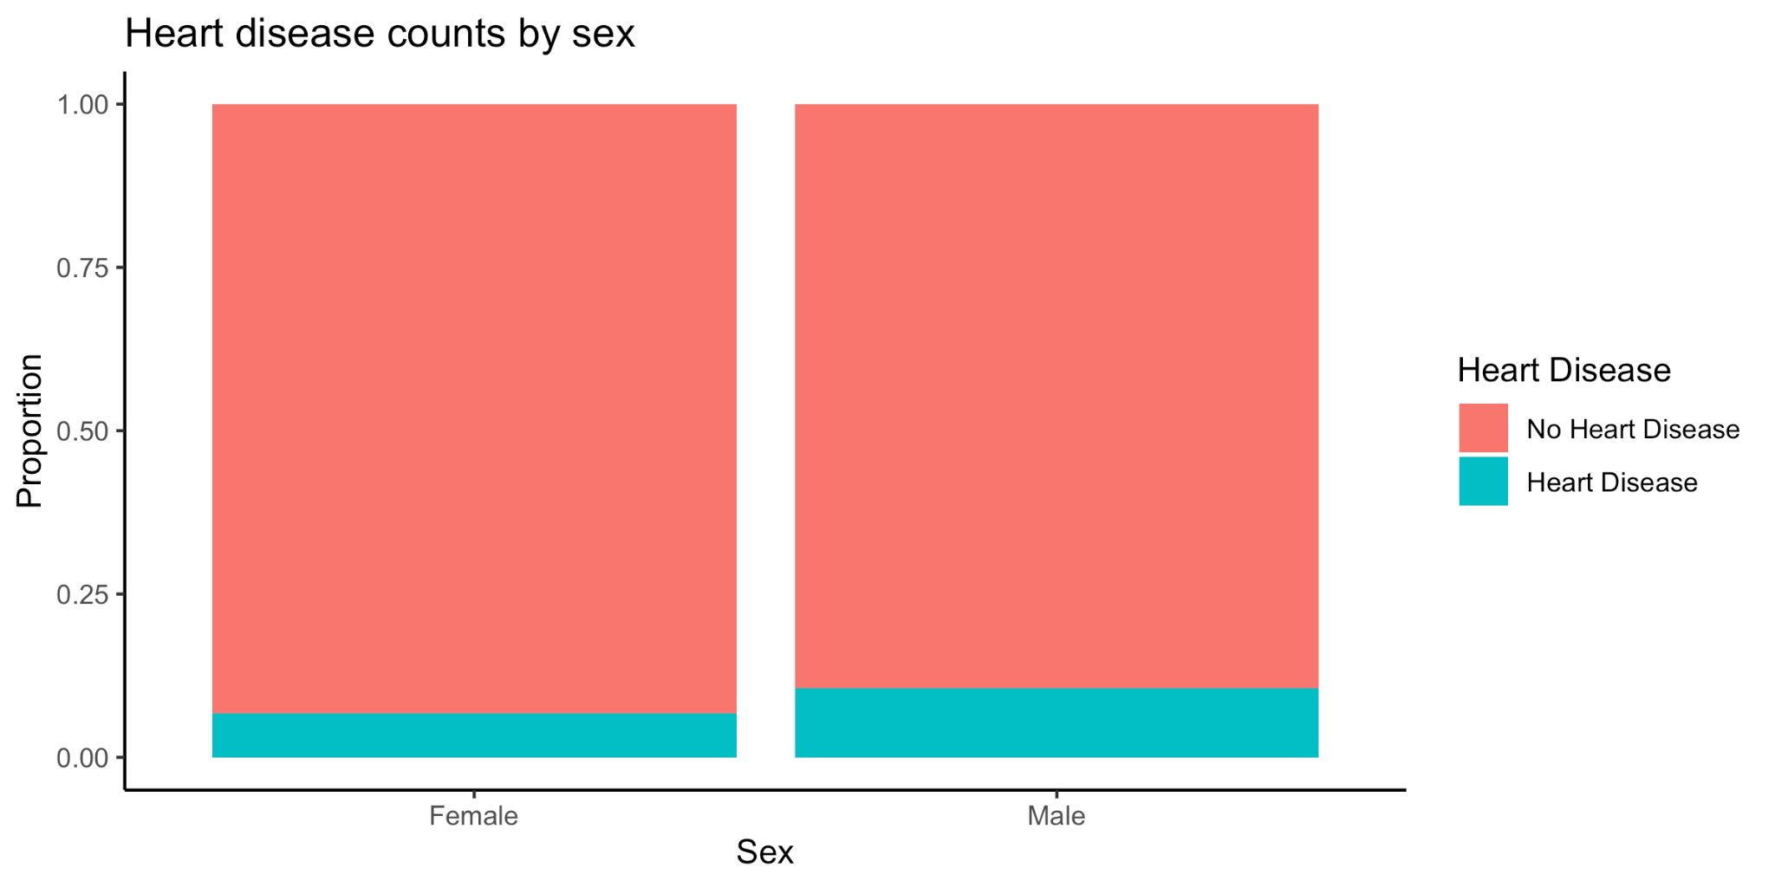
Heart disease by sex
Notes:
Andrew

Slide 8
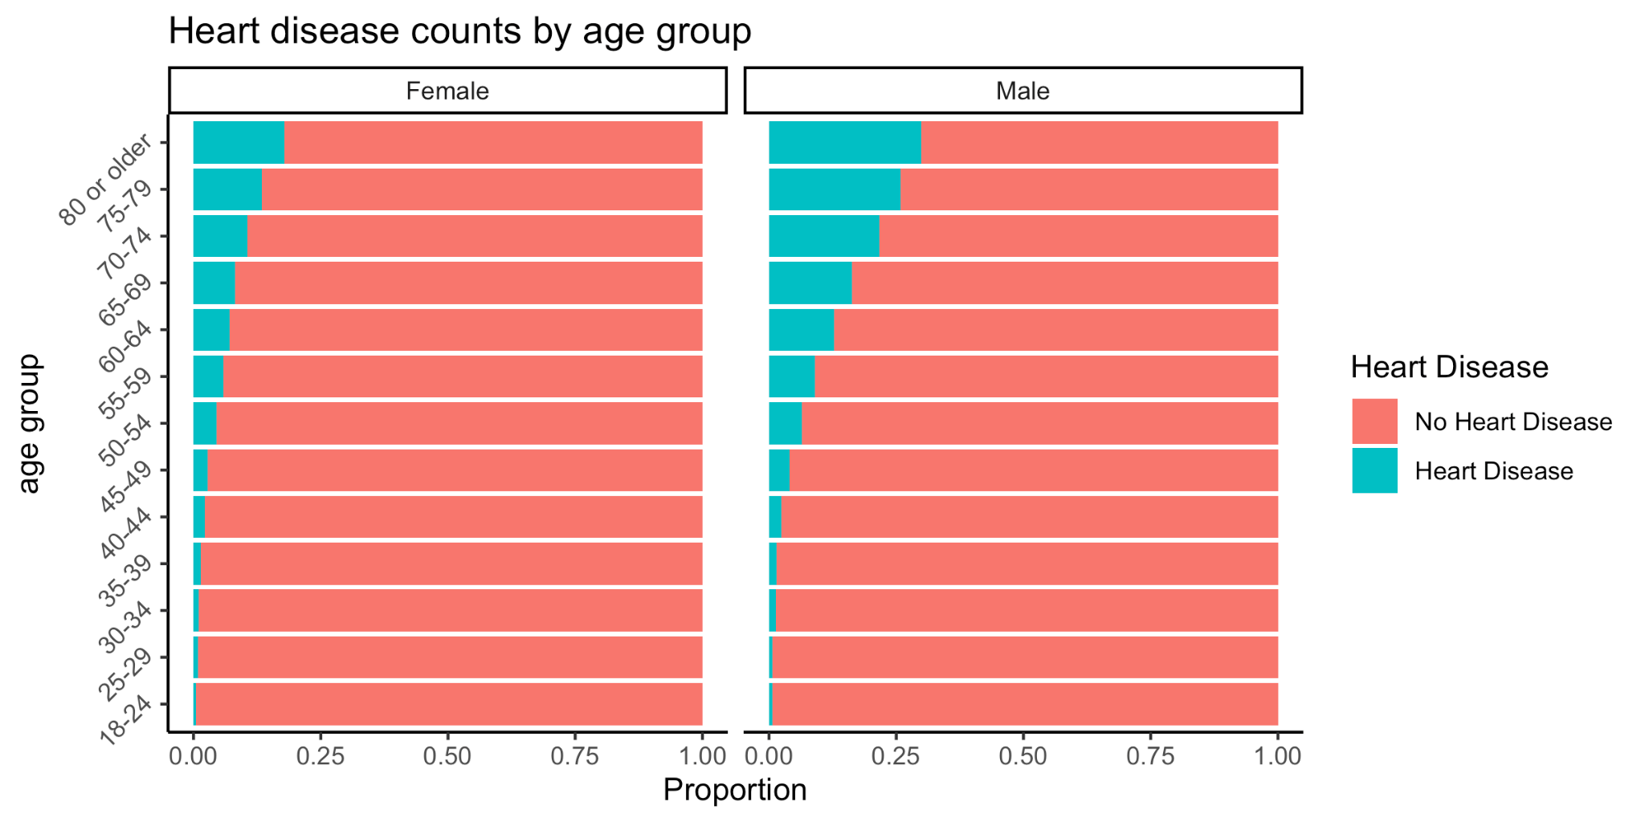
Heart disease by age & sex
Notes:
Andrew

Slide 9
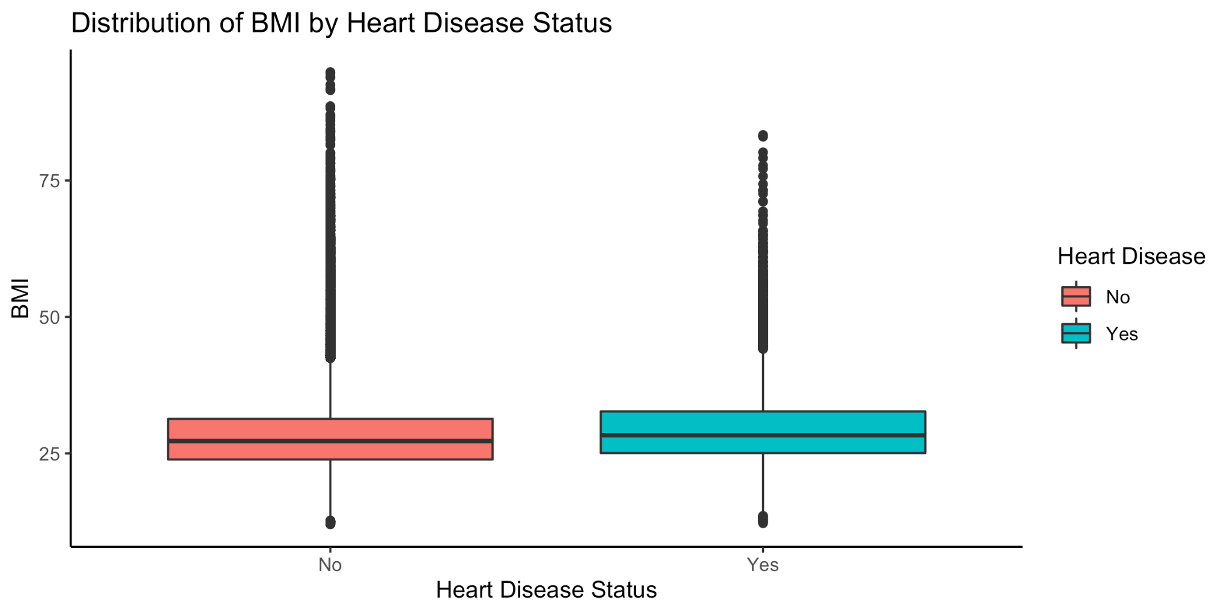
Heart disease by BMI
Notes:
Andrew

Slide 10
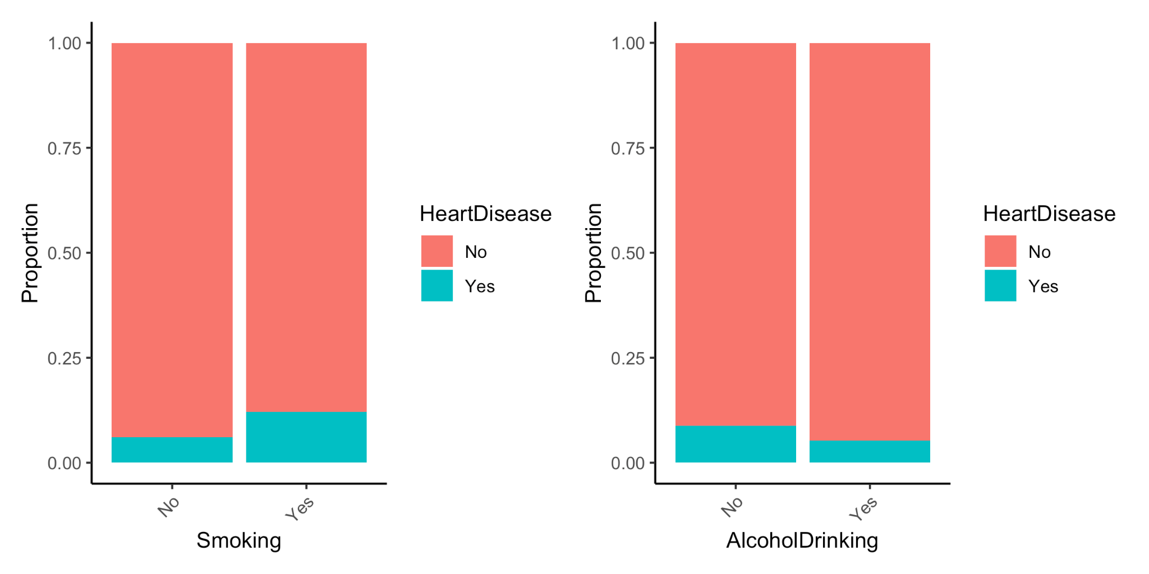
Heart disease by risky behaviors
Notes:
Andrew

Slide 11
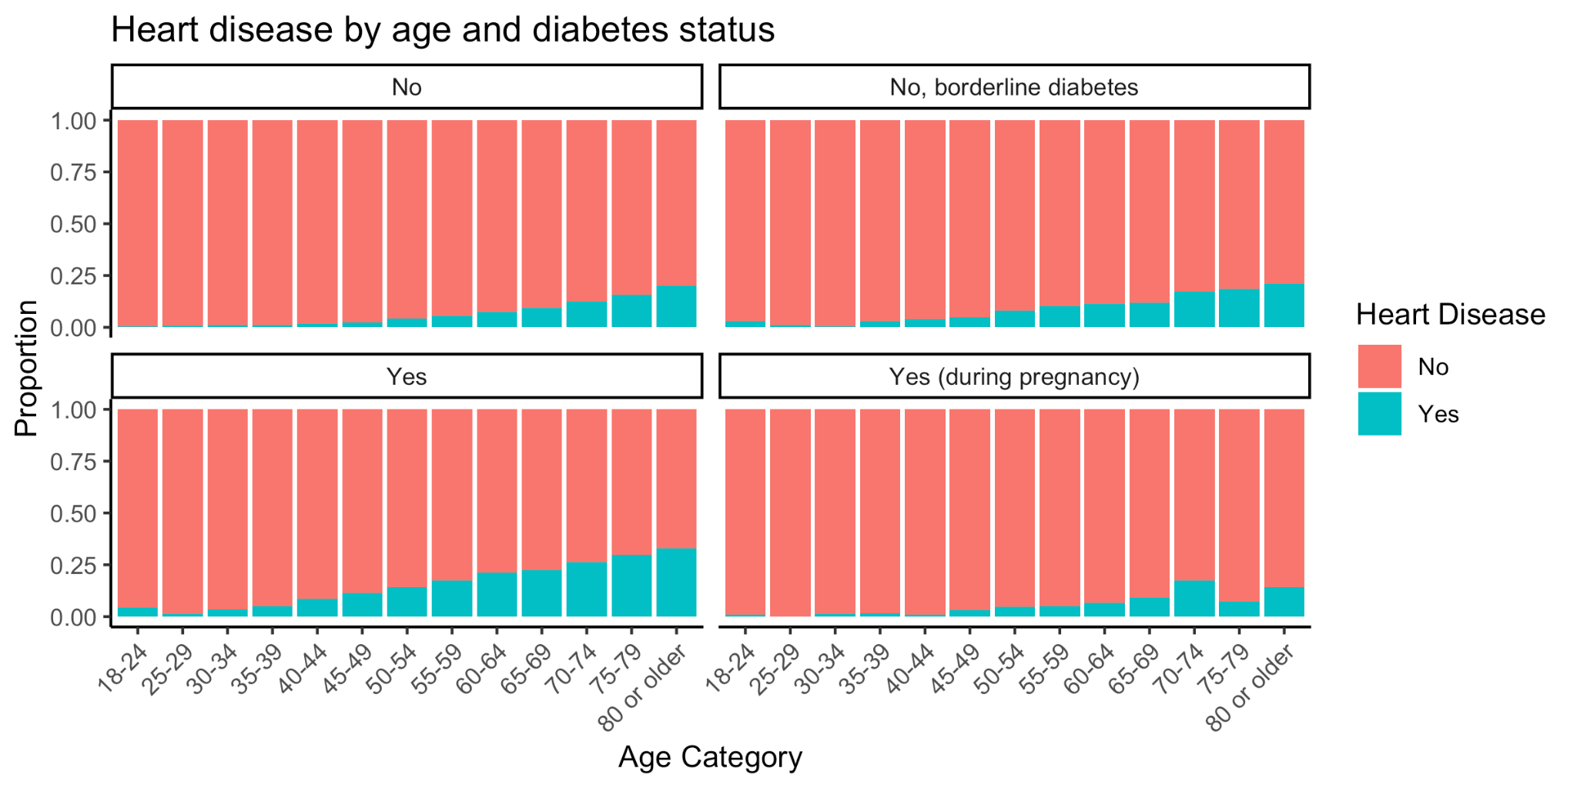
Heart disease by diabetes status & age
Notes:
Andrew

Slide 12
Methods
Notes:
Di & Eunchong

Slide 13
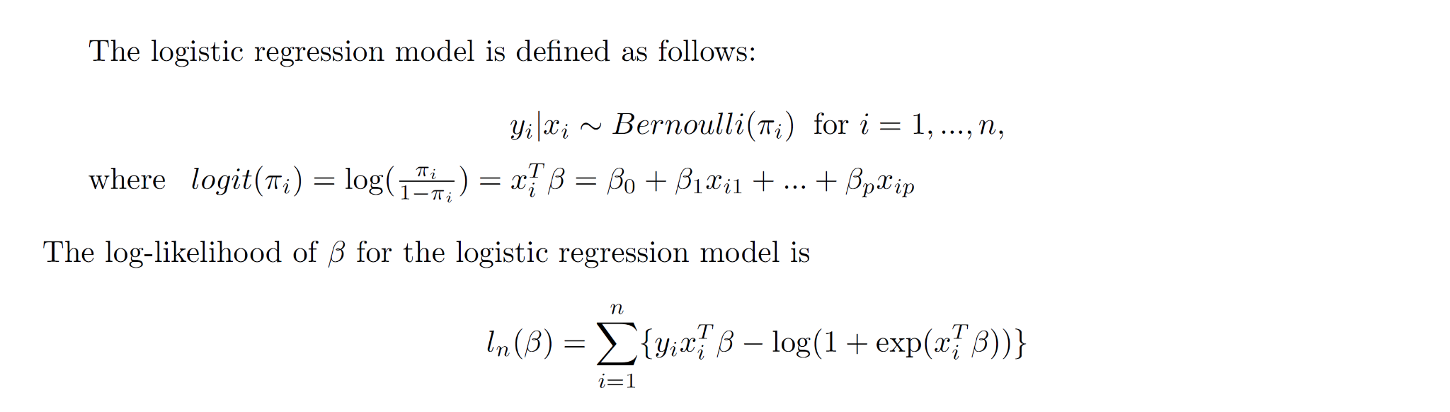
Methods - logistic regression
Notes:
Eunchong
Since we have a binary outcome, the likelihood-based method we used from scratch is logistic regression. The logistic regression uses Bernoulli distribution as everyone knows, and the log-likelihood in terms of beta is defined as this.

Slide 14
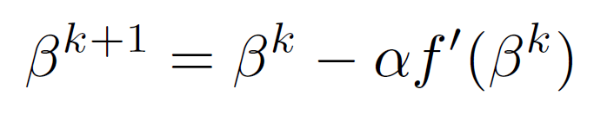
Methods - logistic regression (IRLS Algorithm)
Training set (80% of total dataset)
The number of observations in the training set: 255,837
The number of covariates: 17
Gradient Descent or Stochastic Gradient Descent
The update is
When α=0.0001 and the initial beta is the zero vector, it took more than 1 hour with over 30,000 iterations (2/3 of them was around its convergence)
SGD: Mini-batch with the size of 0.01 * 255,837
It took about 30 mins
NR-based method - Iterative Reweighted Least Squares (IRLS)
Pros: faster, 1st and 2nd derivatives are known
Cons: Sensitive to the starting value, Hessian matrix (size:38*38)
Notes:
Eunchong
Our training dataset contains around 255,000 observations and 17 covariates. Among them 14 variables are categorical. We have a relatively large data.
We considered several method. Gradient Descent and stochastic gradient descent method. The update uses the first derivative scaled by alpha. After we coded it up, we ran the algorithm with alpha 10 to the negative three (point o o o 1) and the starting beta is the zero vector. It took more than 1 hours even closer to 2 hours with 30,000 iterations. So, we tried stochastic gradient descent with the ratio of subsampling 0.01. It showed improvement like around 30 minutes to converge. My code might not have been efficient enough but after we saw glm function spent only 5 seconds, we thought the speed is problem. (gradient descend may not be appropriate in our case.)
So we used IRLS and BFGS methods.
I am going to talk about IRLS
IRLS is faster but sensitive to the starting value.

Slide 15
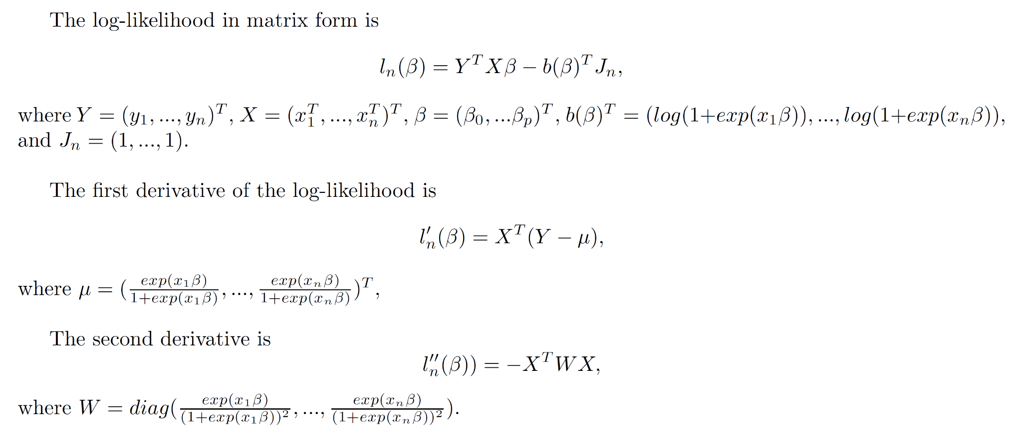
Methods - logistic regression (IRLS Algorithm)
Notes:
Eunchong
Log-likelihood in matrix form is this, and the first and second derivative is known as this.

Slide 16
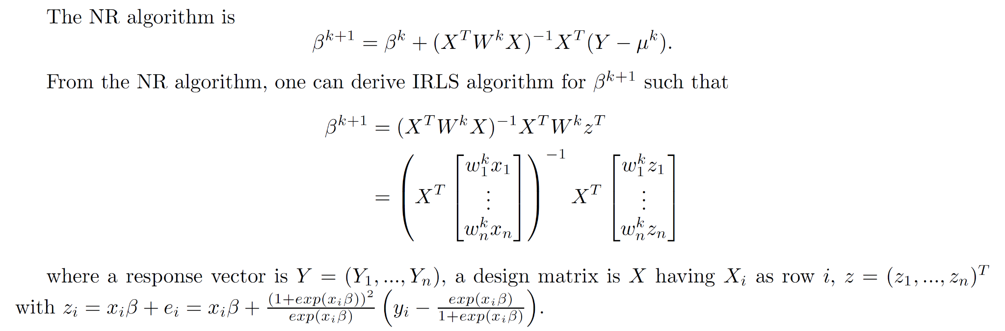
Methods - logistic regression (IRLS Algorithm)
Notes:
Eunchong
From the first and second derivatives, we can derive the Newton-Raphson and IRLS formular. We coded the algorithm using the matrix form but the problem was in W matrix, which is n by n matrix. So in our case, it is 255,000 by 255,000. So element-wise column multiplication was used.

Slide 17
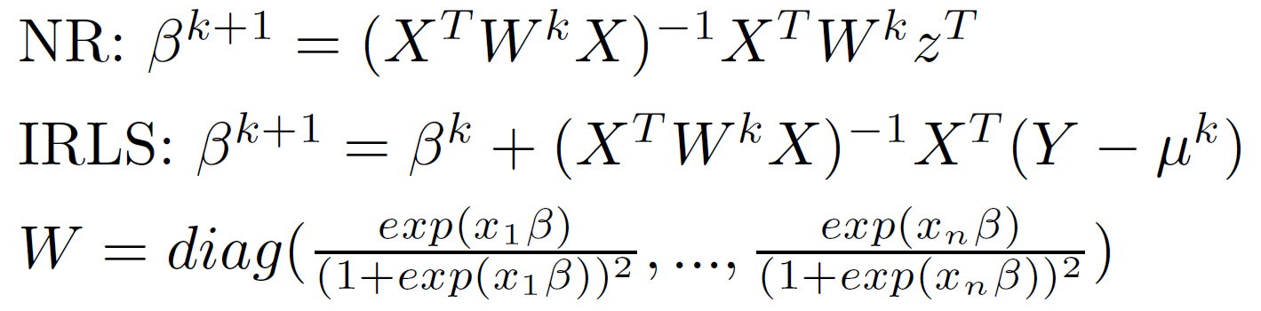
Methods - logistic regression (IRLS Algorithm)
optim.IRLS(X, Y, beta)
X: design matrix, Y: response vector, beta: the starting beta
Convergence criterion: Absolute change of log-likelihood
Tolerance: 10^-10
Speed
About 5 seconds for Convergence
9 Iterations
Convergence
Starting beta with all elements being 0
Converged
Starting beta with all elements being 0.5
Did not converge
Result compared to glm function
Maximum difference between the two parameters: 3.046436*10^-7
Notes:
Eunchong
The algorithm converges in 5-6 seconds with 9 iterations, which is big difference from the SGD.
The starting beta was the zero vector, but when using the starting with all elements one half, it doesn’t converge. The main difference between two starting was in W matrix. (move to W form) when beta is not zero the diagonals of W becomes very small making the inverse of the Hessian very large. In contrast, when beta is zero, the inverse of the second was small. So, we can think Newton update steps may be too aggressive. We set glm function as standard and check the results. Its speed was similar and the results was almost the same in IRLS since glm also uses IRLS.

Slide 18

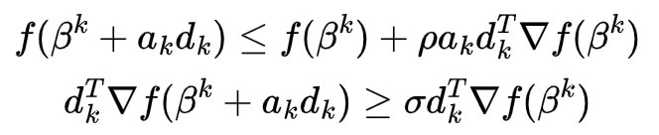
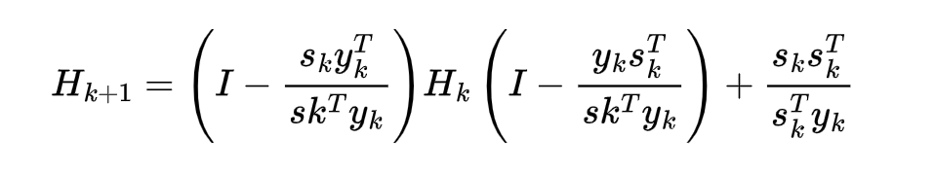
Methods - logistic regression (BFGS Algorithm)
Avoid calculating the inverse of Hessian matrix at each iteration
Need to find a proper step length to guarantee decreasing.
Update the step length using line search satisfying Wolfe conditions:
Update the approximation of the inverse Hessian matrix by
Ensure f decrease sufficiently
Ensure the slope reduces sufficiently
Notes:
Di & Eunchong
Next would be the BFGS method for logistic regression. Since the log-likelihood is non-linear and our data was really large, we considered the BFGS to avoid computing Hessian and its inverse at each iteration.
But as a trade off, it needs to find a proper step length to guarantee decrease. Here we considered update the step length using line search satisfying Wolfe conditions.
The first condition ensures the objective function decrease sufficiently and the seconds one ensures the slope reduces sufficiently.
The inverse Hessian approximation is updated by this formula.

Slide 19
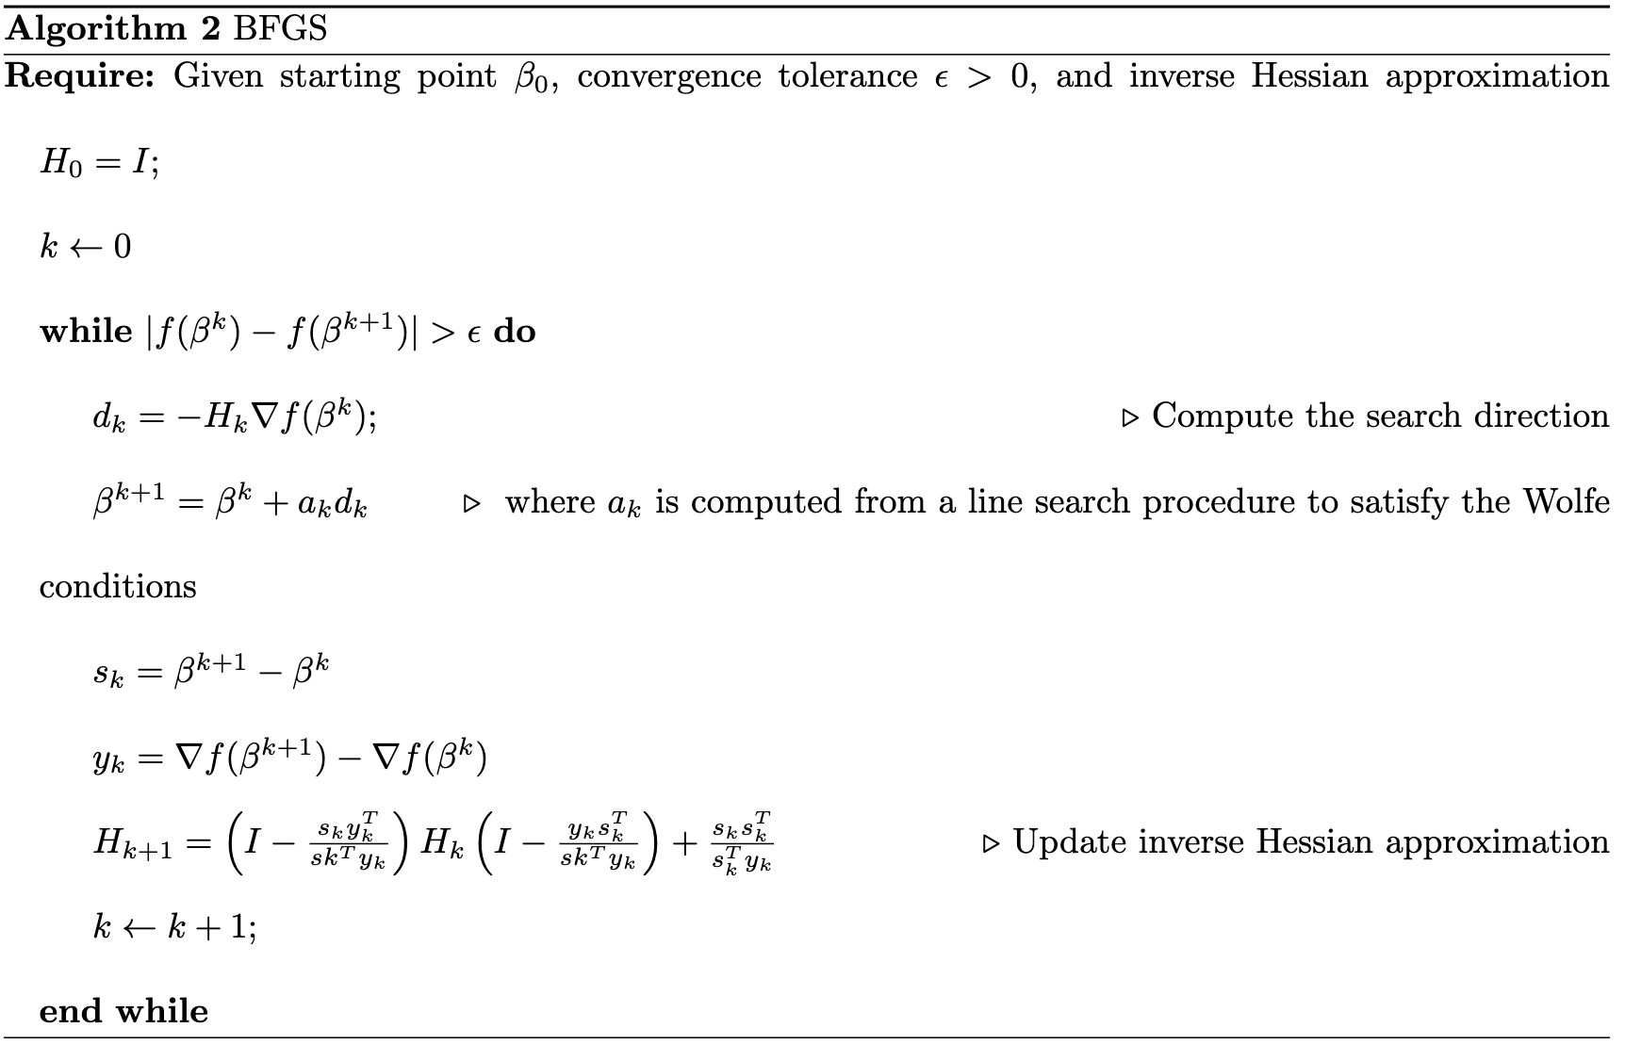
Methods - logistic regression (BFGS Algorithm)
Notes:
Di & Eunchong
Here is the BFGS algorithm.
We first state the initial value, convergence tolerance, and give a initial value, identity matrix for the inverse Hessian.
Then we calculate the search direction
Here should be a line search algorithm to choose proper step length.
Once we get the step length, we can update beta and the inverse Hessian Approximation.

Slide 20
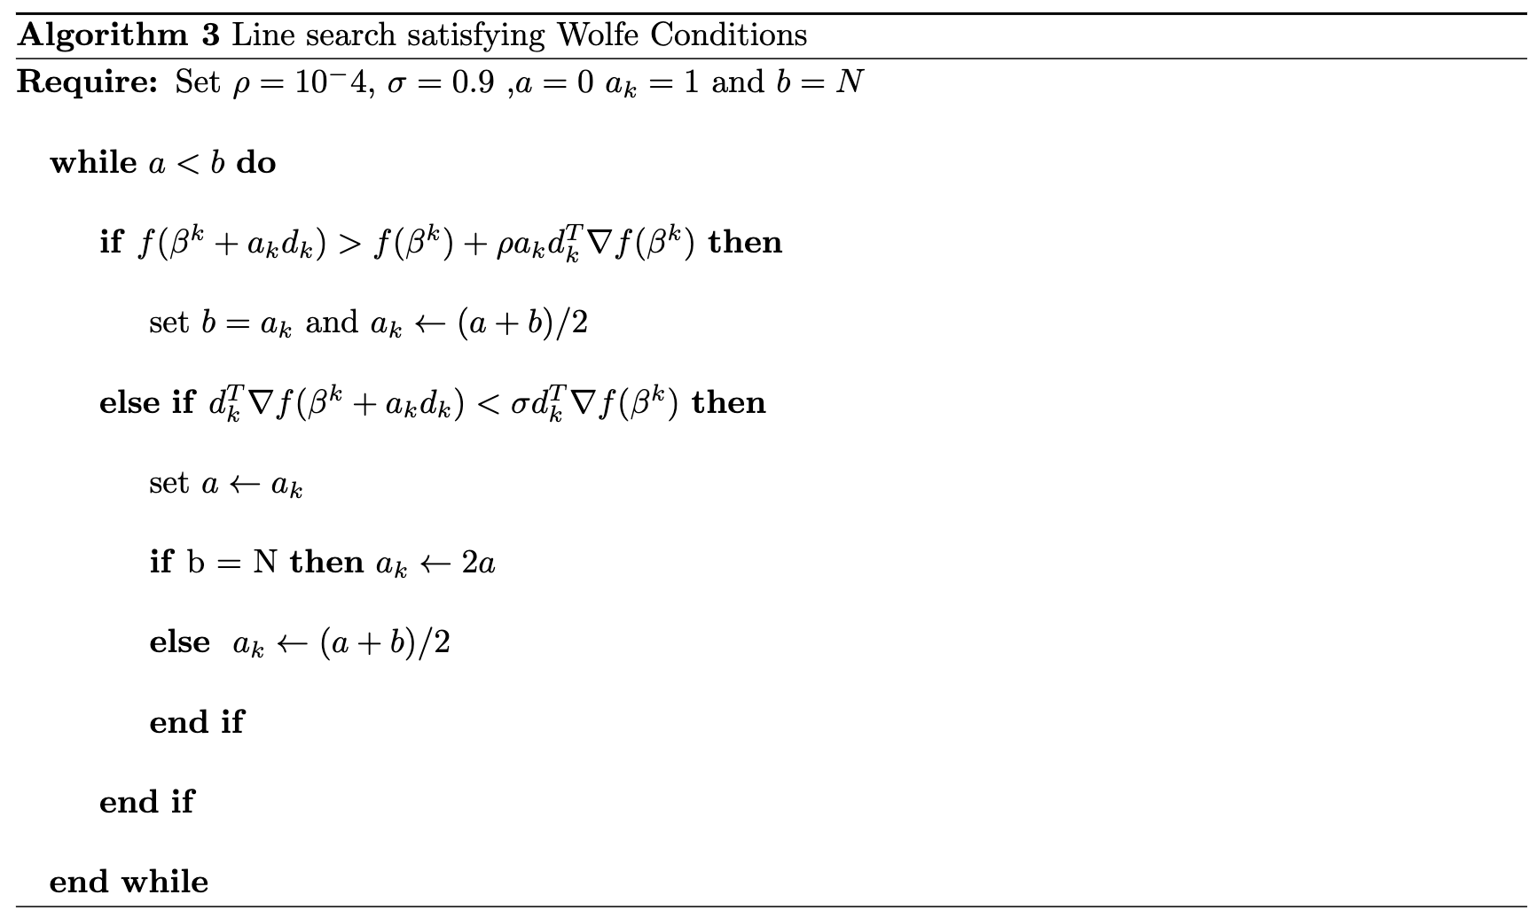
Methods - logistic regression (BFGS Algorithm)
Notes:
Di & Eunchong
So here is the line search algorithm.

Slide 21
Methods - logistic regression (BFGS Algorithm)
optim.BFGS(X, Y, beta)
X: design matrix, Y: response vector, beta: the starting beta
Convergence criterion: Absolute change of log-likelihood
Tolerance: 10^-5
Speed?
About 45 seconds for Convergence
64 Iterations
Convergence?
Starting beta with all elements being 0
Converged
Starting beta with all elements being 0.5
Converged
Result compared to glm function
Maximum difference between the two parameters: 2.07*10^-5
Notes:
Di & Eunchong
Here is the function in our package
It takes about 45 second for converge and converges in 64 iterations.
It not as fast as IRLS. On one hand, the line search algorithm would be time consuming.
On the other hand, more iterations to converge means more time.
It converges for both the starting value setting. hence, BFGS is relatively not sensitive to starting values.
The results compared to glm is really close.

Slide 22
Methods - R package implementation
Package name: “glmLogistic”
Functions – wrote in cpp
Loglik - computes value of log-likelihood
D1.loglik - 1st derivative of log-likelihood
Beta.updater - iterative estimates of β
optim.IRLS - compute parameter estimates with IRLS algorithm
optim.BFGS - compute parameter estimates with BFGS algorithm
Output
Parameter estimates, standard error, log-likelihood, # iterations, final absolute change in log-likelihood
Notes:
Let’s talk about our package. The name of our package is glmLogistic. There are serval functions in our package and wrote in cpp.
Those two are our core functions.
The outcome includes parameter estimates, standard error, log-likellihood and etc

Slide 23
Methods - logistic regression (glm)
logit(p(Heart Disease)) = X’β, where X is the full design matrix of covariate values
Models fit
Heart Disease ~ all covariates
Heart Disease ~ BMI
Heart Disease ~ Smoking + Drinking
Stroke ~ Smoking + Drinking
Full model: backward & forward variable selection based on AIC
Prediction performance evaluated using testing dataset
Notes:
Di & Eunchong
To compare the results from the functions from our pacakge, we used glm function to fit several models.
Those are also for our specific aims.
We evaluated the prediction performance using testing dataset.

Slide 24
Methods - Decision tree
Decision trees are a versatile machine learning method with incredibly high levels of interpretability.
All 17 covariates available for tree construction
Adjusted for imbalance data by sampling approximate 3:1 ratio of negative to positive cases of heart disease (75000 negative vs 21899 positive cases).
Accuracy, sensitivity, and specificity are recorded and reported
Gini impurity measure is used for node splitting (higher coefficient indicates more differences in a node)
Notes:
Di & Eunchong
Beside likelihood based methods, we also considered some machine learning methods.

Slide 25
Methods - random forest & support vector machine
Adjusted for imbalance data by down-samping the training data set to obtain balanced classes (n = 43,798)
Random Forest
ranger package in R
5-fold cross-validation to tune parameter – mtry
Support Vector Machine
caret package in R
Linear kernel
5-fold cross-validation with ‘tunelength = 10’
Prediction performance evaluated using testing dataset
Notes:
Di & Eunchong

Slide 26
Results
Notes:
Wanting

Slide 27
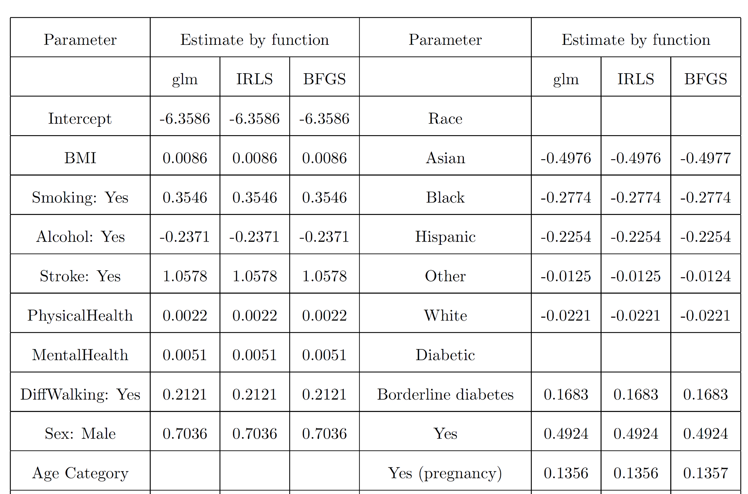
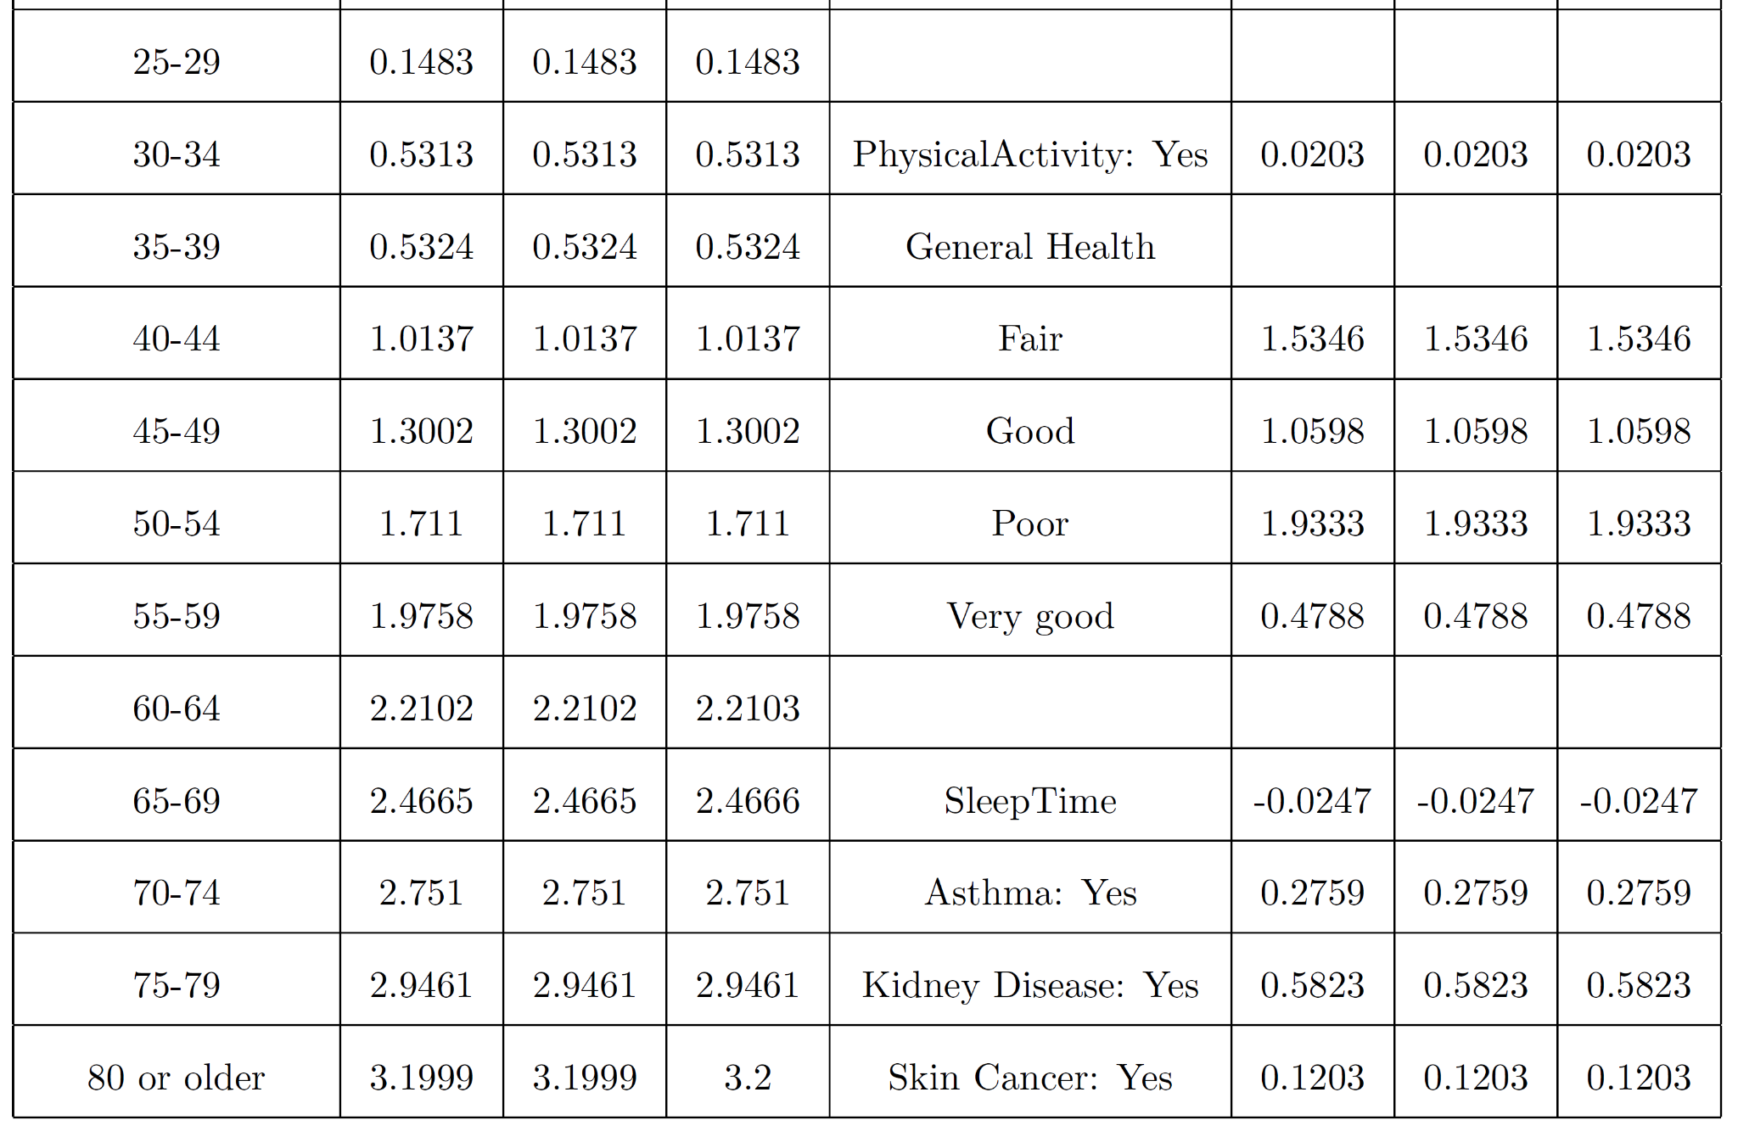
Logistic regression (IRLS, BFGS, & glm)
Notes:
Wanting

Slide 28
Logistic regression (IRLS, BFGS, & glm)
Benchmark result using training dataset:
Function | Min | Median | Mean | Max | N
glm() | 6.203254 | 6.609556 | 6.609328 | 7.388058 | 10
optim.IRLS() | 5.583329 | 5.689595 | 5.731082 | 6.172299 | 10
optim.BFGS() | 43.497902 | 43.973964 | 44.421281 | 47.168376 | 10
Notes:
Wanting

Slide 29
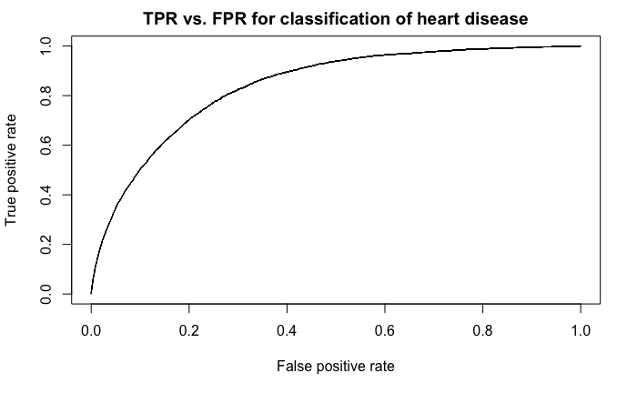
Logistic regression (GLM)
 | Reference
Prediction | No Heart Disease | Heart Disease
No Heart Disease | 57996 (91%) | 4880 (1%)
Heart Disease | 488 (7%) | 594 (1%)
Performance metrics
Accuracy: 0.916 (0.9139, 0.9182)
Sensitivity: 0.109
Specificity: 0.992
Positive predictive value: 0.545
Cohen’s kappa: 0.157
Trained model includes 38 coefficients
BMI = 0.0086
Smoking = 0.355
Alcohol Drinking = -0.237
Age (80+) = 3.20
Diabetes (yes) = 0.492
exp(β)-fold multiplicative change in the odds of heart disease occurrence for a unit change in continuous covariates or presence of binary/categorical covariates (or β change in log-odds
Notes:
Wanting

Slide 30
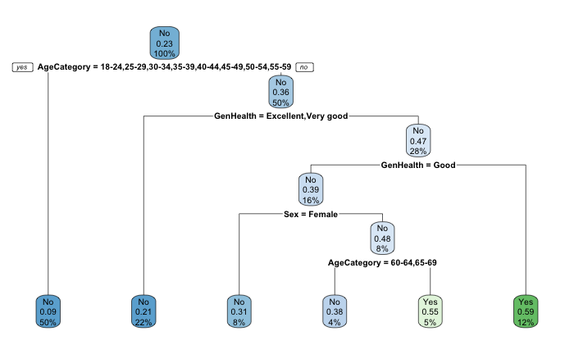
Decision Tree
Age, general health category, & sex used for tree construction (out of 17 covariates)
Subjects who are old and in worse than average health are more likely to have heart disease & Younger patients in good health do not have heart disease
Accuracy: 0.866
Sensitivity: 0.420
Specificity: 0.908
Notes:
Wanting

Slide 31
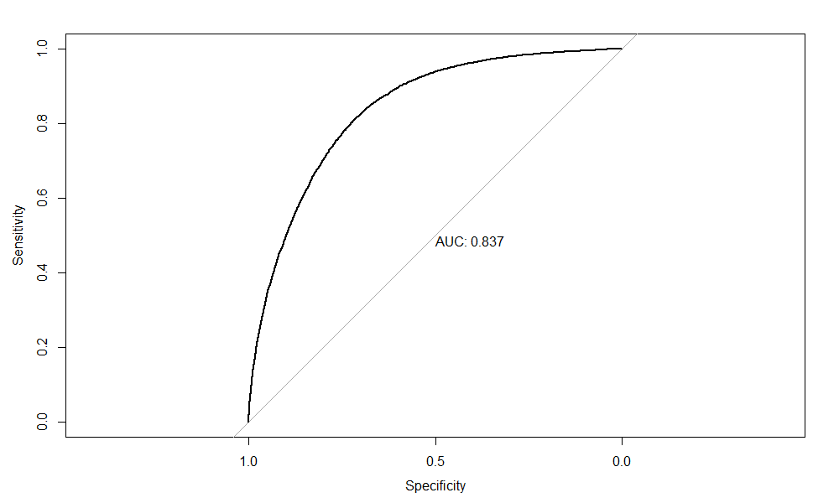
ML methods (RF & SVM)
Random forest
Mtry = 6
SVM
C = 1
Similar performance by both methods
Time consuming compared to logistic regression
 | Accuracy | Kappa | AUC
Random Forest | 0.727 (0.724, 0.731) | 0.229 | 0.832
Linear SVM | 0.753 (0.750, 0.757) | 0.248 | 0.837

Slide 32
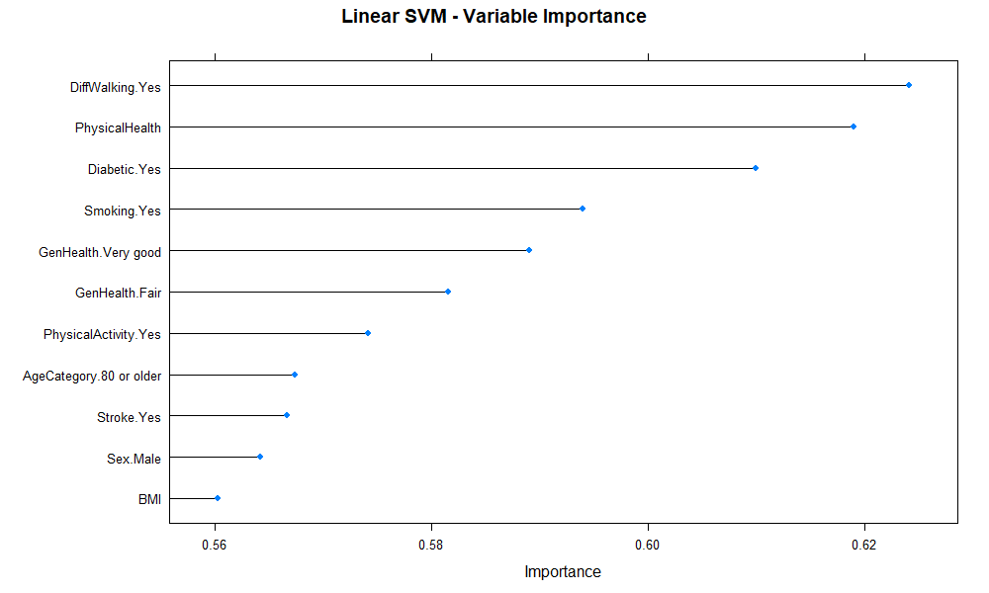
Top 10 most important variables from SVM model
Notes:
Wanting

Slide 33
Results - parametric vs. non-parametric approaches
Logistic regression (parametric) achieved accuracy of 0.916 (0.9139, 0.9182) with sensitivity of 0.109
Non-parametric approaches don’t have specific estimates for covariates in the data (hence the name)
Decision tree is quite interpretable (accuracy = 0.866 / sensitivity = 0.420)
Random forest & SVM are able to make accurate predictions as well as give estimates for relative variable importance.
Both types of methods provide a balance of prediction capabilities & interpretability but sensitivity is a struggle with unbalanced data.
Feature weighting & addressing repeated observations may improve sensitivity
Notes:
Wanting

Slide 34
Conclusion / Discussion
Notes:
Mingwei

Slide 35
Conclusion
Developed R package (glmLogistic) to compute logistic regression parameter estimates with BFGS & IRLS
Estimates agree closely with glm()
Accuracy: 0.916 & Sensitivity: 0.109
Other models: decision tree, random forest, support vector machine
Best accuracy: 0.866 & sensitivity: 0.420
Influential factors
General health, age, smoking status, diabetic status, sex
Interpretation of aims
BMI has 1.09-fold change in odds of heart disease
Smoking doubles risk of heart disease, drinking decreases overall risk
risk of stroke also increased by smoking, decreased by drinking
Notes:
Mingwei

Slide 36
Discussion - clinical relevance
Factors relevant for presence of heart disease can be used to emphasize surveillance efforts
ie. higher prevalence in subjects of old age
Targeting of healthy habit campaigns in the public health sector based on statistical evidence of risk factors like smoking, diabetes, etc.
Individuals with worse than average general health are at a substantially higher risk of heart disease relative to subjects in good health.
Notes:
Mingwei

Slide 37
Discussion - concerns & limitations
Unbalanced data (presence vs. absence of heart disease) leads to reduced model sensitivity in all cases
positive predictive values are approximately 50%
Categorical factors like age are segmented into less refined classes. These may have more influence in estimation if recorded on a continuous scale.
Confounders
Ex: Alcohol associated with reduced risk but heavy drinkers tend to be young
Pre-processing
Notes:
Mingwei

Slide 38
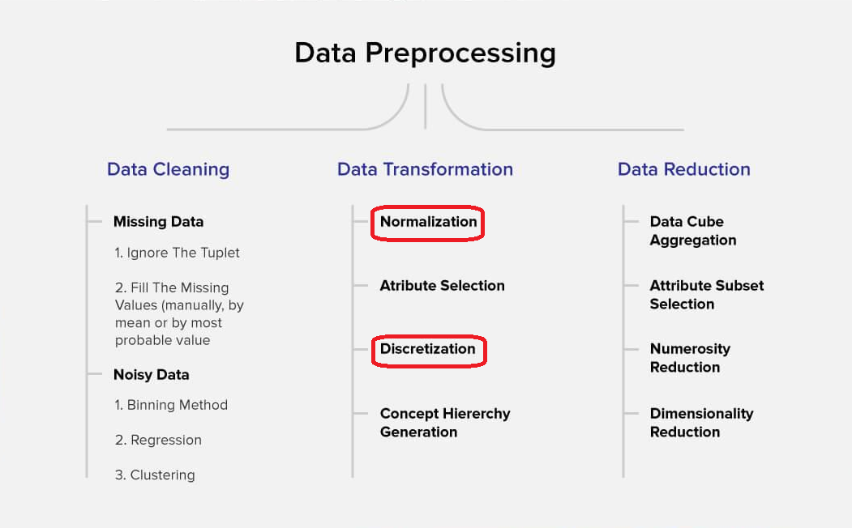
Discussion - concerns & limitations
Notes:
Mingwei
Real-world data, which is the input of data mining algorithms, has several components that can impact it. Among those issues, the presence of noise is a significant factor. It is an unavoidable problem, but have to address to improve the prediction.
Humans are likely to make mistakes during the collection of data,while instruments that collect data can be inaccurate, resulting in dataset errors. The errors are known as noise. Without the proper training,data noise can create issues in machine learning algorithms, as the algorithm thinks of that noise as a pattern and can start generalizing from it.
So the noise data are contradictory examples, mislabeled example, erroneous values, etc.
Important data are weak. We need to reduce the data size, eliminate the erroneous and redundant features
PCA (Principal Component Analysis)
PCA is an arithmetical procedure that uses the orthogonal property to transform the set of feasibly correlated variables (linked variables) into those variables which are not associated (uncorrelated). These new variables are called “principal components.” PCA aims to remove corrupted data by preservative noise from the signal or image while preserving the essential features. This approach is both geometric and statistical; PCA projects the input data along various axes; thus, it lessens the input signal dimension or data.
The data discretization technique is used to divide the attributes of the continuous nature into data with intervals. We replace many constant values of the attributes with labels of small intervals.

