Slide 1
Heart Disease Data Analysis
BIOS 735 Group 2 - Mingwei, Di, Wanting, Eunchong, & Andrew
Github repository

Slide 2
Introduction

Slide 3
Introduction - Background
In 2020, heart disease was the leading cause of death in the United States with 696,962 deaths attributed (followed by cancer & COVID-19) according to the final 2020 U.S. mortality data from the CDC.
Many health status indicators are found related to heart disease such as high blood pressure, high cholesterol, smoking, diabetes, obesity (BMI > 30.0), insufficient physical activity, & excessive alcohol consumption.
Understanding and detecting the factors that have the greatest impact on heart disease occurrence in populations is crucial in healthcare to improve the length and quality of life.

Slide 4
Introduction - dataset
Personal key indicators of heart disease (kaggle)
https://www.kaggle.com/datasets/kamilpytlak/personal-key-indicators-of-heart-disease
319795 observations of 18 variables (1 outcome & 17 covariates)
Primary Outcome of interest: Heart disease occurrence
Subject experienced either coronary heart disease or myocardial infarction (binary)
Other factors:
BMI, Smoking status, alcohol consumption, stroke occurrence, poor physical health, poor mental health, walking difficulty, sex, age, race, diabetes, physical activity, general health status, average sleep time, asthma, kidney disease occurrence, skin cancer occurrence

Slide 5
Introduction - project aims/research questions
Aim 1: determine relationship between heart disease prevalence and all other factors
Aim 2: determine relationship between BMI & heart disease
Aim 3: determine relationship between risky behaviors (smoking & drinking) with heart disease or stroke (poor health outcomes)
Aim 4: Compare the model fitting performance between logistic regression model and other machine learning methods. And propose predictions for occurrence of heart disease given health condition indicators

Slide 6
Exploratory figures

Slide 7
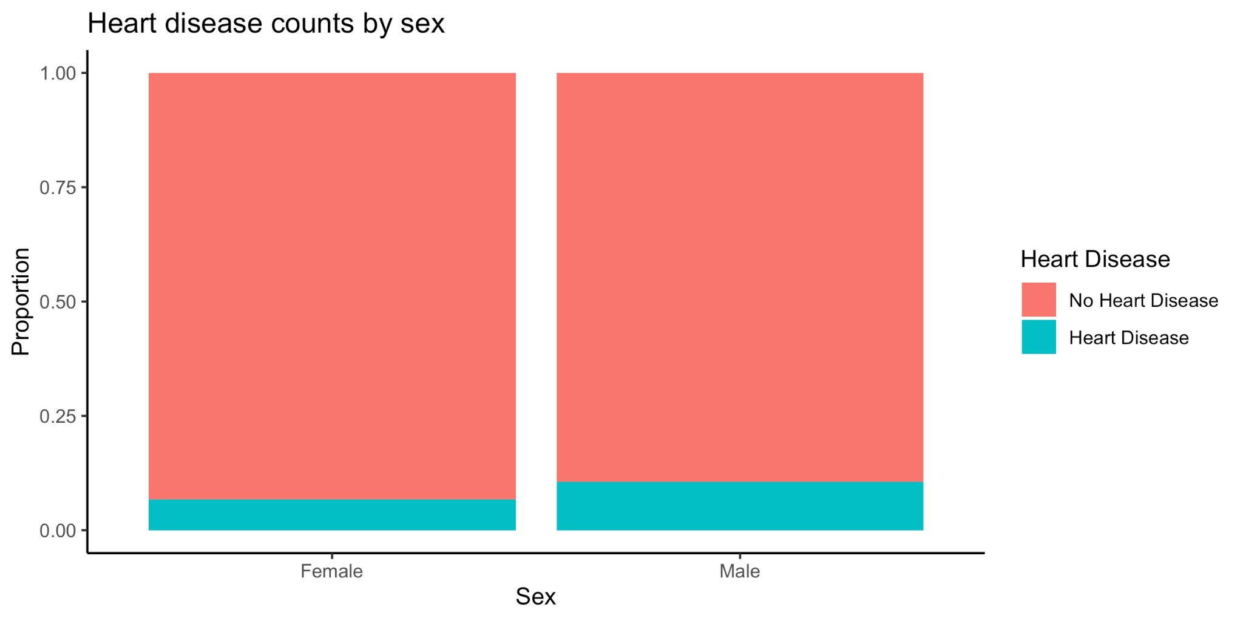
Heart disease by sex

Slide 8
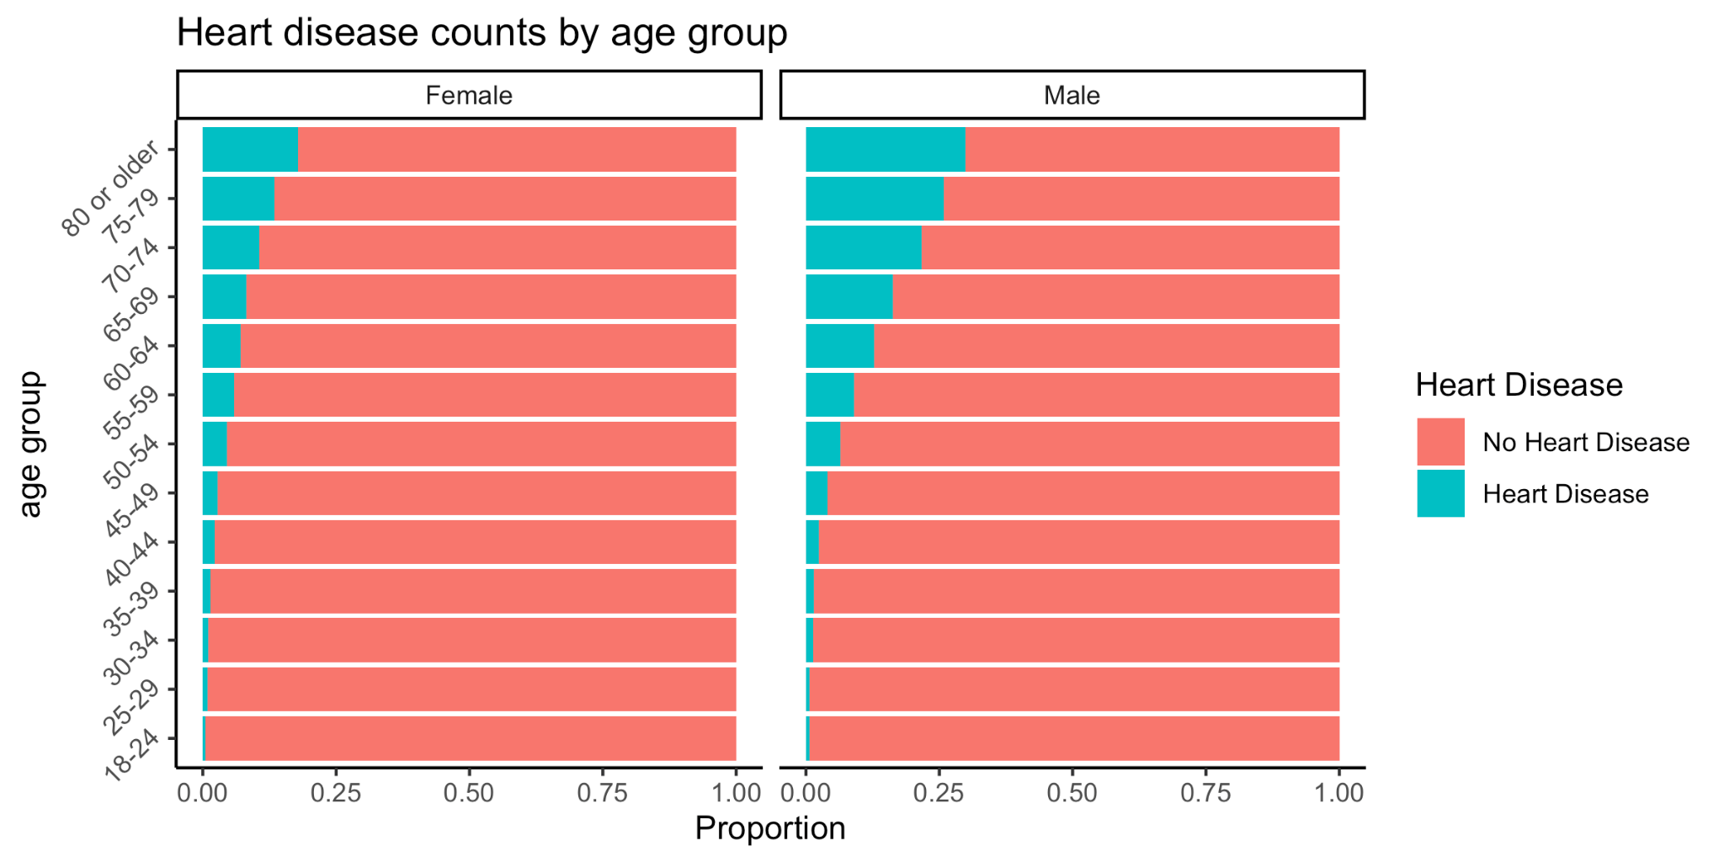
Heart disease by age & sex

Slide 9
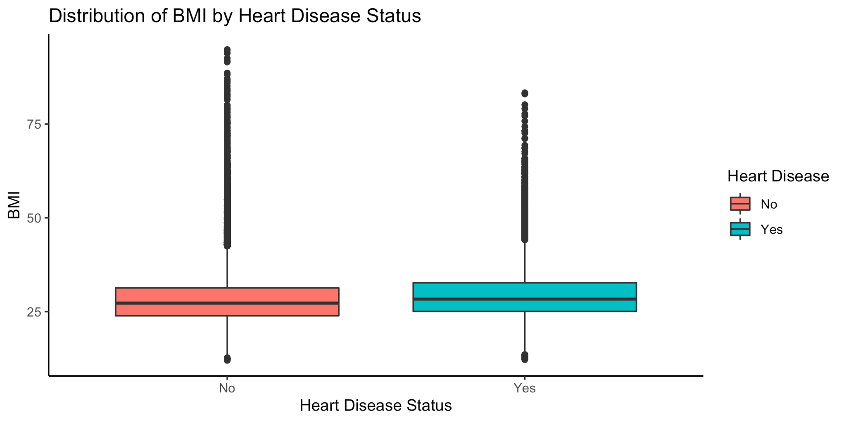
Heart disease by BMI

Slide 10
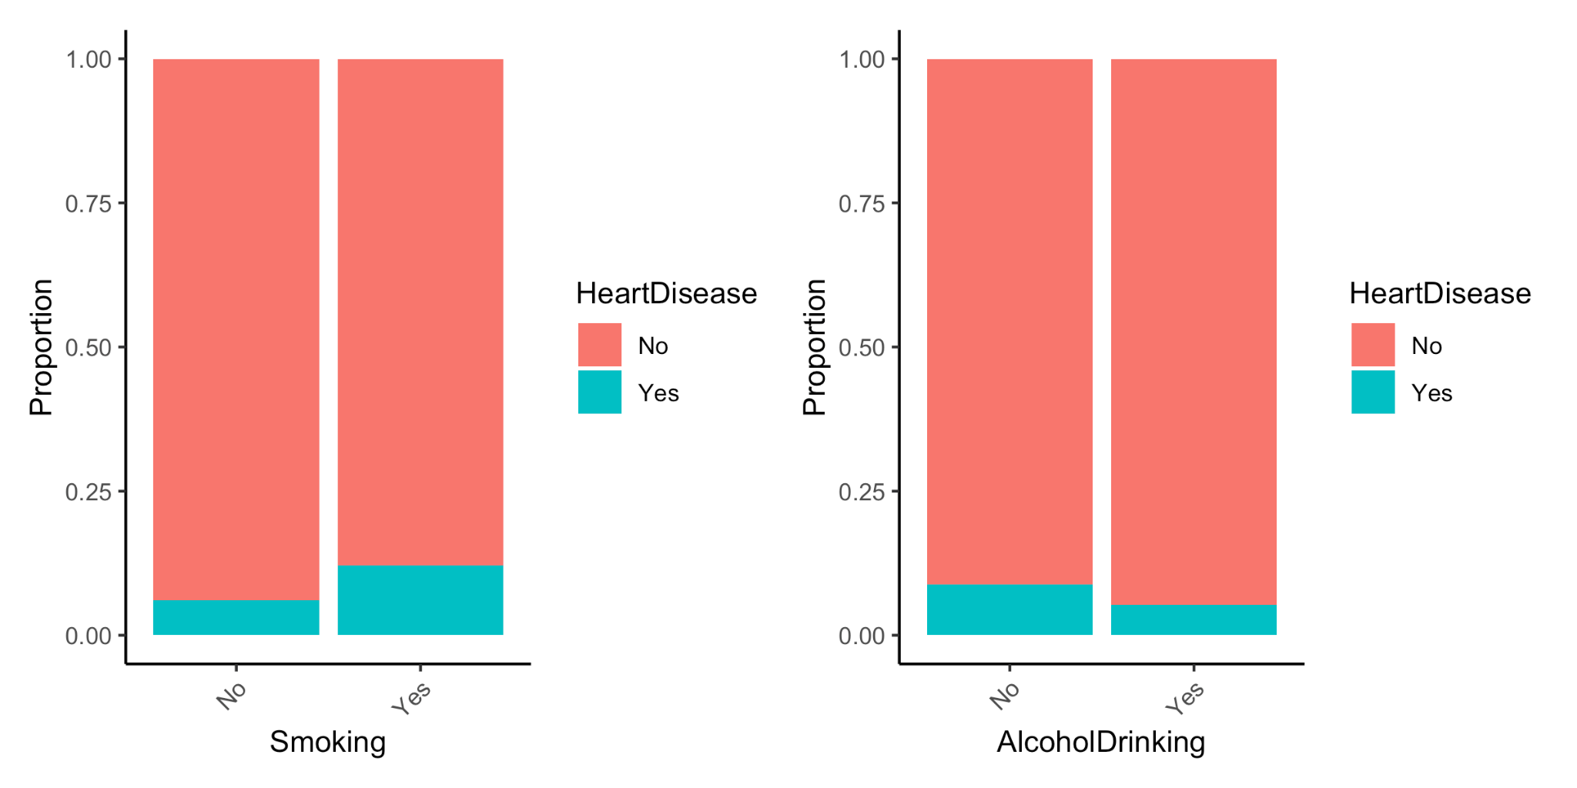
Heart disease by risky behaviors

Slide 11
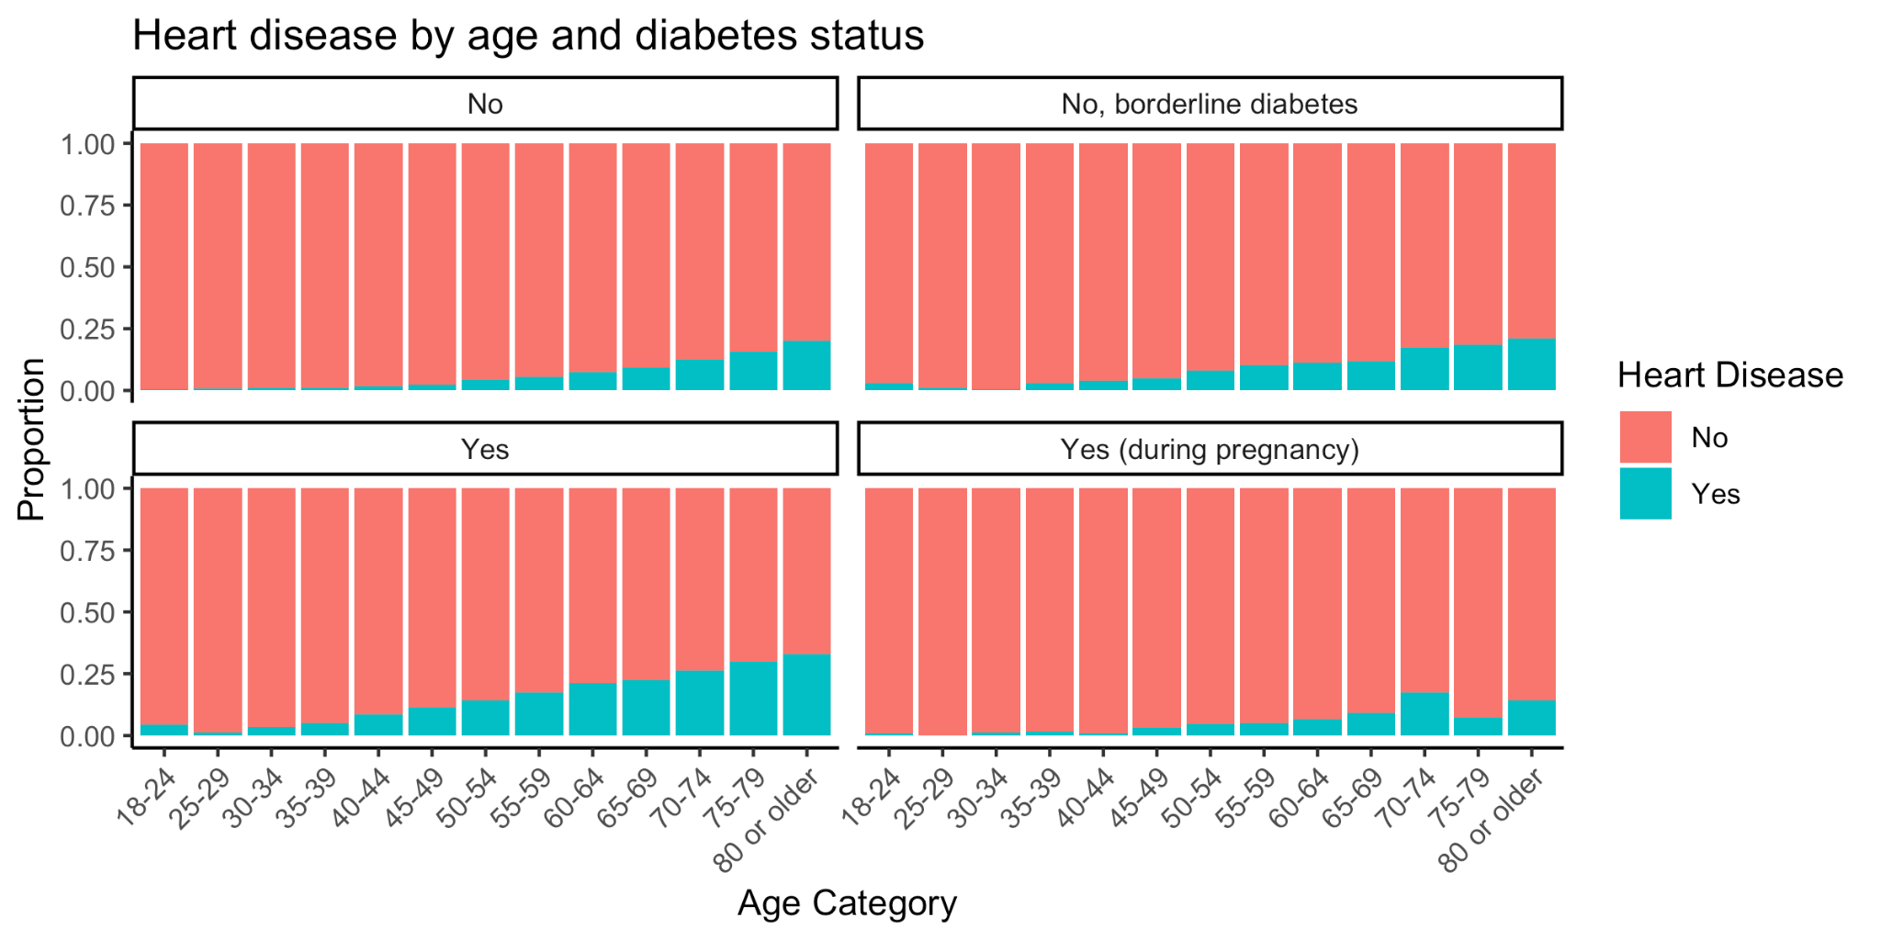
Heart disease by diabetes status & age

Slide 12
Data Pre-process
Data preparation
Feature scaling (continuous variable transform to stand normal)
Missing imputation (KNN)
Create dummy variables for categories
Train/Test split
Split the dataset based on heart disease outcome (4:1)
Training: 255837 observations
Testing: 63958 observations
Cross validation on Train dataset
Report test data performance

Slide 13
Methods

Slide 14
Methods - Decision tree
Decision trees are a versatile machine learning method with incredibly high levels of interpretability.
All 17 covariates available for tree construction
Adjusted for imbalance data by sampling approximate 3:1 ratio of negative to positive cases of heart disease.
Accuracy, sensitivity, and specificity are recorded and reported
Gini impurity measure is used for node splitting (higher coefficient indicates more differences in a node)

Slide 15
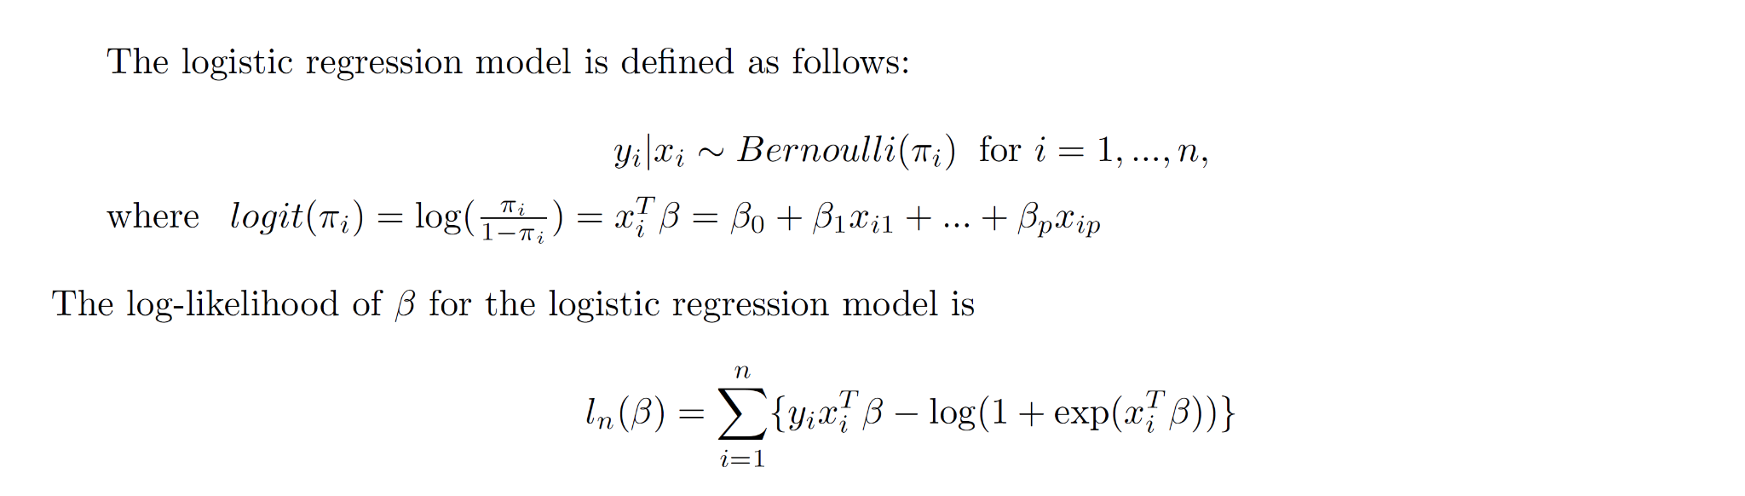
Methods - logistic regression

Slide 16
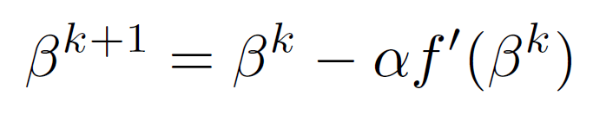
Methods - logistic regression (IRLS Algorithm)
Training set (80% of total dataset)
The number of observations in the training set: 255,837
The number of covariates: 17
Gradient Descent or Stochastic Gradient Descent (briefly or not)
The update is
When α=0.0001 and the initial beta is the zero vector, it took more than 1 hour with over 30,000 iterations (2/3 of them was around its convergence)
SGD: Mini-batch with the size of 0.01 * 255,837
It took about 30 mins
Iterative Reweighted Least Squares (IRLS)
Pros: Faster, 1st and 2nd derivatives are known
Cons: Sensitive to the starting value, Hessian matrix (size:38*38)

Slide 17
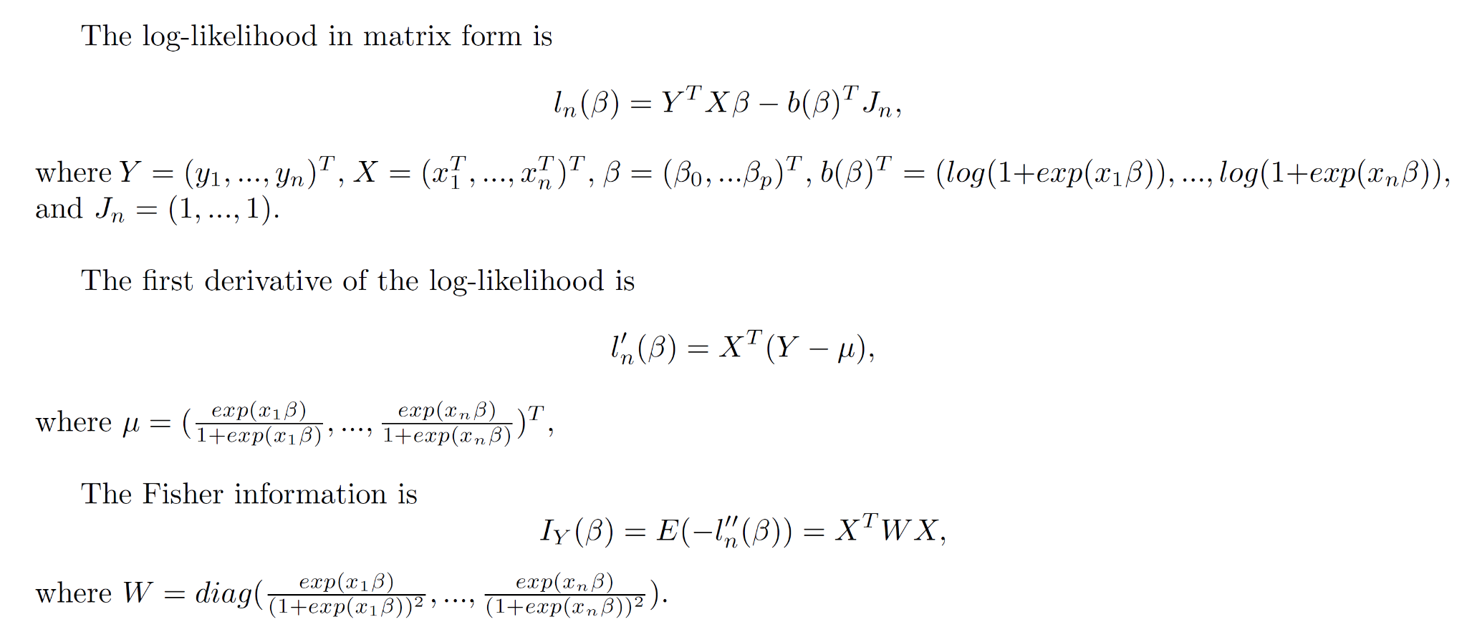
Methods - logistic regression (IRLS Algorithm)

Slide 18
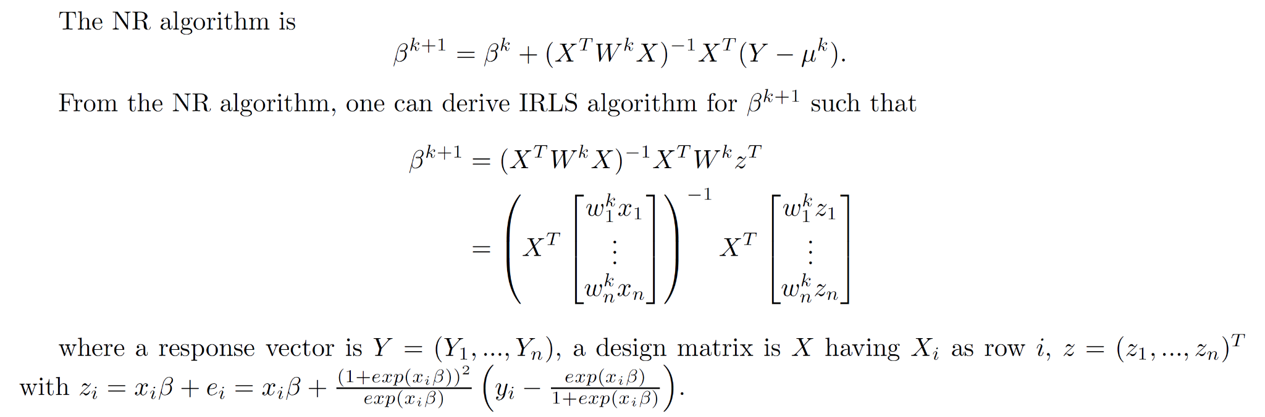
Methods - logistic regression (IRLS Algorithm)

Slide 19
Methods - logistic regression (IRLS Algorithm)
optim.IRLS(X, Y, beta)
X: design matrix, Y: response vector, beta: the starting beta
Convergence criterion: Absolute change of log-likelihood
Tolerance: 10^-10
Speed?
About 5 seconds for Convergence
9 Iterations
Convergence?
Starting beta with all elements being 0
Converged
Starting beta with all elements being 0.5
Did not converge
Result compared to glm function
Maximum difference between the two parameters: 3.046436*10^-7

Slide 20

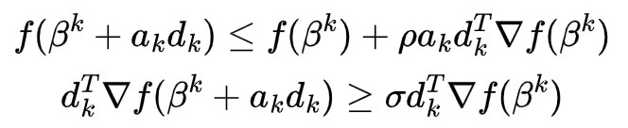
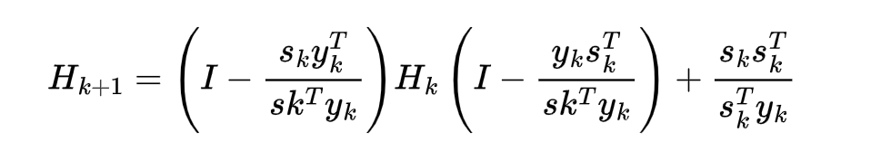
Methods - logistic regression (BFGS Algorithm)
Quasi-Newton Method – Avoid calculating the inverse of Hessian matrix at each iteration
Update the step length using line search satisfying Wolfe conditions:
Update the approximation of the inverse of Hessian matrix by

Slide 21
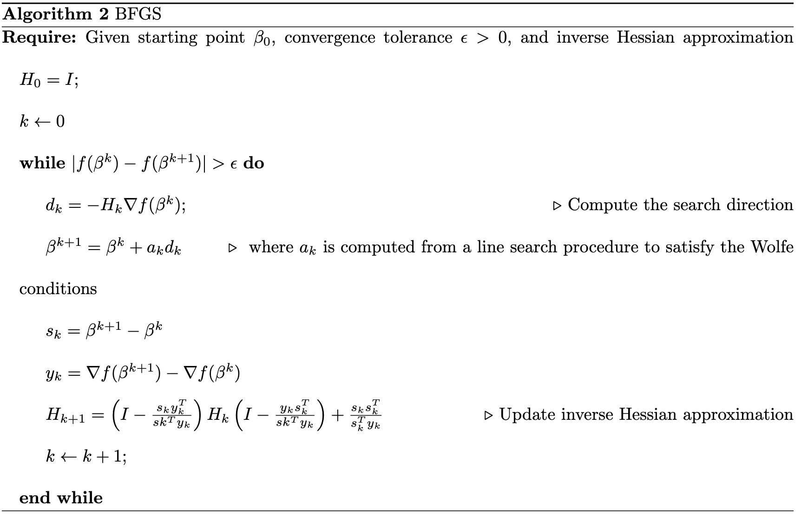
Methods - logistic regression (BFGS Algorithm)

Slide 22
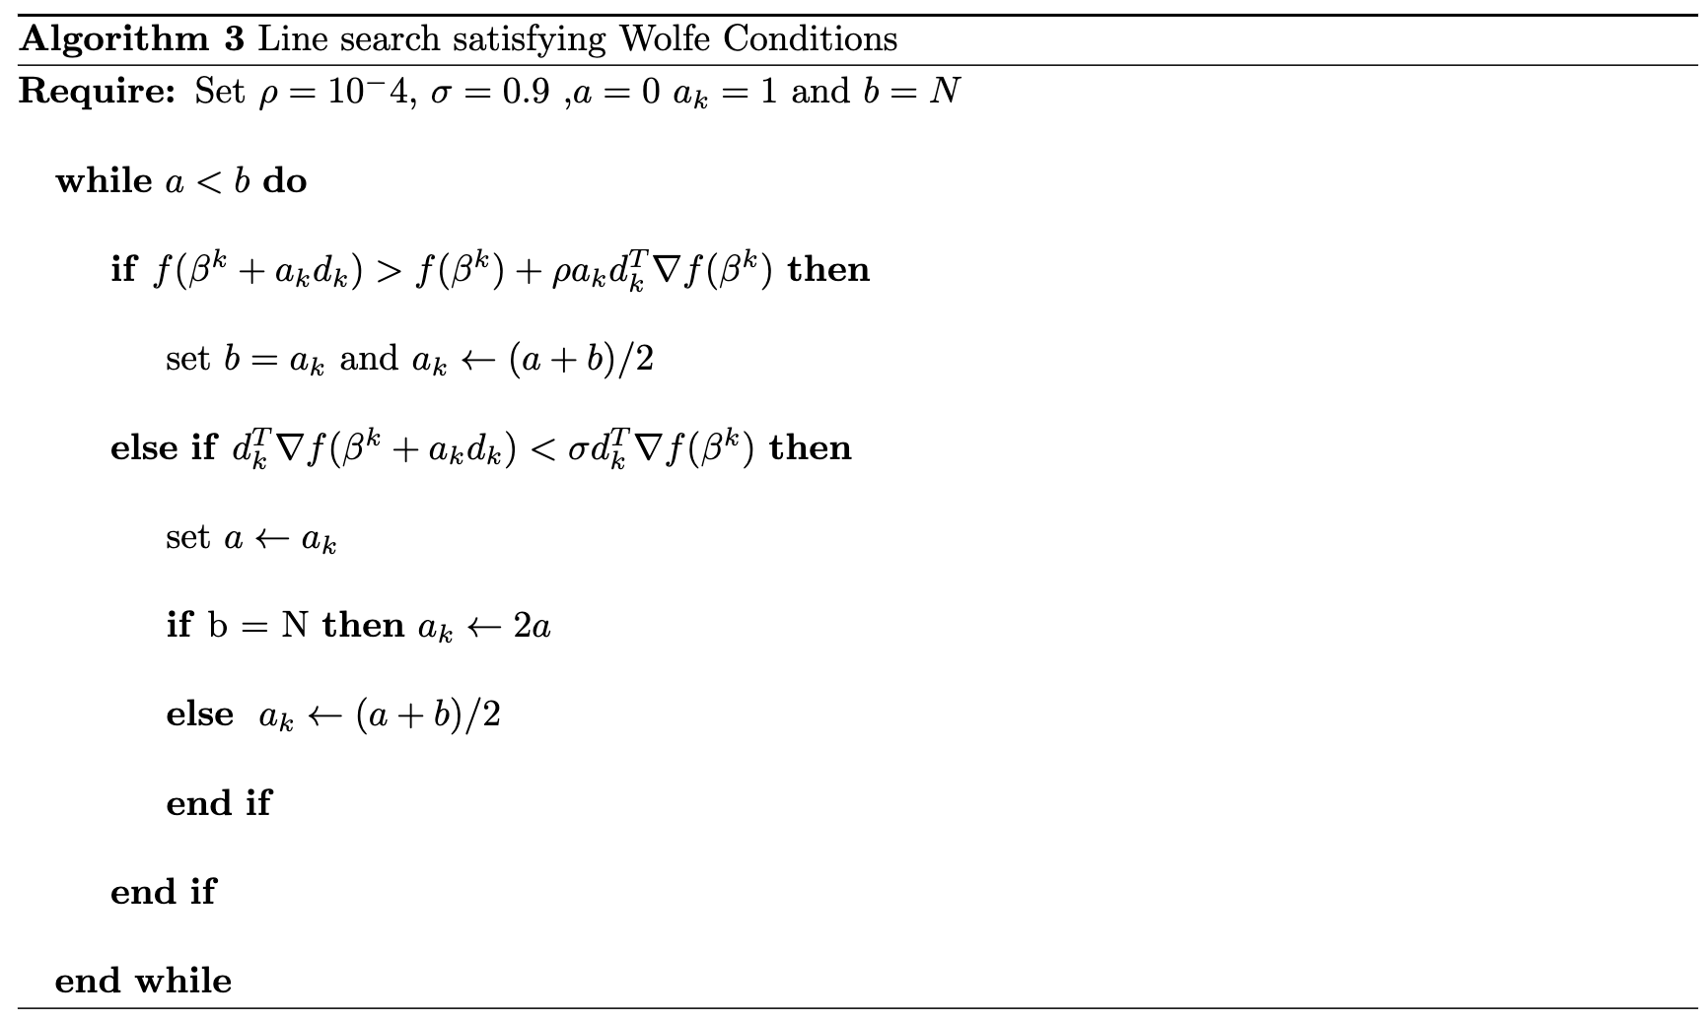
Methods - logistic regression (BFGS Algorithm)

Slide 23
Methods - logistic regression (glm)
logit(p(Heart Disease)) = X’β, where X is the full design matrix of covariate values
Models fit
Heart Disease ~ all covariates
Heart Disease ~ BMI
Heart Disease ~ Smoking + Drinking
Stroke ~ Smoking + Drinking
Full model: backward & forward variable selection based on AIC
Heart disease classification predictions made on test set

Slide 24
Methods - R package implementation
Package name: “glmLogistic”
Functions
Loglik - computes value of log-likelihood
D1.loglik - 1st derivative of log-likelihood
Beta.updater - iterative estimates of β
optim.IRLS - compute parameter estimates with IRLS algorithm
optim.BFGS - compute parameter estimates with BFGS algorithm
Output
Parameter estimates, standard error, log-likelihood, # iterations, final absolute change in log-likelihood

Slide 25
Methods - random forest & support vector machine
Down-sample the training data set to obtain balanced classes
Random Forest
R ranger package
5-fold cross-validation to tune parameter – mtry
Support Vector Machine
R caret package
Linear kernel
5-fold cross-validation with ‘tunelength = 10’
Transfer categorical variable into dummy variables and center and scale before fitting
Prediction performance evaluated using testing data set

Slide 26
Machine Learning Methods
Classification Problem:
Logistic Regression with Elastic net
Random Forest/Boosting
Ranger function more suitable for random forest in large dataset
SVM
Slow due to iterations to get distance of one sample with all others
Principle Component
Used often when most are continuous variables, assuming linearity
Features need to be correlated
K- means
Used in pre-process of data if missing, reduce dimensions

Slide 27
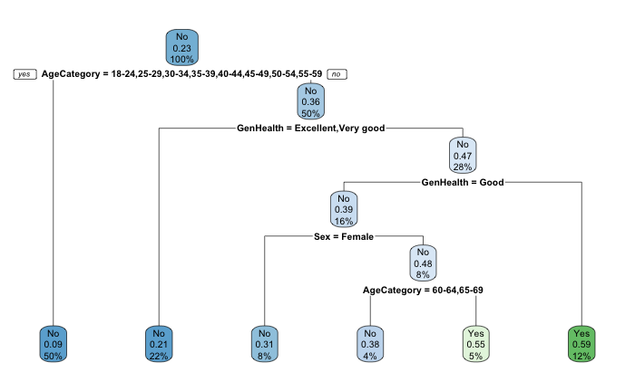
Decision Tree
Age, general health category, & sex used for tree construction (out of 17 covariates)
Subjects who are old and in worse than average health are more likely to have heart disease & Younger patients in good health do not have heart disease
Accuracy: 0.866
Sensitivity: 0.420
Specificity: 0.908

Slide 28
Results

Slide 29
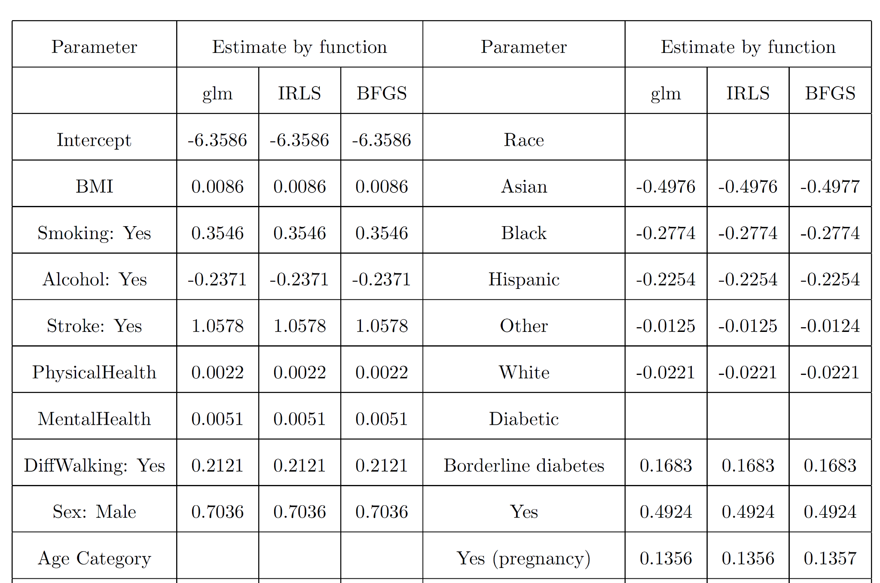
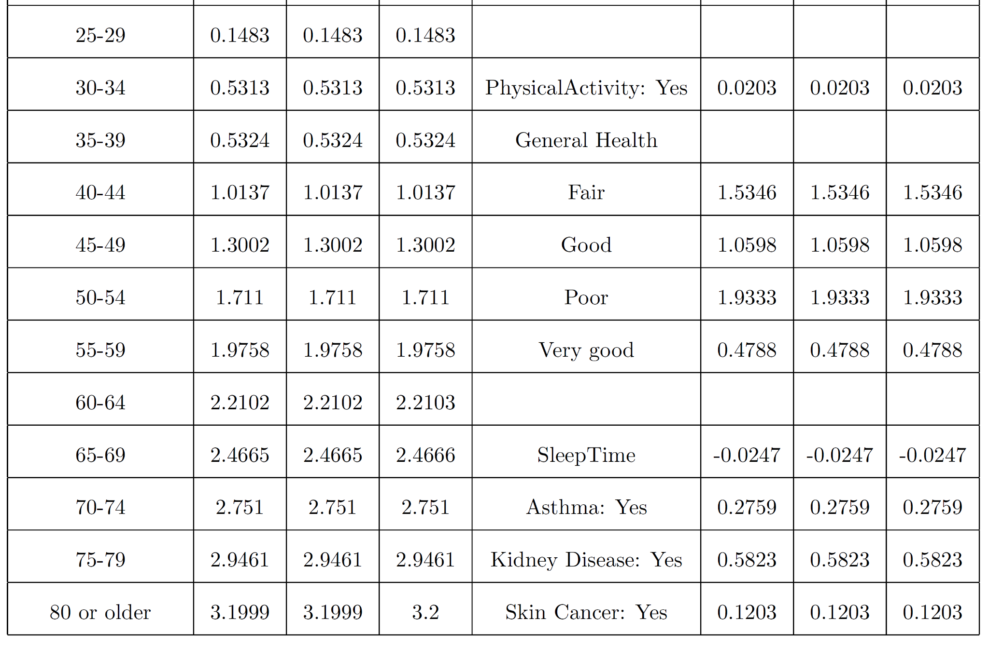
Logistic regression (IRLS, BFGS, & glm)

Slide 30
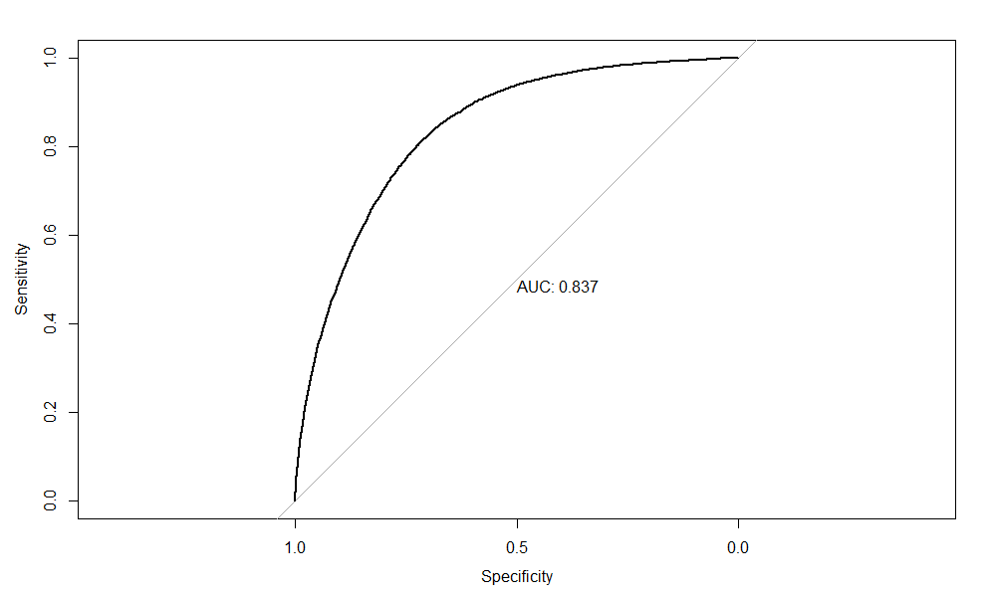
Machine Learning
Random forest
Mtry = 6
SVM
C = 1
 | Accuracy | Kappa | AUC
Random Forest | 0.727 (0.724, 0.731) | 0.229 | 0.832
Linear SVM | 0.753 (0.750, 0.757) | 0.248 | 0.837

Slide 31
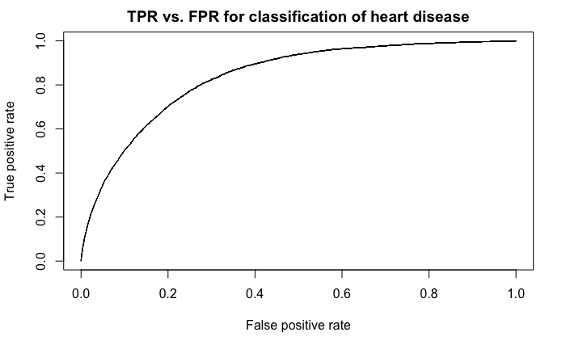
Logistic regression (GLM)
 | Reference
Prediction | No Heart Disease | Heart Disease
Heart Disease | 57996 (91%) | 4880 (1%)
No Heart Disease | 488 (7%) | 594 (1%)
Performance metrics
Accuracy: 0.916 (0.9139, 0.9182)
Sensitivity: 0.109
Specificity: 0.992
Positive predictive value: 0.545
Cohen’s kappa: 0.157
Trained model includes 38 coefficients
BMI = 0.0086
Smoking = 0.355
Alcohol Drinking = -0.237
Age (80+) = 3.20
Diabetes (yes) = 0.492
exp(β)-fold multiplicative change in the odds of heart disease occurrence for a unit change in continuous covariates or presence of binary/categorical covariates (or β-fold change in log-odds

Slide 32
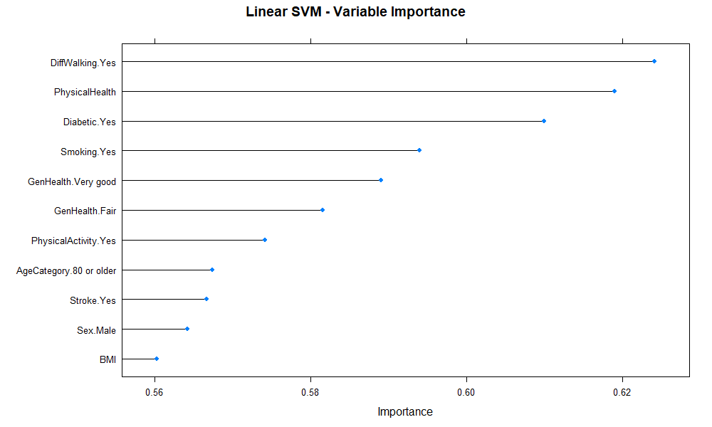
Top 10 most important variables from SVM model

Slide 33
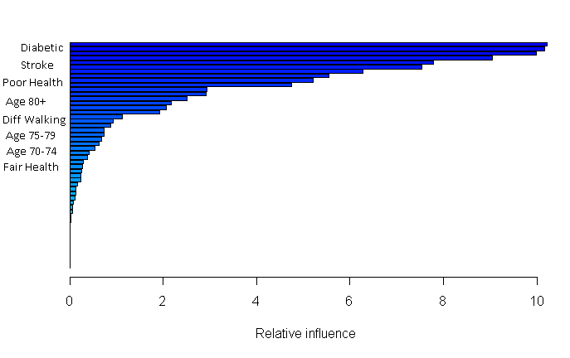
High Risk Factors

Slide 34
Results - parametric vs. non-parametric approaches
Logistic regression (parametric) achieved accuracy of 0.916 (0.9139, 0.9182) with sensitivity of 0.109
Non-parametric approaches don’t have specific estimates for covariates in the data (hence the name)
Decision tree is quite interpretable (accuracy = 0.866 / sensitivity = 0.420)
Random forest & SVM are able to make accurate predictions as well as give estimates for relative variable importance.
Both types of methods provide a balance of prediction capabilities & interpretability but sensitivity is a struggle with unbalanced data.
Feature weighting & addressing repeated observations may improve sensitivity

Slide 35
Conclusion / Discussion

Slide 36
Conclusion
Developed R package (glmLogistic) to compute logistic regression parameter estimates with BFGS & IRLS
Estimates agree closely with glm()
Accuracy: 0.916 & Sensitivity: 0.109
Other models: decision tree, random forest, support vector machine
Best accuracy: 0.866 & sensitivity: 0.420
Influential factors
General health, age, smoking status, diabetic status, sex
Interpretation of aims
BMI has 1.09-fold change in odds of heart disease
Smoking doubles risk of heart disease, drinking decreases overall risk
risk of stroke also increased by smoking, decreased by drinking

Slide 37
Discussion - clinical relevance
Factors relevant for presence of heart disease can be used to emphasize surveillance efforts
ie. higher prevalence in subjects of old age
Targeting of healthy habit campaigns in the public health sector based on statistical evidence of risk factors like smoking, diabetes, etc.
Individuals with worse than average general health are at a substantially higher risk of heart disease relative to subjects in good health.

Slide 38
Discussion - concerns & limitations
Unbalanced data (presence vs. absence of heart disease) leads to reduced model sensitivity in all cases
positive predictive values are approximately 50%
Categorical factors like age are segmented into less refined classes. These may have more influence in estimation if recorded on a continuous scale.
Confounders
Alcohol associated with reduced risk but heavy drinkers tend to be young

