Slide 1

Simultaneous Linear Equations
Topic: Gaussian Elimination
http://numericalmethods.eng.usf.edu

Slide 2

Gaussian Elimination
One of the most popular techniques for solving simultaneous linear equations of the form
Consists of 2 steps
1. Forward Elimination of Unknowns.
2. Back Substitution

Slide 3
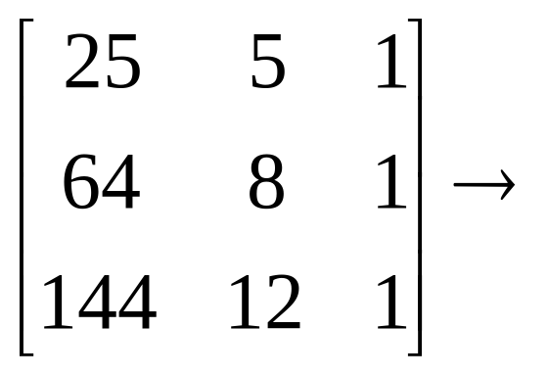
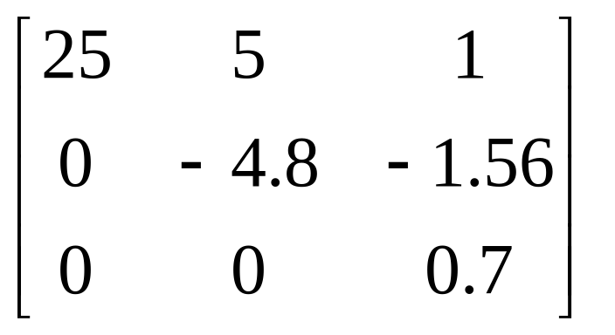
Forward Elimination
The goal of Forward Elimination is to transform the coefficient matrix into an Upper Triangular Matrix

Slide 4
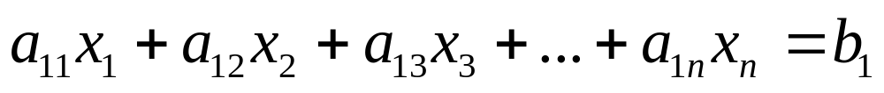

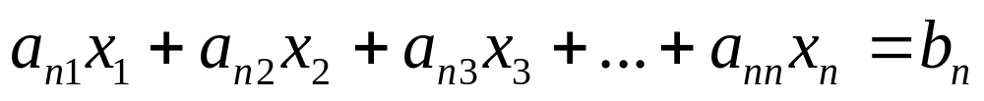
Forward Elimination
Linear Equations
A set of n equations and n unknowns
. .
. .
. .

Slide 5
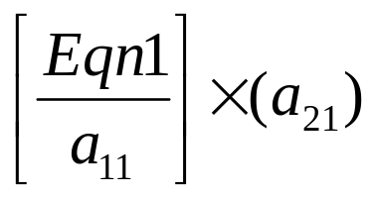
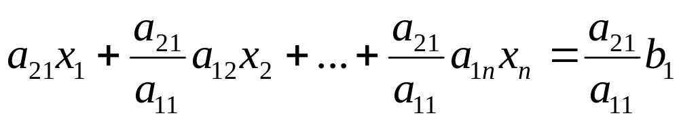
Forward Elimination
Transform to an Upper Triangular Matrix
Step 1: Eliminate x₁ in 2nd equation using equation 1 as the pivot equation
Which will yield

Slide 6
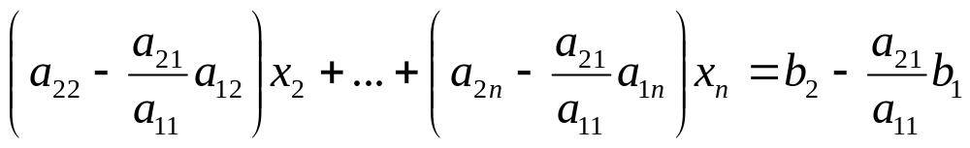

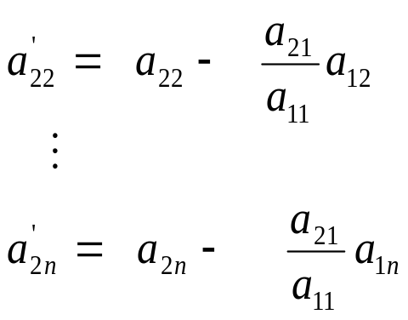
Forward Elimination
Zeroing out the coefficient of x₁ in the 2nd equation.
Subtract this equation from 2nd equation
Or Where

Slide 7
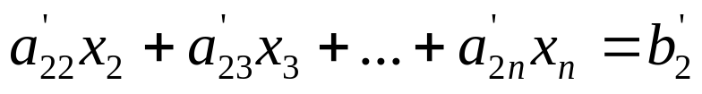
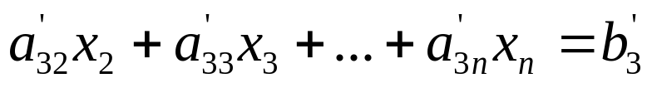
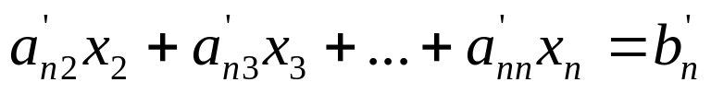
Forward Elimination
Repeat this procedure for the remaining equations to reduce the set of equations as
. . .
. . .
. . .

Slide 8
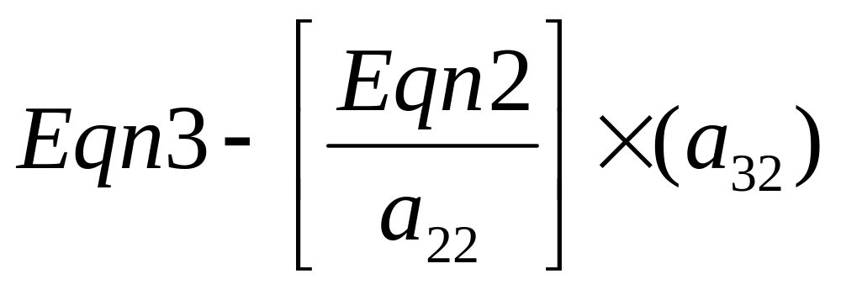
Forward Elimination
Step 2: Eliminate x₂ in the 3rd equation.
Equivalent to eliminating x₁ in the 2nd equation using equation 2 as the pivot equation.

Slide 9
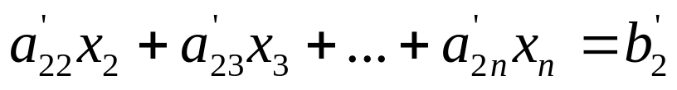
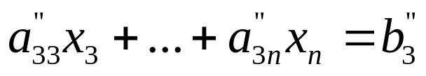
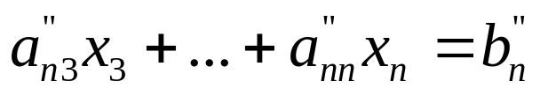
Forward Elimination
This procedure is repeated for the remaining equations to reduce the set of equations as
. .
. .
. .

Slide 10
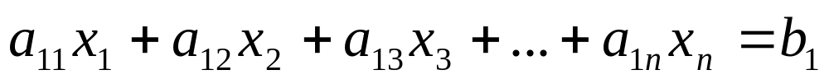

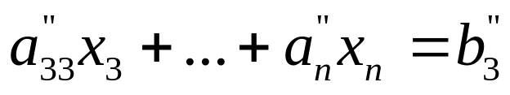
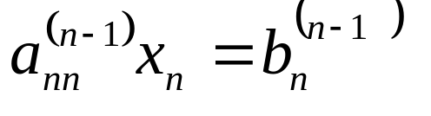
Forward Elimination
Continue this procedure by using the third equation as the pivot equation and so on.
At the end of (n-1) Forward Elimination steps, the system of equations will look like:
. .
. .
. .

Slide 11
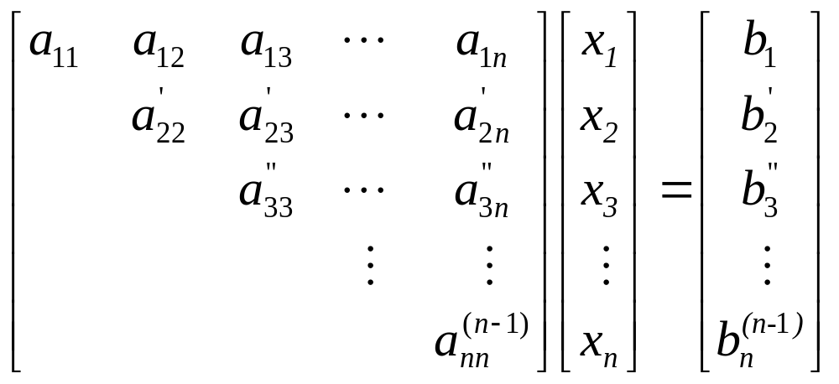
Forward Elimination
At the end of the Forward Elimination steps

Slide 12
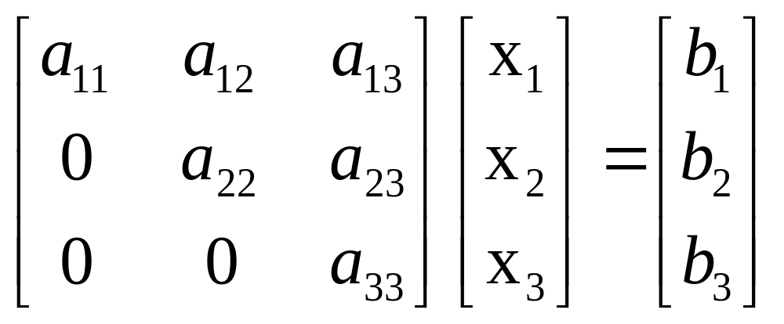
Back Substitution
The goal of Back Substitution is to solve each of the equations using the upper triangular matrix.
Example of a system of 3 equations

Slide 13
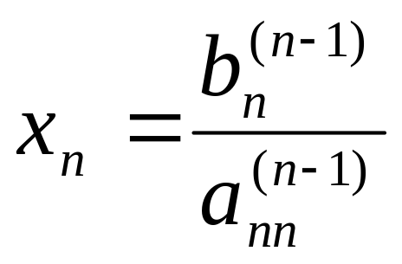
Back Substitution
Start with the last equation because it has only one unknown
Solve the second from last equation (n-1)^{th} using x_{n} solved for previously.
This solves for x_{n-1}.

Slide 14
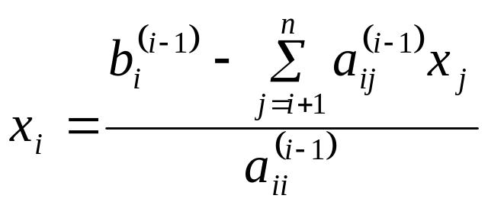

Back Substitution
Representing Back Substitution for all equations by formula
For i=n-1, n-2,….,1
and

Slide 15

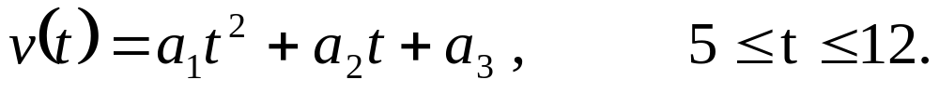
Example: Rocket Velocity
The upward velocity of a rocket is given at three different times
Time, t | Velocity, v
s | m/s
5 | 106.8
8 | 177.2
12 | 279.2
The velocity data is approximated by a polynomial as:
Find: The Velocity at t=6,7.5,9, and 11 seconds.

Slide 16
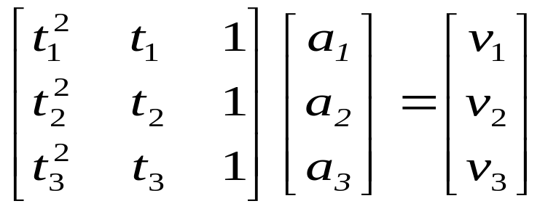

Example: Rocket Velocity
Assume
Results in a matrix template of the form:
Using date from the time / velocity table, the matrix becomes:

Slide 17
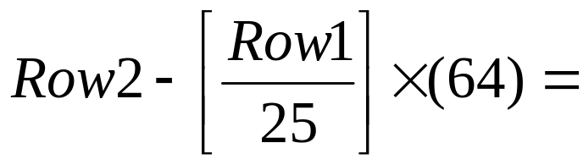
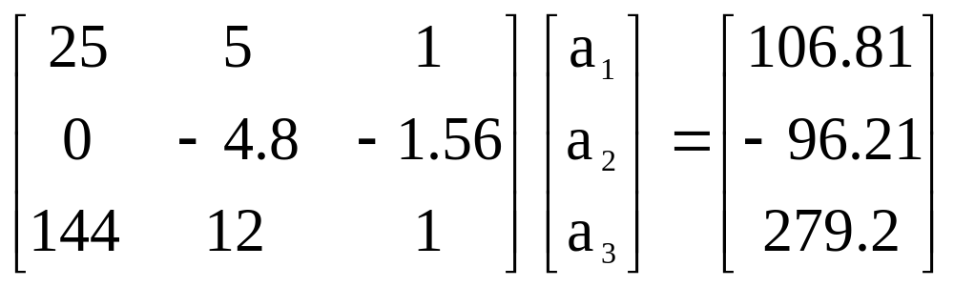
Example: Rocket Velocity
Forward Elimination: Step 1
Yields

Slide 18
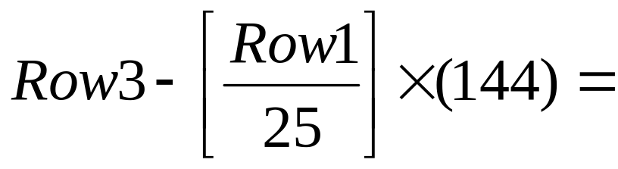
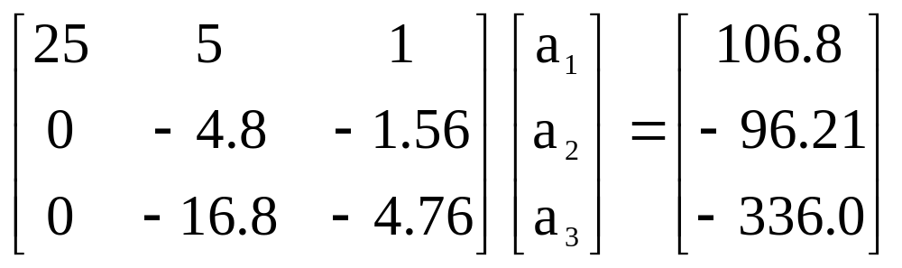
Example: Rocket Velocity
Forward Elimination: Step 1
Yields

Slide 19
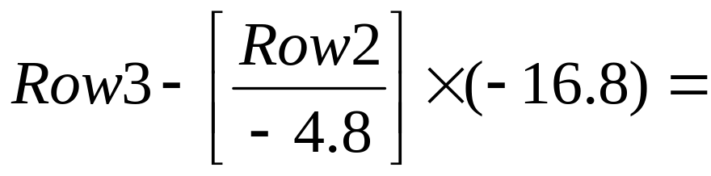
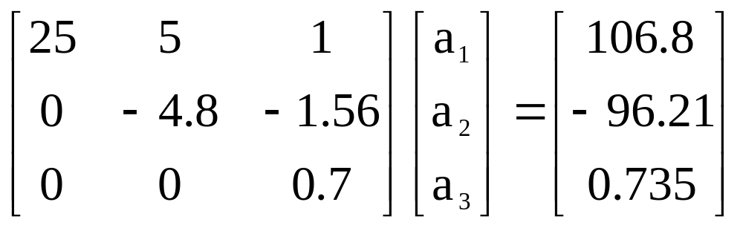
Example: Rocket Velocity
Forward Elimination: Step 2
Yields
This is now ready for Back Substitution

Slide 20
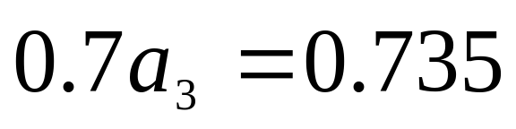
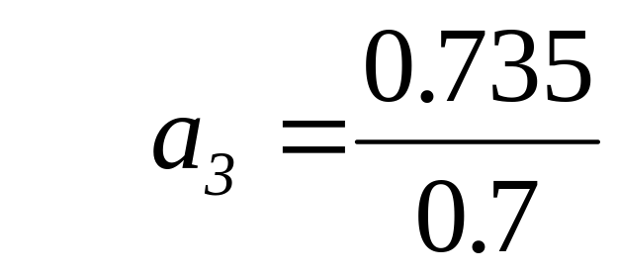

Example: Rocket Velocity
Back Substitution: Solve for a₃ using the third equation

Slide 21
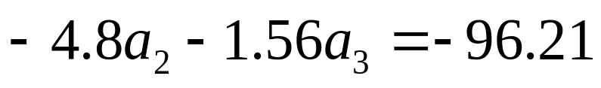
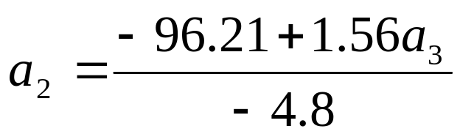
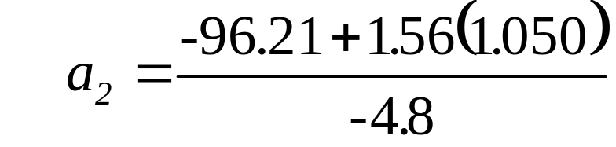
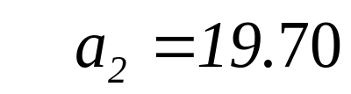
Example: Rocket Velocity
Back Substitution: Solve for a₂ using the second equation

Slide 22
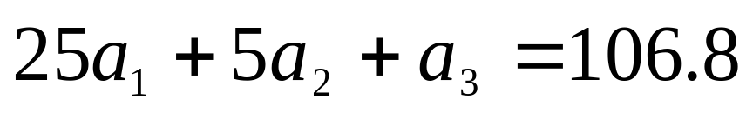
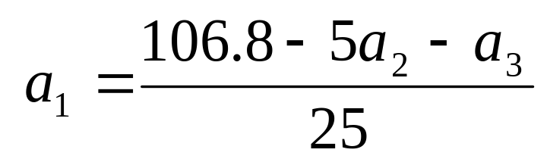
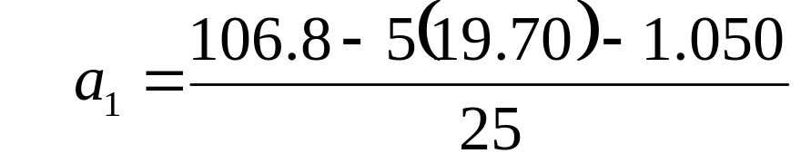

Example: Rocket Velocity
Back Substitution: Solve for a₁ using the first equation

Slide 23
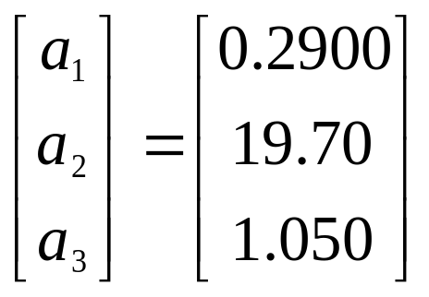
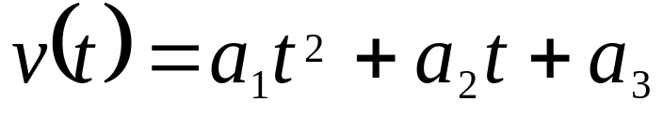
Example: Rocket Velocity
Solution:
The solution vector is
The polynomial that passes through the three data points is then:

Slide 24
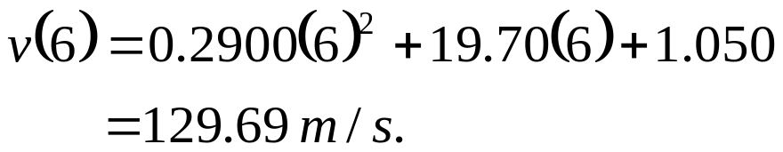
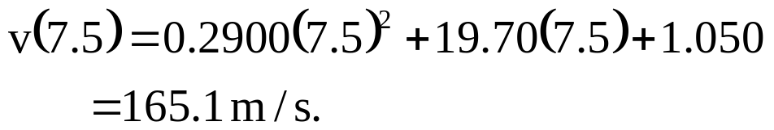
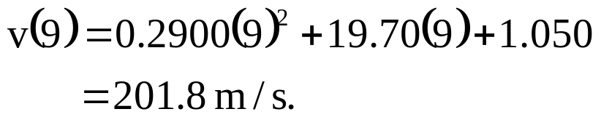
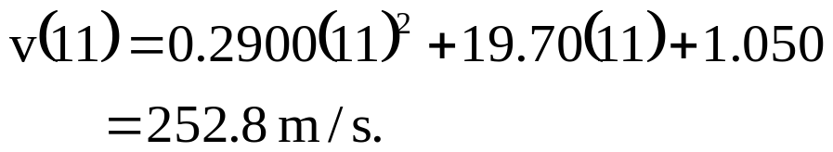
Example: Rocket Velocity
Solution:
Substitute each value of t to find the corresponding velocity

Slide 25
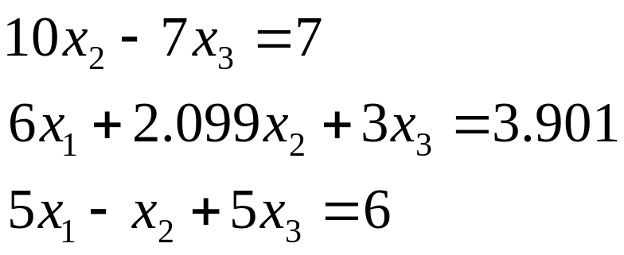
Pitfalls
Two Potential Pitfalls
Division by zero: May occur in the forward elimination steps. Consider the set of equations:
- Round-off error: Prone to round-off errors.

Slide 26
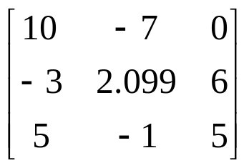
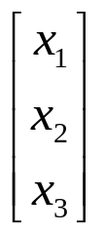
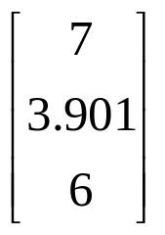
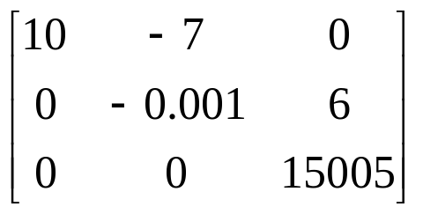


Pitfalls: Example
Consider the system of equations:
Use five significant figures with chopping
=
At the end of Forward Elimination
=

Slide 27




Pitfalls: Example
Back Substitution

Slide 28


Pitfalls: Example
Compare the calculated values with the exact solution

Slide 29
Improvements
Increase the number of significant digits
Decreases round off error
Does not avoid division by zero
Gaussian Elimination with Partial Pivoting
Avoids division by zero
Reduces round off error

Slide 30



Partial Pivoting
Gaussian Elimination with partial pivoting applies row switching to normal Gaussian Elimination.
How?
At the beginning of the k^{th} step of forward elimination, find the maximum of
If the maximum of the values is
In the p^{th} row,
then switch rows p and k.

Slide 31
Partial Pivoting
What does it Mean?
Gaussian Elimination with Partial Pivoting ensures that each step of Forward Elimination is performed with the pivoting element |a_{kk}| having the largest absolute value.

Slide 32




Partial Pivoting: Example
Consider the system of equations
In matrix form
=
Solve using Gaussian Elimination with Partial Pivoting using five significant digits with chopping

Slide 33



Partial Pivoting: Example
Forward Elimination: Step 1
Examining the values of the first column
|10|, |-3|, and |5| or 10, 3, and 5
The largest absolute value is 10, which means, to follow the rules of Partial Pivoting, we switch row1 with row1.
Performing Forward Elimination

Slide 34

Partial Pivoting: Example
Forward Elimination: Step 2
Examining the values of the first column
|-0.001| and |2.5| or 0.0001 and 2.5
The largest absolute value is 2.5, so row 2 is switched with row 3
Performing the row swap

Slide 35

Partial Pivoting: Example
Forward Elimination: Step 2
Performing the Forward Elimination results in:

Slide 36



Partial Pivoting: Example
Back Substitution
Solving the equations through back substitution

Slide 37


Partial Pivoting: Example
Compare the calculated and exact solution
The fact that they are equal is coincidence, but it does illustrate the advantage of Partial Pivoting

Slide 38
Summary
Forward Elimination
Back Substitution
Pitfalls
Improvements
Partial Pivoting

