Slide 1

`
State Diagram
LiveMenu Click
Live TV
(Just before menu)
Live TV
LiveMenu Click
(Just before menu)
LiveMenu Click
(no history)
Screen Click,
Press Back Key
Screen Click
Live Menu
Click Button(Recorded)
Recorded
(List)
Press Back Key,
Panel Click
Filtering
Click Button
(Channels)
Press Back Key,
Panel Click
Click Icon (Time Machine)
Item
Click
Channel
(List)
Filtering
Time Machine App
Screen Click
Now, Next
Press Back Key
Ch Click
(Ch Change)
(Live)
DVR Player
Ch Click
Press Back Key,
Panel Click
(scheduled)
Program Info
Reminder
(Information exist)
Screen Click
Schedule
Recording
(Information exist)

Slide 2
State Table
Event State | Live TV | Live Menu | Channel(List) | Program Info | Recorded(List)
Ch Banner Click | Live Menu Channel(List) Program info Recorded(List)
Screen Click |  | Live TV | Live TV | Live TV | Live TV
Press Back Key |  | Live TV | Live Menu | Channel(List) | Live Menu
Click Button (Channels) |  | Channel(List)
Click Button (Recorded) |  | Recorded(List)
Panel Click |  |  | Live Menu | Channel(List) | Live Menu
Filtering |  |  | Channel(List) |  | Recorded(List)
Now, Next |  |  | Channel(List)
Ch Click (live) |  |  | Channel(List)
Ch Click (scheduled) |  |  | Program Info
Reminder |  |  |  | Program Info
Schedule Recording |  |  |  | Program Info
Click Icon (Time Machine) |  |  |  |  | Time Machine App
Click Item |  |  |  |  | DVR Player

Slide 3
Transition Tree (1/4)
Live TV
Live Menu
path 1
Live TV
Live TV
path 2
Live Menu
path 3
Live Menu
path 4
Channel(List)
path 5
Live Menu
Channel(List)
Channel(List)
path 6
Channel(List)
path 7
Program Info
path 8
Live TV
path 9
Live Menu
path 10
Live Menu
path 11
Recorded(List)
Recorded(List)
path 12
Time Machine App
path 13
DVR Player
path 14

Slide 4
Transition Tree (2/4)
Live TV
Channel(List)
path 15
Live TV
path 16
Live TV
path 17
Live Menu
Channel(List)
path 18
Recorded(List)
path 19
Live Menu
Live TV
path 20
Live Menu
path 21
Channel(List)
Channel(List)
Live Menu
path 22
Channel(List)
path 23
Channel(List)
Channel(List)
path 24
Channel(List)
path 25
Channel(List)
Program Info
path 26
Live TV
path 27
Program Info
Channel(List)
path 28
Channel(List)
path 29
Program Info
path 30
Program Info
path 31

Slide 5
Transition Tree (3/4)
Live TV
Program Info
path 32
Live TV
path 33
Live Menu
path 34
Channel(List)
Live Menu
path 35
Channel(List)
path 36
Channel(List)
path 37
Program Info
Channel(List)
Channel(List)
path 38
Program Info
path 39
Live TV
path 40
Program Info
Channel(List)
path 41
Channel(List)
path 42
Program Info
path 43
Program Info
Program Info
path 44

Slide 6
Transition Tree (4/4)
Live TV
Recorded(List)
path 45
Live TV
path 46
Live TV
path 47
Live Menu
Channel(List)
path 48
Recorded(List)
path 49
Live Menu
Recorded(List)
Live TV
path 50
Recorded(List)
Live Menu
path 51
Live Menu
path 52
Time Machine App
Recorded(List)
path 53
Time Machine App
path 54
DVR Player
DVR Player
path 55

Slide 7
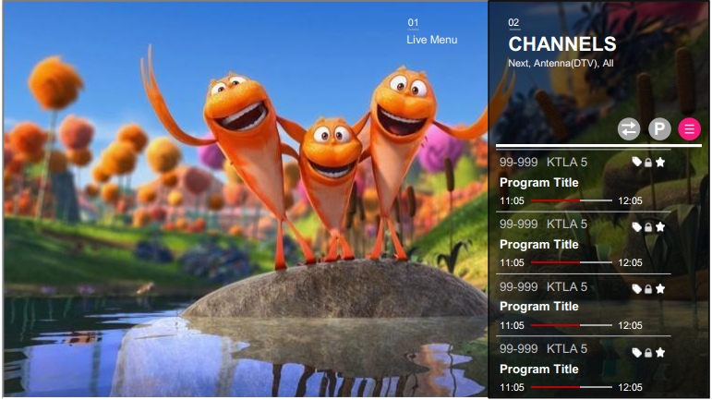
Moonstone Components – Live Menu
Channels
LiveMenu.Panel
LiveMenu.IconButton
LiveMenu.ListActions
moon.Divider
LiveMenu.ListActionItem
moon.CheckboxItem
moon.TooltipDecorator
LiveMenu.Tooltip
moon.DataList
moon.DataGridList
moon.Scroller
moon.MarqueeText
moon.ProgressBar

Slide 8
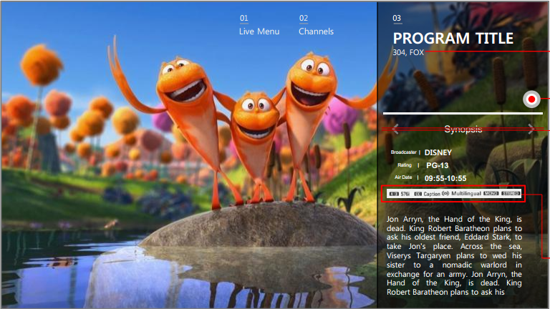
Moonstone Components – Live Menu
Program Info
LiveMenu.Panel
moon.TooltipDecorator
LiveMenu.Tooltip
LiveMenu.IconButton
moon.Scroller
moon.Divider

Slide 9
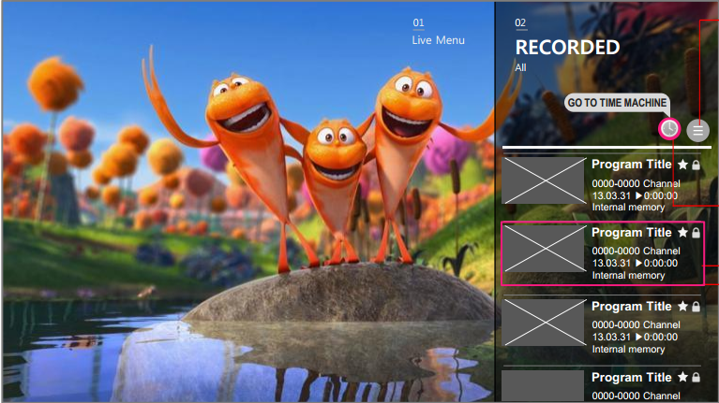
Moonstone Components – Live Menu
Recorded
(List)
LiveMenu.Panel
LiveMenu.IconButton
LiveMenu.ListActions
moon.Divider
LiveMenu.ListActionItem
moon.CheckboxItem
moon.TooltipDecorator
LiveMenu.Tooltip
moon.DataList
moon.Scroller
moon.MarqueeText

