Slide 1
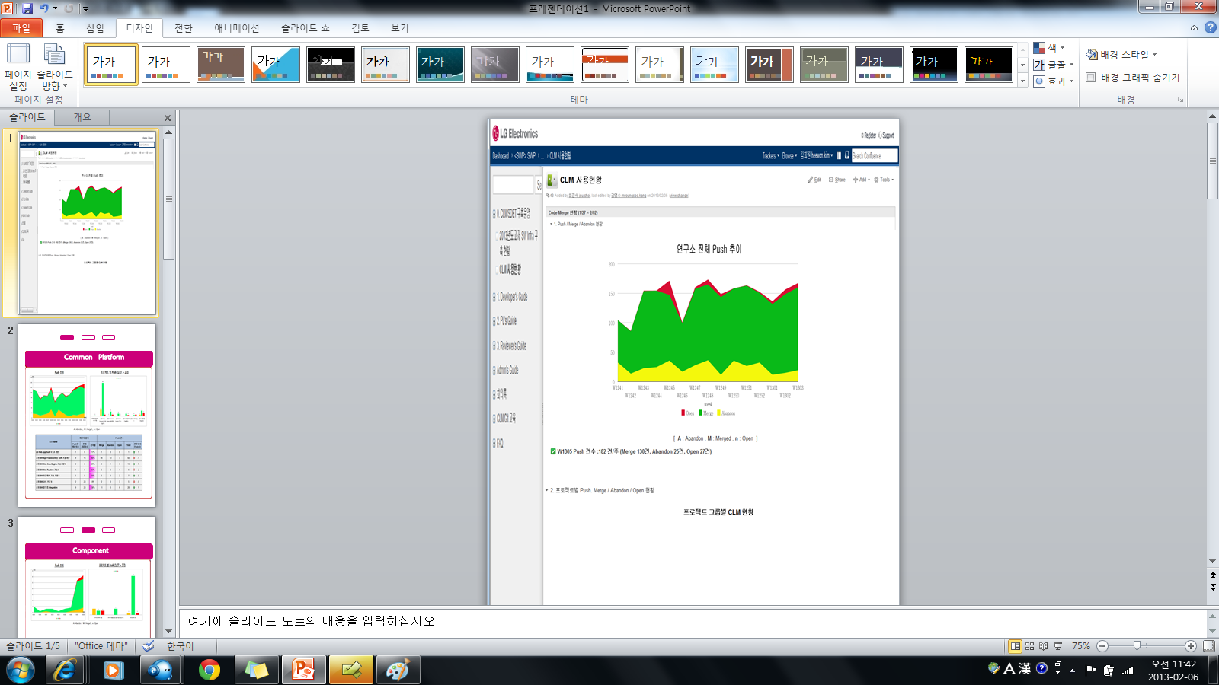
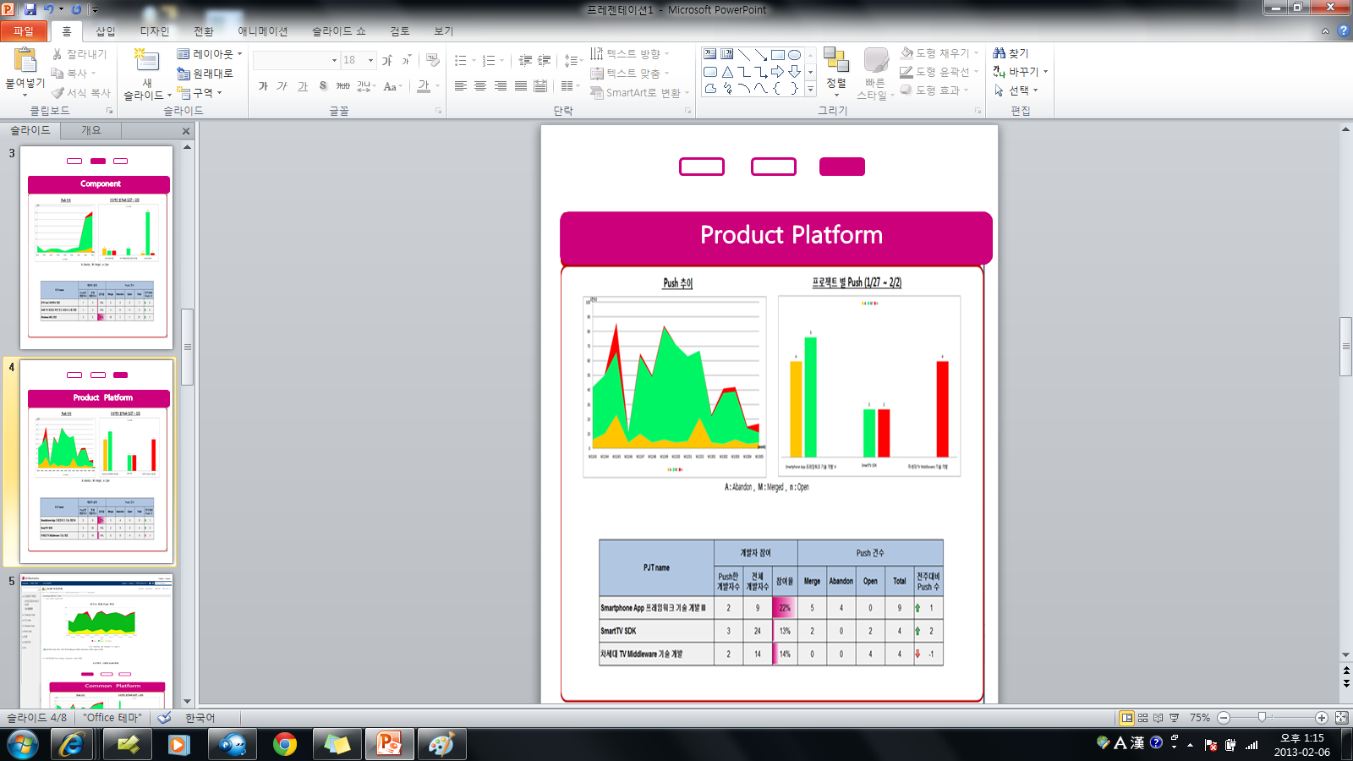
index.html
summary.jsp
main.jsp
component.html
productplatform.html
commonplatform.html
custom.js
basic.css

Slide 2
productplatform.html
productplatform-chart.jsp
productplatform-table.jsp
basic.css

