Slide 1
손바닥ML
With Scikit-Learn & Tensorflow
2018. 2. 21

Slide 2
Ⅰ
Part I. The Fundamentals of ML
Ch.1 The Machine Learning
Landscape

Slide 3
Supervised/Unsupervised Learning
Supervised Learning : the training data includes labels
- Classification : not numeric data
- Regression : numeric data
Unsupervised Learning : the training data is unlabeled
Reinforce Learning : The learning system(called agent) can observe the environment, select and perform actions, and get rewards in return(or penalties in the form of negative rewards).

Slide 4
Batch/Online Learning
In batch learning, the system is incapable of learning incrementally: it must be trained using all the available data.
In online learning, you train the system incrementally by feeding it data instances sequentially, either individually or by small group called mini-batches.

Slide 5
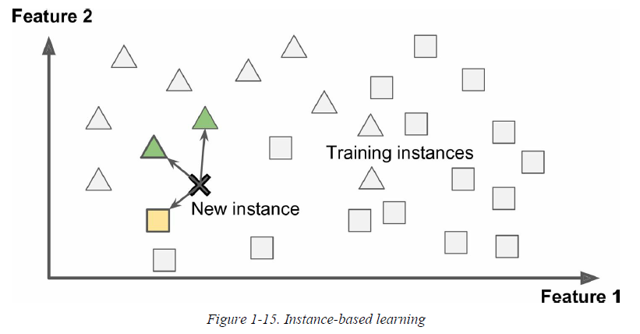
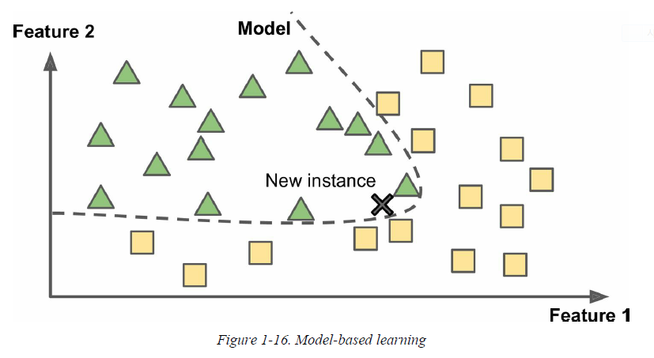
Instance-based/Model-based Learning

Slide 6
Ⅰ
Part I. The Fundamentals of ML
Ch.2 End-to-End Machine
Learning Project

Slide 7
Machine Learning WorkFlow
EDA (Exploratory Data Analysis)
- Visualization, Descriptive Statistic
Preprocessing
- Data Cleaning, Dummification, Feature Extraction,
Feature Scaling etc.
Model Specification
- Feature Selection, Hyperparameter tuning
Model Evaluation & Prediction
- Cross Validation, Descriptive Statistics measure

Slide 8
Pipeline
Feature scaler 는 StandardScaler() 사용
Import pandas as pd
From sklearn.preprocessing import LabelEncoder
From sklearn.decomposition import PCA
From sklearn.model_selection import train_test_split
From sklearn.preprocessing import StandardScaler
From sklearn.linear_model import LogisticRegression
From sklearn.pipeline import Pipeline
Pip_lr = Pipeline([(‘scl’, StandardScaler()),(‘pca’,PCA(n_components=2)),
('clf', LogisticRegression(random_state=1))])
df = pd.read_csv('https://archive.ics.uci.edu/ml/machine-learning-databases/breast-cancer-wisconsin/wdbc.data')
# feature 의미는 https://archive.ics.uci.edu/ml/machine-learning-databases/breast-cancer-wisconsin/wdbc.names 에서 확인
X = df.iloc[:,2:].values
y = df.iloc[:,1].values
le = LabelEncoder()
y = le.fit_transform(y)
X_train, X_test, y_train, y_test = train_test_split(X, y, test_size=0.2, random_state = 1)
pip_lr.fit(X_train, y_train)
print(pip_lr.score(X_test,y_test))
>>> 0.956140350877
2개의 component 사용
Classifire는 Logistic
Regression 을 사용

Slide 9
GridSearchCV
Randomforest 에서 사용하는 decision tree의 갯수
from sklearn.model_selection import GridSearchCV
param_grid = [
# try 12 (3×4) combinations of hyperparameters
{'n_estimators': [3, 10, 30], 'max_features': [2, 4, 6, 8]},
# then try 6 (2×3) combinations with bootstrap set as False
{'bootstrap': [False], 'n_estimators': [3, 10], 'max_features': [2, 3, 4]},
]
forest_reg = RandomForestRegressor(random_state=42)
# train across 5 folds, that's a total of (12+6)*5=90 rounds of training
grid_search = GridSearchCV(forest_reg, param_grid, cv=5,
scoring='neg_mean_squared_error')
grid_search.fit(housing_prepared, housing_labels)
feature 수의 한계
RandomForestRegressor, param_grid를 이용해서 5-fold cross validation 을 써서 neg_mean_squared_error score 로 체크한 가장 좋은 모델을 찾는 grid search 함수

Slide 10
Ⅰ
Part I. The Fundamentals of ML
Ch.3 Classification

Slide 11
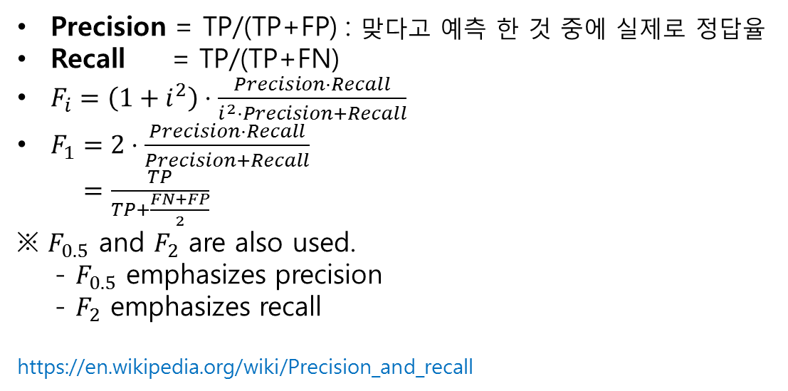
Confusion Matrix
 |  | Predicted
 |  | Negative | Positive
Actual | Negative | TN | FP
 | Positive | FN | TP
Precision = TP/(TP+FP) : 맞다고 예측 한 것 중에 실제로 정답율
Recall = TP/(TP+FN)
$F_{i}=\left(1+i^{2}\right)⋅\frac{Precision⋅Recall}{i^{2}⋅Precision+Recall}$
$F_{1}=2⋅\frac{Precision⋅Recall}{Precision+Recall}$
$=\frac{TP}{TP+\frac{FN+FP}{2}}$
※$F_{0.5}$and $F_{2}$are also used.
- $F_{0.5}$ emphasizes precision
- $F_{2}$emphasizes recall
https://en.wikipedia.org/wiki/Precision_and_recall

Slide 12
Confusion Matrix
 |  | Predicted
 |  | Negative | Positive
Actual | Negative | TN | FP
 | Positive | FN | TP
Spam Filter : 스팸메일을 잘 체크하는것 보다 중요한 메일을 스팸으로 분류하지 않는것이 더 중요.
⇒ Goal : TP↑& FP↓
⇒ Check Precision
보험사기 판별 : 보험사기가 아닌데 보험사기라고 하는 것 보다, 보험사기인데 아니라고 하면 안 된다.
⇒ Goal : TP↑& FN↓
⇒ Check Recall

Slide 13
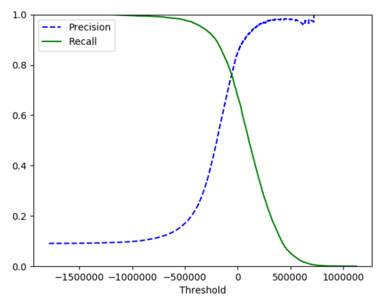
Confusion Matrix

Slide 14
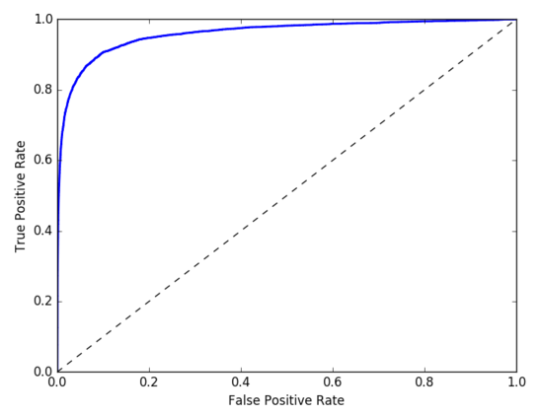
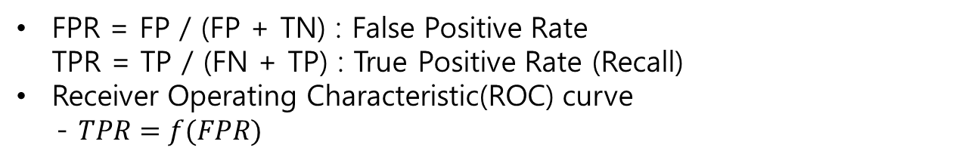

ROC curve
FPR = FP / (FP + TN) : False Positive Rate TPR = TP / (FN + TP) : True Positive Rate (Recall)
Receiver Operating Characteristic(ROC) curve
- $TPR=f(FPR)$
 |  | Predicted
 |  | Negative | Positive
Actual | Negative | TN | FN
 | Positive | FP | TP
TPR이 높아질수록, FPR도 높아지게 된다.
ROC커브가 기준선($y=x)$에서 멀어질수록 성능이 좋다. 또한 ROC커브의 밑 넓이가 1에 가까울수록 성능이 좋다고 판단할 수 있다.
ROC커브 밑넓이를 Area Under the Curve(AUC) 라고하며, 1에 가까울수록 성능이좋고, 반대로 0.5에 가까울수록성능이 나쁘다고 판단할수있다

Slide 15
Ⅰ
Part I. The Fundamentals of ML
Ch.4 Training Models

Slide 16
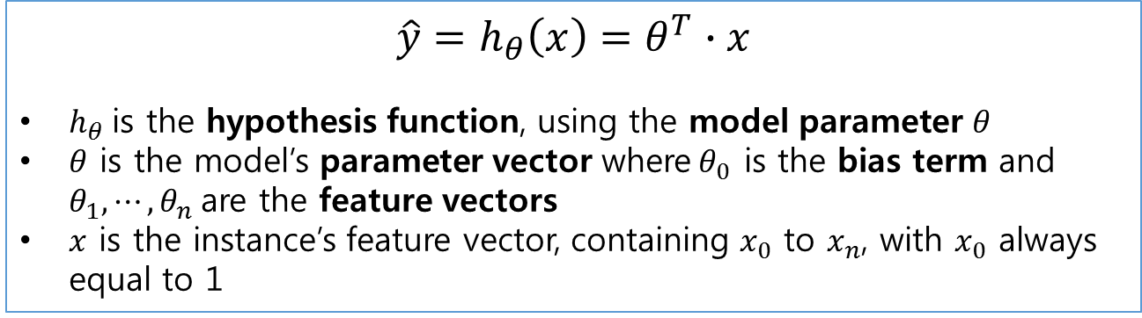
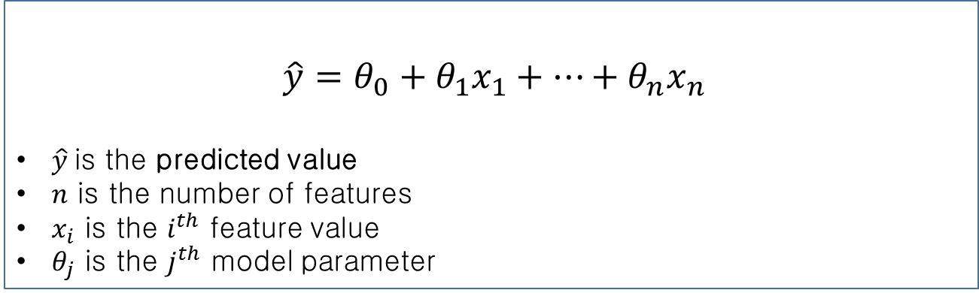
Linear Regression
$\hat{y}=θ_{0}+θ_{1}x_{1}+⋯+θ_{n}x_{n}$
$\hat{y}$is the predicted value
$n$ is the number of features
$x_{i}$ is the $i^{th}$ feature value
$θ_{j}$ is the $j^{th}$ model parameter
$$\hat{y}=h_{θ}\left(x\right)=θ^{T}∙x$$
$h_{θ}$is the hypothesis function, using the model parameter$θ$
$θ$is the model’s parameter vector where$θ_{0}$ is the bias term and $θ_{1},⋯,θ_{n}$are the feature vectors
$x$ is the instance’s feature vector, containing $x_{0}$ to $x_{n}$, with $x_{0}$ always equal to 1

Slide 17
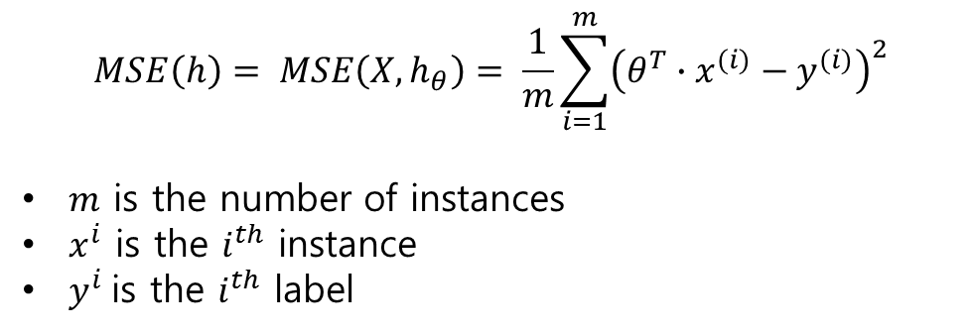
Mean Square Error
$$MSE\left(h\right)= MSE\left(X,h_{θ}\right)= \frac{1}{m}\sum_{i=1}^{m}{{\left(θ^{T}∙x^{(i)}−y^{(i)}\right)}^{2}}$$
$m$is the number of instances
$x^{i}$is the $i^{th}$instance
$y^{i}$is the $i^{th}$label

Slide 18
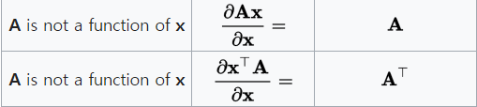
Closed-form solution for Linear Regression
$$\hat{θ}={\left(X^{T}∙X\right)}^{−1}∙X^{T}∙y$$
Matrix calculus
참고사이트
https://en.wikipedia.org/wiki/Matrix_calculus
http://www.dsplog.com/2011/12/04/closed-form-solution-linear-regression/

Slide 19
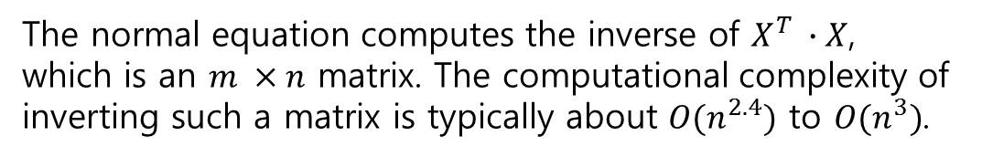
Computational Complexity
The normal equation computes the inverse of $X^{T} ∙X$, which is an $m ×n$matrix. The computational complexity of inverting such a matrix is typically about $O(n^{2.4})$to $O(n^{3})$.

Slide 20
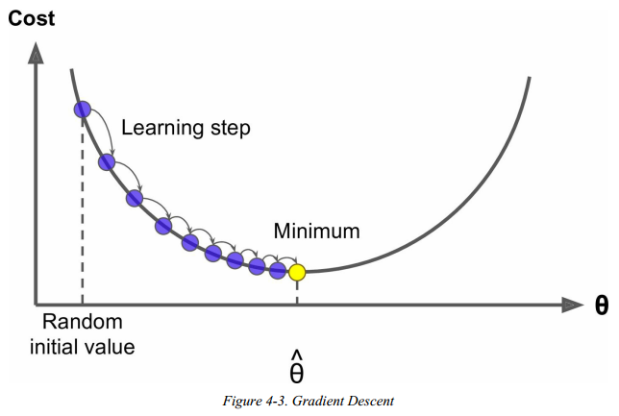
Gradient Descent(GD)
조금씩 값을 움직이면서 Optimal solution 에 다가가는 방법
GD의 hyperparameter 에서 달라질 수 있는 변수(hyperparameter)는 시작점, 간격(learning rate), 횟수 이다.

Slide 21
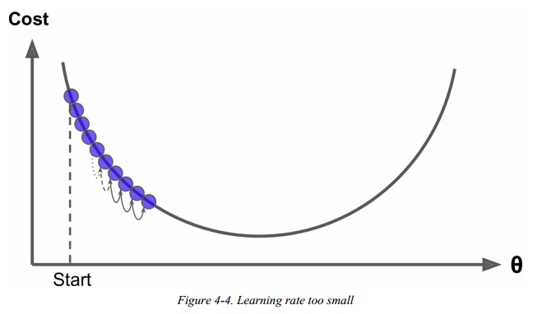
Gradient Descent
Learning rate 가 작거나 횟수가 작으면 최소값에 도달하기 전에 끝날 수 있다.

Slide 22
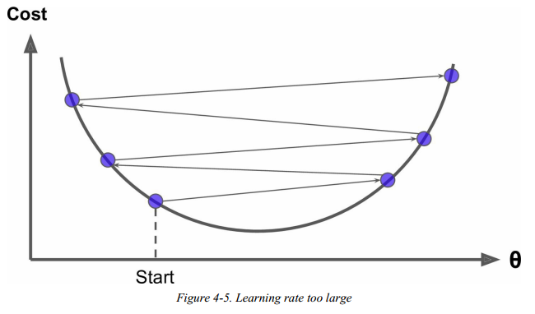
Gradient Descent
Learning rate 가 크면 발산할 수 있다.

Slide 23
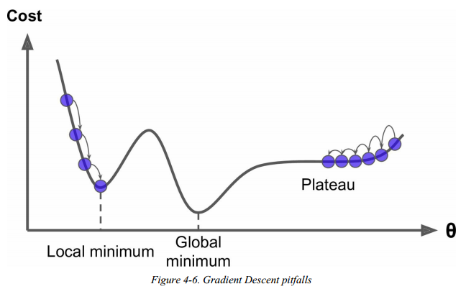
Gradient Descent
Convex function 이 아닌 경우에는 시작점을 다르게 잡을 때마다
다른 최소값을 얻게 된다.

Slide 24
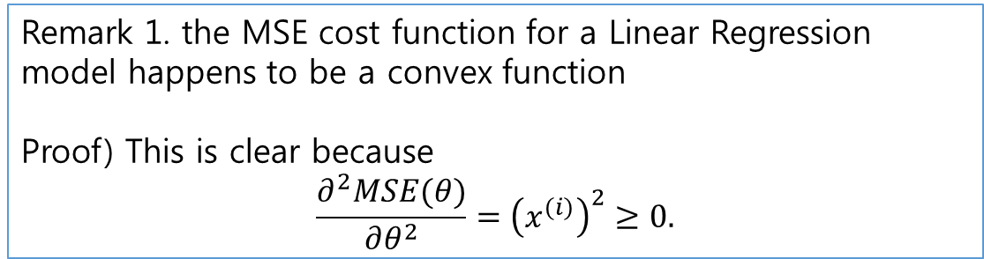
Convexity of MSE for Linear Regression
Remark 1. the MSE cost function for a Linear Regression model happens to be a convex function
Proof) This is clear because
$$\frac{∂^{2}MSE(θ)}{∂θ^{2}}={\left(x^{(i)}\right)}^{2}≥0.$$
Remark 2. When using Gradient Descent, you should ensure that all features have a similar scale (e.g., using Scikit-Learn’s StandardScaler class), or else it will take much longer to converge.
→ 모든 numeric 변수들을 정규화(normalization) 하자

Slide 25
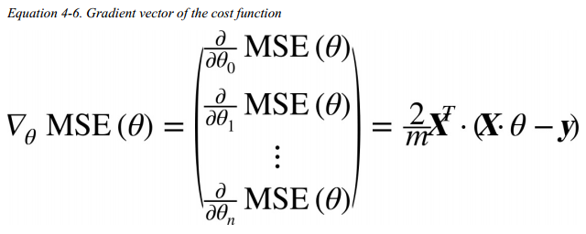
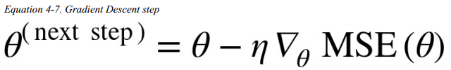
Batch Gradient Descent
즉, BGD는 매번 step 마다 learning rate 만큼 미분한 방향만큼 이동한다. 수식으로 나타내면 아래와 같다.
where $η$is a learning rate.

Slide 26
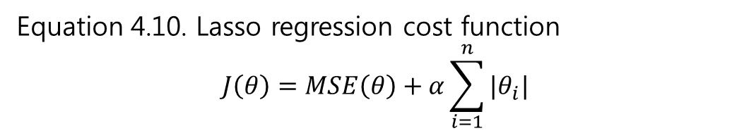
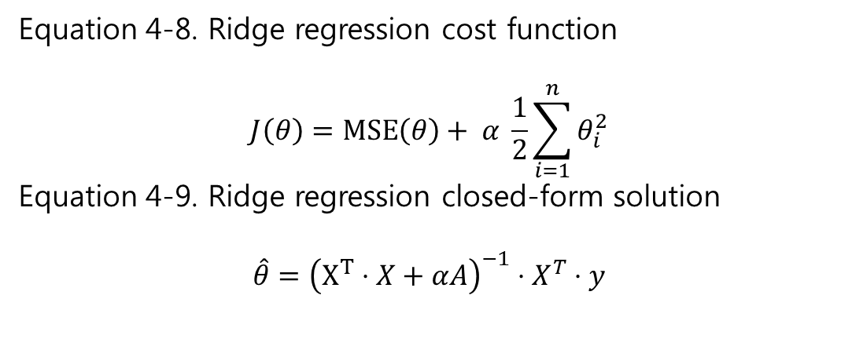
Regularized Linear Models
Equation 4-8. Ridge regression cost function
$$J\left(θ\right)=MSE\left(θ\right)+ α \frac{1}{2}\sum_{i=1}^{n}{θ_{i}^{2}}$$
Equation 4-9. Ridge regression closed-form solution
$$\hat{θ}={\left(X^{T}⋅X+αA\right)}^{−1}⋅X^{T}⋅y$$
Lasso = Least Absolute Shrinkage and Selection Operator
Equation 4.10. Lasso regression cost function
$$J\left(θ\right)=MSE\left(θ\right)+α\sum_{i=1}^{n}{|θ_{i}|}$$

Slide 27
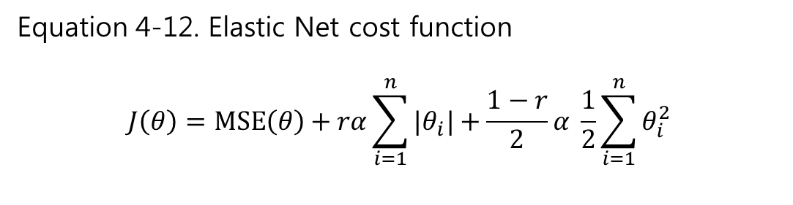
Regularized Linear Models
Equation 4-12. Elastic Net cost function
$$J\left(θ\right)=MSE\left(θ\right)+rα\sum_{i=1}^{n}{|θ_{i}|}+\frac{1−r}{2}α \frac{1}{2}\sum_{i=1}^{n}{θ_{i}^{2}}$$

Slide 28
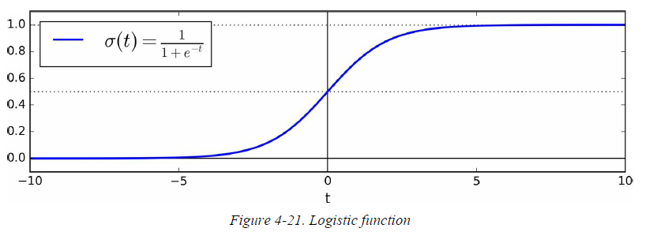
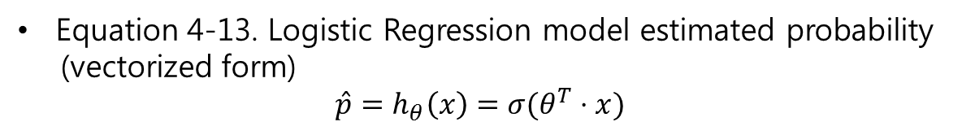
Logistic Regression
Equation 4-13. Logistic Regression model estimated probability
(vectorized form)
$$\hat{p}=h_{θ}\left(x\right)=σ(θ^{T}⋅x)$$

Slide 29
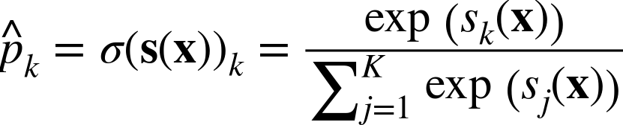
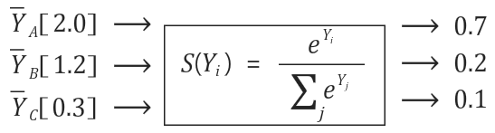
Softmax Function
Softmax Function
= Multinomial Logistic Regression
: multi-labeled classifier

Slide 30
Ⅰ
Part I. The Fundamentals of ML
Ch.5 Support Vector Machines

Slide 31
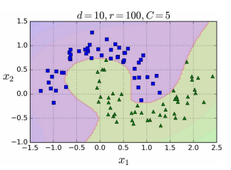
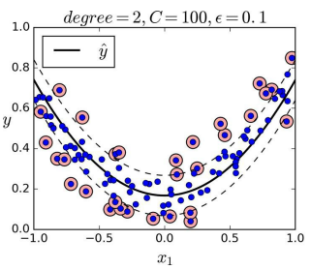
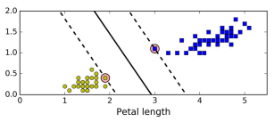
In this chapter, we will discuss about
What is SVM
- supervised learning
- binary classifier
- linear and unlinear regressor
- linear and unlinear learning using kernel trick
Support vectors

Slide 32
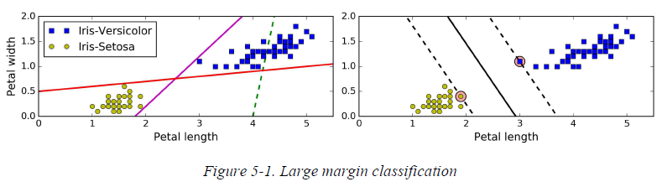
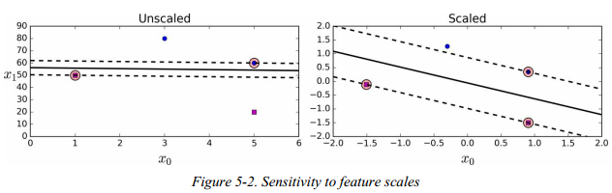
Linear SVM Classification
Decision boundary
= Decision line
= Decision hyperplane
What is Margin?
margin
SVM is sensitive to feature scale
-> use Scikit-Learn's StandardScaler

Slide 33
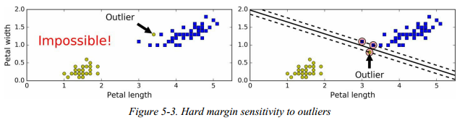
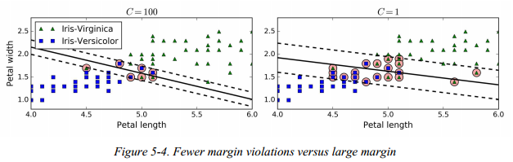
Soft and Hard Margin SVM
Hard Margin SVM : error 를 허용하지 않고 margin 을 최대화함 * Hard Margin SVM 은 outlier 에 취약
그래서 약간의 에누리를 줄 수 있는데, 에누리의 크기를 margin violation 이라고 한다. 이 경우에 support vector와 decision line 사이에 feature 들이 들어있을 수 있음

Slide 34
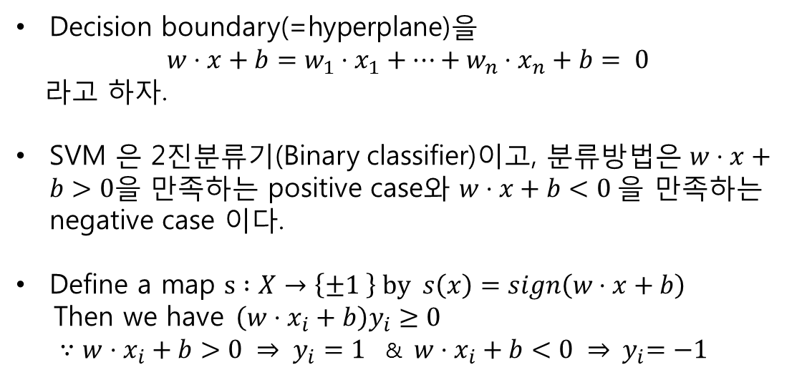
Mathematical approach 1
Decision boundary(=hyperplane)을
$w⋅x+b=w_{1}⋅x_{1}+⋯+w_{n}⋅x_{n}+b= 0$
라고 하자.
SVM 은 2진분류기(Binary classifier)이고, 분류방법은 $w⋅x+b>0을$만족하는 positive case와 $w⋅x+b<0 을$만족하는 negative case 이다.
Define a map $s :X→\left\{±1 \right\} by s\left(x\right)=sign\left(w⋅x+b\right)$
Then we have$\left(w⋅x_{i}+b\right)y_{i}≥0$
$∵w⋅x_{i}+b>0 ⇒ y_{i}=1$&$w⋅x_{i}+b<0 ⇒ { y}_{i}=−1$

Slide 35

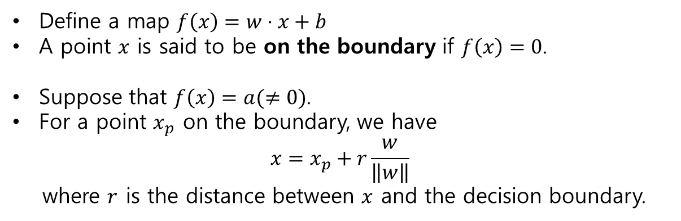


Mathematical approach 2 : Margin Distance
Define a map $f\left(x\right)=w⋅x+b$
A point $x$ is said to be on the boundary if $f\left(x\right)=0$.
Suppose that $f\left(x\right)=a(≠0)$.
For a point $x_{p}$ on the boundary, we have
$$x=x_{p}+r\frac{w}{\left\|w\right\|}$$
where $r$ is the distance between $x$ and the decision boundary.
Decision boundary
$$x_{p}$$
$${90}^{°}$$
$$x$$

Slide 36

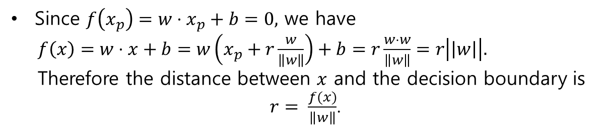



Mathematical approach 2 : Margin Distance
Since $f\left(x_{p}\right)=w⋅x_{p}+b=0,$ we have
$f\left(x\right)=w⋅x+b=w\left(x_{p}+r\frac{w}{\left\|w\right\|}\right)+b=r\frac{w⋅w}{\left\|w\right\|}=r\left|\left|w\right|\right|.$
Therefore the distance between $x$ and the decision boundary is
$r= \frac{f(x)}{\left\|w\right\|}$.
Decision boundary
$$x_{p}$$
$$\frac{f(x)}{\left\|w\right\|}$$
$${90}^{°}$$
$$x$$

Slide 37

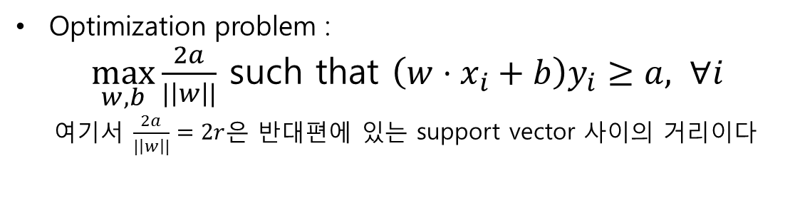
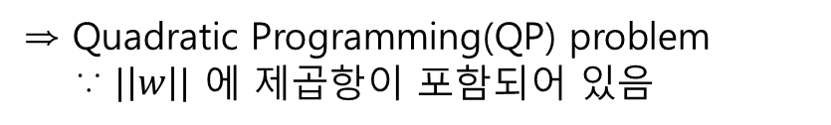
Maximizing the margin
Optimization problem :
$\max_{w,b}{\frac{2a}{|\left|w\right||}}$such that $\left(w⋅x_{i}+b\right)y_{i}≥a, ∀i$
여기서 $\frac{2a}{|\left|w\right||}=2r$은 반대편에 있는 support vector 사이의 거리이다
우리는 $a$ 를 임의의 숫자로 사용했으므로, normalize 하여 아래의 optimization problem 을 얻을 수 있다.
$\min_{w,b}{|\left|w\right||}$such that $\left(w⋅x_{i}+b\right)y_{i}≥1, ∀i$
⇒ Quadratic Programming(QP) problem
∵ $|\left|w\right||$ 에 제곱항이 포함되어 있음

Slide 38

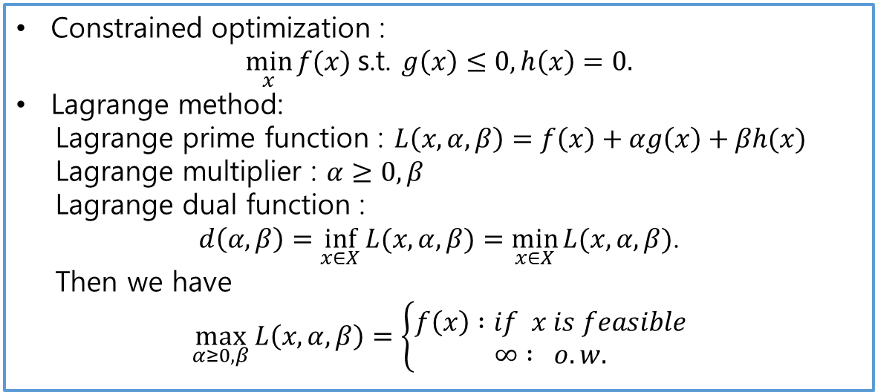

Dual problem
Constrained optimization :
$\min_{x}{f(x)}$s.t.$g\left(x\right)≤0, h\left(x\right)=0.$
Lagrange method:
Lagrange prime function : $L\left(x,α, β\right)=f\left(x\right)+αg\left(x\right)+βh(x)$
Lagrange multiplier : $α≥0, β$
Lagrange dual function :
$d\left(α,β\right)=\inf_{x∈X}{L(x,α,β)}=\min_{x∈X}{L(x,α,β)}$.
Then we have
$$\max_{α≥0,β}{L\left(x,α,β\right)=\left\{\begin{aligned}f\left(x\right) :if x is feasible \\ &∞ : o.w.\end{aligned}\right.}$$
우리의 optimization problem
$\min_{w,b}{|\left|w\right||}$such that $\left(w⋅x_{i}+b\right)y_{i}≥1, ∀i$
을 대입해보면 아래와 같다.
$$f\left(x\right)=\left|\left|w\right|\right|,$$
$g\left(x\right)=\left(w⋅x+b\right)y_{i}−1≤0$,
$h\left(x\right)=0$

Slide 39
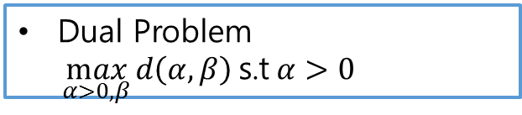
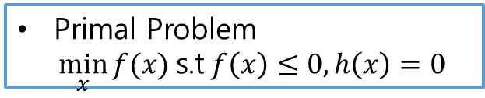
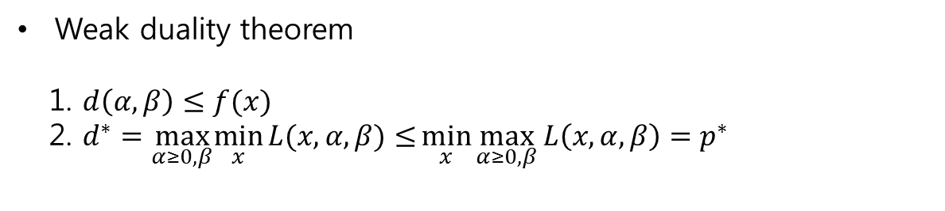


Prime & Dual problem
Primal Problem
$\min_{x}{f(x)}$s.t$f\left(x\right)≤0, h\left(x\right)=0$
Dual Problem
$\max_{α>0,β}{d\left(α,β\right)}$s.t$α>0$
$$\min_{x}{\max_{α≥0,β}{L(x,α,β)}}$$
$$\max_{α≥0,β}\min_{x}{L(x,α,β)}$$
Weak duality theorem
1. $d\left(α,β\right)≤f(x)$
2. $d^{∗}=\max_{α≥0,β}\min_{x}{L(x,α,β)}{≤}\min_{x}{\max_{α≥0,β}{L\left(x,α,β\right)}}=p^{∗}$

Slide 40
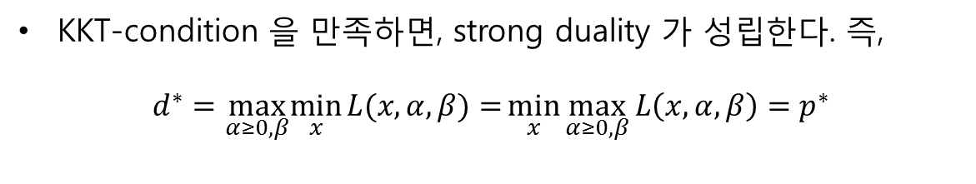
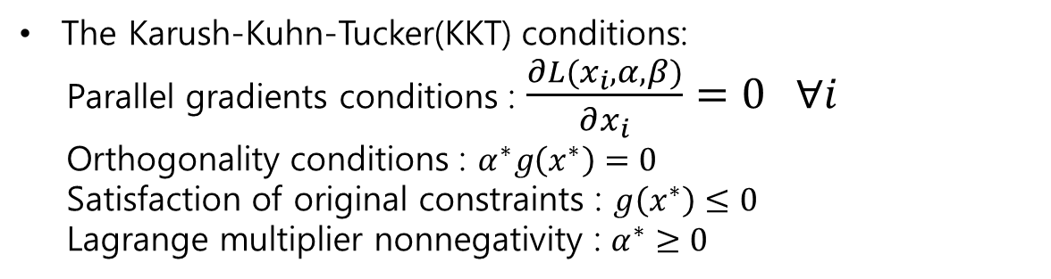
Strong Duality and KKT-conditions
The Karush-Kuhn-Tucker(KKT) conditions:
Parallel gradients conditions : $\frac{∂L(x_{i},α,β)}{∂x_{i}}=0 ∀i$
Orthogonality conditions : $α^{∗}g\left(x^{∗}\right)=0$
Satisfaction of original constraints :$g\left(x^{∗}\right)≤0$
Lagrange multiplier nonnegativity : $α^{∗}≥0$
KKT-condition 을 만족하면, strong duality 가 성립한다. 즉,
$$d^{∗}=\max_{α≥0,β}\min_{x}{L(x,α,β)}{=}\min_{x}{\max_{α≥0,β}{L\left(x,α,β\right)}}=p^{∗}$$

Slide 41
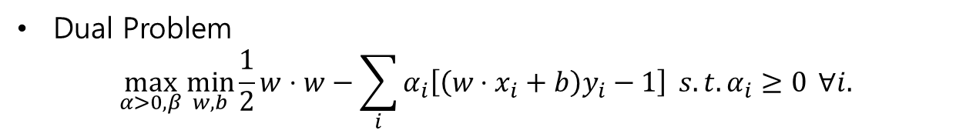
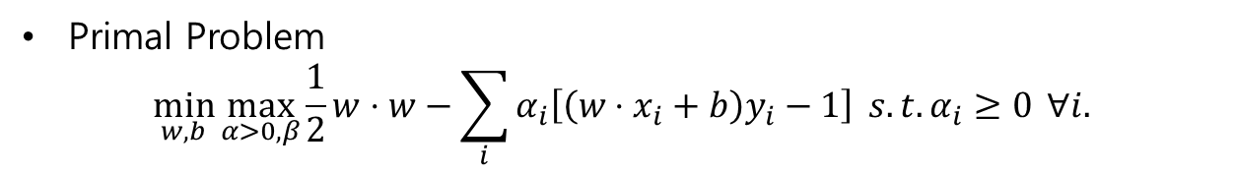
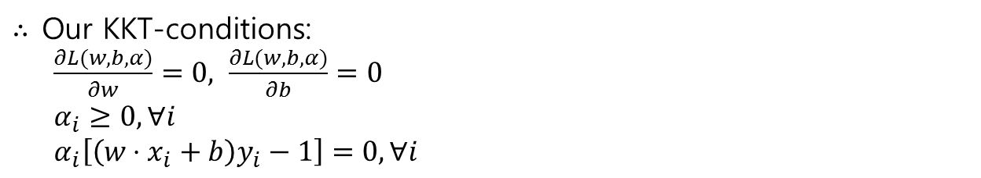
Strong Duality and KKT-conditions
우리의 문제 SVM의 Primal problem, Dual Problem, KKT-conditions 는 아래와 같다.
Primal Problem
$$\min_{w,b}{\max_{α>0,β}{\frac{1}{2}}w⋅w−\sum_{i}{α_{i}\left[\left(w⋅x_{i}+b\right)y_{i}−1\right]} s.t. α_{i}≥0} ∀i.$$
Dual Problem
$$\max_{α>0,β}\min_{w,b}{\frac{1}{2}w⋅w−\sum_{i}{α_{i}\left[\left(w⋅x_{i}+b\right)y_{i}−1\right]} s.t. α_{i}≥0} ∀i.$$
$∴$Our KKT-conditions:
$\frac{∂L(w,b,α)}{∂w}=0, \frac{∂L(w,b,α)}{∂b}=0$
$α_{i}≥0, ∀i$
$α_{i}\left[\left(w⋅x_{i}+b\right)y_{i}−1\right]=0, ∀i$
※ $x_{i}$가 decision boundary에 있지 않으면 $\left(w⋅x_{i}+b\right)y_{i}−1≠0$ 이고, $α_{i}≥0 이$므로, $α_{i}\left[\left(w⋅x_{i}+b\right)y_{i}−1\right]=0$ 으로부터 $α_{i}=0$를 얻을 수 있다.

Slide 42
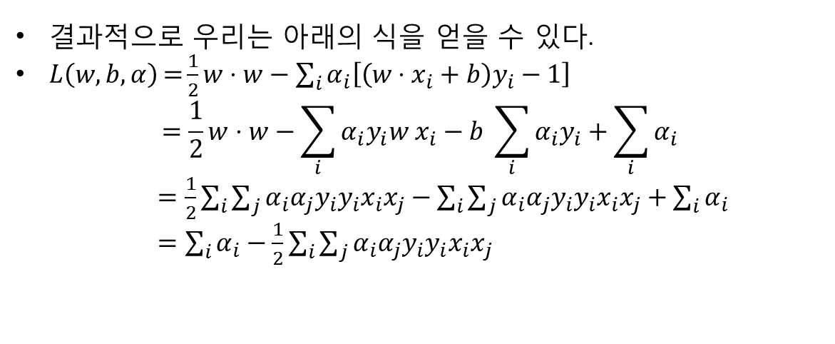

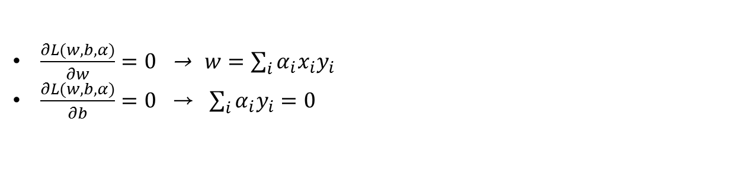
Strong Duality and KKT-conditions
우리의 함수 $f\left(x\right)=w⋅x+b 의$ Lagrange prime function 은
$L\left(w,b,α\right)={\frac{1}{2}w⋅w−\sum_{i}{α_{i}\left[\left(w⋅x_{i}+b\right)y_{i}−1\right]}}$
이므로, KKT-condition 을 풀어보면
$\frac{∂L(w,b,α)}{∂w}=0$ → $w=\sum_{i}{α_{i}x_{i}y_{i}}$
$\frac{∂L(w,b,α)}{∂b}=0$ → $\sum_{i}{α_{i}y_{i}=0}$
결과적으로 우리는 아래의 식을 얻을 수 있다.
$L\left(w,b,α\right)={\frac{1}{2}w⋅w−\sum_{i}{α_{i}\left[\left(w⋅x_{i}+b\right)y_{i}−1\right]}}$
$$=\frac{1}{2}w⋅w−\sum_{i}{α_{i}y_{i}w x_{i}−b \sum_{i}{α_{i}y_{i}+\sum_{i}{α_{i}}}}$$
$=\frac{1}{2}\sum_{i}{\sum_{j}{α_{i}α_{j}y_{i}y_{i}x_{i}x_{j}}}−\sum_{i}{\sum_{j}{α_{i}α_{j}y_{i}y_{i}x_{i}x_{j}}}+\sum_{i}{α_{i}}$
$=\sum_{i}{α_{i}−\frac{1}{2}\sum_{i}{\sum_{j}{α_{i}α_{j}y_{i}y_{i}x_{i}x_{j}}}}$

Slide 43
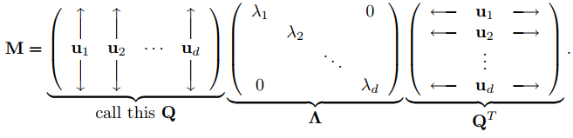



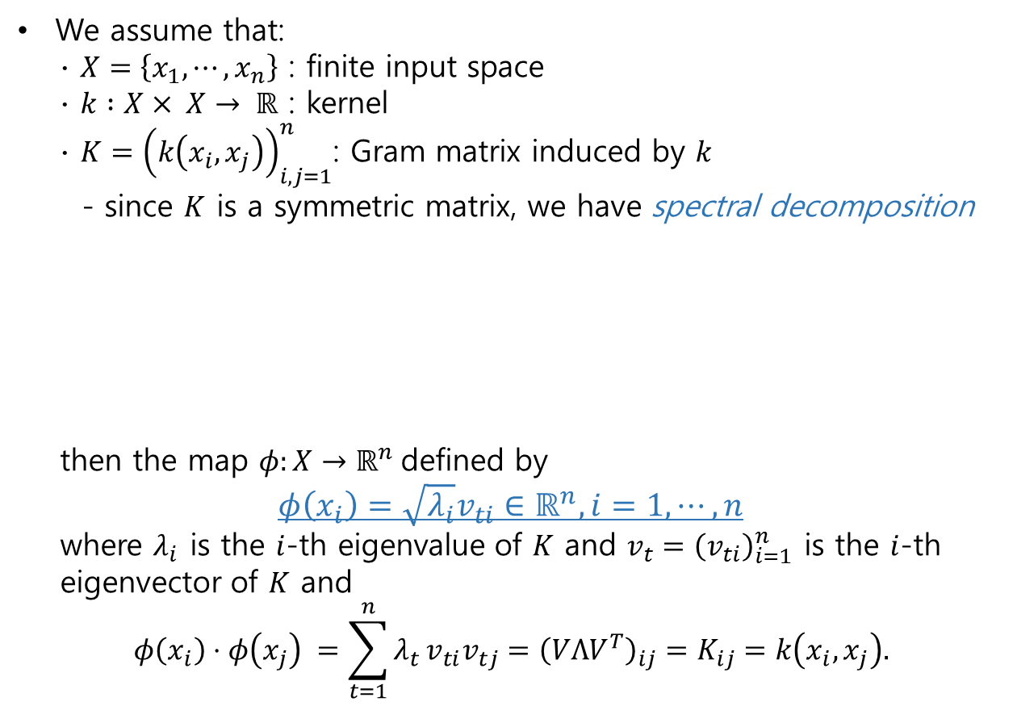






Mercer’s Theorem
We assume that:
∙ $X=\left\{x_{1},⋯,x_{n}\right\}$ : finite input space
∙ $k :X× X→ ℝ$ : kernel
∙ $K={\left(k\left(x_{i},x_{j}\right)\right)}_{i,j=1}^{n}$: Gram matrix induced by $k$
- since $K$ is a symmetric matrix, we have spectral decomposition
thenthe map $φ:X→ℝ^{n}$defined by
$$φ\left(x_{i}\right)=\sqrt{λ_{i}}v_{ti}∈ℝ^{n}, i=1, ⋯,n$$
where $λ_{i}$ is the $i$-th eigenvalue of $K$ and $v_{t}={\left(v_{ti}\right)}_{i=1}^{n}$ is the $i$-th
eigenvector of $K$ and
$$φ\left(x_{i}\right)⋅φ\left(x_{j}\right) =\sum_{t=1}^{n}{λ_{t}}v_{ti}v_{tj}={\left(VΛV^{T}\right)}_{ij}=K_{ij}=k\left(x_{i},x_{j}\right).$$
https://cseweb.ucsd.edu/~dasgupta/291-unsup/lec7.pdf
$$v_{1}$$
$$v_{2}$$
$$K$$
$$v_{1}$$
$$v_{2}$$
$$v_{n}$$
$$v_{n}$$
$$V$$
$$V^{T}$$

Slide 44

Kernel Trick
참고. https://data-flair.training/blogs/svm-kernel-functions/
A function $K :X×X→ ℝ$is a kernel of $φ$ if
$$K\left(x_{i},x_{j}\right)=φ\left(x_{i}\right)⋅φ\left(x_{j}\right).$$
여기서 $φ$는 $X$ 보다 높은 차원으로 embedding 해주는 함수이다.
Polynomial kernel
$$K\left(x_{i},x_{j}\right)={\left(x_{i}⋅x_{j}+1\right)}^{n}$$
Gaussian kernel
$$K\left(x_{i},x_{j}\right)=exp\left(−\frac{{\left|\left|x_{i}−x_{j}\right|\right|}^{2}}{2σ^{2}}\right)$$
Gaussian radial basis function(RBF) :
It is general-purpose kernel; used when there is no prior knowledge
about the data
$K\left(x_{i},x_{j}\right)=exp⁡(−γ{\left|\left|x_{i}−x_{j}\right|\right|}^{2})$, $γ>0$
Laplace RBL kernel
$$K\left(x_{i},x_{j}\right)=exp\left(−\frac{|\left|x_{i}−x_{j}\right||}{σ}\right)$$
Hyperbolic tangent kernel
$$K\left(x_{i},x_{j}\right)=\tanh\left(κx_{i}⋅x_{j}+c\right), κ>0, c<0.$$

Slide 45


Convert dual problem using Kernel Trick
P.14 에서 우리는 아래의 dual problem 을 얻었다.
$$L\left(w,b,α\right)= \sum_{i}{α_{i}−\frac{1}{2}\sum_{i}{\sum_{j}{α_{i}α_{j}y_{i}y_{i}x_{i}x_{j}}}}$$
위의 식을 $φ$ 함수와 kernel 함수 $K$를 이용하여 아래와 같이 변형할 수 있다.
$\max_{α≥0}({\sum_{i}{α_{i}−\frac{1}{2}\sum_{i}{\sum_{j}{α_{i}α_{j}y_{i}y_{i}φ\left(x_{i}\right)φ(x_{j})}}}}$)
= $\max_{α≥0}{(\sum_{i}{α_{i}−\frac{1}{2}\sum_{i}{\sum_{j}{α_{i}α_{j}y_{i}y_{i}K(x_{i},x_{j})}}}}$)
Where
$w=\sum_{i }{α_{i}y_{i}φ(x_{i}})$,
$$b=y_{i}−\sum_{i}{α_{i}y_{i}φ\left(x_{i}\right)φ\left(x_{j}\right)=y_{i}−\sum_{i}{α_{i}y_{i}K(x_{i},x_{j})}}$$

Slide 46

Convert dual problem using Kernel Trick
P.16의 $w$와 $b를$이용하여 아래를 얻을 수 있다.
$sign\left(w⋅φ\left(x\right)+b\right)$
= $sign(\sum_{i}{α_{i}y_{i}φ\left(x_{i}\right)φ\left(x\right)−y_{i}−\sum_{i}{α_{i}y_{i}K\left(x_{i},x_{j}\right)})}$
= $sign(\sum_{i}{α_{i}K(x_{i},x)−y_{i}−\sum_{i}{α_{i}y_{i}K\left(x_{i},x_{j}\right)})}$

Slide 47


The cost function of SVM : Hinge Loss
Decision boundary
$${90}^{°}$$
Hinge Loss Function
1
$$\left(w⋅x_{i}+b\right)y_{i}$$
1

Slide 48
Ⅰ
Part I. The Fundamentals of ML
Ch.6 Decision Trees

Slide 49
Convert dual problem using Kernel Trick
P.16의 $w$와 $b를$이용하여 아래를 얻을 수 있다.
$sign\left(w⋅φ\left(x\right)+b\right)$
= $sign(\sum_{i}{α_{i}y_{i}φ\left(x_{i}\right)φ\left(x\right)−y_{i}−\sum_{i}{α_{i}y_{i}K\left(x_{i},x_{j}\right)})}$
= $sign(\sum_{i}{α_{i}K(x_{i},x)−y_{i}−\sum_{i}{α_{i}y_{i}K\left(x_{i},x_{j}\right)})}$

Slide 50
Convert dual problem using Kernel Trick
P.16의 $w$와 $b를$이용하여 아래를 얻을 수 있다.
$sign\left(w⋅φ\left(x\right)+b\right)$
= $sign(\sum_{i}{α_{i}y_{i}φ\left(x_{i}\right)φ\left(x\right)−y_{i}−\sum_{i}{α_{i}y_{i}K\left(x_{i},x_{j}\right)})}$
= $sign(\sum_{i}{α_{i}K(x_{i},x)−y_{i}−\sum_{i}{α_{i}y_{i}K\left(x_{i},x_{j}\right)})}$

Slide 51
Convert dual problem using Kernel Trick
P.16의 $w$와 $b를$이용하여 아래를 얻을 수 있다.
$sign\left(w⋅φ\left(x\right)+b\right)$
= $sign(\sum_{i}{α_{i}y_{i}φ\left(x_{i}\right)φ\left(x\right)−y_{i}−\sum_{i}{α_{i}y_{i}K\left(x_{i},x_{j}\right)})}$
= $sign(\sum_{i}{α_{i}K(x_{i},x)−y_{i}−\sum_{i}{α_{i}y_{i}K\left(x_{i},x_{j}\right)})}$

Slide 52
Convert dual problem using Kernel Trick
P.16의 $w$와 $b를$이용하여 아래를 얻을 수 있다.
$sign\left(w⋅φ\left(x\right)+b\right)$
= $sign(\sum_{i}{α_{i}y_{i}φ\left(x_{i}\right)φ\left(x\right)−y_{i}−\sum_{i}{α_{i}y_{i}K\left(x_{i},x_{j}\right)})}$
= $sign(\sum_{i}{α_{i}K(x_{i},x)−y_{i}−\sum_{i}{α_{i}y_{i}K\left(x_{i},x_{j}\right)})}$

