Slide 1
VIDEO GAME SALES
AND
DATA ANALYSIS
김은혜

Slide 2
TABLE OF CONTENTS
01.
02.
03.
04.
EDA
VISUALIZATION
CONCLUSION
Business Insight

Slide 3
WHAT!
DATA Analysis Purpose

Slide 4
01.
EDA

Slide 5
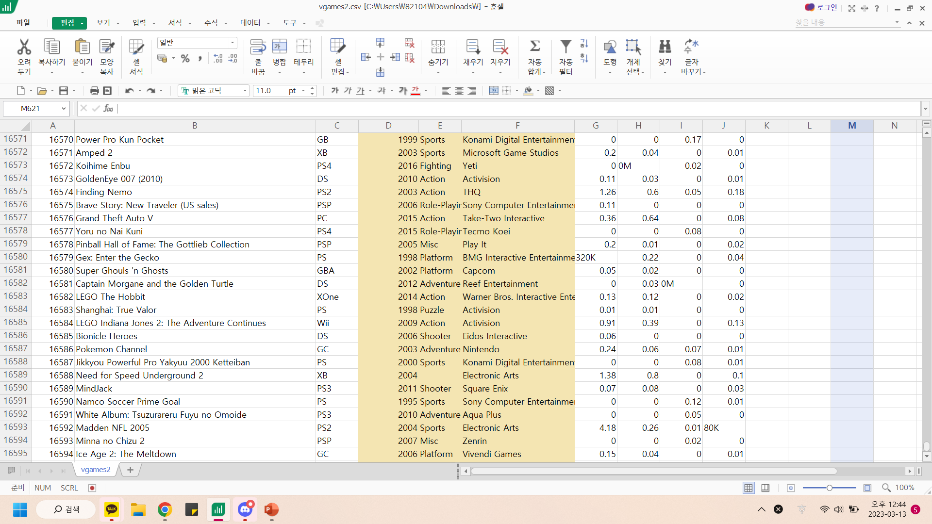
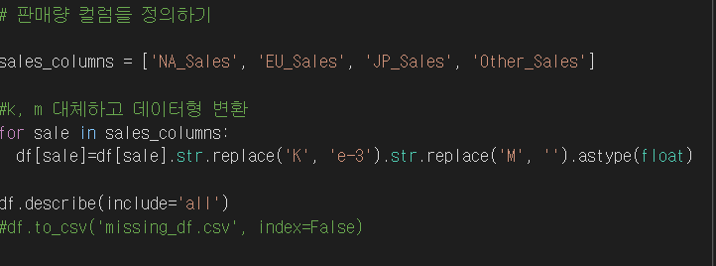
1.Unified unit of Sales
Sales 칼럼들의 단위 통합 및 데이터형 변환

Slide 6
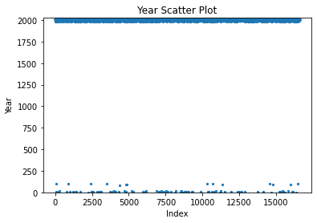

2.Correction of year notation
250년 이하의 데이터 발견

Slide 7
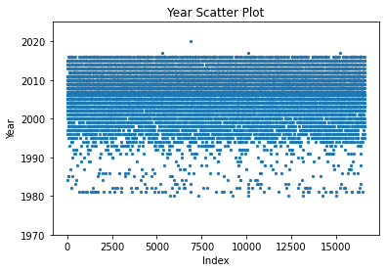

2.Correction of year notation

Slide 8
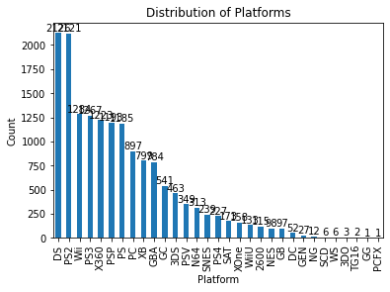
3. Clearing Platform
플랫폼 카테고리 화

Slide 9
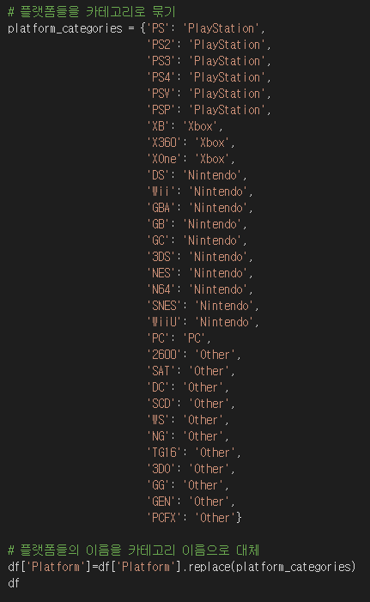
3. Clearing Platform
PlayStation
Xbox
Nintendo
PS PS2 PS3 PS4
PSV PSP
XB X360 XOne
Wii GBA GB GC WiiU
DS 3DS NES N64 SNES
Pc
Other
PC
SAT DC SCD WS NG TG16 3D0 GG GEN PCFX

Slide 10
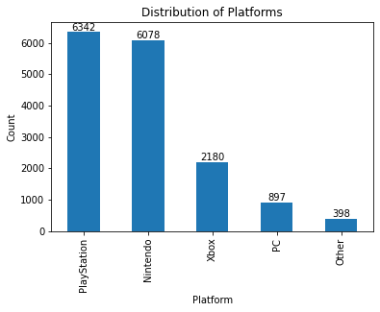
3. Distribution Platforms
플랫폼
Playstation & Nintendo 압도적

Slide 11
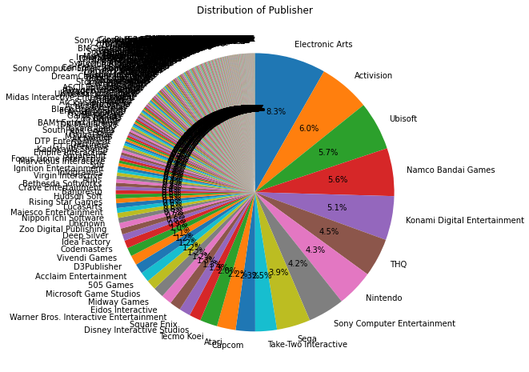
4. Clearing Publisher
상위 출판사만 사용
하위 출판사는 판매량이 영향을 끼치지 못한다 판단

Slide 12
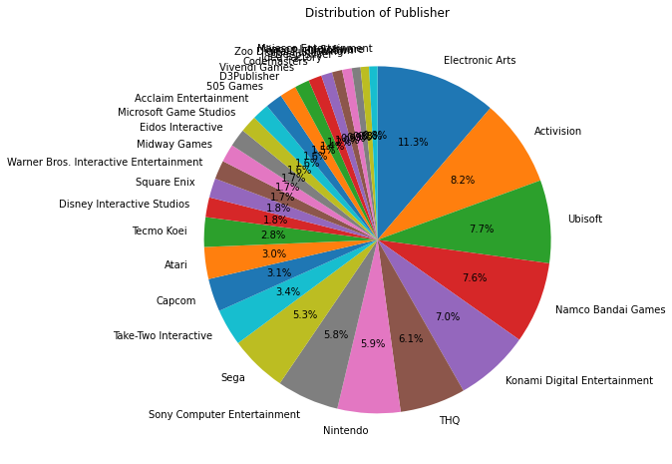
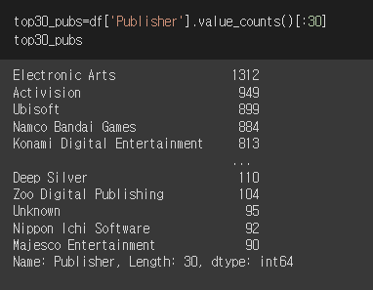
4. Clearing Publisher
출판사 종류가 너무 다양
상위 출판사만 사용
하위 출한사는 판매량이 영향을 끼치지 못한다 판단

Slide 13

5. Combining duplicate names

Slide 14
VISUALIZATION
02.

Slide 15
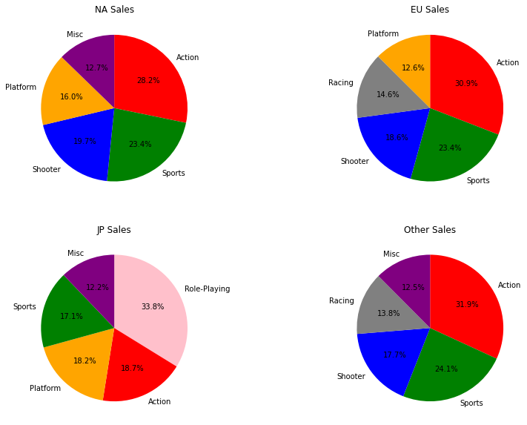
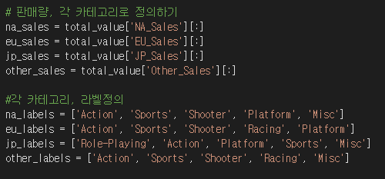
4. GENRE

Slide 16
4. GENRE

Slide 17
A TABLE
 | Genre | NA sales | Genre | EU sales | Genre | JP sales | Genre | Other sales
0 | ACTION | 743.39 | ACTION | 456.97 | ROLE PLAYING | 233.51 | ACTION | 165.20
1 | SPORTS | 615.82 | SPORTS | 346.46 | ACTION | 129.33 | SPORTS | 124.99
2 | SHOOTHER | 518.62 | SHOOTHER | 274.94 | PLATFORM | 125.89 | SHOOTHER | 91.98
3 | PLATFORM | 420.84 | RACING | 215.64 | SPORTS | 118.33 | RACING | 71.73
4 | MISC | 335.73 | PLATFORM | 185.75 | MISC | 83.98 | MISC | 64.56

Slide 18
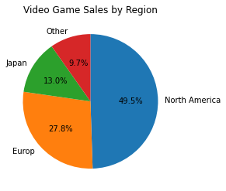
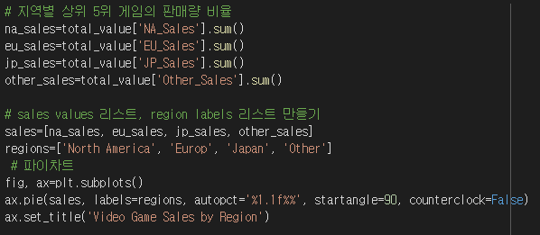
미국 판매량 우세

Slide 19
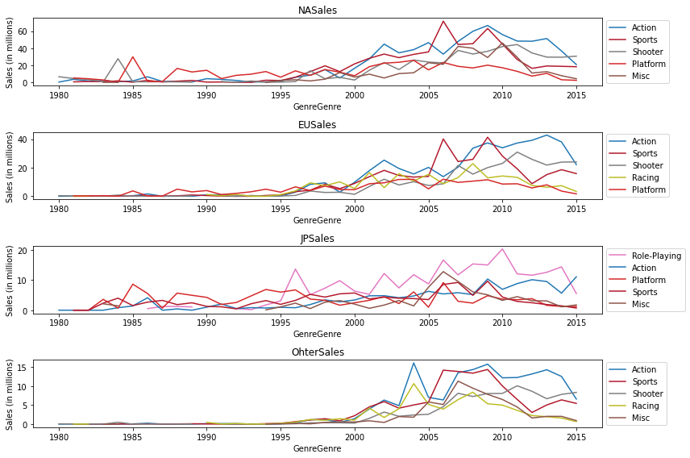
THIS IS A TREND GRAPH

Slide 20
THIS IS A TREND GRAPH

Slide 21
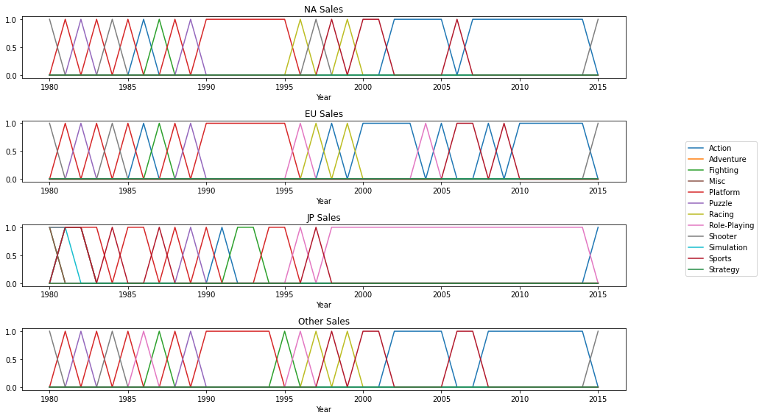
THIS IS A TREND GRAPH

Slide 22
THIS IS A TREND GRAPH

Slide 23
04.
CONCLUSION
You can enter a subtitle here if you need it

Slide 24
PLATFORM

Slide 25
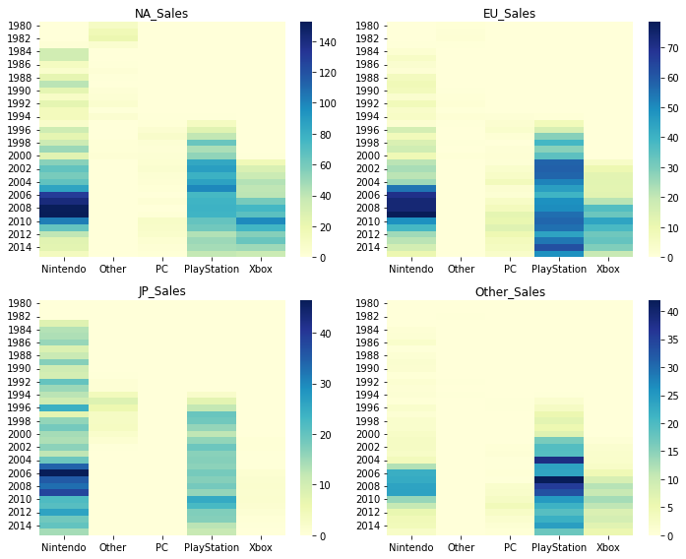
Platform

Slide 26
Platform

Slide 27




PLATFORM
PlayStation
Nintendo

Slide 28

REGION
North
America

Slide 29
ACTION GAME

Slide 30









SPORTS GAME

Slide 31
THANKS!

