Slide 1
Critical Thinking
In the Real World
Seminar 4
Sovan Patra

Slide 2
What You Should Already Know:
Argument
(Deductive/ Inductive)
Good/Acceptable (Sound/Cogent)
Bad/unacceptable (Unsound/Uncogent)
Acceptable (True)
Premise
Unacceptable (False)
Acceptable (Valid/Relatively Strong)
Inference
Unacceptable (Invalid/Relatively weak)
Conclusion
Established, for a good argument
Not established, for a bad argument
2

Slide 3
Your intellectual/ reasonableness obligations: (So far)
Take a (non-expert) opinion seriously if and only if there is a sound/cogent argument for it.
If it is your argument, be as clear as possible in expressing it.
If it is someone else’s argument, be as charitable as possible in interpreting it.
If there is a cogent argument for an opinion, retain some scepticism about the opinion.
If you think there is a sound argument for a normative opinion, check again!
Do not dismiss an opinion as false, just because the argument for it is bad.
Remember: an inference is either valid/invalid [relatively stronger/weaker]; it does not depend on your opinion.
Remember: a statement is either true or false; it can’t be both and does not depend on your opinion.
3

Slide 4
Attacking An Argument
When you don’t want to accept the conclusion of an ‘argument’, you must identify where the ‘argument’ goes awry (i.e. you must ‘attack’ the argument).
You can attack an argument by identifying a statement that challenges either the acceptability of its premises or the acceptability of its inference. Sometimes, you could also challenge the truth of the conclusion.
In an arrow diagram, an attack is represented via a dashed arrow drawn from the attacking statement to the component of the argument that is being attacked.
4

Slide 5
Attacking An Argument: Testing intuitions
Consider the following argument:
(1) Albert drives a taxi.
(2) Many taxi drivers are rich.
+
(3) Albert is rich.
Suppose you do not want to accept the conclusion. Then, you would have to attack either ___, or ____, or the __________, or, ____.
5

Slide 6
Attacking An Argument: Testing intuitions
Consider the statement: (4)Albert is blind
(1) Albert drives a taxi.
(2) Many taxi drivers are rich.
+
(3) Albert is rich.
What would 4 attack?, and why?
6

Slide 7
Attacking An Argument: Testing intuitions
Consider the statement: (5)Albert receives low-income welfare support from the government.
(1) Albert drives a taxi.
(2) Many taxi drivers are rich.
+
(3) Albert is rich.
What would 5 attack?, and why?
7

Slide 8
Attacking An Argument: Testing intuitions
Consider the statement: (6)For every rich taxi driver, there are many more poor ones.
(1) Albert drives a taxi.
(2) Many taxi drivers are rich.
+
(3) Albert is rich.
What would 6 attack?, and why?
8

Slide 9
Determining What Is Under Attack
Given our discussion so far, we can identify what is under attack by using the following definitions: Let’s use P,C, I and AS for premise, conclusion, inference and attacking statement, respectively.
a) A premise is attacked if, and only if, Prob(P | AS) < Prob(P). In other words, with the attacking statement, the premise is less likely to be true, than without.
b) A conclusion is attacked if, and only if, Prob(C| AS) < Prob(C). In other words, with the attacking statement, the conclusion is less likely to be true, than without.
c) An inference is attacked if and only if Prob( C| P + AS) < Prob(C| P). In other words, adding the attacking statement to the existing premises reduces the strength of inference.
9

Slide 10
Determining What Is Under Attack:
More Examples
Example 1
Original Argument: (1)Emma worked very hard last year. So, (2)she was promoted.
Attacking Statement: (3)Emma was on unpaid leave for 10 months last year.
Example 2
Original Argument:(1) Mona is Chinese since (2) Mona is Singaporean and (3) most Singaporeans are Chinese.
Attacking Statement: (4)Mona’s Malay is better than her Chinese.
(2) Mona’s S’porean +
(3) Most S’poreans are Chinese
(1) Mona’s Chinese
10

Slide 11
Determining What Is Under Attack:
More Examples
Example 3
Original Argument: (1)Mona is late and she hasn’t called. (2)She always calls when she is late. (3)Something bad must have happened to her.
Attacking Statement: (4)Mona’s handphone was very low on battery when she left the house.
Example 4
Original Argument: (1)Sovan loves Emma. (2)Emma loves Sovan. (3)They should get married.
Attacking Statement: (4) Sovan only lusts after Emma.
11

Slide 12
Extended Ex: Grayling’s Original Argument
1. Currently legal and currently illegal drugs (nicotine and ganja) are used for the same purposes and pose similar health risks
5. We should not(in a liberal society) police private behaviour unless it damages the social fabric or causes harm to unwilling third parties
6. Use of currently legal drugs does not damage the social fabric or cause harm to unwilling third parties
+
2. There is no important difference between currently legal and currently illegal drugs
3. If there’s no important difference, they should be treated identically in law
+
4. Either we should legalise currently illegal drugs or make currently legal drugs illegal
+
7. We shouldn’t (in a liberal society) make currently legal drugs illegal.
8. We should legalise currently illegal drugs.
12

Slide 13
Determining What Is Under Attack:
More Examples
Example 6: Grayling
What do the following attack?
However, Grayling, (9) parking on a double yellow line does not damage the social fabric or harm unwilling third parties and, yet, it is rightly criminalised. Further, (10) second-hand smoke is a significant health hazard. In addition, (11) research shows that unlike nicotine, ecstasy damages nerve cells. Moreover, (12) if we legalise ecstasy, we will set off a conservative backlash and lose the election. So, (13) we should not legalise ecstasy. And (14) why must all societies be liberal? And, (15) even liberal societies are now criminalising the not wearing of masks!
13

Slide 14
An Attack Is An Argument!
Consider the following diagram:
(4) Albert is blind.
(1) Albert drives a taxi.
(2) Many taxi drivers are rich.
+
(3) Albert is rich.
Note that the attack from (4) on (1) is an argument in its own right!
(4) Albert is blind.
(7) Albert does not drive a taxi
14

Slide 15
An Attack Is An Argument!
Now consider:
(1) Albert drives a taxi.
(2) Many taxi drivers are rich.
+
(3) Albert is rich.
(5) Albert receives welfare support from the government.
(5) Albert receives welfare support from the government.
Note that the attack from (5) on (3) is an argument in its own right!
(8) Albert is not rich.
15

Slide 16
An Attack Is An Argument!
And finally:
(1) Albert drives a taxi.
(2) Many taxi drivers are rich.
+
(6) For every rich taxi driver, there are 3 poor ones.
(3) Albert is rich.
(6) For every rich taxi driver, there are 3 poor ones.
Note that the attack from (6) on the inference is an argument in its own right!
(9) The inference from 1 and 2 to 3 is unacceptable.
16

Slide 17
An Attack Is An Argument: Summary
So:
An attack on a premise is an argument that infers from the attacking statement(s) that the attacked premise is false/likely to be false.
An attack on a conclusion is an argument that infers from the attacking statement(s) that the attacked conclusion is false/likely to be false.
An attack on an inference is an argument that infers from the attacking statement(s) that the attacked inference is weak/invalid.
And, so: since all attacks are arguments, they can be deductive or inductive.
17

Slide 18
An Attack Is An Argument: Summary
If the attacking argument is deductive,
It can be either sound or unsound.
If an attacking argument is sound, we should then say that the statement (premise (or, conclusion)) under attack must be false (Prob(P (or, C) | AS) = 0), or the inference under attack must be unacceptable.
18

Slide 19
An Attack Is An Argument: Summary
If the attacking argument is inductive,
It can be either cogent or uncogent.
If an attacking argument is cogent, we should then say that the statement (premise (or, conclusion)) under attack is highly likely to be false (Prob(P (or, C) | AS) = a relatively low number), or the inference under attack is highly likely to be unacceptable.
19

Slide 20
Attacks and The Principle of Charity
Since the attack is an argument, we extend charity to it in the same way as we would to ‘standard’ arguments. So, a lack of clarity in an attack is clarified in the most favourable way for the attacking argument.
There are several ways in which the attack can be unclear; let’s consider some.
It might be unclear whether the attack is on a conclusion or an inference. In such cases charity requires us to consider it as an attack on inference. To see why consider the argument, “(1) Emma and Mona come from the same JC; (2) Emma is going to university so, (3) Mona will go to university, too.” and, the attacking statement, “(3) But, Mona didn’t even finish JC.” Now consider what an attack generally wants to establish.
So, what does charity mandate?
20

Slide 21
Attacks and The Principle of Charity
So, when it is unclear whether the attack is on a conclusion or an inference, it is charitable to consider it as an attack on the _________________.
21

Slide 22
Attacks and The Principle of Charity
2. The ‘should’ case:
Consider the argument: “(1) Sovan should marry Emma because (2) he loves her and (3) she loves him.” and, the attacking statement, “(4) But, one should not marry for love”
Now if you consider (4) to be on attack on inference, is it acceptable?
If you consider (4) to be an attack on any of the explicit premises, is it acceptable
But, if you consider (4) to be an attack on (5), is it acceptable?
Moral: If an argument has a normative conclusion, then an (implicit) premise can always make the inference valid. The attacking statement, which appears to attack the inference, is really an attack on a (hidden) premise.
22

Slide 23
Sovan and Emma
So, charity to the original argument implies this:
(2) Sovan loves Emma.
+
(3) Emma loves Sovan.
(5) You should marry someone who you love and who loves you.
+
(1) Sovan should marry Emma.
23

Slide 24
Attacks and The Principle of Charity
3. It might be unclear whether a statement attacks the premise or, the inference or, the conclusion of an argument, because any way of interpreting the attacking argument is poor. Consider the argument: “(1) He will be late because (2) he left late and (3) if he left late, he will be late.” and, the attacking statement, “But, (4) you are always late, yourself!”
What does (4) attack?
Moral: If the attack is patently unacceptable, it is charitable to not consider it as an attack, but a separate, unrelated observation.
24

Slide 25
Completing the definition of Cogency
Recall that, in Lecture/Seminar 3, we said an argument is cogent only if it contains true premises and a relatively strong inference.
Now, we are ready to consider the missing ‘if’ in the definition. What needs to be added on to the necessary conditions above, to make the set of conditions sufficient and necessary for cogency?
To that end, let’s consider the following example.
25

Slide 26
Completing the definition of Cogency
Salesman: This brand of air-conditioner is cheaper than the others, cools better, uses less energy, is certified by the PSB and is 100% environment-friendly. So, this air-con is a good buy.
As it stands, assuming what the salesman says is true, is the argument for buying the air-con acceptable?
Can you think of any statement that attacks the inference?
So, if this statement ____________, is true and yet not mentioned in the argument, is the argument for buying the air-con good?
So, it follows that there must be an additional requirement for a cogent argument; this additional condition is reliability.
26

Slide 27
What is reliability?
For an argument to be reliable the premises must NOT leave out any available information that reduces the likelihood of the conclusion.
Information is available if the arguer, or the audience the argument is directed at, has access to it.
27

Slide 28
Reliability & Cogency
A cogent argument must be reliable.
So, an is argument cogent if and only if it has true premises and a relatively strong inference and is reliable.
28

Slide 29
Attacking Arguments in Real Life:
“Dress Codes for University”
Original Argument: The Straits Times, Forum Letter, “Implement dress code for university students”.
I have noticed tertiary students here - male and female alike - attending lectures and tutorial classes wearing slippers, shorts and T-shirts.
This does not seem like an appropriate way to dress.
Institutes of tertiary education are places to acquire knowledge.
Students should respect the sanctity of these places and not treat them like food courts or hawker centres, where there are no restrictions on how one dresses.
I am sure their lecturers and tutors have to adhere to a dress code and dress appropriately when carrying out their professional duties.
We do not see our MPs and ministers wearing slippers, shorts and T-shirts in Parliament.
Even some restaurants have a dress code which guests must follow.
It is about time that the authorities, especially in our universities, introduced some form of dress code for all tertiary students to follow.
If there already is a dress code, then stern action should be taken to enforce it, as it is not being adhered to.
I am not suggesting that tertiary students wear a uniform.
Shoes instead of slippers, trousers instead of shorts, and shirts with sleeves would be ideal.
By implementing a dress code, we would be demonstrating to the world that we are a disciplined society.
29

Slide 30
Determining What is Under Attack:
Exercise – “Dress Codes for University”
Rewritten (numbered) article:
(1) Institutes of tertiary education are places to acquire knowledge. So, (2) these places are sanctified places. (3) Students should respect this sanctity. (4) Not dressing appropriately disrespects this sanctity. So, (5) students should dress appropriately for lectures and classes. (6) But they don’t dress appropriately since (7) I see them wearing slippers, shorts and t-shirts to class. (8) They won’t dress appropriately unless there is an enforced dress code. So, (9) there should be an enforced dress code for university students.
In addition, (10) the enforcement of a dress code shows to the world that we are a disciplined society and (11) there are advantages in demonstrating to the world that we are a disciplined society.
Further, (12) lecturers in universities have to follow some form of dress code. (13) So do MPs and ministers in Parliament since (14) we do not see them dress sloppily. (15) If lecturers and MPs and ministers have to adhere to a dress code, students should have to, as well. (16) Even some restaurants enforce a dress code on their guests. (17) If restaurants do this, university authorities must enforce a dress code on students, too.
30

Slide 31
Determining What is Under Attack:
Exercise – “Dress Codes for University”
The arrow diagram:
(1)
(7)
(2) + (3) + (4)
(14)
(5) + (6) +(8)
(10) + (11)
(12) + (13) + (15)
(16) + (17)
(9)
31

Slide 32
Determining What is Under Attack:
Exercise – “Dress Codes for University”
Attacking Statements:
Now, consider the attacking statements on this link:
https://mothership.sg/2017/12/singapore-university-dress-code/
What do these statements attack?
32

Slide 33
Deep Diagramming
Deep diagramming refers to drawing an arrow diagram, which shows, both, reasons for and against a conclusion.
The supporting reasons for any conclusion are shown, as usual, as solid arrows.
Attacking reasons (or, ‘attacks’) are indicated by dashed arrows.
Don’t forget that one could very well have reasons supporting the attacking statement.
33

Slide 34
A possible deep diagram
Here is how a deep diagram might look like.
How many arguments are there in this deep diagram?
(7)
(6)
(12)
(13)
(4)
(5)
(11)
(2) + (3)
(9) + (10)
(1)
(8)
34

Slide 35
Deep Diagramming
Deep diagramming refers to drawing an arrow diagram, which shows, both, reasons for and against a conclusion.
Let us consider how this is done with the following example:
Sovan:
If I buy a car, I’ll be able to drive to Malaysia and travel around. (2) I have always wanted to visit the Malaysian National Park and to view one of the last remaining pristine jungle environments in Asia. So perhaps (3) it is a good decision to buy a car.
Emma:
But Sovan, (4) if you buy a car, you won’t be able to do any travelling because (5) you’ll need a second job to make the repayments since (6) buying a car is so expensive in Singapore. Besides, (7) you could always hire a car to drive around Malaysia, and anyway,(8) it it is not even a decision for you to make because (9) you are a foreigner and (10) foreigners are not allowed to buy cars in Singapore.
35

Slide 36
Deep Diagramming
Sovan:
(1) If I buy a car, I’ll be able to drive to Malaysia and travel around. (2) I have always wanted to visit the Malaysian National Park and to view one of the last remaining pristine jungle environments in Asia. So perhaps (3) it is a good decision to buy a car.
(1) If I buy a car, I’ll be able to drive to Malaysia and travel around.
(2) I have always wanted to visit the Malaysian National Park and to view one of the last remaining pristine jungle environments in Asia.
(3) It is a good decision to buy a car.
36

Slide 37
Deep Diagramming: Exercise
(1) Zero-emission vehicles won’t sell because (2) only electric cars qualify as zero-emission vehicles and (3) electric cars won't sell. One reason is that (4) they are very expensive. Another is that (5) charging them takes long and (6) recharging facilities are not widely available. However, (7) new generation batteries don’t have to be charged as often. Moreover, (8) people are concerned with the state of the environment and so, (9) people are more eager to switch to vehicles that do not emit greenhouse gases.
How does the deep diagram look like?
37

Slide 38
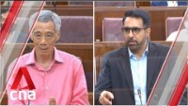
Summative Exercise: Free riders?
What are Pritam Singh and the opposition attacking in LHL’s argument about the opposition campaign strategy? How does the deep diagram look like?
12, 18
38

Slide 39
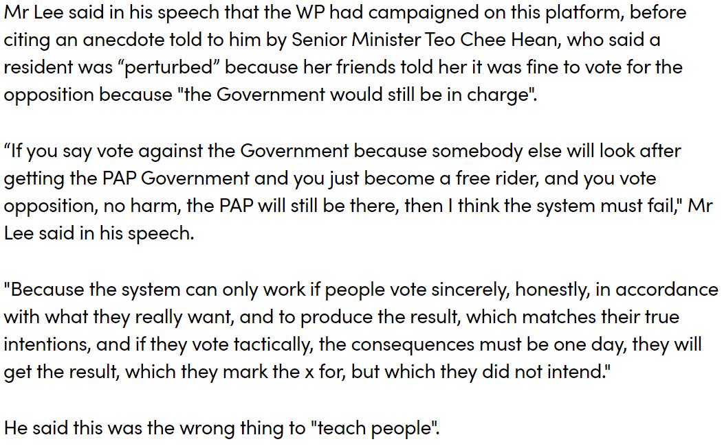

Slide 40
LHL:
When people vote for the opposition while wanting the PAP to govern, they are free riding on others who vote for the PAP.
If enough people free ride, then society might end up voting in a government it didn’t want.
If society votes in a government it doesn’t want, then the electoral system fails.
+
+
↓
It is wrong to encourage people to do something that will cause the electoral system to fail.
+
If enough people free ride, then the electoral system will fail.
↓
It is wrong to encourage people to free ride.
+
WP encouraged people to free ride.
↓
WP was wrong to encourage people to free ride.

Slide 41
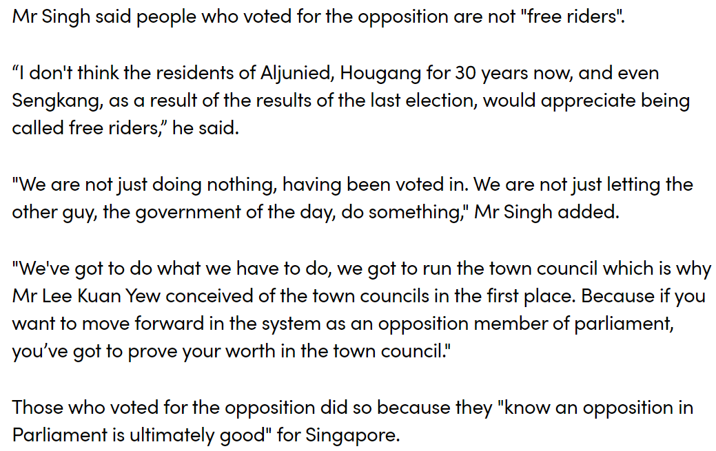

Slide 42
PS:
The opposition is effective in managing its town councils.
Opposition voters realise that an opposition is good for Singapore.
Opposition voters realise that the opposition does its work effectively.
Opposition voters have at least one positive reason for voting for the opposition.
+
If opposition voters have positive reasons for voting for the opposition, they are not free riders.
↓
Opposition voters are not free riders.

Slide 43
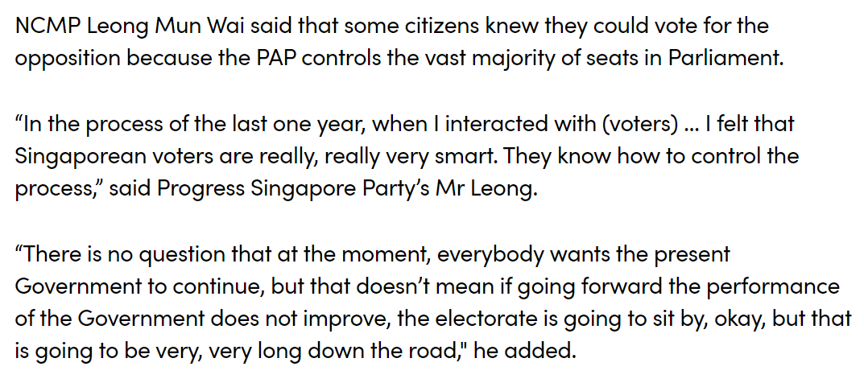

Slide 44
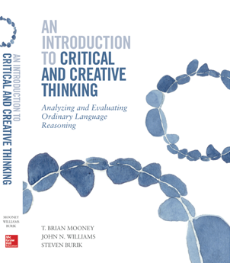
Course text
Read this week
4 (Diagramming)
1.8, 1.9, 1.10 (Soundness & Cogency)
Website Exercises 4.0, 4.2.
44

