Slide 1
Critical Thinking
In the Real World
Seminar 1
Sovan Patra

Slide 2
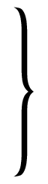
Course Organisation
Week 1
Week 2
Week 3
Week 4
Week 5
Week 6
Week 7
Week 8 Recess
Week 9 Seminar, Online Mid-term Exam
Week 10 Consultations
Week 11 Presentations
Week 12 Presentations
Week 13 Wrap up Seminar
Week 14 Study Week
Week 14/15 Submission of Written Assignment
Main body of seminars
Online Mid-term Exam
2

Slide 3
Assessment
Online Mid-Term Exams 30% - Week 6 and 9
Group Presentation 25% - Weeks 11 and 12
Written Assignment 20% - Week 15 (Monday, 5PM)
Class Participation 15%
e Learn Exercises 10% - Weeks 1-5
3

Slide 4
Critical Thinking in the Real World? WTF??
What is Critical Thinking?
4

Slide 5
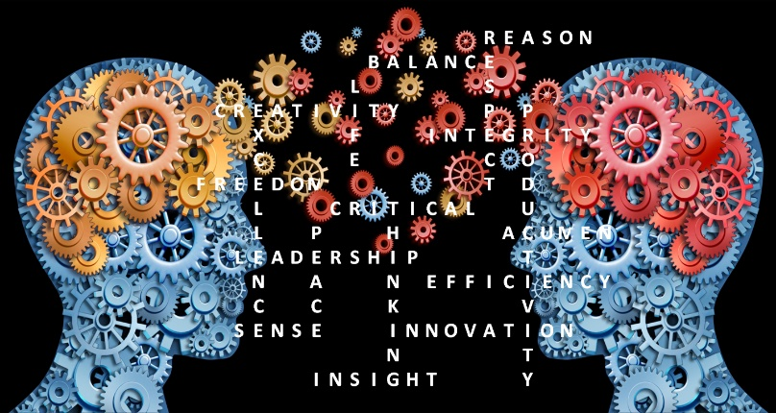
Maybe this, then?
“Critical thinking is the intellectually disciplined process of actively and skillfully conceptualizing, applying, analyzing, synthesizing, and/or evaluating information gathered from, or generated by, observation, experience, reflection, reasoning, or communication, as a guide to belief and action. In its exemplary form, it is based on universal intellectual values that transcend subject matter divisions: clarity, accuracy, precision, consistency, relevance, sound evidence, good reasons, depth, breadth, and fairness.” (Scriven and Paul, 2008)
5

Slide 6
Or, even more specifically,
When you are thinking critically (determining what you know and what else you can believe/know),
You are actively considering if you have reasons for the beliefs that you have
You are actively asking yourself whether your reasons for having a particular belief are ‘good’: so, critical thinking is domain neutral
You are aware that you are doing the above: so, critical thinking involves metacognitive awareness.
So, to be a critical thinker, you need to
Acquire a tool kit: this puts you in a position to distinguish good reasons from bad ones; and,
Develop an attitude: this makes you go to the toolkit by instinct.
6

Slide 7
What Critical Thinking is not.
Don’t confuse critical thinking with:
The mere accumulation of information: Someone who is good at memorizing things may not be any good at critical thinking!
Being argumentative for the sake of being argumentative: Wanting to win an argument at any cost is not critical thinking.
Being overly critical of others: Critical thinking can involve strengthening arguments, finding the best solution to a problem, and cooperating with others to effectively pursue a mutual goal.
7

Slide 8
Critical Thinking in the Real World? WTF??
What is Critical Thinking in the Real World?
We will focus on beliefs about the world we live in;
We will focus on using critical thinking to navigate everyday life;
We will be mindful of the fact that the real world is ‘messy’: partly because ordinary language – the language of the real world is messy;
So, we will not just focus on logic, but focus on learning judgement, as well.
8

Slide 9
Critical thinking has real world benefits, too!
CTRW has substantive benefits!
Private benefits!
Extrinsic advantages, such as?
9

Slide 10
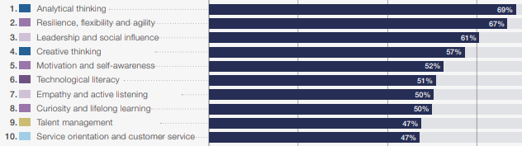
Extrinsic Advantages: Skills for Future Jobs
“Year after year, the skills employers value most in the new graduates they hire are not technical, job specific skills, but written and oral communication, problem-solving, and critical thinking.”
- Wilson Peden, Fortune Magazine, 2015
World Economic Forum Top 10 Skills for Future Jobs (2025 Report)
= critical thinking
10

Slide 11
Extrinsic Advantages: AI proofing your job?
The 2025 World Economic Forum Report considers how AI is reshaping the job market. Many domain-specific skills are expected to become obsolete, while higher-order thinking skills will be crucial to adapting to new technologies and using them effectively. That’s why “analytic thinking” tops the list of skills for future jobs.
11

Slide 12
Critical thinking has real world benefits, too!
CTRW has substantive benefits!
Private benefits!
Extrinsic advantages
Intrinsic advantages, such as?
12

Slide 13
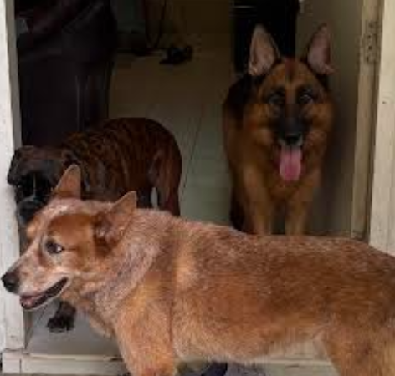
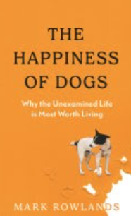
However…..
13

Slide 14
Critical thinking has real world benefits, too!
CTRW has substantive benefits!
Private benefits!
Extrinsic advantages.
Intrinsic advantages.
Social (external) benefits!
You won’t vote for Trump!
You will be reasonable!
14

Slide 15
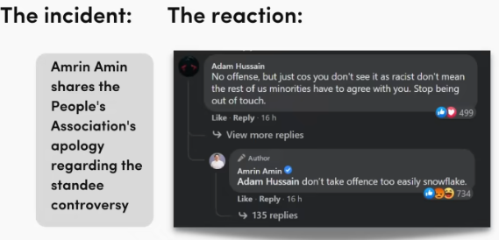
Illustrating the importance of reasonableness!
15

Slide 16
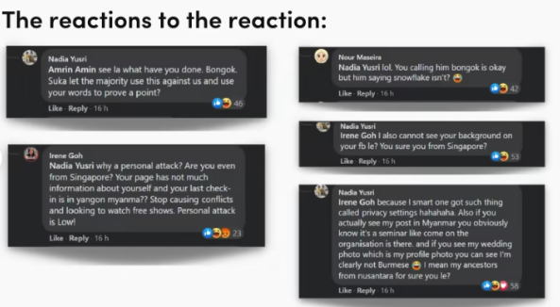
Illustrating the importance of reasonableness!
16

Slide 17
Ok, but must study CTRW, meh?
Don’t you already have the tool kit and the attitude?
Isn’t critical thinking simply using common sense/cognitive intuition?
Let’s test!
17

Slide 18
Test 1
Suppose I give you the following information about Emma:
She is a single, 30 years old woman, who is very bright and outspoken.
Emma studied philosophy at university and wrote her dissertation on why a fair organisation of society is morally desirable.
In addition, she wrote for the university newspaper on issues such as discrimination, social justice, global warming and nuclear disarmament.
Given this information, which of the following statements has a higher probability of being true?
A: Emma works at a bank.
B: Emma works at a bank and is active in the feminist movement.
18

Slide 19
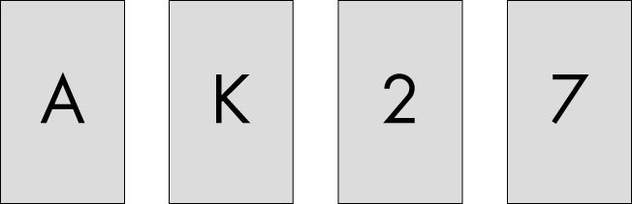
Test 2
Cards have numbers on one side and letters on the other.
Consider the conditional claim “If a card has an A on one side, it has a 2 on the other”.
Which card/s would you have to turn over to test whether this claim is false? (Only turn over the cards that could show that the claim is false.)
19

Slide 20
Test 3
Suppose there is a disease whose prevalence in Singapore is known to be 0.1%. Suppose there is a test for that disease that has no false negatives (i.e. every person who has the disease and undergoes the test is correctly detected as having the disease) and has a false positive rate of 5% (i.e. 5% of the people who in fact don’t have the disease are mistakenly diagnosed by the test as having it).
What is the chance that a Singapore resident found to have a positive test result actually has the disease, assuming you know nothing about the person’s symptoms?
20

Slide 21
Moral of the tests?
Critical thinking is not using 'common sense' although, in some cases, both roads lead to Rome.
Using common sense is rule of thumb/heuristic thinking, which was an efficient use of cognitive capacity in the environmental niche of our hunter-gatherer ancestors.
Our common sense is biased – by natural selection – towards:
Imitation
Avoiding cognitive dissonance
Deferring to successful others
Neglecting baselines
Non-abstract situations
21

Slide 22
Nuts and Bolts: Statements and Sentences
A sentence is an unit of any passage such that:
it ends with a full stop, or a question or an exclamation mark; and,
it is meaningful/grammatically correct.
A statement (or, claim, or, proposition) is a special type of sentence; it is a sentence that has the capacity to be either true or false but not both.
To decide whether a sentence, X, is a statement, we can ask whether “Is it true(or, false) that_X _?” is a sentence (i.e., is meaningful).
If yes, then the sentence is a statement; otherwise, it is not.
22

Slide 23
Nuts and Bolts: Statements or ‘non-statement’ Sentences?
Examples
All men are mortal.
Socrates is a man.
The sky is overcast.
Rich people must pay more taxes.
People who think Taylor Swift is better than Beethoven should be shot.
Please pass me the salt.
Tie your shoelaces.
How old are you?
Let’s get there on time!
People are such fools!
23

Slide 24
Nuts and Bolts: Statements and Sentences
Remember!
Critical thinking is interested only in statements, since it is interested in truth and only statements can be truth bearing.
24

Slide 25
Nuts and Bolts: Questions or Statements?
Are the following questions genuine?
“Does Emma love me?”
“How does an aeroplane fly?”
“Would you like to have a drink with me?”
Are these?
“Romeo, Romeo, wherefore art thou Romeo?”
“Should you be talking to me like that?”
“What were you thinking when you decided to hang out with Emma?”
“What do you think you are doing?”
So, rhetorical questions are really statements in disguise – and should be treated as such.
But, be mindful that questions can, and often are genuine!
25

Slide 26
Nuts and Bolts: Questions or Statements?
Sometimes, it is not clear whether a question is genuine or not.
Consider the following examples.
How good does Emma look in magenta?
Why did you cheat on me?
How old are you?
How much do you love me?
So, when it is unclear whether a question is rhetorical and, on that account, whether we can treat it as a statement, we need to rely on context – tonal, situational, etc/ charity!
Moral of the story: Critical Thinking in the real world is as much art (in the sense that it relies on interpretation and judgement) as it is science (in the sense that it is ‘rule-bound’)
26

Slide 27
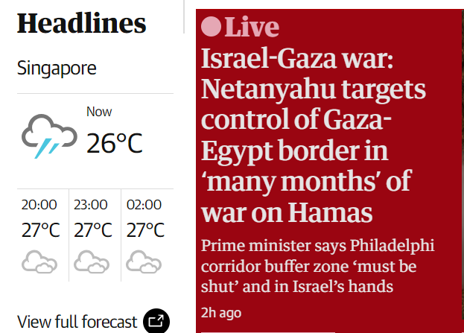
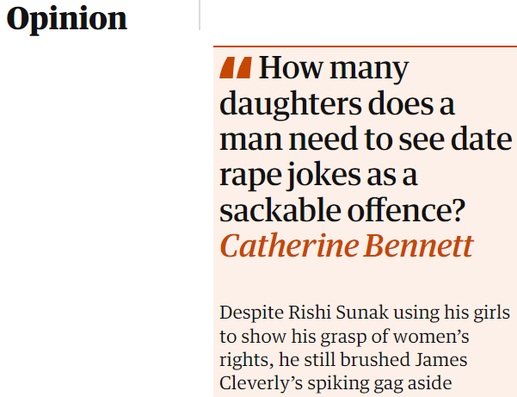
Nuts and Bolts: Facts and Opinions
27

Slide 28
Opinions: What I think the world is (ought to be) like…
When we express an opinion, how do we do it?
Thinking about this tells us these things:
The content of an opinion takes the form of a statement.
It would be meaningful to preface the statement with, “I think that….”; “In my judgement….”
An opinion is about some thing that can’t be directly known by you!
If an opinion, X, is expressed sincerely, the expressor thinks X to be true. In other words, an opinion is a subjectively true statement, which may or may not be a fact.
28

Slide 29
Facts: What the world is like…
May we should begin by building a typology of facts.
Here is a proposal:
Facts can be private (about me) or non-private (about the world).
Private facts can be about affect (example?), perception (example?) , cognitive/epistemic commitments (example?), preferences (example?)
Non – private facts can be about conceptual objects (example?) or empirical phenomena (example?)
Note: When we make a claim/assert a statement, we are either asserting a private fact or, expressing an opinion.
Note: Can we have moral/normative facts?
29

Slide 30
Private Facts and Opinions
Consider the following: what’s the private fact? And the opinion?
I believe that immigrants are eating pet cats and dogs.
I love watching Rafa play.
I am feeling cold/pain.
I love Emma.
Emma loves me.
It is morally wrong that girls don’t go to school in Afghanistan.
I think that if you are a bachelor, you are not married.
Moral: Anytime we express an opinion, we are expressing a fact about ourselves; the converse is not true!
30

Slide 31
Fact-worthy opinion?
Read: “You are not entitled to your own opinion”
And decide:
When is a claim worth considering as 'maybe fact'?
31

Slide 32
But, when is an opinion likely to be a fact (true)?
Some opinions are necessarily true (example?)
Others, we accept as true when there is consensus among reasonable, well informed people that it is true.
What is needed for a consensus? Must every reasonable, well informed person agree?
And, who is reasonable? We will return to this in the last session.
Also, how much information makes one well informed? Or, who are the well informed people?
Or, some others, we accept as true (likely true) if we accept the justification provided for the opinion.
32

Slide 33
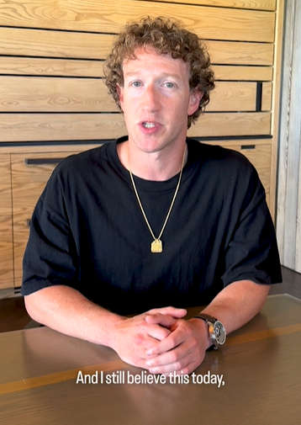
What is the problem?
https://about.fb.com/news/2025/01/meta-more-speech-fewer-mistakes/
33

Slide 34
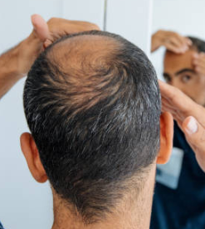
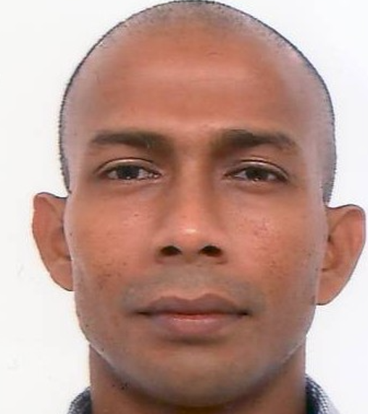
Nuts and Bolts: Ordinary language and Clarity?
Ordinary language – the language of real life – is notoriously unclear.
One source of this lack of clarity is vagueness: a word is vague (and so is the statement containing the word) if and only if the word has no precise meaning.
Examples of vague words are
Bald
Tall
Dark
Others?
These examples should tell you that
a word is vague when the property it typically
denotes, exists on a continuum, but
it is hard to say when there is enough of
the property to justify the use of the word.
34

Slide 35
The problem with vagueness:
Now, consider the following vague statements:
Stefan is bald.
Boxers are big dogs.
Shanthi Pereira is fast.
Gabby Thomas is hot.
What do you think the problem is with statements/opinions that contain a vague word/phrase?
But, note the problem with vagueness disappears when ?
35

Slide 36
Unclear also! Ambiguity
Another source of lack of clarity is ambiguity: a word/phrase/statement is ambiguous if and only if the word/phrase/statement has multiple meanings.
It is useful to distinguish ambiguity into 3 types:
Lexical (Semantic) ambiguity
Example: Lawrence Wong was stoned at a rally in Hougang.
Structural (Syntactic) ambiguity
Example: The police killed the man with an axe.
Example: I love you too, Emma!
Situational (Pragmatic) ambiguity
Example: How old are you?
Given these examples, what is the problem with ambiguous statements??
36

Slide 37
Nuts and Bolts: Vagueness and Ambiguity
Here are some final questions to muse about.
Can a word be both ambiguous and vague?
Do vagueness and ambiguity exhaust lack of clarity?
Why is ordinary language unclear?
‘NBA players are tall’; ‘Sovan drinks every evening’; ‘The dog is ready to eat’? ‘The woman left the dog in the rain to drink beer’? Cognitive efficiency?
The social value of language? “the ummmm”! Social grooming?
So, what should we do about ambiguity/vagueness?
It depends…..
37

Slide 38
The Backbone of Critical Thinking: The argument!
Recall that critical thinking is primarily concerned with investigating: what reasons do we have for claiming/accepting a statement/opinion to be a fact/true?
So, critical thinking is, first and foremost, about (appreciating the importance of and) having reasons for believing a statement or claiming to know a statement.
Having/giving reasons for a claim/statement/proposition is called arguing.
Now, check your intuitions about whether or not there’s an argument in the following.
38

Slide 39
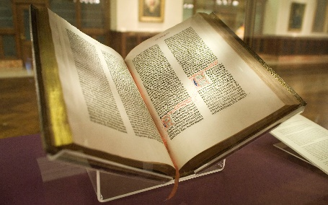
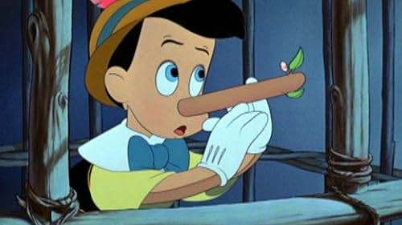
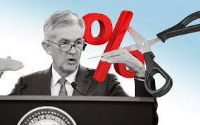
Got argue or not ?
Example 1
“Thou shall not covet thy neighbor’s husband.”
Example 2
“Lying is wrong since the Bible says it is wrong.”
Example 3
“Trump’s tariffs entail/imply that that the Fed is not going to cut interest rates soon.”
39

Slide 40


Got argue or not?
Example 4
“Emma loves me! She really really does! There is no way she doesn’t!”
Example 5
“What you are saying is downright silly and wrong. It does not matter how many times you say it.”
40

Slide 41
What is an argument ?
So, an argument is a collection of statements, such that, the truth of some statement(s) in that collection provide support (are reasons) for the truth (or, likely truth) of other statement(s) in that collection.
The statements that provide support (are reasons) are called the premises of the argument; the supported statements are called the conclusions of the arguments.
The support provided by the premises for the conclusion is called the inference.
41

Slide 42
What is an argument?
So, schematically, a basic argument would look like this:
Premise(s)
(Inference)
Conclusion(s)
42

Slide 43
Inference (Premise & Conclusion) Indicators:
The first skill in thinking critically is to identify an argument: given a passage, video, audio, conversation,
you must, first, determine whether it contains an argument; and,
if it does, you must be able to identify its premises, its conclusions, and the structure of the inference.
This is easy to do with well-articulated arguments because they use inference indicators: words/phrases that draw attention to the fact that an act of inference is ‘taking place’.
Inference indicators come in 2 types: premise indicators, and conclusion indicators.
43

Slide 44
Inference (Premise & Conclusion) Indicators:
Here is a more comprehensive (but not exhaustive) list of inference indicators:
Premise indicators
Because, As, For, Owing to the fact that, Since
Conclusion indicators
Therefore, Hence, Thus, So, It follows that, As such, In conclusion
44

Slide 45
What an argument is not……
Mere contradiction of the claim being made
No, you’re wrong! You’re confused. This is a mistake. I disagree. The reality is ….
Repetition of the conclusion.
Politicians staying “on message”, repeating the same slogan.
Abuse of the opponent.
You would have to be an idiot to believe that. You’re being foolish. You are ugly!
45

Slide 46
A Cautionary Note:
Conditional Statements and Arguments
Consider the following:
If it rained, the streets will be wet.
Only if I have my whisky every evening, I am truly happy.
Each of the above examples asserts that the truth of some statement is a condition for the truth of some other statement.
But can we meaningfully ask: is it true that ‘the truth of the first statement is a condition for the truth of the second statement’?
That is why the sentences in a) and b) above are (conditional) statements; they are not arguments.
To see the difference, consider: Since it rained, the streets will be wet.
46

Slide 47
The Conditional Statement: Some Details
We have established that a conditional statement of the form, If A then B, asserts that the truth of some statement (e.g., A = it rained) is a condition for the truth of some other statement (e.g., B = the streets will be wet).
‘A’ is called the antecedent of the conditional; ‘B’ is called the consequent of the conditional.
So, what is the difference between
If A then B; and
Only if A then B?
‘If A then B’ claims that ________________________________; ‘Only if A then B’ claims that ______________________________.
47

Slide 48
Identifying arguments (premises and conclusions): Exercises
Example 1
“For the crises in the Middle East to end either Trump or Netanyahu must go. If both go, then even better.”
Argument?
Example 2
“No one can be a fan of Doja Cat if they buy sitting tickets for her concert. You cant enjoy Doja if you are not moving your body!”
Argument?
Example 3
“I don’t know whether to date Mona or Emma. Mona is beautiful, but Emma is not, whereas Emma is rich but Mona is not. I have to date either one of them, but I would rather date someone who is both beautiful and rich.”
Argument?
48

Slide 49
Identifying arguments: Exercises
Example 4
“We hit the beach and fanned out. We had agreed on a spot we could all come back to at some point in the night in the hope of finding some of the others, but I doubt if anyone remembered where it was. There were a dozen sound systems spread along the beach. From a distance, it sounded like techno, but they were actually all playing the same kind of idiotic uplifting trance. We drifted from one sound system to the next, dancing for a bit and then moving on. The party was going off, no doubt about that, but I was never able to lose myself in the music which was really quite idiotic.”
- Geoff Dyer 2003
49

Slide 50
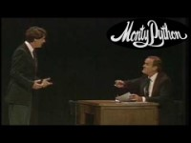
Exercise: How many arguments?
50
Notes:
https://www.youtube.com/watch?v=DkQhK8O9Jik

Slide 51
Descripto!: Learning Clarity through Action
51

Slide 52
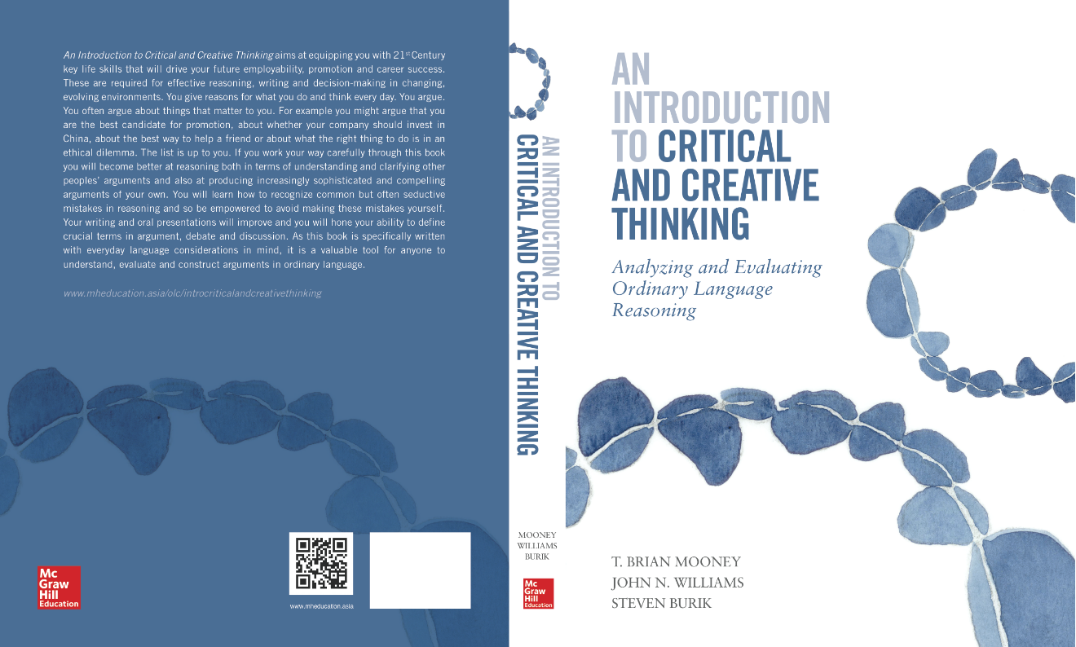
To do
Read this week:
Introduction
Chapter 1
Website Exercises 1.2, 1.3, 1.4 (ungraded)
52

