Slide 1
Critical Thinking
In the Real World
Seminar 5
Sovan Patra

Slide 2
A Preface
Recall that a valid inference is necessary for an argument to be sound.
So far, we have assessed validity in a fairly intuitive manner.
Today, we look at an alternative way of establishing validity; this is done by appealing to the form of an argument.
In technical terms, the elementary form of logic that deals with establishing validity by appealing to form is called propositional logic.
2

Slide 3
Propositional Logic: A brief introduction
The rules of propositional logic can be applied whenever all premises and conclusions in an argument can be expressed either as ‘basic’ statements or as negations, disjunctions, conjunctions or conditionals involving the basic statements.
If A stands for a basic statement, then its negation is not A
If A and B are basic statements/negations, then a basic conditional statement is if A then B. A and B are called the antecedent and consequent of the conditional, respectively.
If A and B are basic statements/negations, then a basic disjunction is either A or B. A and B are called the disjuncts of the disjunction.
If A and B are basic statements, then a basic conjunction is A and B. A and B are called the conjuncts.
3

Slide 4
Propositional Logic: Truth Conditions
We begin by asking how the truth of a ‘compound’ statement depends on the truth of the ‘basic’ statements that constitute it.
An easy way of doing it is to draw a truth table.
Lets illustrate truth tables with a negation, first:
So, a negation is true (false) if and only if what it is negating is false (true).
A | Not A
T | F
F | T
4

Slide 5
Propositional Logic: Truth Conditions
Now, the truth table for the conjunction:
A | B | A and B
T | T | T
T | F | F
F | T | F
F | F | F
So, a conjunction is true if and only if both conjuncts are true.
5

Slide 6
Propositional Logic: Truth Conditions
And, the truth table for the conditional:
A | B | If A then B
T | T | T
T | F | F
F | T | T
F | F | T
So, a conditional is false if the antecedent is true and the consequent is false ; it is true, otherwise.
6
Notes:
If you sleep with me I will marry you

Slide 7
Propositional Logic: Truth Conditions
Now, the truth table for the disjunction.
This is a difficult beast: it has 2 different interpretations; to see the interpretations, consider the following examples.
      Sovan is either dead or alive.
      Sovan is either wearing a white shirt or blue denims.
      I scored badly either because I didn’t understand the concept or the professor doesn’t like my face.
      Sovan is dating either Emma or Gabby.
      Sovan is married to either Emma or Gabby.
So, disjunctions can be of two kinds; exclusive and inclusive and their truth tables look like this:
7

Slide 8
Propositional Logic: Truth Conditions
The truth table for the exclusive/inclusive disjunction:
A | B | A or B
T | T | F/T
T | F | T
F | T | T
F | F | F
So, an exclusive/inclusive disjunction is true, if exactly/at least one of its disjuncts is true; it is false, otherwise.
What should you do when you don’t know whether the disjunction is intended as exclusive or inclusive?
8

Slide 9
Propositional Forms

Slide 10
Standard Propositional Forms (1): Modus Ponens (MP)
Modus Ponens is an argument form with the following structure:
  If P then Q
  P
  __________
  So, Q
Modus ponens is a VALID form of inference regardless of what P and Q stand for. Here is why:
If P then Q + P
Q
P | Q | If P then Q
T | T | T
T | F | F
F | T | T
F | F | T
10

Slide 11
Modus Ponens: Examples
Consider the following examples. Is the inference valid?
Is the argument sound?
    1. If he lives in Bangkok, he lives in Thailand.
    He lives in Bangkok.
    _____________________________
    So, he lives in Thailand.
    2. If I pray to God daily, I will get an A for CTRW.
    I pray to God daily.
    _____________________________
    So, I will get an A for CTRW.
11

Slide 12
Standard Propositional Forms (2):
Denying the Antecedent (DA)
Denying the Antecedent is an argument form with the following structure:
  If P then Q
  not - P
  __________
  So, not - Q
DA is an INVALID form of inference regardless of what P and Q stand for. Here is why:
If P then Q + not - P
not - Q
P not P | Q not Q |  | If P then Q
T F | T | F | T
T F | F | T | F
F T | T | F | T
F T | F | T | T
12

Slide 13
Denying the Antecedent: Examples
Consider the following examples. Is the inference valid?
Is the argument sound?
    1. If he lives in Bangkok, he lives in Thailand.
    He does not live in Bangkok.
    _____________________________
    So, he does not live in Thailand.
    2. If God exists, there would be no evil in the world.
    God doesn’t exist.
    _____________________________
    So, there would be/is evil in the world.
13

Slide 14
Standard Propositional Forms (3): Modus Tollens (MT)
Modus Tollens is an argument form with the following structure:
  If P then Q
  not - Q
  __________
  So, not - P
MT is a VALID form of inference regardless of what P and Q stands for. Here is why:
If P then Q + not - Q
not - P
P not P |  | Q not Q |  | If P then Q
T | F | T | F | T
T | F | F | T | F
F | T | T | F | T
F | T | F | T | T
14

Slide 15
Modus Tollens: Examples
Consider the following examples. Is the inference valid?
Is the argument sound?
    1. If he lives in Bangkok, he lives in Thailand.
    He does not live in Thailand.
    _____________________________
    So, he does not live in Bangkok.
    2. If God exists, there would be no evil in the world.
    There’s evil in the world.
    _____________________________
    So, God doesn’t exist.
15

Slide 16
Standard Propositional Forms (4):
Affirming the Consequent (AC)
The structure of AC is:
  If P then Q
  Q
  _____________
  So, P
Affirming the consequent is an INVALID form of inference (i.e., it is fallacious). Why?
If P then Q + Q
P
16

Slide 17
Affirming the Consequent: Examples
Consider the following examples. Is the inference valid?
Are the arguments sound?
    1. If he lives in Bangkok, he lives in Thailand.
    He lives in Thailand.
    _____________________________
    So, he lives in Bangkok.
    2. If a shape has 3 sides, it is a triangle.
    is a triangle.
    _____________________________
    So, has 3 sides.
17

Slide 18
The 4 Propositional Forms: An Overview
If p then q
p
________
∴ q
If p then q
Not p
________
∴ Not q
1.
2.
Fallacy of Denying the Antecedent (invalid)
Modus Ponens (valid)
If p then q
Not q
________
∴ Not p
If p then q
q
________
∴ p
3.
4.
Fallacy of Affirming the Consequent (invalid)
Modus Tollens (valid)
18

Slide 19
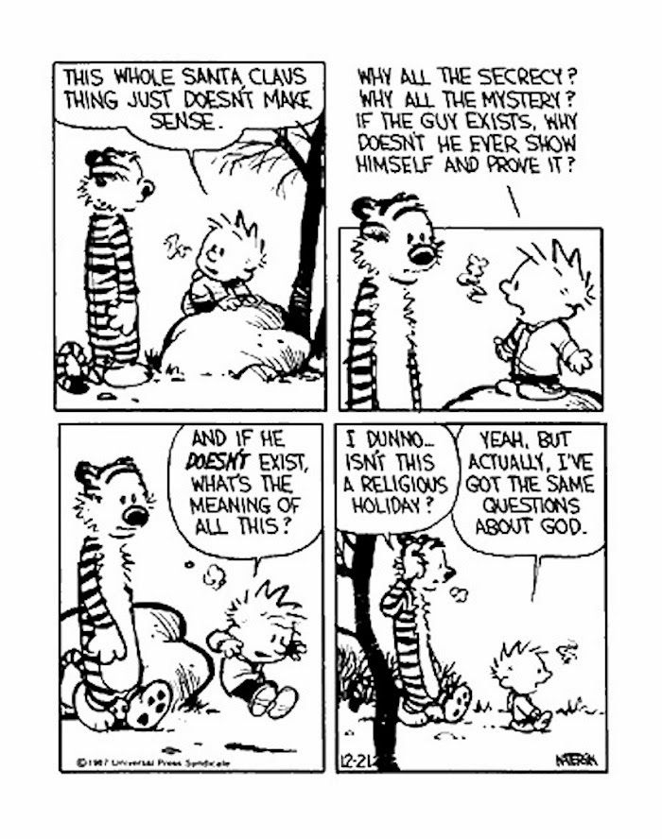
Using Propositional Forms: Activity
19

Slide 20
Calvin’s Argument
If God exists, SHE would show herself
God doesn’t show herself.
+
If God doesn’t exist, Christmas does not make sense.
↓
+
God doesn’t exist.
↓
Christmas does not make sense.
20

Slide 21
Standard Propositional Forms (5):
Hypothetical Syllogism (HS)
The hypothetical syllogism takes the structure:
  If P then Q
  If Q then R
  _____________
  So, if P then R
The hypothetical syllogism is a VALID argument form. Why?
If P then Q + If Q then R
If P then R
21

Slide 22
Hypothetical Syllogism: Examples
Consider the following examples. Is the inference valid?
Are the arguments sound?
  1. If he lives in Bangkok, he lives in Thailand.
  If he lives in Thailand, he lives in Asia.
  _____________________________
  So, if he lives in Bangkok, he lives in Asia.
  2. If God exists then, he is all knowing, all powerful and all good.
  If he is all that, then there should be no evil in the world
  _____________________________
  So, if God exists, there should be no evil in the world.
22

Slide 23
Standard Propositional Forms (6): Transposition
Transposition has this structure:
  If P then Q
  _____________
  So, if not-Q then not-P [ or, _______ if Q, then P]
Transposition is a VALID argument form.
Transposition can be restated as:
If P is sufficient for Q, then Q is ___________ for P.
23

Slide 24
Transposition: Examples
Consider the following examples. Is the inference valid?
Are the arguments sound?
  1. If he lives in Bangkok, he lives in Thailand.
  _____________________________
  So, if he does not live in Thailand, he does not live in Bangkok.
  2. If he lives in Thailand, he lives in Bangkok.
  _____________________________
  So, if he does not live in Bangkok, he does not live in Thailand.
24

Slide 25
A note on ‘if’, ‘only if’, and ‘if and only if’, and unless
You must be clear about these equivalences:
  P is sufficient for Q ↔ If P then Q ↔ If not-Q, then not-P ↔ Only if Q then P ↔ Q is necessary for P
  P is necessary for Q ↔ Only if P then Q ↔ If not-P then not-Q ↔ If not-not-Q then not-not-P ↔ If Q then P ↔ Q is sufficient for P.
  If and only if P, then Q ↔ P is sufficient and necessary for Q ↔ Q is necessary and sufficient for P ↔ If and only if Q, then P.
  Q unless P ↔ If not-P then Q [Emma will dump Sovan unless he asks her to marry him]
25

Slide 26
Standard Propositional Forms (7): Disjunctive Syllogism (DS)
The disjunctive syllogism takes the structure:
  Either P or Q
  Not-P [or, not-Q]
  _____________
  So, Q [or, So, P]
The disjunctive syllogism is a VALID form of inference. Why?
P or Q + not P
Q
P not P |  | Q | P or Q
T | F | T | F/T
T | F | F | T
F | T | T | T
F | T | F | F
26

Slide 27
Disjunctive Syllogism: Examples
Consider the following examples. Is the inference valid?
Are the arguments sound?
    1. Sovan is teaching or wearing jeans.
    Sovan is not wearing jeans.
    _____________________________
    So, Sovan is teaching.
    2. Either Sovan is playing tennis or walking his dogs.
    Sovan is not playing tennis.
    _____________________________
    So, Sovan is walking his dogs.
27

Slide 28
Standard Propositional Forms (8): Affirming the Disjunct (AD)
The AD takes the structure:
  Either P or Q
  Q [or, P]
  _____________
  So, not - P[or, So, not - Q]
The VALIDITY of AD is ambiguous. Why?
P or Q + Q
Not - P
P not P |  | Q | P or Q
T | F | T | F/T
T | F | F | T
F | T | T | T
F | T | F | F
28

Slide 29
Affirming the Disjunct: Examples
To reinforce why the validity of AD is ambiguous, consider the following examples: which of the inferences are valid?
    1. Sovan is married to either Emma or Gabby. (Singapore)
    Sovan is married to Emma.
    _____________________________
    So, Sovan is not married to Gabby.
    2. Sovan is married to either Emma or Gabby (Polygamous society) .
    Sovan is married to Emma.
    _____________________________
    So, Sovan is not married to Gabby.
29

Slide 30
Affirming the Disjunct & Charity
So, should you read the disjunction, in the AD, as ‘exclusive’ or ‘inclusive’?
Well, ask the person! (and, if you are stating the disjunction, make it clear).
If the ambiguity can’t be resolved by asking, then use ______.
How do you use charity?
  If the exclusive disjunction is clearly true (exactly one disjunct is true), then read it exclusively (why?); and treat ‘affirming the disjunct’ as valid.
  If the exclusive disjunction is not clearly true (possible that both disjuncts are true), then it is not clear which way charity blows:
    If you treat it exclusively in an ‘affirming the disjunct’ , then the premise might be false (but, the inference valid)
    If you treat it inclusively in an ‘affirming the disjunct’, then the inference is invalid (even if the premise might be true)
30

Slide 31
Standard Propositional Forms (9): Dilemma
Dilemmas come in two forms, constructive and destructive; both are valid
The constructive dilemma has this structure:
  If P then R
  If Q then S
  Either P or Q
  _____________
  So, either R or S
The destructive dilemma has this structure:
  If P then R
  If Q then S
  Either not-R or not-S
  _____________
  So, either not-P or not-Q
If P then R + If Q then S + P or Q
R or S
If P then R + If Q then S + not R or not S
Not P or Not Q
31

Slide 32
Dilemma: Examples
Consider the following examples. Is the inference valid?
Are the arguments sound?
    1. Either I will get an A for CTRW or not.
    If I get an A, studying hard is redundant.
    If I don’t, studying hard is futile.
    _____________________________
    So, studying hard is either redundant or futile.
    2. If I study medicine, I’d be a doctor.
    If I study law, I’d be a lawyer.
    I wouldn’t be a doctor or a lawyer.
    _____________________________
    So, either I wouldn’t study medicine or law.
32

Slide 33
Grayling and Propositional forms
Currently legal and currently illegal drugs (nicotine and ganja) are used for the same purposes and pose similar health risks
We should not(in a liberal society) police private behaviour unless it damages the social fabric or causes harm to unwilling third parties
Use of currently legal drugs does not damage the social fabric or cause harm to unwilling third parties
+
There is no important difference between currently legal and currently illegal drugs
If there’s no important difference, they should be treated identically in law
+
Either we should legalise currently illegal drugs or make currently legal drugs illegal
+
We shouldn’t (in a liberal society) make currently legal drugs illegal.
We should legalise currently illegal drugs
33

Slide 34
Using Propositional Forms: Exercise
Dolphins have been known to mourn for their dead (D). If so, then they have a concept of their own species (C) and understand what death means (U). But they cannot understand what death means unless they have a capacity for abstraction (A), and they can have a capacity for abstraction only if they can think (T). So dolphins have moral rights (M) because being able to think is sufficient for having moral rights.
If the unsupported premises are all true, has the conclusion been established/guaranteed? Can you validly get to the conclusion from the premises?
34

Slide 35
Using Propositional Forms: Exercise
D. If D, then C and U. If not A then not U. If not T then not A. So, M because if T then M.
If the unsupported premises are all true, has the conclusion been established/guaranteed?
35

Slide 36
Dolphins have moral rights!
D + If D then (C and U)
C and U
U [= not (not U)] + If not A then not U
Not (not A) [=A] + If not T then not A
Not (not T) [=T] + If T then M
M
36

Slide 37
If p then q + p
q
If not q then not p + not not p
not not q

Slide 38
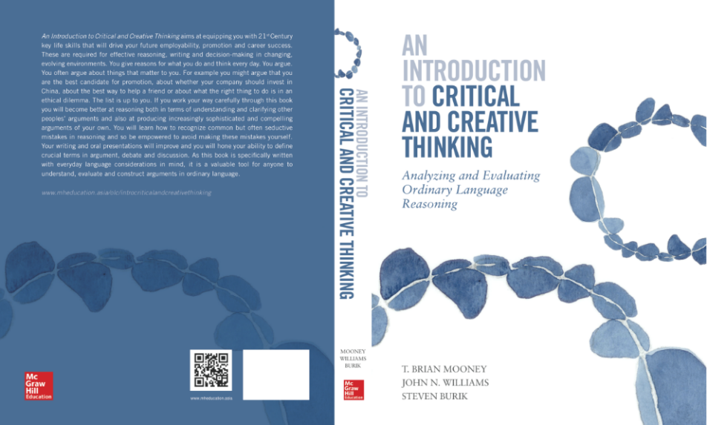
Course Text
Read this week:
Chapter 5.1, 5.4-5.8
Exercise 5.1, 5.2
38

Slide 39
Midterm preparation
Section 1: True or False
Q1. 1 + 2
3 4
5 < - - - 6
You know that (1) and (2) are true, that (3) is false, and that all the inferences (including the attacking inference) are valid. It therefore follows that (5) is true and that (6) is false.
a. True
b. False
39

Slide 40
Midterm preparation
Q2. Consider the following statements:
X: Provided all the premises of a strong inductive argument are true, we can say that the conclusion of this argument will likely be true.
Y: Provided all the premises of a valid deductive argument are true, we can say that the conclusion of this argument will be true.
Both statements X and Y are true.
a. True
b. False
40

Slide 41
Midterm preparation
Q3. Consider the following passage:
If we want to increase market share, then either we must reduce prices or increase our advertising budget. We should reduce prices only if our competitors will not match our price cuts. But we know from experience that they will. And surely, we want to increase market share. So, we must increase our advertising budget.
All inferences in this passage are valid.
True
False
41

Slide 42
Midterm preparation
Q3. Consider the following passage:
If M, then either R or A. R only if not C [ = ‘If R then not C’] . But in the past they have C. So, they will C . And surely, M. So, A.
All inferences in this passage are valid.
True
False
M: We want to increase our market share.
R: We must reduce prices
A: We will increase ad budget
C: Competitors will not match our price cuts
42

Slide 43
Midterm preparation
M + If M then (R or A)
In the past, C
C [= not (not C)] + If R then not C
Not R + R or A
A
43

Slide 44
Midterm preparation
Section 2: Definitions
Q1. A rumour is a false statement or account of events, circulating among people in a community.
Which of the following statements is true?
  This definition is unfairly emotive.
  This definition is too narrow.
  This definition is circular.
  This is an ostensive definition.
  None of the above.
44

Slide 45
Midterm preparation
Q2. Which of the following is the best definition of ‘dictatorship’?
  A form of government that is typified by the rule of one person.
  A political system in which citizens have no rights.
  A political system in which citizens have no real power to challenge their government.
  A state governed under a dictatorial system.
  A state like that of the Russia of Putin or the Turkey of Erdogan.
45

Slide 46
Midterm preparation
Section 3: Diagramming
Q1. Using only the given numbers, diagram the following passage using only solid arrows and then answer the questions that follow.
Since (1) lockdowns lead to a cessation of all social interaction and bring an end to all, but essential, in-person economic interaction, (2) lockdowns lead to immense economic and mental distress. (3) Anything that causes large scale economic and mental distress is, to some extent, socially undesirable. So (4) lockdowns are, to some extent, socially undesirable. But, for the same reasons that lockdowns cause hardship , (5) lockdowns are the only way of getting people to stay at home and (6) getting people to stay at home is the only way to stop the transmission of COVID-19, because (7) we don’t have a vaccine for it. It follows that (8) lockdowns are the only way of stopping the spread of COVID-19. And (9) stopping the spread of COVID-19 is socially desirable, so (10) in at least one respect, lockdowns are socially desirable. So, (11) lockdowns can for different reasons be socially desirable and undesirable. Of course, all said and done, (12) I still don’t like lockdowns.
46

Slide 47
Midterm preparation
7. We don’t have a vaccine for COVID-19
1. Lockdowns lead to a cessation of all social interaction and bring an end to all, but essential, in-person economic interaction
6. Getting people to stay at home is the only way to stop the transmission of COVID-19
5. Lockdowns are the only way of getting people to stay at home
3. Anything that causes large scale economic and mental distress is, to some extent, socially undesirable
2. Lockdowns lead to immense economic and mental distress
+
+
8. Lockdowns are the only way of stopping the spread of COVID-19
9. Stopping the spread of COVID-19 is socially desirable
+
10. In at least one respect, lockdowns are socially desirable
+
4. Lockdowns are, to some extent, socially undesirable
(11)Lockdowns can for different reasons be socially desirable and undesirable
47

Slide 48
Midterm preparation
Q2. How many instances of linked reasoning does this passage contain?
    0
    1
    2
    3
    4
48

Slide 49
Midterm preparation
Q3. How many intermediate conclusions are there in the correct diagram?
    None of the following
    1
    2
    3
    4
49

Slide 50
Midterm preparation
Q4. Fill in the blank.
The passage contains only one instance of ______, and only one instance of ______ reasoning.
    serial, convergent
    divergent, convergent
    serial, divergent
    serial, linked
    None of the above
50

Slide 51
Midterm preparation
Q5. How many instances of valid inferences does this passage contain?
    0
    1
    2
    3
    4
51

Slide 52
Midterm preparation
Q6. Fill in the blank.
The statement, “People can be given economic incentives to stay home” attacks a/an _______in the passage.
    unsupported premise
    intermediate conclusion
    final conclusion
    All of the above, a, b, and c
    None of the above, a, b, and c
52

