Slide 1
Critical Thinking
In the Real World
Seminar 7
Sovan Patra

Slide 2
Evaluating Abduction: The question of bestness
So, how does one attack the following argument?
Like with other arguments, you could
  a) Deny 1. Would that work?
  b) Deny 3. Would that work?
  c) Deny 2. Would that work?
  d) Assert that ‘the best explanation isn’t the correct explanation.’ If you say this, what are you attacking? Would that work?
1. It is observed that O
2. E is the best explanation of the observation.
O: Sovan looks sad and he and Emma aren't hanging out anymore.
E: They must have broken up.
+
3. E
2

Slide 3
Geological phenomena like volcanoes, lightning and micrometeorites would all create too little phosphine to account for how much is observed.
On a rocky planet like Venus, the other production routes, like those in Saturn, are unavailable.
Earth microbes would need to work at only 10% of their maximum productivity to produce the amount of phosphine that is observed.
Known photochemical processes can’t produce the observed level of phosphine.
+
+
+
↓
2 telescopes show trace levels of phosphine, about 20 molecules per billion, at least 30 miles high in the Venusian sky. Most appears at the mid-latitudes with none detected at the poles.
The best explanation of the levels of phosphine detected is that the atmosphere of Venus contains microbial life.
+
↓
The atmosphere of Venus contains microbial life.

Slide 4

Criteria for “Bestness”: Your Intuitions
Exercise 1
You are driving along an isolated stretch of Lim Chu Kang Road at 2am when you see a human-like figure in white wafting across the road. You should abduce that: ?
Exercise 2
Your boyfriend said that he is too busy for dinner. So you decided to hang out with your girlfriends. During dinner, you spot your boyfriend at another table with another girl.
What is the best explanation?
4

Slide 5


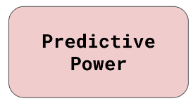
Criteria for “Bestness”
Recall also that, whether an abductive argument is cogent depends primarily on whether the explanation picked as best is indeed the best.
To evaluate which explanation is the best, you should consider:
  The simplicity of an explanation
  The coherence of an explanation
  The predictive power of an explanation
5

Slide 6
Criterion for “Bestness”: Simplicity
An explanation is simpler if it makes fewer assumptions, or has fewer vague terms, or requires fewer further explanations.
If all candidate explanations can explain the evidence equally well; have equal degrees of predictive power; cohere equally well with your justified background beliefs; then, the simpler explanation is better.
This criterion (also known as Occam’s Razor) suggests that, if everything else is equal, the simpler explanation is the better one.
6

Slide 7
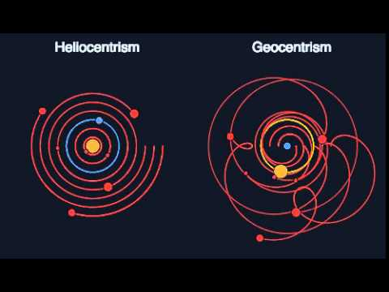
Simplicity: Example
For example, consider the following explanations of planetary observations. Which is simpler?
And, is a ‘supernatural’ or a ‘natural’ explanation simpler?
7

Slide 8
Criterion for Bestness:
Coherence
The most common/ most instinctive way of choosing the best explanation is by appealing to coherence.
To see how coherence works, note that explanations do not happen in a vacuum – we bring background epistemological baggage to the task of explaining.
The ‘coherence’ of an explanation is the degree to which the explanation does not contradict (or, is consistent) with our background beliefs about the nature and structure of our world.
If there must be contradiction, then the explanation would contradict less strongly held beliefs.
Everything else being the same, the more coherent an explanation is, the better it is as an explanation of the observation.
But, how do we acquire our background beliefs?
8

Slide 9
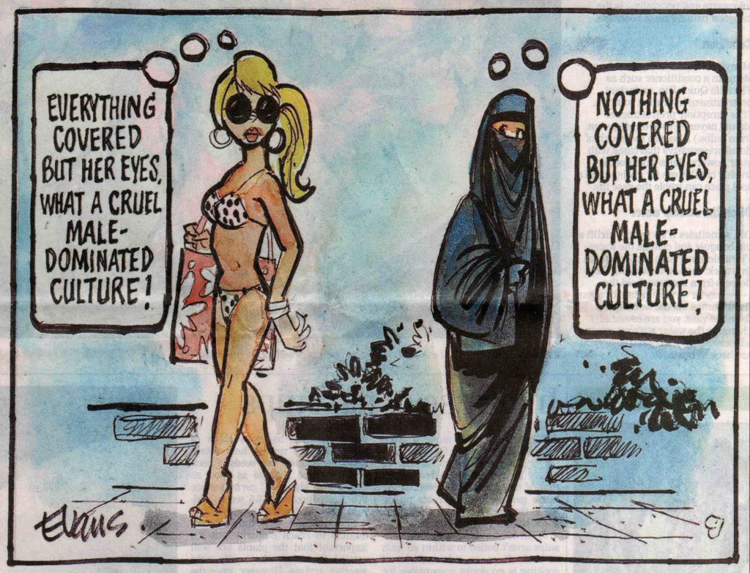
Coherence & Subjectivity:
Our background beliefs might differ. In that case, relying on coherence might make different people pick different explanations as more coherent.
How would disease be explained in
  The ‘modern’ world?
  The ‘premodern’ world?
Differences in background beliefs need not be cultural: they can be interpersonal too!
9

Slide 10
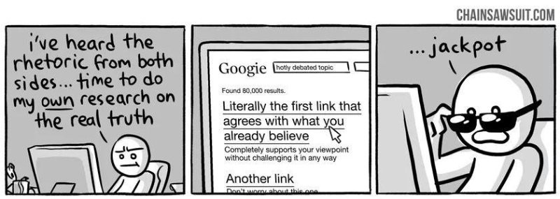
Coherence: Dealing with Subjectivity
Given the subjectivity, for coherence to effectively track bestness, we need to ensure that our background beliefs about the world are routinely scrutinized, reviewed and revised. Avoid being dogmatic!
In performing these acts, we need to be disciplined to avoid our natural tendency towards the confirmation bias.
Confirmation bias is our tendency to look for evidence that supports our existing beliefs (confirming evidence) and ignore (or not look for) evidence that refutes the same.
10

Slide 11
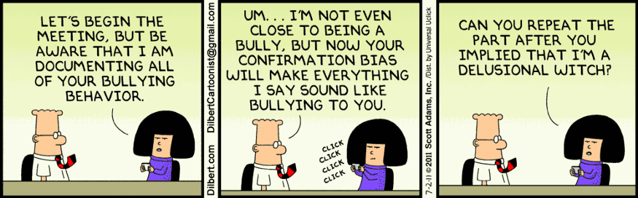
Avoiding Confirmation Bias:
Learnt Your Lesson?
Let’s check whether you have learnt your lesson.
Here is a sequence of 3 numbers. I have used a rule to generate these 3 numbers: 2, 4, 6.
Guess the rule in your head. If I asked you to check your guess with a next number in the sequence, what would that number be?
11

Slide 12
Criteria for “Bestness”: Predictive Power
Given that simplicity is an aesthetic criterion and coherence can be subjective, the gold standard of bestness is predictive power.
To understand predictive power, note that an explanation comes from a theory about how the world is like: so, if the theory (and the explanation) is correct, then we should be able to predict other observations we can make in the world.
For example, if
  My dog is not eating,…..?
  I see Emma behaving all weird and distant…..?
The more correct/ accurate predictions an explanation makes, the higher the predictive power and the better it is.
12

Slide 13
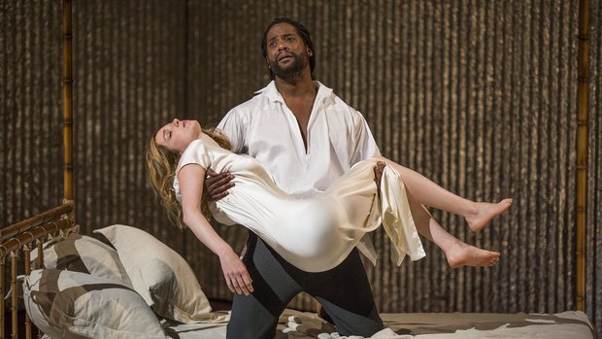
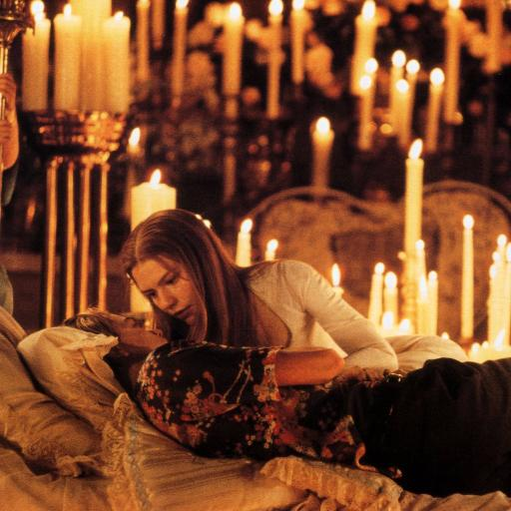
Bad Abduction & Tragic Consequences
So, what should you do to abduce correctly?
And, if you don’t?
13

Slide 14
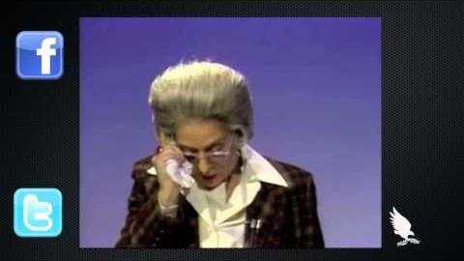
Summative Exercise: Which inductive forms?
14

Slide 15

Summative Exercise: Which Argument form is attacked?
15

Slide 16
Appeal to Ignorance: Examples
Consider the following examples:
Example 1
Premise: There’s no sign that my boyfriend loves me.
Conclusion: So, he doesn’t.
Example 2
Premise: There is no evidence that God exists.
Conclusion: So, he doesn’t.
In these examples, the conclusion infers that something is (or, is likely to be) false/true because there is no evidence for it/against it; such arguments are ‘appeals to ignorance’.
16

Slide 17
Appeal to Ignorance, Reconstructed
At its most general, the structure of an appeal to ignorance is this:
  Premise: We have no evidence that X/not X.
  Conclusion: So, X is false/true.
As it stands, the appeal to ignorance is a bad argument; it clearly has a relatively weak inference.
The most charitable approach to such arguments, then, is to consider them as abductive:
  O: There is no evidence for X
  The best explanation for O is E* = ‘X is false’.
C. X is false
17

Slide 18
Appeals to Ignorance: Cogent or Uncogent?
In evaluating appeals to ignorance, the standard criteria for evaluating abductive arguments apply.
Is this argument cogent?
O: There’s no sign that my boyfriend loves me.
The best explanation for O is E*: ‘He doesn’t love me’.
C. He doesn’t love me
Is this?
O: There is no evidence that God exists
The best explanation for O is E*: ‘God doesn’t exist’.
C. God doesn’t exist.
18

Slide 19
Appeal to Ignorance: Exercises
Example 1
Premise: I have no evidence (from several blood and other diagnostic tests) that I have HIV.
Conclusion: So, I don’t have HIV.
Example 2
Premise: We have no evidence that there is any community transmission of Covid in Laos.
Conclusion: So, there isn’t any community transmission.
Example 3
Premise: There is no evidence that Israeli intelligence suspected that a Hamas attack like that on October 7th was in the works.
Conclusion: So, Israeli intelligence had no such suspicions.
19

Slide 20


Appeal to Ignorance: Exercises
Example 4
Premise 1: United Nations has found no evidence that Saddam Hussein is stockpiling weapons of mass destruction.
Premise 2: The best explanation of this is that Saddam is not stockpiling such weapons.
Conclusion: So, Saddam is not stockpiling WMDs.
20

Slide 21
Appeal to Ignorance & Burden of Proof
In many instances, where appeals to ignorance are made, there might not be any evidence either for or against X.
In these cases, appeals to ignorance can be made both to affirm or deny that X.
Example 1:
You: There is no evidence that God exists. So, he doesn’t. | I: There is no evidence that God doesn’t exists. So, he does.
Example 2:
You: There is no evidence that our ministers aren’t corrupt. So, they are. | I: There is no evidence that our ministers are corrupt. So, they aren’t.
21

Slide 22
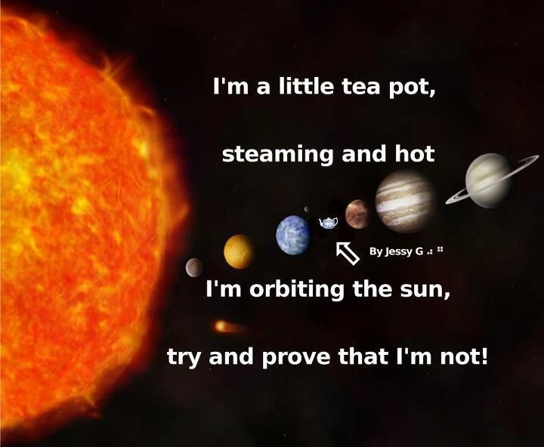
Appeal to Ignorance & Burden of Proof
In these cases, since the conclusions can’t, both, be true, who must provide ‘proof’? You or I? On who, does the burden of proof lie?
Bertrand Russell has this to say:
But, it is controversial whether
Russell is correct…
22

Slide 23

Burden of Proof: Controversial
Atheist: If you want to maintain that God exists then the burden of proof is on you to produce some evidence.
Theist: If you want to hold that billions of believers around the world are deluded then the burden of proof is on you to prove it.
23

Slide 24
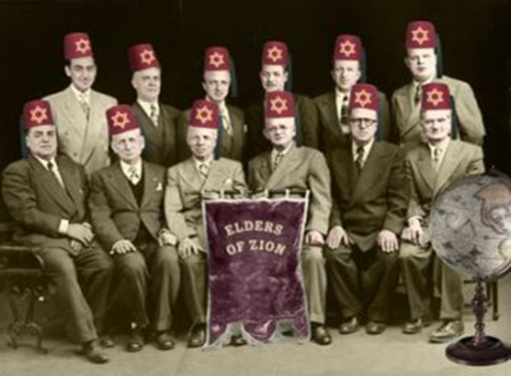
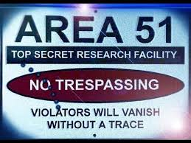
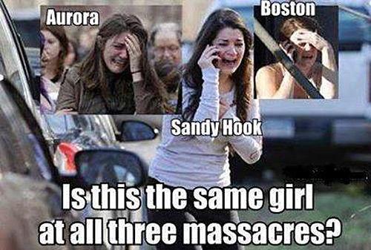





Forms of Abduction : Conspiracy Theories (CT)
Do you know these stories?
24

Slide 25

And what about this?
25

Slide 26
Conspiracy Theory (CT): Definition and Features
A conspiracy theory is the claim that a closed network of powerful people secretively act(ed) in a particular way.
This claim is supposed to explain a particular set of observations
Here are other key aspects of a CT:
    A CT can be either ‘local’ or ‘global’: for a local CT, the ‘particular way’ is a one-off event; for a global CT, the ‘particular way’ refers to a collection of events: to that end, a global CT may tie prima facie unrelated events together.
    A CT generally attributes malevolent intentions to the ‘conspirators’.
    A CT generally rejects the received wisdom about what is the best explanation of the observations.
26

Slide 27
Conspiracy Theory: CT as a Form of Abduction
The most charitable way of justifying a CT is as the conclusion of an abductive argument.
A conspiracy theory fits the standard template of abduction in the following manner:
    P1: O: _____?_____
    P2: E₁ = “Conspiracy Theory” is the best explanation out of all explanations (E₁, E₂,…, E_{n})
    C: The Conspiracy Theory is true.
27

Slide 28
Theorising a Conspiracy: Good or Bad Abduction?
Again, in evaluating CTs you look at whether the abductive argument is cogent. Again, that largely depends on whether the CT is the best explanation.
To determine whether it is, you should ask the following questions:
    Does the conspiracy theorist ignore simpler and equally good explanations?
    (simpler to consider the virus spreading from bats to humans than being an accidentally released bio weapon)
    Does the conspiracy theorist either ignore or use disconfirming evidence as confirmation of the fact that there is a conspiracy?
    (evidence that China wasn’t developing a Covid bio weapon doesn’t mean China is good at hiding what it does)
    Does the conspiracy theorist appeal to ignorance and shift the burden of proof?
    (no evidence that China wasn’t developing a bio weapon means it was)
28

Slide 29

So, Why Do We Believe CTs?
29

Slide 30
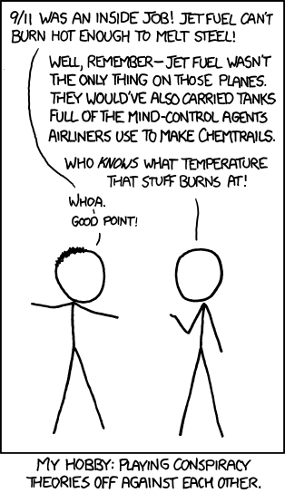
Conspiracy Theory: Exercises
Consider the following arguments, what is the conspiracy theory? Is it good or bad abduction?
Example 1
It never rains on National Day. This is not a coincidence. The Singapore Government believes that a successful ND helps to reinforce their popularity so they secretly get the air force to conduct cloud-seeding. A few days before ND jets spray chemicals into the clouds that induce rain. This drains the clouds making rain on ND unlikely.
Example 2
In the aftermath of the 9/11 attack on the World Trade Centre, Bush said he saw tv footage of the first plane hit; but none was screened! He must have watched secret footage. So, he knew that a plane was going to hit the WTC.
What’s your favourite?
30

Slide 31

Reading
Additional readings (on eLearn)
Exercises (on eLearn):
Abduction Exercises
31

