Slide 1


Light Scattering from Closely Spaced Atom Pairs
Yoo Kyung Lee
This work: Massachusetts Institute of Technology
Current affiliation: Harvard University

Slide 2

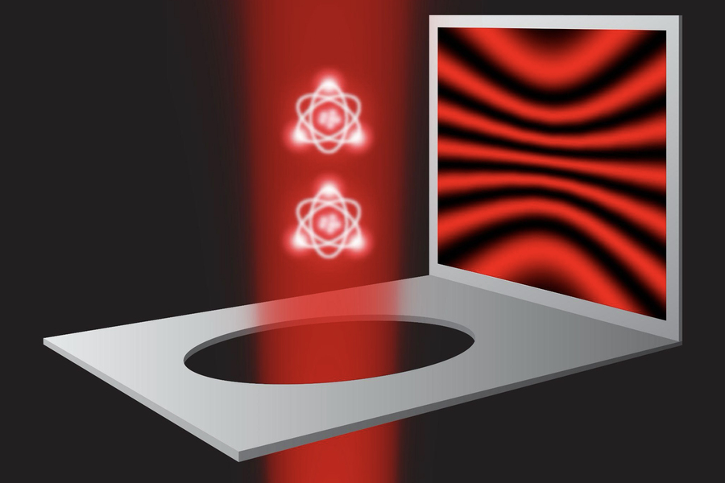
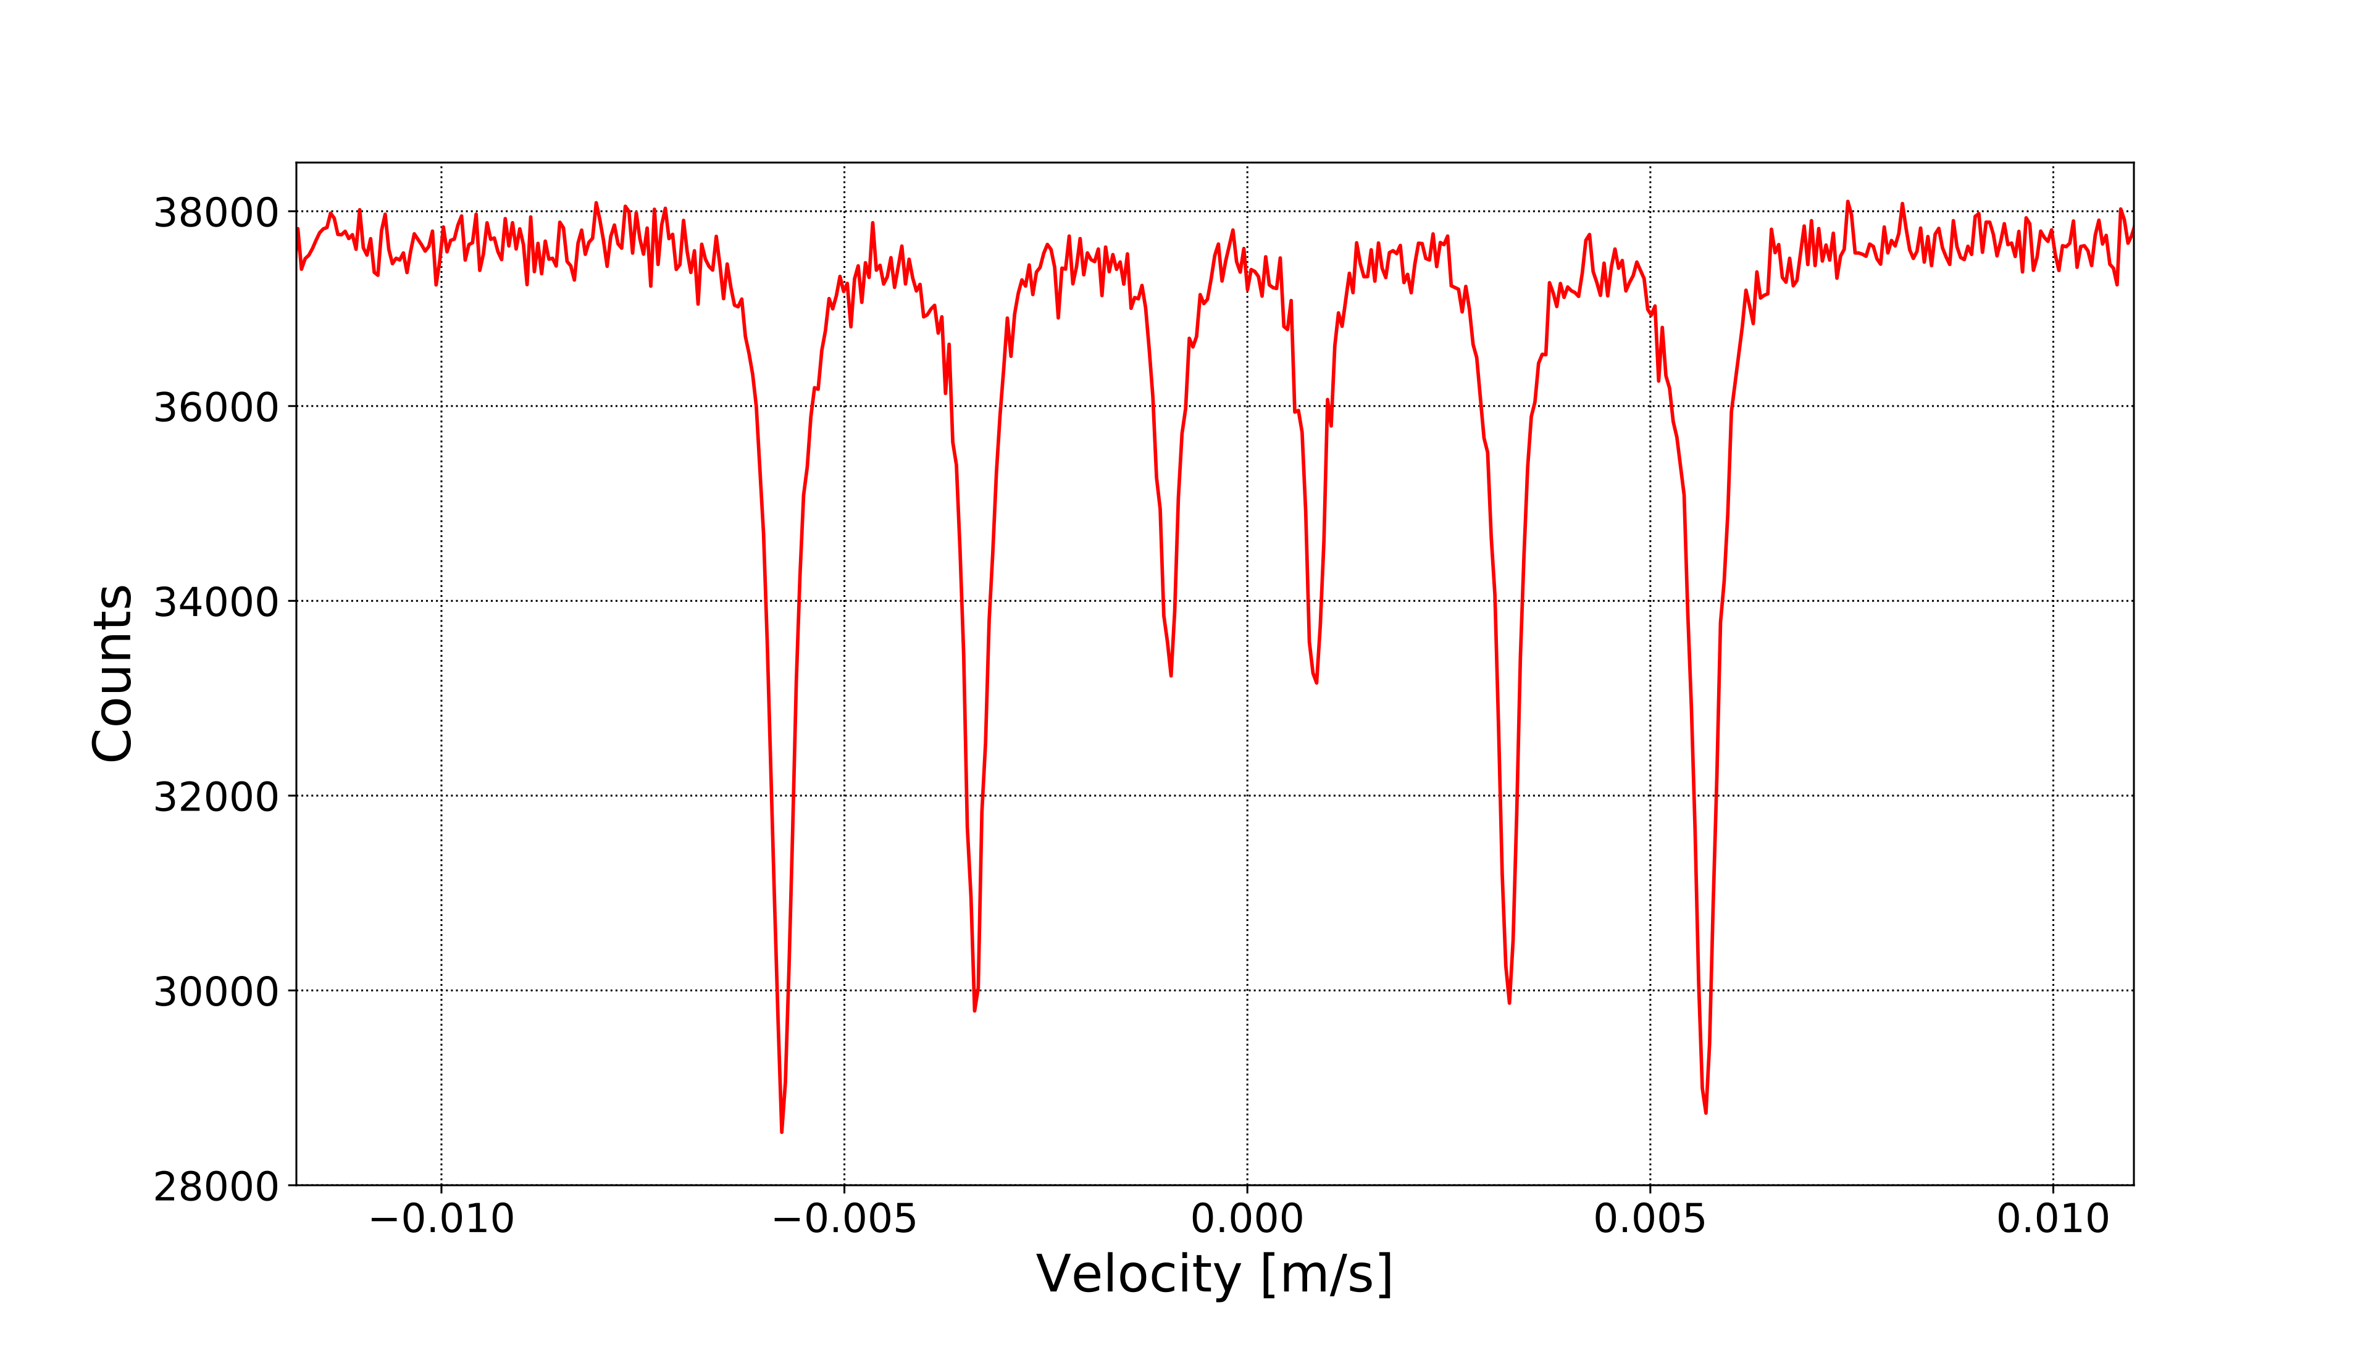
Light Scattering from Single Atoms
Rayleigh scattering
Double-slit gedankenexperiment
Mössbauer (recoilless) scattering
Notes:
https://www.ambong-ambong.com/blog/health-benefits-of-watching-sunsets/
https://news.mit.edu/2025/famous-double-slit-experiment-holds-when-stripped-to-quantum-essentials-0728
Blue sky
Orange sky
Sunbeams - crepuscular rays on dust motes in the atmosphere
Clouds
Reflections from the water
Going forward
Furthermore, we consider the perturbative limit of weak excitation and we assume that the atoms scatter light independently which is valid for sufficiently far-detuned light.

Slide 3
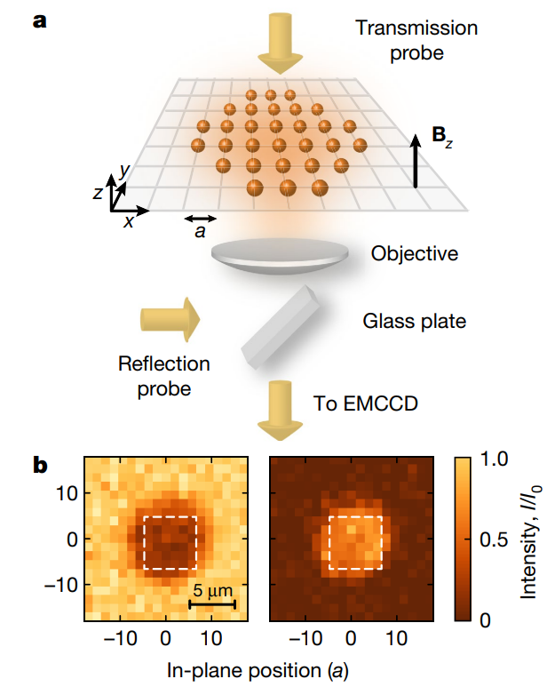
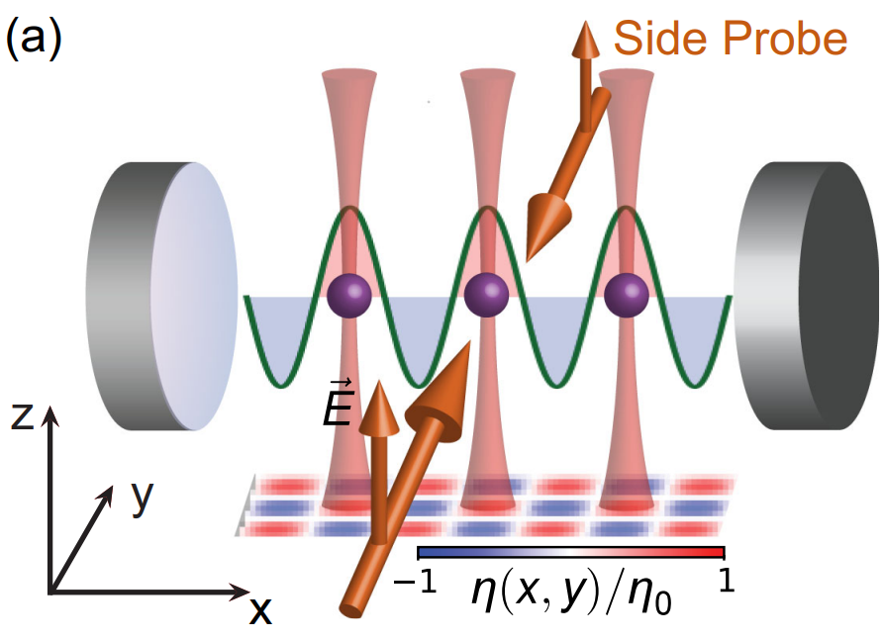
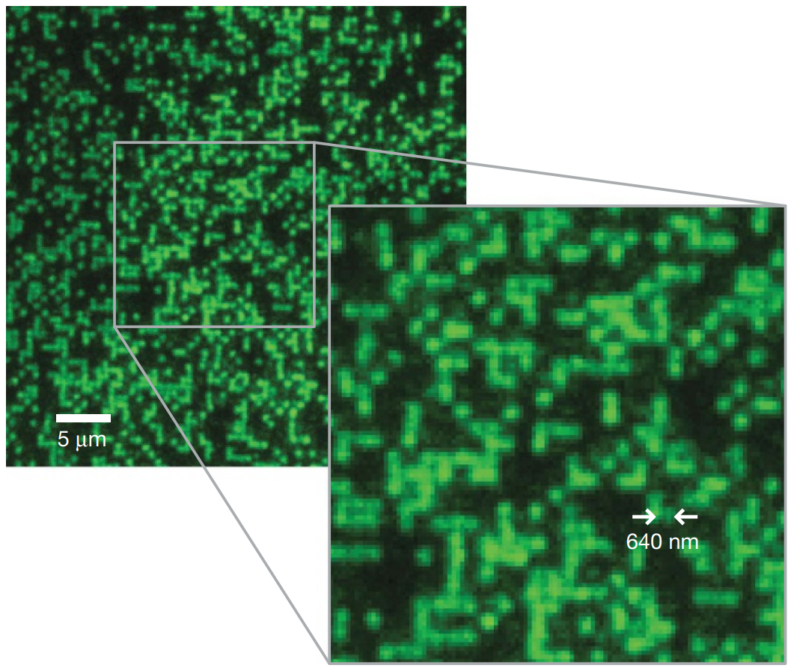
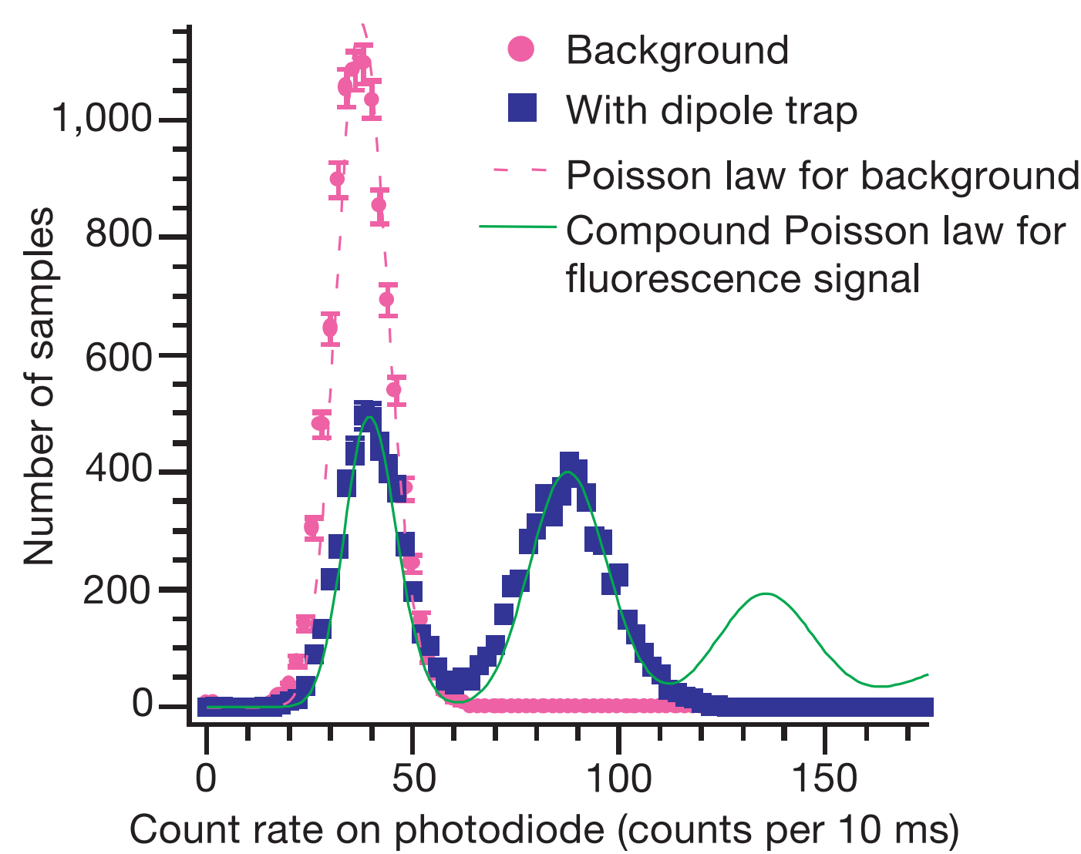
Collective Scattering
Parity projection in quantum gas microscopes
Nature 462, 74 (2009)
Atomically thin mirrors
Nature 583, 369–374 (2020)
Superradiant and subradiant cavity scattering
Phys. Rev. Lett. 131, 253603 (2023)
Sub-Poissonian tweezer loading
Nature 411, 1024 (2001)
Notes:
New phenomena arise when atoms scatter light notindependently but cooperatively. For instance, construc-tive and destructive interference lead to superradiant andsubradiant states. More recently, this has become a veryactive frontier for quantum control of photons in atomarrays, for approaching the highest precision in atomicclocks, and as a novel many-body system [1–4]. Theproperties of correlated light scattering change qualita-tively when the separation of atoms becomes smaller thanλ ≡ λ/2π, the reduced wavelength. For instance, the in-teraction of oscillating dipoles becomes dominated by theshort-range 1/r3 interaction, and not the retarded longrange 1/r part.

Slide 4
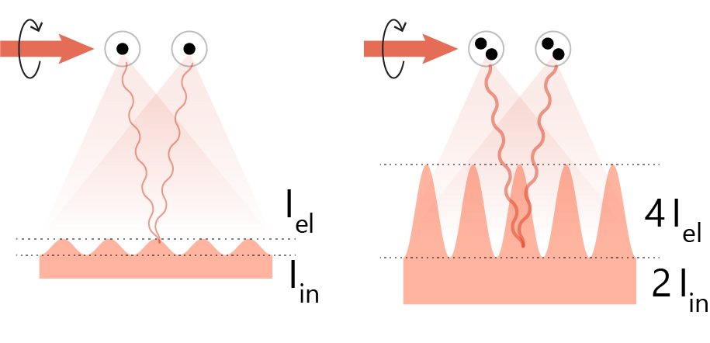
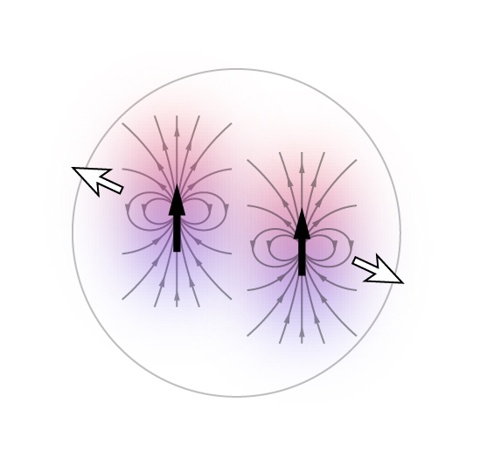
The Role of Interactions
N-particle scattering: Dicke superradiance
Light scattering properties also depend on
How tightly particles are localized
Light-induced dipole-dipole interaction
Contact interactions (scattering length)
Blue-detuned light leads to repulsive dipole-dipole interactions
Effect is large when atoms are closely spaced relative to resonance wavelength λ
Gedankenexperiment with two atoms in a harmonic oscillator

Slide 5
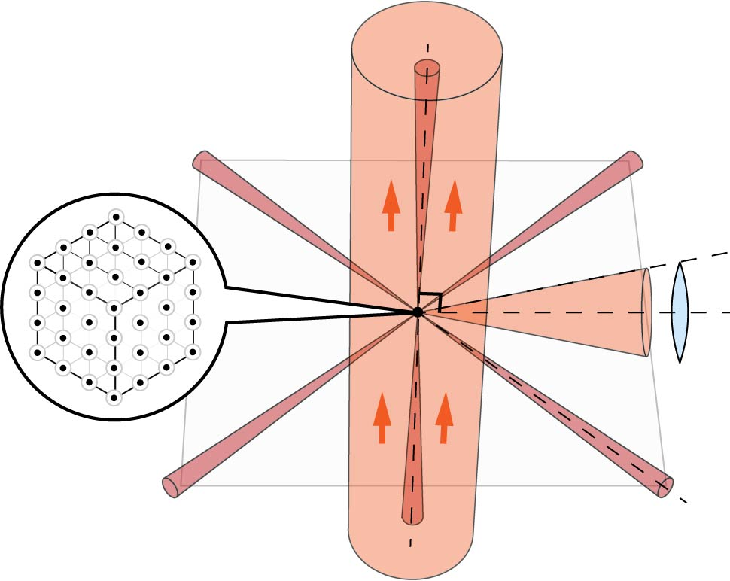
Experiments and Results

Slide 6
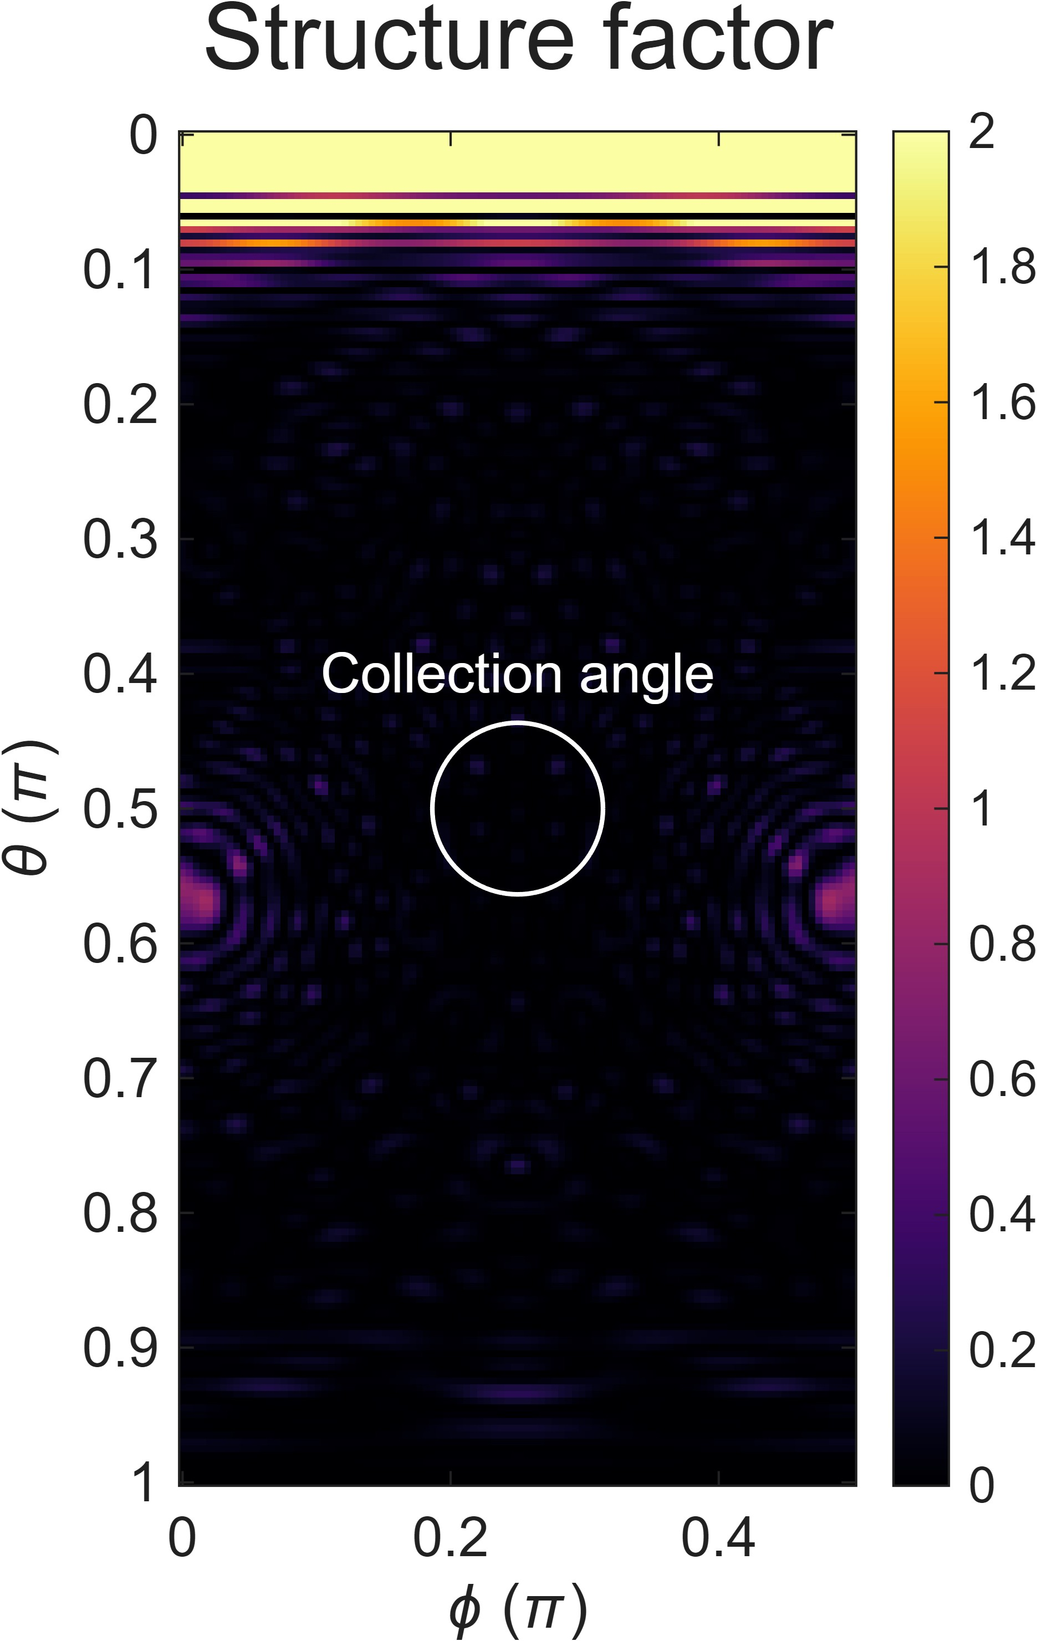
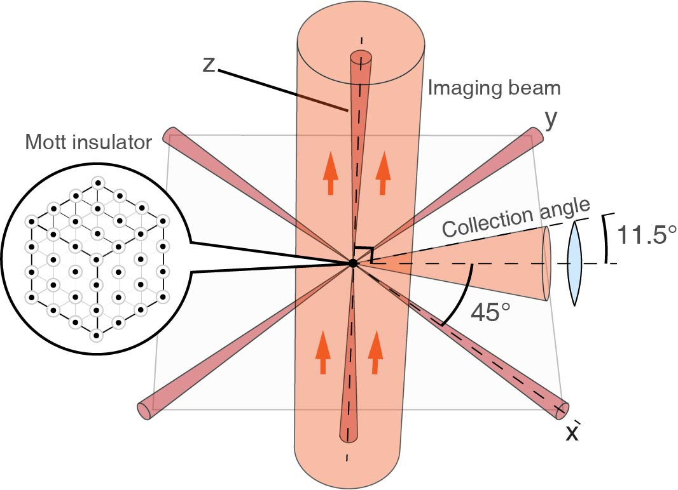

Elastic vs Inelastic Scattering
Mott insulator in a cubic optical lattice: a generalized version of the double-slit experiment
Observed intensity
$$I=DS\left(Q\right)+(1−D)$$
Debye-Waller $D=exp(−η2)$
Lamb-Dicke parameter $η=QΔx$
Momentum transfer $Q=|kin−kout|$
Structure factor
$$S(Q)={\frac{1}{N}\left|\sum_{j=1}^{N}{\exp\left(iQ∙R_{j}\right)}\right|}^{2}$$
Elastic light destructively interferes, so inelastic light is main contribution to intensity
Elastic
Inelastic
Does the lattice trap influence the amount of elastically vs inelastically scattered light?
Notes:
We load 3 × 104 ultracold atoms into a deep optical lattice very close to the ground state of a Mott insulator with one atom per site (End Matter). This realizes an almost perfect crystal of single atoms, each experiencing strong harmonic confinement
The atoms are illuminated with probe light far from Bragg angles, and the light is collected at a right angle with respect to the probe beam. We operate in the limit of Rayleigh scattering by using a cycling transition and sufficiently far detuning to ensure low optical densities. This avoids optical pumping to other states and multiple scattering events.
We generalize the classic double-slit experiment from 2 to 30,000 slits. Furthermore, it has many advantages over other types of spectroscopy:
The large number of scatterers greatly increases the signal-to-noise ratio. Furthermore, by looking far from the Bragg angle, our detection does not need the angular resolution ∼1=N1=3 required to resolve the Bragg peak. Additionally, loading into the lattice prepares the atoms are in Heisenberg uncertainty-limited wave packets with ΔxΔpx = ℏ=2.
For two atoms, SðQÞ is the double-slit pattern. A perfect crystal of infinite size has SðQÞ¼ 0 unless the angle of the incoming laser beam satisfies a Bragg condition [for which SðQÞ¼ N]

Slide 7
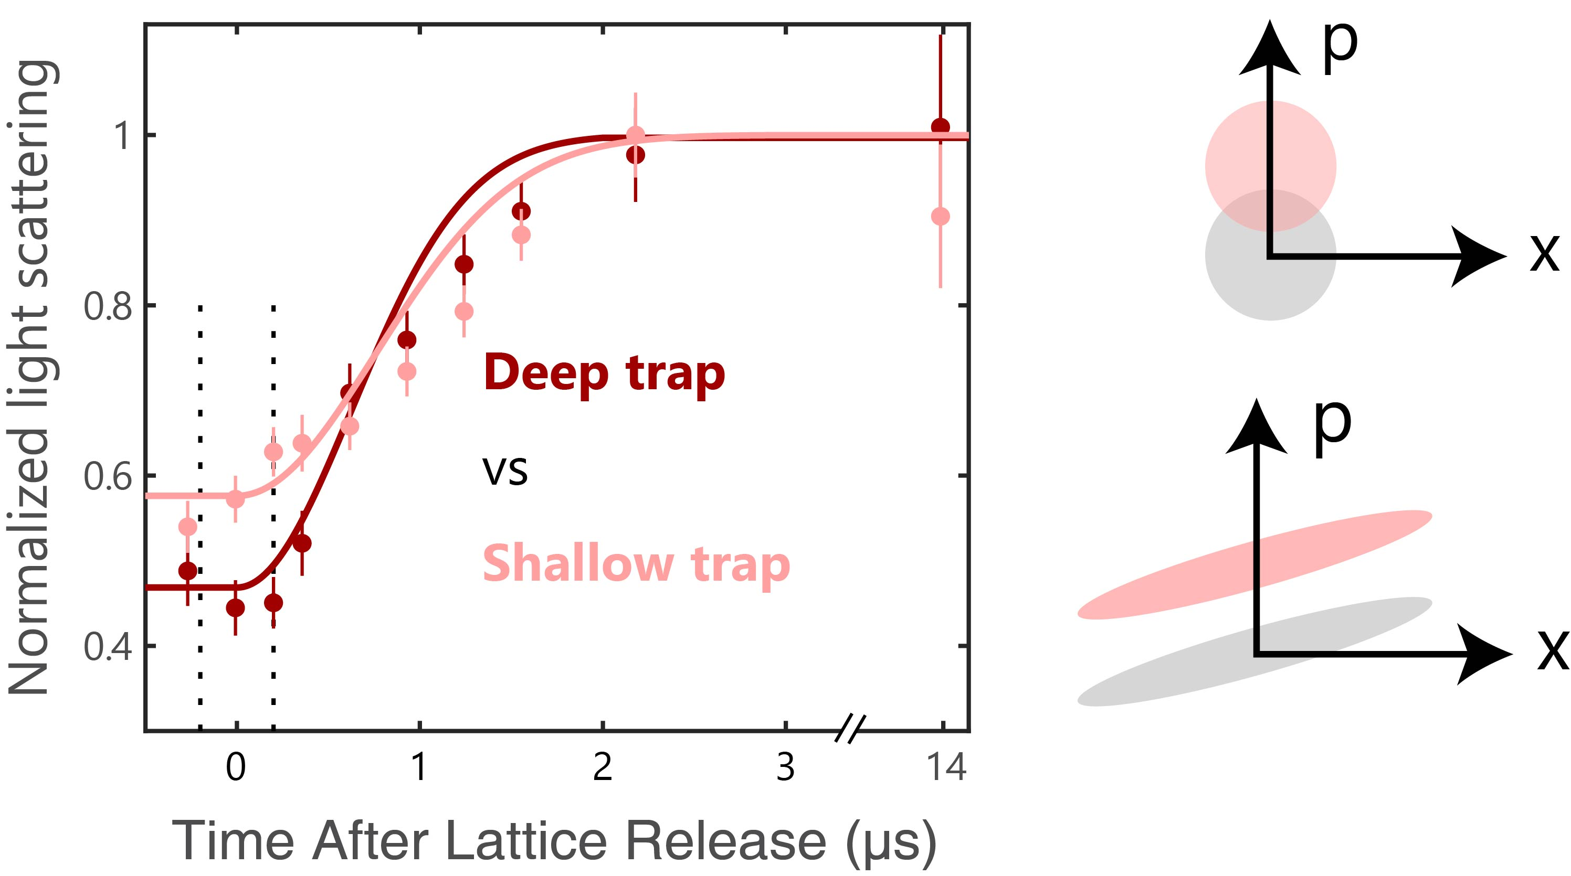
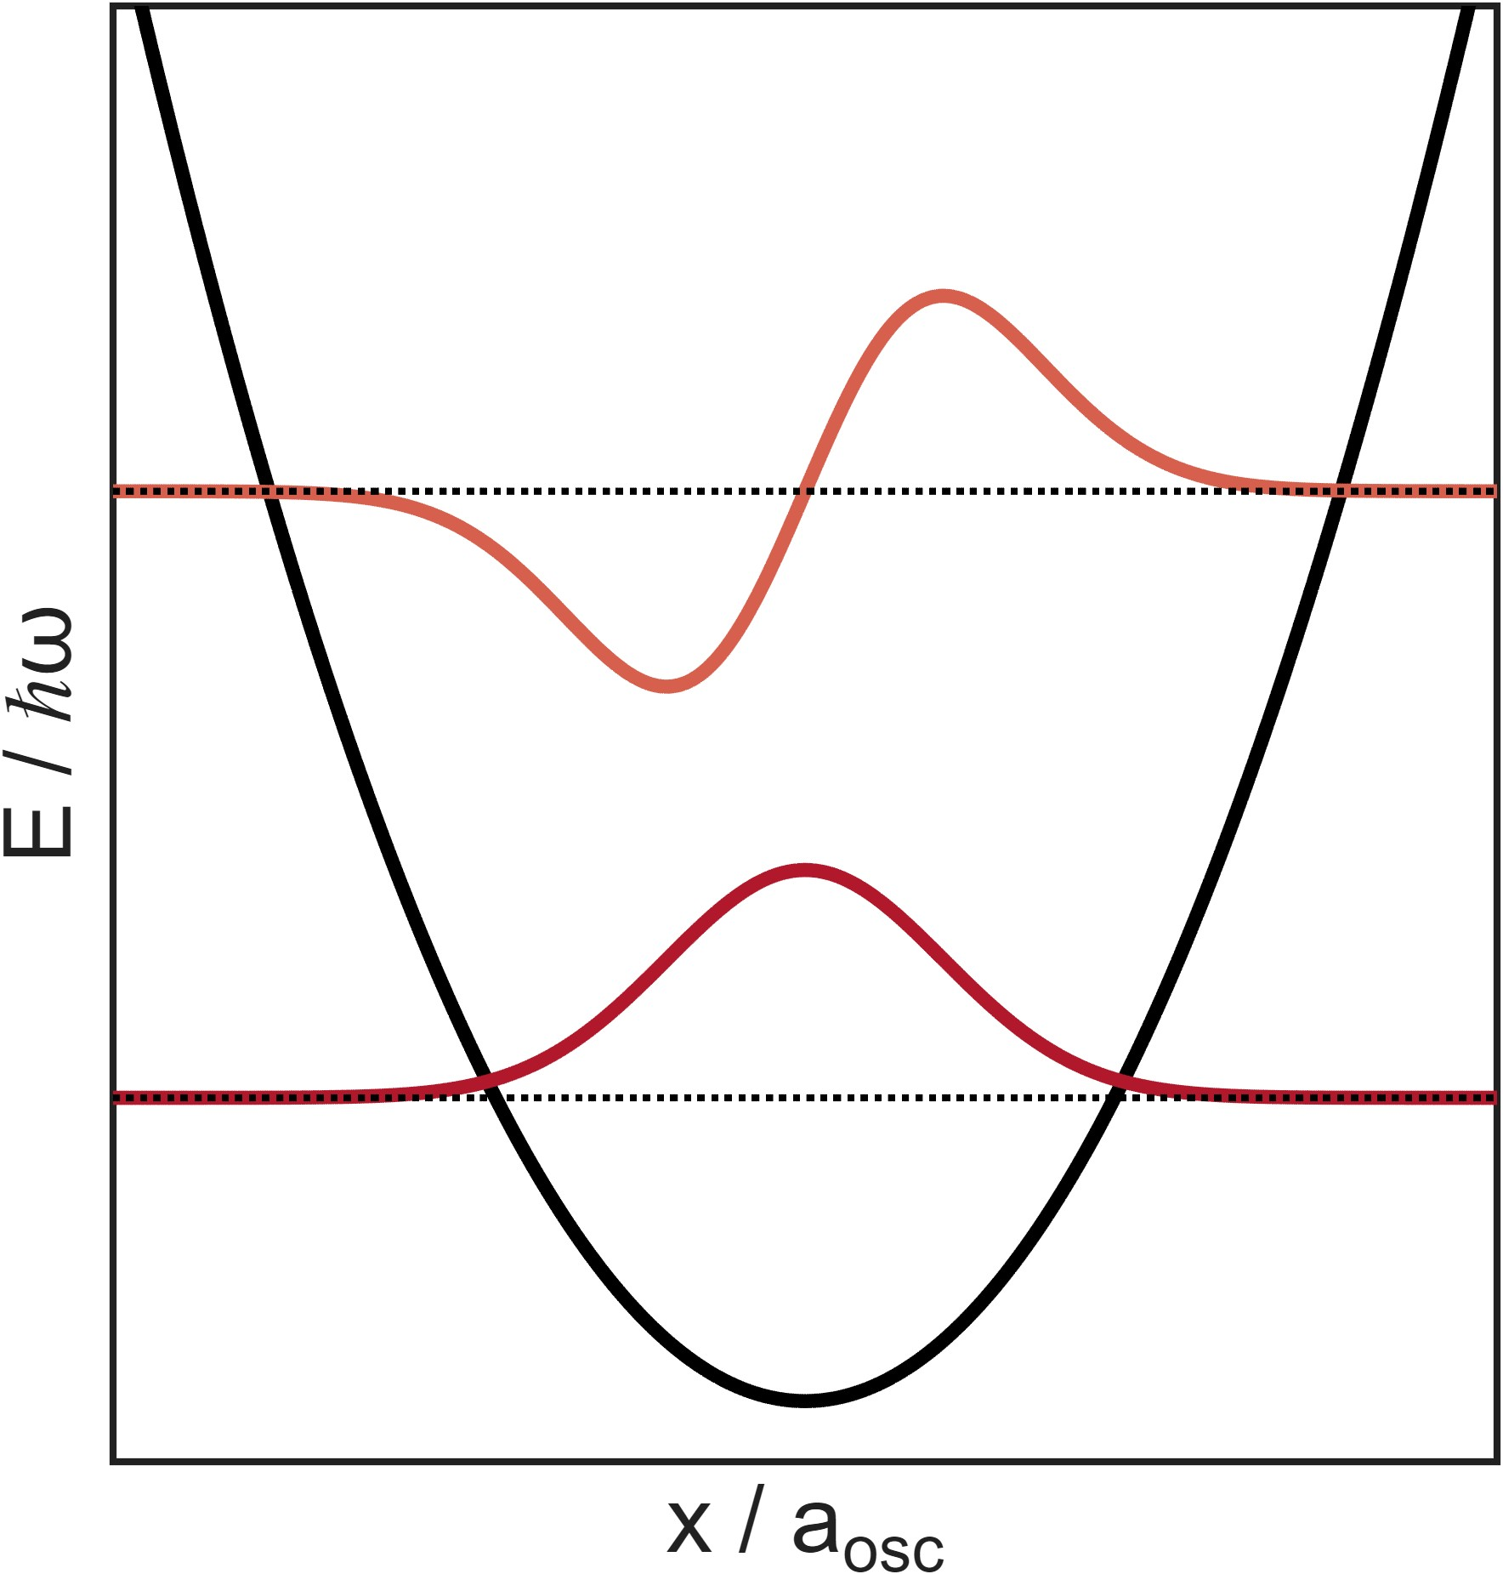
Trapped vs Free Space
Harmonic oscillator picture
In a trap
Coherent state picture
In free space
Data shows these pictures are equivalent
Phys. Rev. Lett. 135, 043601
Mössbauer effect
Sideband scattering
Excitation of harmonic oscillators
Partial entanglement
Moving on to atom pairs…
Notes:
In the harmonic oscillator picture, where there is a trap, the Debye-Waller Factor can be described as the probability for the atom to remain in the same motional state. If the atom changes state, then the photon must have a different frequency, and emitted on a sideband. This is an inelastic process.
In the free space picture, there are no harmonic oscillator states to ‘record’ which way information. Furthermore, strictly speaking, all light scattering in free space is inelastic due to the recoil shift. However, we can use coherent states and note that the recoil momentum of the photon is imparted to the atom. However, there is still finite overlap between the initial (gray) and final (red) states. In the limit of small excitation probability, these two quantities are identical and describe the amount of which-way information has been generated.
We see this experimentally in the data. The two dashed lines indicate when the lattice is fully ON and fully OFF, respectively (there is some finite turn-off time). The amount of inelastically scattered light is equal. This arises from the partial entanglement between the light and atomic motion. As there is longer time of flight, the wavefunctions expand, leading to more separation between the initial and final states after the photon recoil, as can be seen in the cartoon.
This shows that recoilless scattering in a crystal (Mössbauer effect), the different frequency of sidebands, and the excitation of an excited harmonic oscillator state are not essential to the question which fraction of light scattering is coherent or incoherent. What matters is only the partial entanglement between light and atoms.
Therefore, recoilless scattering in a crystal (Mössbauer effect), the different frequency of sidebands, and the excitation of an excited harmonic oscillator state are not essential to the question which fraction of light scattering is coherent or incoherent. What matters is only the partial entanglement between light and atoms.
A classical distribution of antennas identical to the density of the atomic wave packet would scatter light only coherently with no random phase. The amount of coherently scattered light is the same as in the quantum treatment. To introduce incoherence classically, we assume that for every scattering event, the atoms are point particles with a position randomly chosen with probabilities consistent with the density of the wave packet. This model agrees with the quantum description also for the incoherent light scattering (see End Matter) [23]. However, it is wrong to assume that light scattering localizes the atom to a point source: the reason for incoherent light scattering is partial entanglement. In both pictures, incoherence comes from the spatial delocalization: in the classical picture it gives rise to a random phase, while in the quantum picture it results in entanglement and subsequently a Fock state with undetermined phase.

Slide 8
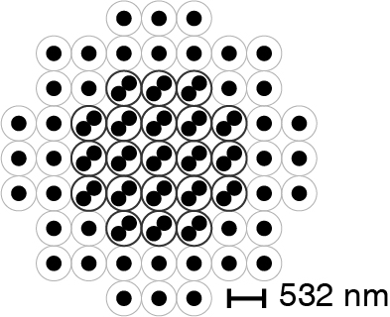
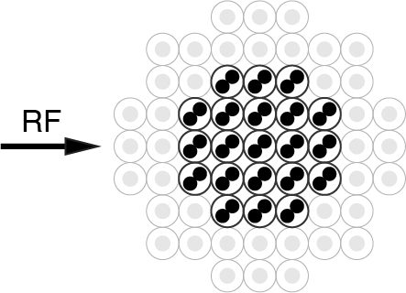
Making Pairs: Doublons in a Mott Insulator
Mott insulator with a core of doubly occupied sites, or “doublons”
Closely spaced pairs: oscillator length 100 nm ~ λ/2π
Remove single atoms to a near-dark state with an RF pulse
Singlons
Singlons
Doublons
Doublons
Notes:
Simplest two-body state, where intermolecular bond is replaced by an external potential

Slide 9
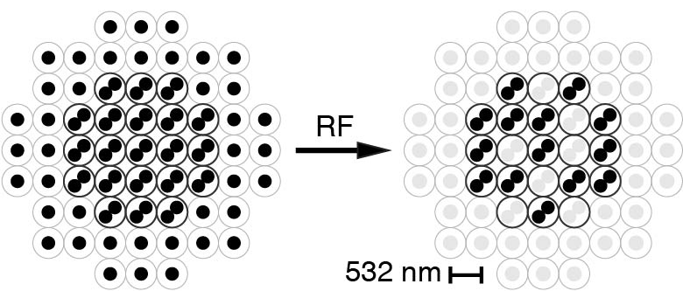
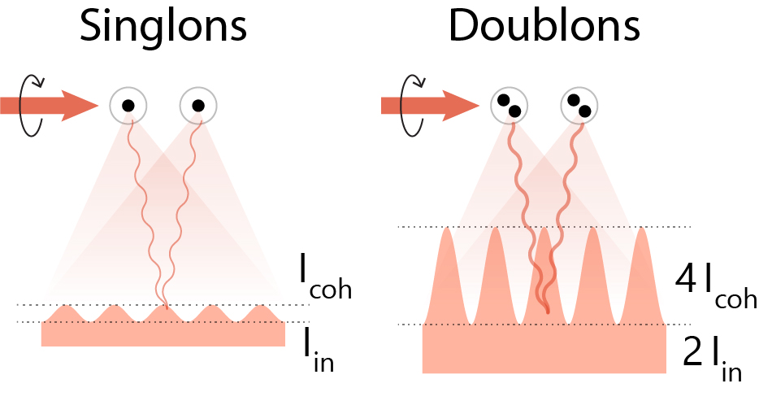
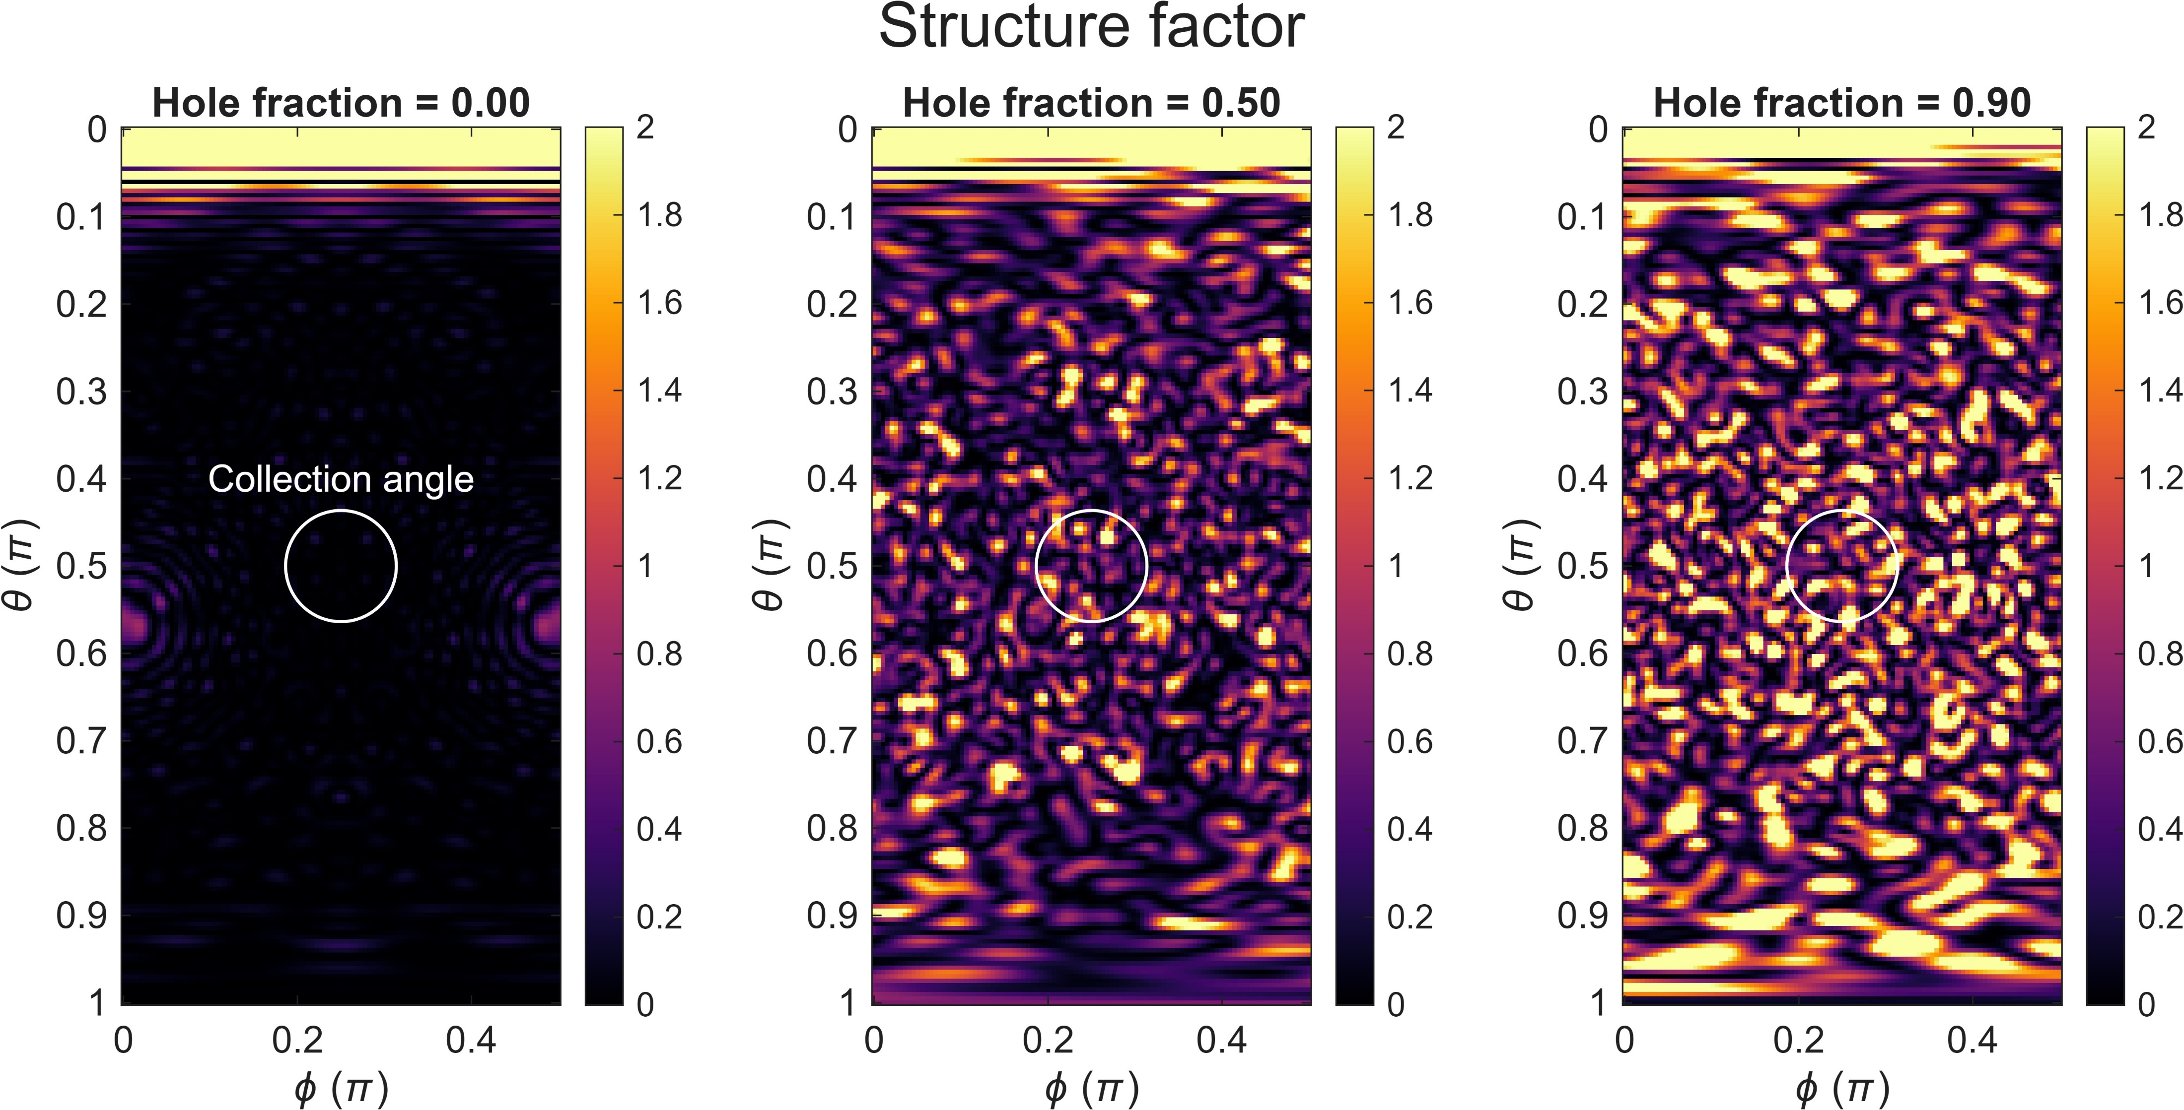
Noninteracting: Dicke Superradiance
Elastic scattering adds in amplitude → N-times enhanced
Inelastic scattering adds in intensity → No enhancement
Structure factor for an ideal crystal is 0, so we can’t probe the coherent part that way
Solution: Add random holes

Slide 10
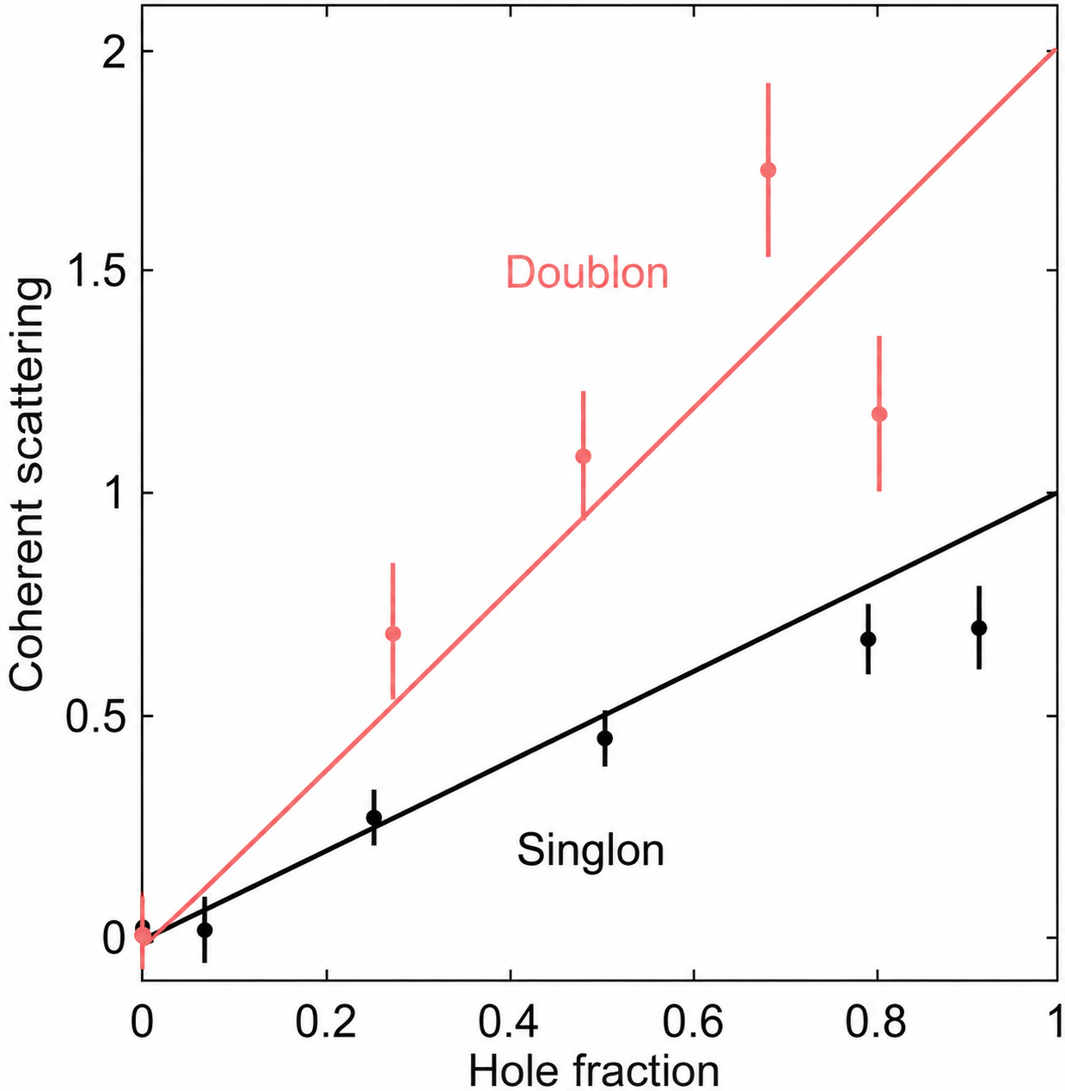
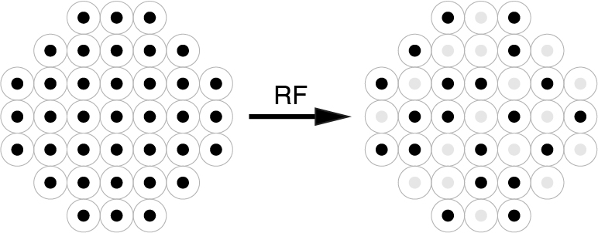
Superradiance for Doublons
Elastic part of illumination demonstrates superradiant enhancement
Doublon-hole
preparation
Singlon-hole
preparation
What about the inelastic part?

Slide 11
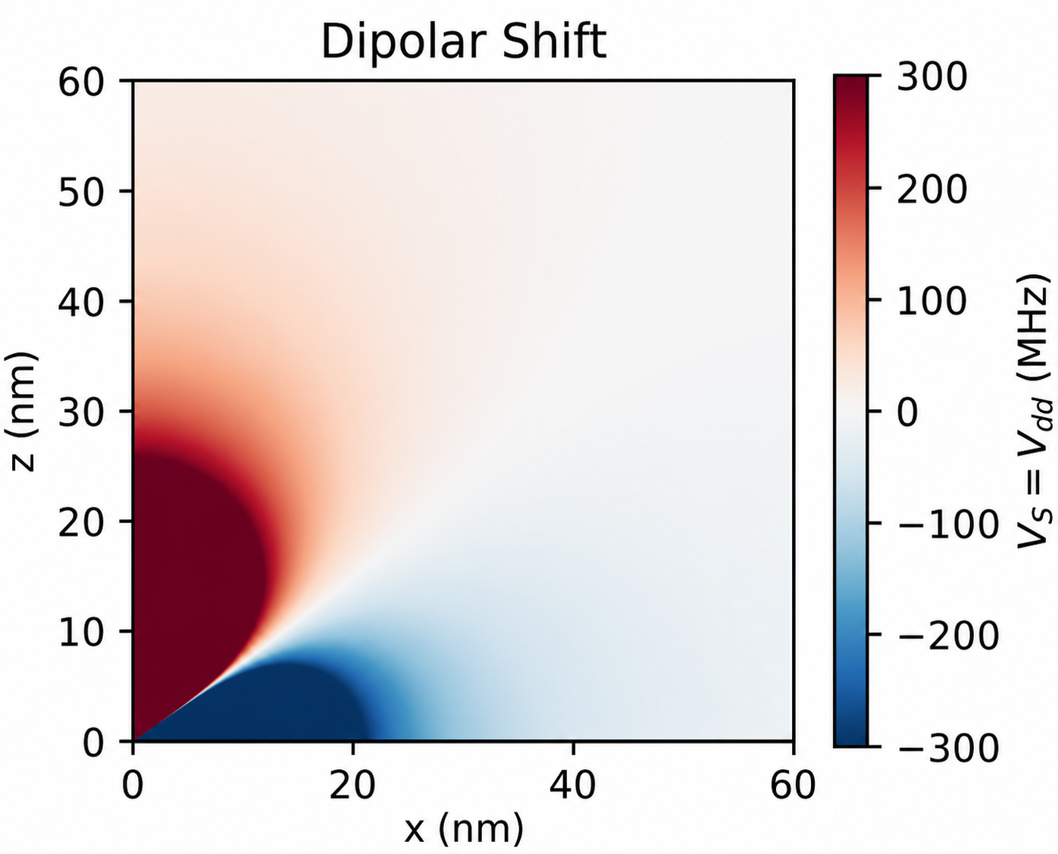
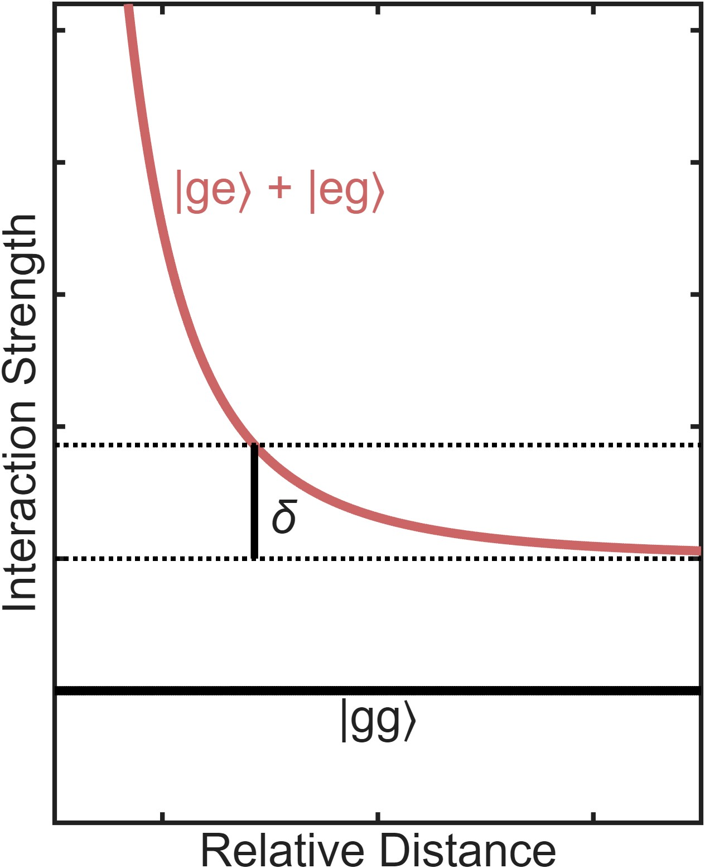
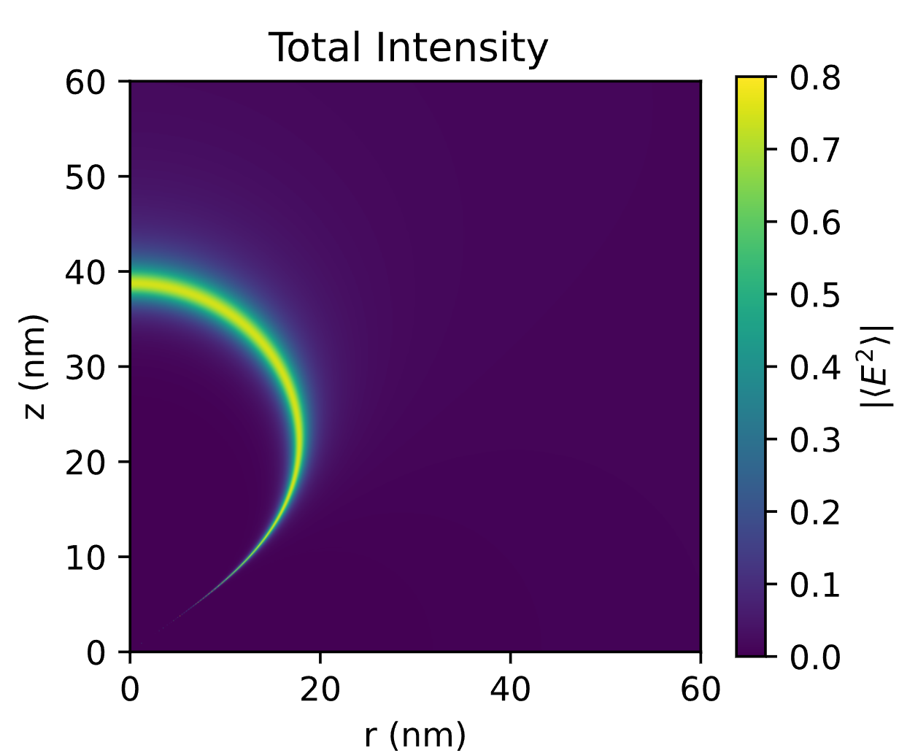
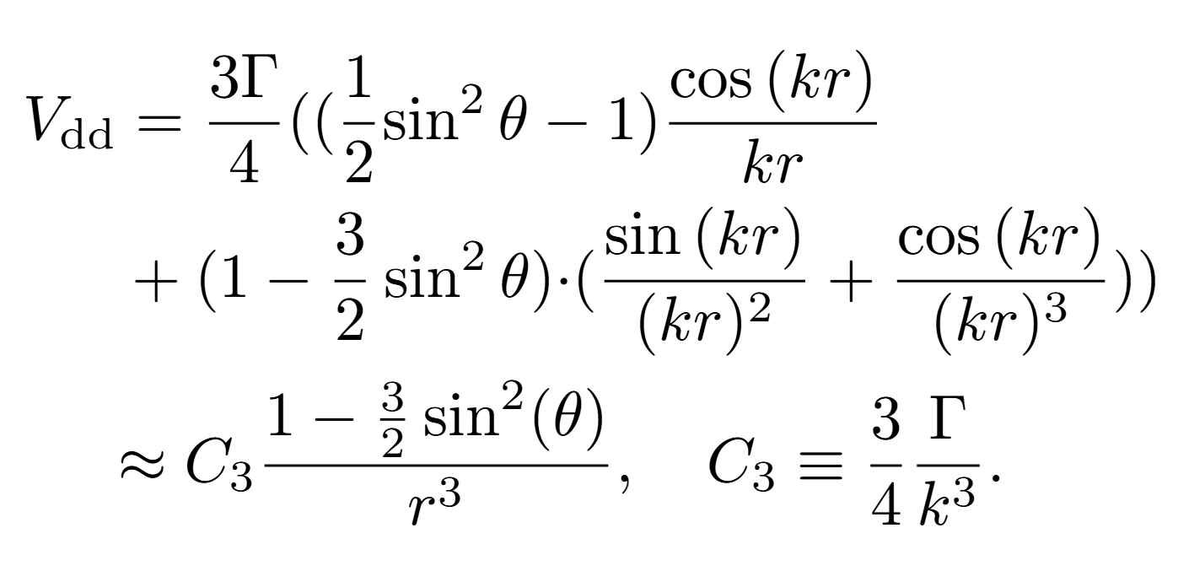
The Condon Region
Spatial variation of the dipole-dipole interaction
Cut along x = 0
Spatial variation of scattering intensity
Condon
region
Part of the wavefunction is always in resonance due to the dipole-dipole shift.
Notes:
The two lines cross at the Condon point, where the dipolar interaction is equal to the detuning
Until now, we have considered the weak excitation limit. When the optical transition is saturated, multiphoton scattering events emerge, leading to the Mollow triplet. The sidebands correspond to transitions between the different dressed states and are therefore also inelastic, whereas the carrier is mostly elastic (unless strongly saturated). According to Ref. [50], the inelastic fraction of the scattered light is s/(1 + s) where s = 2(Ω/Γ)2/(1 + 4∆2/Γ 2 ) is the saturation parameter

Slide 12
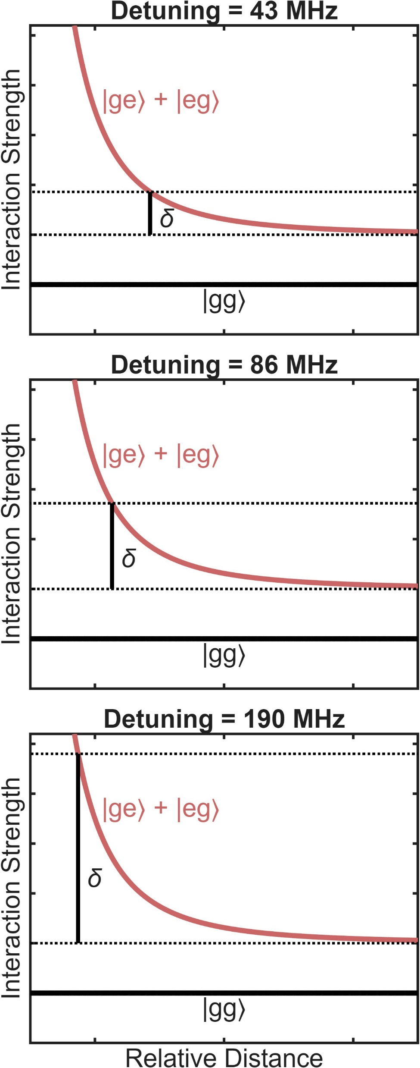
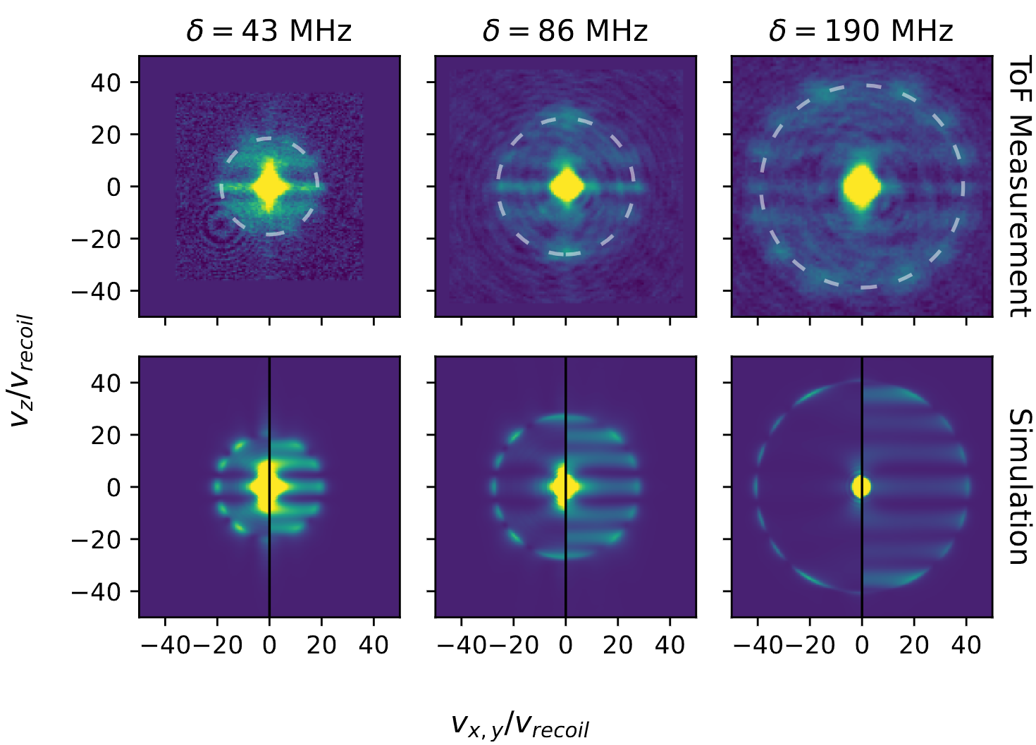
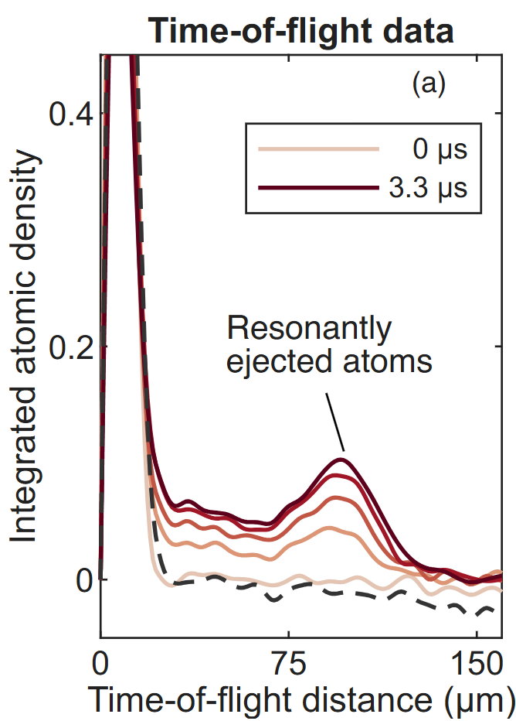
Resonantly Ejected Atoms in Time-of-Flight
Detuning determines the kinetic energy acquired
Radial average

Slide 13
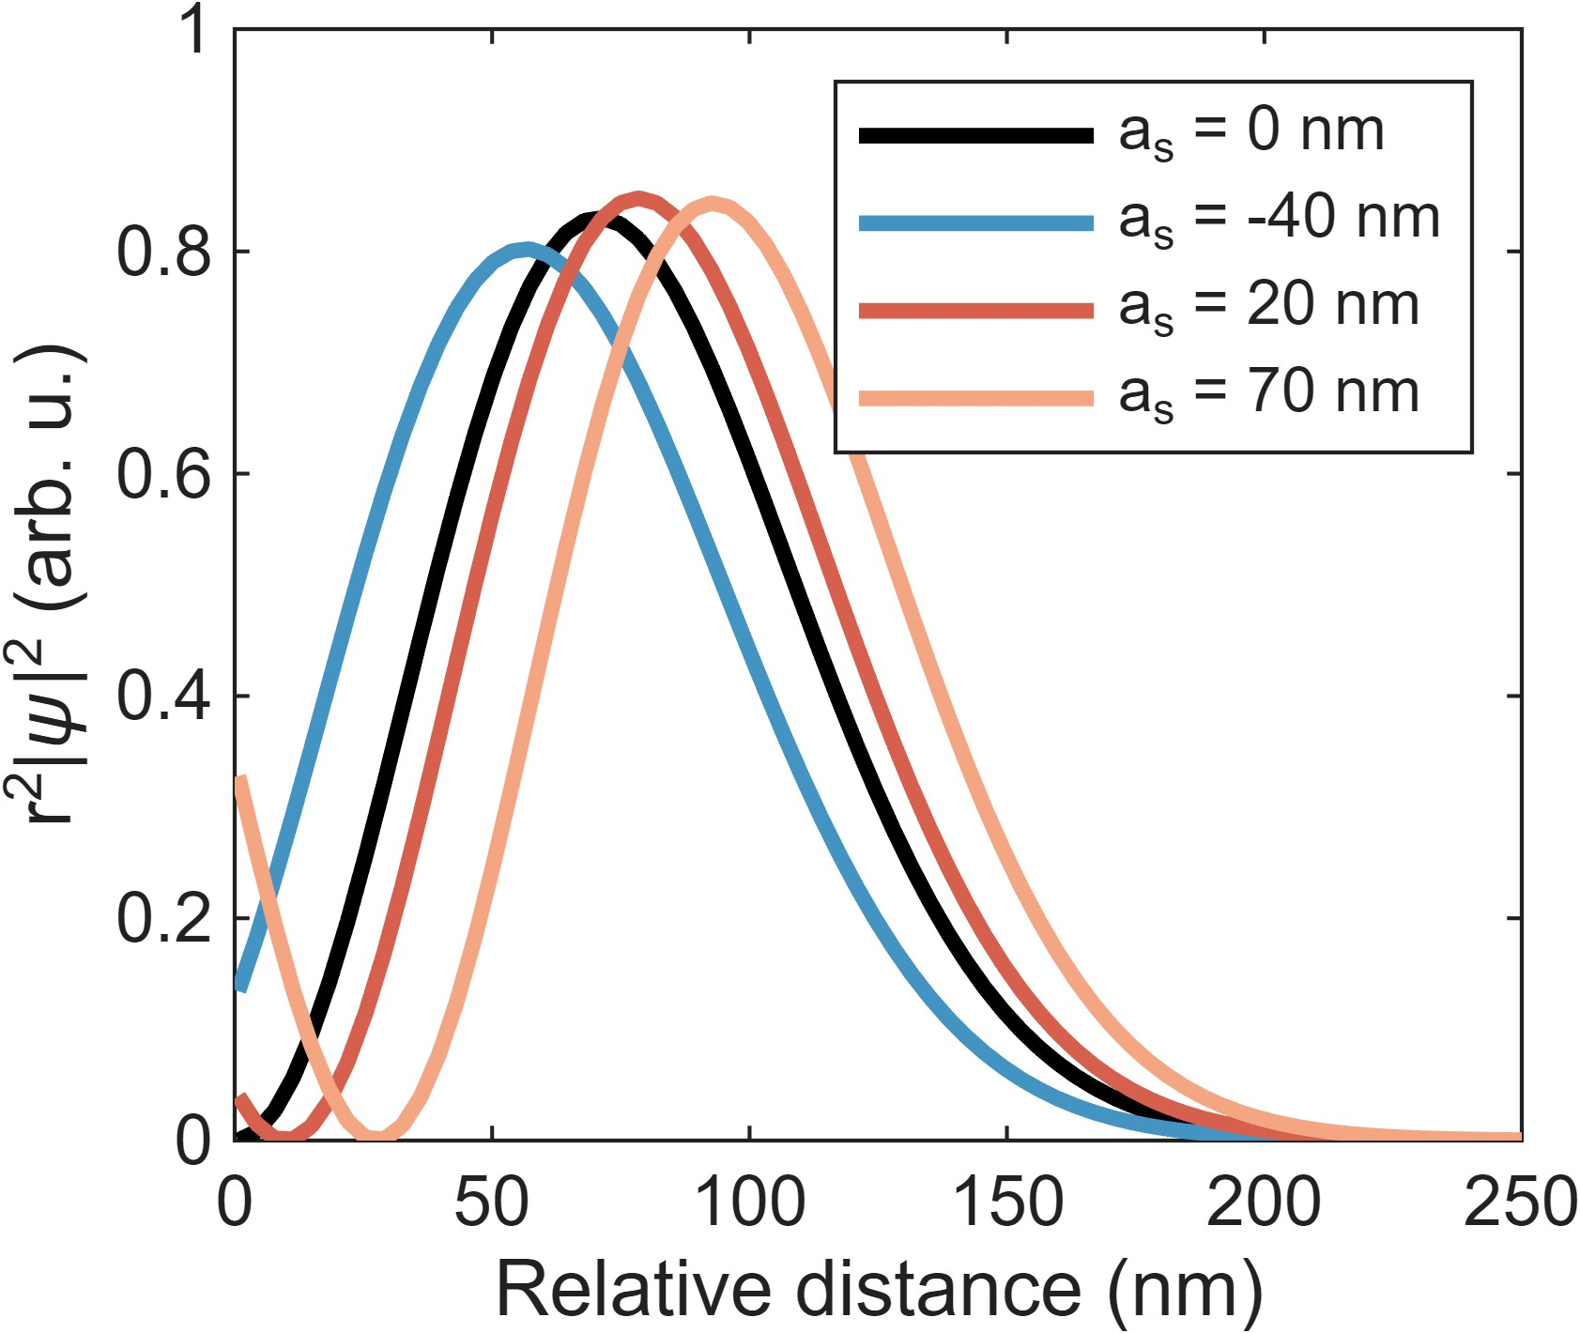
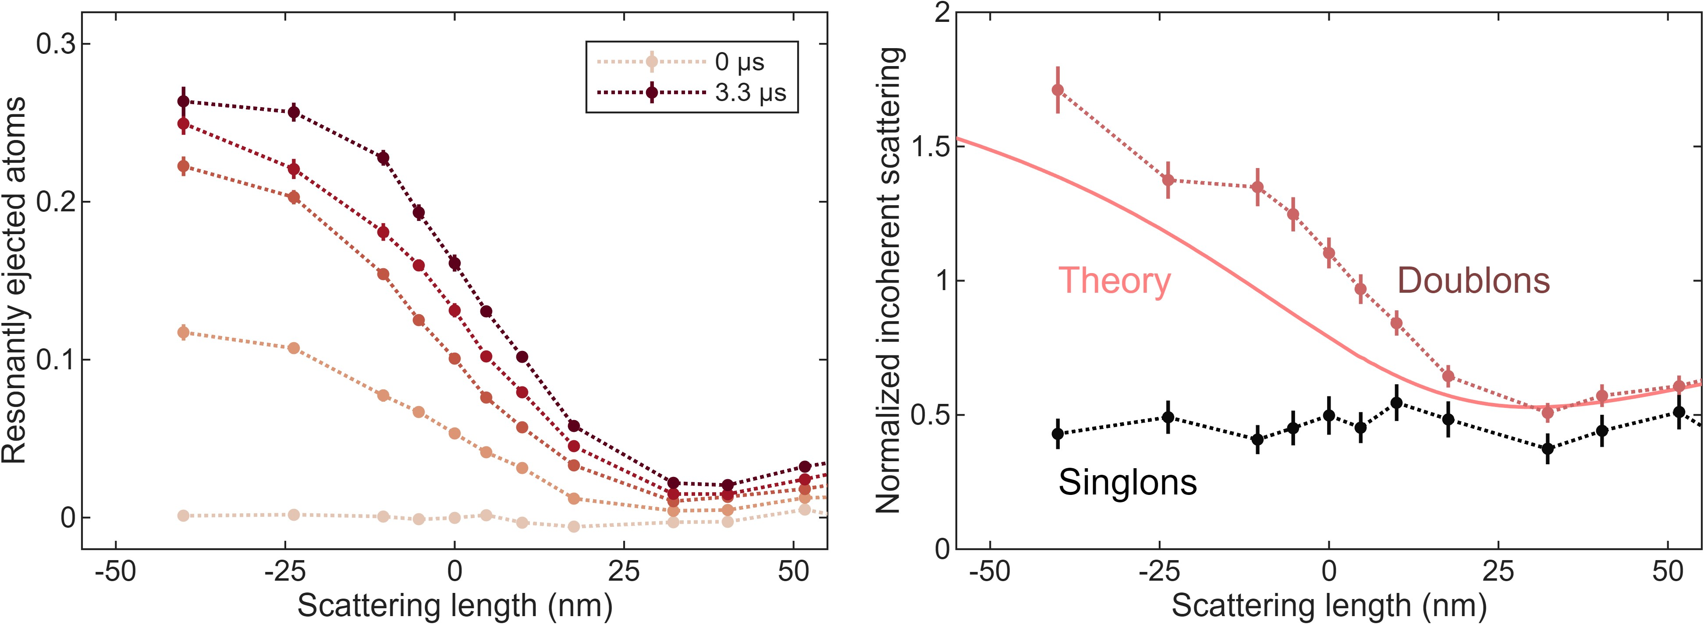
Altering Wavefunction with Scattering Length
Scattering length alters the two-particle wavefunction
Changes amount of inelastic scattering due to near-resonant Condon region
Condon
region
More atoms in Condon region
→ More atoms inelastically scatter

Slide 14
Outlook
Three atoms per site
Probe for few-body or molecular physics

Slide 15
Acknowledgments
Ketterle group

Slide 16
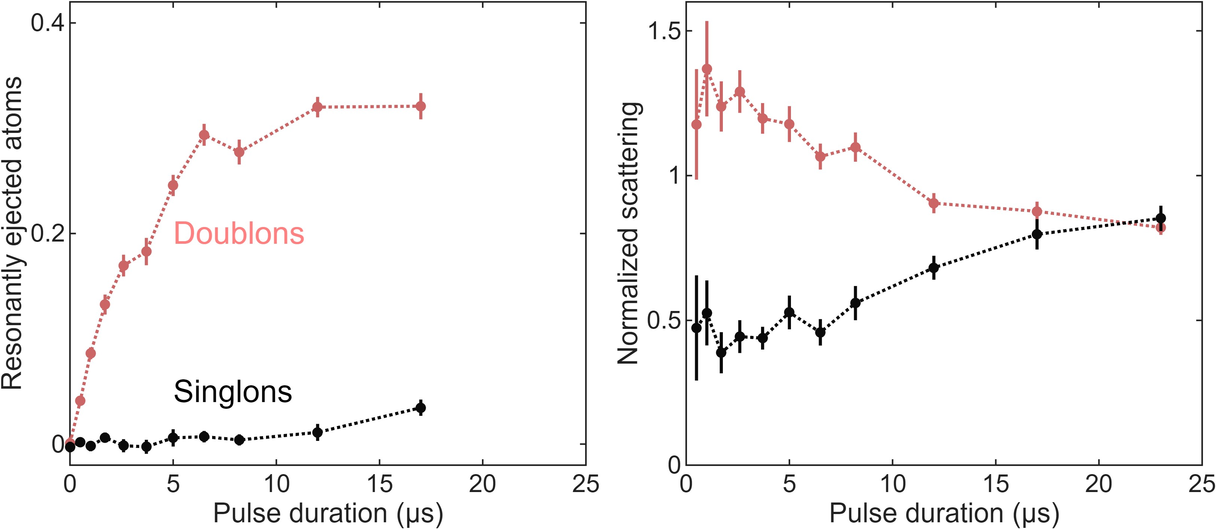
Dynamics of the Condon Region
Number of resonantly ejected atoms increases as a function of pulse duration
Doesn’t immediately saturate because the region is getting refilled by inner wavefunction

Slide 17
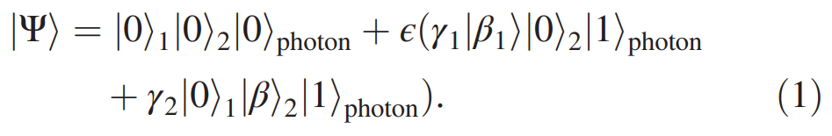
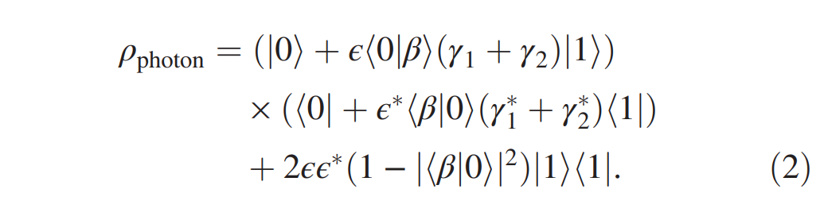
Partial Trace Picture

Slide 18
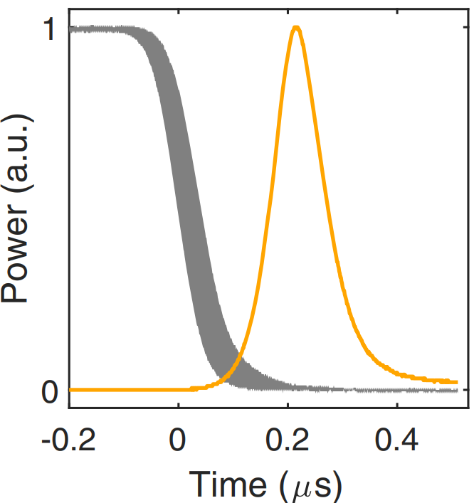
Light pulses

