Slide 1
ML Based Power Maximization of Heat Engines
Using Lennard-Jones Potential
20241292 박은재
20231267 정종원

Slide 2
Contents
Theoretical Background
Design Method
Working Example
Further Improvement Needed
Reference

Slide 3
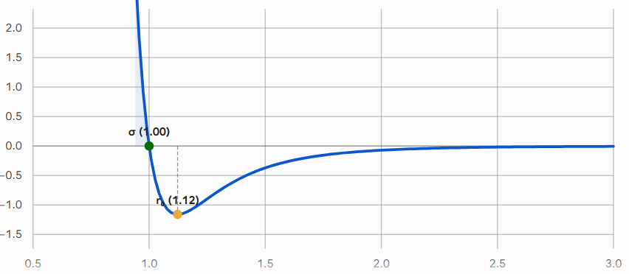
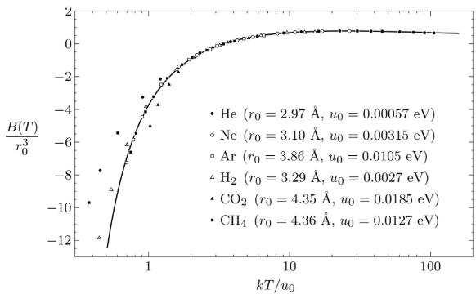
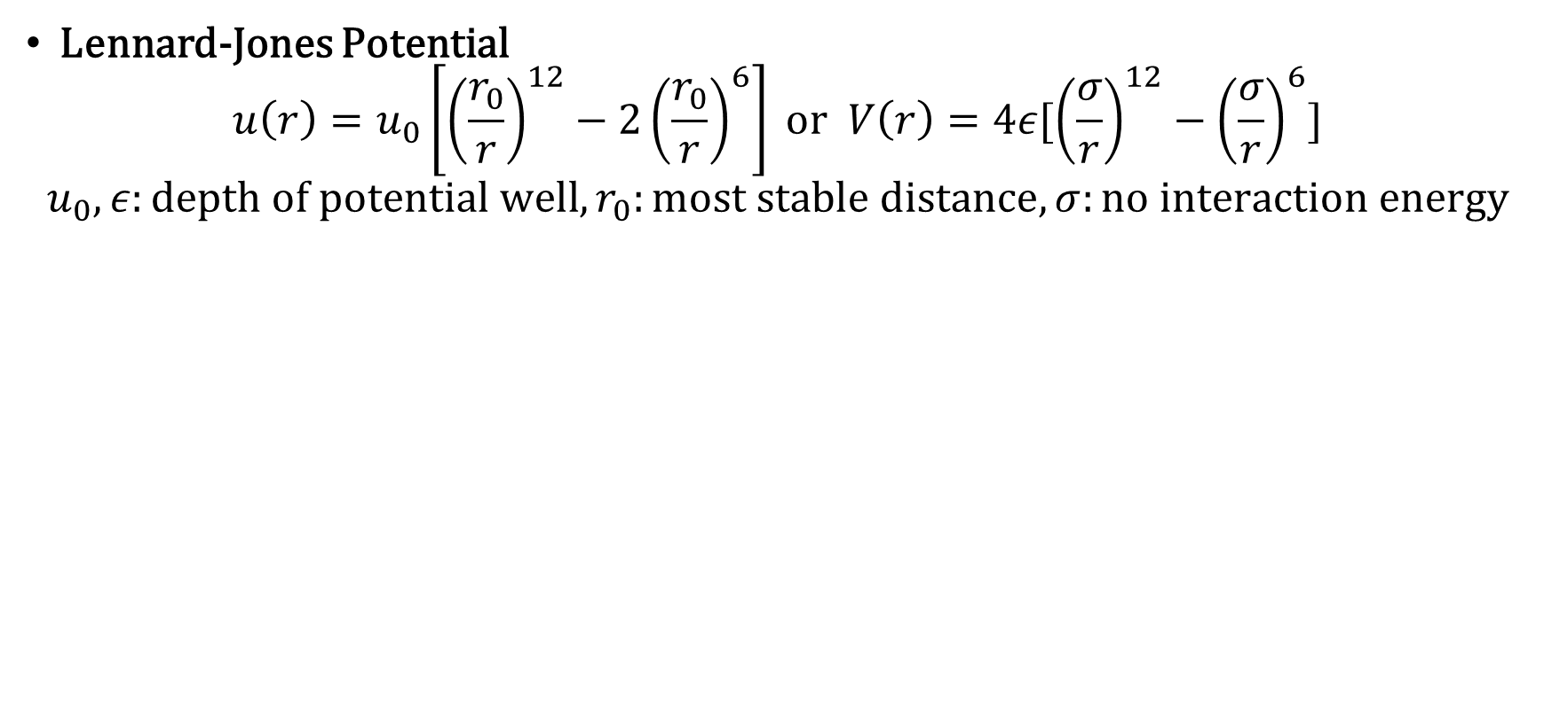
Theoretical Background
Lennard-Jones Potential
$$u\left(r\right)=u_{0}\left[{\left(\frac{r_{0}}{r}\right)}^{12}−2{\left(\frac{r_{0}}{r}\right)}^{6}\right] or V\left(r\right)=4ε[{\left(\frac{σ}{r}\right)}^{12}−{\left(\frac{σ}{r}\right)}^{6}]$$
$$u_{0}, ε:depth of potential well, r_{0}:most stable distance, σ:no interaction energy$$
Good approximation for noble gases & nonpolar molecules
Notes:
식 두개 같은 식임, 검증 가능

Slide 4
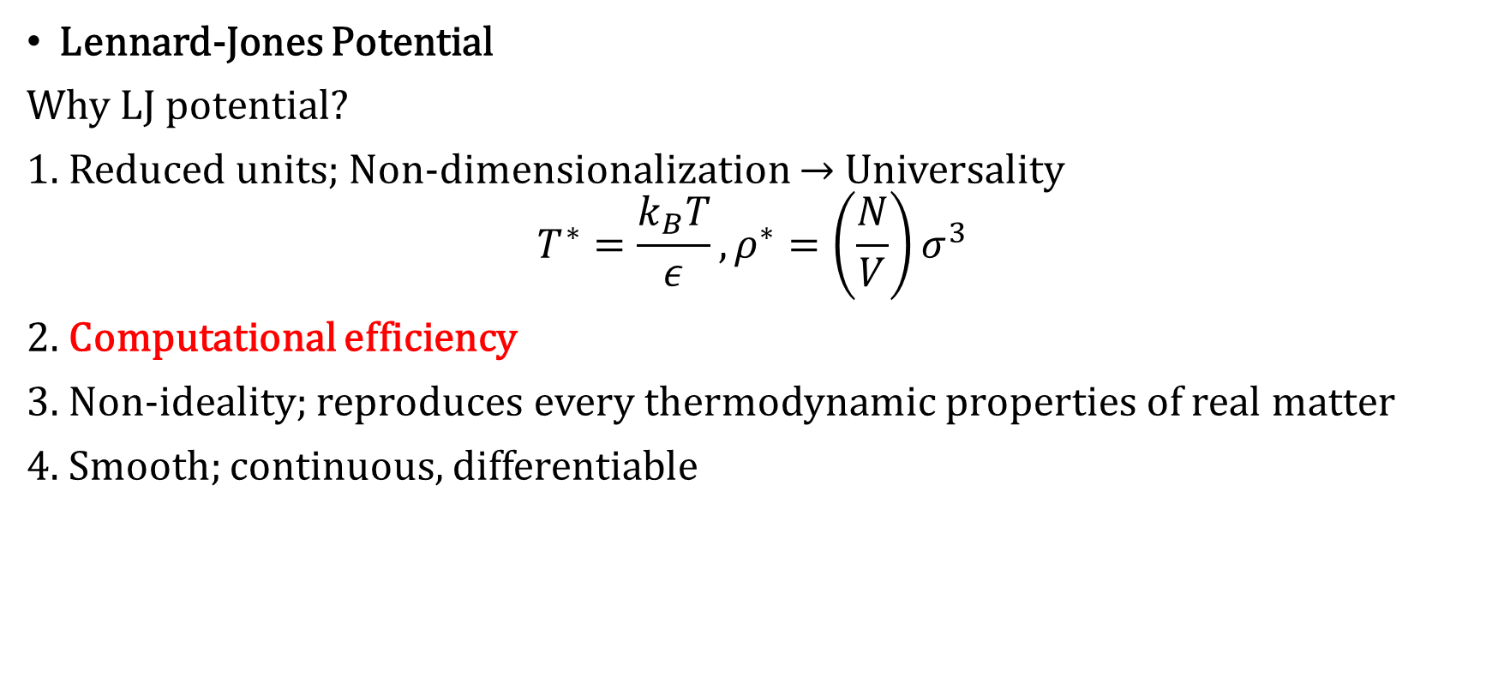
Theoretical Background
Lennard-Jones Potential
Why LJ potential?
1. Reduced units; Non-dimensionalization → Universality
$$T^{∗}=\frac{k_{B}T}{ε},ρ^{∗}=\left(\frac{N}{V}\right)σ^{3}$$
2. Computational efficiency
3. Non-ideality; reproduces every thermodynamic properties of real matter
4. Smooth; continuous, differentiable
Notes:
무차원량 의미: T 쪽은 Thermal energy scale과 결합에너지 epsilon 비교 -> T가 작으면 well에 갇혀 응축, T가 크면 입자가 well 나가서 ideal gas처럼 행동
밀도 쪽은 sigma가 turn-around point이므로 대략적 packing fraction을 구할 수 있음

Slide 5
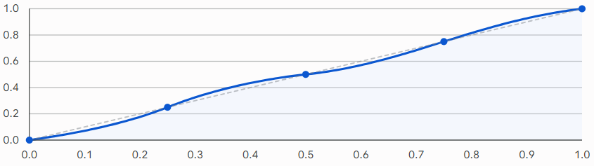
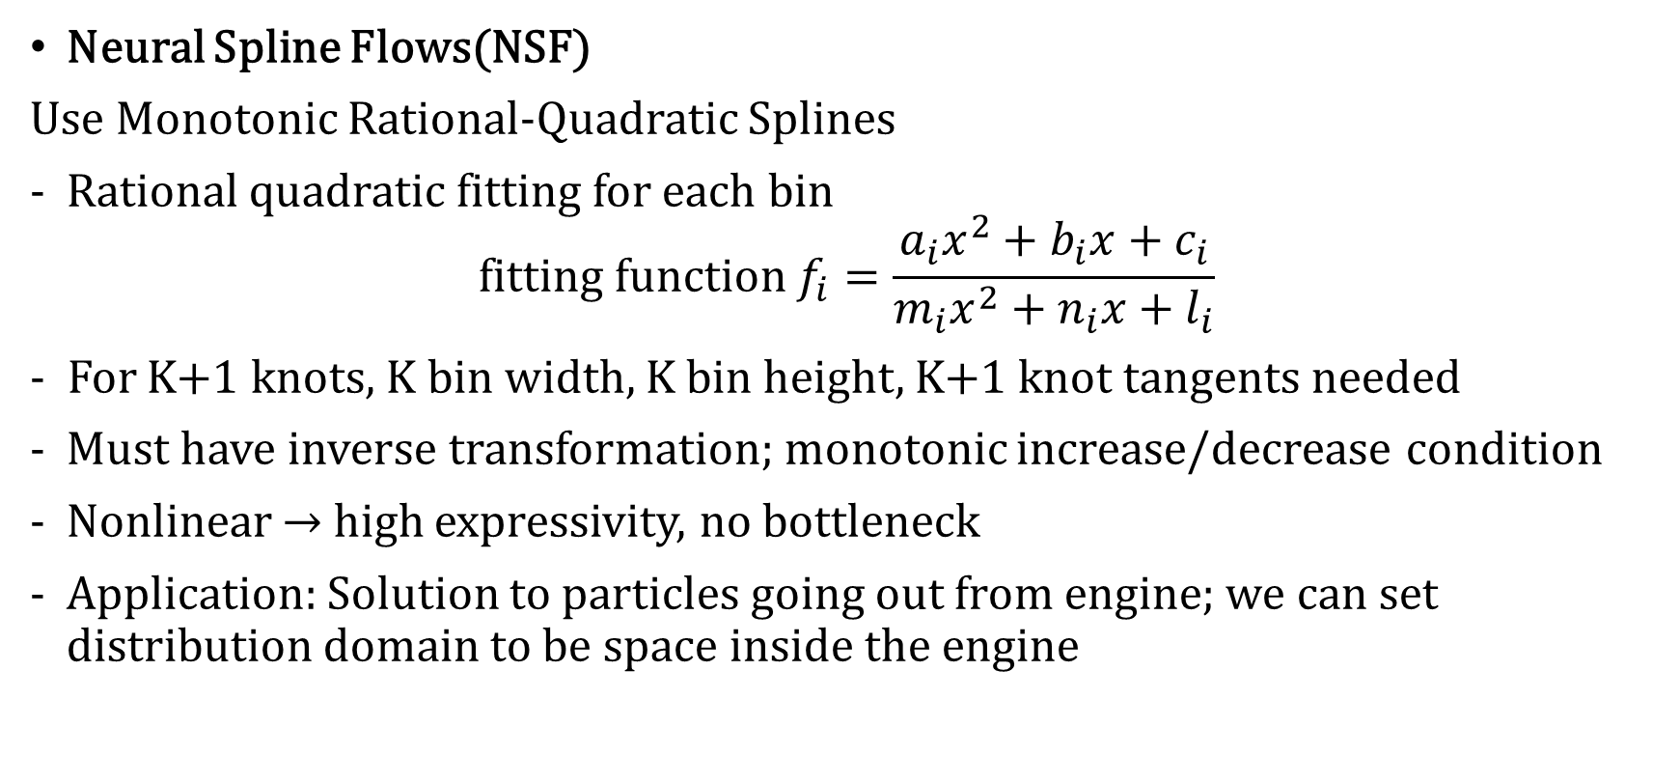
Theoretical Background
Neural Spline Flows(NSF)
Use Monotonic Rational-Quadratic Splines
Rational quadratic fitting for each bin
$$fitting function f_{i}=\frac{a_{i}x^{2}+b_{i}x+c_{i}}{m_{i}x^{2}+n_{i}x+l_{i}}$$
- For K+1 knots, K bin width, K bin height, K+1 knot tangents needed
Must have inverse transformation; monotonic increase/decrease condition
Nonlinear → high expressivity, no bottleneck
Application: Solution to particles going out from engine; we can set distribution domain to be space inside the engine
Notes:
Gaussian은 무한대까지 꼬리 뻗어있어서 벽뚫 가능성이 남아있고 실제로 학습시키다 벽뚫난게 한두번이 아님, 그래서 NSF로 실린더 내부 구간은 truncated normal distribution으로 하고 외부는 0으로 정해버리는 것-> 확률 보존하며 벽뚫방지

Slide 6
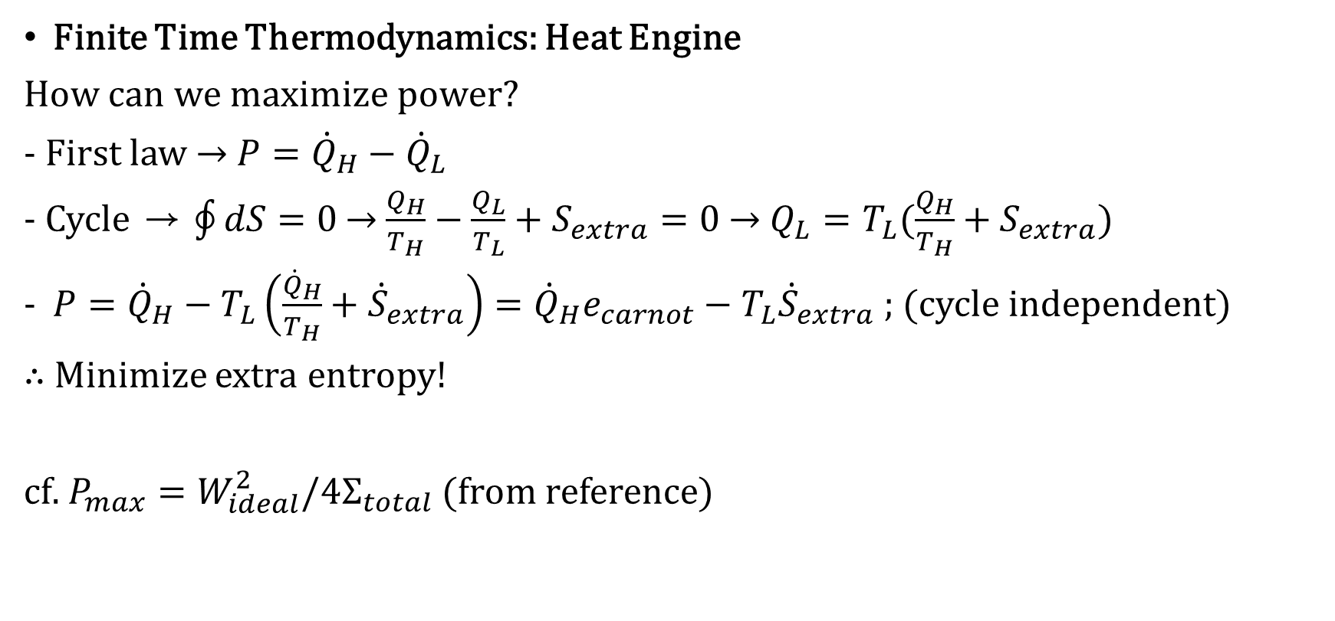
Theoretical Background
Finite Time Thermodynamics: Heat Engine
How can we maximize power?
- First law → $P={\dot{Q}}_{H}−{\dot{Q}}_{L}$
- Cycle → $\oint{dS}=0$ → $\frac{Q_{H}}{T_{H}}−\frac{Q_{L}}{T_{L}}+S_{extra}=0$ → $Q_{L}=T_{L}(\frac{Q_{H}}{T_{H}}+S_{extra})$
$P={\dot{Q}}_{H}−T_{L}\left(\frac{{\dot{Q}}_{H}}{T_{H}}+{\dot{S}}_{extra}\right)={\dot{Q}}_{H}e_{carnot}−T_{L}{\dot{S}}_{extra}$ ; (cycle independent)
∴ Minimize extra entropy!
cf. $P_{max}=W_{ideal}^{2}/4Σ_{total}$ (from reference)
Notes:
쉬운?파트. Power랑 엔트로피 생성 최소화 사이 관계 해명

Slide 7
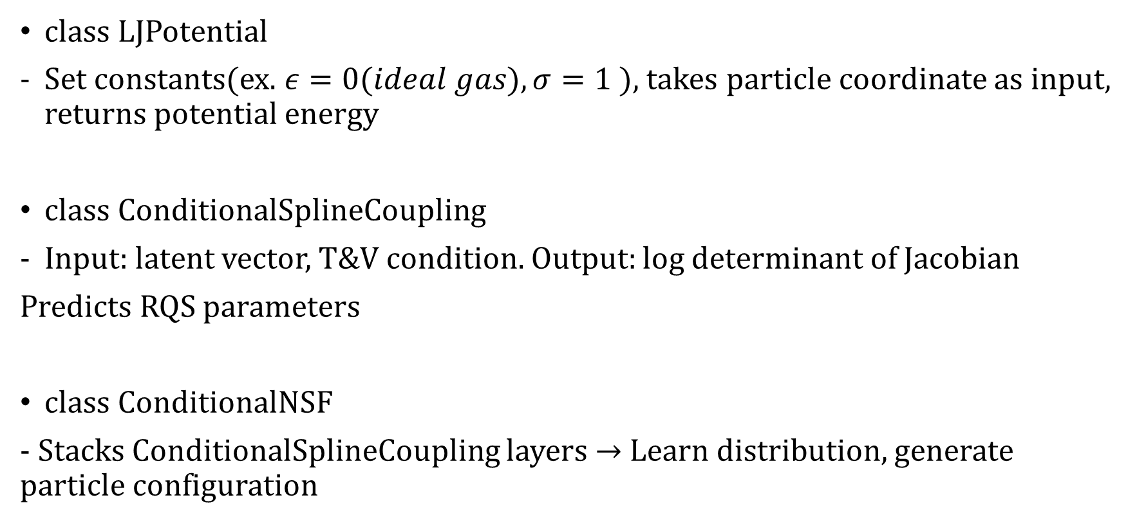
Design Method
class LJPotential
Set constants(ex. $ε=0(ideal gas), σ=1$), takes particle coordinate as input, returns potential energy
class ConditionalSplineCoupling
Input: latent vector, T&V condition. Output: log determinant of Jacobian
Predicts RQS parameters
class ConditionalNSF
- Stacks ConditionalSplineCoupling layers → Learn distribution, generate particle configuration

Slide 8
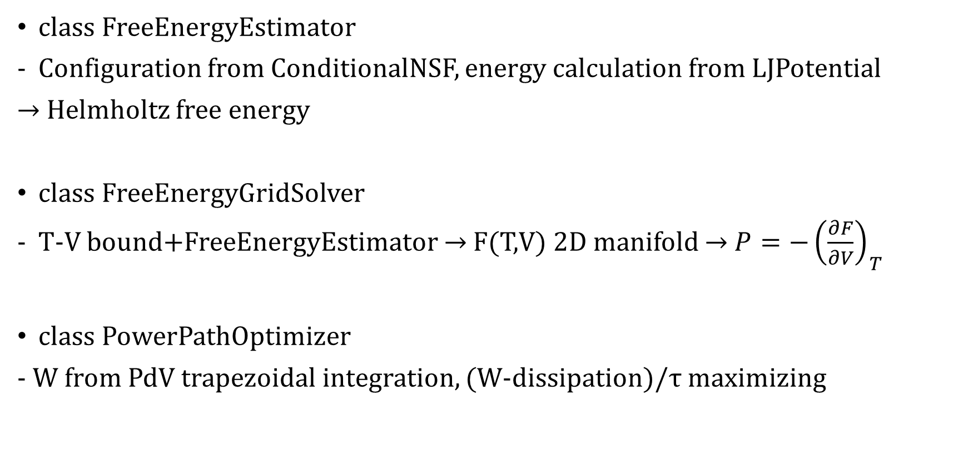
Design Method
class FreeEnergyEstimator
Configuration from ConditionalNSF, energy calculation from LJPotential
→ Helmholtz free energy
class FreeEnergyGridSolver
T-V bound+FreeEnergyEstimator → F(T,V) 2D manifold → $P=−{\left(\frac{∂F}{∂V}\right)}_{T}$
class PowerPathOptimizer
- W from PdV trapezoidal integration, (W-dissipation)/τ maximizing

Slide 9
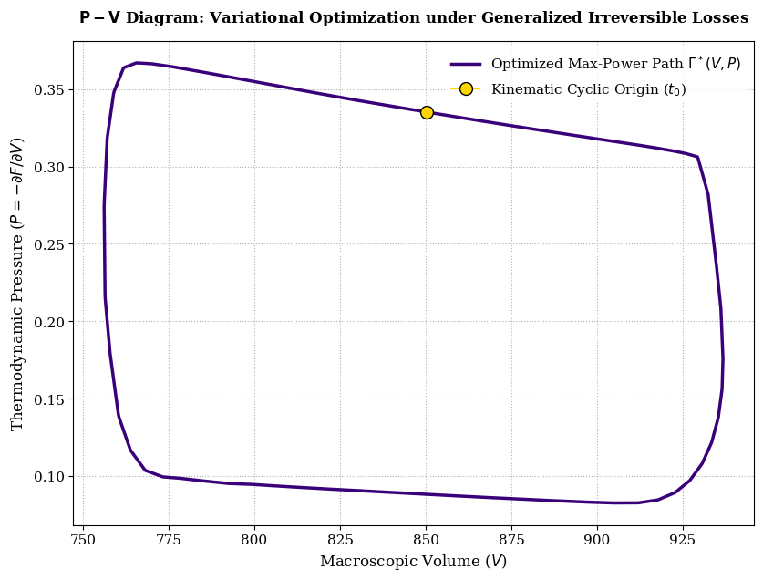
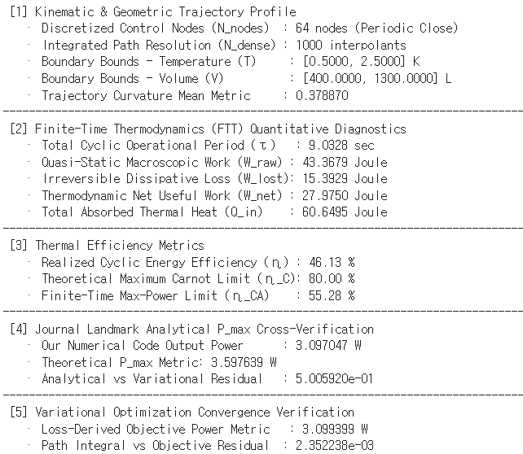
Working Example

Slide 10
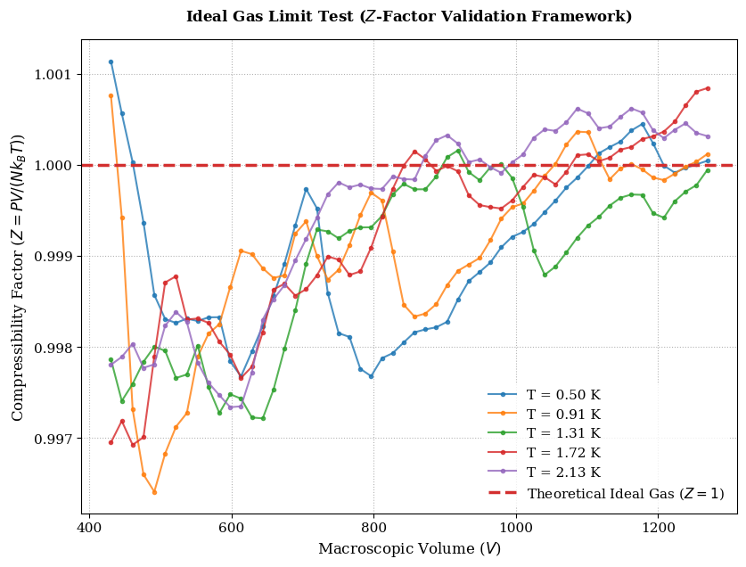

Working Example

Slide 11
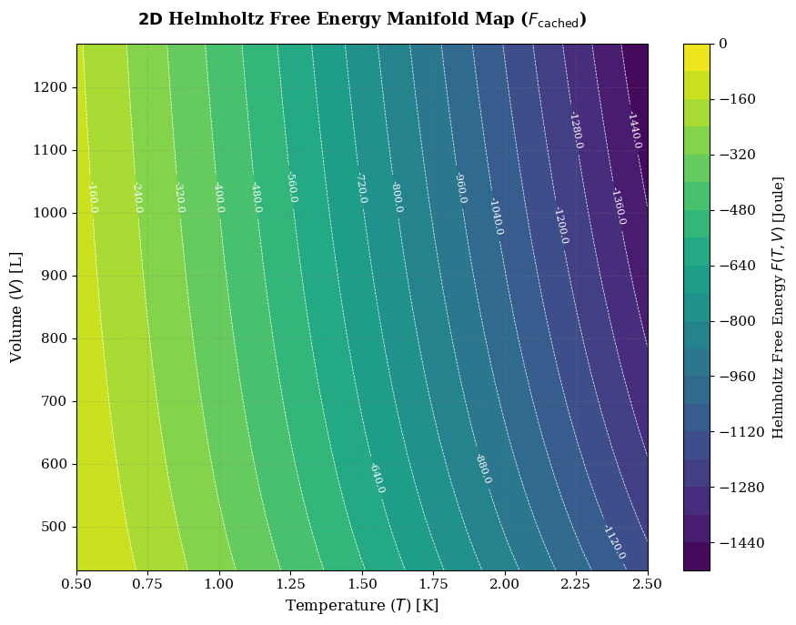
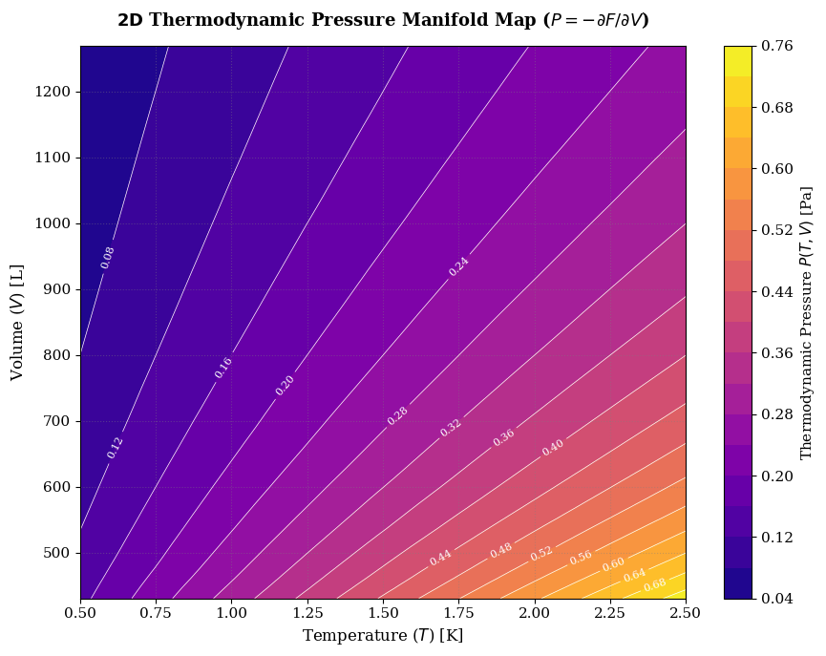
Working Example

Slide 12
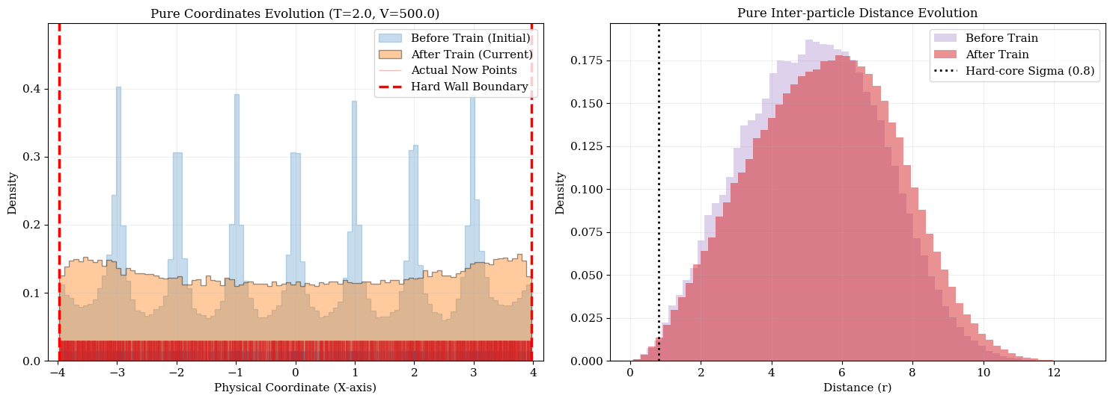
Working Example

Slide 13
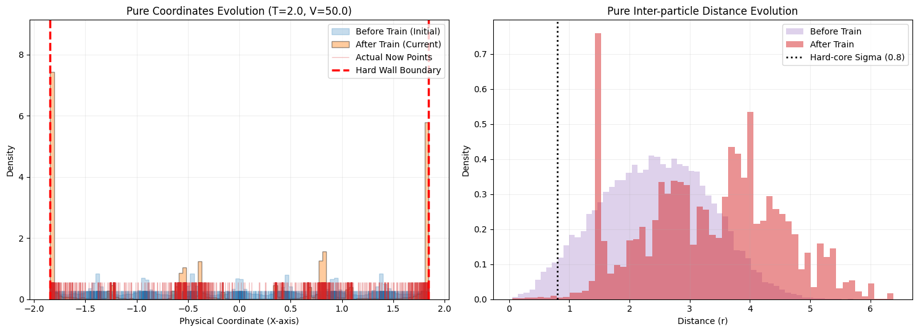
Further Improvement Needed

Slide 14
Reference
Daniel V. Schroeder, An Introduction to Thermal Physics, Oxford University Press, 2021, pp 126-127, pp 335-337
C. Durkan, A. Bekasov, I. Murray, G. Papamakarios, “Neural Spline Flows”, NeurIPS 2019. arXiv 1906.04032
A. Bejan, “Entropy generation minimization: The new thermodynamics of finite-size devices and finite-time processes”, J. Appl. Phys., vol. 79, no. 3, pp. 1191-1218, Feb. 1996
P. Abiuso, H. J. D. Miller, M. Perarnau-Llobet, and M. Scandi, "Geometric optimization of quantum thermodynamic processes," Entropy, vol. 22, no. 10, p. 1076, Sep. 2020

