Slide 1
To bring biological insights to everyone in the world
DREAM CHALLENGE PROTEOGENOMICS
sub task 2 overview

Slide 2
Contents
Overall architecture
Suggestions
Grouping proteins ( one model on one group)
Selecting Features based on Correlation (computational)
Additional features : Gene meta info
Additional features : Patients type label

Slide 3
Overall architecture
Proteins
mRNA(RNA-seq only)
CNA
Drop Missing proteins
feature oriented standadization(z-scoring)
Filled missing values as sample acrossing mean
Grouping Proteins
Select correlated Feauture Set
(RNA + CNA, 300)
Protein Group A
Train Model 1
Gene Meta Info(CODON count, GC percentage, Protein Folding Engergy)
.
.
.
Patient Type( clustering Label, 2 types )
Protein Group N
Train Model N
5-fold cv(Xgboost, gradient boost, random frorest)
Stacking Ensemble(by Ridge)

Slide 4
Suggestions
1. Grouping proteins ( one model on one group)
In the given protein set, build protein groups based on correlation score
First, pick one protein.
Calculate correlation score over proteins in the given set and select top 10 proteins. Exclude them from the protein set.
For the rest proteins, iterate that process until all proteins are fully selected.
Grouping increase sample size.
In leaderboard, the model with protein groups showed improved performance

Slide 5
Suggestions
2. Selecting Features based on Correlation (computational)
A model with 10 proteins has features of following:
The fundamental data corresponds to each of 10 proteins: protein id(pid), gene name, copy number alteration (CNA), RNA, CNA*RNA, meta data (gene meta info, patient type label)
Additionally, CNAs or RNAs of other proteins showing top 300 correlation score with the protein levels of 10 proteins

Slide 6
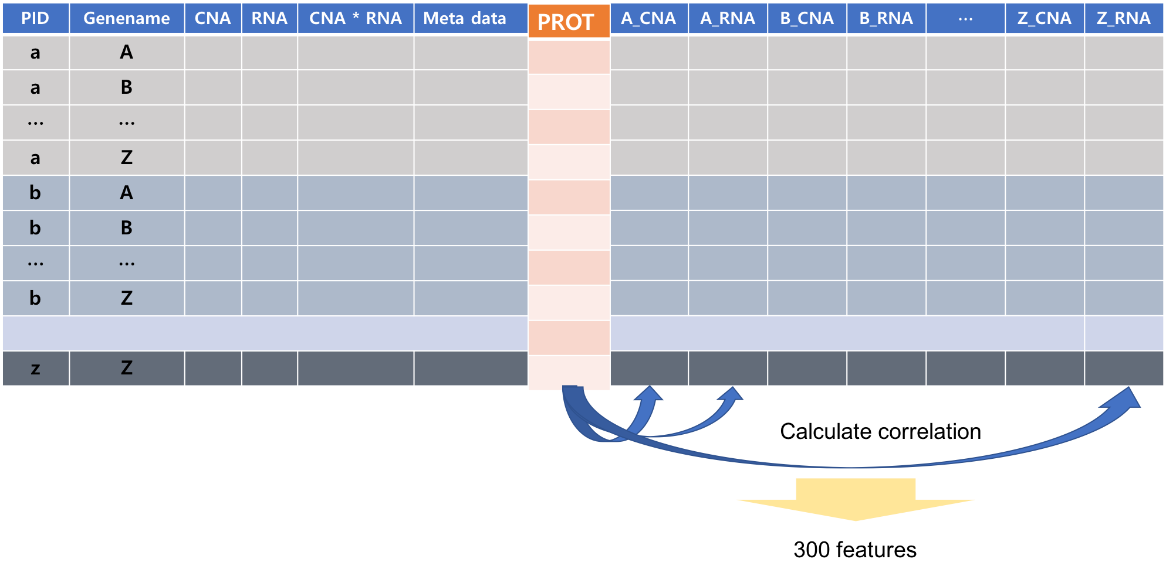
Suggestions
2. Selecting Features based on Correlation (computational)

Slide 7
Suggestions
3. Additional features : Gene meta info
- CODON counts, GC percentage, protein folding energy
4. Additional features : Patients type label (breast)
PCA and K-means clustering algorithms(k=2) with CNA and RNA data
This label shows similar clustering with that of PAM50 (representative bio-marker for breast cancer)

Slide 8
Thank you
‘To bring biological insights to everyone in the world’

