Slide 1
Survival Analysis (Elastic net regularization) 18.01.17

Slide 2
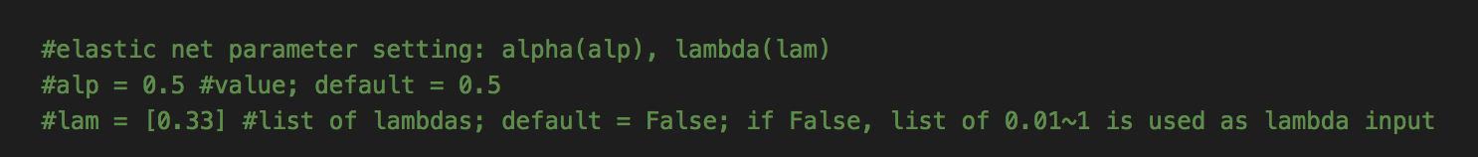
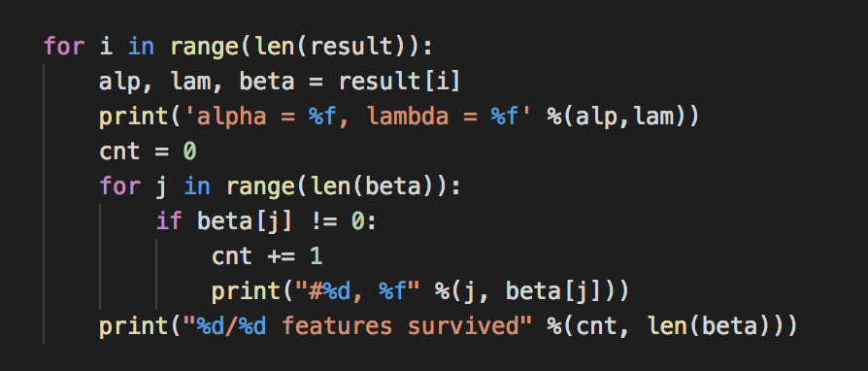
Build up
Elastic net regularization for Cox model (parameter: alpha, lambda)

Slide 3
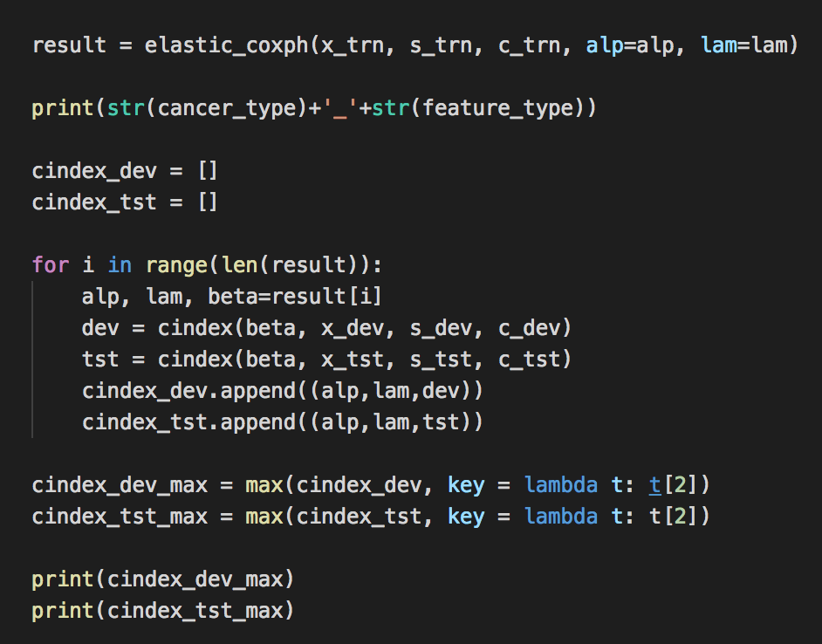
Build up
Elastic net regularization for Cox model (parameter: alpha, lambda)

Slide 4
Data
LUAD_T_ normalized_RNA-seq.hg19
LUAD_T_ RPM_miRNA.hg19.mirbase
LUAD_T_ betaValue_methyl.hg19.sd15
LUAD_T_ betaValue_methyl.hg19.sd17
LUAD_T_ betaValue_methyl.hg19.sd20
LUSC_T_ normalized_RNA-seq.hg19
LUSC_T_ RPM_miRNA.hg19.mirbase
LUSC_T_ betaValue_methyl.hg19.sd15
LUSC_T_ betaValue_methyl.hg19.sd17
LUSC_T_ betaValue_methyl.hg19.sd20

Slide 5
Elastic net regularization for Cox; grid search ( parameter: alpha = 0.0~0.9 (10), lambda = 0.0~0.59(60))
c–index
 | LUAD |  |  |  |  | LUSC
 | normalized_RNA-seq.hg19 20163 | RPM_miRNA.hg19.mirbase 1595 | betaValue_methyl.hg19.sd15 34513 | betaValue_methyl.hg19.sd17 | betaValue_methyl.hg19.sd20 | Normalized_RNA-seq.hg19 20172 | RPM_miRNA.hg19.mirbase 1565 | betaValue_methyl.hg19.sd15 34513 | betaValue_methyl.hg19.sd17 | betaValue_methyl.hg19.sd20
dev | 0.4, 0.23, 0.694 | 0.7, 0.02, 0.530 | 0.0, 0.0, 0.714 | 0.6,0.0,0.721 | 0.4,0.12,0.629 | 0.4, 0.55, 0.750 | 0.3, 0.59, 0.625 | 0.5, 0.47, 0.500 | 0.8,0.0,0.625 | 0.1,0.19,0.547
tst | 0.3, 0.49, 0.622 | 0.9, 0.13, 0.714 | 0.6, 0.24, 0.613 | 0.8,0.18 0.558 | 0.0,0.0,0.520 | 0.4, 0.55, 0.578 | 0.5, 0.31, 0.565 | 0.0, 0.0, 0.621 | 0.0,0.0,0.638 | 0.0,0.0,0.628
(Alpha,lambda,maximum c-index)

Slide 6
Elastic net regularization for Cox; grid search ( parameter: alpha = 0.0~0.9 (10), lambda = 0.0~0.59(100))
 | LUAD |  |  |  |  | LUSC
 | normalized_RNA-seq.hg19 | RPM_miRNA.hg19.mirbase | betaValue_methyl.hg19.sd15 | betaValue_methyl.hg19.sd17 | betaValue_methyl.hg19.sd20 | Normalized_RNA-seq.hg19 | RPM_miRNA.hg19.mirbase | betaValue_methyl.hg19.sd15 | betaValue_methyl.hg19.sd17 | betaValue_methyl.hg19.sd20
dev | 0.6940298507462687 | 0.5298507462686567 | 0.7142857142857143 | 0.7214285714285714 | 0.6285714285714286 | 0.75 | 0.625 | 0.5 | 0.625 | 0.546875
tst | alpha=0.400000, lambda=0.230000 0.5861266294227188 | alpha=0.700000, lambda=0.020000 0.5833333333333334 | alpha=0.000000, lambda=0.000000 0.5124282982791587 | alpha=0.600000, lambda=0.000000 0.4574569789674952 | alpha=0.400000, lambda=0.120000 0.49569789674952197 | alpha=0.300000, lambda=0.740000 0.5747368421052632 | alpha=0.200000, lambda=0.850000 0.5389473684210526 | alpha=0.300000, lambda=0.790000 0.5503157894736842 | alpha=0.800000, lambda=0.000000 0.5806315789473684 | alpha=0.100000, lambda=0.190000 0.6105263157894737

Slide 7
Feature Selection
parameter(alp, lam) was set at which c-index is maximized
 | LUAD |  |  |  |  | LUSC
 | normalized_RNA-seq.hg19 20163 | RPM_miRNA.hg19.mirbase 1595 | betaValue_methyl.hg19.sd15 34513 | betaValue_methyl.hg19.sd17 | betaValue_methyl.hg19.sd20 | Normalized_RNA-seq.hg19 20172 | RPM_miRNA.hg19.mirbase 1565 | betaValue_methyl.hg19.sd15 34513 | betaValue_methyl.hg19.sd17 | betaValue_methyl.hg19.sd20
# variables selected /# total | 0.3, 0.49, 46/20163 | 0.9, 0.13, 19/1595 | 0.6, 0.24, 14/34512 | 0.8,0.18 10/13819 | 0.0, 0.0, 3459/3459 | 0.4, 0.55, 1/20172 | 0.5, 0.31, 8/1565 | 0.0, 0.0, 34513/34513 | 0.0, 0.0, 13819/13819 | 0.0, 0.0, 3459/3459
Q? 어떤 경우인지?
Deep learning feature reduction 에 활용가능
Maximum c-index 나오는 parameter(위의 경우) + 다른 어떤 조건에서의 parameter 확인?
Notes:
13819/13819?
i.e. Lambda=0 사용 가능?

Slide 8
Feature Selection
 | LUAD |  |  |  |  | LUSC
 | normalized_RNA-seq.hg19 | RPM_miRNA.hg19.mirbase | betaValue_methyl.hg19.sd15 | betaValue_methyl.hg19.sd17 | betaValue_methyl.hg19.sd20 | Normalized_RNA-seq.hg19 | RPM_miRNA.hg19.mirbase | betaValue_methyl.hg19.sd15 | betaValue_methyl.hg19.sd17 | betaValue_methyl.hg19.sd20
# features selected /# total | alpha=0.400000, lambda=0.230000 114/20163 features survived | alpha=0.700000, lambda=0.020000 265/1595 features survived | alpha=0.000000, lambda=0.000000 34513/34513 features survived | alpha=0.600000, lambda=0.000000 808/13819 features survived | alpha=0.400000, lambda=0.120000 141/3459 features survived | alpha=0.300000, lambda=0.740000 1/20172 features survived | alpha=0.200000, lambda=0.850000 6/1565 features survived | alpha=0.300000, lambda=0.790000 5/34513 features survived | alpha=0.800000, lambda=0.000000 366/13819 features survived | alpha=0.100000, lambda=0.190000 550/3459 features survived

Slide 9
Data
LUAD_T_ normalized_RNA-seq.hg19
LUAD_T_ RPM_miRNA.hg19.mirbase
LUAD_T_ betaValue_methyl.hg19.sd15
LUAD_T_ normalized_RNA-seq.hg19
LUAD_T_ RPM_miRNA.hg19.mirbase
LUAD_T_ betaValue_methyl.hg19.sd17
LUAD_T_ normalized_RNA-seq.hg19
LUAD_T_ RPM_miRNA.hg19.mirbase
LUAD_T_ betaValue_methyl.hg19.sd20
LUSC_T_ normalized_RNA-seq.hg19
LUSC_T_ RPM_miRNA.hg19.mirbase
LUSC_T_ betaValue_methyl.hg19.sd15
LUSC_T_ normalized_RNA-seq.hg19
LUSC_T_ RPM_miRNA.hg19.mirbase
LUSC_T_ betaValue_methyl.hg19.sd17
LUSC_T_ normalized_RNA-seq.hg19
LUSC_T_ RPM_miRNA.hg19.mirbase
LUSC_T_ betaValue_methyl.hg19.sd20

Slide 10
Elastic net regularization for Cox; grid search ( parameter: alpha = 0.0~0.9 (10), lambda = 0.0~0.59(60))
c–index maximum
 | LUAD |  |  | LUSC
 | 15 | 17 | 20 | 15 | 17 | 20
dev | 0.646 | 0.648 | 0.618 | 0.625 | 0.667 | 0.641
tst | 0.650 | 0.631 | 0.619 | 0.588 | 0.594 | 0.590
(Alpha,lambda,maximum c-index)

Slide 11
Elastic net regularization for Cox; data concatenate;
grid search ( parameter: alpha = 0.0~0.9 (10), lambda = 0.0~0.59(100))
c–index
 | LUAD |  |  | LUSC
 | 15 | 17 | 20 | 15 | 17 | 20
validation | 0.6190476190476191 | 0.5904761904761905 | 0.638095238095238 | 0.5625 | 0.625 | 0.75
test | alpha=0.800000, lambda=0.010000 0.5221674876847291 | alpha=0.500000, lambda=0.010000 0.5651589789520824 | alpha=0.600000, lambda=0.010000 0.5606806986117331 | alpha=0.200000, lambda=0.270000 0.5393684210526316 | alpha=0.400000, lambda=0.610000 0.5591578947368421 | alpha=0.300000, lambda=0.810000 0.5747368421052632

Slide 12
Elastic net regularization for Cox; data concatenate; 3-fold cross validation;
grid search ( parameter: alpha = 0.0~0.9 (10), lambda = 0.0~0.59(60))
c–index
 | LUAD |  |  | LUSC
 | 15 | 17 | 20 | 15 | 17 | 20
validation |  | 0.6395299716816029 | 0.636202115401392 | 0.559832555981845
test | alpha = 0.200000, lambda = 0.600000 82/56271 features survived 0.5772503358710255 | alpha = 0.200000, lambda = 0.600000 77/35577 features survived 0.5727720555306762 | alpha = 0.200000, lambda = 0.600000 75/25217 features survived 0.5754590237348858 | alpha = 0.100000, lambda = 0.000000 3026/56250 features survived 0.5532631578947368 | alpha = 0.100000, lambda = 0.000000 2717/35556 features survived 0.5486315789473685 | alpha = 0.100000, lambda = 0.000000 2489/25196 features survived 0.5418947368421053

Slide 13
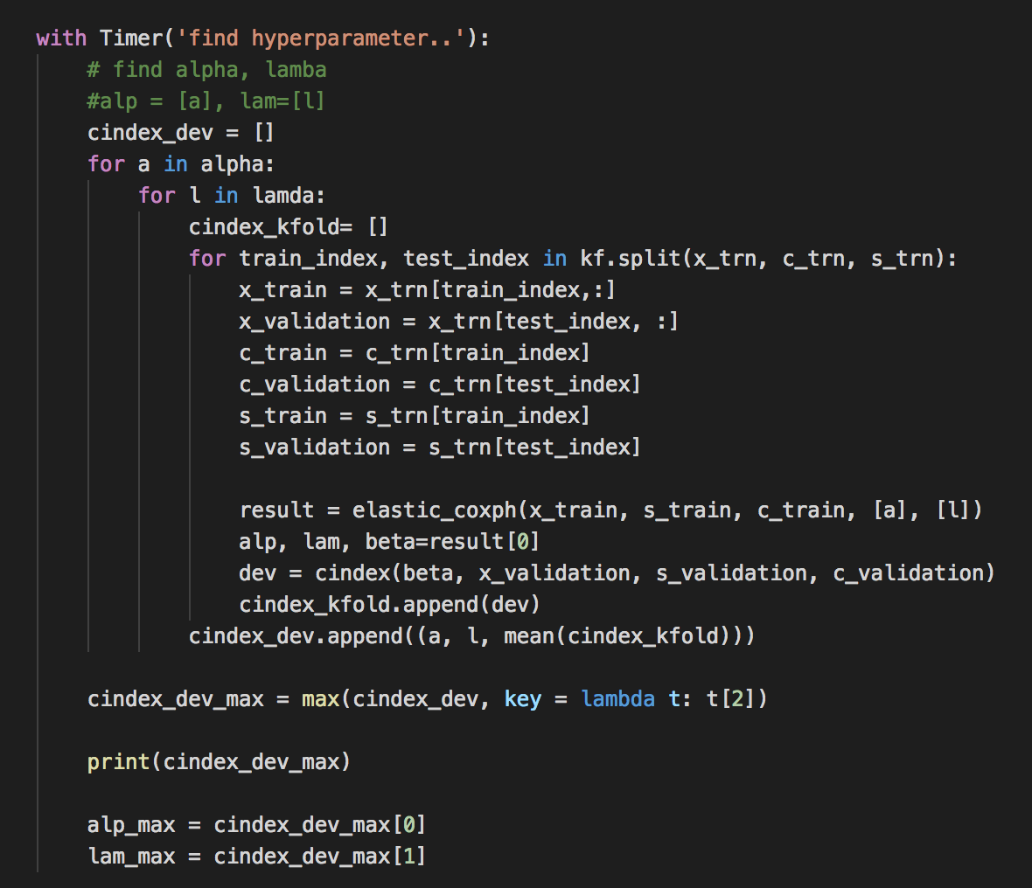
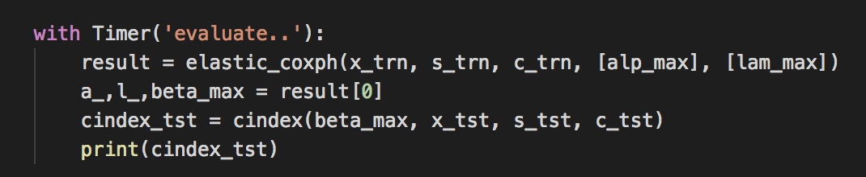
Cross-validation; Build up
(a,l)
Training_set
test_set

Slide 14
Elastic net regularization for cox; Bayesian Optimization; Build up

Slide 15
Survival Analysis (Support Vector Machine) 18.01.10

Slide 16
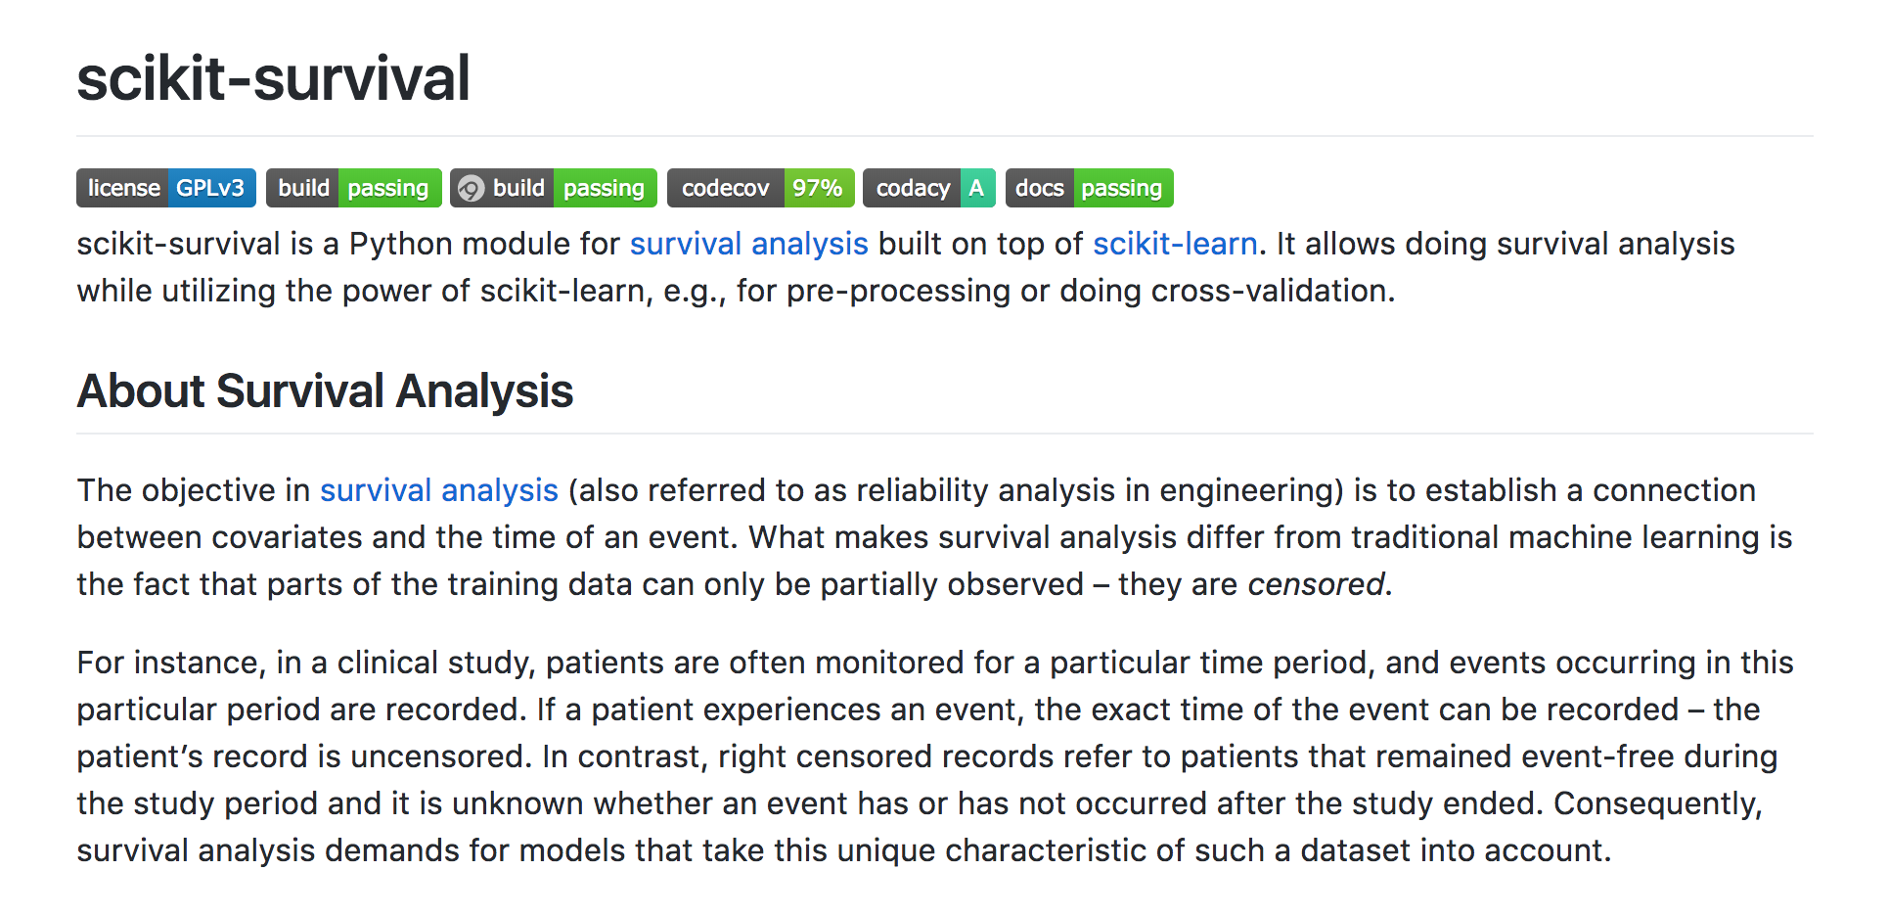
SVM for cox
https://github.com/sebp/scikit-survival

Slide 17
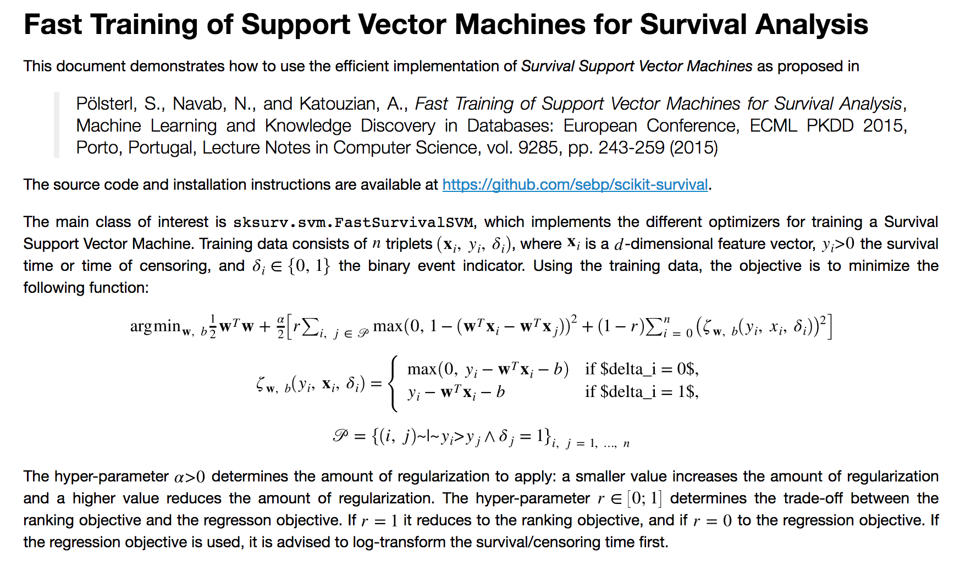
SVM for cox
https://github.com/sebp/scikit-survival

Slide 18

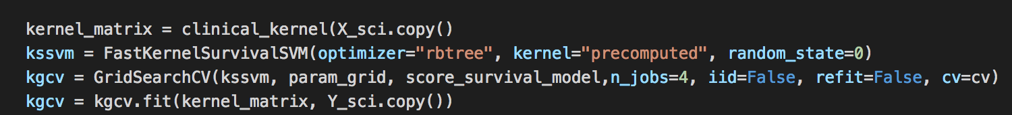
Build up
Support Vector Machine for survival analysis

