Slide 1
Find n-th element from Stern’s Diatomic Series
https://www.geeksforgeeks.org/find-n-th-element-from-sterns-diatomic-series/
2018.07.15 원은지

Slide 2
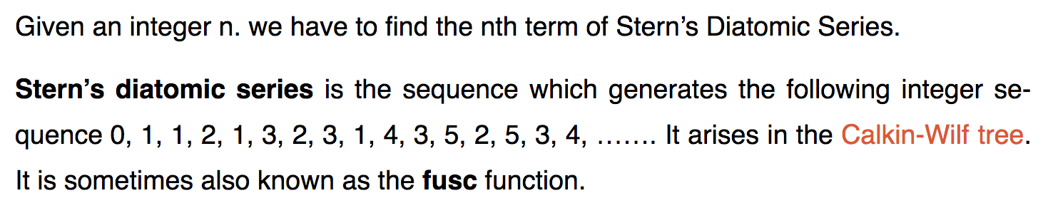
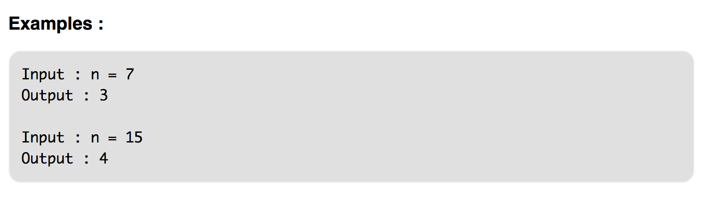
어떤 문제인가?

Slide 3
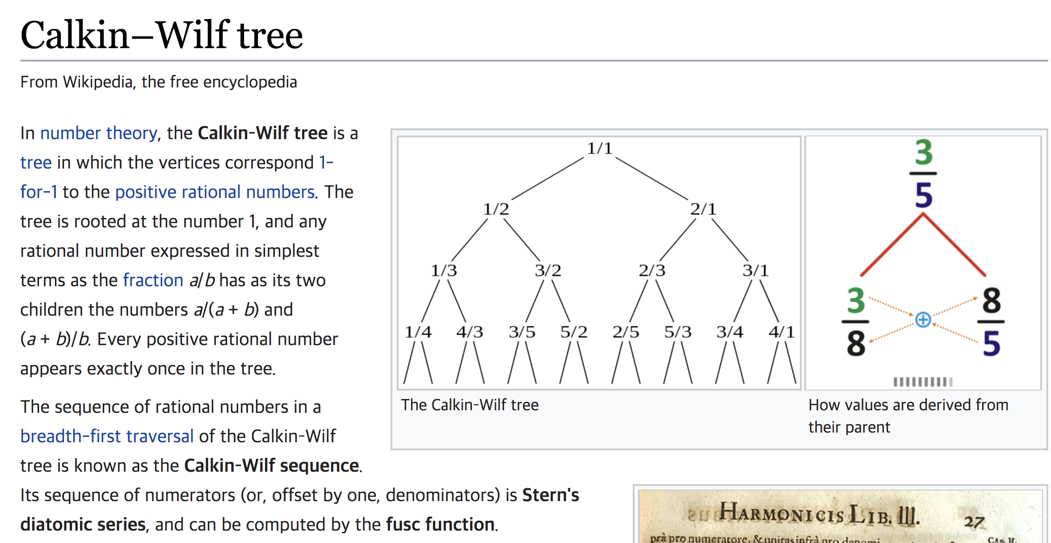

Slide 4

