Slide 1
Subset with sum divisible by m
https://www.geeksforgeeks.org/subset-sum-divisible-m/
2018.08.05 원은지

Slide 2
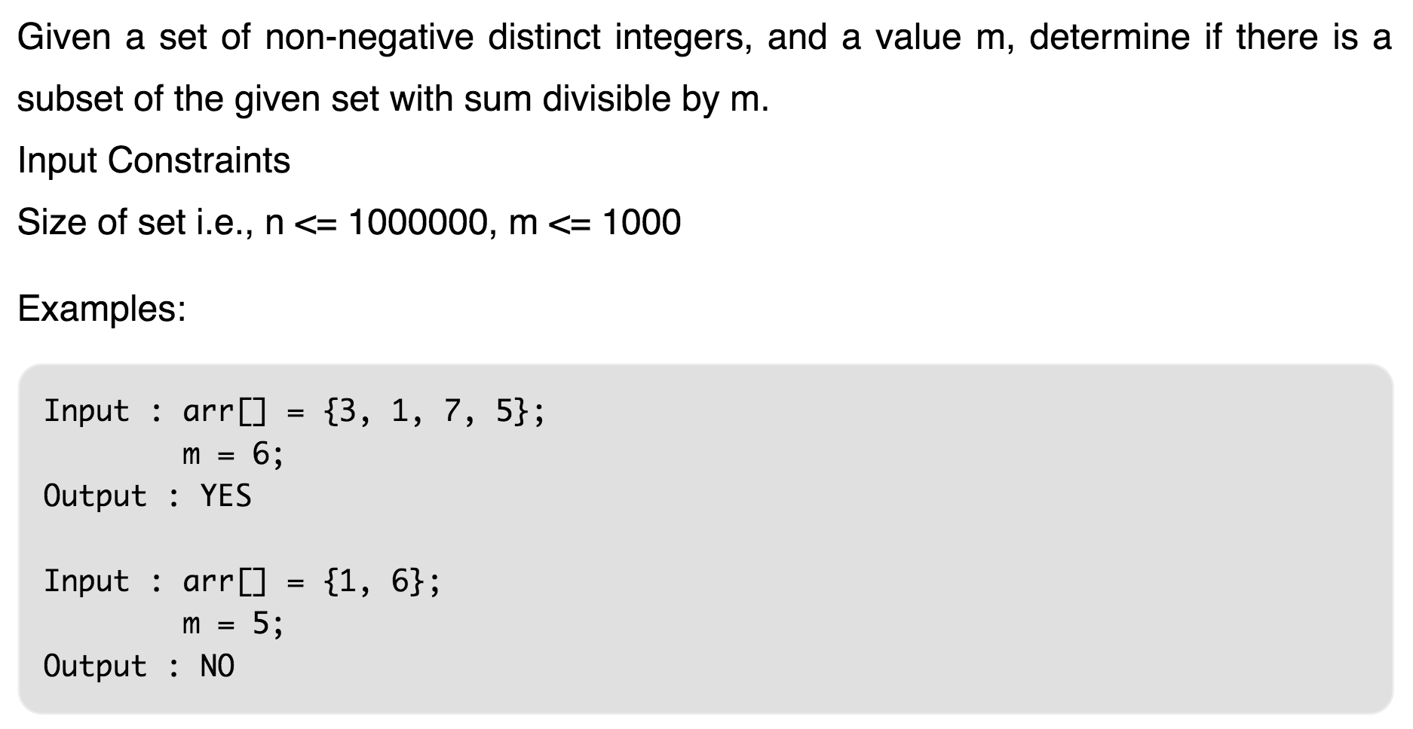
어떤 문제인가?

Slide 3
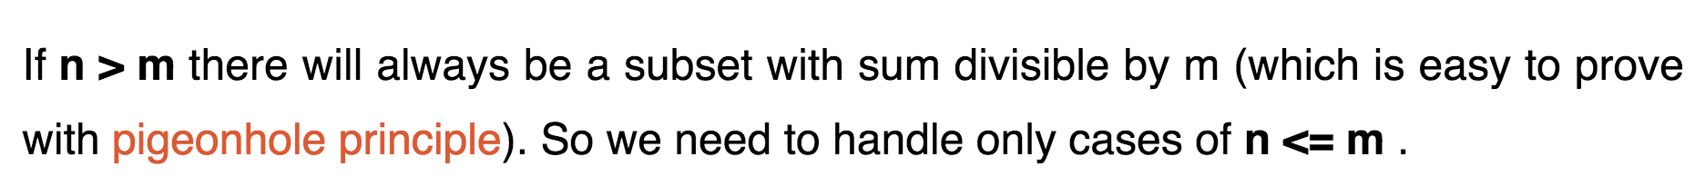
어떻게 푸는가?

Slide 4
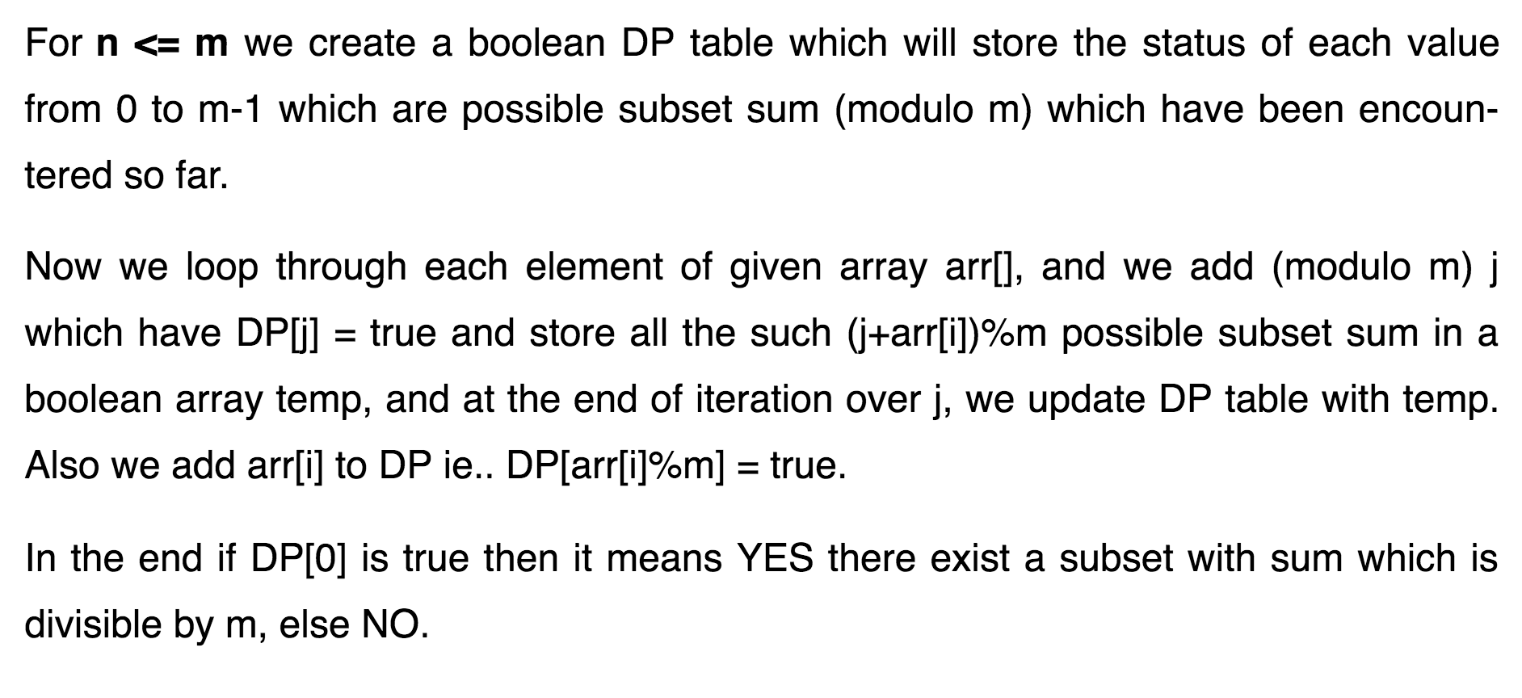
어떻게 푸는가?

Slide 5
어떻게 푸는가?
https://www.geeksforgeeks.org/subset-sum-divisible-m/

