Slide 1
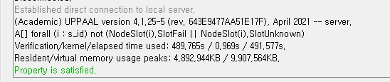
TENDERMINT_7NODE_1VALUE

