Slide 1
Exploring Author Gender in Book Rating and Recommendation
Michael D.Ekstrand, Mucun Tian, Mohammed R. Imran Kazi, Hoda Mehrpouyan, Daniel Kluver
RecSYS 2018
CSCE 670 Paper Breakdown Presented by:
Unnati Eramangalath
UIN : 930001393

Slide 2

What is so interesting about it?
Social efforts are made in many segments of publishing industry to improve representation of women, ethnic minorities, and other underrepresented groups in the literary landscape; Recommender systems are one of the mediating factors that affect how they get to their audience .
This paper seeks to understand how different recommendation algorithms interact with such efforts: are they a help, a hindrance, or a neutral conduit?
Goal – To figure out which of these three paths does the recommender take and to what extent.

Slide 3
Research Questions Addressed
RQ1 How are author genders distributed in cataloged books?
RQ2 How are author genders distributed in user book ratings?
RQ3 How are author genders distributed in recommendations?
RQ4 How do recommendations respond to user profiles?

Slide 4
How did they position Algorithmic and Recommendation fairness?
Provider Fairness – Authors of recommended contents and how the system treats them taking a user perspective.
Calibrated Fairness – How does the balance of the output recommendations relate to the balance of the input profile.
Also, the paper simply describes the current state of the data and algorithms and DOES NOT make any normative claims regarding the distributions observed.

Slide 5
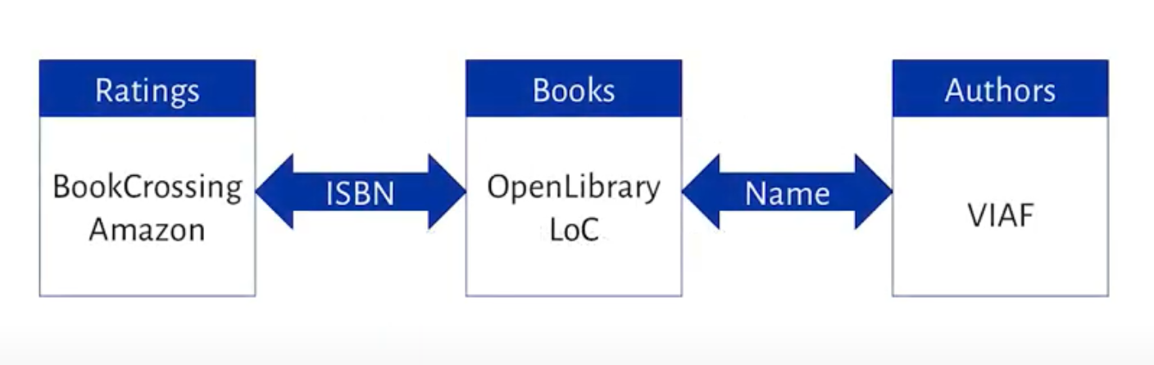
Data Sources and Integration
Ratings - Used to train Collaborative Filter and analyze user consumption profile.
Book Meta Data – Information on who are the authors?
Still no information of authors as people ☹ , So…
Virtual Internet Authority File – Has Author metadata and one field for Gender Identity.
LINK THEM TOGETHER!

Slide 6
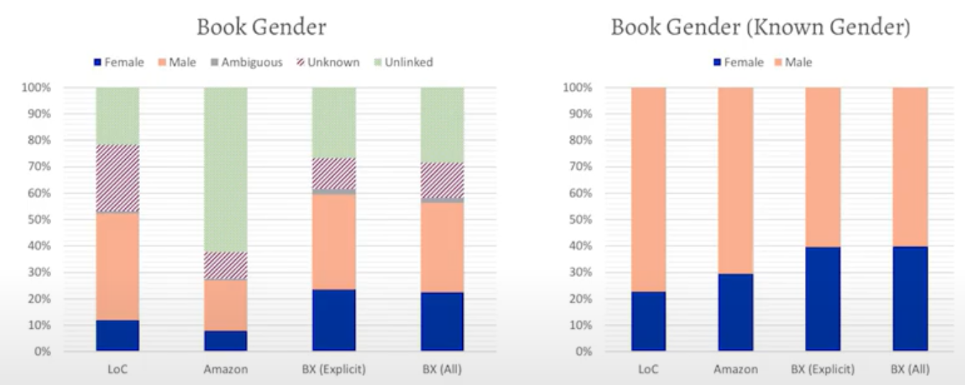
RQ1 Catalog Distribution
Baseline Gender Distribution :
Women are more represented in the rated books than they are in the book inventory as approximated by the LOC.
Representation among rated books is more balanced.

Slide 7
Recommender Experiment
Sample 1000 users ( each rating 5 books with known author gender)
Measure user profile gender distribution (RQ2)
Generate 50 recommendations for each user.
i) User-User
ii) Item-Item
iii) MF
iv) Poisson factorization
Compute recommendation list distribution (RQ3)
Compute recommendation lists to user profiles (RQ4)

Slide 8
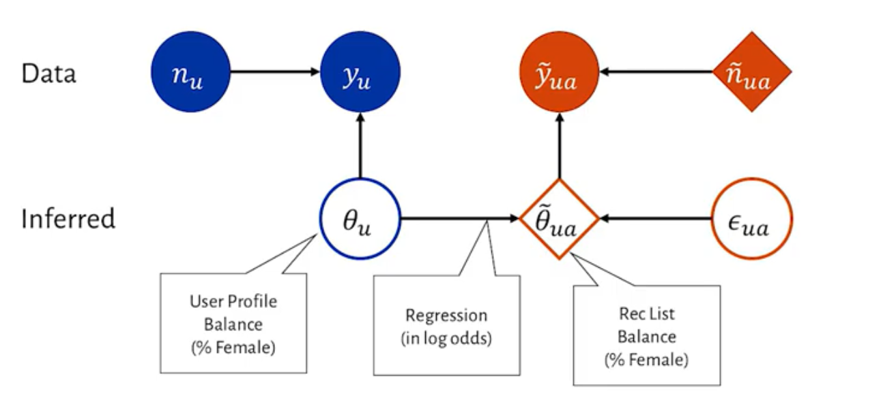
Hierarchical Bayesian Model
Model user rating behavior for books by female authors out of the set of books with known authors.
Model recommendation list distributions as a linear function of user profile distributions + random variance.

Slide 9
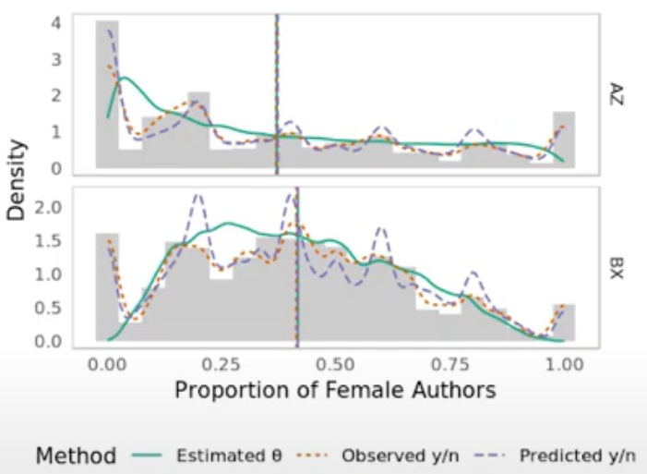
RESULTS
RQ2 : User Profile Distribution
Mild tendency towards male authors (mean < 0.5)
High Variance in user profile composition
Average is more balanced than book catalog.
User are diffuse in their rating tendencies, with an overall trend favoring male authors but less strongly than the baseline distribution.

Slide 10
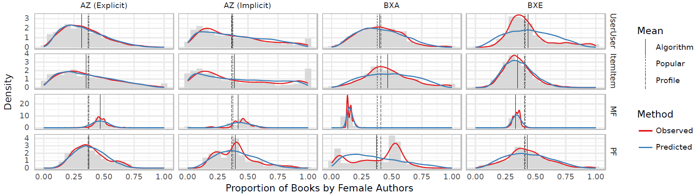
RQ3 : Recommendation List Distribution
Different CF techniques produce recommendations with quite different distributions.
Less Variance than User profiles.
Average balance usually comparable.
Nearest Neighbor had most shift (closer to user profile) ( U-U on explicit ratings , I-I on BX)
MF on Book Crossing produced reliably male-biased recommendations.

Slide 11
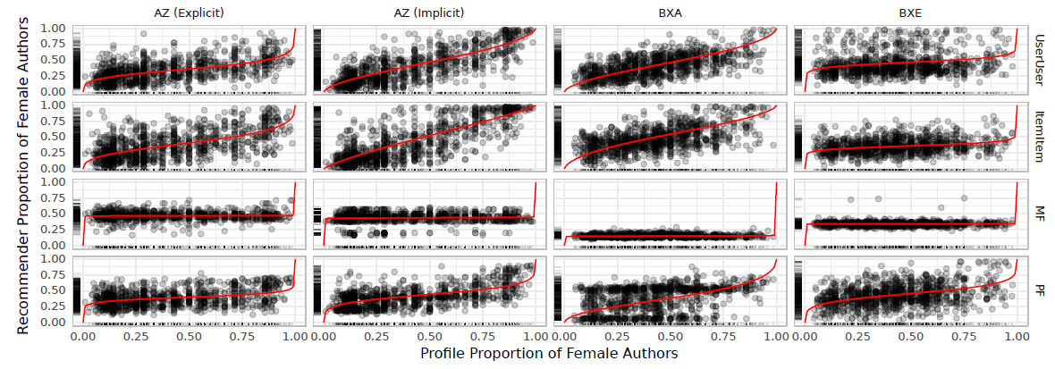
RQ4 : Recommendation List Response
Personalized algorithms propagate some of the user input balance into the output recommendations, though the extent varies.
Reflection of each user’s profile tendency in their recommendations was substantially stronger for implicit feedback than explicit feedback recommendations.

Slide 12
Conclusion
Users in Book Crossing data exhibit milder diffuse tendency towards books written by men as compared to users in Amazon dataset.
User profiles are more balanced than book catalog.
The Matrix Factorization technique tested consistently exhibited a much stronger bias towards male authors and was largely oblivious to individual user’s preferences or biases.
Nearest–Neighbor and PF Algorithms propagated (some) user balance to recommendations.
Thus recommender's interaction with gender distributions depend on algorithm, application and a few other variables.

Slide 13
Limitations
Rating data is extremely sparse
Algorithms didn’t perform particularly well
MF –> very non-personalized
Data and statistical models only consider binary gender identities.
Limited set of collaborative filtering algorithms.

Slide 14
Future Work
Better data
Better statistical model
More author features and domains
More diversifying algorithms
I feel considering the following aspects can also help study the trends and their differences:
Include geographical data as a parameter
Study genre-wise book data

Slide 15
THANK YOU! ☺

