Slide 1
Bpftime: Userspace eBPF runtime
https://github.com/eunomia-bpf/bpftime
Yusheng Zheng
yunwei356@gmail.com

Slide 2
Bpftime: Userspace eBPF runtime
bpftime, a full-featured, high-performance eBPF runtime designed to operate in userspace：
Fast Uprobe and Syscall hook capabilities
Userspace uprobe can be 10x faster than kernel uprobe
Trace the functions or modify the function calls
Programmatically hook all syscalls of a process safely and efficiently.
Monitor or Modify the syscall behavior
Compare to:
Wasm in userspace
eBPF in kernel space
Other userspace eBPF runtime and toolchains
Other plugin systems or runtimes

Slide 3
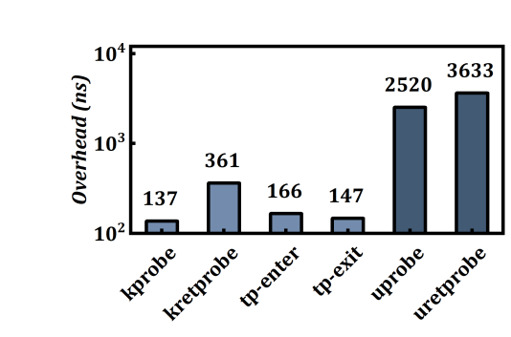
Motivation
1. Kernel Uprobe Performance Issues
Current UProbe implementation necessitates two kernel context copies.
Results in significant performance overhead.
Not suitable for real-time monitoring in latency-sensitive applications.
Uprobe's Wide Adoption in Production
Traces user-space protocols: SSL, TLS, HTTP2.
Monitors memory allocation and detects leaks.
Tracks threads and goroutine dynamics.
Provides passive, non-instrumental tracing.
And more...

Slide 4
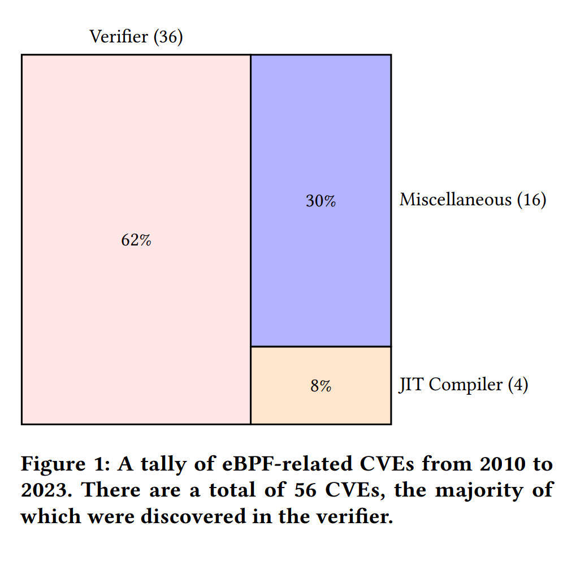
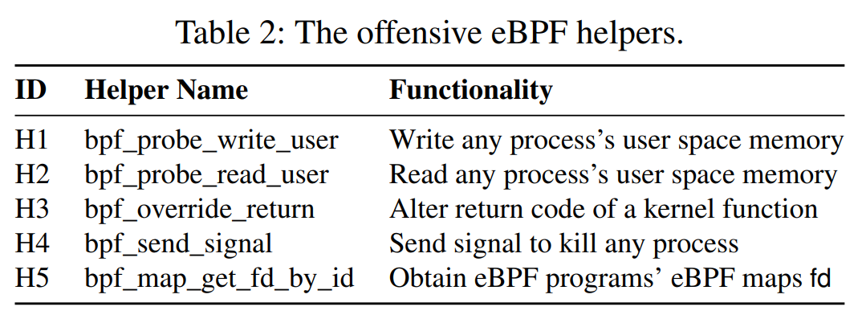
Motivation
2. Kernel eBPF Security Concerns and limited configurable
eBPF programs run in kernel mode, requiring root access.
Increases attack surface, posing risks like container escape.
Inherent vulnerabilities in eBPF can lead to Kernel Exploits.
Verifier has limited the operation of eBPF, config requires kernel change

Slide 5
Motivation
3. Wasm Runtime or other plugin systems Limitations
Manual integration needed, making it less adaptable to API version changes.
Relies on underlying libraries for complex operations, e.g., Wasi-nn.
Security concerns with external APIs like Wasi require additional validation and runtime checks, leading to high performance costs.
eBPF: performance first and security second, use verifier for security
Wasm: puts more emphasis on security at the cost of some runtime overheads, use SFI for security

Slide 6
Current eBPF userspace Runtimes
Ubpf: ELF parsing, simple hash map, arm64, x86 JIT.
Rbpf: Helper mechanism, x86 JIT, VM. GitHub.
Drawbacks:
Complex integration and usage, cannot use kernel eBPF library and toolchains, e.g. libbpf/bpftrace/clang
No attach support. No interprocess maps.
Limited functionality in userspace.
JIT supports for only arm64 or x86

Slide 7
Existing Non-linux eBPF Usecases
Qemu+uBPF: Combines Qemu with uBPF. Video.
Oko: Extends Open vSwitch-DPDK with BPF. Enhances tools for better integration. GitHub.
Solana: Userspace eBPF for High-performance Smart Contract. GitHub.
DPDK eBPF: Libraries for fast packet processing. Enhanced by Userspace eBPF.
eBPF for Windows: Brings eBPF toolchains and runtime to Windows kernel.
Papers:
Rapidpatch: Firmware Hotpatching for Real-Time Embedded Devices
Femto-Containers: Lightweight Virtualization and Fault Isolation For Small Software Functions on Low-Power IoT Microcontrollers
Networks + plugins + edge runtime + smart contract + hotpatch + Windows

Slide 8
Features of bpftime
Run eBPF in userspace just like in the kernel
Achieve 10x speedup vs. kernel uprobes.
Use shared eBPF maps for data & control.
Compatible with clang, libbpf, and existing eBPF toolchains; supports CO-RE & BTF.
Support external functions(ffi) and pointers
Includes cross-platform interpreter & fast LLVM JIT compiler & handcraft x86 JIT in C for limited resources, Near to native speed
Inject eBPF runtime to Any running Process without restart or manually recompile
Runing not only in Linux: all unix system and windows, even Iot devices

Slide 9
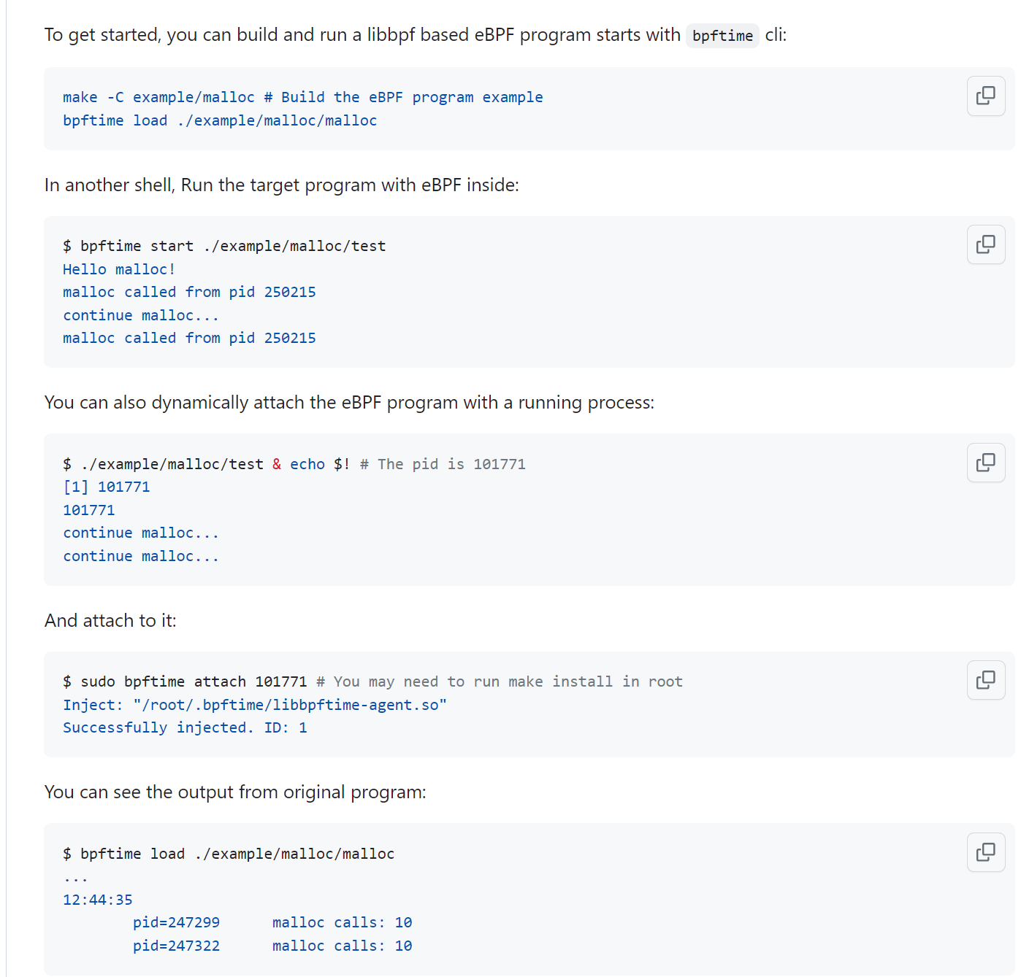
Examples
Use uprobe to monitor userspace malloc function in libc, with hash maps

Slide 10
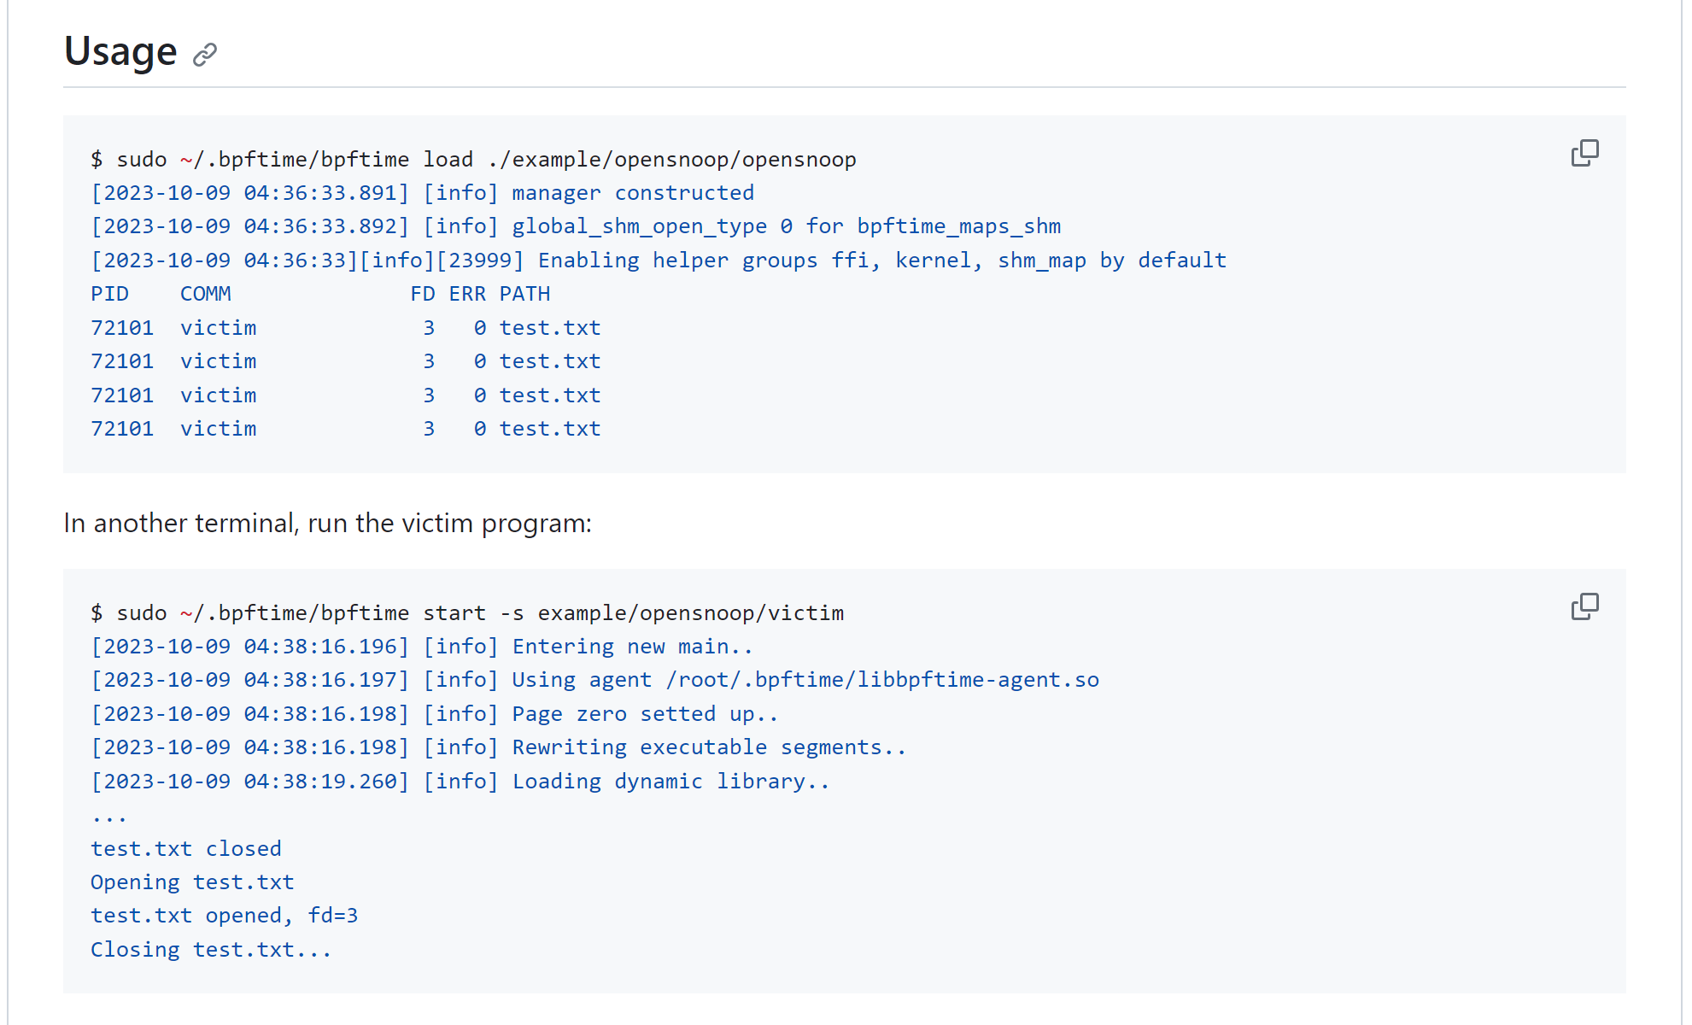
Examples
Use syscall tracepoint to monitor open and close syscall, with ring buffer for output

Slide 11

eBPF program source
eBPF userspace applications
Target process
eBPF bytecode
Existing eBPF toolchains：clang/bpftool/bpftrace…
Userspace library: libbpf…
Uprobe
function
breakpoint
load
Context switch
Userspace
load
Userspace
bpf syscall
Trap
syscall
Kernel space
eBPF program
tracepoint
verifier
eBPF maps
kprobe
JIT compiler
socket
Original Kernel eBPF
attach
attach

Slide 12
eBPF program source
eBPF userspace applications
Target process
eBPF bytecode
inlineHook
Existing eBPF toolchains：clang/bpftool/bpftrace…
Userspace library: libbpf…
function
uprobe
syscall
tracepoint
bpf function call
bpftime-syscall.so
bpftime-agent.so
bpftime: userspace eBPF
program
verifier
JIT AOT compiler
inject
Userspace
Share memory
eBPF maps
load
bpf syscall
Kernel space
socket
attach
kprobe

Slide 13
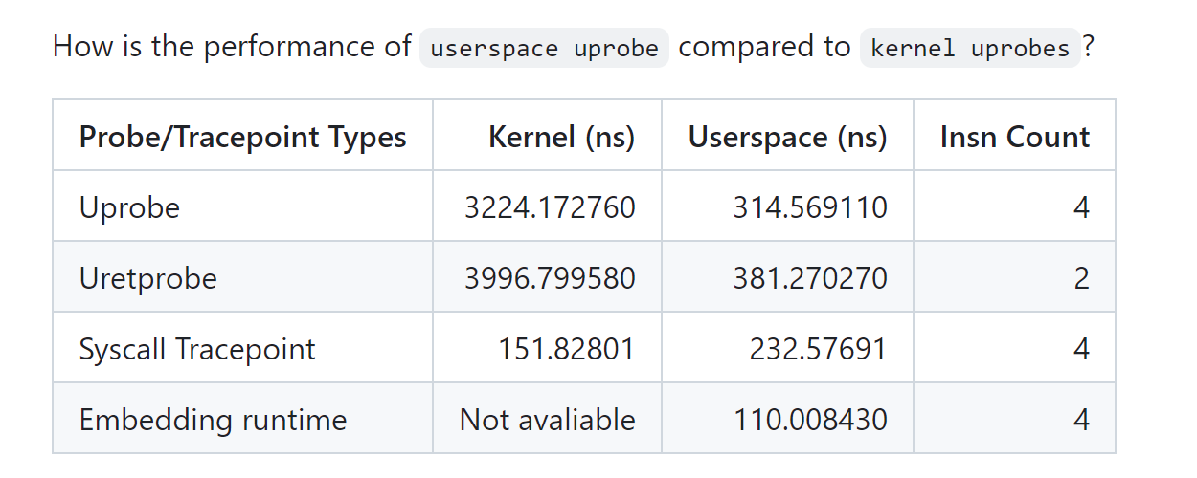
Benchmark

Slide 14
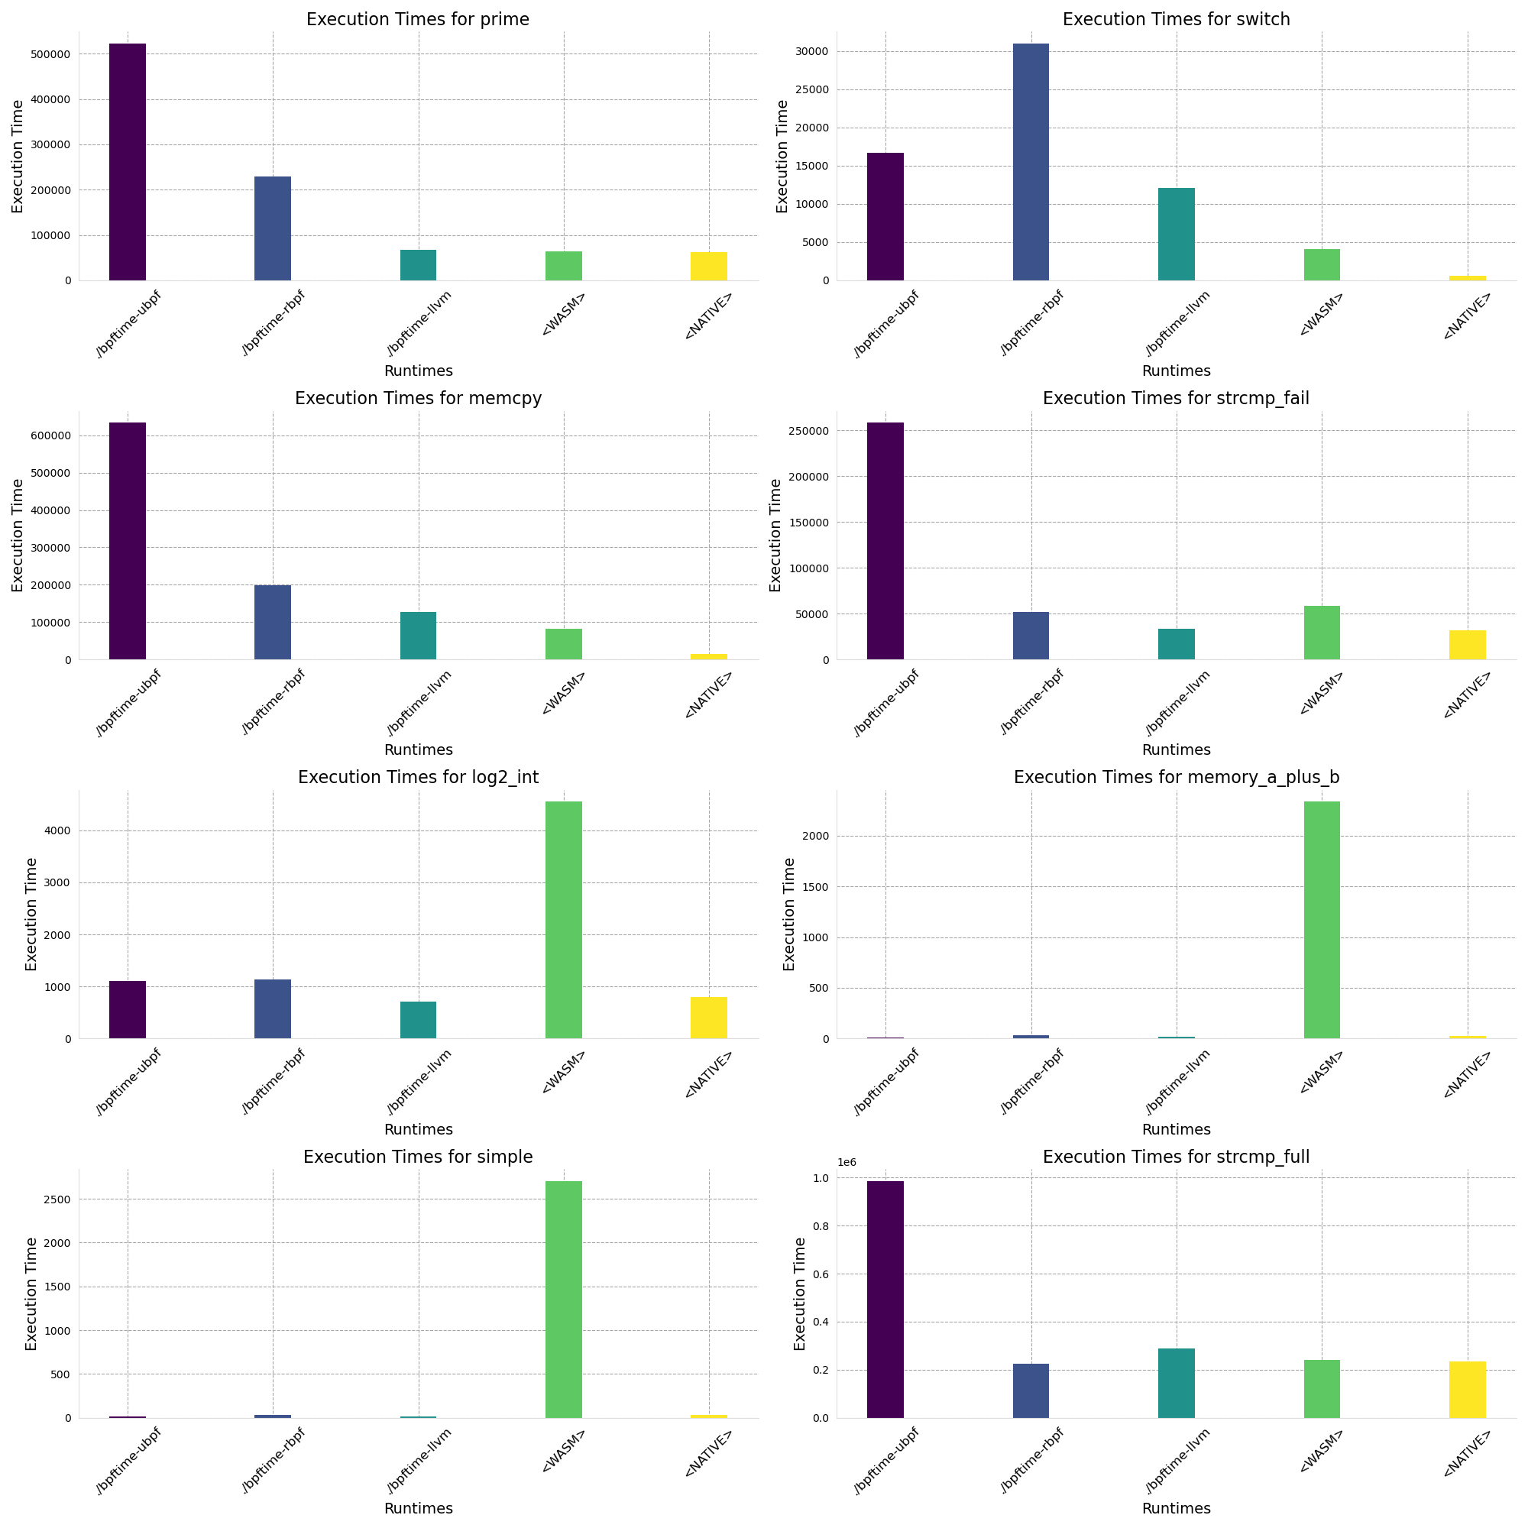
Benchmark
Exec time: Left to right: ubpf jit, rbpf jit, llvm jit/aot, wasm, native
LLVM jit can be the fastest
LLVM is heavy? AOT is on the way

Slide 15
More is coming…
Figure out how to run it together transparently with kernel probe
An AOT compiler for eBPF can be easily added based on the LLVM IR.
More examples and usecases.
…
This project is open-sourced by https://github.com/eunomia-bpf/bpftime

Slide 16
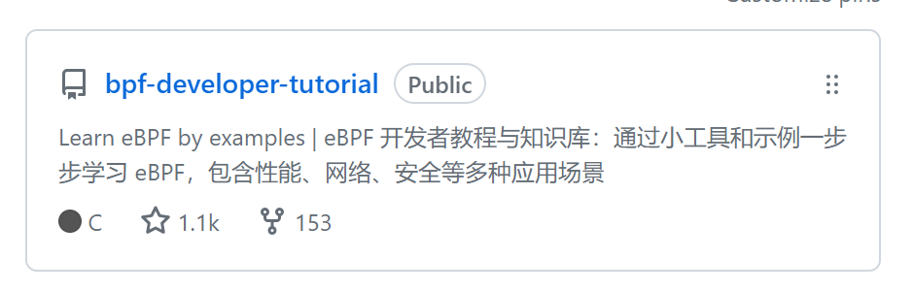
bpf-developer-tutorial
https://github.com/eunomia-bpf/bpf-developer-tutorial
1.1k+ stars in Github
10W+ readings on various Platform: zhihu, wechat, juejin…

Slide 17
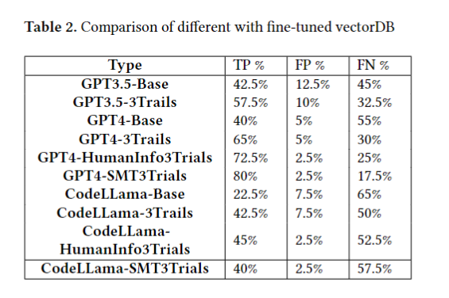
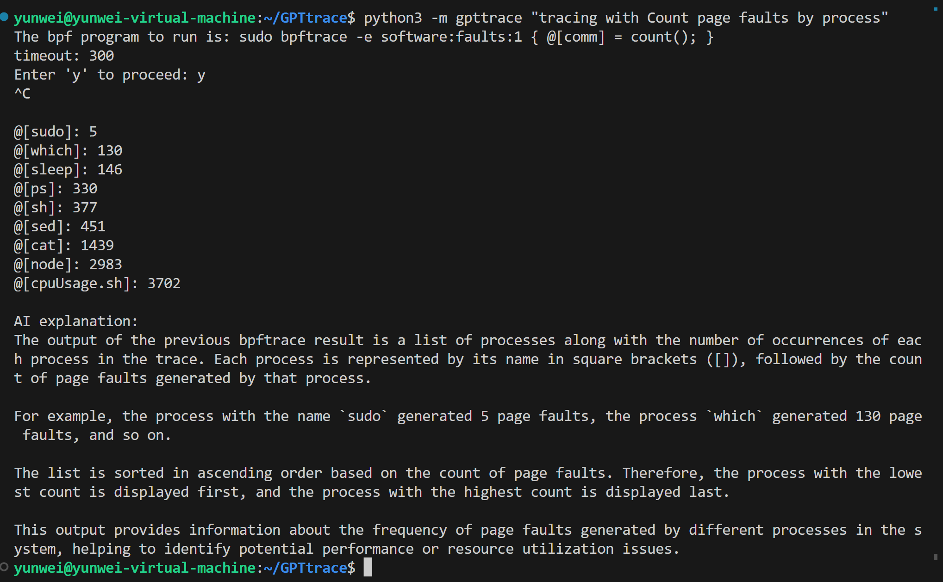
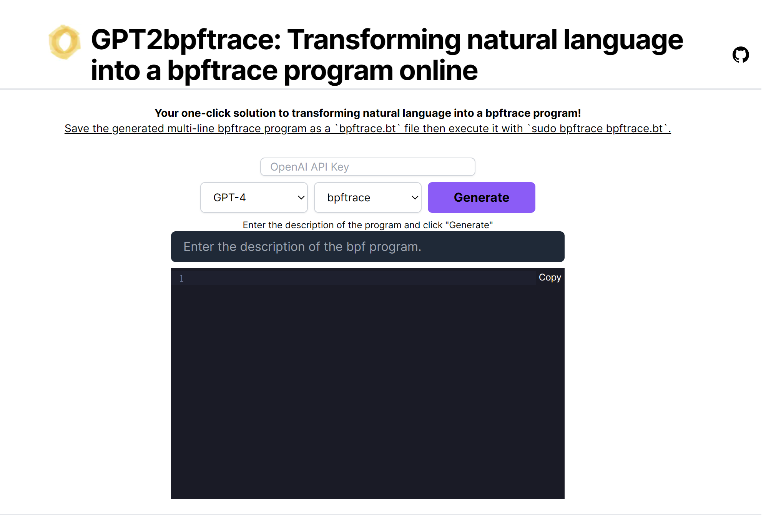
AI for eBPF code Generation
https://gpt-2-bpftrace.vercel.app/
https://github.com/eunomia-bpf/GPTtrace
KEN project （Not yet open-sourced）
GPT4 can generate eBPF code up to 80% correct with our AI agents

