Slide 1
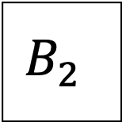
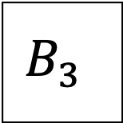
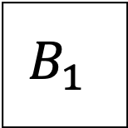
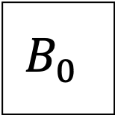
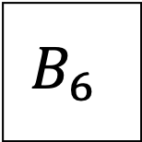
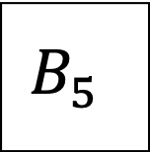
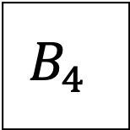
$$B_{0}$$
$$B_{1}$$
$$B_{2}$$
$$B_{3}$$
$$B_{4}$$
$$B_{5}$$
$$B_{6}$$

Slide 2







$$B_{0}$$
$$B_{1}$$
$$B_{2}$$
$$B_{3}$$
Phase 1
$$B_{4}$$
$$B_{5}$$
$$B_{6}$$
Phase 2

