Slide 1


AgentSight: System‑Level Observability for AI Agents Using eBPF
Yusheng Zheng, Yanpeng Hu, Tong Yu, Andi Quinn

Slide 2
Motivation — Security: Trusted Artifact Exfiltration
Benign goal: build & publish → plan “mvn package && mvn deploy”
Over‑broad globs/resource expansion stash secrets in JAR (e.g., META‑INF/.aws/)
Trusted egress: deploy to internal registry; processes/domains look normal
But…
Prompt view misses it (no adversarial text);
system view misses it (open/write/upload are all normal)

Slide 3
Motivation — Performance: Who Burned CPU/Memory?
Agent infrastructure can dominate: serverless env ≥40% of total cost; CPU/memory can take up to 70% of LLM API cost
Need to optimize heavy steps: fix loops/args, long-running tools, tune retrieval/storage
Requires joining prompts/commands with CPU & memory to attribute spikes
https://arxiv.org/html/2509.09525v1 TrEnv, a work from Alibaba that extend their SOSP’24 paper

Slide 4
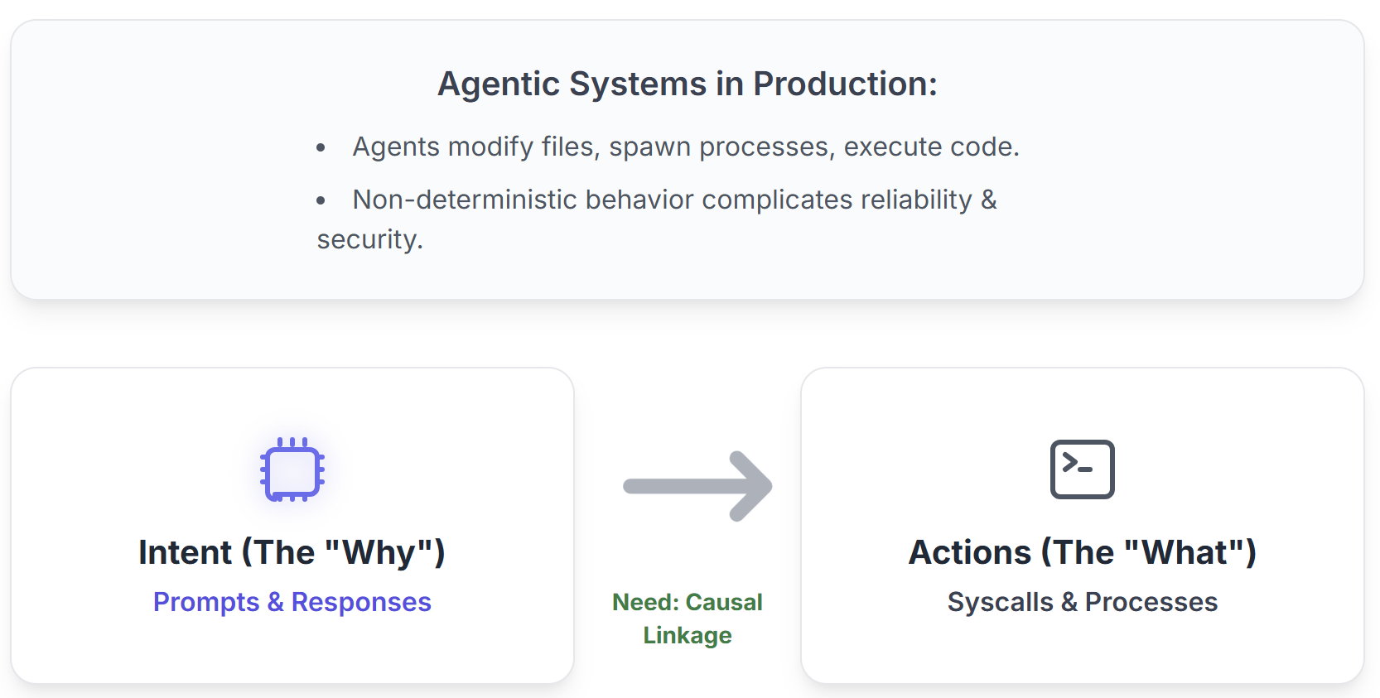
The Semantic Gap

Slide 5
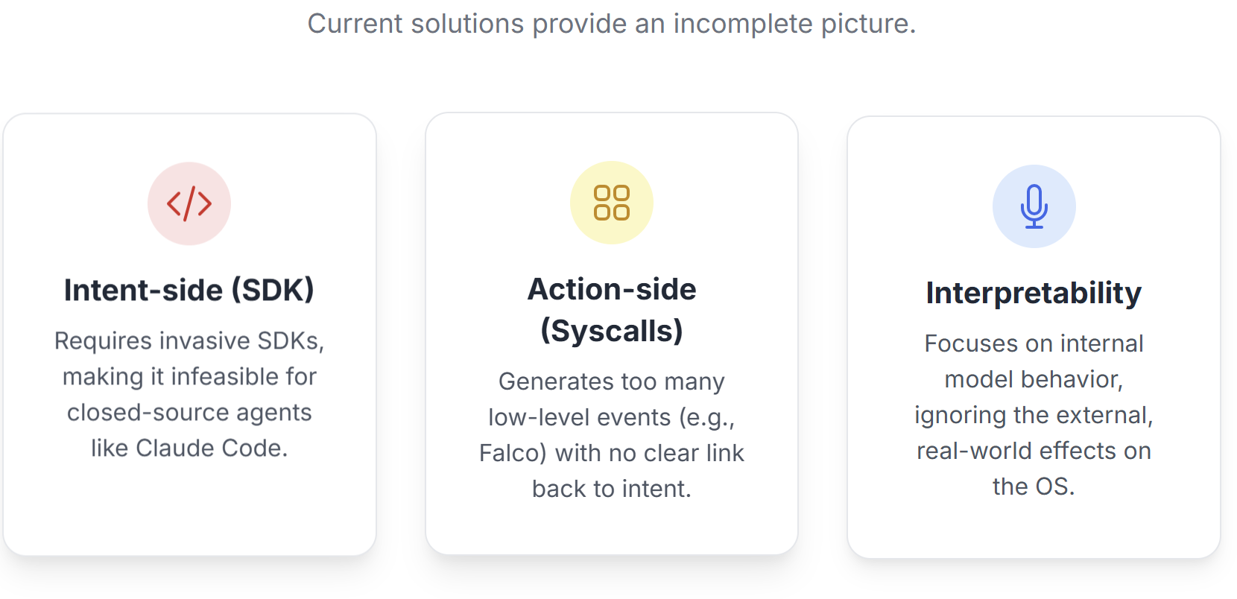
Limits of Existing Approaches

Slide 6
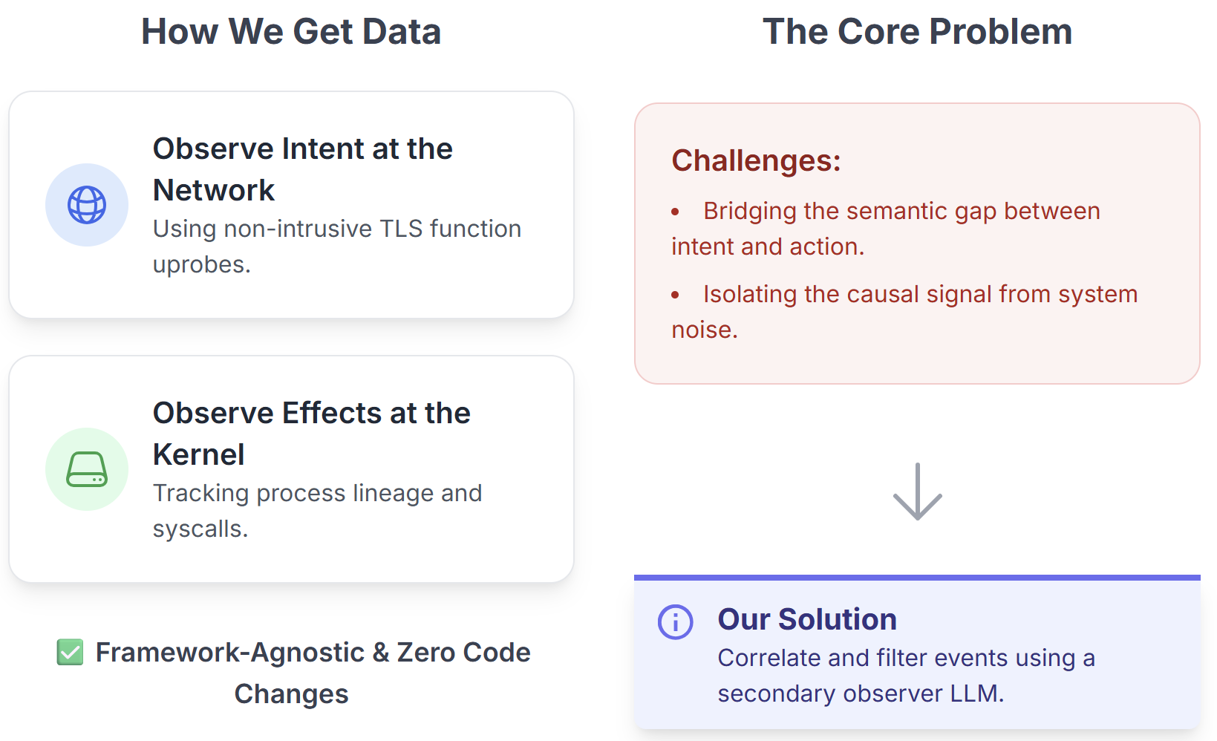
Key Idea: Boundary Tracing

Slide 7
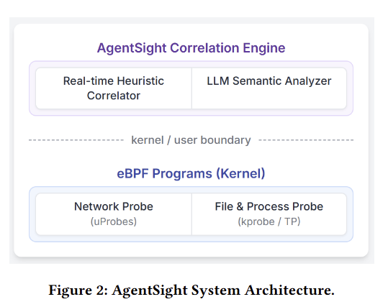
Architecture Overview
Intent stream: eBPF uprobes on SSL_read/SSL_write
Action stream: eBPF kprobes/tracepoints (process + I/O)
Userspace correlation with observer LLM

Slide 8
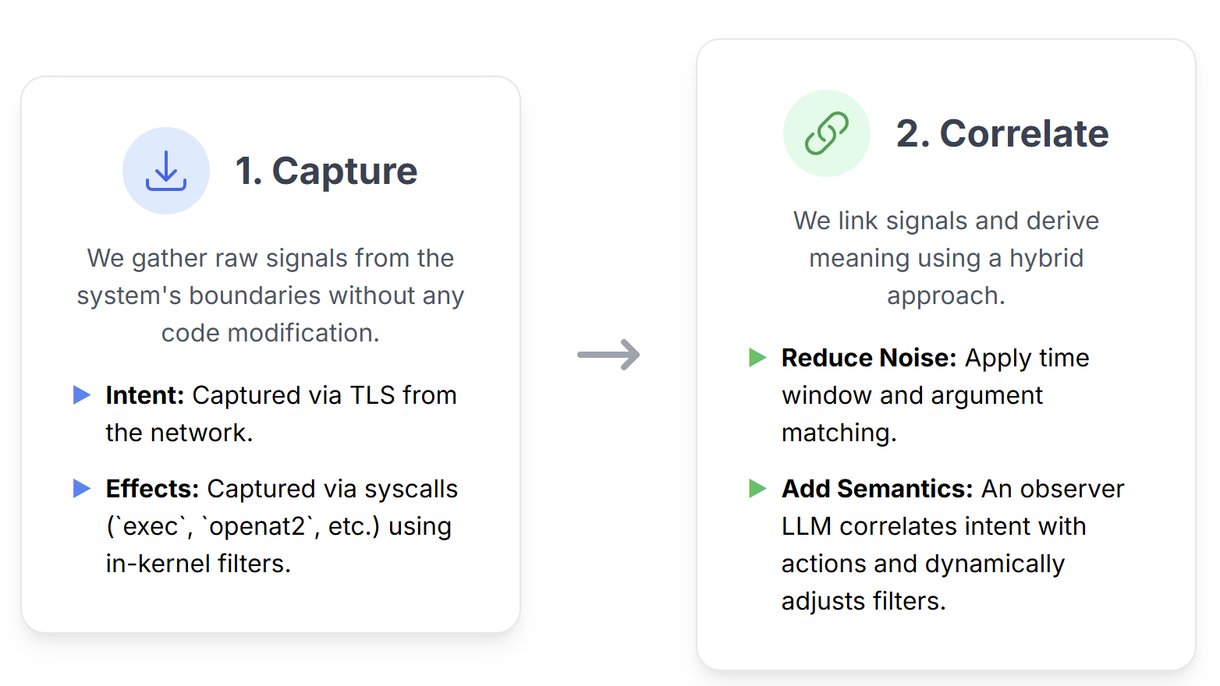
From Signals → Causality → Semantics

Slide 9
Implementation
Userspace daemon (~6K LOC Rust/C) + TypeScript UI (~3K LOC)
File path mapping, process trees, network trace, metrics, llm prompts…
Instrumentation‑free and framework‑agnostic

Slide 10
Evaluation
Setup: Ubuntu 22.04 (Linux 6.14), Claude Code 1.0.62
Average overhead ≈ 2.9% (max ≈ 4.9%) across repo/code/compile
Usecases:
Detect prompt injection
Detect tool use loops with wrong args
Detect multi‑agent collaborate issues

Slide 11
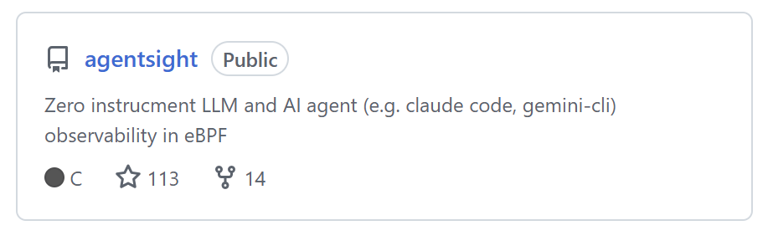
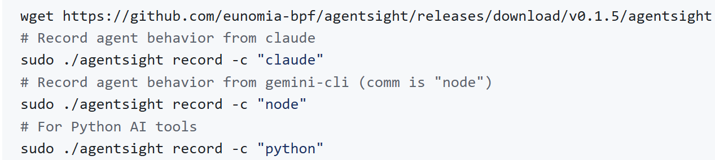
Open Source & Quick Start
https://github.com/eunomia-bpf/agentsight
Quick Start:

Slide 12
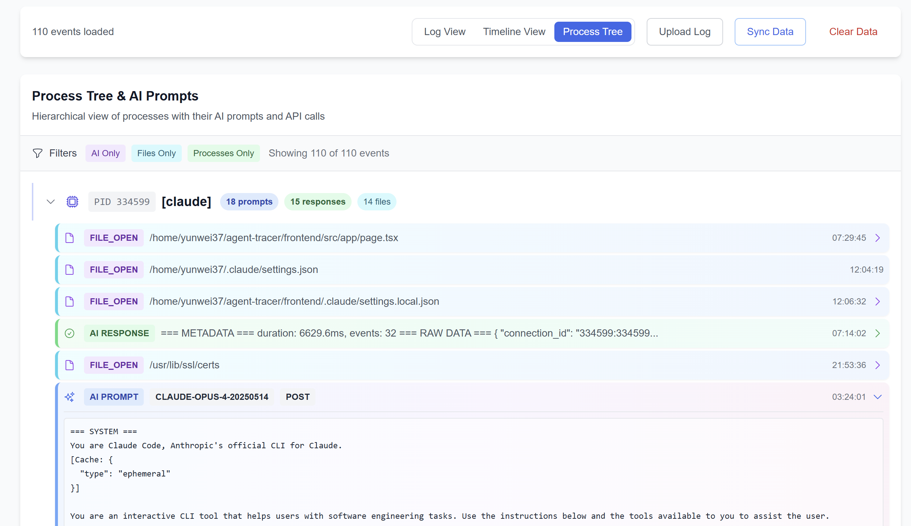
Frontend Demos
Process Tree: real‑time agent interactions & ops

Slide 13
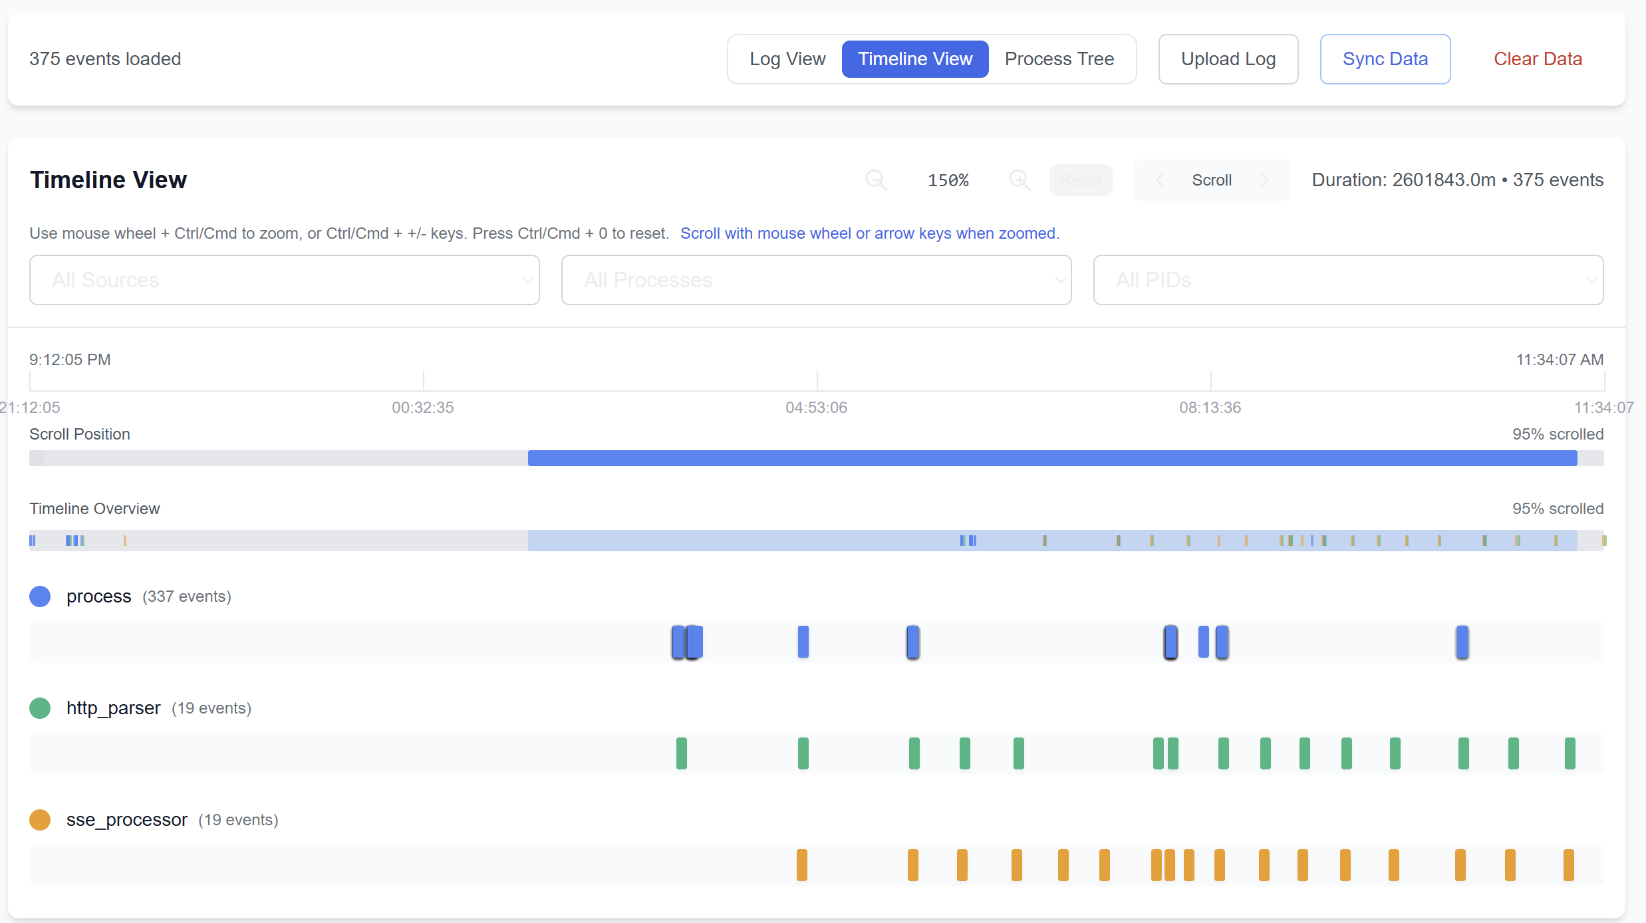
Frontend Demos
Timeline: prompts/responses aligned with system calls

Slide 14
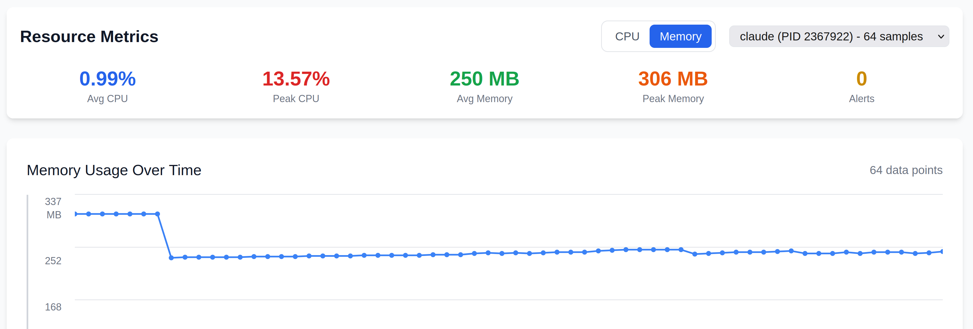
Frontend Demos
Metrics: CPU/memory

Slide 15
Limitations, Future Work, Takeaways
Limits: heuristic correlation; observer‑model cost/latency; cross‑host correlation
Next: toward inline guardrails/enforcement; broader platform support
Takeaway: boundary tracing + hybrid correlation bridges intent ↔ actions with low overhead

Slide 16
Backup

Slide 17
The Semantic Gap (Why vs. What)
Agentic Systems in Production:
Agents modify files, spawn processes, execute code
Non‑deterministic behavior complicates reliability & security
What they have:
Intent: prompts/responses;
Actions: syscalls/processes
Need: causal linkage from LLM output → system behavior

Slide 18
Limits of Existing Approaches
Intent‑side (SDK): needs SDK inside the agent app; infeasible for closed‑source agents (e.g., Claude Code)
Action‑side (Falco/Tracee): many events, no link to intent/semantics
Interpretability: focuses on model internals, not external OS effects

Slide 19
Key Idea: Boundary Tracing
To get data:
Observe intent at network (TLS function uprobes)
Observe effects at kernel (process lineage + syscalls)
Framework‑agnostic, zero code changes
Challenges:
Bridging the Semantic Gap Between Intent and Action
Isolating the Causal Signal from System Noise
Solution: Correlated and filtered with LLM

Slide 20
From Signals → Causality → Semantics
Capture: intent via TLS; effects via exec/fork + openat2/connect/execve with in-kernel filters
Correlate: time window + argument matching to reduce noise; observer LLM correlates intent and actions, dynamically adjusts filtering rules

