Slide 1
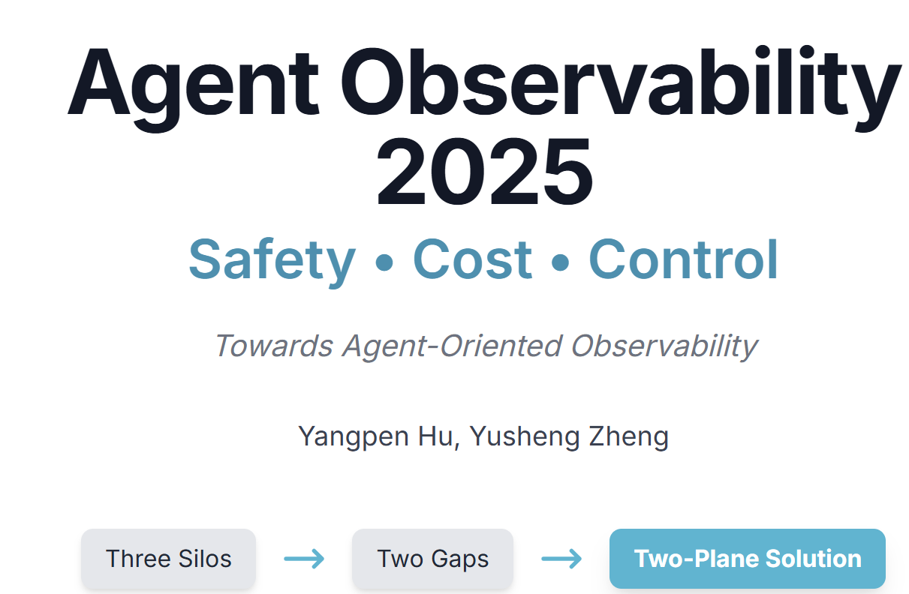

Slide 2
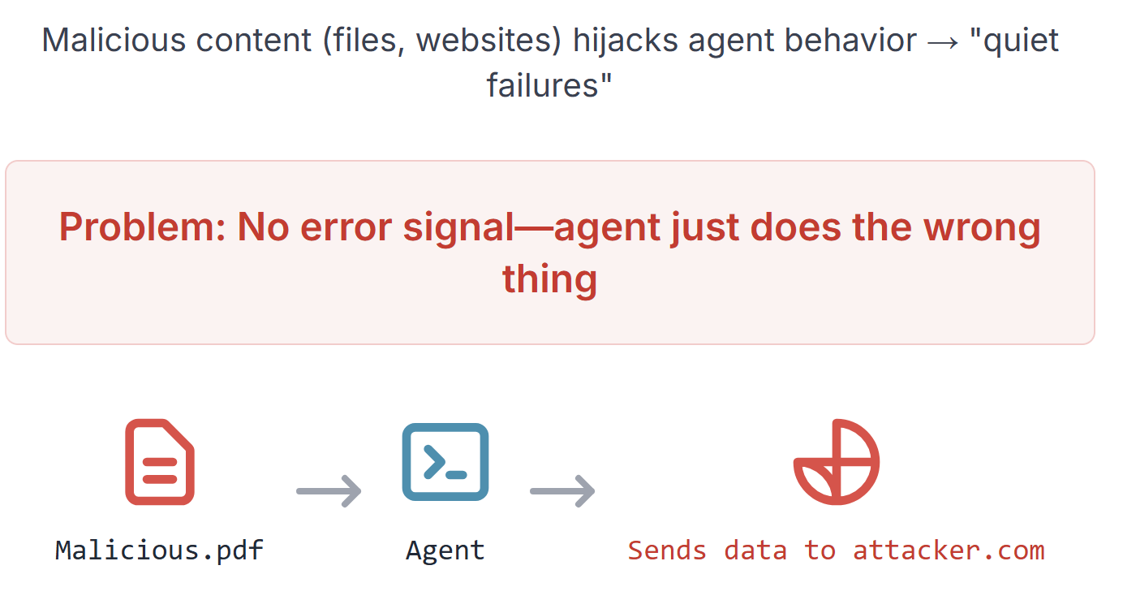
Safety Threat: Indirect Prompt Injection
*Footer: InjecAgent, ACL Findings 2024*

Slide 3
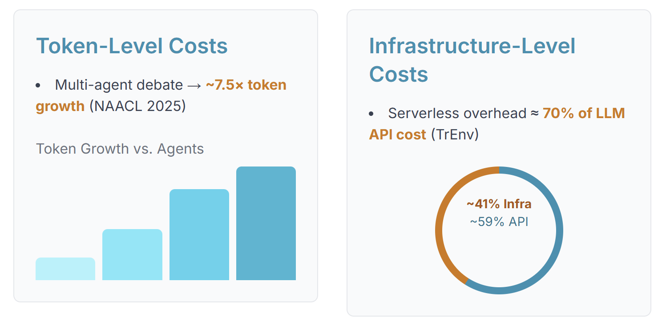
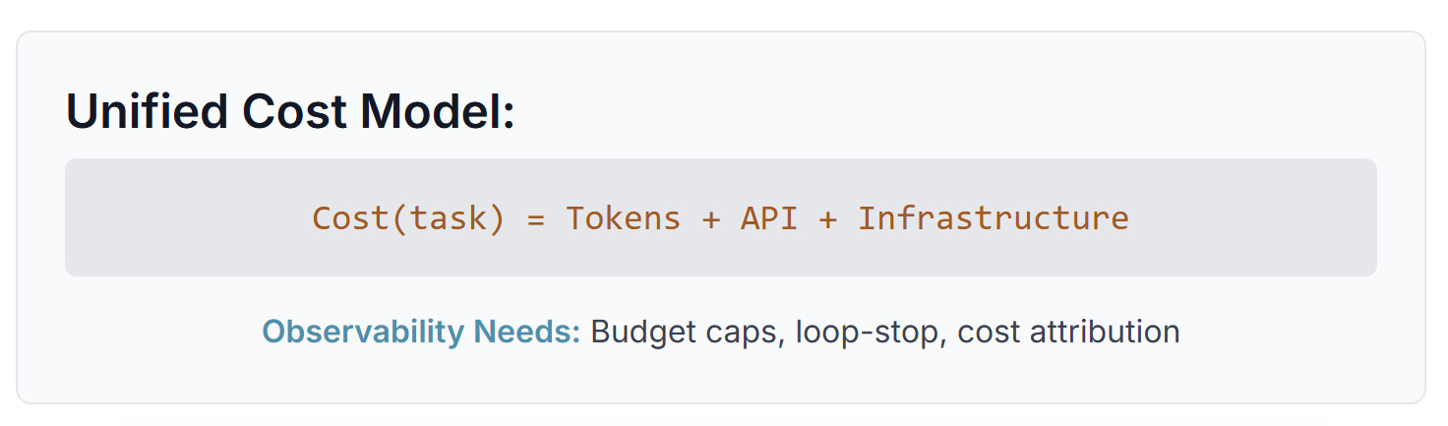
Cost & ROI: Two Escalation Fronts
*Footer: ¹NAACL 2025, ²arXiv:2509.09525*

Slide 4
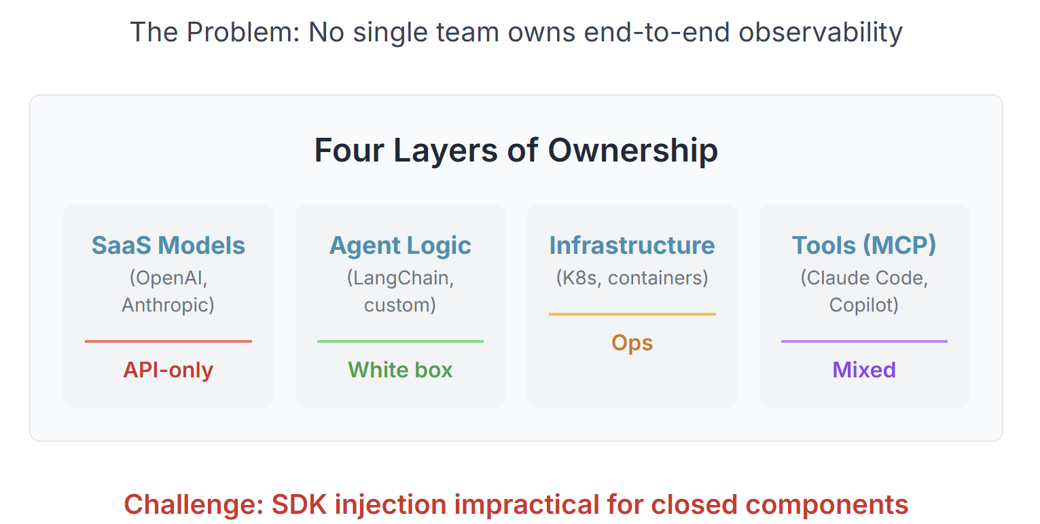
Fragmentation: Multi-Vendor Stacks
*Footer: ¹Microsoft Build 2025, ²Anthropic*

Slide 5
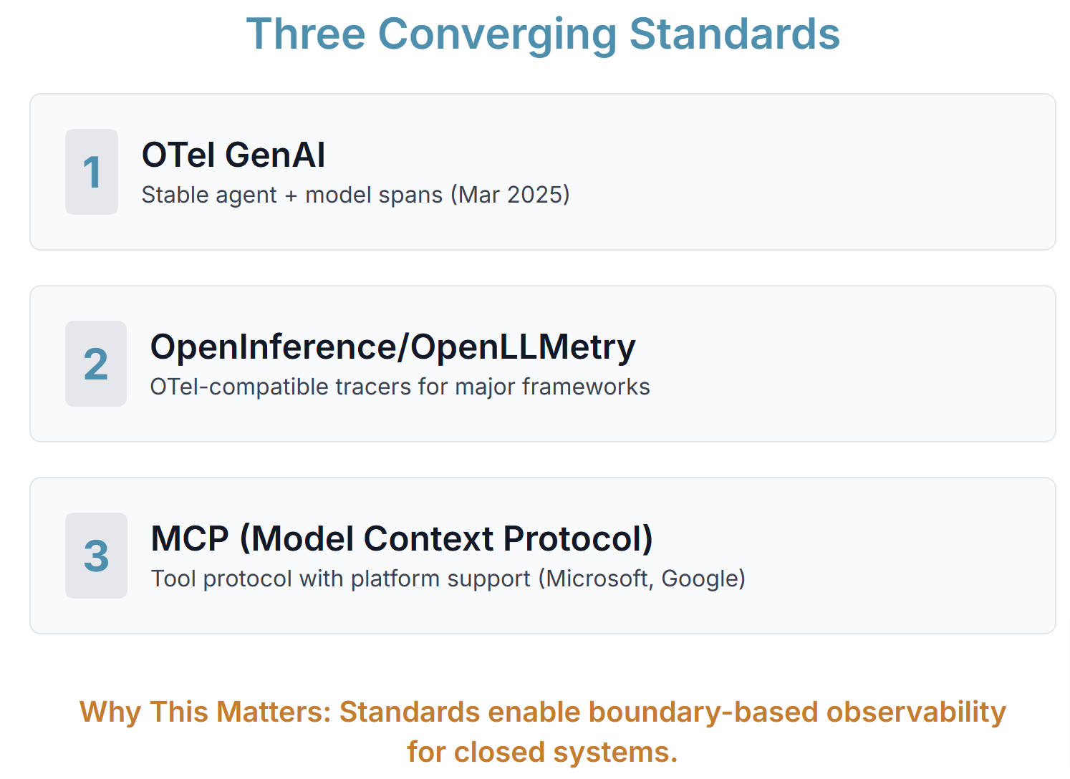
Standards & Ecosystem (Why Now)
*Footer: ¹OTel Blog 2025, ²Microsoft Build 2025*

Slide 6
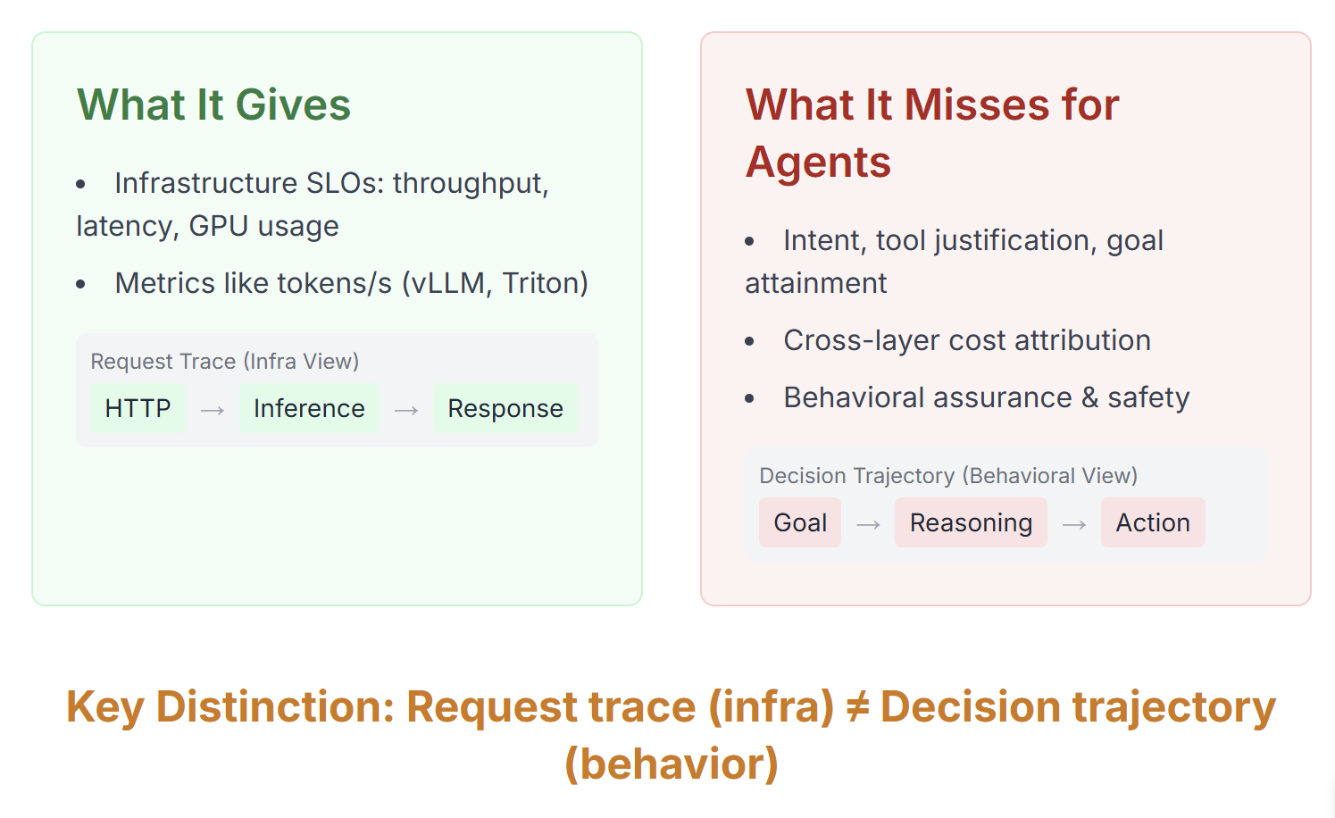
Background I: APM/Serving
*Footer: ¹vLLM, ²Triton*

Slide 7
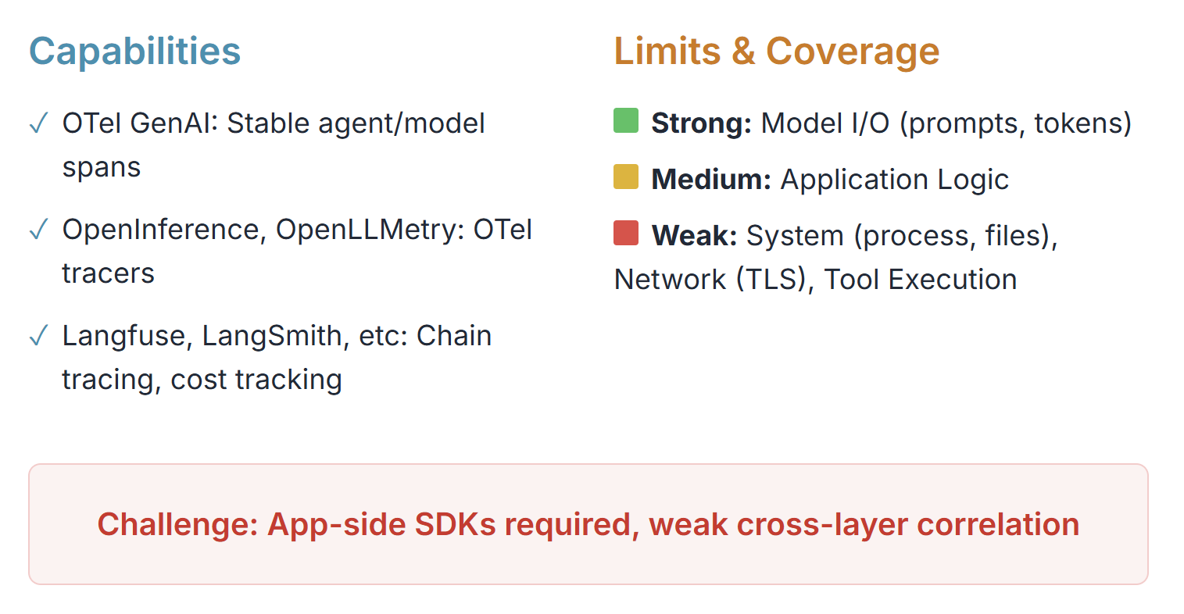
Background II: Model-Centric Tools
*Footer: ¹OTel GenAI, ²Langfuse*

Slide 8
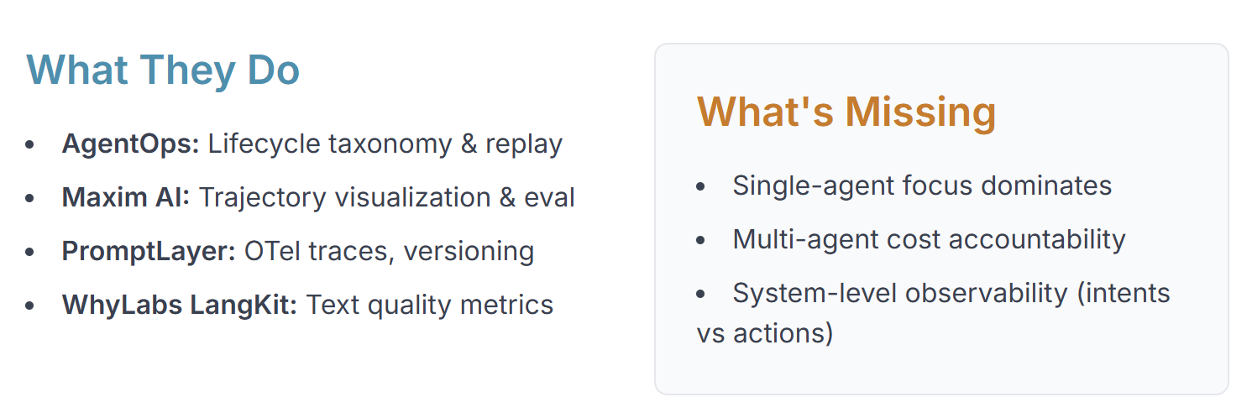
Background III: Agent-Level Frameworks
*Footer: ¹AgentOps arXiv, ²Maxim AI, ³PromptLayer*

Slide 9
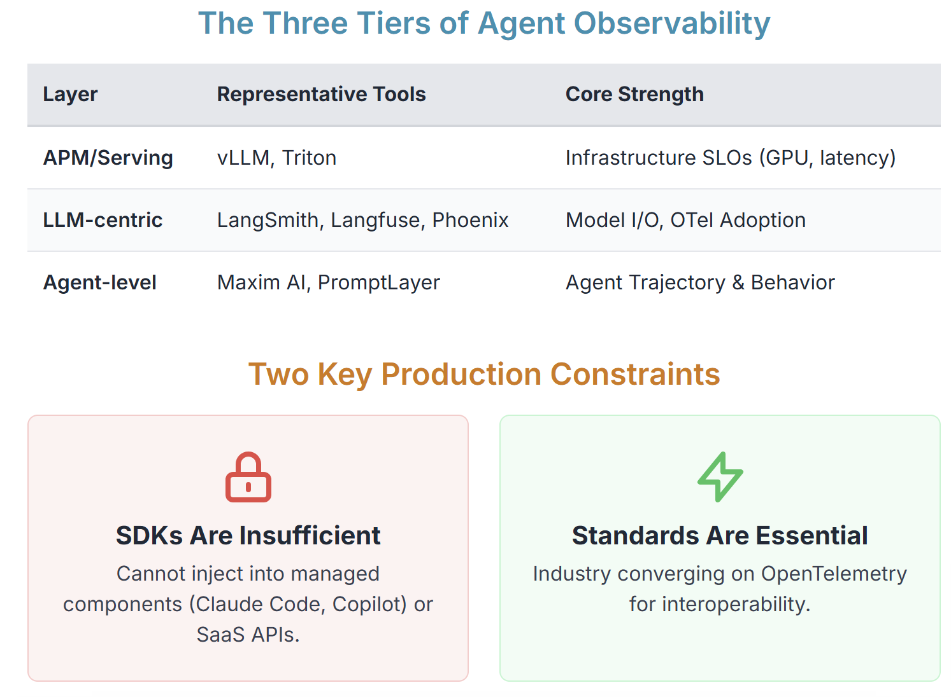
Industrial Landscape
*Footer: ¹vLLM, ²OTel Blog 2025, ³Microsoft Build 2025*

Slide 10
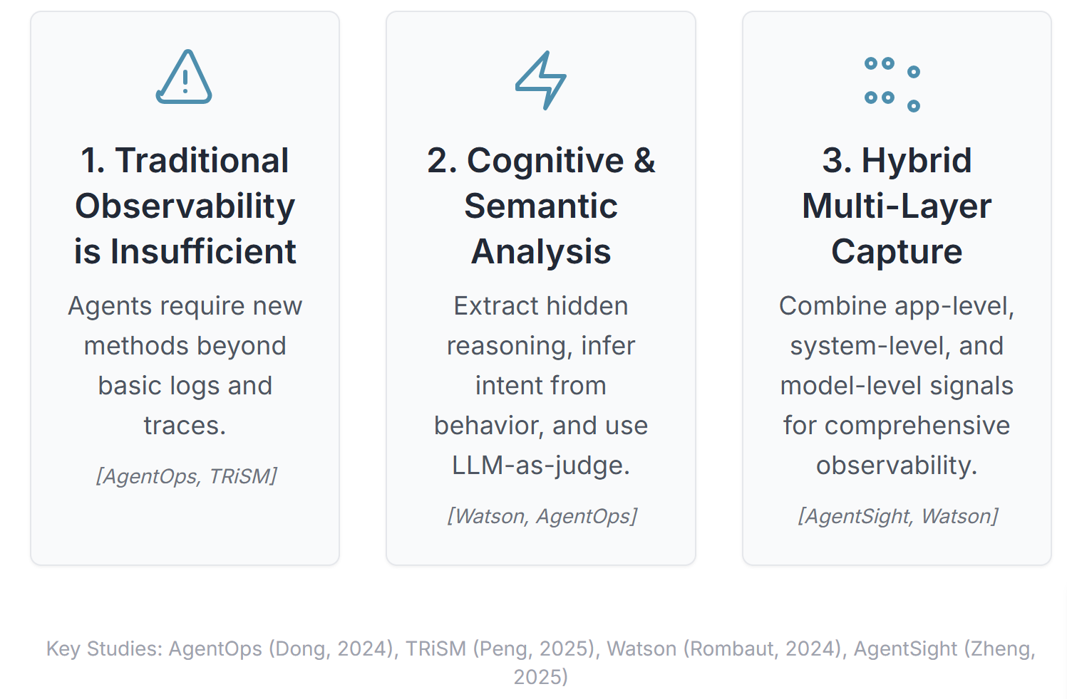
Academic Signals: Validating the Challenges

Slide 11
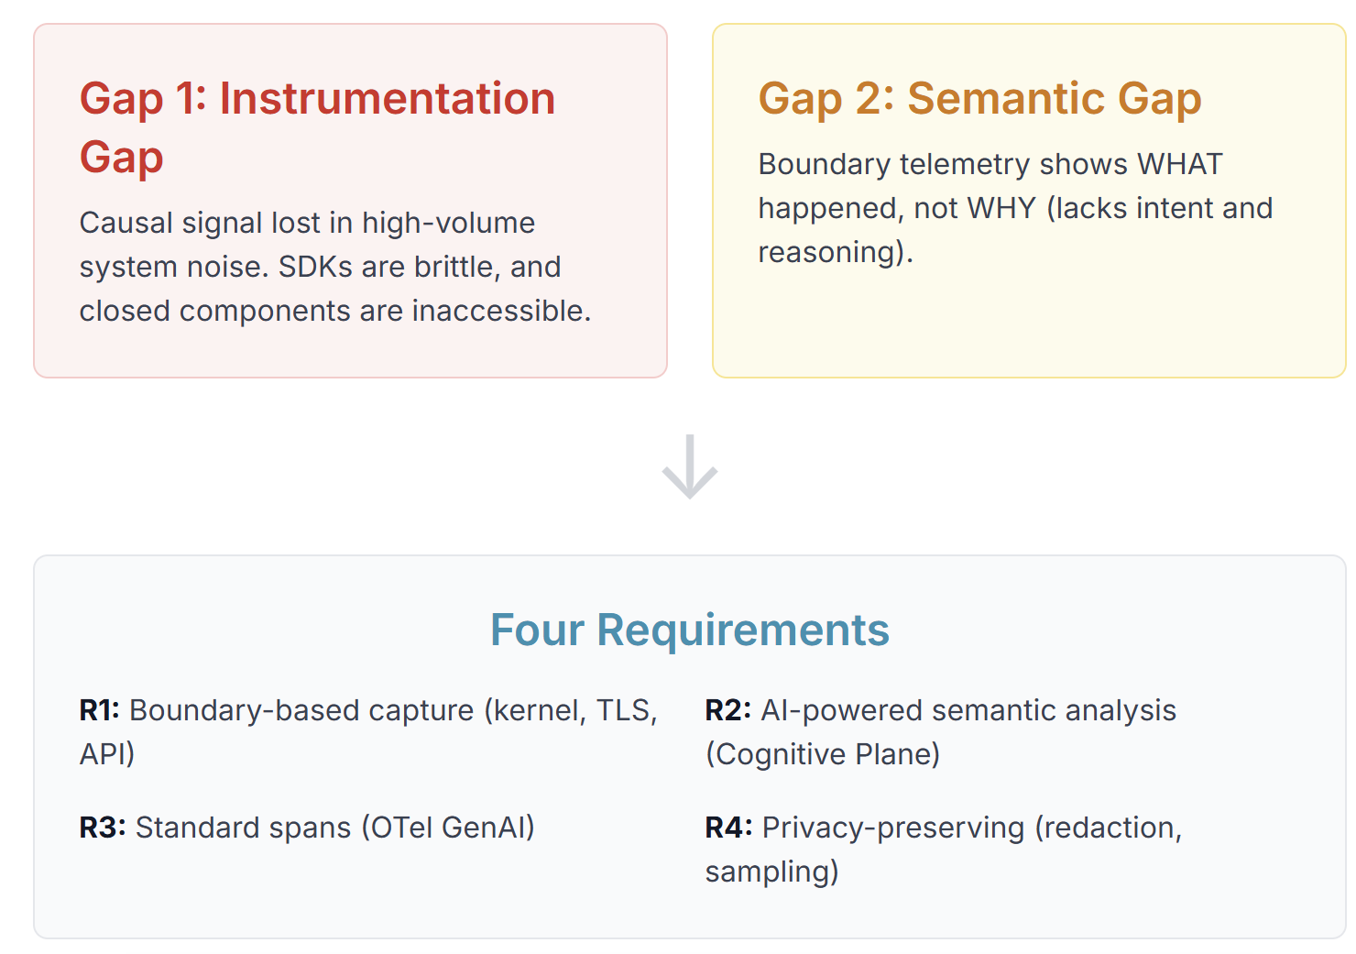
Two Gaps & Requirements
*Footer: ¹Tetragon, ²Watson arXiv, ³OTel GenAI*

Slide 12
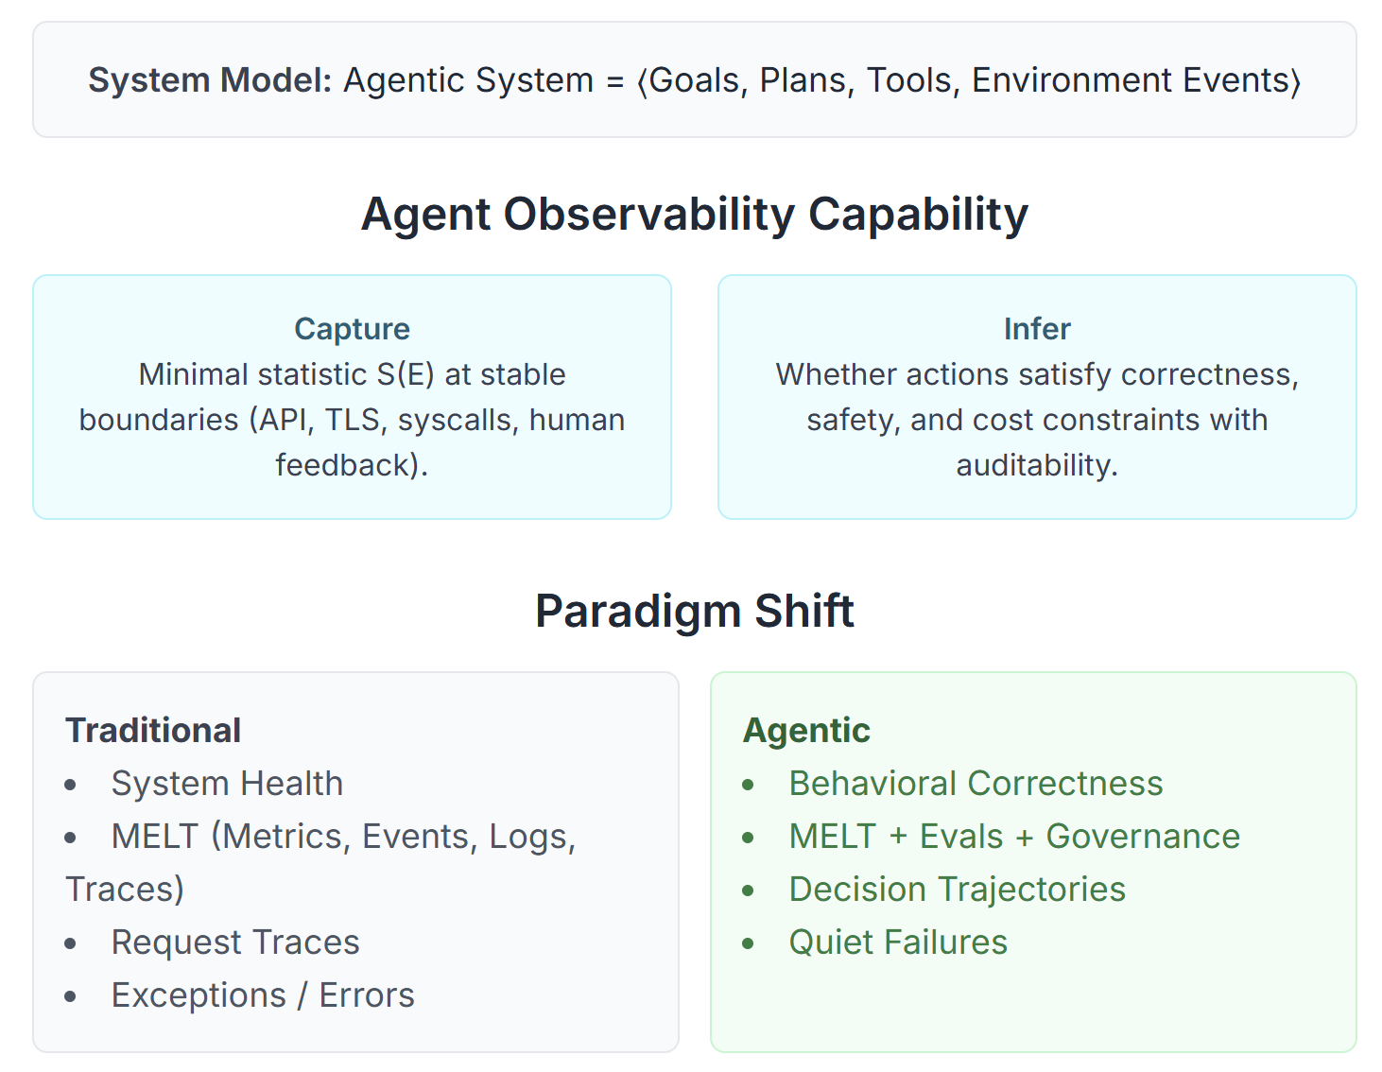
Formal Definition: Agent Observability
*Footer: ¹InjecAgent ACL 2024, ²S²-MAD NAACL 2025*

Slide 13
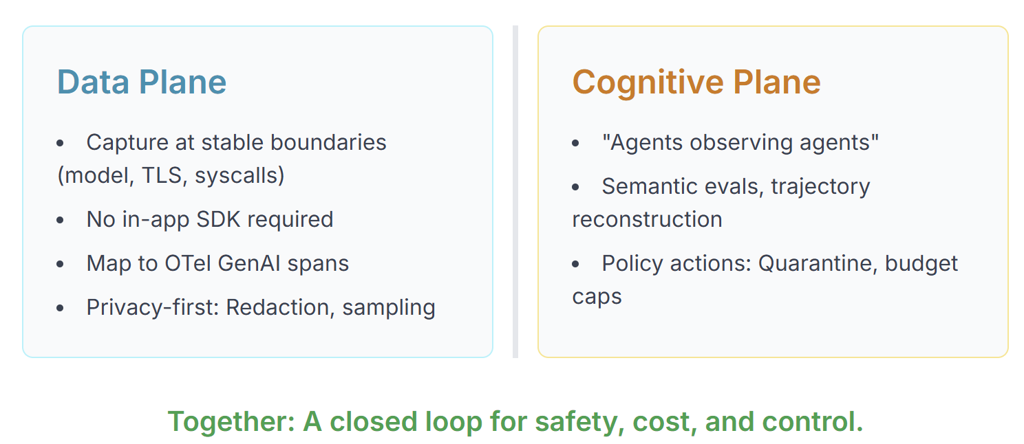
Vision: Two-Plane Architecture
*Footer: ¹OTel GenAI*

Slide 14
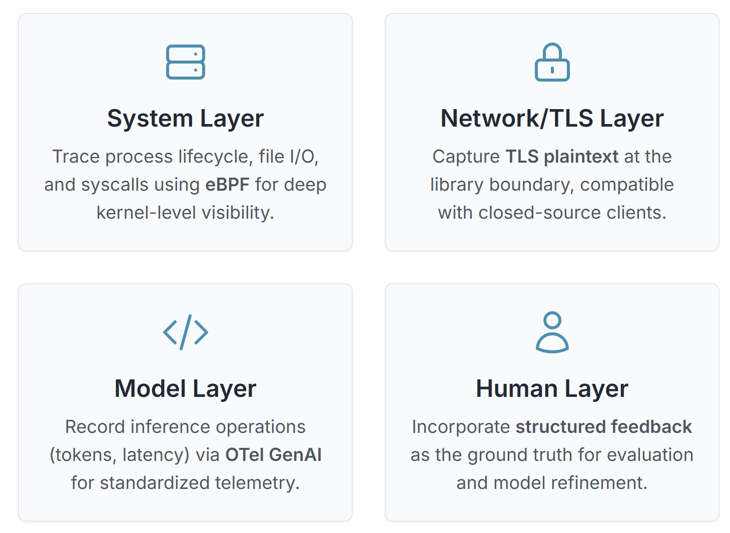
Vision: Data Plane
*Footer: ¹Tetragon, ²eCapture, ³OTel GenAI*

Slide 15
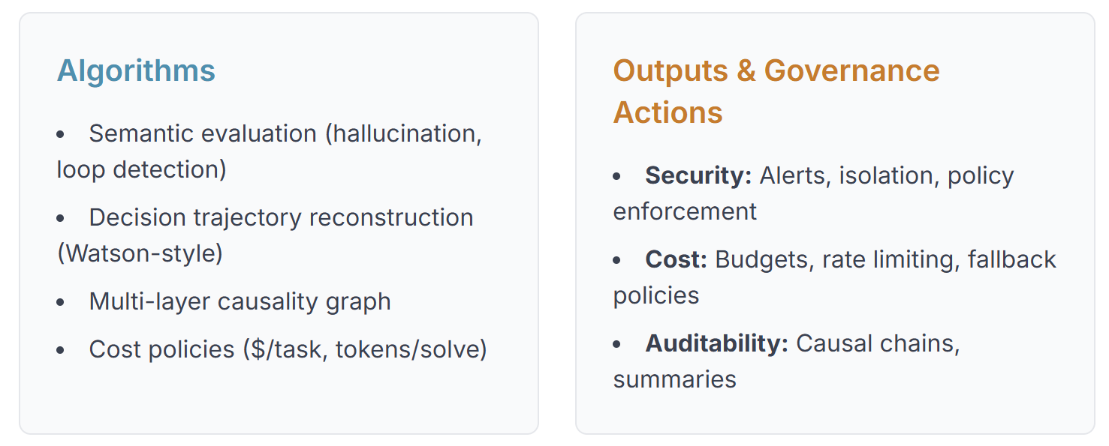
Vision: Cognitive Plane
*Footer: ¹Watson arXiv*

Slide 16
backup

Slide 17
Agent Observability 2025
Safety • Cost • Control
*Towards Agent-Oriented Observability*
Yangpen Hu, Yusheng Zheng
Visual: Flow diagram: `[Three Silos] → [Two Gaps] → [Two-Plane Solution]`

Slide 18
Safety Threat: Indirect Prompt Injection
Malicious content (files, websites) hijacks agent behavior → "quiet failures"
Problem: No error signal—agent just does the wrong thing
Visual: Simple diagram: `Malicious PDF → Agent → Sends data to attacker.com`
*Footer: InjecAgent, ACL Findings 2024*

Slide 19
Cost & ROI: Two Escalation Fronts
Token-Level Costs:
• Multi-agent debate → ~7.5× token growth (NAACL 2025)
Infrastructure-Level Costs:
• Serverless overhead ≈70% of LLM API cost (TrEnv)
Unified Cost Model:
Cost(task) = Tokens + API + Infrastructure
Observability Needs: Budget caps, loop-stop, cost attribution
Visual: Bar chart (token growth), Pie chart (70% infra / 30% API)
*Footer: ¹NAACL 2025, ²arXiv:2509.09525*

Slide 20
Fragmentation: Multi-Vendor Stacks
The Problem: No single team owns end-to-end observability
Four Layers:
• SaaS Models (OpenAI, Anthropic) — API-only
• Agent Logic (LangChain, custom) — White box
• Infrastructure (K8s, containers) — Ops
• Tools (MCP: Claude Code, Copilot) — Mixed
Challenge: SDK injection impractical for closed components
Solution: Boundary capture (TLS, syscalls, API) + OTel GenAI
Visual: 4-layer swimlane with boundary capture points
*Footer: ¹Microsoft Build 2025, ²Anthropic*

Slide 21
Standards & Ecosystem (Why Now)
Three Converging Standards:
1) OTel GenAI: Stable agent + model spans (Mar 2025)
2) OpenInference/OpenLLMetry: OTel-compatible tracers
3) MCP: Tool protocol with platform support (Microsoft, Google)
Why This Matters: Standards enable boundary-based observability for closed systems
Visual: (text-only placeholder)
*Footer: ¹OTel Blog 2025, ²Microsoft Build 2025*

Slide 22
Background I: APM/Serving
What It Gives:
• Infrastructure SLOs: throughput, latency, GPU, tokens/s (vLLM, Triton)
What It Misses for Agents:
• Intent, tool justification, goal attainment
• Cross-layer cost attribution
• Behavioral assurance
Key Distinction: Request trace (infra) ≠ Decision trajectory (behavior)
Visual: Split diagram (Grafana metrics vs decision trajectory)
*Footer: ¹vLLM, ²Triton*

Slide 23
Background II: Model-Centric Tools
Capabilities:
• OTel GenAI: Stable agent/model spans
• OpenInference, OpenLLMetry: OTel-compatible tracers
• Langfuse, LangSmith, Datadog: Chain tracing, cost tracking
Limits:
• Strong: Model I/O (prompts, tokens, latency)
• Weak: System layer (process, files), network (TLS), tool execution
• Challenge: App-side SDKs required, weak cross-layer correlation
Visual: Coverage heatmap (strong/weak layers)
*Footer: ¹OTel GenAI, ²Langfuse*

Slide 24
Background III: Agent-Level Frameworks
What They Do:
• AgentOps: Lifecycle taxonomy (goals, plans, tools, sessions), session replay
• Maxim AI: Trajectory visualization, distributed tracing, evaluation
• PromptLayer: OTel-compatible traces, prompt versioning, cost per variant
• WhyLabs LangKit: Text metrics (PII, toxicity, sentiment), drift detection
What's Missing:
• Single-agent focus dominates, under-serves production multi-agent needs
• Cost accountability: Which agent/decision caused costs?
• Multi-agent coordination: Orchestration patterns, causality, resource attribution
• System-level observability: Agent intents vs system actions
Our Contribution: Formalize instrumentation + semantic gaps; propose Two-Plane Architecture
Visual: (text-only placeholder)
*Footer: ¹AgentOps arXiv, ²Maxim AI, ³PromptLayer*

Slide 25
Industrial Landscape: Three Tiers & Production Constraints
The Three Tiers of Agent Observability
| Layer | Representative Tools | Core Strength |
| APM/Serving | vLLM, Triton | Infrastructure SLOs (GPU, latency)|
| LLM-centric | LangSmith, Langfuse, Phoenix| Model I/O, OTel Adoption |
| Agent-level | Maxim AI, PromptLayer | Agent Trajectory & Behavior |
Two Key Production Constraints
1) SDKs Are Insufficient: Cannot inject into managed components (Claude Code, Windows Copilot) or SaaS APIs
2) Standards Are Essential: Industry converging on OpenTelemetry for interoperability
Visual: Clean 3-row table + two icons (Closed Components & OTel Standard)
*Footer: ¹vLLM, ²OTel Blog 2025, ³Microsoft Build 2025*

Slide 26
Academic Signals: Validating the Challenges
1) Safety: IPI is a Formally Recognized Threat
- InjecAgent (ACL Findings 2024): Benchmarks IPI across 30 frameworks, finds persistent vulnerabilities
- Key Finding: "Quiet failures" are common—demands audit-quality traces
2) Cost: Token Growth is a First-Class Research Problem
- S²-MAD (NAACL 2025): Targets token reduction as primary goal for multi-agent systems
- ICLR 2025 Papers: Document non-linear token growth (~7.5×) as major cost driver
3) A Balanced View is Emerging
- "Stop Overvaluing MAD" (arXiv 2025): Complex strategies don't always outperform simpler ones
- Implication: Demands empirical cost-benefit analysis
Visual: Three academic papers with key takeaways (ACL, NAACL, arXiv logos if possible)
*Footer: ¹ACL 2024, ²NAACL 2025, ³arXiv 2025*

Slide 27
Two Gaps & Requirements
Gap 1: Instrumentation Gap
• Causal signal lost in high-volume syscall noise
• App-layer SDKs brittle, closed components inaccessible
Gap 2: Semantic Gap
• Boundary telemetry shows WHAT, not WHY (no intent/reasoning)
Four Requirements:
• R1: Boundary-based capture (kernel, TLS, API)
• R2: AI-powered semantic analysis (Cognitive Plane)
• R3: Standard spans (OTel GenAI)
• R4: Privacy-preserving (redaction, sampling)
Visual: Production Challenges → Two Gaps → Four Requirements
*Footer: ¹Tetragon, ²Watson arXiv, ³OTel GenAI*

Slide 28
Formal Definition: Agent Observability
System Model: Agentic system = ⟨Goals, Plans, Tools, Environment Events⟩
Agent Observability Capability:
• Capture: Minimal statistic S(E) at stable boundaries (model API, TLS, syscalls, human feedback)
• Infer: Whether reasoning/actions satisfy correctness, safety, cost constraints with auditability
Paradigm Shift:
• Traditional: System health, MELT, request traces, exceptions
• Agentic: Behavioral correctness, MELT + Evals + Governance, decision trajectories, quiet failures
Three Problem Dimensions:
• Safety: Uncertainty → semantic failures (IPI, tool misuse)
• Cost: Multi-layer, non-linear growth (7.5× tokens, 70% infra)
• Fragmentation: Multi-vendor stacks (SaaS, managed agents, MCP)
Visual: Comparison table (Traditional vs Agentic observability)
*Footer: ¹InjecAgent ACL 2024, ²S²-MAD NAACL 2025*

Slide 29
Vision: Two-Plane Architecture
Data Plane:
• Capture at stable boundaries (model, TLS, syscalls, human feedback)
• No in-app SDK required
• Map to OTel GenAI spans
• Privacy-first: Redaction, sampling, scoped retention
Cognitive Plane:
• Agents observe agents
• Semantic evals, trajectory reconstruction, cross-layer causality
• Policy actions: Quarantine, budget caps, alerts
Together: Safety, cost, and control closed loop
Key Metrics:
• Security: Attack capture rate, MTTA, trajectory completeness
• Cost: $/successful task, tokens/solve, runaway prevention
• Reliability: MTTR, tool-success ratio, quiet failure detection
• Standards: OTel conformance, MCP coverage
Visual: Two-plane architecture diagram with data flow
*Footer: ¹OTel GenAI*

Slide 30
Vision: Data Plane (Evidence & Practice)
System Layer:
• Tetragon (eBPF): Process lifecycle, execve, file I/O, K8s correlation
Network/TLS Layer:
• eCapture (uprobes): TLS plaintext at library boundary (OpenSSL, GnuTLS)
• Compatible with closed-source/managed clients
Model Layer:
• OTel GenAI: Inference operations (tokens, latency, provider)
• Flows to Langfuse, Phoenix, Datadog, Honeycomb
Human Layer:
• Structured feedback as ground truth
Deployment Path (90 Days):
• P0 (Weeks 1–2): Boundary tracing (eBPF, TLS, model I/O)
• P1 (Weeks 3–4): OTel GenAI spans, OpenInference/OpenLLMetry
• P2 (Weeks 5–8): Cognitive agents (Watson-style)
• P3 (Weeks 9–12): Causal graphs, compliance, MCP capture
Visual: (text-only placeholder)
*Footer: ¹Tetragon, ²eCapture, ³OTel GenAI*

Slide 31
Vision: Cognitive Plane (Algorithms & Outputs)
Algorithms:
• Semantic evaluation: Hallucination, loop, tool-misuse detection
• Decision trajectory reconstruction (Watson-style surrogate observers)
• Multi-layer causality graph (decisions → costs → actions → outcomes)
• Cost policies: $/task, tokens/solve thresholds
Outputs:
• Security: Alerts, isolation, policy enforcement, quarantine
• Cost: Budgets, rate limiting, fallback policies, routing to cheaper agents
• Auditability: Multi-agent causal chains, structured summaries
Privacy & Compliance:
• Redaction/masking, sampling (1–10% full / 90–99% metadata)
• Scoped retention: 7d full / 90d aggregates / ∞ audit logs
• OTel privacy attributes, MCP policy metadata
• Consent & transparency for compliance
Visual: Flow diagram (text-only placeholder)
*Footer: ¹Watson arXiv*

