Slide 1
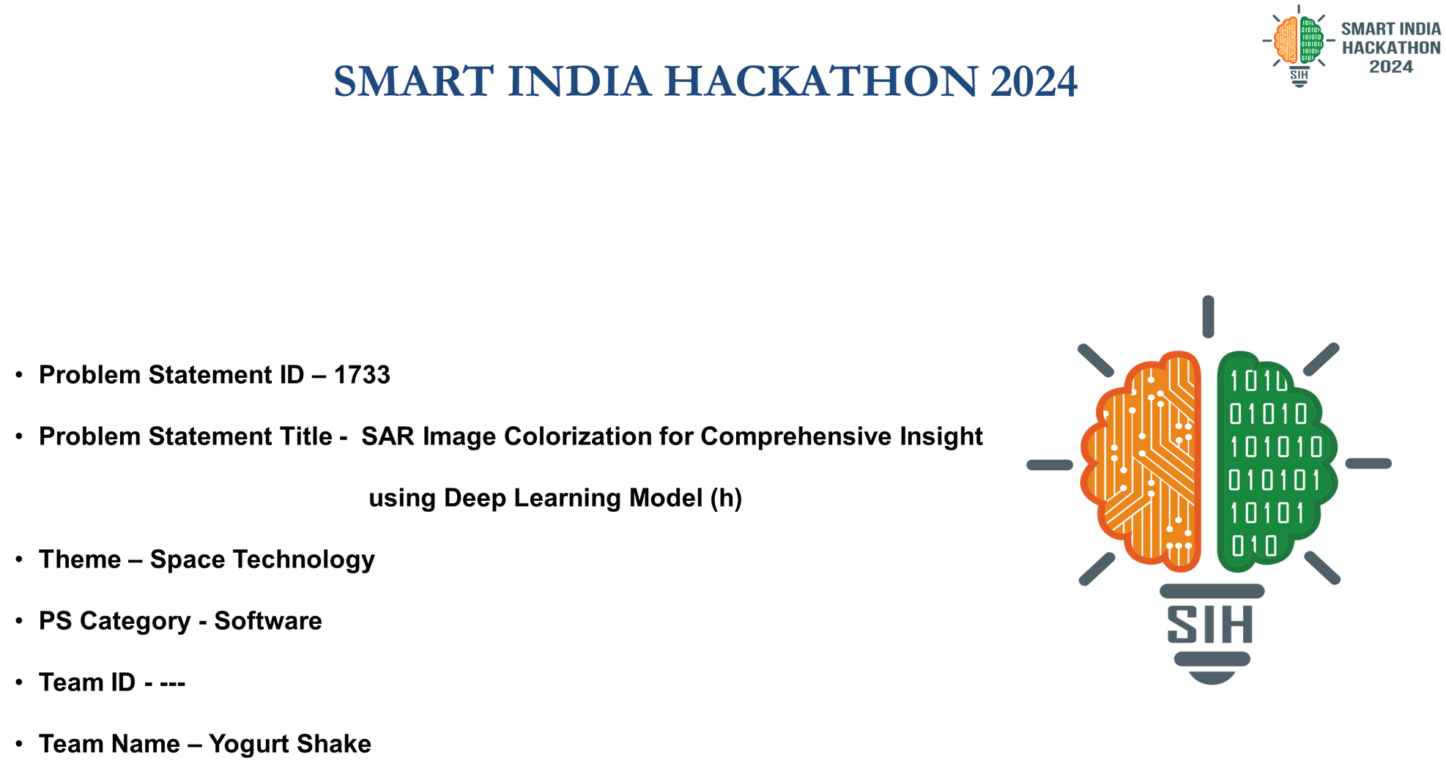

Slide 2
Team
Kishika Goel
Jia Khot
Rishita Mohan
Raashi Sharma
Akshita Siddamshetty
Dhanya Girdhar

Slide 3
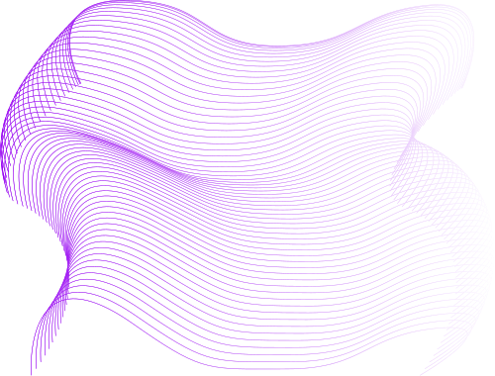
SAR (Synthetic Aperture Radar) image colorization Synthetic Aperture Radar (SAR) imagery is rich in structural and textural information but lacks the intuitive appeal of color, which can provide more comprehensive insights for space borne applications. The project aims to develop an innovative solution to colorize grayscale SAR images for enhanced interpretation and analysis of feature targets. A novel DL model needs to be designed and trained using pairs of SAR and Optical images, minimizing a loss function that captures the difference between predicted and actual color images.
Problem Statement

Slide 4
Encoder
Consists of convolutional layers that reduce the image's spatial dimensions while increasing its depth (channels). It extracts and compresses features, capturing important patterns, textures, and shapes.
Bottleneck
Model Info
Deepest part of the network, where the image is represented as a compact, abstract feature map. - It represents the most important and compressed features extracted by the encoder.
The Model:
Decoder
A 27 Convolution, encoded-decoded U-Net CNN
Responsible for transforming the compressed feature map back to the original image size while simultaneously predicting each pixel's color information.
Skip Connectors
Directly connect layers from the encoder to corresponding layers in the decoder. These connections help the network retain fine-grained details that might be lost during downsampling.

Slide 5
Since we have three components i.e. L, A, and B, altering the brightness of the image does not affect the colors of that image.
The returned (predicted) tensor concatenates three tensors in either case, but it helps that the LAB scale already has the L tensor laid out in the form of the input greyscale image. This makes for slightly quicker and likely more accurate guesses regarding the other two dimensions.
Also, The LAB color space is designed to be perceptually uniform, meaning that a change of the same amount in a color value should produce a change of about the same visual importance.
The LAB-RGB Decision

Slide 6
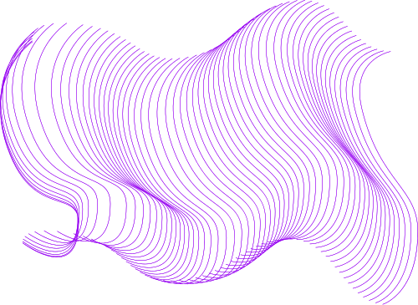
Next Steps
Training and Retraining
Reworking architecture using GANs
Comparison of Loss Functions
Optimization and comparison will take place, with many functions adjusted for minimum loss
Deliberation between display of individual or compound loss functions, and their reliability
Using GANs to make models closer to the level of the best optimized results in this field

Slide 7
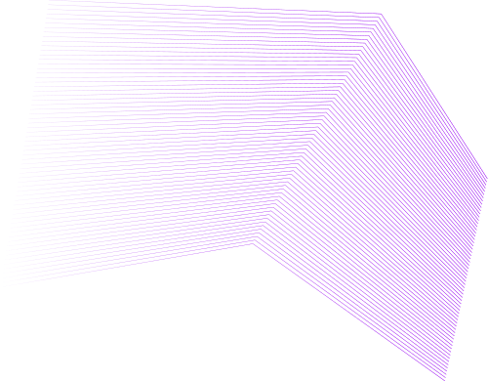
GANs are very good at producing images close to the desired outputs laid out in datasets | Tailor made to focus on image generation and processing
Preserves and recreates structural and textural details very well | Discriminators are flexible and effective
Maps the data pairings very effectively | Maintains consistency
Why GANs?

