Slide 1
Docker

Slide 2
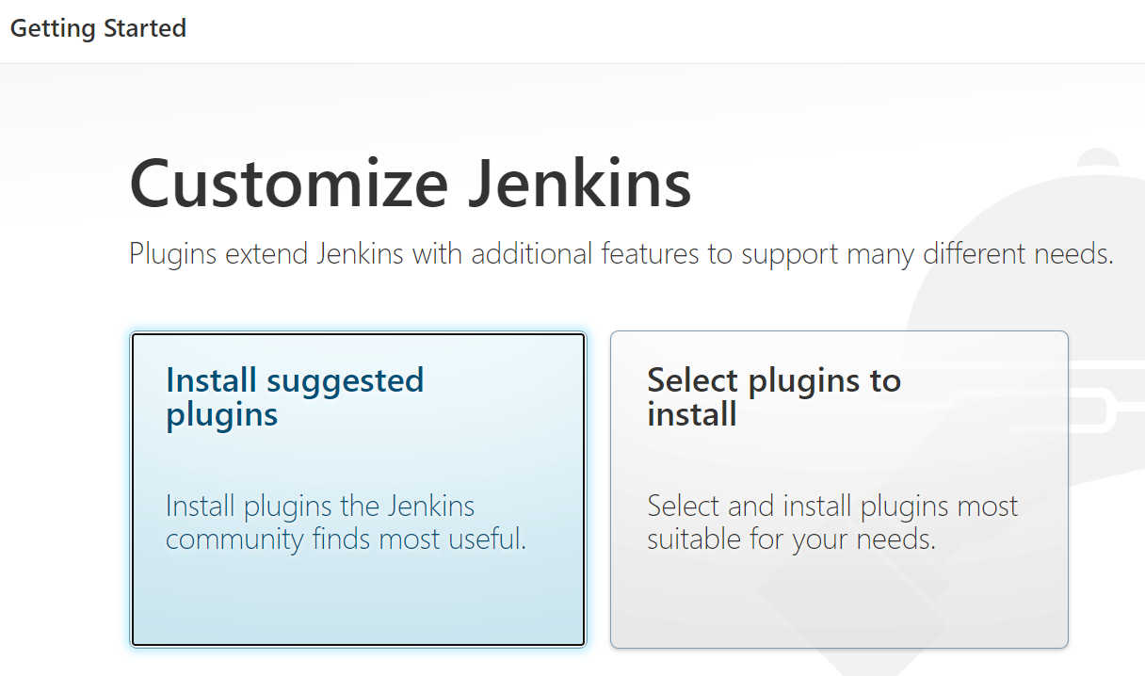
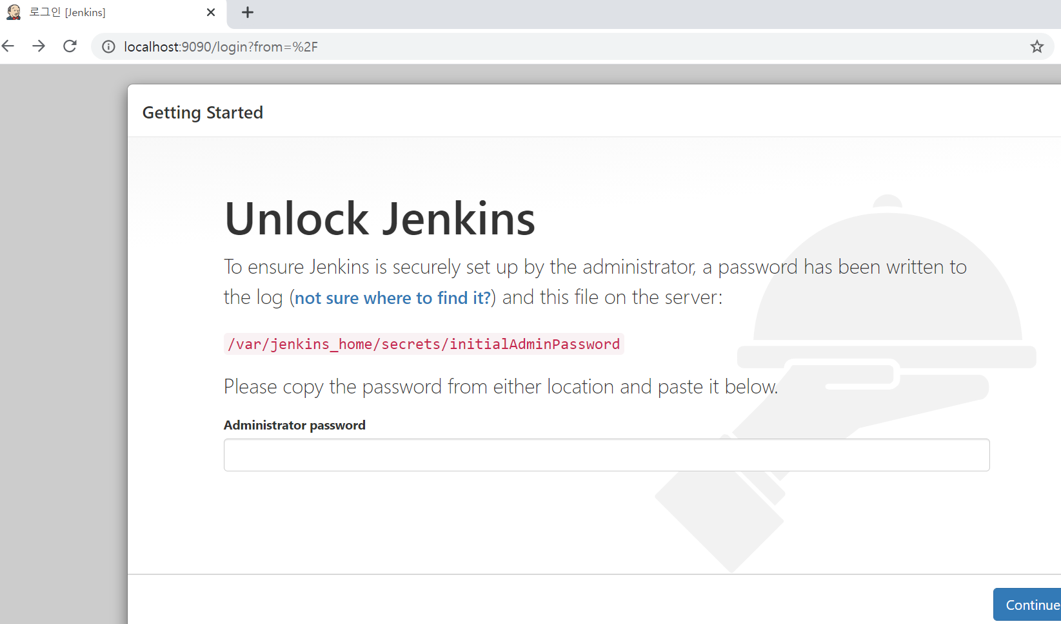
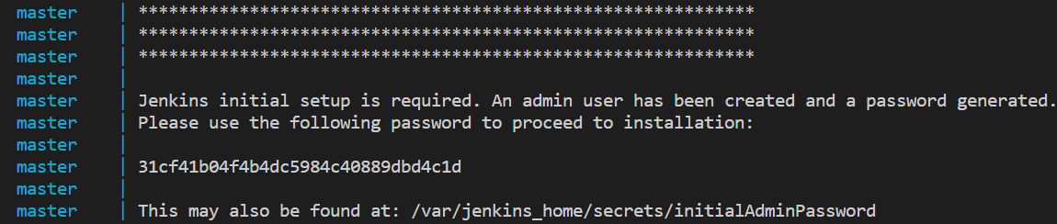
Jenkins(1/3)
docker-compose.yml
version: "3" #docker-compose version
services:
master:
container_name: master
image: jenkins/jenkins
ports: #port forwading
- 9090:8080
volumes: #host 현재 작업위치/jenkins_home과 jenkins container mount
- ./jenkins_home:/var/jenkins_home
docker-compose up
Jenkins install (localhost:9090)

Slide 3
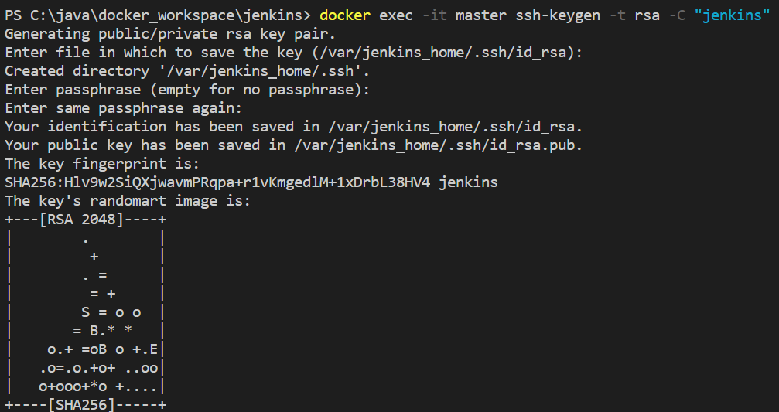
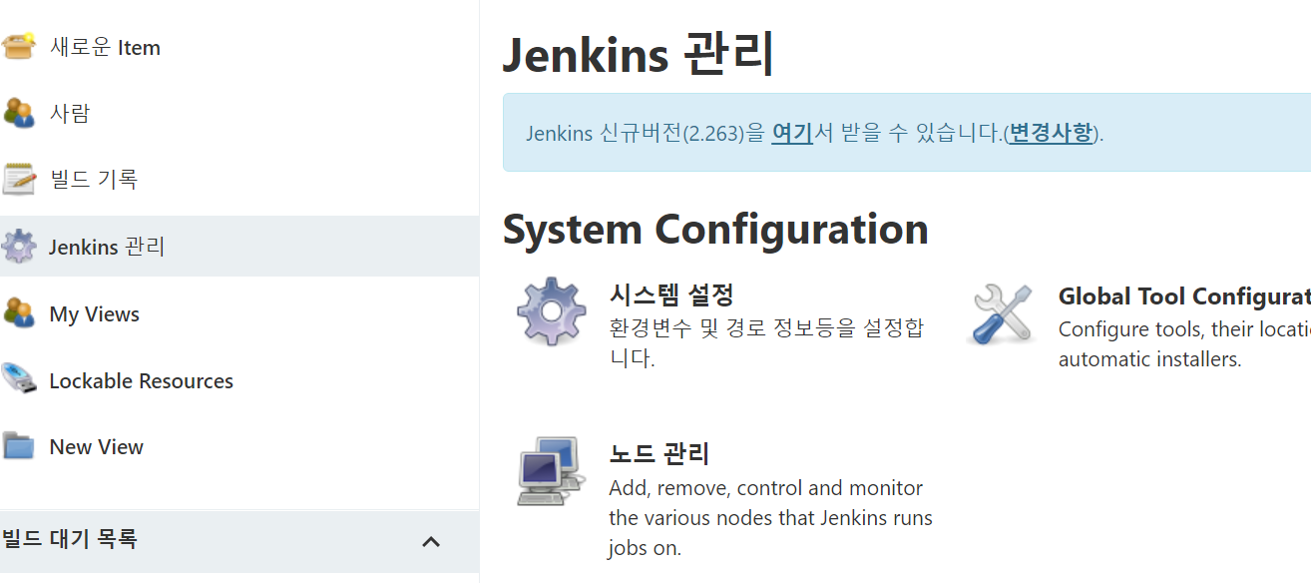
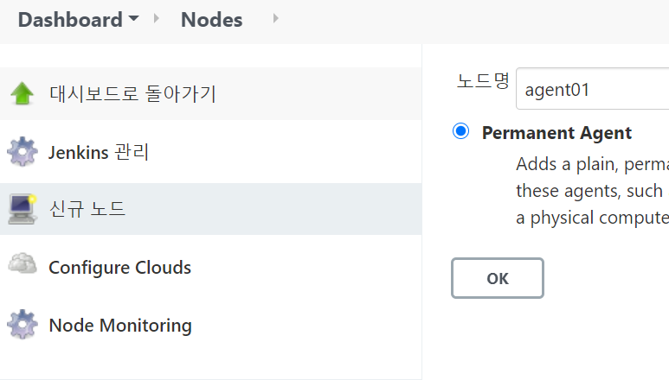
Jenkins(2/3)
master Jenkins SSH key 생성
docker exec -it master ssh-keygen -t rsa -C “comment"
Agent Jenkins container 생성
docker-compose.yml에 agent 추가
…
links:
- agent01
agent01:
container_name: agent01
image: jenkinsci/ssh-slave
environment:
- JENKINS_SLAVE_SSH_PUBKEY=ssh-rsa public key복사
docker-compose up -d
agent container 실행 확인 (docker-compose ps )
Master Jenkins에 agent 등록

Slide 4
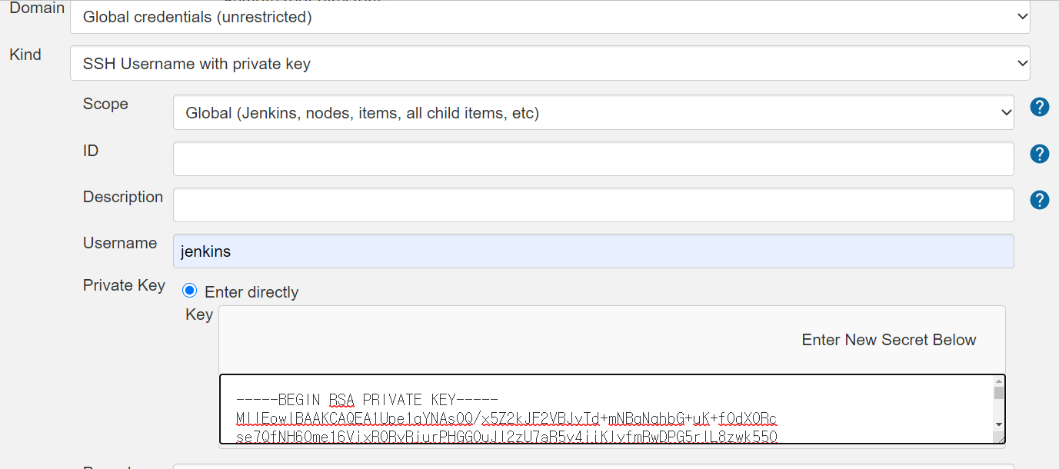
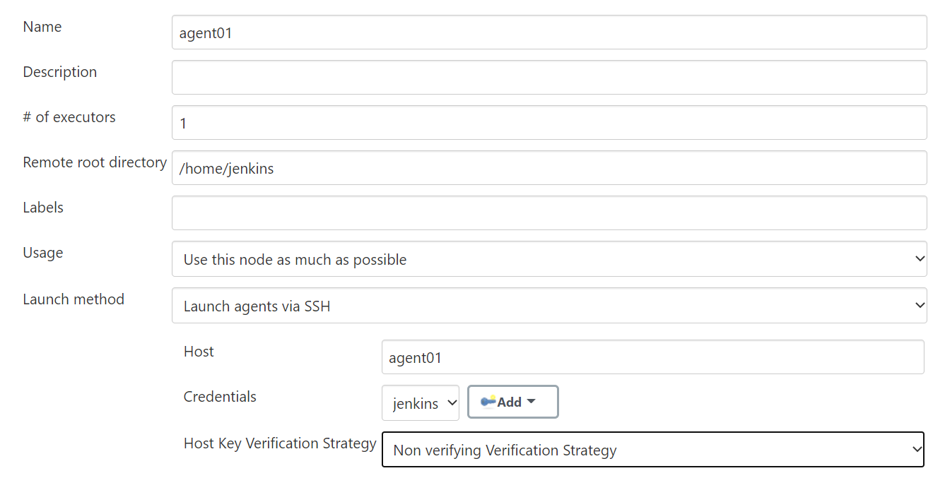
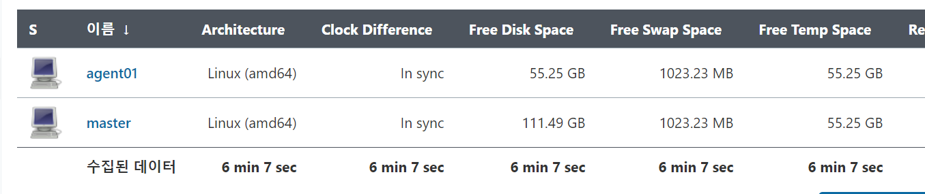
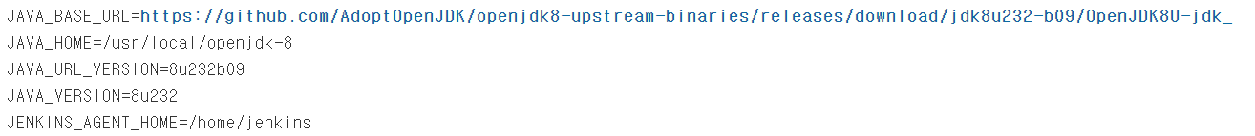
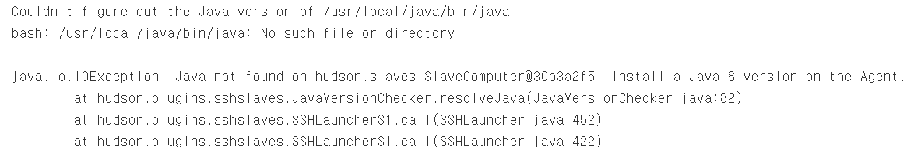
Jenkins(3/3)
master에 agent연결
JDK 오류나는 경우 jdk버전, path확인
docker exec –it master bash
#cd /usr/local
#mv openjdk-8 java
docker exec -it agent01 bash
#whereis java
java: /usr/local/openjdk-8/bin/java

