Slide 1
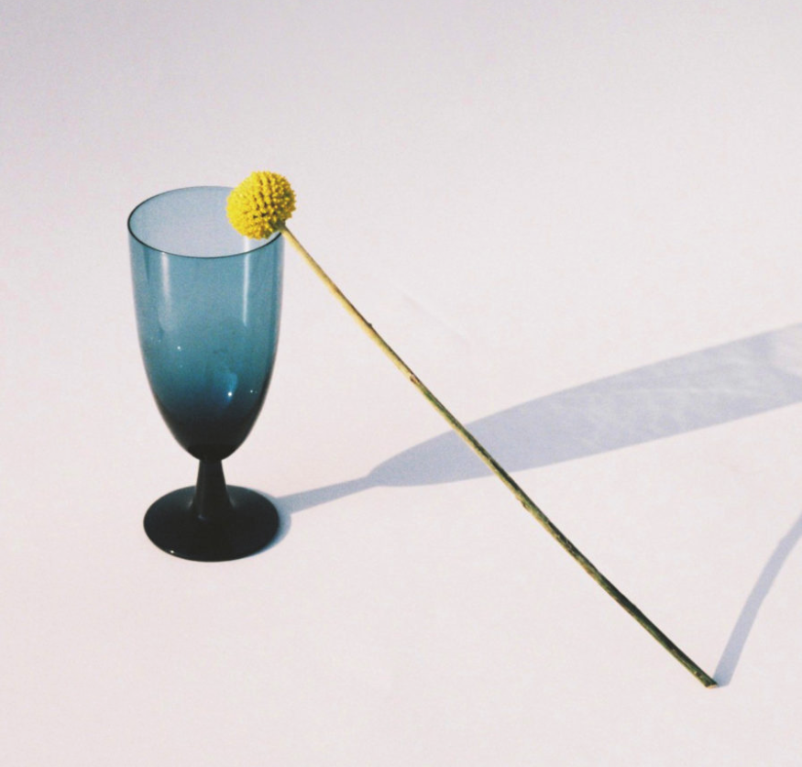
mood board
curation.
Discover

Slide 2
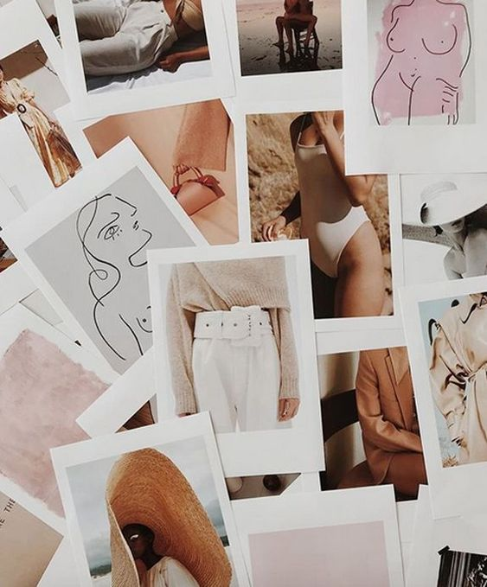
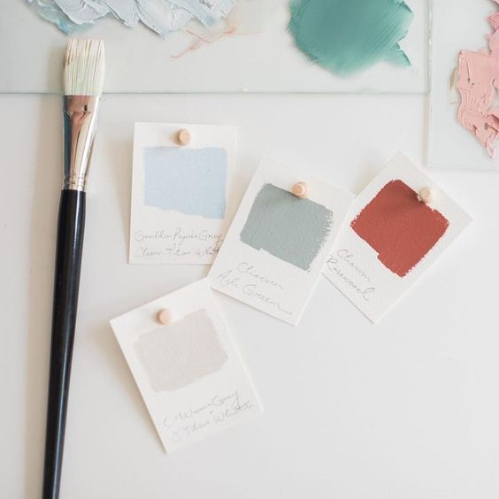
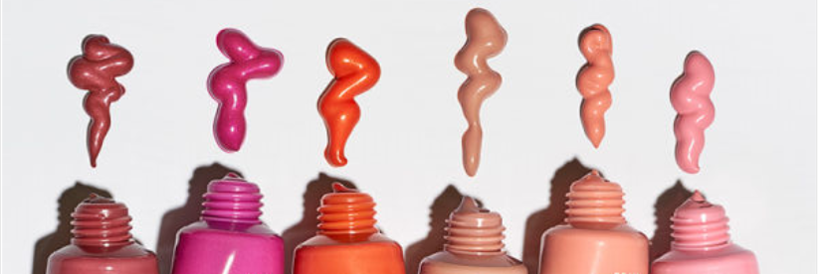
mood board curation.
modern & chic mood board
color palette
mood board
inspire
inspire
branding guide
mood board
modern & chic mood board
inspire
inspire
color palette
mood board
branding guide
mood board
inspire
inspire

Slide 3
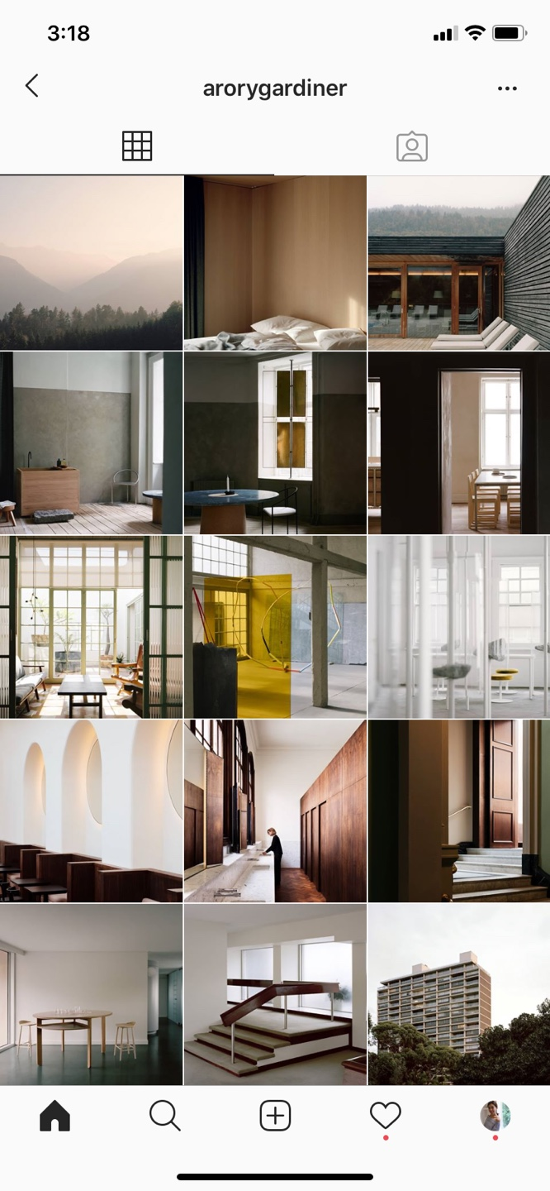
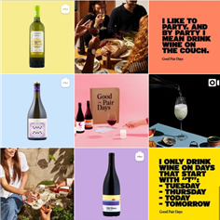
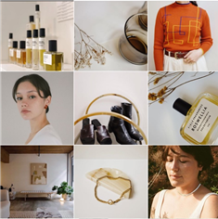
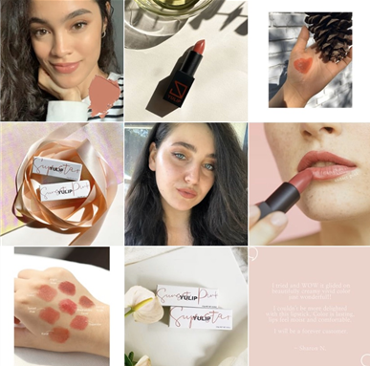
#hashtag 검색 기능
1 카테고리 추가 기능 / 카테고리 삭제 기능
2 링크 추가
/ 삭제 기능
modern & chic mood board
Generation Z
Model agency
Artist agency
Photographer / Korea / global
Stylist
Makeup & hair artist
Design studio
Magazine & webzine
Mood asset
Branding
Rising brand
inspire

Slide 5
