Slide 1
Research and Implementation of Key Technology in
Multi-FPGA Hardware Emulation
多FPGA硬件仿真关键技术研究与实现
硕士研究生中期答辩
Student： | Hu Guanghui | 2024234318
Academic mentor： | Ha Yajun | Professor
Enterprise mentor： | Zhang Ke | Professor
2026.10.30

Slide 2
Contents
01
Background & Research Goal
Motivation, research gap and REMUS overview
02
Research Progress
Execution & pause · State & replay · Partitioning · Runtime
03
Prototype & Evaluation
Dual-FPGA platform, workloads and experimental results
04
Current Challenges & Future Work
Remaining limitations and the next research steps
Notes:
Place this page after the cover and before the background section. Introduce the defense in four parts. First, motivate replayable multi-FPGA emulation, identify the research gap and outline REMUS. Second, explain cycle-accurate execution and consistent pause, distributed state capture and replay, automated partitioning, and the scalable Runtime/Fabric design. Third, present the dual-FPGA direct-PCIe prototype and measured results. Finally, connect observed limitations to future work on resource balance, execution performance, runtime control and system expansion. The current content mapping is background 1-5, progress 6-9, prototype 10 and future work 11. These are content identifiers rather than final deck page numbers. Source: docs/midterm-presentation-outline.md. This contents page does not assert completion of all technical goals.

Slide 3


Intro: From RTL Simulation to Multi-FPGA Prototyping
RTL Simulation
Full visibility
Flexible debugging
Low performance
FPGA Prototyping
MHz-level execution
Long software workloads
Limited by single-FPGA capacity
Multi-FPGA Prototyping
Partition large designs
Extend capacity
Enable large-scale SoC execution
1
Notes:
Introduce the capacity-versus-observability motivation. RTL simulation provides visibility and flexible debugging, but long software workloads are slow. FPGA prototyping accelerates execution, while one FPGA limits design capacity. Partitioning across multiple FPGAs extends capacity. The next slide introduces the need for coordinated debugging. MHz-level execution is a general prototype characteristic here, not a measured REMUS performance result. Layout reference: figure/presentation-reference/midterm-background-01.png.

Slide 4

Motivation: Multi-FPGA Prototyping Is Fast, but Hard to Debug
Multi-FPGA Prototyping
Replayable Multi-FPGA Emulation
Large design capacity
Run large RTL designs
High execution speed
Cycle-consistent global pause
Long software workloads
Full-state extraction
State restore
Limited visibility
Deterministic replay
Limited full-state replay
Waveform reconstruction
Run
Run
Pause
Dump
Restore
Replay
Limited visibility
Global snapshot
Waveform
2
Notes:
Contrast typical prototyping strengths and common debug limitations with the target capabilities of replayable multi-FPGA emulation. This is a research motivation slide, not a completed-feature checklist or an empirical comparison of every prototyping system. The right panel and workflow express goals; REMUS implementation and validation status are reported later. Dump represents collection and aggregation of distributed state into a global snapshot. Restore and replay are conceptual stages; execution backends and correctness conditions are explained on the technical slides. The return loop represents another debugging iteration. Layout reference: figure/presentation-reference/midterm-background-02.png.

Slide 5


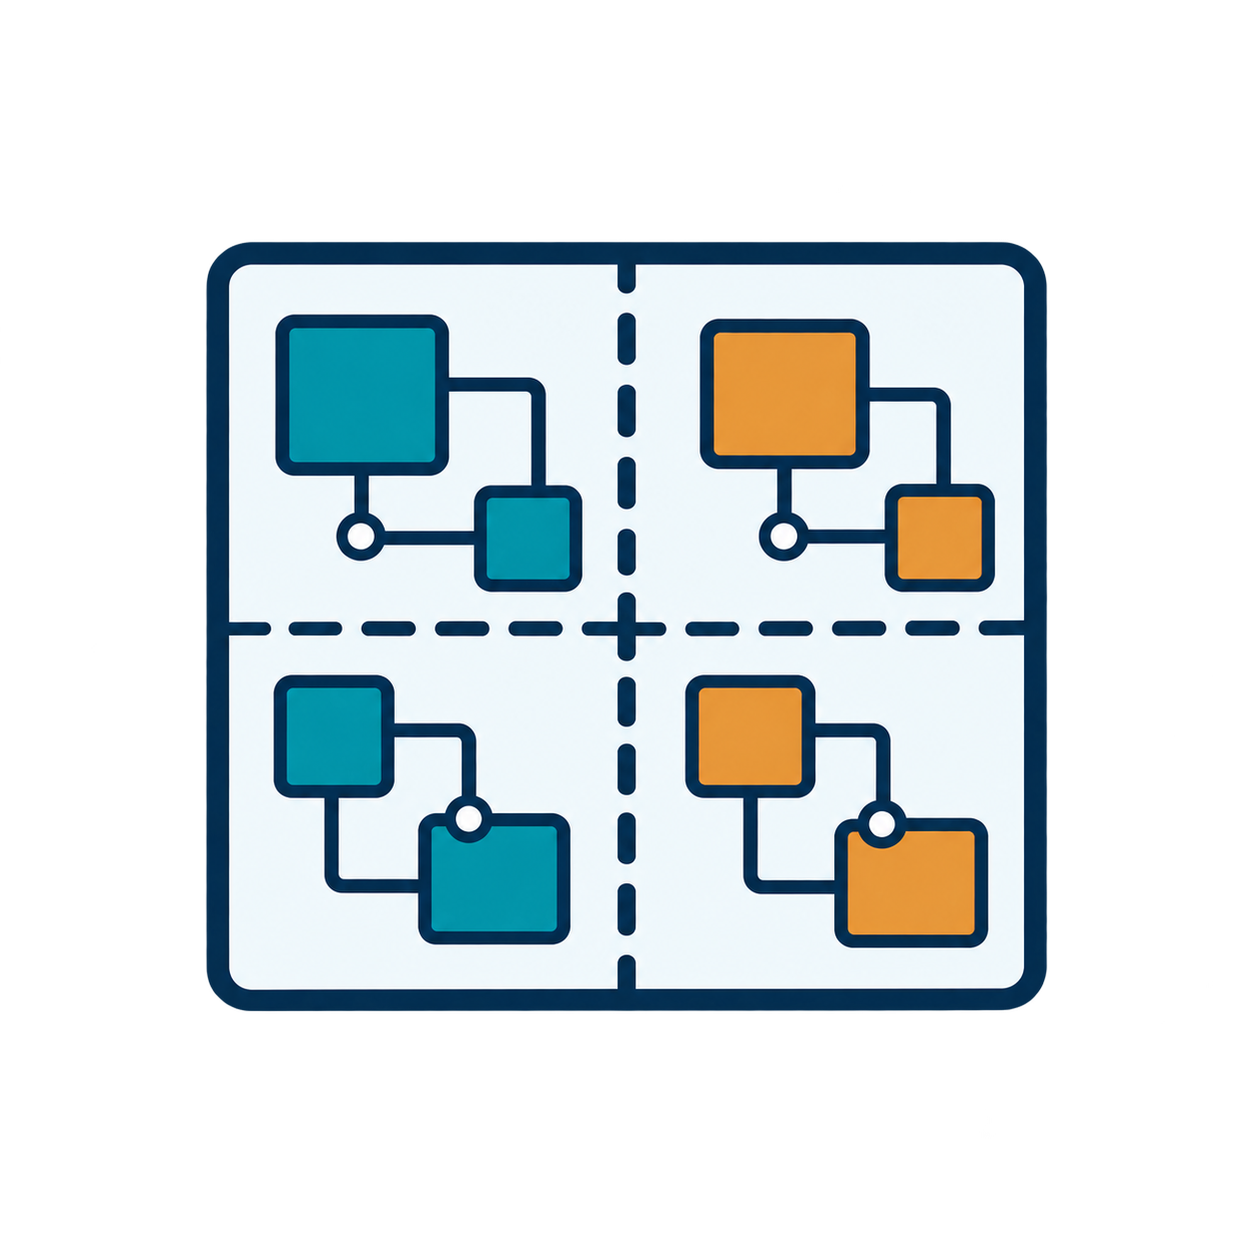
Key Challenges of Replayable Multi-FPGA Emulation
Cycle-Accurate Execution
Cycle-Consistent
Global Pause
Align DUT cycles across
partitions
Stop partitions at the
same logical cycle
Account for cross-FPGA
communication latency
Internal states from different cycle can not be replayed
Same DUT cycle n
Same DUT cycle n
Local states
Distributed State
Management
Automated Partitioning
Balance resources and
cut size
Extract local states
Limit Maximum Path-Cut Number through granularity
Form a global snapshot
for restore and replay
Global snapshot
Partitioned design
Academe have made progress in individual fields, still gaps in Multi-FPGA Emulation system.
3
Notes:
This slide introduces research challenges, not completed REMUS results. DUT logical cycles must remain aligned despite cross-FPGA communication latency; the pulse is conceptual, not a measured clock waveform. Global pause requires all partitions at the same DUT cycle and drained links, providing a stable boundary. Local partition states must be mapped and aggregated into a global snapshot for restoration and deterministic replay. Partitioning must balance resources and cut size while limiting the maximum path-cut number through granularity selection. Multiple chip icons and the partitioned circuit illustrate the problem, not an experimentally verified FPGA count. Reference: figure/presentation-reference/midterm-background-03.png.

Slide 6

Research Gap and Goal
Multi-FPGA
Prototyping
Single-FPGA
Replayable Emulation
This Work: REMUS
Related work: FireAxe, DUOHUAFEN
Related work: REMU
Research Goal
Scalable deployment
Limited by one FPGA
Scalable deployment
Fast execution
Fast execution
Fast execution
?
Cycle-consistent pause
Cycle-controlled pause
Cycle-consistent pause
?
Global snapshot
Full-state snapshot
Global snapshot
?
Deterministic replay
Deterministic replay
Deterministic replay
?
Waveform reconstruction
Waveform reconstruction
Waveform reconstruction
Goal: combine multi-FPGA scalability with replayable emulation for large-scale SoC debugging
4
Notes:
Research motivation: combine multi-FPGA deployment with replayable emulation. The prototype column indicates typical focus; amber marks system-dependent debug capabilities, not universal absence. The middle column represents scan-based single-FPGA replayable emulation such as the REMU foundation described in docs/thesis-writing-guidelines.md and src/proposal/significance_and_related_work.tex. A full-state snapshot in that setting fits within one FPGA's capacity. REMUS is explicitly a Research Goal: its checks are target capabilities, not measured results or a completed-feature checklist. The diagram is conceptual and does not establish restoration backend or a tested FPGA count. No exhaustive prior-art or novelty claim is made by this qualitative comparison. Layout: figure/presentation-reference/midterm-background-04.png.

Slide 7

REMUS: Overall Workflow and Mid-Term Scope
Overall Workflow
1
2
3
4
5
RTL Design
Automated
Partitioning
Multi-FPGA
Deployment
Cycle-Accurate
Execution & Global Pause
State Capture,
Restore & Replay
Fabric routing &
runtime control
Debug and replay support
Synchronized DUT cycles
Mid-Term Scope
Partitioning
framework
Cycle-accurate
execution
Global pause &
state dump
Restore & replay
Dual-FPGA prototype
RTL partitioning
and mapping
Multi-FPGA runs
with cycle control
Global snapshots
across FPGAs
Planned: restore & replay checks
Initial evaluation and system tests
5
Notes:
Overall target workflow and mid-term work areas, based on the user's updated five-stage reference figure/presentation-reference/midterm-background-05.png. The State Capture, Restore & Replay card deliberately uses the same blue/teal styling as preceding stages, not yellow. Fabric routing and runtime control are folded into deployment; cycle execution and global pause form one stage. The four FPGA icons are an illustrative topology, not evidence of a tested four-FPGA system. State capture aggregates local states into a global snapshot; the final icon depicts the intended path from snapshot through restoration and replay to waveform reconstruction, not direct conversion of a dump into a waveform. Restore/replay is planned for further development and validation according to src/midterm/outline.md sections 1.1 and 1.7. Scope bullets are work areas, not completed-feature checks; implementation and experiment evidence belong on the later progress slides.

Slide 8
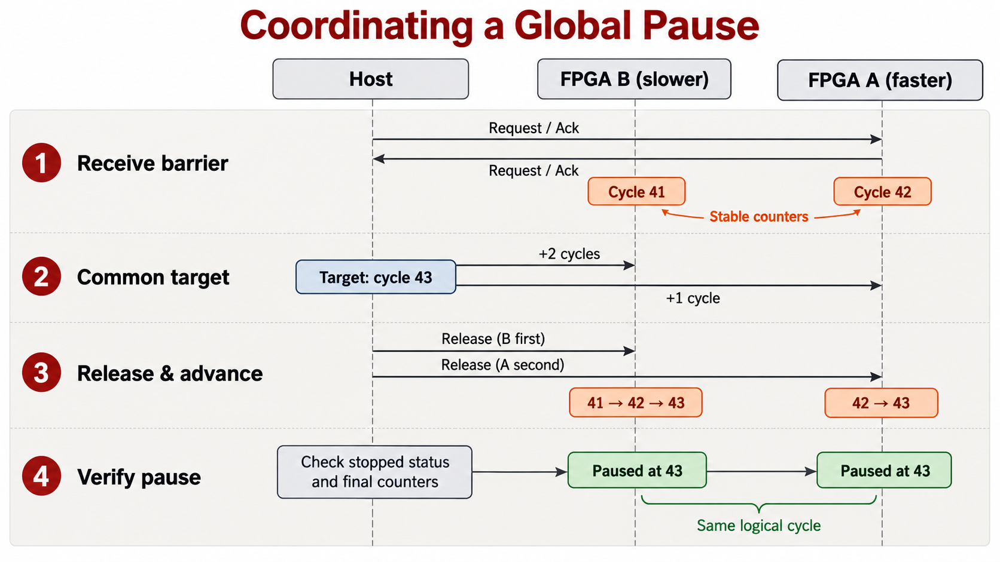
Pregress1: Cycle-Accurate Execution and Global Pause
Cycle-Accurate Execution
Execution based on DUOHUAFEN LI-TDM^{[1]}
Optimized communication flow
Reduce once data exchange per cycle
Cycle-Consistent Pause
1
Stabilize progress
2
Set a common target
3
Advance and verify
[1] G. Zhu. Cross-Node Deployment of Digital Logic Design for FPGA Cloud. Master's thesis, ShanghaiTech University, 2024.
6
Notes:
REMUS builds on DUOHUAFEN's LI-TDM for cycle-accurate execution. The first-stage receive and last-stage send are omitted to reduce redundant communication; this is a protocol optimization, not a measured percentage speedup. Keep these implementation details in the narration. For global pause, the Host collects all receive-barrier acknowledgements before sampling stable counters. Barrier acknowledgement alone is not a valid global pause. In the illustrative example, B is at 41 and A at 42. The common target is 43; configure two steps for B and one for A while barriers remain held, then release B before A. LI-TDM dependencies still apply. Finally check stopped/pause status and final counters on all partitions. Equal logical cycles do not imply simultaneous physical stops or prove all-state equivalence. Required propagation must finish. The diagram's shared arrows are a simplified visual summary of Host operations on each partition, not FPGA-to-FPGA forwarding of Host commands. The cycle numbers are illustrative, not experimental data. Source: src/midterm/progress/cycle_control.tex. The right illustration is intentionally a raster crop per user request; the title, left text and page number are editable. The three requested supplementary callouts from the design reference are omitted. Reference [1]: G. Zhu. Cross-Node Deployment of Digital Logic Design for FPGA Cloud. Master's thesis, ShanghaiTech University, 2024.

Slide 9
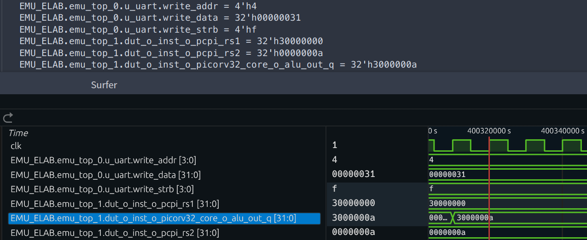
Progress2: Distributed State Capture, Restore and Replay
01
Global Snapshot
Reuse REMU's Scan Dump mechanism^{[1]}
Collect and merge each partition’s states
02
FPGA Restore
Write back scan data by partition
Restore local registers, SRAM and memory
Waveform replay reproduces the same signal
values as FPGA execution
03
Software RTL Replay
Decode partition data through state mapping
Load RTL states and replay recorded inputs
[1] Y. Chen et al. REMU: Enabling Cost-Effective Checkpointing and Deterministic Replay in FPGA-based Emulation. ICCD, 2023, pp. 21–29.
7
Notes:
The previous slide establishes a common DUT cycle. REMUS reuses REMU's local Scan Dump and organizes per-partition scan files as a Global Snapshot. Memory and input management retain the existing REMU mechanisms. FPGA Restore writes each partition's scan data back to the corresponding FPGA with the matching design and scan layout, restoring local registers and SRAM plus the memory-model data before execution resumes. Software restoration instead decodes local scan positions through state mapping and loads the corresponding RTL objects. Recorded inputs are replayed by logical cycle, enabling waveform observation. The user-approved conclusion summarizes reported tested functionality; it is not an all-state or all-cycle equivalence assertion. The displayed image specifically compares a TWO-PARTITION COSIM checkpoint at cycle 42080 with Icarus Verilog software RTL replay from checkpoint 2048. Six selected signals match at relative cycle 40032. Inputs remain unchanged after 2048 in this example. It is not a physical-board restore screenshot. The author separately confirmed board-vs-Cosim checkpoint consistency and FPGA restoration/replay results; original board comparison records are still being archived. Do not present this software example as direct evidence of physical FPGA restore or merge different observation sets into a full equivalence claim. Sources: src/midterm/progress/state_replay.tex; experiments/picorv32-cosim-replay.md; experiments/board-execution.md. Design: figure/presentation-reference/midterm-state-replay-07-v2.png. All slide text is editable; the experiment screenshot is an unchanged raster. Reference [1]: Y. Chen et al. REMU: Enabling Cost-Effective Checkpointing and Deterministic Replay in FPGA-based Emulation. ICCD, 2023, pp. 21–29. DOI: 10.1109/ICCD58817.2023.00014.

Slide 10
Progress3: Automated Multi-FPGA Circuit Partitioning
Automated Partitioning
Post-Synthesis Resource Utilization
KMH · Two partitions · Utilization (%)
1
Adaptive-granularity
RTL partitioning
2
KaHyPar-based
hypergraph partitioning
3
Path-cut number analysis
for LI-TDM
Experimental Results:
The hypergraph size was reduced to 1/10
No significant change in the cut-size and path-cut number
Similar LUT usage, uneven FF and BRAM distribution.
8
Notes:
REMUS implements adaptive RTL granularity selection, weighted hypergraph partitioning using KaHyPar, and path-cut analysis for LI-TDM configuration. The author's revised slide reports graph size around one tenth of the netlist-level baseline, with no significant change in cut-size and path-cut number. These are author-reported comparisons; this slide synchronization does not independently validate the baseline runs. Confirm matched DUTs, configurations and graph-size definitions when finalizing the experimental record. The main chart uses archived KMH two-Part Vivado 2024.2 synthesis results: Part 0 LUT/FF/BRAM utilization 73.18/17.66/14.31 percent; Part 1 75.77/8.17/0.00 percent. BRAM counts are 288.5 and 0 tiles. URAM is 13 versus 0, omitted from the plot for focus. The scope is role_i/ClockResetCore_0/emu_system, including inserted infrastructure; not pure DUT, full board consumption, or post-route utilization. The denominator is whole-device capacity, not the remaining Part budget. The observed resource asymmetry does not isolate adaptive granularity or scalar weights as its sole cause. Constraints, module grouping and synthesis mapping may also matter. Exact build matching between partition summaries and synthesis reports remains to be completed, so no estimation-error or baseline-gain inference is made from their combination. Sources: experiments/synthesis-utilization.md (3.2); src/midterm/progress/partitioning.tex; src/midterm/problems.tex.

Slide 11
Progress4: Scalable Multi-FPGA Runtime
Direct PCIe Access
Fabric-Based Access
Host
Host
PCIe
PCIe
PCIe
PCIe
FPGA A
FPGA B
FPGA C
Ref FPGA
FPGA B
FPGA C
Fabric
Fabric
Registers
Memory
Registers
Memory
Registers
Memory
Registers
Memory
Registers
Memory
Registers
Memory
Separate Host connection per FPGA
One Host entry via Ref
Limited by Host PCIe connectivity
Unified register and memory access
Extend through inter-FPGA links
9
Notes:
Runtime operations such as global pause and state management require Host access to each FPGA's registers and memory. The baseline dual-board prototype uses a separate PCIe connection to each FPGA. Fabric provides a shared Host entry through the Ref node and carries resource requests over inter-FPGA links. Ref also retains its local DUT and resources. The diagrams illustrate architecture; three nodes and chain links do not claim a validated three-FPGA deployment. Access bandwidth is shared at Ref, and supported scale still depends on links and implementation constraints. Fabric components and the Driver backend are implemented; the dual-node Cosim environment is established. Current documented evidence does not establish complete end-to-end or Fabric board-level validation. At the user's request, these status lines and the illustrative-topology caption are omitted from the visible slide, not converted into success claims. Sources: src/midterm/progress/runtime.tex; ../docs/source/project-notes/fabric/status.md. Design reference: figure/presentation-reference/midterm-runtime-09-v1.png. All visible text, diagrams, and arrows are native editable PowerPoint elements.

Slide 12
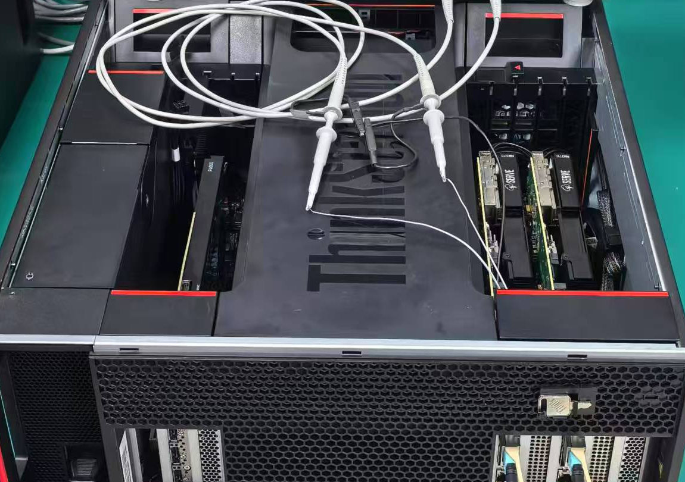
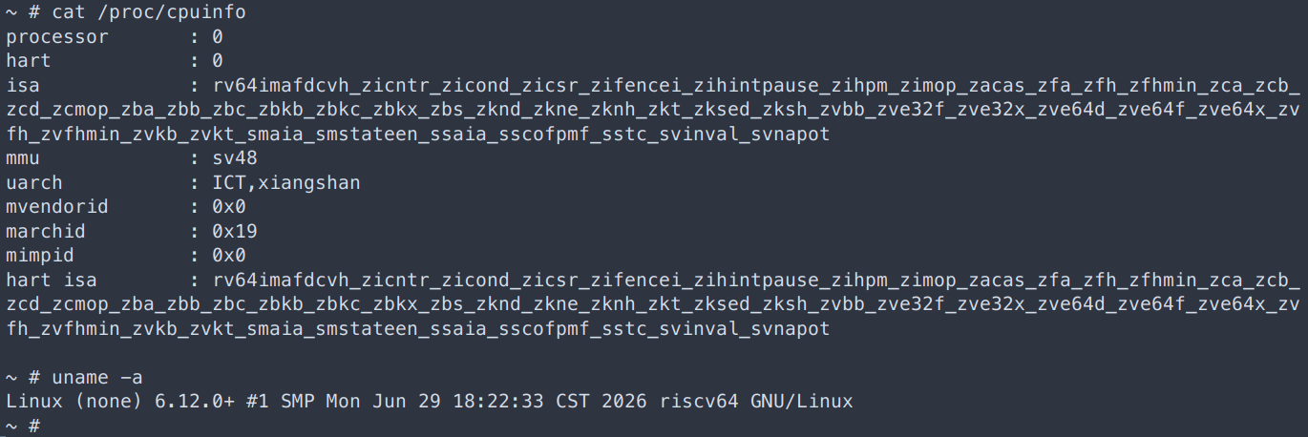
Evaluation: Dual-FPGA Emulation System
Experimental Platform
DUTs and Workloads
DUTs
Workloads
PicoRV32 · Rocket
Bare-metal programs
Nanhu · KMH
OpenSBI and Linux
Two NM37 boards with VU37P FPGAs
PCIe access from a shared Host
QSFP/Aurora links between FPGAs
KMH boots Linux and supports interactive shell commands.
PicoRV32 · Effective Rate
KMH · Effective Rate
Global Pause · Host-Observed
≈0.327 MHz
≈0.322 MHz
≈0.8~1.1 ms
10
Notes:
This is the real dual-FPGA PCIe-direct prototype, not a completed Fabric board deployment. Two NM37 boards use VU37P devices with separate PCIe Host access and QSFP/Aurora board communication. The real photo is figure/remus-2fpga-hw.jpg; its oscilloscope is cropped away. PicoRV32 and Rocket run hand-written bare-metal workloads; Nanhu and single-core KMH run OpenSBI/Linux, as confirmed by the author in src/midterm/progress/prototype.tex. The terminal specifically belongs to KMH, not all four DUTs. The crop shows shell commands, cpuinfo and uname for Linux 6.12.0+. Image timestamps are not Host elapsed time. Performance comes from experiments/board-performance.md and raw/perf.txt. PicoRV32's longer runs are 0.326741 and 0.327423 MHz; combined cycles/time gives about 0.326834 MHz, rounded here to 0.327. KMH's 0.322073 MHz is a 1095817-cycle, 3.40238-second window BEFORE checkpoint save, not the full Linux boot or post-CLI rate. These are logical progress over Host time, not FPGA physical clocks. Pause records include 23 PicoRV32 observations from 0.803824 to 0.925013 ms and one KMH observation of 1.04744 ms, rounded to approximately 0.8–1.1 ms. They are Host-visible synchronized-pause times, not pure hardware barrier latency, independent repeat trials or a success-rate measurement. Detailed checkpoint timings and resources are intentionally omitted. Sources: src/midterm/progress/prototype.tex; experiments/board-execution.md; experiments/board-performance.md. Original photos are embedded unchanged and cropped only through PPT properties; all slide text/cells are editable.

Slide 13
11. Future Work
1.
Fabric Deployment &
Four-FPGA Integration
Complete board-level Fabric integration and validation.
Build a four-FPGA emulation system.
2.
Performance Analysis &
Runtime Optimization
Analyze execution and communication overheads on four FPGAs.
3.
Thesis Writing
Consolidate experimental results and complete the thesis.
11
Notes:
The author's revised plan contains three items: Fabric board-level integration and validation followed by a four-FPGA system; execution and communication overhead analysis on that system; consolidation of results and thesis writing. These are future work. The separate partitioning-optimization item and interrupt-driven-control sentence were removed in the author's 2026-10-29 revision.

Slide 14
Thank you
Student： | Hu Guanghui | 2024234318
Academic mentor： | Ha Yajun | Professor
Enterprise mentor： | Zhang Ke | Professor
2026.10.30

