Slide 1



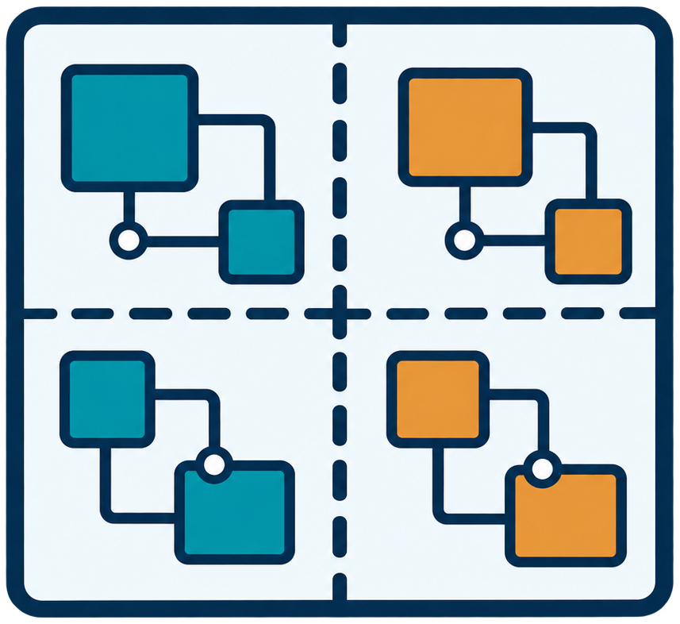

3. Key Challenges of Replayable Multi-FPGA Emulation
Cycle-Accurate
Execution
Cycle-Consistent
Global Pause
Align DUT cycles across
partitions
Stop partitions at the
same logical cycle
Account for cross-FPGA
communication latency
Drain links for a stable
snapshot boundary
DUT cycle n
Same DUT cycle n
Local states
Distributed State
Management
Automated
Partitioning
Extract local states
Balance resources and
cut size
Form a global snapshot
for restore and replay
Limit Maximum
Path-Cut Number
through granularity
Global snapshot
Partitioned design
Replayable emulation requires scalable deployment and globally coordinated debugging.
3
Notes:
This slide introduces research challenges, not completed REMUS results. DUT logical cycles must remain aligned despite cross-FPGA communication latency; the pulse is conceptual, not a measured clock waveform. Global pause requires all partitions at the same DUT cycle and drained links, providing a stable boundary. Local partition states must be mapped and aggregated into a global snapshot for restoration and deterministic replay. Partitioning must balance resources and cut size while limiting the maximum path-cut number through granularity selection. Multiple chip icons and the partitioned circuit illustrate the problem, not an experimentally verified FPGA count. Reference: figure/presentation-reference/midterm-background-03.png.

