Slide 1

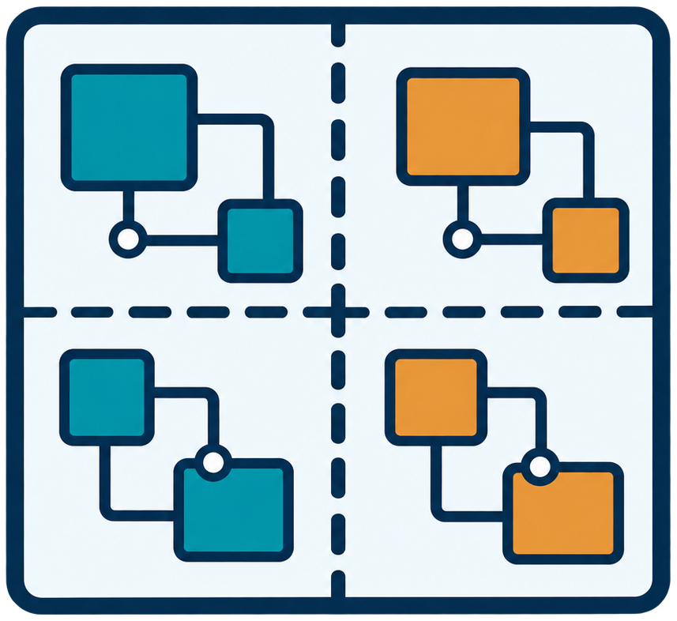



5. REMUS: Overall Workflow and Mid-Term Scope
Overall Workflow
1
2
3
4
5
RTL Design
Automated
Partitioning
Multi-FPGA
Deployment
Cycle-Accurate
Execution & Global Pause
State Capture,
Restore & Replay
Fabric routing &
runtime control
Debug and replay support
Synchronized DUT cycles
Restore / replay
Planned
Illustrative topology
Synchronized
Mid-Term Scope
Partitioning
framework
Cycle-accurate
execution
Global pause &
state dump
Restore & replay
Dual-FPGA
prototype
RTL partitioning
and mapping
Multi-FPGA runs
with cycle control
Global snapshots
across FPGAs
Planned: restore
& replay checks
Initial evaluation
and system tests
5
Notes:
Overall target workflow and mid-term work areas, based on the user's updated five-stage reference figure/presentation-reference/midterm-background-05.png. The State Capture, Restore & Replay card deliberately uses the same blue/teal styling as preceding stages, not yellow. Fabric routing and runtime control are folded into deployment; cycle execution and global pause form one stage. The four FPGA icons are an illustrative topology, not evidence of a tested four-FPGA system. State capture aggregates local states into a global snapshot; the final icon depicts the intended path from snapshot through restoration and replay to waveform reconstruction, not direct conversion of a dump into a waveform. Restore/replay is planned for further development and validation according to src/midterm/outline.md sections 1.1 and 1.7. Scope bullets are work areas, not completed-feature checks; implementation and experiment evidence belong on the later progress slides.

