Slide 1


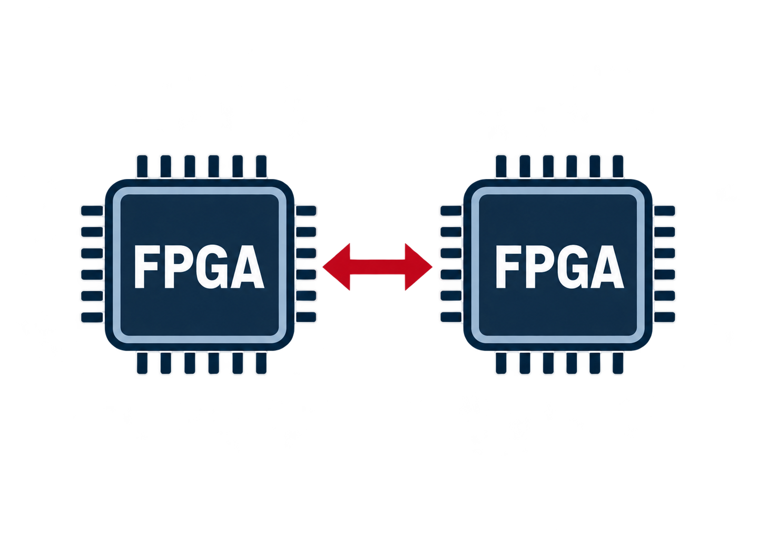
1. From RTL Simulation to Multi-FPGA Prototyping
RTL Simulation
Full visibility
Flexible debugging
Low performance
FPGA Prototyping
MHz-level execution
Long software workloads
Limited by single-FPGA capacity
Multi-FPGA Prototyping
Partition large designs
Extend capacity
Enable large-scale SoC execution
1

