Slide 1
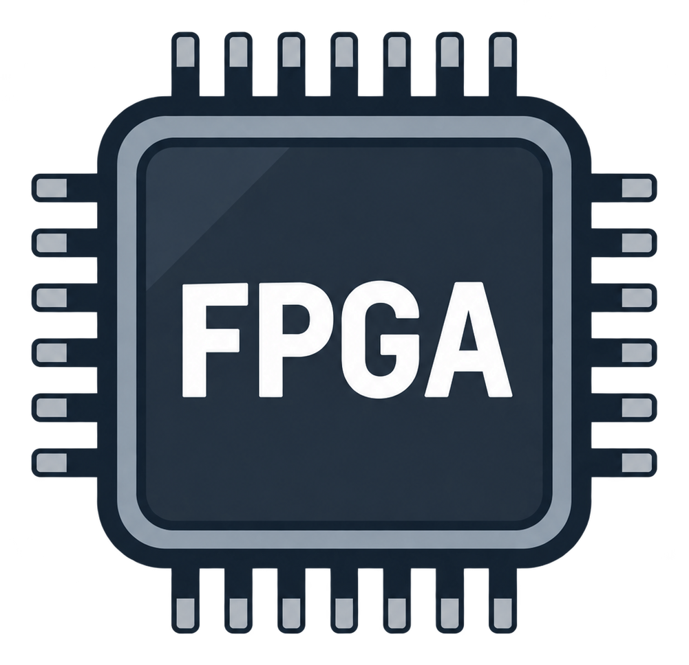


2. Multi-FPGA Prototyping Is Fast, but Hard to Debug
Multi-FPGA Prototyping
Replayable Multi-FPGA Emulation
✓
Large design capacity
✓
Run large RTL designs
✓
High execution speed
✓
Cycle-consistent global pause
✓
Long software workloads
✓
Full-state extraction
×
Limited visibility
✓
State restore
×
Limited full-state replay
✓
Deterministic replay
✓
Waveform reconstruction
Run
Run
Pause
Dump
Restore
Replay
Limited visibility
Global snapshot
Waveform
2

