Slide 1
Research and Implementation of Key Technology in
Multi-FPGA Hardware Emulation
多FPGA硬件仿真关键技术研究与实现
硕士研究生开题答辩
Student： | Hu Guanghui | 2024234318
Academic mentor： | Ha Yajun | Professor
Enterprise mentor： | Zhang Ke | Professor
2025.12.10
Notes:
My proposal title is Research and Implementation of Key Technology in Multi-FPGA Hardware Emulation

Slide 2
Contents
Introduction
Related Work
Research Goal
Key Problem and Technology
Experiment
Project Timeline
Notes:
Today’s contents is as follow, let‘s focus on introduction firstly
这是今天课题介绍的顺序，我们先介绍研究背景

Slide 3
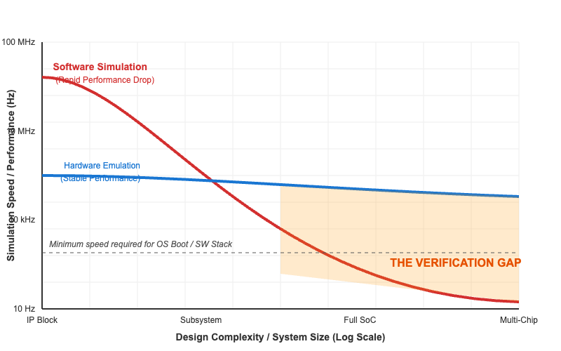
Intro: Challenges in Chip Verification
Complexity Explosion
  Trend: "Stagnant Process" vs. "Skyrocketing Complexity"
  Result: Verification effort now dominates the chip design cycle (~70%)
The Simulation Bottleneck
  Speed Gap: Real Silicon (GHz) vs. Simulation (KHz)
The Unmet Need
  Requirement: Pre-silicon HW/SW co-verification (OS, Drivers, Apps)
  Reality: Software simulation fails to run real-world workloads in feasible time
Solution: Hardware Emulation
Notes:
现代芯片的性能每年都会增长，但是工艺演进速度的进展却十分缓慢，只能通过增加集成度来实现性能增长。
这导致现代SoC已经到了万亿门级的规模，这对于验证来说是一个不小的挑战，据统计有将近70%的时间都是用于芯片验证。
从右图可以看到挑战的根源，红色的线代表逻辑仿真软件的仿真速度，随着规模的增大不断下降，但是厚重的软件栈，例如操作系统、AI应用等，又要求全面的软硬件联合验证。
软件仿真的速度和芯片本身的速度鸿沟的拉大，让验证的时间成本变得不可接受
为了解决这个问题，学者们提出了硬件仿真这个概念，它能够用较快的对芯片进行验证，如右图蓝色的线

Slide 4
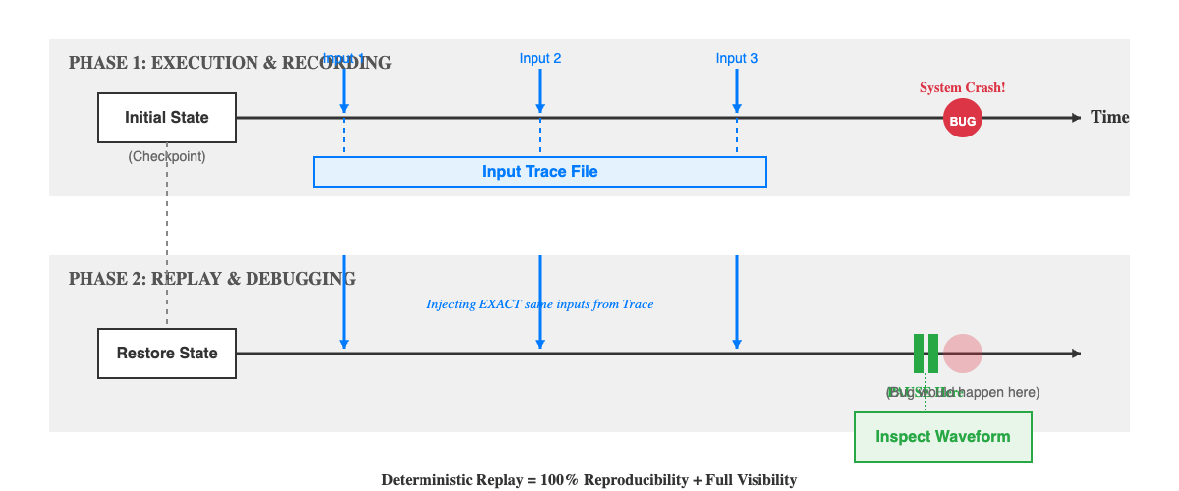
Intro: Hardware Emulation for Verification
Definition & Advantages
  Hardware Acceleration: Utilizing ASIC or FPGA to execute logic in parallel
  Speed: Running at MHz range, 1000x - 10000x faster than software simulation
  High Visibility: full visibility of internal signals for debugging
Core Feature: Deterministic Replay
  Have exact same behaviors under the same initial state and input sequence
  Guarantees 100% reproducibility for complex race conditions
Notes:
所谓硬件仿真，就是用专用硬件，例如ASIC或者FPGA，来加速逻辑仿真和波形采集的过程。
它的速度能够达到MHz的级别，相对软件仿真快了3到4个数量级。
仿真不光需要运行，也需要在出错的时候可调试，这也要求硬件仿真能够获取到所有信号的波形。
硬件仿真最重要的一点就是确定性可重放，也叫可重放。
在真实芯片中，总会由于随机的物理延迟导致每次运行的行为会稍有不同，当错误出现的时候，难移复现和调试，这也就是不可重放。
为了增强可调试性，硬件仿真需要保证在给定初始状态和输入序列后，输出结果和行为是一致的，这也就是可重放。
可重放是改研究的一个重点。
So, what is hardware emulation? It's the bridge between slow software simulation and fast but invisual FPGA prototyping."（硬件仿真是什么？它是慢速软件仿真和快速但不可见的FPGA原型之间的桥梁。）
关于加速： "It uses specialized hardware to run the design in parallel, achieving MHz speeds."
重点解释 Deterministic Replay（重中之重）：
"The most critical feature is Deterministic Replay."
“In real silicon or standard FPGA prototypes, delay is different due to physical factors (temperature, routing delays). If a bug happens once, it might not happen again.（在真实芯片或普通FPGA原型中，时序会因物理因素变化。）
"Hardware Emulation guarantees that Input A plus State B always equals Output C. It captures the exact sequence of events, allowing us to 'rewind' time and inspect any signal, just like a video recording."（硬件仿真保证输入A+状态B永远等于输出C。它就像录像回放一样，允许我们“倒退时间”去检查任意信号。）

Slide 5
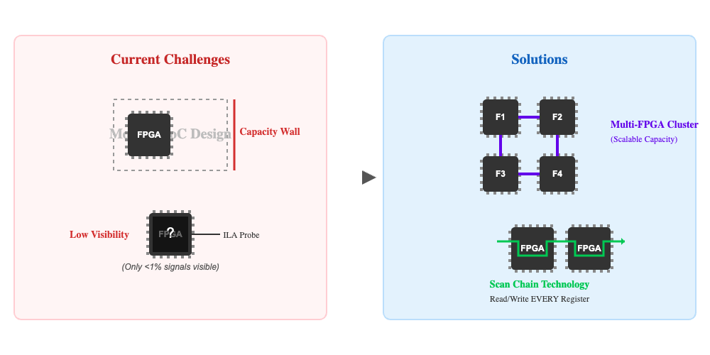
Intro: FPGA for Hardware Emulation
Advantages:
  High Reconfigurability
  Near-Silicon Speed
Fundamental Bottlenecks:
  Limited Visibility
  Capacity Wall
Bridging the Gap:
  Solution to Visibility: Scan Chain
    Insert scan logic to capture and restore full system state
  Solution to Capacity: Multi-FPGA Architecture
    Breaks the capacity limit by partitioning large designs across interconnected FPGA clusters
Notes:
在硬件仿真中，主要有两类技术路线，一类是基于专用ASIC的，一个是基于FPGA得，基于ASIC的解决方案十分昂贵，工业界也对相关技术进行保密。因此，本文的研究聚焦于FPGA的硬件仿真。
关于FPGA具有高度的可重构性和接近实际的运行速度，十分适合作为硬件仿真的平台。
但也存在问题，首先是FPGA得信号可见性极低，只能通过有限的探针手动插入，第二就是单片FPGA的容量有限，无法支持现代大型SoC的硬件仿真
为了解决可见性，可以在原设计中插入扫描链，读出所有的寄存器。
为了解决容量问题，可以从单片扩展到多片，将设计切分并协同工作。
分类： "Industrially, we have expensive ASIC-based machines and scalable FPGA-based solutions. My research focuses on the FPGA path."（工业界有昂贵的ASIC方案和可扩展的FPGA方案。我的研究聚焦于FPGA路线。）
关于FPGA的优缺点： "We chose FPGA as our platform because it's reconfigurable and fast. However, it's not perfect. The biggest issues are visibility and capacity. You can't see enough signals inside, and a single chip is just too small for large SoC."
关于解决思路（对应您的两个大方向）：
"To fix the visibility issue, we insert Scan Chains, It allow us to read out every flip-flop in the design."（为了解决可见性，我们不使用标准探针，而是插入扫描链，读出所有触发器。）
"To fix the capacity issue, we move from Single-FPGA to Multi-FPGA. We split the design into pieces and make them work together"（为了解决容量问题，我们从单片扩展到多片，将设计切分并协同工作。）

Slide 6
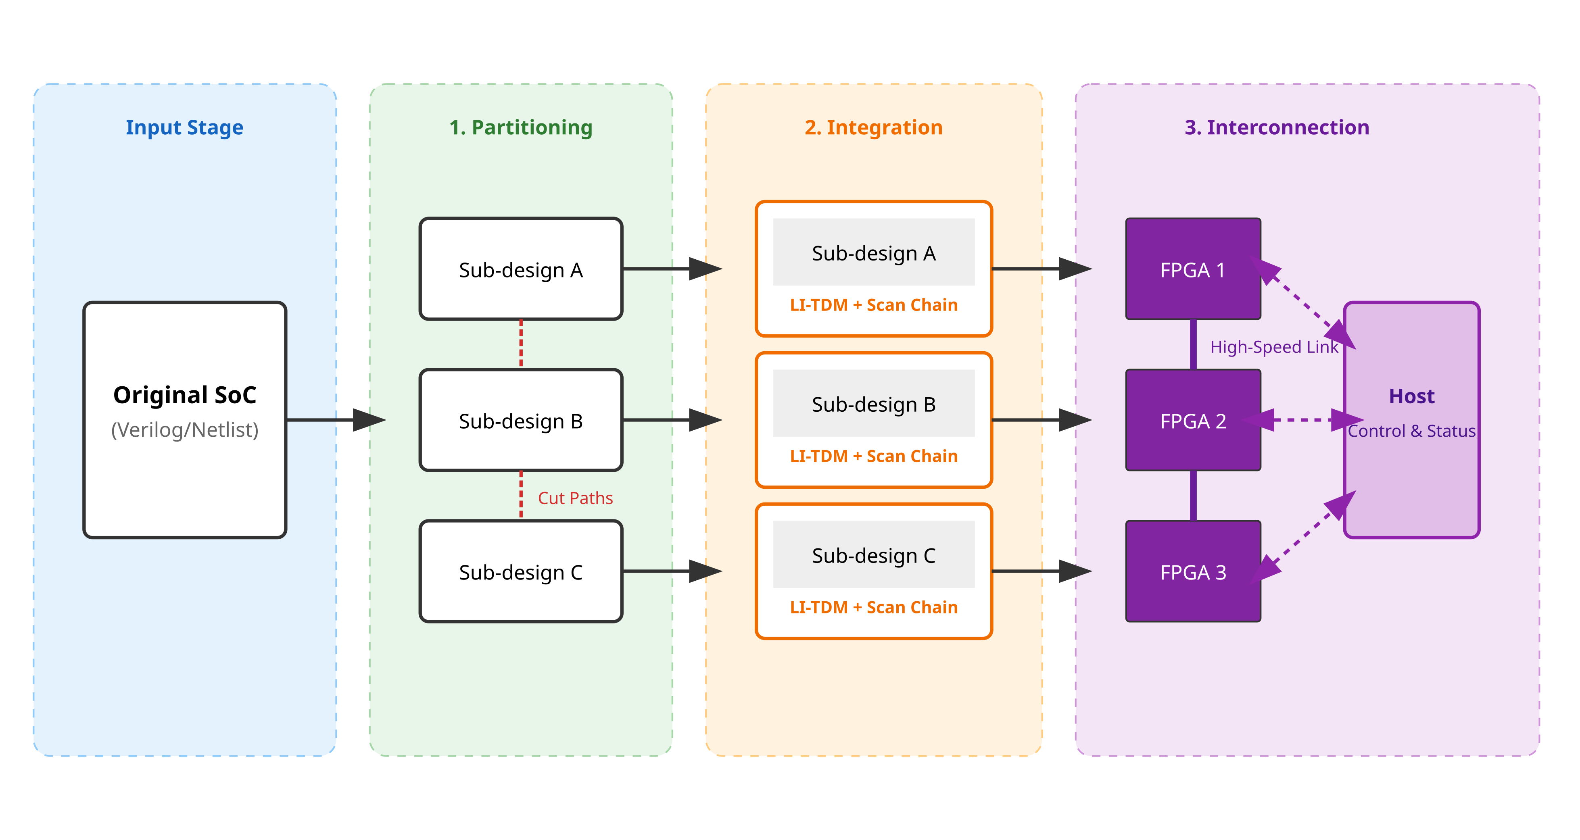
Intro: Existing Limitations in FPGA Hardware Emulation
Limitations of State-of-the-Art
  No Large-Scale Replay
    Current replay solutions are limited to Single-FPGA
    Large-scale prototypes lack deterministic replayability
  Lack of Automation in Partitioning
    Existing tools rely on manual guidance or fixed granularity
  Rigid Scalability & Portability
    Coupled with specific hardware platform
One Limitation For a Key Phase
  Partitioning: Automation & Multi-Granularity
  Integration: Large-Scale Replay
  Interconnection: Scalability & Portability
Notes:
Existing works in academic still have three main limitation.
Firstly, there is no large-scale replay. The exist work like REMU can only replay in Signal FPGA. or like FireAxe can run a large design with no debugging. But we want both
Secondly, Partitioning is a pain. Tools like FireAxe need manual guidance. And other work like ViTAL and DUOHUAFEN can either partition in netlist or module level. We want to a automated tool support multi-granularity
Thirdly, exist work are difficult to migrate between different hardware platform. They assumed all links between FPGAs are homogeneous. May not portable for heterogeneous.
The figure on the right illustrates the three core steps for build multi-FPGA hardware emulation, with each phase is corresponding to a limitation.
In first phase design is splitt to different partitions, this phase need automation and multi-granularity.
Then comes integration, this phase change the sub design to a scalable and replayable unit. But it hasn't been achieved yet.
Final phase is interconnection, connect different FPGA by physical link, and connect FPGA with host. Interconnection need Scalability and Portability.
Ok that is all about introduction. let focus these limitations in related work

Slide 7
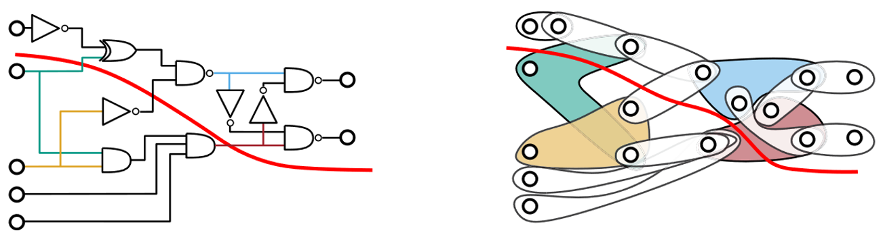
Related Work: Automated Circuit Partition
Foundations: From Graph to Hypergraph
  Early Approaches: Originated from VLSI physical design
  The Modern Standard: Hypergraph Model
    Accurately models multi-port nets (1-to-many connections)
    Remains the algorithmic backbone for today's tools
Limitations of State-of-the-Art
  FireAxe: High performance but relies on Manual Partition
  ViTAL & DUOHUAFEN: Limited to Fixed Granularity
Research Goal: A Fully Automated partition technology supporting Multi-Granularity
From netlist to hypergraph (ACM J. Exp. Algo., 2023)
Notes:
The first challenge is partition.
关于历史： "Partitioning isn't new. It started with simple Graphs in VLSI design. Later, we moved to Hypergraphs like hMetis to handle complex connections. This is the math foundation."（划分不是新鲜事。它始于VLSI设计中的简单图。后来我们转向hMetis这样的超图来处理复杂连接。这是数学基础。）
关于现状： "Today's tools have issues. FireAxe is fast but needs manually cut the design. ViTAL only cuts modules, and DUOHUAFEN only cuts netlists. They are too rigid."（今天的工具存在问题。FireAxe很快，但需要我手动切割。ViTAL只切模块，DUOHUAFEN只切网表。它们太僵化了。）
关于缺口： "What's missing is a tool that is Automated and support Multi-Granularity."（缺少的是一种自动化且自适应的工具——混合模块和网表，集众家之长。）

Slide 8
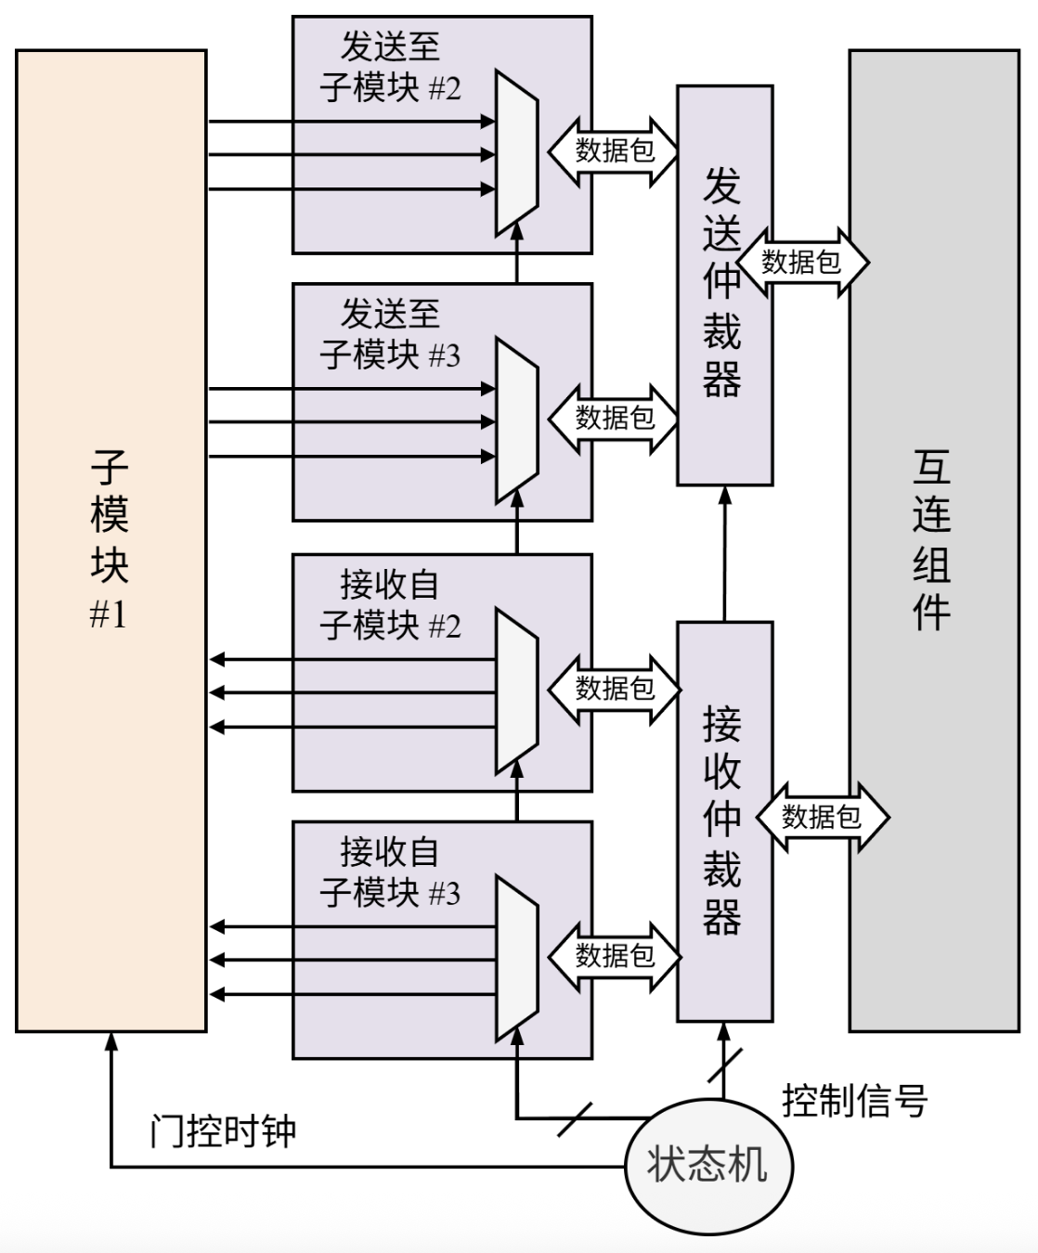
Related Work: Boundary Interface in Integration
The Key to Scalability
  Role: Ensures semantic consistency when splitting a design across FPGAs
  Scientific Challenges:
    Handling Cross-boundary Combinational Paths
    Balancing Bandwidth vs. Communication Latency
Classic Approaches
  Time-Division Multiplexing
  Latency-Insensitive
Evolution of Hybrid Interfaces
  LI-BDN: Supports combinational logic but complex to implement
  LI-TDM (foundation):
    Combines the robustness of LI with the logic support of TDM
    Lightweight & Timing-Simple
The Implementation of LI-TDM (DUOHUAFEN., 2025)
Notes:
Second challenge is about Scalable and Replayable integration.
To implement scalability, It need boundary interface to connect different partition.
关于挑战： "When we cut a wire between FPGAs, it's not just a wire anymore. It becomes a communication channel. The biggest challenge is ensuring combinational logic still works correctly across this channe."
关于经典方法： “Classically, TDM is fast but fragile—it has strict requirements for the timing of the physical link. LI is robust but too simple—it can‘t handle combinational logic paths."
关于为何选择LI-TDM： "That's why we look at Hybrid approaches. LI-TDM is the sweet spot. It allows us to run complex logic (like TDM) over unreliable cables (like LI). It's lightweight and efficient, making it the perfect foundation for my work."

Slide 9
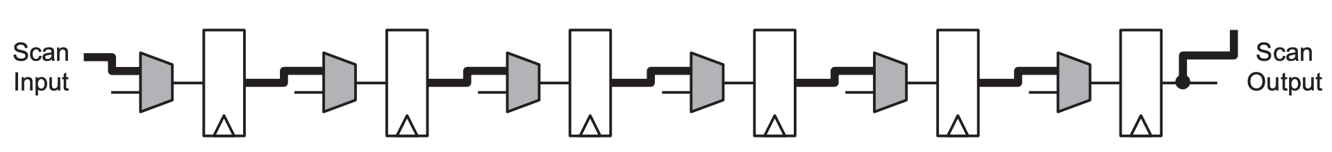
Related Work: Scan Chain in Integration
The Core Value of Scan Chain
  Function: Connects storage elements (FFs, SRAMs) into serial chains
  Benefit: Enables Cycle-Accurate and Bit-Exact waveform replay
Evolution of Tools
  StateMover: Pioneered scan-based FPGA emulation
    Con: No supports SRAM
  REMU (Baseline):
    Pro: Supports arbitrary sequential circuits (Registers + SRAMs)
Challenge
  From Single to Multi-FPGA: Global Consistency & Atomic Pausing
Notes:
Another theme of integration is replayability. Scan Chain can help solve this problem.
关于核心价值： It converts the FPGA from a black box into a white box. By reading out the state of every flip-flop and memory, It can achieve Cycle-Accurate and Bit-Exact replay."
关于现有工作（StateMover vs REMU）：
"StateMover was a good start, but it couldn't scan SRAMs. Modern SoCs are full of caches, so StateMover fails there."（StateMover是个好的开始，但它不能扫描SRAM。现代SoC到处是缓存，所以StateMover无法适用。）
"REMU improved this by supporting arbitrary circuits, including SRAMs. It works great on a single FPGA and serves as our baseline."
关于挑战（Challenge）： "However, REMU is designed for one chip. The real challenge is: How do we synchronize scan chains across multiple FPGAs? We need to ensure that when we pause, every FPGA stops at the exact same logical cycle to maintain global consistency."（然而，REMU是为单芯片设计的。真正的挑战是：如何在多FPGA间同步扫描链？我们需要确保暂停时，所有FPGA停在完全相同的逻辑周期，以维持全局一致性。）

Slide 10
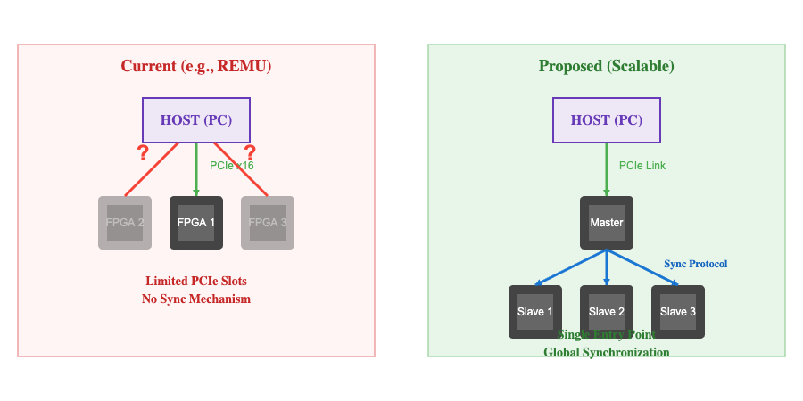
Related Work: Scalable & Portable Interconnection
FPGA-to-FPGA Interconnection (Data Plane)
  Increase of Speed: Network-based vs QSFP P2P
  Abstraction: DUOHUAFEN proposed physical-channel-independent streaming for universality
  The Gap: Existing works assume Homogeneous links, lacks of Heterogeneous links portability
Host-to-FPGA Interconnection (Control Plane)
  Limitation: Relies on direct PCIe connection (1-to-1 mapping)
  The Challenge:
    Developing a Scalable, Synchronized topology for 1-to-N communication (Host-to-Cluster)
Notes:
The last challenge is about interconnection.
For data transfer between FPGAs, the trend is 'Faster and Lower Latency'. FireAxe pushed this to the limit with QSFP cables. DUOHUAFEN try to increase portability by introducing abstraction. However, they all assume the links are Homogeneous. We want to handle Heterogeneous links.
关于主机互连： "For control, REMU uses direct PCIe. This works for one board but fails for a cluster because a PC has limited PCIe slots. We face the challenge of designing a topology that allows one Host to control many FPGAs with perfect synchronization."

Slide 11
Research Goal: The SMART Methodology
Proposed Solution: SMART
  Full Name: Scalable Multi-FPGA Automated Replayable Technology
  Mission: A unified framework for large-scale SoC FPGA emulation
  Scope:
    Multi-Level: Intra-chip -> Inter-chip -> Cross-server
    Multi-Granularity: Module-level & Netlist-level
Three Key Technology
  Scalable Replayable Integration Technology:
    Unified "Scan Chain + LI-TDM" structure for large-scale replayability
  Automated Multi-Granularity Partition:
    Adaptive Granularity algorithm supporting RTL and Netlist without manual guidance
  Scalable & Portable Interconnection:
    Abstracted streaming architecture ensuring portability across heterogeneous clusters
Notes:
引入 SMART: "To address all the challenges mentioned, we propose SMART. It stands for Scalable Multi-FPGA Automated Replay Technology."（为了解决上述所有挑战，我们提出了 SMART。它代表可扩展、多FPGA、自动化重放技术。）
强调范围 (Scope): "Unlike previous works that focus on just one level, SMART covers multi-levels: from inside a chip, to across boards, to across servers. It handles both fine-grained netlists and coarse-grained modules."（不同于以往只关注单一层面的工作，SMART 覆盖了一切：从芯片内部，到板卡之间，再到服务器之间。它既处理细粒度的网表，也处理粗粒度的模块。）
三支柱 (Three Pillars): "SMART is built on three key technology:
Replayable Integration for debugging.
Automated Partitioning for ease of use.
Scalable Interconnect for growing large."

Slide 12
Research Goal: SMART Workflow
Automated Circuit Partition
  Adaptive Granularity Pre-processing
  Hypergraph Partitioning
Scalable Replayable Integration
  Scan Chain Insertion
  LI-TDM Interface Generation
Portable & Scalable Interconnection
  Portable Abstracted Interface
  Scalable Host Control
  Runtime software
Notes:
总览: "The SMART workflow consists of three automated phases, transforming user RTL into a replayable emulation cluster."
第一阶段 (Partitioning): "First, we take the user's design and automatically partition it. Our Adaptive Pre-processing decides the best granularity—keeping modules whole where possible, and breaking them down when necessary."
第二阶段 (Integration): "Next, we integrate the necessary structures. We insert Scan Chains for debugging and add LI-TDM wrappers to handle the communication between split parts."
第三阶段 (Interconnect): "Finally, we connect everything. We adapt to the physical cables (like QSFP) and use our Runtime Software to control the entire cluster, enabling features like pause and replay."

Slide 13
Phase I: Adaptive Granularity Circuit Partition
Key Challenge: The Automation Dilemma
  Limitations: Manual Partition & Netlist Flattening
  Goal: "RTL-in, RTL-out”
Core Technology: Resource-Aware Adaptive Granularity Algorithm
  Algorithm Logic (Recursive Flattening):
    Estimation: Analyze resource usage (LUT/FF/BRAM) of all top-level instances
    Checking: Expanding (not flatten) the instance, if Resource > Threshold
    Iteration: Repeat until all leaf nodes fit within the granularity threshold
  Advantages: Adaptive & Efficient
Notes:
关于痛点： "Currently, partitioning is painful. You either do it manually, or you let the tool flatten everything into a mess of gates. We want a 'Black Box' experience: You give us RTL, we give you a partitioned RTL, automatically."
关于算法（核心）： "How do we do it? We use a Resource-Aware algorithm. It looks at the design hierarchy. If a module is too big (like a CPU core), we break it down. If a module is small enough (like an ALU), we keep it whole."（我们如何做？我们使用资源感知算法。如果一个模块太大，比如CPU核，我们把它打散；如果够小，比如ALU，我们保留它。）
关于优势： "This implies Adaptive Granularity. We don't force a choice between Netlist or Module; we find the best balance to make the subsequent Hypergraph partitioning faster and better."（这意味着自适应粒度。我们不强迫在网表或模块间二选一，而是找到最佳平衡点。）

Slide 14
Phase II: Scalable Replayable Integration
Key Challenge: Semantic Conflict
  Goal: Enable Cross-Boundary Connectivity and Deterministic Replay for sub-design.
  Conflict: LI-TDM and Scan Chain operate on different control FSMs.
Core Technology: Fused Integration Controller
  Communication: Adopts LI-TDM from DUOHUAFEN
  Observation: Adopts Scan Chain from REMU
  Fused FSM: Merges LI-TDM with Scan Chain.

Slide 15
Phase III: Scalable & Portable Interconnection
Key Challenge
  Limitations: Diverse Physical Links & Insufficient Host PCIe slots.
  Goals: Heterogeneous links portability & Scalable Host connection
Core Technology 1: Scalable Control Tree
  Link Reuse: Multiplexes control packets over existing FPGA-to-FPGA data links
  Packet Forwarding: Host -> Master -> Slaves
Core Technology 2: Physical-Channel-Independent Stream
  AXI-Stream based Interface: Data packets supporting dynamic routing
Notes:
关于瓶颈： "A standard server only has a few PCIe slots, but we might have dozens of FPGAs. We can't plug them all in directly. Also, how do we make 100 separate chips act like one single synchronized chip?"（标准服务器只有几个PCIe插槽，但我们可能有几十个FPGA。我们无法全部直连。另外，我们如何让100个独立的芯片像一个同步芯片那样工作？）
关于树状拓扑： "Our solution is a Tree-Based Control Plane. We only connect the Master FPGA to the Host. The Master then passes control signals to Slaves using the existing data cables. We built special hardware to forward these messages."（我们的方案是树状控制平面。我们只将Master FPGA连到主机。Master通过现有的数据线将控制信号传递给Slaves。我们构建了专用硬件来转发这些消息。）
关于同步（精髓）： "For synchronization, we use the magic of LI-TDM. It's 'Latency Insensitive'. If we stop the Master, it stops sending data. The Slaves, waiting for data, will automatically pause. This chain reaction ensures the whole system freezes at a precise logical point."（关于同步，我们利用了LI-TDM的魔力。它是“延迟不敏感”的。如果我们停止Master，它就停止发送数据。等待数据的Slaves会自动暂停。这种连锁反应确保整个系统停在一个精确的逻辑点上。）

Slide 16
Component-Level Experiments
Partition Experiment
  Performance: Cut Size & Hop Count
  Correctness: Use Formal Verification (LEC) to prove logical equivalence
Integration Experiment
  Functional: Using Logic Simulation to verify Atomic Pause & Waveform Replay
  Resource Cost: Analyze Resource Overhead (LUT/FF) and Critical Path on Vivado
Interconnection Experiment
  Metrics: End-to-End Latency & Throughput
  Scenarios:
    Intra-Chip (AXI crossbar)
    Inter-Chip (QSFP / Aurora)
    Cross-Server (100G Ethernet / TCP/IP)

Slide 17
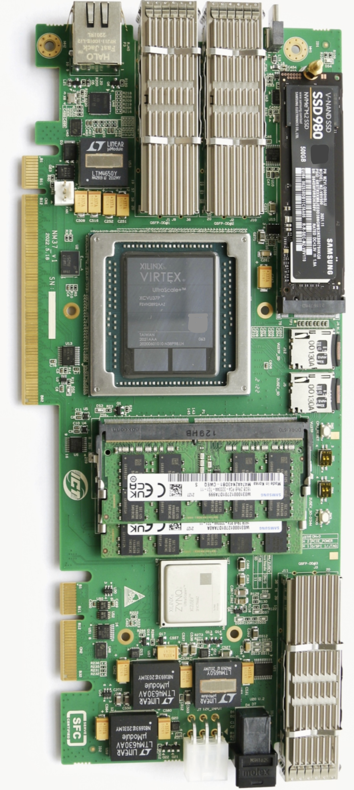
System Experiment: Prototype & Estimation
Experimental Platform
  Hardware: Self-built Multi-FPGA Cluster, based on AMD/Xilinx XCVU37P
  Interconnect:
    Data Plane: High-speed P2P via QSFP
    Control Plane: Direct, Tree-based Hierarchy
Target Designs (DUT)
  XiangShan (Kunminghu): High-performance RISC-V Processor
  OpenGPGPU: Large-scale multi-core GPU architecture
Key Estimation Metrics
  System Performance: Logical Clock Frequency running real benchmarks
  Replayability: Verification of Cycle-Accurate Replay & Signal Tracing
  Scalability: 4-Board testing to validate the Tree-based Host Control
Enterprise-built FPGA Acceleration Card

Slide 18
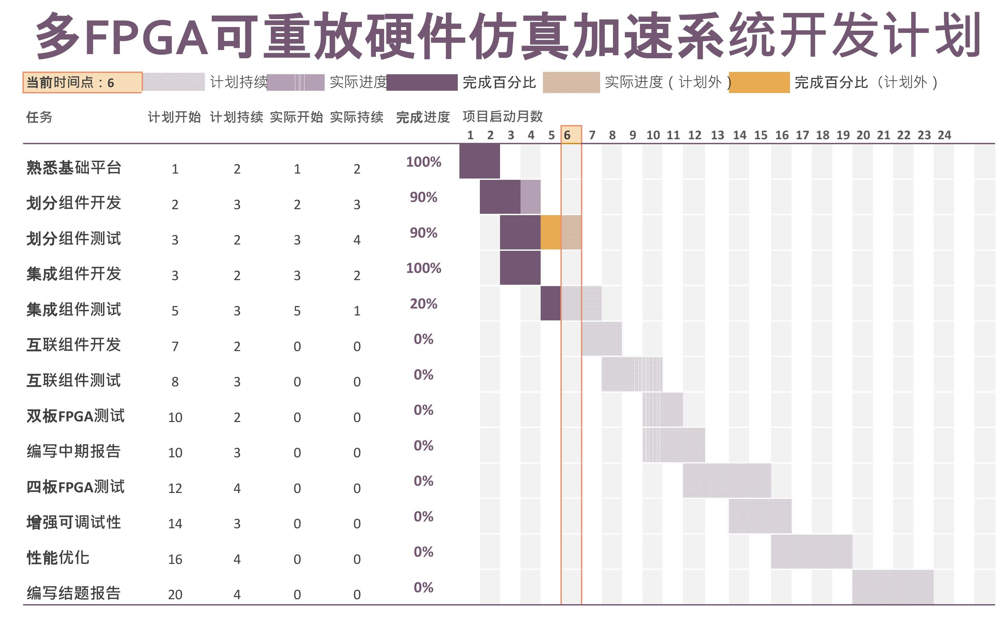
Project Timeline
Current Status (Completed)
  Partition: Development & Verification finished
  Integration & Interconnection: Development finished, not verification yet
Mid-Term Goals
  System Scale: Stable 2-FPGA Emulation System
  Target Design: PicoRV32 SoC (Small-scale)
  Workload: Bare-metal programs
  Debug Capability: Waveform Replay
Final Goals
  System Scale: Scaled 4-FPGA System running
  Target Design: Dual-core XiangShan (Kunminghu)
  Workload: Full-stack Linux OS & User Applications
  Debug Capability: Waveform Replay & Trace

Slide 19
Thank you
Student： | Hu Guanghui | 2024234318
Academic mentor： | Ha Yajun | Professor
Enterprise mentor： | Zhang Ke | Professor
2025.12.10

