Slide 1
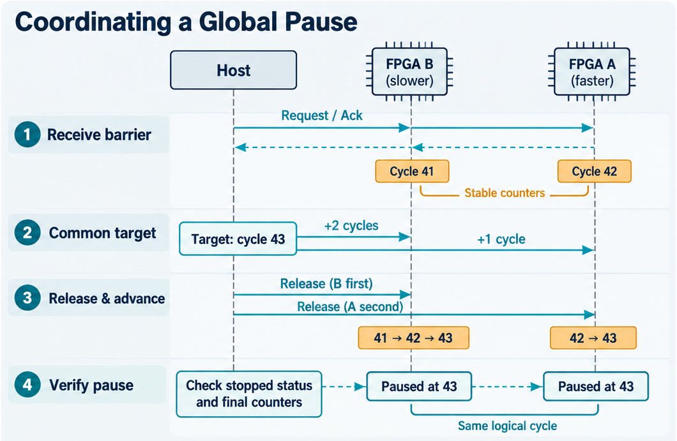
Pregress1: Cycle-Accurate Execution and Global Pause
Cycle-Accurate Execution
Execution based on DUOHUAFEN LI-TDM^{[1]}
Optimized communication flow
Reduce once data exchange per cycle
Cycle-Consistent Pause
1
Stabilize progress
2
Set a common target
3
Advance and verify
[1] G. Zhu. Cross-Node Deployment of Digital Logic Design for FPGA Cloud. Master's thesis, ShanghaiTech University, 2024.
6
Notes:
REMUS builds on DUOHUAFEN's LI-TDM for cycle-accurate execution. The first-stage receive and last-stage send are omitted to reduce redundant communication; this is a protocol optimization, not a measured percentage speedup. Keep these implementation details in the narration. For global pause, the Host collects all receive-barrier acknowledgements before sampling stable counters. Barrier acknowledgement alone is not a valid global pause. In the illustrative example, B is at 41 and A at 42. The common target is 43; configure two steps for B and one for A while barriers remain held, then release B before A. LI-TDM dependencies still apply. Finally check stopped/pause status and final counters on all partitions. Equal logical cycles do not imply simultaneous physical stops or prove all-state equivalence. Required propagation must finish. The diagram's shared arrows are a simplified visual summary of Host operations on each partition, not FPGA-to-FPGA forwarding of Host commands. The cycle numbers are illustrative, not experimental data. Source: src/midterm/progress/cycle_control.tex. The right illustration is intentionally a raster crop per user request; the title, left text and page number are editable. The three requested supplementary callouts from the design reference are omitted. Reference [1]: G. Zhu. Cross-Node Deployment of Digital Logic Design for FPGA Cloud. Master's thesis, ShanghaiTech University, 2024.

