Slide 1
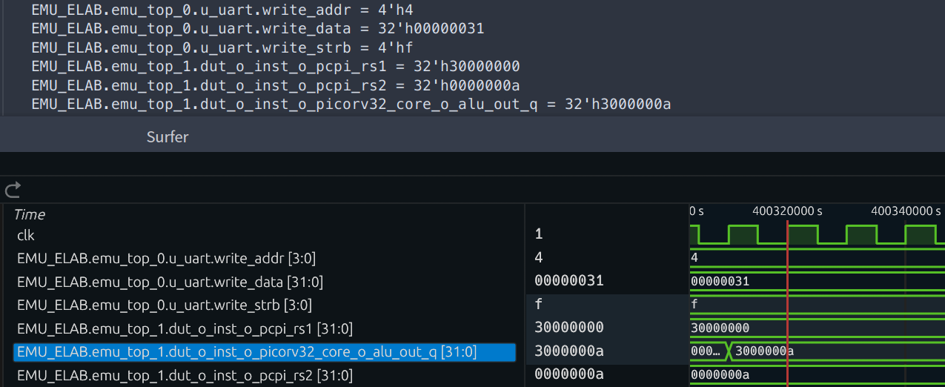
Progress2: Distributed State Capture, Restore and Replay
01
Global Snapshot
Reuse REMU's Scan Dump mechanism^{[1]}
Collect and merge each partition’s states
02
FPGA Restore
Write back scan data by partition
Restore local registers, SRAM and memory
Waveform replay reproduces the same signal
values as FPGA execution
03
Software RTL Replay
Decode partition data through state mapping
Load RTL states and replay recorded inputs
[1] Y. Chen et al. REMU: Enabling Cost-Effective Checkpointing and Deterministic Replay in FPGA-based Emulation. ICCD, 2023, pp. 21–29.
7
Notes:
The previous slide establishes a common DUT cycle. REMUS reuses REMU's local Scan Dump and organizes per-partition scan files as a Global Snapshot. Memory and input management retain the existing REMU mechanisms. FPGA Restore writes each partition's scan data back to the corresponding FPGA with the matching design and scan layout, restoring local registers and SRAM plus the memory-model data before execution resumes. Software restoration instead decodes local scan positions through state mapping and loads the corresponding RTL objects. Recorded inputs are replayed by logical cycle, enabling waveform observation. The user-approved conclusion summarizes reported tested functionality; it is not an all-state or all-cycle equivalence assertion. The displayed image specifically compares a TWO-PARTITION COSIM checkpoint at cycle 42080 with Icarus Verilog software RTL replay from checkpoint 2048. Six selected signals match at relative cycle 40032. Inputs remain unchanged after 2048 in this example. It is not a physical-board restore screenshot. The author separately confirmed board-vs-Cosim checkpoint consistency and FPGA restoration/replay results; original board comparison records are still being archived. Do not present this software example as direct evidence of physical FPGA restore or merge different observation sets into a full equivalence claim. Sources: src/midterm/progress/state_replay.tex; experiments/picorv32-cosim-replay.md; experiments/board-execution.md. Design: figure/presentation-reference/midterm-state-replay-07-v2.png. All slide text is editable; the experiment screenshot is an unchanged raster. Reference [1]: Y. Chen et al. REMU: Enabling Cost-Effective Checkpointing and Deterministic Replay in FPGA-based Emulation. ICCD, 2023, pp. 21–29. DOI: 10.1109/ICCD58817.2023.00014.

