Slide 1
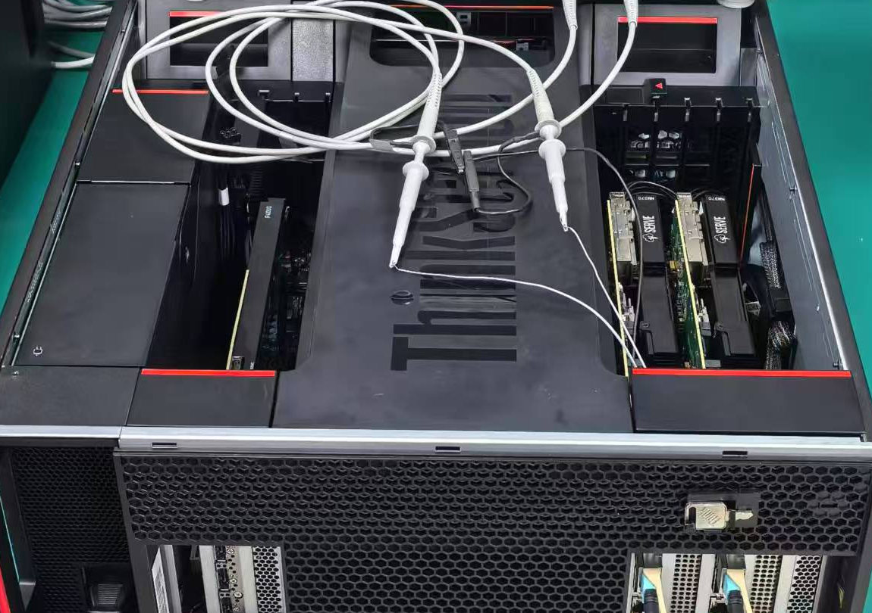
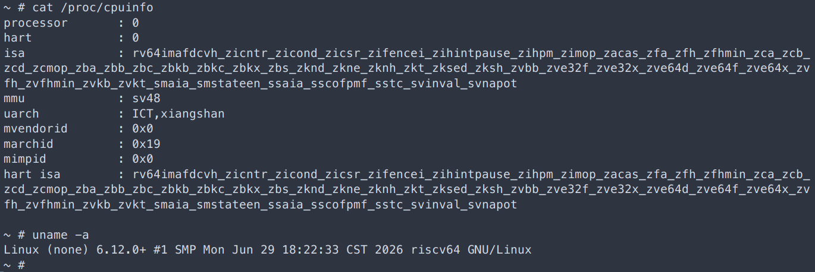
Evaluation: Dual-FPGA Emulation System
Experimental Platform
DUTs and Workloads
DUTs
Workloads
PicoRV32 · Rocket
Bare-metal programs
Nanhu · KMH
OpenSBI and Linux
Two NM37 boards with VU37P FPGAs
PCIe access from a shared Host
QSFP/Aurora links between FPGAs
KMH boots Linux and supports interactive shell commands.
PicoRV32 · Effective Rate
KMH · Effective Rate
Global Pause · Host-Observed
≈0.327 MHz
≈0.322 MHz
≈0.8~1.1 ms
10
Notes:
This is the real dual-FPGA PCIe-direct prototype, not a completed Fabric board deployment. Two NM37 boards use VU37P devices with separate PCIe Host access and QSFP/Aurora board communication. The real photo is figure/remus-2fpga-hw.jpg; its oscilloscope is cropped away. PicoRV32 and Rocket run hand-written bare-metal workloads; Nanhu and single-core KMH run OpenSBI/Linux, as confirmed by the author in src/midterm/progress/prototype.tex. The terminal specifically belongs to KMH, not all four DUTs. The crop shows shell commands, cpuinfo and uname for Linux 6.12.0+. Image timestamps are not Host elapsed time. Performance comes from experiments/board-performance.md and raw/perf.txt. PicoRV32's longer runs are 0.326741 and 0.327423 MHz; combined cycles/time gives about 0.326834 MHz, rounded here to 0.327. KMH's 0.322073 MHz is a 1095817-cycle, 3.40238-second window BEFORE checkpoint save, not the full Linux boot or post-CLI rate. These are logical progress over Host time, not FPGA physical clocks. Pause records include 23 PicoRV32 observations from 0.803824 to 0.925013 ms and one KMH observation of 1.04744 ms, rounded to approximately 0.8–1.1 ms. They are Host-visible synchronized-pause times, not pure hardware barrier latency, independent repeat trials or a success-rate measurement. Detailed checkpoint timings and resources are intentionally omitted. Sources: src/midterm/progress/prototype.tex; experiments/board-execution.md; experiments/board-performance.md. Original photos are embedded unchanged and cropped only through PPT properties; all slide text/cells are editable.

