Slide 1

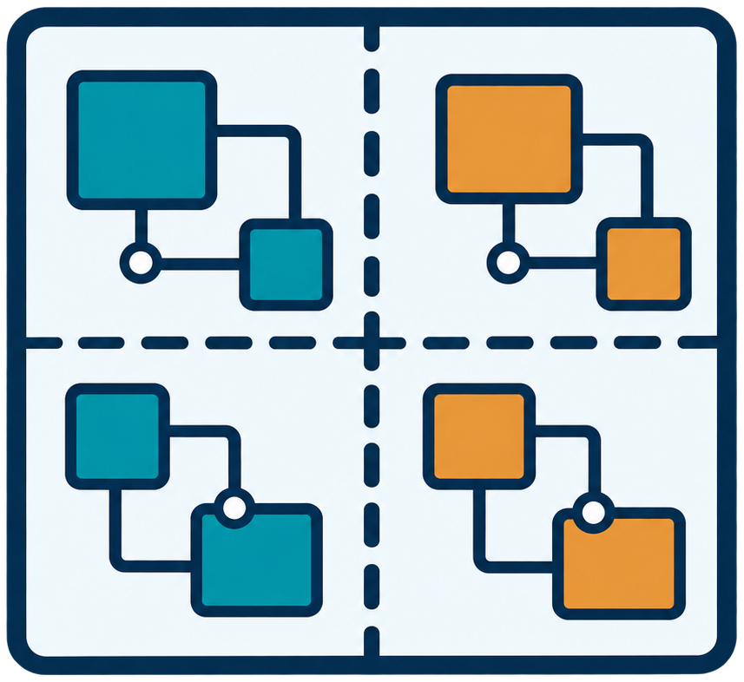
1
2
3
4
5
RTL Design
Automated
Partitioning
Multi-FPGA
Deployment
Cycle-Accurate
Execution &
Global Pause
Global Snapshot
Host Runtime
FPGA0
FPGA0
LI-TDM
FPGA0
FPGA1
FPGA1
FPGA1
Global
Snapshot
Fabric
FPGA Restore
Software RTL Replay
FPGA0
FPGA1
RTL
Notes:
Conceptual REMUS workflow, reconstructed from figure/FPGA与RTL全流程图.png. RTL and partitioning illustrations reuse figure/ppt-assets. All FPGA icons, labels, waveform traces and flow lines are editable native objects. Restore and software RTL replay are parallel uses of a global snapshot; this figure is not evidence of implementation or experimental completion.

