Slide 1
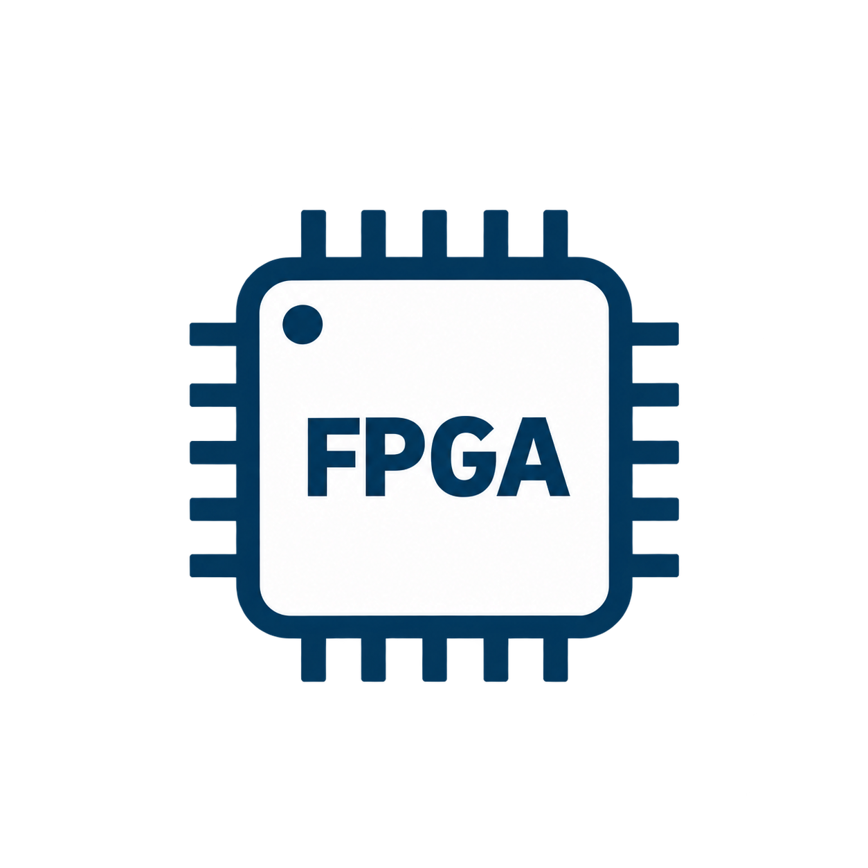


4. Research Gap and Goal
Multi-FPGA
Prototyping
Single-FPGA
Replayable Emulation
This Work: REMUS
Primary focus: capacity & speed
Scan-based state & replay
Research Goal
Scalable deployment
Limited by one FPGA
Scalable deployment
Fast execution
Fast execution
Fast execution
?
Cycle-consistent pause
Cycle-controlled pause
Cycle-consistent pause
?
Global snapshot
Full-state snapshot
Global snapshot
?
Deterministic replay
Deterministic replay
Deterministic replay
?
Waveform reconstruction
Waveform reconstruction
Waveform reconstruction
Debug support varies by system
Replay within single-FPGA capacity
Target capabilities; validation follows
Goal: combine multi-FPGA scalability with replayable emulation
for large-scale SoC debugging.
4
Notes:
Research motivation: combine multi-FPGA deployment with replayable emulation. The prototype column indicates typical focus; amber marks system-dependent debug capabilities, not universal absence. The middle column represents scan-based single-FPGA replayable emulation such as the REMU foundation described in docs/thesis-writing-guidelines.md and src/proposal/significance_and_related_work.tex. A full-state snapshot in that setting fits within one FPGA's capacity. REMUS is explicitly a Research Goal: its checks are target capabilities, not measured results or a completed-feature checklist. The diagram is conceptual and does not establish restoration backend or a tested FPGA count. No exhaustive prior-art or novelty claim is made by this qualitative comparison. Layout: figure/presentation-reference/midterm-background-04.png.

