Slide 1
组合逻辑3
Combinational Logic
刘鹏
liupeng@zju.edu.cn
浙江大学信息与电子工程学院
March 12, 2019
ZDMC – Lec. #5
Notes:
Multiplexers: Two-to-one-line, Four-to-one-line multiplexer, 74HC153,

Slide 2
复习
选择器Multiplexer
加法器Adder
比较器Comparator
本节内容
采用模块组件实现组合电路
显示译码器
竞争和冒险
ZDMC – Lec. #5

Slide 3
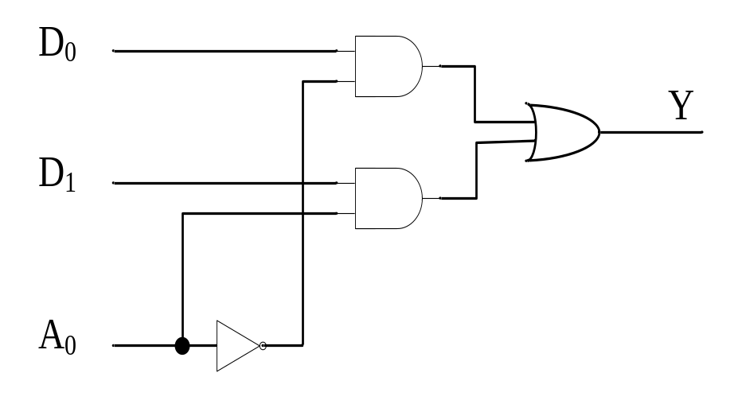
数据选择器 Multiplexers
复习
数据选择器是从多路输入线中选择其中的一路到输出线的一种组合电路。
二选一数据选择器：
  数据输入线D₀-D₁
  选择线A₀
  输出线Y
电路图
表达式：Y=A₀’D₀+A₀D₁
ZDMC – Lec. #5

Slide 4
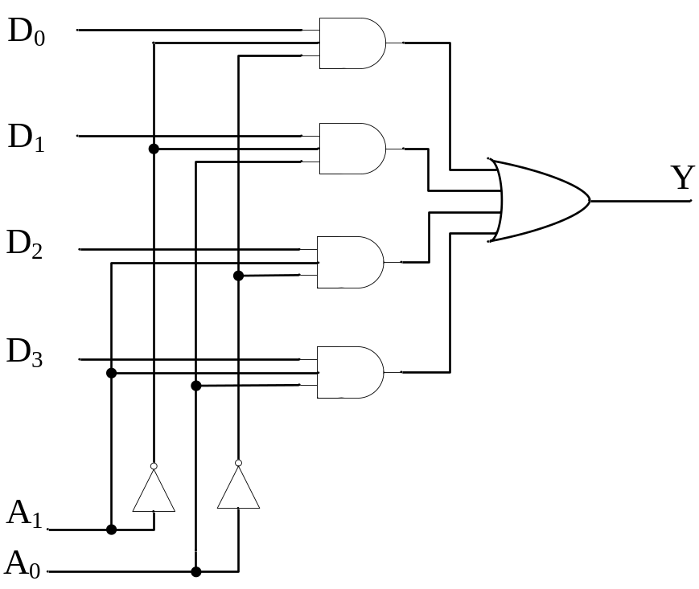
4选1 Multiplexer
复习
四选一数据选择器逻辑图
功能表
A1 | A0 | Y
0 | 0 | D0
0 | 1 | D1
1 | 0 | D2
1 | 1 | D3
逻辑函数式
Y= A₁’A₀’D0+A₁’A₀D1+A₁A₀’D2+A₁A₀D3
ZDMC – Lec. #5

Slide 5
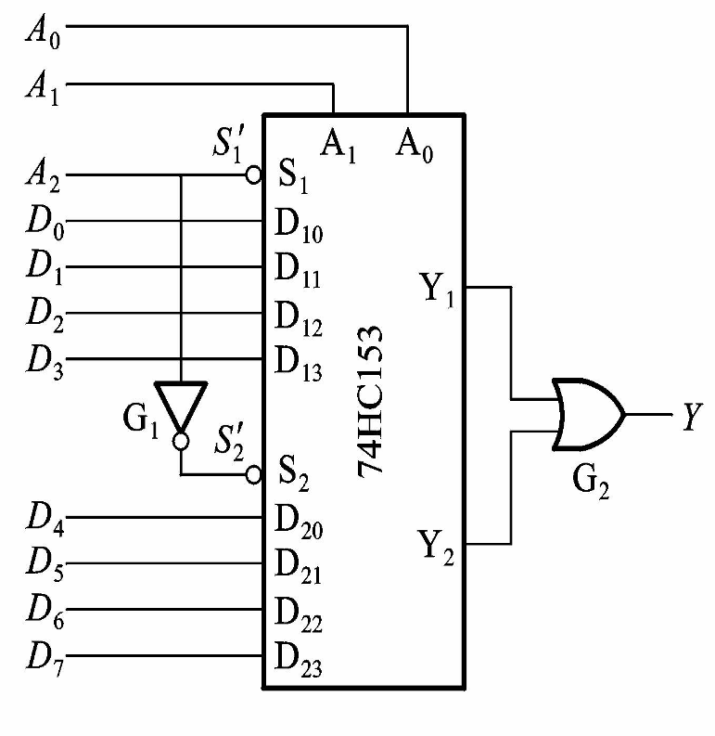

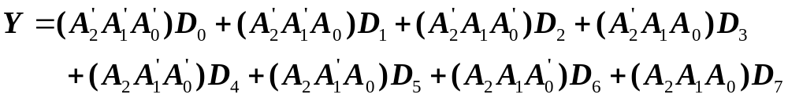
例：74HC153,两个“四选一”接成“八选一”
“四选一”只有2位地址输入，从四个输入中选中一个
“八选一”的八个数据需要3位地址代码指定其中任何一个
ZDMC – Lec. #5

Slide 6
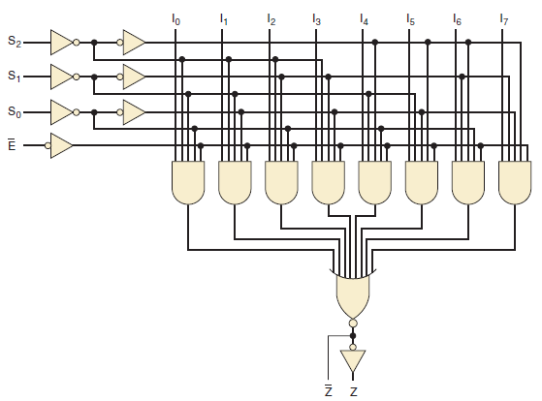
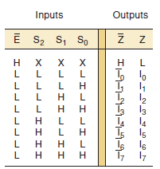
74LS151
I₀
I₁
I₂
I₃
I₄
I₅
I₆
I₇
S₂
74LS151
S₁
S₀
E’
ZDMC – Lec. #5
Z’
Z

Slide 7
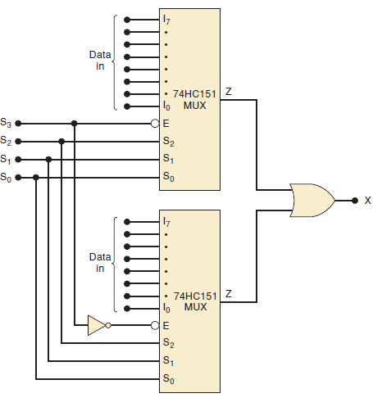
16-input multiplexer
Two 74HC151s combined to form a 16-input multiplexer
ZDMC – Lec. #5
Notes:
Two 74HC151s combined to form a 16-input multiplexer

Slide 8
采用数据选择器设计组合电路
复习
基本原理
  Y= D₀A₁’A₀’ +D₁A₁’A₀+D₂A₁A₀’ + D₃A₁A₀
  具有n-1位地址输入的数据选择器，可实现n个变量布尔函数。
  数据选择器就是一个带或（OR） 门的译码器
ZDMC – Lec. #5

Slide 9
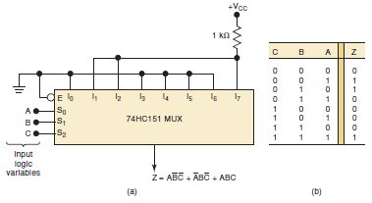
选择器实现逻辑功能
复习
ZDMC – Lec. #5
Notes:
An eight-input multiplexer can be used to implement the logic circuit that satisfies the given truth table.

Slide 10
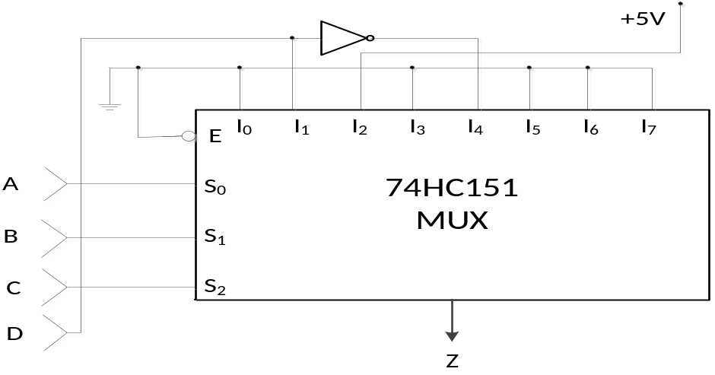
选择器设计组合电路
下图电路说明了一个8输入的MUX如何用来产生一个4变量的逻辑函数，尽管MUX只有3个选择输入端。其中的3个逻辑变量A, B与C与选择输入端相连。第4个变量D与它的反变量D’连接到MUX的数据输入端，以满足逻辑函数的要求。MUX的其他数据输入端按逻辑函数的要求分别置为低电平或高电平。列出真值表表示16种可能的输入组合所对应的输出Z的状态。
ZDMC – Lec. #5

Slide 11
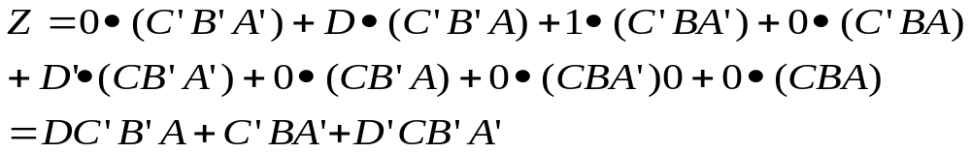
选择器设计组合电路（续）
8选1数据选择器74HC151控制端有效情况下，输出的逻辑式为：
ZDMC – Lec. #5

Slide 12
选择器设计组合电路（续）
列出逻辑式的真值表：
输入 |  |  |  |  | 输出
C | B | A | 对应的选通数据 | D | Z
0 | 0 | 0 | 0 | 0 | 0
0 | 0 | 0 |  | 1 | 0
0 | 0 | 1 | D | 0 | 0
0 | 0 | 1 |  | 1 | 1
0 | 1 | 0 | 1 | 0 | 1
0 | 1 | 0 |  | 1 | 1
0 | 1 | 1 | 0 | 0 | 0
0 | 1 | 1 |  | 1 | 0
1 | 0 | 0 | D’ | 0 | 1
1 | 0 | 0 |  | 1 | 0
1 | 0 | 1 | 0 | 0 | 0
1 | 0 | 1 |  | 1 | 0
1 | 1 | 0 | 0 | 0 | 0
1 | 1 | 0 |  | 1 | 0
1 | 1 | 1 | 0 | 0 | 0
1 | 1 | 1 |  | 1 | 0
ZDMC – Lec. #5

Slide 13
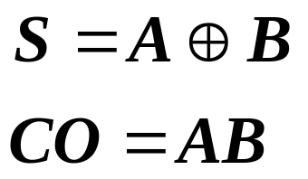
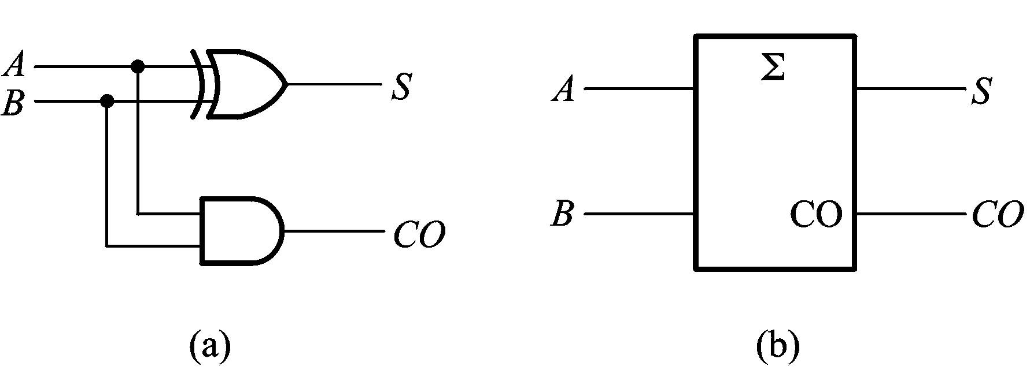
加法器：半加器Half Adder, HA
复习
半加器，不考虑来自低位的进位，将两个1位的二进制数相加.
我们指定符号S(for sum) and CO(for carry) to the outputs。
输入为A和B。
真值表the truth table
输 入 |  | 输 出
A | B | S | CO
0 | 0 | 0 | 0
0 | 1 | 1 | 0
1 | 0 | 1 | 0
1 | 1 | 0 | 1
一个异或门和一个与门
ZDMC – Lec. #5

Slide 14
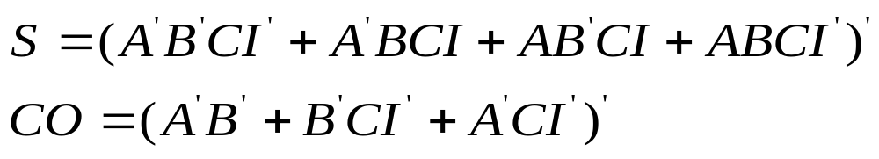
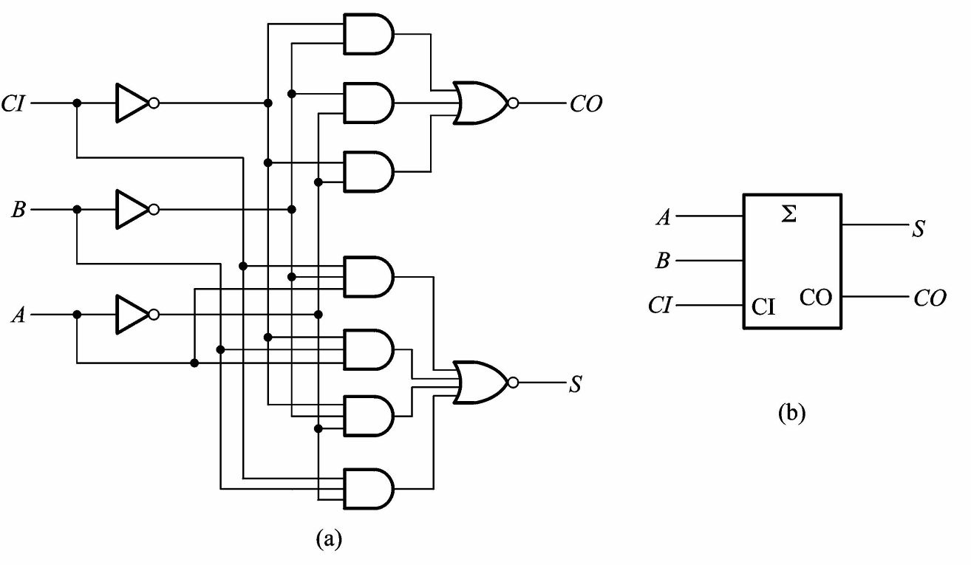
全加器Full Adder, FA
复习
将两个1位二进制数A,B及来自低位的进位CI相加
输 入 |  |  | 输 出
A | B | CI | S | CO
0 | 0 | 0 | 0 | 0
0 | 0 | 1 | 1 | 0
0 | 1 | 0 | 1 | 0
0 | 1 | 1 | 0 | 1
1 | 0 | 0 | 1 | 0
1 | 0 | 1 | 0 | 1
1 | 1 | 0 | 0 | 1
1 | 1 | 1 | 1 | 1
74LS183
74HC183
ZDMC – Lec. #5

Slide 15
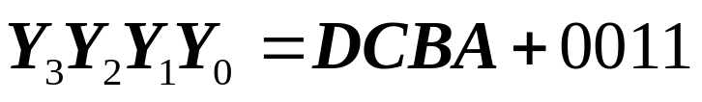
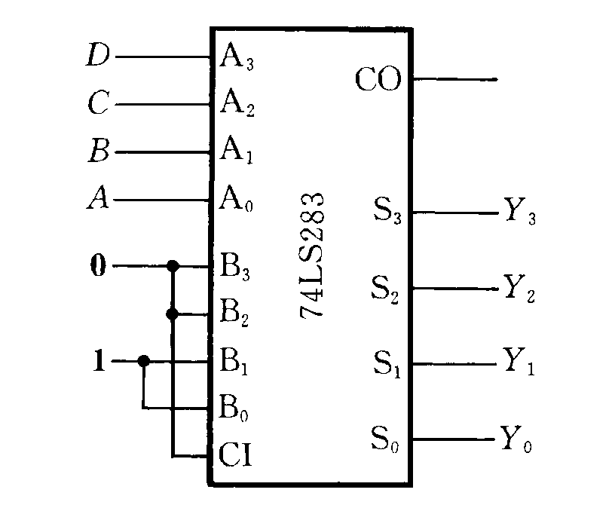
用加法器设计组合电路
复习
基本原理：
若能生成函数可变换成输入变量与输入变量相加
若能生成函数可变换成输入变量与常量相加
例：将BCD的8421码转换为余3码
输 入 |  |  |  | 输 出
D | C | B | A | Y3 | Y2 | Y1 | Y0
0 | 0 | 0 | 0 | 0 | 0 | 1 | 1
0 | 0 | 0 | 1 | 0 | 1 | 0 | 0
0 | 0 | 1 | 0 | 0 | 1 | 0 | 1
0 | 0 | 1 | 1 | 0 | 1 | 1 | 0
0 | 1 | 0 | 0 | 0 | 1 | 1 | 1
0 | 1 | 0 | 1 | 1 | 0 | 0 | 0
0 | 1 | 1 | 0 | 1 | 0 | 0 | 1
0 | 1 | 1 | 1 | 1 | 0 | 1 | 0
1 | 0 | 0 | 0 | 1 | 0 | 1 | 1
1 | 0 | 0 | 1 | 1 | 1 | 0 | 0
ZDMC – Lec. #5

Slide 16
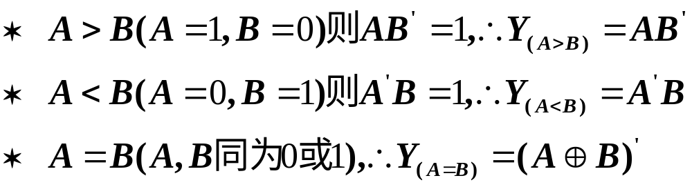
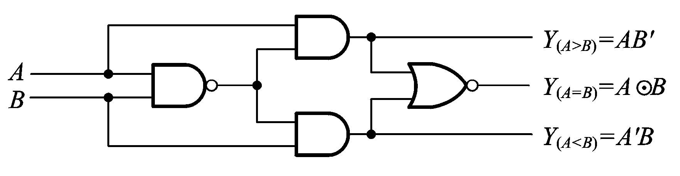
数值比较器 MAGNITUDE COMPARATOR
复习
用来比较两个二进制数的数值大小
一、1位数值比较器 A,B比较有三种可能结果
ZDMC – Lec. #5

Slide 17
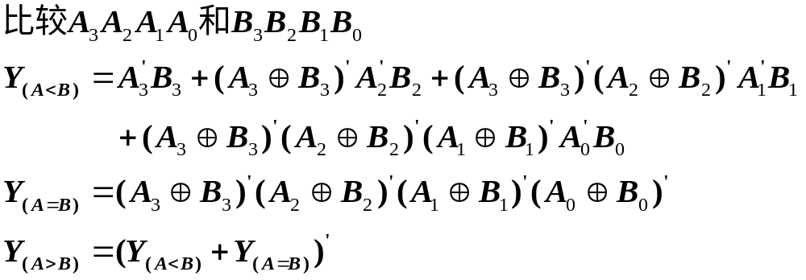
多位数值比较器
原理：从高位比起，只有高位相等，才比较下一位。
例如：
ZDMC – Lec. #5

Slide 18
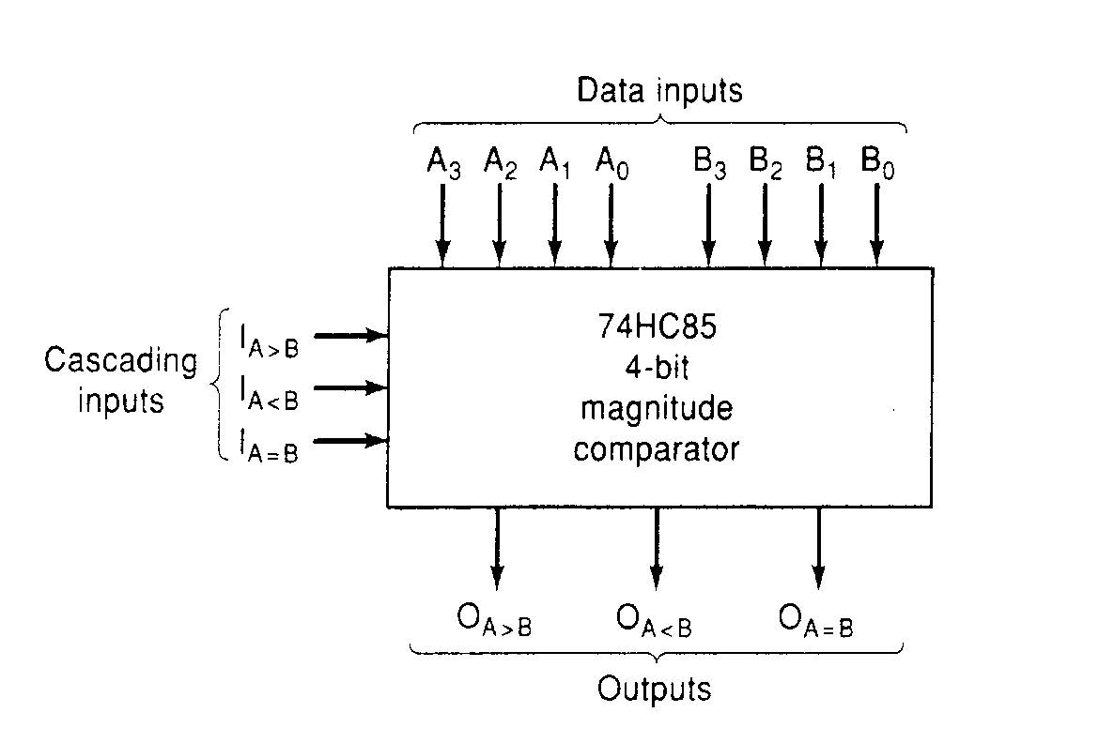
Four-bit Magnitude Comparator 4位比较器
复习
ZDMC – Lec. #5
Notes:
Three active-HIGH outputs.

Slide 19
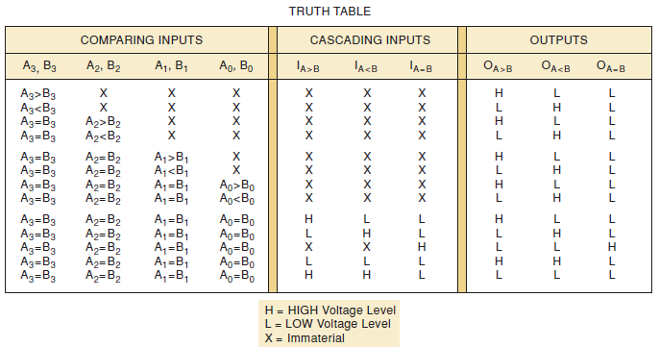
4-位比较器的真值表
复习
ZDMC – Lec. #5

Slide 20
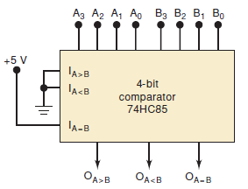

4位比较器
复习
ZDMC – Lec. #5

Slide 21
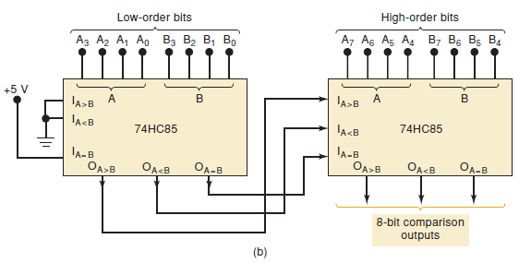
8-bit 比较
复习
ZDMC – Lec. #5

Slide 22
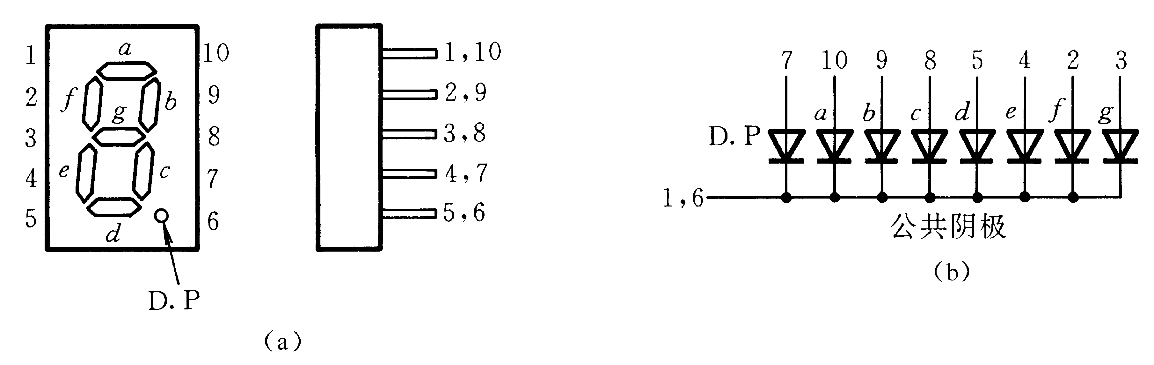
显示译码器
1. 七段字符显示器
如：
ZDMC – Lec. #5

Slide 23
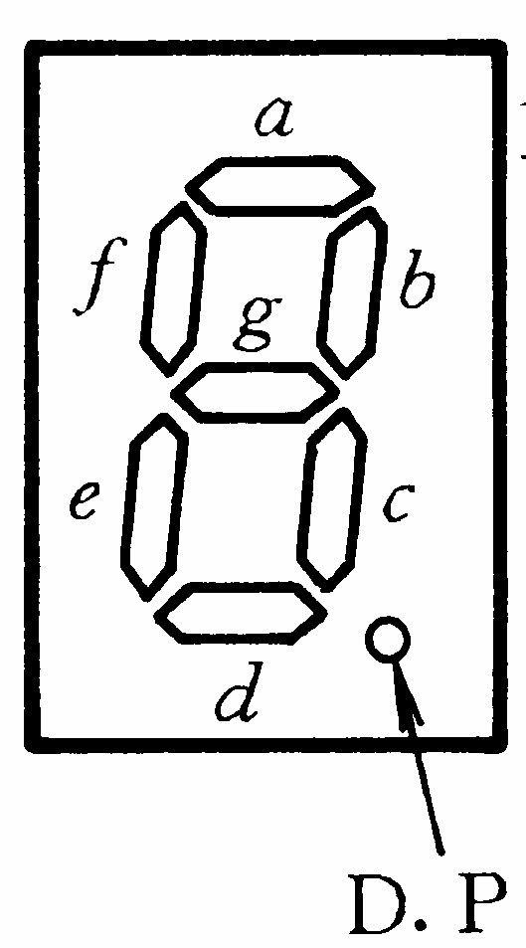
2. BCD七段字符显示译码器 （代码转换器）7448
输 入 |  |  |  |  | 输 出
数字 | A₃ | A₂ | A₁ | A₀ | Y_{a} | Y_{b} | Y_{c} | Y_{d} | Y_{e} | Y_{f} | Y_{g} | 字形
0 | 0 | 0 | 0 | 0 | 1 | 1 | 1 | 1 | 1 | 1 | 0
1 | 0 | 0 | 0 | 1 | 0 | 1 | 1 | 0 | 0 | 0 | 0
2 | 0 | 0 | 1 | 0 | 1 | 1 | 0 | 1 | 1 | 0 | 1
3 | 0 | 0 | 1 | 1 | 1 | 1 | 1 | 1 | 0 | 0 | 1
4 | 0 | 1 | 0 | 0 | 0 | 1 | 1 | 0 | 0 | 1 | 1
5 | 0 | 1 | 0 | 1 | 1 | 0 | 1 | 1 | 0 | 1 | 1
6 | 0 | 1 | 1 | 0 | 0 | 0 | 1 | 1 | 1 | 1 | 1
7 | 0 | 1 | 1 | 1 | 1 | 1 | 1 | 0 | 0 | 0 | 0
8 | 1 | 0 | 0 | 0 | 1 | 1 | 1 | 1 | 1 | 1 | 1
9 | 1 | 0 | 0 | 1 | 1 | 1 | 1 | 0 | 0 | 1 | 1
10 | 1 | 0 | 1 | 0 | 0 | 0 | 0 | 1 | 1 | 0 | 1
11 | 1 | 0 | 1 | 1 | 0 | 0 | 1 | 1 | 0 | 0 | 1
12 | 1 | 1 | 0 | 0 | 0 | 1 | 0 | 0 | 0 | 1 | 1
13 | 1 | 1 | 0 | 1 | 1 | 0 | 0 | 1 | 0 | 1 | 1
14 | 1 | 1 | 1 | 0 | 0 | 0 | 0 | 1 | 1 | 1 | 1
15 | 1 | 1 | 1 | 1 | 0 | 0 | 0 | 0 | 0 | 0 | 0
ZDMC – Lec. #5

Slide 24
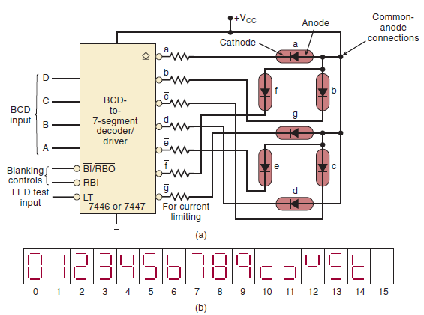
BCD-to-7段译码器/驱动共阳极7段LED显示
ZDMC – Lec. #5
Notes:
A common-anode type, the anodes of all of the segments are tied together to Vcc.
A common-cathode arrangement where the cathodes of all of the segments are tied together and connected to ground.
Each segment of a typical 7-segment LED display is rated to operate at 10mA at 2.7V for normal brightness.
Calculate the value of the current-limiting resistor needed to produce approximately 10mA per segment.
Rs=2.3V/10mA=230Ω

Slide 25
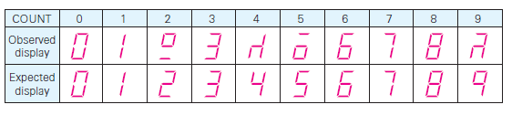
Troubleshooting(故障查找)
ZDMC – Lec. #5
Notes:
Crossed the connections to the e and f segments.
As circuits and systems become more complex, the number of possible causes of failure obviously increases.
Whereas the procedure for fault isolation and correction remains essentially the same, the application of the observation/analysis process is more important for complex circuits because it helps the troubleshooter narrow the location of the fault to a small area of the circuit.
Observing the symptoms of the failure, and reasoning through the operation, the troubleshooter can often predict the possible faults before
ever picking up a logic probe or an oscilloscope.
Another vital strategy in troubleshooting is known as divide-and-conquer.

Slide 26
Troubleshooting(故障查找)
Comparing the observed display with the expected display for each count, we see several important points:
  The correct segment patterns (0,1,3,6,7,and 8) have the common property that segments e and f are either both on or both off.
  The incorrect segment patterns have the common property that segments e and f are in opposite states, and if we interchange the states of these two segments, the correct pattern is obtained.
ZDMC – Lec. #5
Notes:
“Crossed” the connections to the e and f segments.
As circuits and systems become more complex, the number of possible causes of failure obviously increases.
Whereas the procedure for fault isolation and correction remains essentially the same, the application of the observation/analysis process is more important for complex circuits because it helps the troubleshooter narrow the location of the fault to a small area of the circuit.
Observing the symptoms of the failure, and reasoning through the operation, the troubleshooter can often predict the possible faults before
ever picking up a logic probe or an oscilloscope.
Another vital strategy in troubleshooting is known as divide-and-conquer.

Slide 27
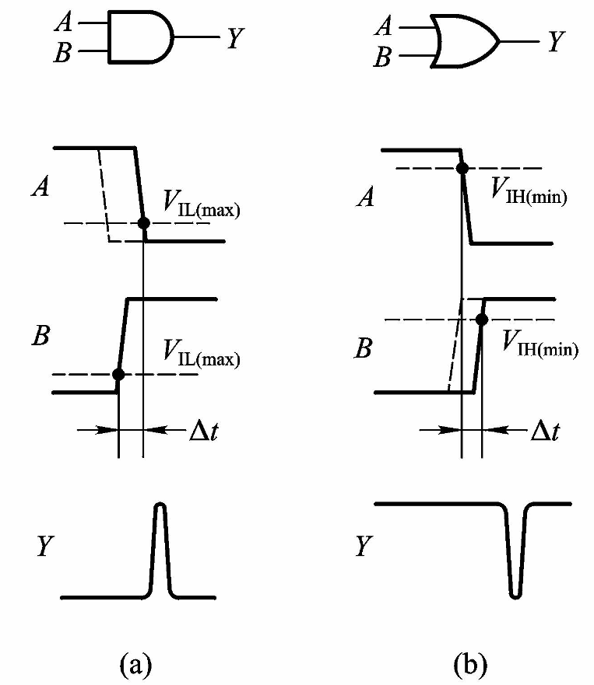
组合逻辑电路中的竞争-冒险现象
竞争-冒险现象及成因
一、什么是“竞争”
两个输入“同时向相反的逻辑电平变化”，称存在“竞争”
二、因“竞争”而可能在输出产
生尖峰脉冲的现象，称为
“竞争-冒险”。
ZDMC – Lec. #5

Slide 28
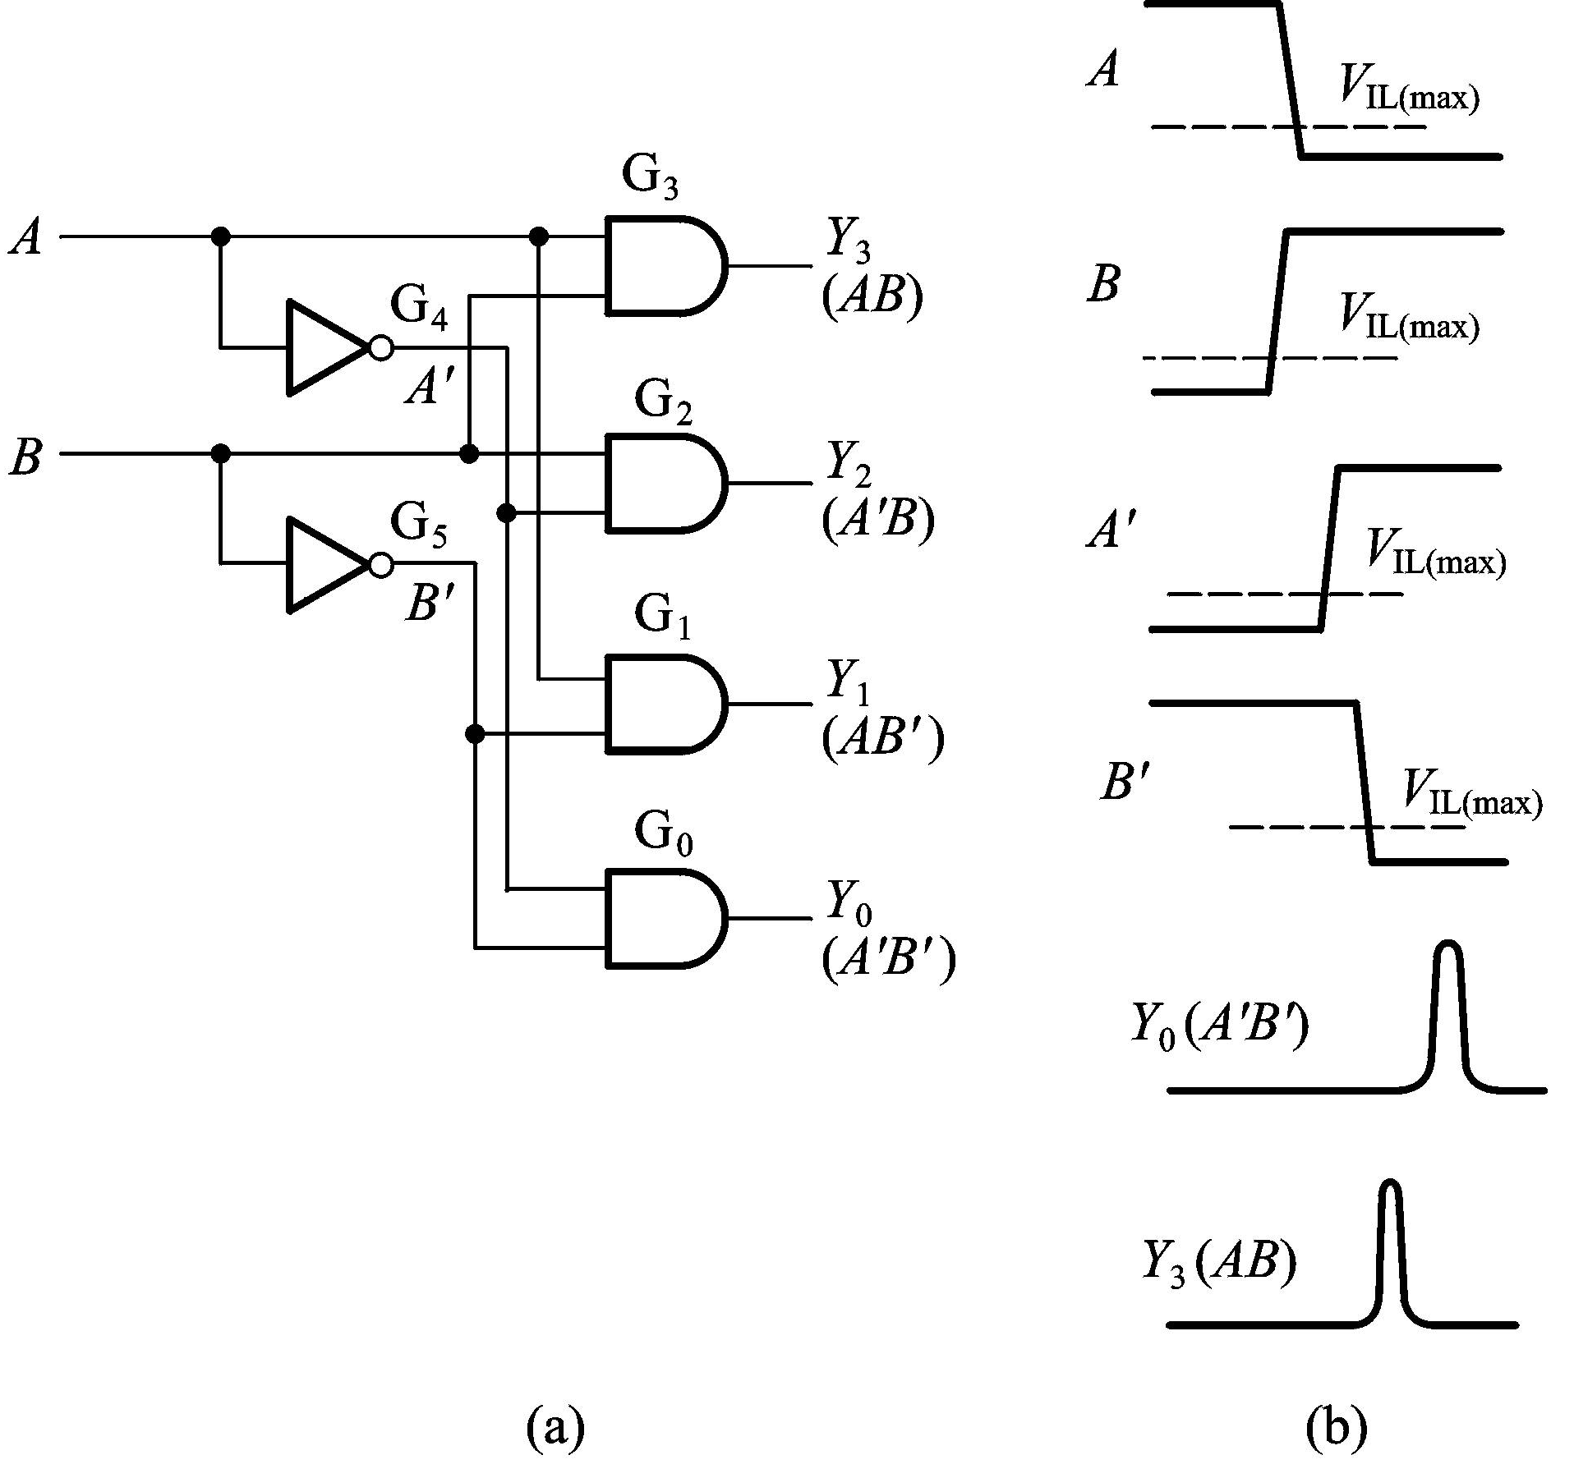
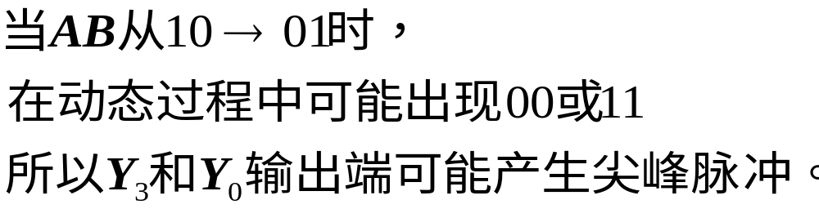
2线—4线译码器中的竞争-冒险现象
ZDMC – Lec. #5

Slide 29
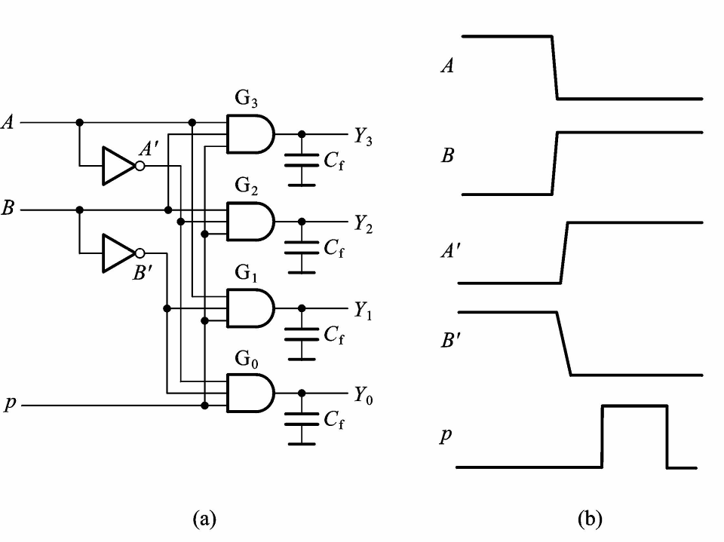
消除竞争-冒险现象的方法
一、接入滤波电容
尖峰脉冲很窄，用很小的电容就可将尖峰削弱到 V_{TH} 以下。
二、引入选通脉冲
取选通脉冲作用时间，在电路达到稳定之后，P的高电平期的输出信号不会出现尖峰。
ZDMC – Lec. #5

Slide 30
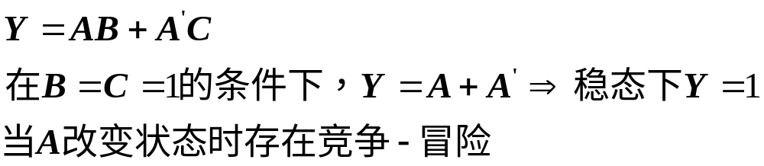

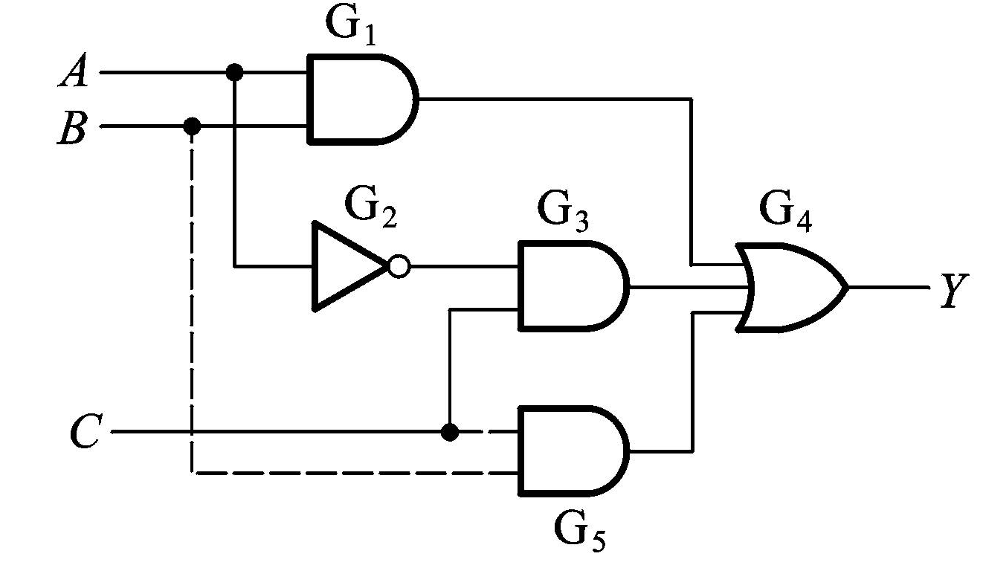
三、修改逻辑设计
例：
ZDMC – Lec. #5

Slide 31
概括 (Recap)
组合电路的基本模块
  译码器、编码器、选择器、加法器、比较器
  采用基本模块来设计组合电路
组合电路的竞争和冒险
ZDMC – Lec. #5

Slide 32
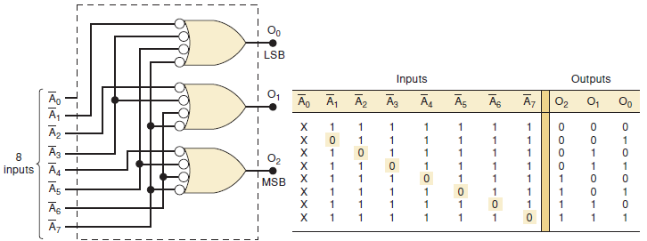
Encoder
ZDMC – Lec. #5
Notes:
octal-to-binary (8-line-to-3-line) encoder
For proper operation, only one input should be active at one time.
A3’ and A5’ are simultaneously LOW
The binary code 111. Clearly, this is not the code for either activated input.

Slide 33
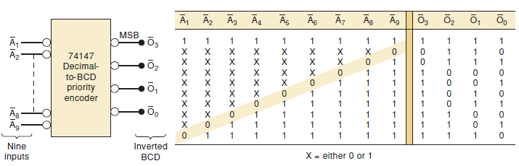
Priority Encoder (74147 decimal-to-BCD)
ZDMC – Lec. #5
Notes:
The 74147 outputs will normally the HIGH when none of the inputs are activated.
This corresponds to the decimal 0 input condition.

Slide 34
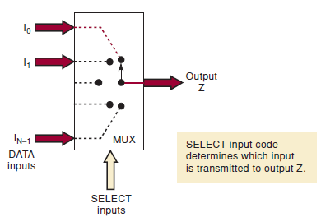
Multiplexers (Data Selectors)
Functional diagram of a digital multiplexer (MUX)
ZDMC – Lec. #5
Notes:
The 74147 outputs will normally the HIGH when none of the inputs are activated.
This corresponds to the decimal 0 input condition.

Slide 35
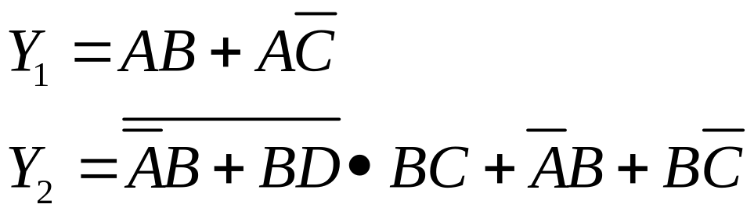
习题
用一个3线-8线译码器和门电路设计逻辑函数：
ZDMC – Lec. #5

Slide 36
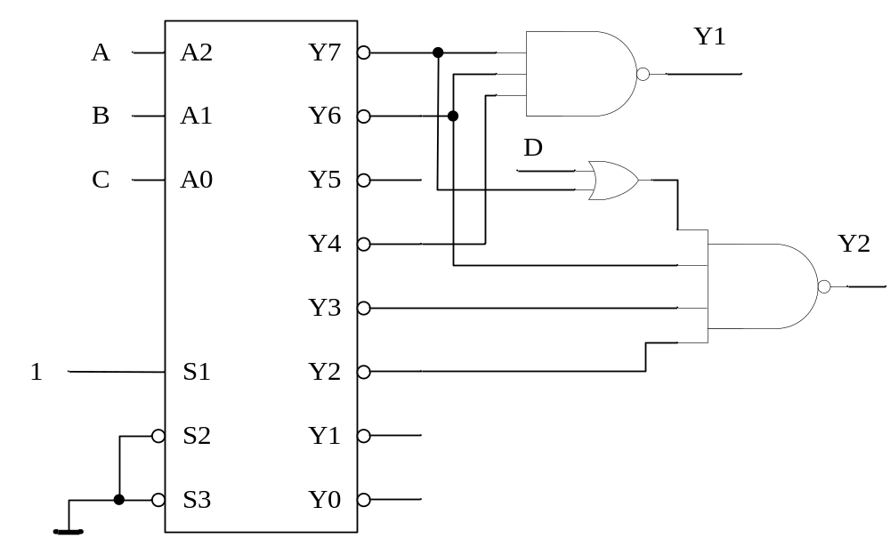
组合电路设计（续）
ZDMC – Lec. #5

Slide 37
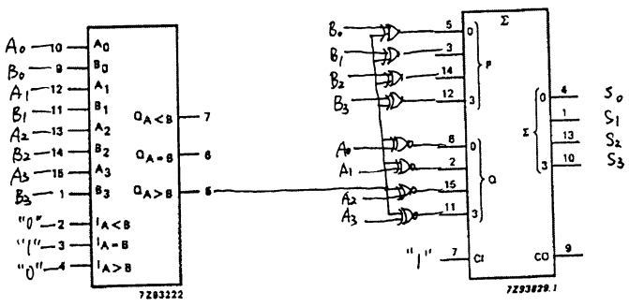
组合电路设计例2
已知A和B分别为4位二进制变量，试使用一片74HC85四位比较器、一片74HC283四位加法器以及若干门电路实现如下功能。 S = |A-B|
当 A>B, S = A+B’+1 =A-B
当 A<B, S = B-A = A’ +B+1
ZDMC – Lec. #5

Slide 38
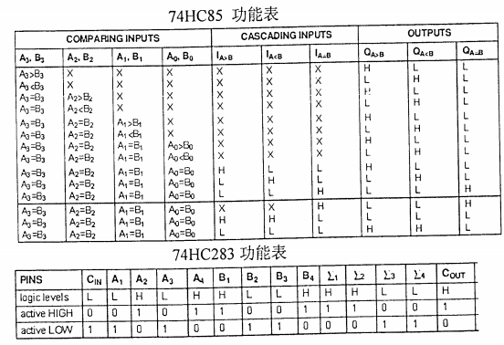
ZDMC – Lec. #5

