Slide 1
触发器 Flip-Flops
刘鹏
liupeng@zju.edu.cn
浙江大学信息与电子工程学院
March 19, 2019
ZDMC – Lec. #7
Notes:
Construct and analyze the operation of latch flip-flop made from NAND and NOR gates.
Understand the operation of edge-triggered flip-flops.
Analyze and apply the various flip-flop timing parameters specified by the manufactures.
Troubleshoot various types of flip-flop circuits.
Write HDL code for latches.
Use logic primitives, components, and libraries in HDL code.
Build structural level circuits from components.

Slide 2
复习
组合电路和Verilog语言
本节内容
时序电路的基本概念
触发器
ZDMC – Lec. #7

Slide 3
Sequential Logic 时序逻辑
Sequential Circuits 时序电路
  Simple circuits with feedback
  Latches (level sensitive)
    Storage elements that operate with signal levels (rather than signal transitions) are referred to as latches.
  Flip-flops (edge sensitive) (abbreviated FF)
    A flip-flop is a binary storage device capable of storing one bit of information.
Timing Methodologies定时
  Cascading级联 flip-flops for proper operation
  Clock skew时钟偏移
ZDMC – Lec. #7

Slide 4
Sequential Circuits
Circuits with Feedback
  Outputs = f(inputs, past inputs, past outputs)
  Basis for building "memory" into logic circuits
  Door combination lock is an example of a sequential circuit
    State is memory
    State is an "output" and an "input" to combinational logic
    Combination storage elements are also memory
new
equal
reset
value
C1
C2
C3
mux
control
multiplexer
comb. logic
comparator
state
clock
equal
open/closed
ZDMC – Lec. #7

Slide 5
Circuits with Feedback
How to control feedback?
  What stops values from cycling around endlessly
X1
X2
•
•
•
Xn
Z1
Z2
•
•
•
Zn
switching
network
ZDMC – Lec. #7

Slide 6


Simplest Circuits with Feedback
Two inverters form a static memory cell
  Will hold value as long as it has power applied
How to get a new value into the memory cell?
  Selectively break feedback path
  Load new value into cell
"1"
"stored value"
"0"
"remember"
"load"
"stored value"
"data"
ZDMC – Lec. #7

Slide 7




Memory with Cross-coupled Gates
Cross-coupled NOR gates
  Similar to inverter pair, with capability to force output to 0 (reset=1) or 1 (set=1)
Cross-coupled NAND gates
  Similar to inverter pair, with capability to force output to 0 (reset=0) or 1 (set=0)
R
Q
Q
R
S
S
Q'
S'
Q
Q
S'
R'
Q'
R'
ZDMC – Lec. #7
Notes:
Q=1, Q’=0 called HIGH or 1 state, also called SET state
Q=0, Q’=1 called LOW or 0 state, also called CLEAR or RESET state

Slide 8
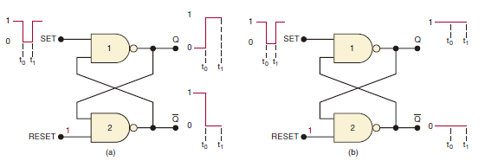
Setting the Latch (FF)
Pulsing the SET input to the 0 state when (a) Q = 0 prior to SET pulse; (b) Q = 1 prior to SET pulse. Note that, in both cases, Q ends up HIGH.
ZDMC – Lec. #7

Slide 9
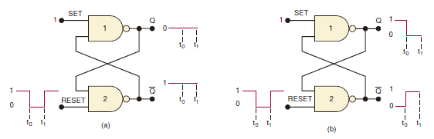
Resetting the Latch (FF)
Pulsing the RESET input to the LOW state when (a) Q = 0 prior to RESET pulse; (b) Q = 1 prior to RESET pulse. In each case, Q ends up low.
ZDMC – Lec. #7

Slide 10
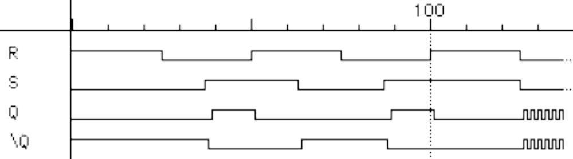
Timing Behavior
R
Q
S
Q'
Reset
Hold
Set
Reset
Set
100
Race
R
S
Q
\Q
ZDMC – Lec. #7

Slide 11
State Behavior of R-S latch
Truth table of R-S latch behavior
Q Q'
0 1
Q Q'
1 0
S R Q
0 0 hold
0 1 0
1 0 1
1 1 unstable
Q Q'
0 0
Q Q'
1 1
ZDMC – Lec. #7

Slide 12
Theoretical R-S Latch Behavior
SR=10
SR=00
SR=01
SR=00
SR=10
Q Q'
0 1
SR=01
Q Q'
1 0
SR=01
SR=10
SR=11
State Diagram
  States: possible values
  Transitions: changes
  based on inputs
Q Q'
0 0
SR=11
SR=11
SR=00
SR=11
SR=00
SR=01
SR=10
possible oscillation
between states 00 and 11
Q Q'
1 1
ZDMC – Lec. #7

Slide 13
Observed R-S Latch Behavior
Very difficult to observe R-S latch in the 1-1 state
  One of R or S usually changes first
Ambiguously returns to state 0-1 or 1-0
  A so-called "race condition"
  Or non-deterministic transition
SR=10
SR=00
SR=01
SR=00
SR=10
Q Q'
0 1
SR=01
Q Q'
1 0
SR=01
SR=10
SR=11
Q Q'
0 0
SR=11
SR=11
SR=00
SR=00
ZDMC – Lec. #7

Slide 14

R-S Latch Analysis
Break feedback path
R
Q
Q(t)
S
Q(t+Δ)
S
Q'
R
S R Q(t) Q(t+Δ)
0 0 0 0
0 0 1 1
0 1 0 0
0 1 1 0
1 0 0 1
1 0 1 1
1 1 0 X
1 1 1 X
hold
S
0 0
1 0
X 1
X 1
reset
Q(t)
set
R
not allowed
characteristic equation
Q(t+Δ) = S + R’ Q(t)
ZDMC – Lec. #7

Slide 15

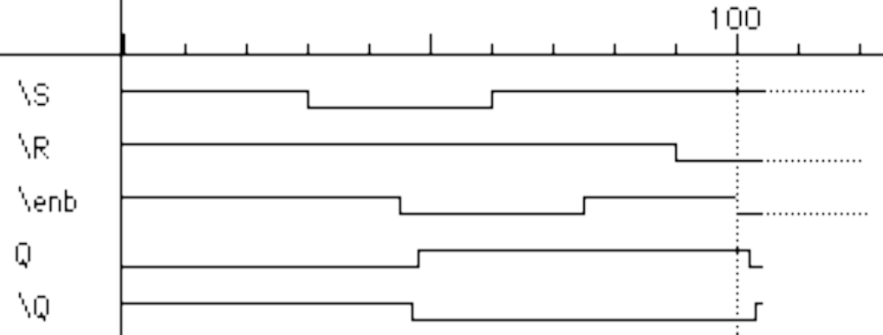
Gated R-S Latch
Control when R and S inputs matter
  Otherwise, the slightest glitch on R or S while enable is low could cause
  change in value stored
R'
R
Q
enable'
Q'
S'
S
Set
Reset
100
S'
R'
enable'
Q
Q'
ZDMC – Lec. #7

Slide 16
Clocks
Used to keep time
  Wait long enough for inputs (R' and S') to settle
  Then allow to have effect on value stored
Clocks are regular periodic signals
  Period (time between ticks)
  Duty-cycle (time clock is high between ticks - expressed as % of period)
duty cycle (in this case, 50%)
period
ZDMC – Lec. #7

Slide 17
Clocks (cont’d)
Controlling an R-S latch with a clock
  Can't let R and S change while clock is active (allowing R and S to pass)
  Only have half of clock period for signal changes to propagate
  Signals must be stable for the other half of clock period
R'
R
Q
clock'
Q'
S'
S
stable
changing
stable
changing
stable
R' and S'
clock
ZDMC – Lec. #7

Slide 18
Cascading Latches
Connect output of one latch to input of another
How to stop changes from racing through chain?
  Need to control flow of data from one latch to the next
  Advance from one latch per clock period
  Worry about logic between latches (arrows) that is too fast
R
R
Q'
R
Q'
S
S
Q
S
Q
clock
ZDMC – Lec. #7

Slide 19
Master-Slave Structure
Break flow by alternating clocks (like an air-lock)
  Use positive clock to latch inputs into one R-S latch
  Use negative clock to change outputs with another R-S latch
View pair as one basic unit
  master-slave flip-flop
  twice as much logic
  output changes a few gate delays after the falling edge of clock but does not affect any cascaded flip-flops
master stage
slave stage
R
P'
R
Q'
R
Q'
S
S
Q
S
Q
P
CLK
ZDMC – Lec. #7

Slide 20
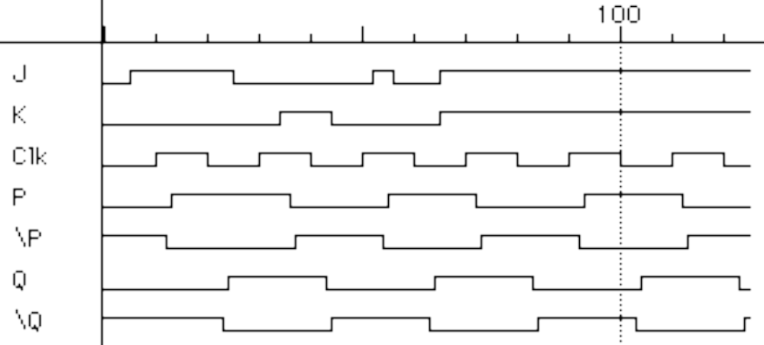
The 1s Catching Problem
In first R-S stage of master-slave FF
  0-1-0 glitch on R or S while clock is high "caught" by master stage
  Leads to constraints on logic to be hazard-free
master stage
slave stage
R
R
Q'
P'
R
Q'
1s
catch
S
S
Q
P
S
Q
Set
Reset
CLK
S
R
CLK
P
P'
Q
Q'
Master
Outputs
Slave
Outputs
ZDMC – Lec. #7

Slide 21
D Flip-Flop
Make S and R complements of each other
  Eliminates 1s catching problem
  Can't just hold previous value (must have new value ready every clock period)
  Value of D just before clock goes low is what is stored in flip-flop
  Can make R-S flip-flop by adding logic to make D = S + R' Q
master stage
slave stage
P'
Q'
R
Q'
R
Q'
D
S
Q
S
Q
Q
P
CLK
10 gates
ZDMC – Lec. #7

