Slide 1
触发器 Flip-Flops
刘鹏
liupeng@zju.edu.cn
浙江大学信息与电子工程学院
March 21, 2019
ZDMC – Lec. #8

Slide 2




Memory with Cross-coupled Gates
复习
Cross-coupled NOR gates
  Similar to inverter pair, with capability to force output to 0 (reset=1) or 1 (set=1)
Cross-coupled NAND gates
  Similar to inverter pair, with capability to force output to 0 (reset=0) or 1 (set=0)
R
Q
Q
R
S
S
Q'
S'
Q
Q
S'
R'
Q'
R'
ZDMC – Lec. #8

Slide 3
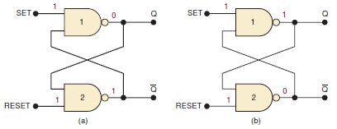

NAND Latch
复习
ZDMC – Lec. #8
Notes:
A NAND latch has two possible resting states when SET=RESET=1.
Under normal conditions, these outputs will always be the inverse of each other. There are two latch inputs: the SET input is the input that sets Q to the 1 state; the RESET input is the input that resets Q to the 0 state.
The SET and RESET inputs are both normally resting in the HIGH state, and one of them will be pulsed LOW whenever we want to change the latch outputs.
We begin our analysis by showing that there are two equally likely output states when SET= RESET =1.

Slide 4
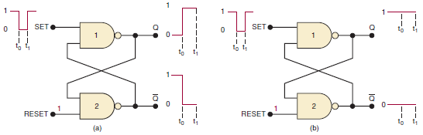
Setting the Latch (FF)
复习
Pulsing the SET input to the 0 state when (a) Q = 0 prior to SET pulse; (b) Q = 1 prior to SET pulse. Note that, in both cases, Q ends up HIGH.
ZDMC – Lec. #8
Notes:
Now let’s investigate what happens when the SET input is momentarily pulsed LOW while RESET is kept HIGH.
A LOW pulse on the SET input will always cause the latch to end up in the Q = 1 state.
This operation is called setting the latch or FF.

Slide 5
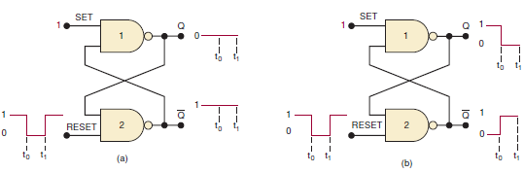
Resetting the Latch (FF)
复习
Pulsing the RESET input to the LOW state when (a) Q = 0 prior to RESET pulse; (b) Q =1 prior to RESET pulse. In each case, Q ends up LOW.
ZDMC – Lec. #8
Notes:
Now let’s consider what occurs when the RESET input is pulsed LOW while SET is kept HIGH.
A LOW pulse on the RESET input will always cause the latch to end up in the Q = 0 state.
This operation is called clearing or resetting the latch.

Slide 6
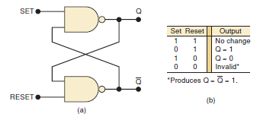
Summary of NADN Latch
(a) NAND latch; (b) function table.
ZDMC – Lec. #8
Notes:
Simultaneous Setting and Resetting
The last case to consider is the case where the SET and RESET inputs are simultaneously pulsed LOW.
This will produce HIGH levels at both NAND outputs so that Q = Q’= 1.
Clearly, this is an undesired condition because the two outputs are supposed to be inverses of each other.
Furthermore, when the SET and RESET inputs return HIGH, the resulting output state will depend on which input returns HIGH first.
Simultaneous transitions back to the 1 state will produce unpredictable results.
For these reasons the SET = RESET = 0 condition is normally not used for the NAND latch.

Slide 7
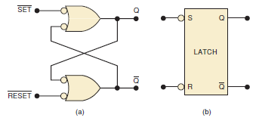
Alternate Representations
(a) NAND latch equivalent representation;
(b) simplified block symbol.
ZDMC – Lec. #8
Notes:
From the description of the NAND latch operation, it should be clear that the SET and RESET inputs are active-LOW.
The SET input will set Q = 1 when SET goes LOW;
The RESET input will clear Q = 0 when RESET goes LOW.
For this reason, the NAND latch is often drawn using the alternate representation for each NADN gate, as shown in Figure a.
The bubbles on the inputs, as well as the labeling of the signals as SET/ and RESET/, indicate the active-LOW status of these inputs.

Slide 8
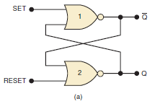
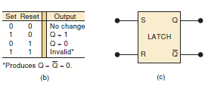
NOR Gate Latch
(a) NOR gate latch
(b) function table
(c) simplified block symbol
ZDMC – Lec. #8
Notes:
Is similar to the NAND latch except the Q and Q’ outputs have reversed positions.
The NOR gate latch operates exactly like the NAND latch except that the SET and RESET inputs are active-HIGH rather than active-LOW,
And the normal resting state is SET = RESET = 0.

Slide 9
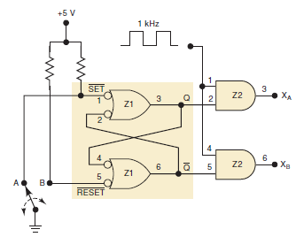

Analyze and describe the operation of the circuit
ZDMC – Lec. #8
Notes:
The switch is used to set or clear the NAND latch to produce clean, bounce-free signals at Q and Q’.
These latch outputs control the passage of the 1-kHz pulse signal through to the AND outputs X_A and X_B

Slide 10
Observed R-S Latch Behavior
复习
Very difficult to observe R-S latch in the 1-1 state
  One of R or S usually changes first
Ambiguously returns to state 0-1 or 1-0
  A so-called "race condition"
  Or non-deterministic transition
SR=10
SR=00
SR=01
SR=00
SR=10
Q Q'
0 1
SR=01
Q Q'
1 0
SR=01
SR=10
SR=11
Q Q'
0 0
SR=11
SR=11
SR=00
SR=00
ZDMC – Lec. #8

Slide 11

Clocks (cont’d)
复习
Controlling an R-S latch with a clock
  Can't let R and S change while clock is active (allowing R and S to pass)
  Only have half of clock period for signal changes to propagate
  Signals must be stable for the other half of clock period
R'
R
Q
clock'
Q'
S'
S
stable
changing
stable
changing
stable
R' and S'
clock
ZDMC – Lec. #8

Slide 12
Master-Slave Structure
复习
Break flow by alternating clocks (like an air-lock)
  Use positive clock to latch inputs into one R-S latch
  Use negative clock to change outputs with another R-S latch
View pair as one basic unit
  master-slave flip-flop
  twice as much logic
  output changes a few gate delays after the falling edge of clock but does not affect any cascaded flip-flops
master stage
slave stage
R
P'
R
Q'
R
Q'
S
S
Q
S
Q
P
CLK
ZDMC – Lec. #8

Slide 13
D Flip-Flop
复习
Make S and R complements of each other
  Eliminates 1s catching problem
  Can't just hold previous value (must have new value ready every clock period)
  Value of D just before clock goes low is what is stored in flip-flop
  Can make R-S flip-flop by adding logic to make D = S + R' Q
master stage
slave stage
P'
Q'
R
Q'
R
Q'
D
S
Q
S
Q
Q
P
CLK
10 gates
ZDMC – Lec. #8

Slide 14
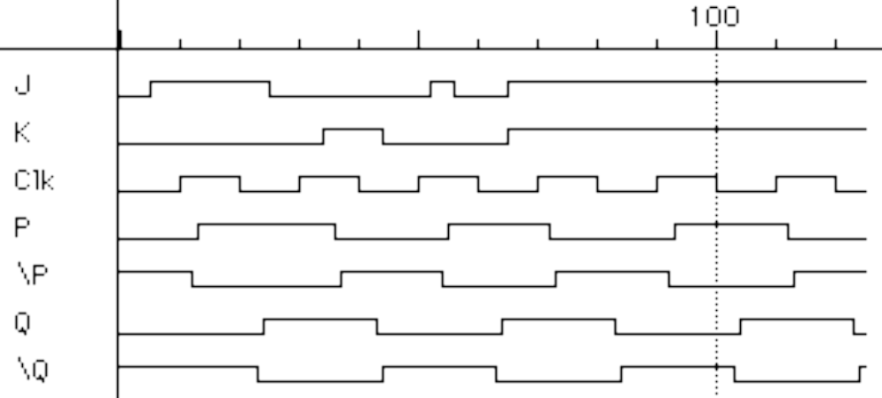
The 1s Catching Problem
In first R-S stage of master-slave FF
  0-1-0 glitch on R or S while clock is high "caught" by master stage
  Leads to constraints on logic to be hazard-free
master stage
slave stage
R
R
Q'
P'
R
Q'
1s
catch
S
S
Q
P
S
Q
Set
Reset
CLK
S
R
CLK
P
P'
Q
Q'
Master
Outputs
Slave
Outputs
ZDMC – Lec. #7

Slide 15
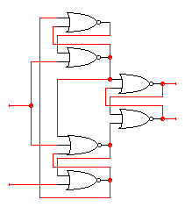

Edge-Triggered Flip-Flops
More efficient solution: only 6 gates
  sensitive to inputs only near edge of clock signal (not while high)
D’
D
holds D' when
clock goes low
negative edge-triggered D
flip-flop (D-FF)
4-5 gate delays
must respect setup and hold time
constraints to successfully
capture input
0
R
Q
Clk=1
Q’
S
0
holds D when
clock goes low
characteristic equation
Q(t+1) = D
D
D’
ZDMC – Lec. #8

Slide 16
Edge-Triggered Flip-Flops (cont’d)
Step-by-step analysis
D’
D
D’
D
D’
D’
R
R
Q
Q
Clk=0
Clk=0
S
S
D
D
D’
new D
D’
D
when clock goes high-to-low
data is latched
new D ≠ old D
when clock is low
data is held
ZDMC – Lec. #8

Slide 17
Edge-Triggered Flip-Flops (cont’d)
D = 0, Clk High
1
0
D’
Act as inverters
D
0
0
D’
R
Q
Hold state
Clk=1
1
S
0
D
0
D
D’
1
ZDMC – Lec. #8

Slide 18
Edge-Triggered Flip-Flops (cont’d)
1 → 0
0 → 1
1
0
D = 1, Clk High
D’
D
0
0
D’
R
Q
Clk=1
1
S
0
D
0 → 1
0
0
D
D’
1 → 0
1
ZDMC – Lec. #8

Slide 19
Edge-Triggered Flip-Flops (cont’d)
0
1
0
D = 1, Clk LOW
D’
Act as inverters
D
0
0 → 1
D’
0
R
Q
Clk=0
1 → 0
1
S
0 → 1
0
D
1
0
D
D’
0
ZDMC – Lec. #8

Slide 20
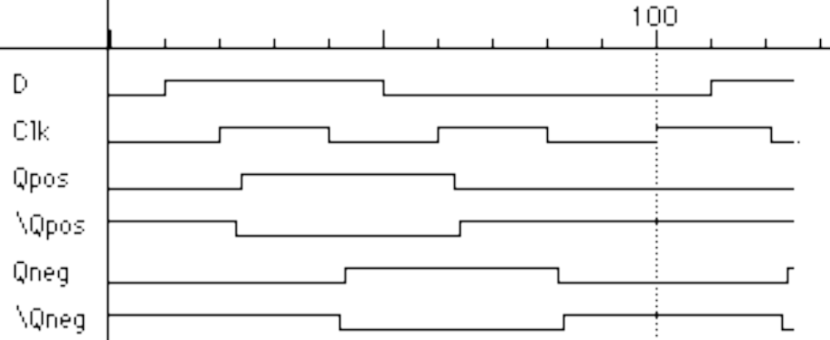
Edge-Triggered Flip-Flops (cont’d)
Positive edge-triggered
  Inputs sampled on rising edge; outputs change after rising edge
Negative edge-triggered flip-flops
  Inputs sampled on falling edge; outputs change after falling edge
100
D
CLK
Qpos
Qpos'
Qneg
Qneg'
positive edge-triggered FF
negative edge-triggered FF
ZDMC – Lec. #8

Slide 21
Negative Edge Trigger FF in Verilog
module d_ff (q, q_bar, data, clk);
input data, clk;
output q, q_bar;
reg q;
assign q_bar = ~q;
always @(negedge clk)
begin
q <= data;
end
endmodule
ZDMC – Lec. #8

Slide 22
Comparison of Latches and Flip-Flops
D Q
CLK
D
CLK
Qedge
Qlatch
positive
edge-triggered
flip-flop
D Q
G
CLK
transparent
(level-sensitive)
latch
behavior is the same unless input changes
while the clock is high
ZDMC – Lec. #8

Slide 23
Comparison of Latches and Flip-Flops (cont’d)
Type When inputs are sampled When output is valid
unclocked always propagation delay from input change
latch
level-sensitive clock high propagation delay from input change
latch (Tsu/Th around falling or clock edge (whichever is later)
edge of clock)
master-slave clock high propagation delay from falling edge
flip-flop (Tsu/Th around falling of clock
edge of clock)
negative clock hi-to-lo transition propagation delay from falling edge
edge-triggered (Tsu/Th around falling of clock
flip-flop edge of clock)
ZDMC – Lec. #8

Slide 24
本讲内容
边沿触发器
时序的基本概念
Flip-Flop分类
ZDMC – Lec. #8

Slide 25
Timing Methodologies
Rules for interconnecting components and clocks
  Guarantee proper operation of system when strictly followed
Approach depends on building blocks used for memory elements
  Focus on systems with edge-triggered flip-flops
    Found in programmable logic devices
  Many custom integrated circuits focus on level-sensitive latches
Basic rules for correct timing:
  (1) Correct inputs, with respect to time, are provided to the flip-flops
  (2) No flip-flop changes state more than once per clocking event
ZDMC – Lec. #8

Slide 26
Timing Methodologies (cont’d)
Definition of terms
  clock: periodic event, causes state of memory element to change; can be rising or falling edge, or high or low level
  setup time: minimum time before the clocking event by which the input must be stable (Tsu)
  hold time: minimum time after the clocking event until which the input must remain stable (Th)
T_{su}
T_{h}
data
D
Q
D
Q
input
clock
clock
there is a timing "window"
around the clocking event
during which the input must
remain stable and unchanged
in order to be recognized
stable
changing
data
clock
ZDMC – Lec. #8

Slide 27
Typical Timing Specifications
Positive edge-triggered D flip-flop
  Setup and hold times
  Minimum clock width
  Propagation delays (low to high, high to low, max and typical)
D
Tsu
20ns
Th
5ns
Tsu
20ns
Th
5ns
CLK
Tw 25ns
Tplh
25ns
13ns
Tphl
40ns
25ns
Q
all measurements are made from the clocking event that is,
the rising edge of the clock
ZDMC – Lec. #8

Slide 28
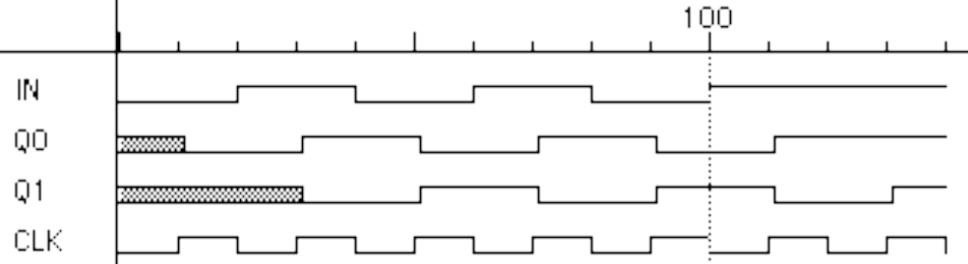
Cascading Edge-triggered Flip-Flops
Shift register
  New value goes into first stage
  While previous value of first stage goes into second stage
  Consider setup/hold/propagation delays (prop must be > hold)
Q0
Q1
IN
D
Q
D
Q
OUT
CLK
100
IN
Q0
Q1
CLK
ZDMC – Lec. #8

Slide 29
Cascading Edge-triggered Flip-Flops (cont’d)
Why this works
  Propagation delays exceed hold times
  Clock width constraint exceeds setup time
  This guarantees following stage will latch current value before it changes to new value
In
Q0
Q1
CLK
T_{su}
4ns
T_{su}
4ns
timing constraints
guarantee proper
operation of
cascaded components
T_{p}
3ns
T_{p}
3ns
assumes infinitely fast
distribution of the clock
T_{h}
2ns
T_{h}
2ns
ZDMC – Lec. #8

Slide 30
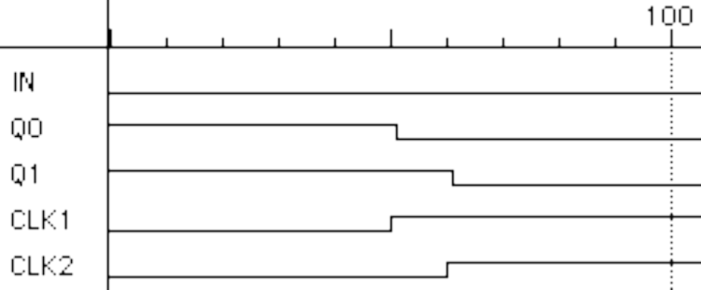
Clock Skew
The problem
  Correct behavior assumes next state of all storage elements
  determined by all storage elements at the same time
  Difficult in high-performance systems because time for clock to arrive at flip-flop is comparable to delays through logic (and will soon become greater than logic delay)
  Effect of skew on cascaded flip-flops:
original state: IN = 0, Q0 = 1, Q1 = 1
due to skew, next state becomes: Q0 = 0, Q1 = 0, and not Q0 = 0, Q1 = 1
100
In
Q0
Q1
CLK0
CLK1
CLK1 is a delayed
version of CLK0
ZDMC – Lec. #8

Slide 31
触发器Flip-Flop分类
逻辑功能分类
  RS锁存器
  JK触发器
  T触发器
  D触发器
逻辑功能指按触发器的次态和现态及输入信号之间的逻辑关系.
  特性表
  特性方程
  状态转换图
ZDMC – Lec. #8

Slide 32
RS 锁存器
特性方程Q^{n+1}=S+R’Q^{n}
RS Latch的状态转换图
特性表/真值表
S=1,R=0
0
S=X,R=0
S=0,R=X
1
S R Q^{n} Q^{n+1}
0 0 0 0
0 0 1 1
0 1 0 0
0 1 1 0
1 0 0 1
1 0 1 1
1 1 0 0
1 1 1 0
保持
S=0,R=1
复位
置位
不定
ZDMC – Lec. #8

Slide 33
JK 触发器
特性方程:Q^{n+1}=JQ^{n}’+K’Q^{n}
JK FF的状态转换图
特性表/真值表
J=1,K=X
0
J=X,K=0
J=0,K=X
1
J K Q^{n} Q^{n+1}
0 0 0 0
0 0 1 1
0 1 0 0
0 1 1 0
1 0 0 1
1 0 1 1
1 1 0 1
1 1 1 0
保持
J=X,K=1
复位
置位
翻转
ZDMC – Lec. #8

Slide 34
T 触发器
特性方程:Q^{n+1}=TQ^{n}’+T’Q^{n}
T FF的状态转换图
特性表/真值表
T’触发器：T=1, Q^{n+1}=Q^{n}’
T=1
T=0
0
1
T=0
T Q^{n} Q^{n+1}
0 0 0
0 1 1
1 0 1
1 1 0
保持
T=1
翻转
JK触发器的两个输入端连在一起作为T端，可以构成T Flip-flop
ZDMC – Lec. #8

Slide 35
D 触发器
特性方程:Q^{n+1}=D
D FF的状态转换图
特性表/真值表
D=1
D=0
0
1
D=1
D Q^{n} Q^{n+1}
0 0 0
0 1 0
1 0 1
1 1 1
reset
D=1
set
ZDMC – Lec. #8

Slide 36
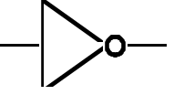

采用D 触发器实现JK触发器
K
D
Q
J
Clk
clk
Q’
ZDMC – Lec. #8

Slide 37
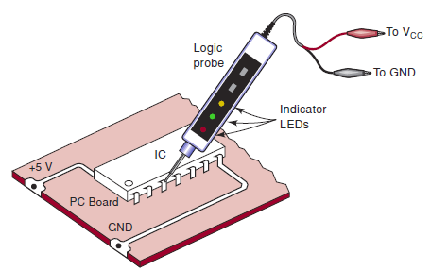
Troubleshooting Digital Systems(阅读)
Fault detection
Fault isolation
Fault correction
Internal Digital IC Faults
  Malfunction in the internal circuitry
  Inputs or outputs shorted to ground or Vcc
  Inputs or outputs open-circuited
  Short between two pins (other than ground or Vcc)
Troubleshooting case study
ZDMC – Lec. #8
Notes:
Open or floating – that is, not connected to any source of voltage
Logic probe, oscilloscope, logic pulser

Slide 38
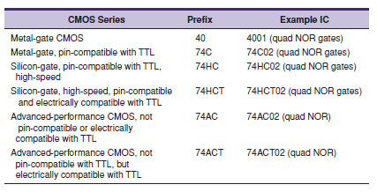
Various series within the CMOS logic family
ZDMC – Lec. #8

