Slide 1
触发器
刘鹏
liupeng@zju.edu.cn
浙江大学信息与电子工程学院
March 26, 2019
ZDMC

Slide 2
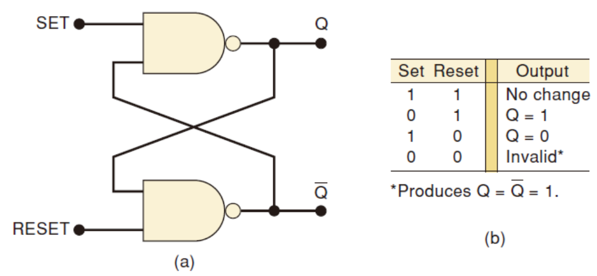
NAND Latch
复习
(a) NAND latch; (b) function table.
ZDMC
Notes:
Simultaneous Setting and Resetting
The last case to consider is the case where the SET and RESET inputs are simultaneously pulsed LOW.
This will produce HIGH levels at both NAND outputs so that Q = Q’= 1.
Clearly, this is an undesired condition because the two outputs are supposed to be inverses of each other.
Furthermore, when the SET and RESET inputs return HIGH, the resulting output state will depend on which input returns HIGH first.
Simultaneous transitions back to the 1 state will produce unpredictable results.
For these reasons the SET = RESET = 0 condition is normally not used for the NAND latch.

Slide 3
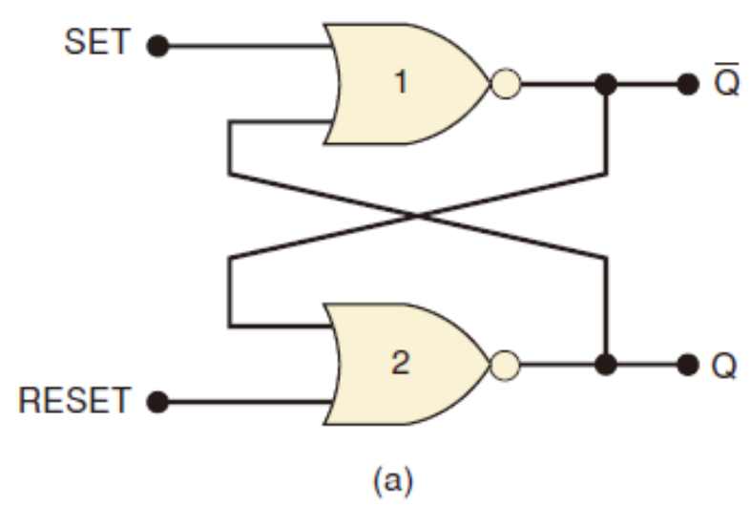
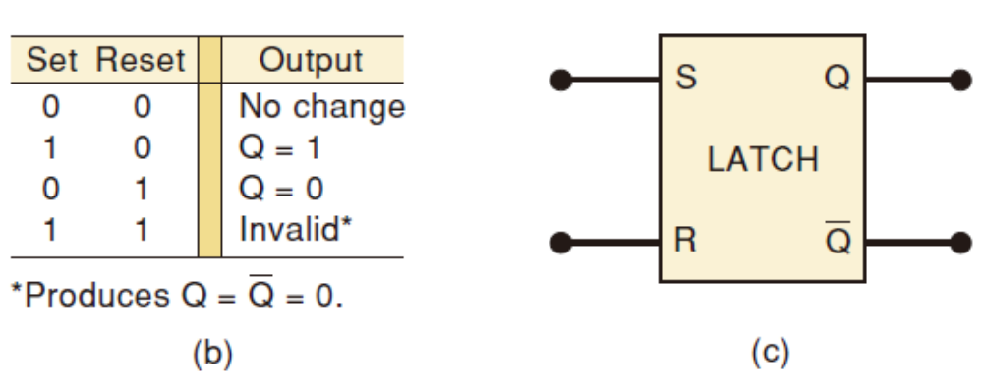
NOR Gate Latch
复习
(a) NOR gate latch
(b) function table
(c) simplified block symbol
ZDMC
Notes:
Is similar to the NAND latch except the Q and Q’ outputs have reversed positions.
The NOR gate latch operates exactly like the NAND latch except that the SET and RESET inputs are active-HIGH rather than active-LOW,
And the normal resting state is SET = RESET = 0.

Slide 4
Master-Slave Structure
复习
Break flow by alternating clocks (like an air-lock)
  Use positive clock to latch inputs into one R-S latch
  Use negative clock to change outputs with another R-S latch
View pair as one basic unit
  master-slave flip-flop
  twice as much logic
  output changes a few gate delays after the falling edge of clock but does not affect any cascaded flip-flops
master stage
slave stage
R
P'
R
Q'
R
Q'
S
S
Q
S
Q
P
CLK
ZDMC

Slide 5
D Flip-Flop
复习
Make S and R complements of each other
  Eliminates 1s catching problem
  Can't just hold previous value (must have new value ready every clock period)
  Value of D just before clock goes low is what is stored in flip-flop
  Can make R-S flip-flop by adding logic to make D = S + R' Q
master stage
slave stage
P'
Q'
R
Q'
R
Q'
D
S
Q
S
Q
Q
P
CLK
10 gates
ZDMC – Lec. #8

Slide 6
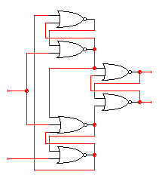

Edge-Triggered Flip-Flops
More efficient solution: only 6 gates
  sensitive to inputs only near edge of clock signal (not while high)
D’
D
holds D' when
clock goes low
negative edge-triggered D
flip-flop (D-FF)
4-5 gate delays
must respect setup and hold time
constraints to successfully
capture input
0
R
Q
Clk=1
Q’
S
0
holds D when
clock goes low
characteristic equation
Q(t+1) = D
D
D’
ZDMC – Lec. #8

Slide 7
Edge-Triggered Flip-Flops (cont’d)
Step-by-step analysis
D’
D
D’
D
D’
D’
R
R
Q
Q
Clk=0
Clk=0
S
S
D
D
D’
new D
D’
D
when clock goes high-to-low
data is latched
new D ≠ old D
when clock is low
data is held
ZDMC – Lec. #8

Slide 8
Edge-Triggered Flip-Flops (cont’d)
D = 0, Clk High
1
0
D’
Act as inverters
D
0
0
D’
R
Q
Hold state
Clk=1
1
S
0
D
0
D
D’
1
ZDMC – Lec. #8

Slide 9
Edge-Triggered Flip-Flops (cont’d)
1 → 0
0 → 1
1
0
D = 1, Clk High
D’
D
0
0
D’
R
Q
Clk=1
1
S
0
D
0 → 1
0
0
D
D’
1 → 0
1
ZDMC – Lec. #8

Slide 10
Edge-Triggered Flip-Flops (cont’d)
0
1
0
D = 1, Clk LOW
D’
Act as inverters
D
0
0 → 1
D’
0
R
Q
Clk=0
1 → 0
1
S
0 → 1
0
D
1
0
D
D’
0
ZDMC – Lec. #8

Slide 11
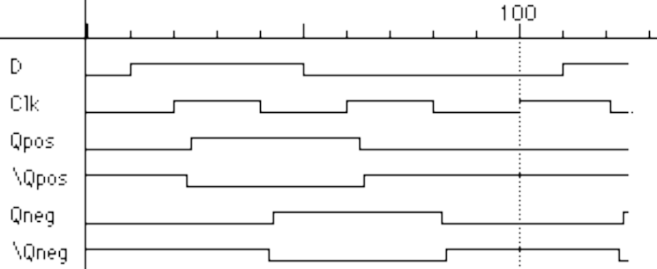
Edge-Triggered Flip-Flops (cont’d)
Positive edge-triggered
  Inputs sampled on rising edge; outputs change after rising edge
Negative edge-triggered flip-flops
  Inputs sampled on falling edge; outputs change after falling edge
100
D
CLK
Qpos
Qpos'
Qneg
Qneg'
positive edge-triggered FF
negative edge-triggered FF
ZDMC – Lec. #8

Slide 12
Negative Edge Trigger FF in Verilog
module d_ff (q, q_bar, data, clk);
input data, clk;
output q, q_bar;
reg q;
assign q_bar = ~q;
always @(negedge clk)
begin
q <= data;
end
endmodule
ZDMC – Lec. #8

Slide 13
Comparison of Latches and Flip-Flops
D Q
CLK
D
CLK
Qedge
Qlatch
positive
edge-triggered
flip-flop
D Q
G
CLK
transparent
(level-sensitive)
latch
behavior is the same unless input changes
while the clock is high
ZDMC – Lec. #8

Slide 14
Comparison of Latches and Flip-Flops (cont’d)
Type When inputs are sampled When output is valid
unclocked always propagation delay from input change
latch
level-sensitive clock high propagation delay from input change
latch (Tsu/Th around falling or clock edge (whichever is later)
edge of clock)
master-slave clock high propagation delay from falling edge
flip-flop (Tsu/Th around falling of clock
edge of clock)
negative clock hi-to-lo transition propagation delay from falling edge
edge-triggered (Tsu/Th around falling of clock
flip-flop edge of clock)
ZDMC – Lec. #8

Slide 15
Master-Slave Structure
复习
Break flow by alternating clocks (like an air-lock)
  Use positive clock to latch inputs into one R-S latch
  Use negative clock to change outputs with another R-S latch
View pair as one basic unit
  master-slave flip-flop
  twice as much logic
  output changes a few gate delays after the falling edge of clock but does not affect any cascaded flip-flops
master stage
slave stage
R
P'
R
Q'
R
Q'
S
S
Q
S
Q
P
CLK
ZDMC

Slide 16
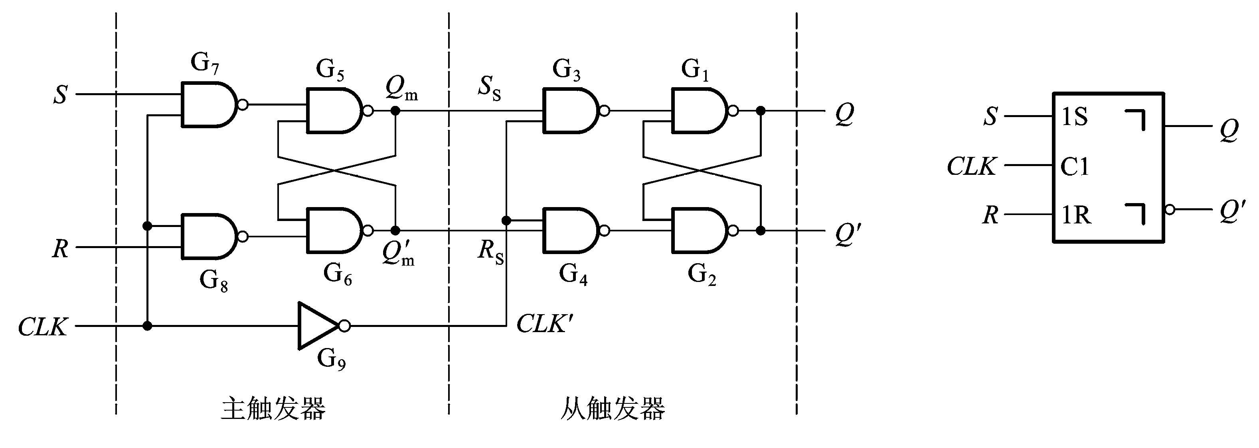
脉冲触发的触发器
一、电路结构与工作原理
提高可靠性，要求每个CLK周期输出状态只能改变1次
ZDMC
Notes:
EE141
主从触发器电路结构（SR latches） “¬ ”表示“延迟输出”，即CLK回到低电平（有效电平）以后，输出状态才改变。因此，图中所示电路输出状态的变化发生在CLK的下降沿。

Slide 17


X | X | X | X
 | 0 | 0 | 0 | 0
 | 0 | 0 | 1 | 1
 | 1 | 0 | 0 | 1
 | 1 | 0 | 1 | 1
 | 0 | 1 | 0 | 0
 | 0 | 1 | 1 | 0
 | 1 | 1 | 0 | 1*
 | 1 | 1 | 1 | 1*
1.主从SR触发器
（1）clk=1时，“主”按S,R翻转，“从”保持；
（2）clk下降沿到达时，“主”保持，
“从”根据“主”的状态翻转。
所以每个clk周期，输出状态只可能改变一次。
ZDMC
Notes:
EE141

Slide 18
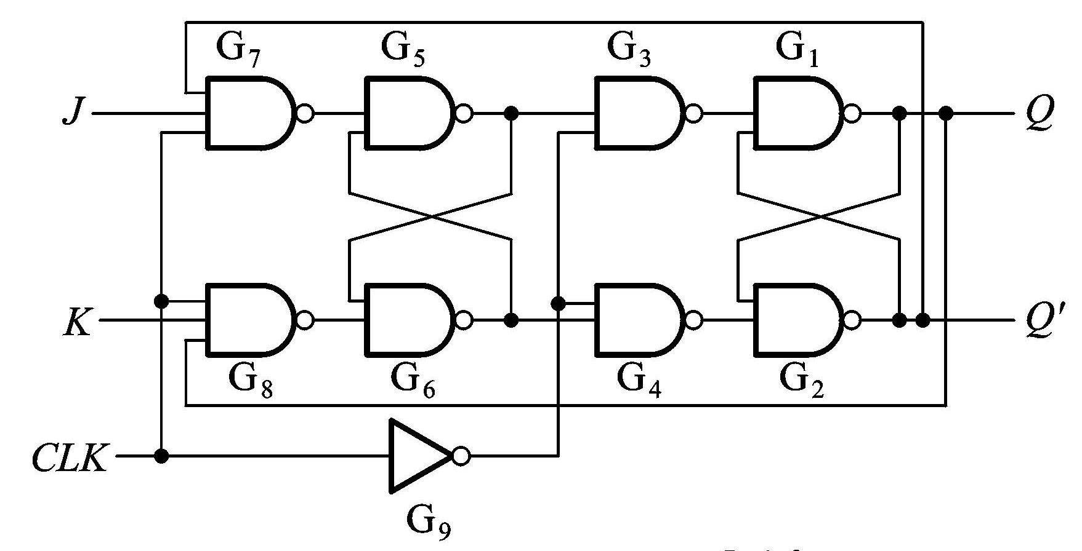
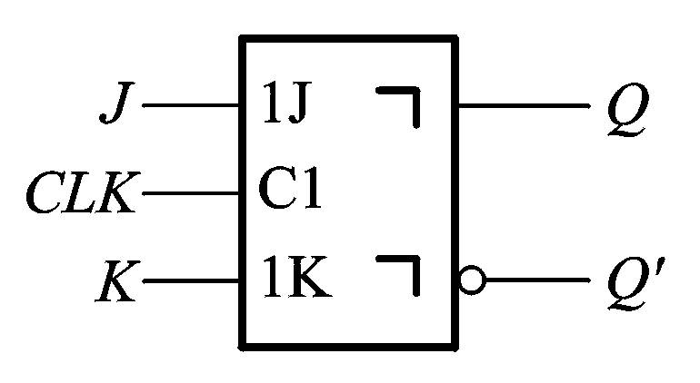
2. 主从JK触发器
为解除约束，即使出现S=R=1的情况下，Q*也是确定的。
J
Q
Q
主
S
从
K
Q’
Q’
R
CLK
ZDMC
Notes:
EE141

Slide 19
主从JK触发器分析
J
Q
Q
主
S
从
K
Q’
Q’
R
CLK
(1)若J = 1, K = 0, clk = 1时
Q*=1, 主保持1；Q*=0，主=1；当clk↓后，从=1
(2)若J = 0, K = 1, clk = 1时
Q*=1, 主=0；Q*=0，主保持0；当clk↓后，从=0
(3)若J = K = 0, clk = 1时
Q*=1, 主保持；Q*=0，主保持；当clk↓后，从保持
(4)J = K = 1, clk = 1时
若Q*=1, 则主置0；若Q*=0，则主置1；当clk↓后，从=(Q*)’
ZDMC
Notes:
EE141

Slide 20



(5) 列出真值表
X | X | X | X
 | 0 | 0 | 0 | 0
 | 0 | 0 | 1 | 1
 | 1 | 0 | 0 | 1
 | 1 | 0 | 1 | 1
 | 0 | 1 | 0 | 0
 | 0 | 1 | 1 | 0
 | 1 | 1 | 0 | 1*
 | 1 | 1 | 1 | 1*
X | X | X | X
 | 0 | 0 | 0 | 0
 | 0 | 0 | 1 | 1
 | 1 | 0 | 0 | 1
 | 1 | 0 | 1 | 1
 | 0 | 1 | 0 | 0
 | 0 | 1 | 1 | 0
 | 1 | 1 | 0 | 1
 | 1 | 1 | 1 | 0
J
Q
Q
主
S
从
K
Q’
Q’
R
CLK
ZDMC
Notes:
EE141

Slide 21
脉冲触发的触发器
脉冲触发方式的动作特点
  分两步动作：
    第一步clk=1时，主接收信号，从保持；
    第二步clk下降沿到达后，从按主状态翻转；
    输出状态只能改变一次。
  主从SR，主为同步SR，clk=1的全部时间里输入信号对主都起控制作用；但主从JK在clk高电平期间，主只可能翻转一次。
  在clk=1期间里输入发生变化时，要找出clk下降沿前Q’最后的状态，决定Q*的状态。
J
Q
Q
主
Q=0时，只允许J=1的信号进入主触发器
Q=1时，只允许K=1的信号进入主触发器
S
从
K
Q’
Q’
R
CLK
ZDMC
Notes:
EE141

Slide 22
触发器Flip-Flop分类
逻辑功能分类
  RS锁存器
  JK触发器
  T触发器
  D触发器
逻辑功能指按触发器的次态和现态及输入信号之间的逻辑关系.
  特性表
  特性方程
  状态转换图
ZDMC – Lec. #8

Slide 23
RS 锁存器
特性方程Q^{n+1}=S+R’Q^{n}
RS Latch的状态转换图
特性表/真值表
S=1,R=0
0
S=X,R=0
S=0,R=X
1
S R Q^{n} Q^{n+1}
0 0 0 0
0 0 1 1
0 1 0 0
0 1 1 0
1 0 0 1
1 0 1 1
1 1 0 0
1 1 1 0
保持
S=0,R=1
复位
置位
不定
ZDMC – Lec. #8

Slide 24
JK 触发器
特性方程:Q^{n+1}=JQ^{n}’+K’Q^{n}
JK FF的状态转换图
特性表/真值表
J=1,K=X
0
J=X,K=0
J=0,K=X
1
J K Q^{n} Q^{n+1}
0 0 0 0
0 0 1 1
0 1 0 0
0 1 1 0
1 0 0 1
1 0 1 1
1 1 0 1
1 1 1 0
保持
J=X,K=1
复位
置位
翻转
ZDMC – Lec. #8

Slide 25
T 触发器
特性方程:Q^{n+1}=TQ^{n}’+T’Q^{n}
T FF的状态转换图
特性表/真值表
T’触发器：T=1, Q^{n+1}=Q^{n}’
T=1
T=0
0
1
T=0
T Q^{n} Q^{n+1}
0 0 0
0 1 1
1 0 1
1 1 0
保持
T=1
翻转
JK触发器的两个输入端连在一起作为T端，可以构成T Flip-flop
ZDMC – Lec. #8

Slide 26
D 触发器
特性方程:Q^{n+1}=D
D FF的状态转换图
特性表/真值表
D=1
D=0
0
1
D=1
D Q^{n} Q^{n+1}
0 0 0
0 1 0
1 0 1
1 1 1
reset
D=1
set
ZDMC – Lec. #8

Slide 27
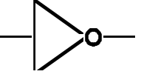

采用D 触发器实现JK触发器
K
D
Q
J
Clk
clk
Q’
ZDMC – Lec. #8

Slide 28
Timing Methodologies
Rules for interconnecting components and clocks
  Guarantee proper operation of system when strictly followed
Approach depends on building blocks used for memory elements
  Focus on systems with edge-triggered flip-flops
    Found in programmable logic devices
  Many custom integrated circuits focus on level-sensitive latches
Basic rules for correct timing:
  (1) Correct inputs, with respect to time, are provided to the flip-flops
  (2) No flip-flop changes state more than once per clocking event
ZDMC – Lec. #8

Slide 29
Timing Methodologies (cont’d)
Definition of terms
  clock: periodic event, causes state of memory element to change; can be rising or falling edge, or high or low level
  setup time: minimum time before the clocking event by which the input must be stable (Tsu)
  hold time: minimum time after the clocking event until which the input must remain stable (Th)
T_{su}
T_{h}
data
D
Q
D
Q
input
clock
clock
there is a timing "window"
around the clocking event
during which the input must
remain stable and unchanged
in order to be recognized
stable
changing
data
clock
ZDMC – Lec. #8

Slide 30
Typical Timing Specifications
Positive edge-triggered D flip-flop
  Setup and hold times
  Minimum clock width
  Propagation delays (low to high, high to low, max and typical)
D
Tsu
20ns
Th
5ns
Tsu
20ns
Th
5ns
CLK
Tw 25ns
Tplh
25ns
13ns
Tphl
40ns
25ns
Q
all measurements are made from the clocking event that is,
the rising edge of the clock
ZDMC – Lec. #8

Slide 31
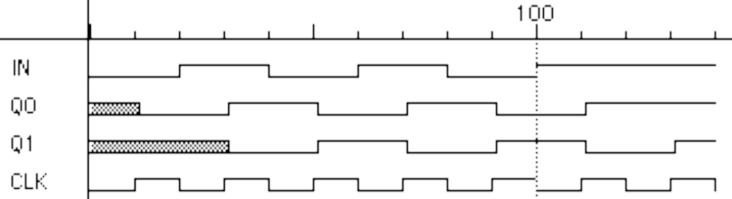
Cascading Edge-triggered Flip-Flops
Shift register
  New value goes into first stage
  While previous value of first stage goes into second stage
  Consider setup/hold/propagation delays (prop must be > hold)
Q0
Q1
IN
D
Q
D
Q
OUT
CLK
100
IN
Q0
Q1
CLK
ZDMC – Lec. #8

Slide 32
Cascading Edge-triggered Flip-Flops (cont’d)
Why this works
  Propagation delays exceed hold times
  Clock width constraint exceeds setup time
  This guarantees following stage will latch current value before it changes to new value
In
Q0
Q1
CLK
T_{su}
4ns
T_{su}
4ns
timing constraints
guarantee proper
operation of
cascaded components
T_{p}
3ns
T_{p}
3ns
assumes infinitely fast
distribution of the clock
T_{h}
2ns
T_{h}
2ns
ZDMC – Lec. #8

Slide 33
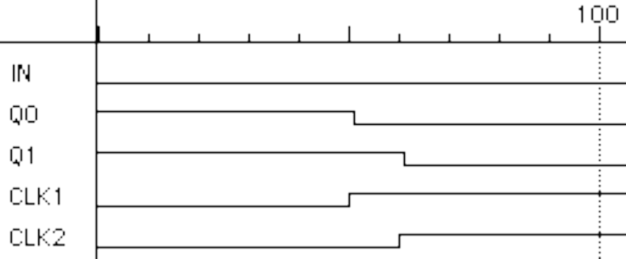
Clock Skew
The problem
  Correct behavior assumes next state of all storage elements
  determined by all storage elements at the same time
  Difficult in high-performance systems because time for clock to arrive at flip-flop is comparable to delays through logic (and will soon become greater than logic delay)
  Effect of skew on cascaded flip-flops:
original state: IN = 0, Q0 = 1, Q1 = 1
due to skew, next state becomes: Q0 = 0, Q1 = 0, and not Q0 = 0, Q1 = 1
100
In
Q0
Q1
CLK0
CLK1
CLK1 is a delayed
version of CLK0
ZDMC – Lec. #8

Slide 34
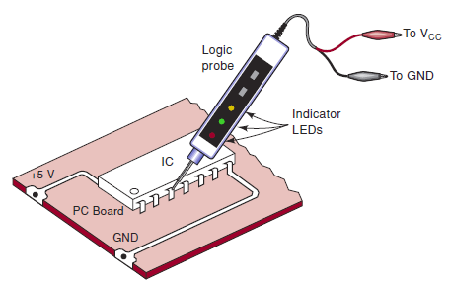
Troubleshooting Digital Systems(阅读)
Fault detection
Fault isolation
Fault correction
Internal Digital IC Faults
  Malfunction in the internal circuitry
  Inputs or outputs shorted to ground or Vcc
  Inputs or outputs open-circuited
  Short between two pins (other than ground or Vcc)
Troubleshooting case study
ZDMC – Lec. #8
Notes:
Open or floating – that is, not connected to any source of voltage
Logic probe, oscilloscope, logic pulser

Slide 35
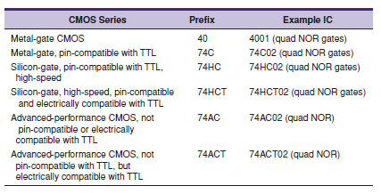

Various series within the CMOS logic family
ZDMC – Lec. #8

