Slide 1
时序电路Verilog描述与设计
刘鹏
liupeng@zju.edu.cn
浙江大学信息与电子工程学院
Apr. 16, 2019
ZDMC – Lec. #14
Notes:
数字系统设计@浙大数芯

Slide 2
Verilog Synthesis
Synthesis vs. Compilation
Descriptions mapped to hardware
Verilog design patterns for best synthesis
ZDMC – Lec. #14
Notes:
数字系统设计@浙大数芯

Slide 3

Logic Synthesis
Verilog and VHDL started out as simulation languages, but soon programs were written to automatically convert Verilog code into low-level circuit descriptions (netlists).
Synthesis converts Verilog (or other HDL) descriptions to an implementation using technology-specific primitives:
  For FPGAs: LUTs, flip-flops, and RAM blocks
  For ASICs: standard cell gate and flip-flop libraries, and memory blocks
ZDMC – Lec. #14
Notes:
数字系统设计@浙大数芯

Slide 4
Why Perform Logic Synthesis?
Automatically manages many details of the design process:
  Fewer bugs
  Improves productivity
Abstracts the design data (HDL description) from any particular implementation technology
  Designs can be re-synthesized targeting different chip technologies; E.g.: first implement in FPGA then later in ASIC
In some cases, leads to a more optimal design than could be achieved by manual means (e.g.: logic optimization)
Why Not Logic Synthesis?
May lead to less than optimal designs in some cases
ZDMC – Lec. #14
Notes:
数字系统设计@浙大数芯

Slide 5
How Does It Work?
Variety of general and ad-hoc (special case) methods:
  Instantiation: maintains a library of primitive modules (AND, OR, etc.) and user defined modules
  “Macro expansion”/substitution: a large set of language operators
  (+, -, Boolean operators, etc.) and constructs (if-else, case) expand into special circuits
  Inference: special patterns are detected in the language description and treated specially (e.g.,: inferring memory blocks from variable declaration and read/write statements, FSM detection and generation from “always @ (posedge clk)” blocks)
  Logic optimization: Boolean operations are grouped and optimized with logic minimization techniques
  Structural reorganization: advanced techniques including sharing of operators, and retiming of circuits (moving FFs), and others
ZDMC – Lec. #14
Notes:
数字系统设计@浙大数芯

Slide 6
Operators
Logical operators map into primitive logic gates
Arithmetic operators map into adders, subtractors, …
  Unsigned 2s complement
  Model carry: target is one-bit wider that source
  Watch out for *, %, and /
Relational operators generate comparators
Shifts by constant amount are just wire connections
  No logic involved
Variable shift amounts a whole different story --- shifter
Conditional expression generates logic or MUX
Y = ~X << 2
X[3]
Y[5]
X[2]
Y[4]
X[1]
Y[3]
X[0]
Y[2]
Y[1]
Y[0]
ZDMC – Lec. #14
Notes:
数字系统设计@浙大数芯

Slide 7
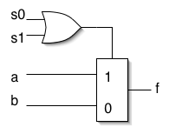
Simple Example
module foo (a,b,s0,s1,f);
input [3:0] a;
input [3:0] b;
input s0,s1;
output [3:0] f;
reg f;
always @ (a or b or s0 or s1)
if (!s0 && s1 || s0) f = a; else f = b;
endmodule
Should expand if-else into 4-bit wide multiplexer (a, b, f are 4-bit vectors) and optimize/minimize the control logic:
ZDMC – Lec. #14
Notes:
数字系统设计@浙大数芯

Slide 8
Module Template
Synthesis tools expects to find modules in this format.
module <top_module_name>(<port list>);
/* Port declarations. followed by wire, reg, integer, task and function declarations */
/* Describe hardware with one or more continuous assignments, always blocks, module instantiations and gate instantiations */
// Continuous assignment
wire <result_signal_name>;
assign <result_signal_name> = <expression>;
// always block
always @(<event expression>)
begin
// Procedural assignments
// if statements
// case, casex, and casez statements
// while, repeat and for loops
// user task and user function calls
end
// Module instantiation
<module_name> <instance_name> (<port list>);
// Instantiation of built-in gate primitive
gate_type_keyword (<port list>);
endmodule
Order of these statements is irrelevant, all execute concurrently
Statements between the begin and end in an always block execute sequentially from top to bottom (however, beware of blocking versus non-blocking assignment)
Statements within a fork-join statement in an always block execute concurrently
ZDMC – Lec. #14
Notes:
数字系统设计@浙大数芯

Slide 9
Procedural Assignments
Verilog has two types of assignments within always blocks:
Blocking procedural assignment “=“
  RHS is executed and assignment is completed before the next statement is executed; e.g.,
    Assume A holds the value 1 … A = 2; B = A; A is left with 2, B with 2.
Non-blocking procedural assignment “<=“
  RHS is executed and assignment takes place at the end of the current time step (not clock cycle); e.g.,
    Assume A holds the value 1 … A <= 2; B <= A; A is left with 2, B with 1.
Notion of “current time step” is tricky in synthesis, so to guarantee that your simulation matches the behavior of the synthesized circuit, follow these rules:
  Use blocking assignments to model combinational logic within an always block
  Use non-blocking assignments to implement sequential logic
  Do not mix blocking and non-blocking assignments in the same always block
  Do not make assignments to the same variable from more than one always block
ZDMC – Lec. #14
Notes:
数字系统设计@浙大数芯
RHS 运算符右边的操作数 right hand side

Slide 10
Supported Verilog Constructs
  Net types: wire, tri, supply1, supply0; register types: reg, integer, time (64 bit reg); arrays of reg
  Continuous assignments
  Gate primitive and module instantiations
  always blocks, user tasks, user functions
  inputs, outputs, and inouts to a module
  All operators (+, -, *, /, %, <, >, <=, >=, ==, !=, ===, !==, &&, ||, !, ~, &, ~&, |, ~|, ^~, ~^, ^, <<, >>, ?:, { }, {{ }}) [Note: / and % are supported for compile-time constants and constant powers of 2]
  Procedural statements: if-else-if, case, casex, casez, for, repeat, while, forever, begin, end, fork, join
  Procedural assignments: blocking assignments =, nonblocking assignments <= (Note: <= cannot be mixed with = for the same register).
  Compiler directives: `define, `ifdef, `else, `endif, `include, `undef
  Miscellaneous:
    Integer ranges and parameter ranges
    Local declarations to begin-end block
    Variable indexing of bit vectors on the left and right sides of assignments
ZDMC – Lec. #14
Notes:
数字系统设计@浙大数芯

Slide 11
Unsupported Language Constructs
Generate error and halt synthesis
Simply ignored
Net types: trireg, wor, trior, wand, triand, tri0, tri1, and charge strength;
register type: real
Built-in unidirectional and bidirectional switches, and pull-up, pull-down
Procedural statements: assign (different from the “continuous assignment”), deassign, wait
Named events and event triggers
UDPs (user defined primitives) and specify blocks
force, release, and hierarchical net names (for simulation only)
Delay, delay control, and drive strength
Scalared, vectored
Initial block
Compiler directives (except for `define, `ifdef, `else, `endif, `include, and `undef, which are supported)
Calls to system tasks and system functions (they are only for simulation)
ZDMC – Lec. #14
Notes:
数字系统设计@浙大数芯

Slide 12
Combinational Logic
CL can be generated using:
  Primitive gate instantiation:
    AND, OR, etc.
  Continuous assignment (assign keyword), example:
  module adder_8 (cout, sum, a, b, cin);
  output cout;
  output [7:0] sum;
  input cin;
  input [7:0] a, b;
  assign {cout, sum} = a + b + cin;
  endmodule
  Always block:
  always @ (event_expression)
  begin
  // procedural assignment statements, if statements,
  // case statements, while, repeat, and for loops.
  // Task and function calls
  end
ZDMC – Lec. #14
Notes:
数字系统设计@浙大数芯

Slide 13
Combinational Logic Always Blocks
Make sure all signals assigned in a combinational always block are explicitly assigned values every time that the always block executes--otherwise latches will be generated to hold the last value for the signals not assigned values!
module mux4to1 (out, a, b, c, d, sel);
output out;
input a, b, c, d;
input [1:0] sel;
reg out;
always @(sel or a or b or c or d)
begin
case (sel)
2'd0: out = a;
2'd1: out = b;
2'd3: out = d;
endcase
end
endmodule
Example:
  Sel case value 2’d2 omitted
  Out is not updated when select line has 2’d2
  Latch is added by tool to hold the last value of out under this condition
ZDMC – Lec. #14
Notes:
数字系统设计@浙大数芯

Slide 14
Combinational Logic Always Blocks (cont.)
To avoid synthesizing a latch in this case, add the missing select line:
2'd2: out = c;
Or, in general, use the “default” case:
default: out = foo;
If you don’t care about the assignment in a case (for instance you know that it will never come up) then assign the value “x” to the variable; E.g.:
default: out = 1‘bx;
The x is treated as a “don’t care” for synthesis and will simplify the logic
(The synthesis directive “full_case” will accomplish the same, but can lead to differences between simulation and synthesis.)
ZDMC – Lec. #14
Notes:
数字系统设计@浙大数芯

Slide 15
Latch Rule
If a variable is not assigned in all possible executions of an always statement then a latch is inferred
  E.g., when not assigned in all branches of an if or case
  Even a variable declared locally within an always is inferred as a latch if incompletely assigned in a conditional statement
ZDMC – Lec. #14
Notes:
数字系统设计@浙大数芯

Slide 16
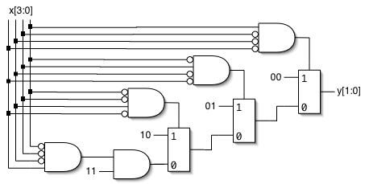
Encoder Example
Nested IF-ELSE might lead to “priority logic”
  Example: 4-to-2 encoder
This style of cascaded logic may adversely affect the performance of the circuit
always @(x)
begin : encode
if (x == 4'b0001) y = 2'b00;
else if (x == 4'b0010) y = 2'b01;
else if (x == 4'b0100) y = 2'b10;
else if (x == 4'b1000) y = 2'b11;
else y = 2'bxx;
end
ZDMC – Lec. #14
Notes:
数字系统设计@浙大数芯

Slide 17
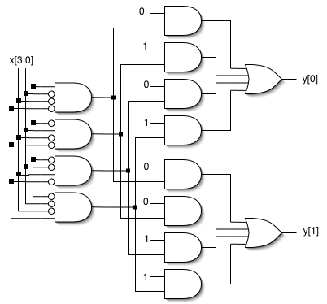
Encoder Example (cont.)
To avoid “priority logic” use the case construct:
All cases are matched in parallel
Note, you don’t need the “parallel case” directive (except under special circumstances, described later)
always @(x)
begin : encode
case (x)
4’b0001: y = 2'b00;
4’b0010: y = 2'b01;
4'b0100: y = 2'b10;
4'b1000: y = 2'b11;
default: y = 2'bxx;
endcase
end
ZDMC – Lec. #14
Notes:
数字系统设计@浙大数芯

Slide 18
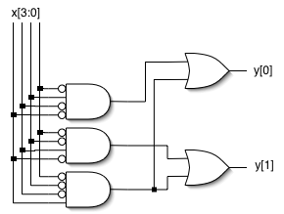
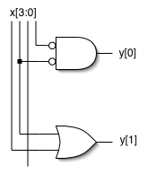
Encoder Example (cont.)
Circuit would be simplified during synthesis to take advantage of constant values as follows and other Boolean equalities:
A similar simplification would be applied to the if-else version also
ZDMC – Lec. #14
Notes:
数字系统设计@浙大数芯

Slide 19
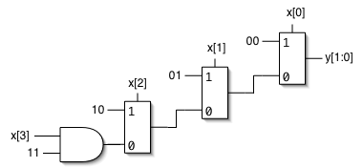
Encoder Example (cont.)
If you can guarantee that only one 1 appears in the input (one hot encoding), then simpler logic can be generated:
If the input applied has more than one 1, then this version functions as a “priority encoder” -- least significant 1 gets priority (the more significant 1’s are ignored); the circuit will be simplified when possible
always @(x)
begin : encode
if (x[0]) y = 2'b00;
else if (x[1]) y = 2'b01;
else if (x[2]) y = 2'b10;
else if (x[3]) y = 2'b11;
else y = 2'bxx;
end
ZDMC – Lec. #14
Notes:
数字系统设计@浙大数芯

Slide 20
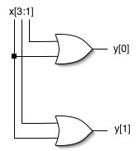
Encoder Example (cont.)
Parallel version, assuming we can guarantee only one 1 in the input:
Note now more than one case might match the input
Therefore use “parallel case” directive: without it, synthesis adds appropriate matching logic to force priority
  Semantics of case construct says that the cases are evaluated from top to bottom
  Only an issue for synthesis when more than one case could match input
always @(x)
begin : encode
casex (x) // synthesis parallel_case
4’bxxx1: y = 2'b00;
4’bxx1x: y = 2'b01;
4'bx1xx: y = 2'b10;
4'b1xxx: y = 2'b11;
default: y = 2'bxx;
endcase
end
ZDMC – Lec. #14
Notes:
数字系统设计@浙大数芯

Slide 21
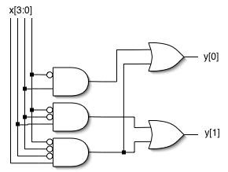
Encoder Example (cont.)
Parallel version of “priority encoder”:
Note: “parallel case” directive is not used, synthesis adds appropriate matching logic to force priority
  Just what we want for a priority encoder
Behavior matches that of the if-else version presented earlier
always @(x)
begin : encode
casex (x)
4’bxxx1: y = 2'b00;
4’bxx1x: y = 2'b01;
4'bx1xx: y = 2'b10;
4'b1xxx: y = 2'b11;
default: y = 2'bxx;
endcase
end
ZDMC – Lec. #14
Notes:
数字系统设计@浙大数芯

Slide 22
Sequential Logic
Example: D flip-flop with synchronous set/reset:
module dff(q, d, clk, set, rst);
input d, clk, set, rst;
output q;
reg q;
always @(posedge clk)
if (reset)
q <= 0;
else if (set)
q <= 1;
else
q <= d;
endmodule
“@ (posedge clk)” key to flip-flop generation
Note in this case, priority logic is appropriate
For Xilinx Virtex FPGAs, the tool infers a native flip-flop
  No extra logic needed for set/reset
We prefer synchronous set/reset,
but how would you specify
asynchronous preset/clear?
s
d
q
clk
r
ZDMC – Lec. #14
Notes:
数字系统设计@浙大数芯

Slide 23
Finite State Machines
module FSM1(clk,rst, enable, data_in, data_out);
input clk, rst, enable;
input data_in;
output data_out;
/* Defined state encoding;
this style preferred over ‘defines*/
parameter default=2'bxx;
parameter idle=2'b00;
parameter read=2'b01;
parameter write=2'b10;
reg data_out;
reg [1:0] state, next_state;
/* always block for sequential logic*/
always @(posedge clk)
if (rst) state <= idle;
else state <= next_state;
Style guidelines (some of these are to get the right result, and some just for readability)
  Must have reset
  Use separate always blocks for sequential and combination logic parts
  Represent states with defined labels or enumerated types
ZDMC – Lec. #14
Notes:
数字系统设计@浙大数芯

Slide 24
FSMs (cont.)
/* always block for CL */
always @(state or enable or data_in)
begin
case (state)
/* For each state def output and next */
idle : begin
data_out = 1’b0;
if (enable)
next_state = read;
else next_state = idle;
end
read : begin … end
write : begin … end
default : begin
next_state = default;
data_out = 1’bx;
end
endcase
end
endmodule
Use CASE statement in an always to implement next state and output logic
Always use default case and assert the state variable and output to ‘bx:
  Avoids implied latches
  Allows use of don’t cares leading to simplified logic
“FSM compiler” within synthesis tool can re-encode your states; Process is controlled by using a synthesis attribute (passed in a comment).
  Details in Synplify guide
ZDMC – Lec. #14
Notes:
数字系统设计@浙大数芯

Slide 25
Bottom-line
Have the hardware design clear in your mind when you write the Verilog
Write the Verilog to describe that HW
  It is a Hardware Description Language not a Hardware Imagination Language
If you are very clear, the synthesis tools are likely to figure it out
ZDMC – Lec. #14
Notes:
数字系统设计@浙大数芯

Slide 26
常用时序电路模块的设计
带异步清0、异步置1的D触发器
module DFF1(q, qn, d, clk, set, reset);
input d, clk, set, reset;
output q, qn;
reg q, qn;
always @(posedge clk or negedge set or negedge reset)
begin
if (! reset)
begin q <= 0; qn <= 1; end //异步清0，低电平有效
else if (! set )
begin q <= 1; qn <= 0; end //异步置1，低电平有效
else begin q <= d; qn <= ~d; end
end
endmodule
不需要同步输入端D。与组合差别？
set
S
d
q
1D
clk
C1
qn
reset
R
ZDMC – Lec. #14

Slide 27
带同步清0、同步置1的D触发器
module DFF2(q, qn, d, clk, set, reset);
input d, clk, set, reset;
output q, qn;
reg q, qn;
always @ (posedge clk)
begin
if(reset)
begin q <= 0; qn <= 1; end //同步清0，高电平有效
else if (set)
begin q <= 1;qn <= 0; end //同步置1，高电平有效
else
begin q <= d; qn <= ~d; end
end
endmodule
注意：清0和置1，同步与异步差别？
set
1S
d
q
1D
clk
C1
qn
reset
1R
ZDMC – Lec. #14

Slide 28
数据锁存器
电平敏感的一位数据锁存器(同步D）
d
1D
q
module latch_1(q, d, clk);
output q;
input d, clk;
assign q = clk ? d : q; //时钟高电平时，将输入端数据锁存
endmodule
clk
C1
带置位和复位端的1位数据锁存器
set
module latch_2(q, d, clk, set, reset);
output q;
input d, clk, set, reset;
assign q = reset ? 0 : (set ? 1 : (clk ? d : q) );
endmodule
1S
d
q
1D
clk
C1
reset
1R
ZDMC – Lec. #14

Slide 29
8位数据锁存器
8
8
data
1D
qout
module latch_8(qout, data, clk);
output[7 : 0] qout;
input[7 : 0] data;
input clk;
reg[7:0] qout;
always @ (clk or data) begin
if(clk)
qout = data;
end
endmodule
clk
C1
clk高电平有效，
当clk=1时：输出、输入是透明。
ZDMC – Lec. #14

Slide 30
8位数据寄存器
module reg8(out_data,in_data,clk,clr);
output[7:0] out_data;
input clk,clr;
input[7:0] in_data;
reg[7:0] out_data;
always @ (posedge clk or posedge clr) begin
if(clr) out_data <=0;
else out_data <= in_data;
end
endmodule
8
8
in_data
1D
clk
C1
out_data
clr
R
数据锁存器与数据寄存器的差别？
电平触发
边沿触发
ZDMC – Lec. #14

Slide 31
移位寄存器（单向）
SRG8
clr
1R
clk
C1/
din
dout1
module shifter(din , clk , clr ,dout);
parameter n=8;
input din , clk , clr;
output[8:1] dout ;
reg[8:1] dout;
always @(posedge clk) begin
if (clr) dout <= 0; // 同步清0，高电平有效
else begin
dout <= dout << 1; //输出信号左移一位
dout[1] <= din; //输入信号补充到输出信号的最低位
end
end
endmodule
1D
dout8
ZDMC – Lec. #14

Slide 32
计数器
可预置的n位二进制计数器（带异步清0）
module counter_n (out, cout, data, load, cin, clr, clk);
parameter n = 8;
output [n:1] out;
output cout;
input load, cin, clr, clk;
input [n:1] data;
reg [n:1] out;
always @(posedge clk or negedge clr) //异步清0
begin
if(!clr) out <= 0;
else if (load) out <= data; //置数
else
out <= out + cin; //计数或保持
end
assign cout = &out&cin; // 进位
endmodule
clr
CTR8
R
计数器的位数
load
M1
M2
cout
cin
3CT=255
G3
clk
C4/2,3+
8
8
1,4D
data
out
ZDMC – Lec. #14

Slide 33
任意进制计数器（带异步清0）
n:模；size：计数器位数
module n_counter (Q, CO, EN ,clr, clk);
parameter n = 30;
parameter size = 5;
output [size : 1] Q;
output CO;
input EN, clr, clk;
reg [size : 1] Q;
always @(posedge clk or negedge clr) //异步清0
begin
if(!clr) Q <= 0;
else if (Q == (n-1)) Q <= EN ? 0 : Q; //计数或保持
else Q <= Q + EN; //计数或保持
end
assign CO = (Q == (n-1)) & EN; // 进位
endmodule
ZDMC – Lec. #14

Slide 34
可预置的加减计数器
CTR8
module up_down_count(d, clk, clear, load, up_down, qd);
parameter size = 8;
input[size:1] d;
input clk, clear, load, up_down ;
output[size:1] qd;
reg[size:1] cnt;
assign qd = cnt;
always @(posedge clk) begin
if(!clear) cnt <= 0; //低电平、同步复位
else if(load) cnt <= d; //高电平,同步置数
else if(up_down) cnt <= cnt + 1; //加法计数
else cnt <= cnt - 1; //减法计数
end
endmodule
clr
5CT=0
load
M1
M2
M3(dn)
up_down
M4(up)
clk
C5/
1,4+;1,3-
8
8
1,4D
d
qd
ZDMC – Lec. #14

Slide 35
BCD码计数器
module count60(qout, cout, data, load, cin, reset, clk);
parameter MODULUS = 8'h23;
output[7:0] qout;
output cout;
input[7:0] data;
input load, cin, reset, clk;
reg [7:0] qout;
assign cout = (qout==MODULUS) & cin; //进位
always @(posedge clk) begin
  if(reset) qout <= 0;
  else if(load) qout <= data;//同步置数
  else if(cin) //cin=1,计数cin=0,保持
  begin
  if(qout == MODULUS) qout <= 0 ;
  else if (qout[3:0] == 9)begin
  qout[3:0] <= 0;
  qout[7:4] <= qout[7:4]+1;
  end
    else qout[3:0] <= qout[3:0]+1;
    end
  end
endmodule
改变MODULUS的值（<=100)，即可改变模
ZDMC – Lec. #14

Slide 36

More Help
Online documentation for Synplify Synthesis Tool:
  Under Documents/General Documentation, see Synplify Web Site/Literature:
  http://www.synplicity.com/literature/index.html
  Online examples from Synplicity
Bhasker is a good synthesis reference
Trial and error with the synthesis tool
  Synplify will display the output of synthesis in schematic form for your inspection--try different input and see what it produces
ZDMC – Lec. #14
Notes:
数字系统设计@浙大数芯

Slide 37
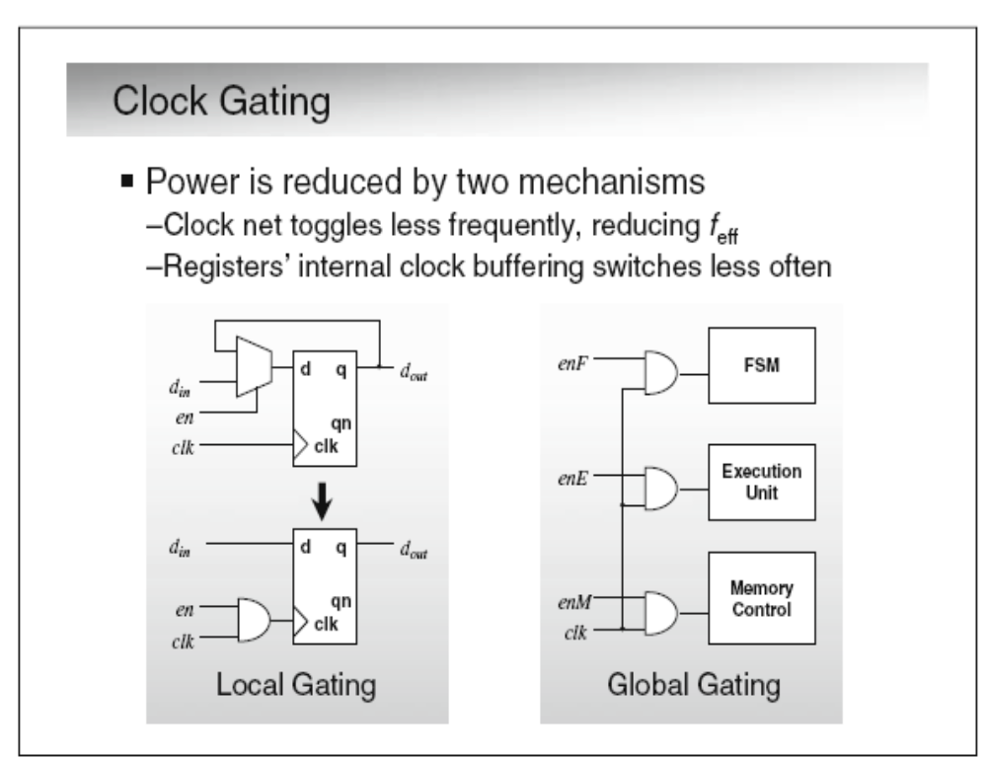
Clock gating is the single most popular technique for reducing dynamic power.
ZDMC – Lec. #14

Slide 38
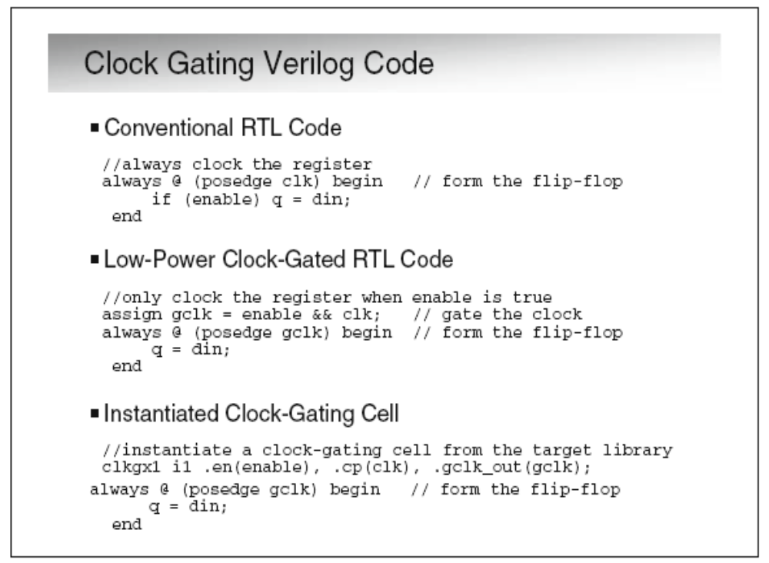
The first snippet of Verilog RTL code
ZDMC – Lec. #14
Notes:
数字系统设计@浙大数芯

