Slide 1
测试
Testing
刘鹏
liupeng@zju.edu.cn
College of ISEE
Zhejiang University
Source: 补充讲义
June 2019
ZDMC
Notes:
EE141
对设计过程的测试称为“设计验证”，对制造过程的测试就是集成电路领域常说的“测试”。传统的测试方法是使用自动测试设备（Automatic Test Equipment，简称ATE或测试仪）对被测芯片施加测试向量，捕获芯片的输出结果与预期的正确结果进行比较，以判断芯片中是否存在某一类型的故障。
对于数字电路，单固定故障模型是最简单和实用的。

Slide 2
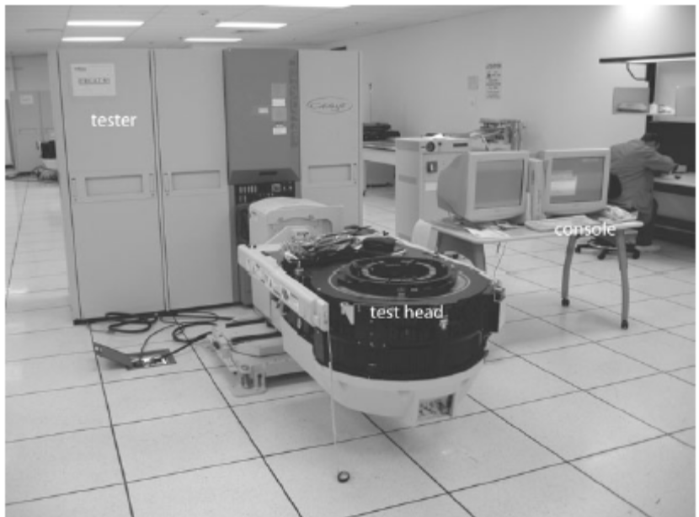
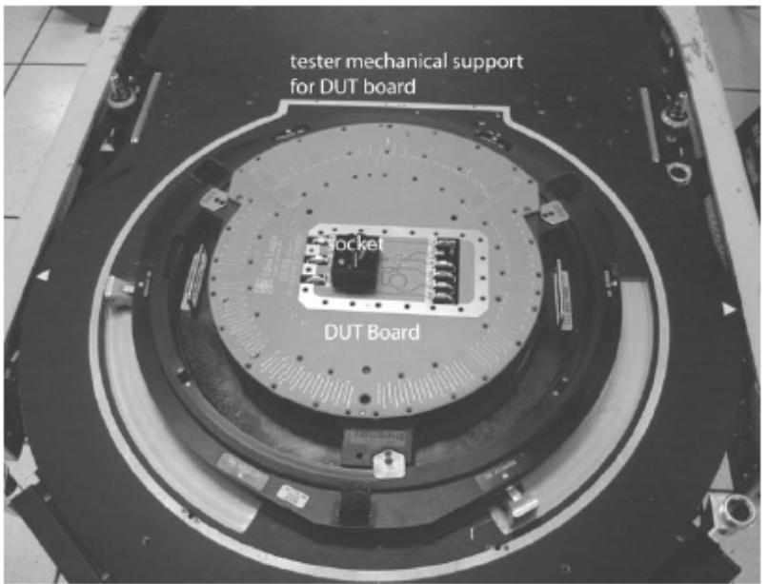
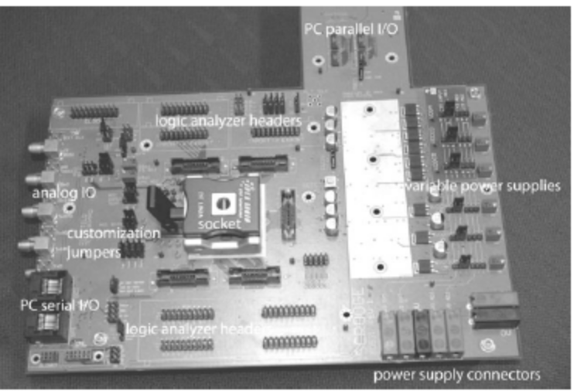
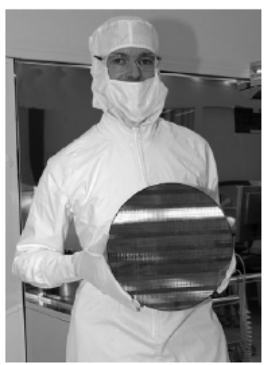
Fabrication, Packaging, and Testing
ZDMC
Notes:
A typical production tester
Tester load board in test head
Typical test board
Engineer holding processed 12-inch wafer
ZDMC

Slide 3
Design Methodology in Detail
Design Specification
Postsynthesis
Design Validation
Design Partition
Postsynthesis
Timing Verification
Design Entry
Behavioral Modeling
Test Generation and
Fault Simulation
Simulation/Functional
Verification
Cell Placement/Scan
Insertation/Routing
Design Integration
And Verification
Verify Physical and
Electrical Rules
Pre-Synthesis
Sign-Off
Synthesize and Map
Gate-level Net List
Synthesize and Map
Gate-level Net List
Design Sign-Off
ZDMC

Slide 4
Testing of Logic Circuits
Fault Models(故障模型)
Test Generation and Coverage
Fault Detection
Design for Test（可测试性设计）
ZDMC
Notes:
EE141

Slide 5
Fault Model (故障模型)
Stuck-At Model（固定型故障模型）
  Assume selected wires (gate input or output) are “stuck at” logic value 0 or 1
  Models curtain kinds of fabrication flaws that short circuit wires to ground or power, or broken wires that are floating
    Wire w stuck-at-0: w/0
    Wire w stuck-at-1: w/1
  Often assume there is only one fault at a time—even though in real circuits multiple simultaneous faults are possible and can mask each other
  Obviously a very simplistic model!
ZDMC
Notes:
curtain:隐藏

Slide 6


Fault Model
Simple example:
Generate a testcase to determine if a is stuck at 1
  Try 000
  If a stuck at 1, expect to see f = 0, but see 1 instead
0
0
0
w₁
w₂
w₃
a/1
b
c
f
see 1
but should be 0
d
0
ZDMC

Slide 7
Fault Model(故障模型)
Simple example
w₁
w₂
w₃
a
b
c
f
d
Test
w1 w2 w3
000
001
010
011
100
101
110
111
Fault Detected
a/0
X
X
X
a/1
X
X
X
b/0
X
b/1
X
c/0
X
c/1
X
d/0
X
d/1
X
X
X
f/0
X
X
X
X
X
f/1
X
X
X
Test
Set
ZDMC
Notes:
EE141

Slide 8
Problems with Fault Model
In general, n-input circuits require much less than 2^{n} test inputs to cover all possible stuck-at-faults in the circuit
However, this number is usually still too large in real circuits for practical purposes
Finding minimum test cover is an NP-hard problem too
ZDMC

Slide 9
Path Sensitization（路径敏化）
Wire-at-time testing too laborious
Better to focus on wiring paths, enabling multi-wire testing at the same time
“Activate” a path so that changes in signal propagating along the path affects the output
ZDMC

Slide 10
Path Sensitization （路径敏化）
Simple Example:
w₁
w₂
a
b
1
c
w₃
0
f
To activate the path, set inputs so that w₁ can influence f
E.g., w₂ = 1, w₃ = 0, w₄ = 1
AND gates: one input at 1 passes the other input
NOR gates: one input at 0 inverts the other input
To test: w₁ set to 1 should generate f = 0 if path ok
faults a/0, b/0, c/1 cause f = 1
w₁ set to 0 should generate f = 1 if path ok
faults a/1, b/1, c/0 cause f = 0
One test can capture several faults at once!
w₄
1
ZDMC

Slide 11
Path Sensitization （路径敏化）
Good news: one test checks for several faults
  Number of paths much smaller than number of wires
  Still an impractically large number of paths for large-scale circuits
Path idea can be used to “propagate” a fault to the output to observe the fault
  Set inputs and intermediate values so as to pass an internal wire to the output while setting inputs to drive that internal wire to a known value
  If propagated value isn’t as expected, then we have found a fault on the isolated wire
ZDMC

Slide 12
Fault Propagation
w₁
w₂
b
b/0
h
g
f
w₃
w₄
c
k
w₁
w₂
0
0
D
D
D
1
f
w₃
w₄
1
1
0
1
ZDMC

Slide 13
Fault Propagation
w₁
w₂
b
h
g
g/1
f
w₃
w₄
c
k
w₁
w₂
0
0
1
D
D
D
f
w₃
w₄
0
0
1
D
ZDMC

Slide 14
Tree Structured Circuits
To test inputs stuck-at-0 at given AND gate
  Set inputs at other gates to generate AND output of zero
  Force inputs at selected gate to generate a one
  If f is 1 then circuit ok, else fault
To test inputs stuck-at-1 at given AND gate
  Drive input to test to 0, rest of inputs driven to 1
  Other gates driven with inputs that force gates to 0
  If f is 0 then OK, else fault.
w₁
w₃
w₄
w₂
w₃
w₄
f
w₁
w₂
w₃
ZDMC
Notes:
ZDMC

Slide 15
Tree Structured Circuits
Product Term
Test
Stuck-at-0
w₁
1
0
0
0
1
1
1
0
w₃
1
1
0
1
0
1
0
0
w₄
1
0
0
1
1
0
0
0
w₂
0
1
1
1
1
0
1
0
w₃
1
1
0
1
0
1
0
0
w₄
0
1
1
0
0
1
1
1
w₁
0
1
1
1
0
0
0
1
w₂
0
1
1
1
1
0
1
0
w₃
0
0
1
0
1
0
1
1
w₁
1
0
0
0
1
1
1
0
w₂
0
1
1
1
1
0
1
0
w₃
0
0
1
0
1
0
1
1
w₄
0
1
1
0
0
1
1
1
1
1
1
0
1
0
0
0
0
w₁
w₃
w₄
1
2
3
4
5
6
7
8
Stuck-at-0
w₂
w₃
w₄
0
0
0
f
0
w₁
w₂
w₃
Stuck-at-1
ZDMC
Notes:
EE141

Slide 16
Tree Structured Circuits
Product Term
Test
Stuck-at-0
w₁
1
0
0
0
1
1
1
0
w₃
1
1
0
1
0
1
0
0
w₄
1
0
0
1
1
0
0
0
w₂
0
1
1
1
1
0
1
0
w₃
1
1
0
1
0
1
0
0
w₄
0
1
1
0
0
1
1
1
w₁
0
1
1
1
0
0
0
1
w₂
0
1
1
1
1
0
1
0
w₃
0
0
1
0
1
0
1
1
w₁
1
0
0
0
1
1
1
0
w₂
0
1
1
1
1
0
1
0
w₃
0
0
1
0
1
0
1
1
w₄
0
1
1
0
0
1
1
1
0
1
0
1
1
1
1
1
0
w₁
w₃
w₄
1
2
3
4
5
6
7
8
Stuck-at-0
w₂
w₃
w₄
0
0
0
f
0
w₁
w₂
w₃
Stuck-at-1
ZDMC
Notes:
EE141

Slide 17
Tree Structured Circuits
Product Term
Test
Stuck-at-0
w₁
1
0
0
0
1
1
1
0
w₃
1
1
0
1
0
1
0
0
w₄
1
0
0
1
1
0
0
0
w₂
0
1
1
1
1
0
1
0
w₃
1
1
0
1
0
1
0
0
w₄
0
1
1
0
0
1
1
1
w₁
0
1
1
1
0
0
0
1
w₂
0
1
1
1
1
0
1
0
w₃
0
0
1
0
1
0
1
1
w₁
1
0
0
0
1
1
1
0
w₂
0
1
1
1
1
0
1
0
w₃
0
0
1
0
1
0
1
1
w₄
0
1
1
0
0
1
1
1
0
0
0
1
0
1
1
1
1
w₁
w₃
w₄
1
2
3
4
5
6
7
8
Stuck-at-0
w₂
w₃
w₄
0
0
0
f
0
w₁
w₂
w₃
Stuck-at-1
ZDMC
Notes:
EE141

Slide 18
Tree Structured Circuits
Product Term
Test
Stuck-at-1
w₁
1
0
0
0
1
1
1
0
w₃
1
1
0
1
0
1
0
0
w₄
1
0
0
1
1
0
0
0
w₂
0
1
1
1
1
0
1
0
w₃
1
1
0
1
0
1
0
0
w₄
0
1
1
0
0
1
1
1
w₁
0
1
1
1
0
0
0
1
w₂
0
1
1
1
1
0
1
0
w₃
0
0
1
0
1
0
1
1
w₁
1
0
0
0
1
1
1
0
w₂
0
1
1
1
1
0
1
0
w₃
0
0
1
0
1
0
1
1
w₄
0
1
1
0
0
1
1
1
0
1
1
1
1
0
1
1
0
w₁
w₃
w₄
1
2
3
4
5
6
7
8
Stuck-at-0
w₂
w₃
w₄
1
0
0
f
1
w₁
w₂
w₃
Stuck-at-1
ZDMC
Notes:
EE141

Slide 19
Tree Structured Circuits
Product Term
Test
Stuck-at-1
w₁
1
0
0
0
1
1
1
0
w₃
1
1
0
1
0
1
0
0
w₄
1
0
0
1
1
0
0
0
w₂
0
1
1
1
1
0
1
0
w₃
1
1
0
1
0
1
0
0
w₄
0
1
1
0
0
1
1
1
w₁
0
1
1
1
0
0
0
1
w₂
0
1
1
1
1
0
1
0
w₃
0
0
1
0
1
0
1
1
w₁
1
0
0
0
1
1
1
0
w₂
0
1
1
1
1
0
1
0
w₃
0
0
1
0
1
0
1
1
w₄
0
1
1
0
0
1
1
1
0
1
1
1
1
0
1
1
0
w₁
w₃
w₄
1
2
3
4
5
6
7
8
Stuck-at-0
w₂
w₃
w₄
0
1
0
f
1
w₁
w₂
w₃
Stuck-at-1
ZDMC
Notes:
EE141

Slide 20
Tree Structured Circuits
Product Term
Test
Stuck-at-1
w₁
1
0
0
0
1
1
1
0
w₃
1
1
0
1
0
1
0
0
w₄
1
0
0
1
1
0
0
0
w₂
0
1
1
1
1
0
1
0
w₃
1
1
0
1
0
1
0
0
w₄
0
1
1
0
0
1
1
1
w₁
0
1
1
1
0
0
0
1
w₂
0
1
1
1
1
0
1
0
w₃
0
0
1
0
1
0
1
1
w₁
1
0
0
0
1
1
1
0
w₂
0
1
1
1
1
0
1
0
w₃
0
0
1
0
1
0
1
1
w₄
0
1
1
0
0
1
1
1
0
1
1
1
1
0
1
1
0
w₁
w₃
w₄
1
2
3
4
5
6
7
8
Stuck-at-0
w₂
w₃
w₄
0
0
1
f
1
w₁
w₂
w₃
Stuck-at-1
ZDMC
Notes:
EE141

Slide 21
Tree Structured Circuits
Product Term
Test
Stuck-at-1
w₁
1
0
0
0
1
1
1
0
w₃
1
1
0
1
0
1
0
0
w₄
1
0
0
1
1
0
0
0
w₂
0
1
1
1
1
0
1
0
w₃
1
1
0
1
0
1
0
0
w₄
0
1
1
0
0
1
1
1
w₁
0
1
1
1
0
0
0
1
w₂
0
1
1
1
1
0
1
0
w₃
0
0
1
0
1
0
1
1
w₁
1
0
0
0
1
1
1
0
w₂
0
1
1
1
1
0
1
0
w₃
0
0
1
0
1
0
1
1
w₄
0
1
1
0
0
1
1
1
1
0
1
1
0
0
0
1
1
w₁
w₃
w₄
1
2
3
4
5
6
7
8
Stuck-at-0
w₂
w₃
w₄
1
0
0
f
1
w₁
w₂
w₃
Stuck-at-1
ZDMC
Notes:
EE141

Slide 22
Tree Structured Circuits
Product Term
Test
Stuck-at-1
w₁
1
0
0
0
1
1
1
0
w₃
1
1
0
1
0
1
0
0
w₄
1
0
0
1
1
0
0
0
w₂
0
1
1
1
1
0
1
0
w₃
1
1
0
1
0
1
0
0
w₄
0
1
1
0
0
1
1
1
w₁
0
1
1
1
0
0
0
1
w₂
0
1
1
1
1
0
1
0
w₃
0
0
1
0
1
0
1
1
w₁
1
0
0
0
1
1
1
0
w₂
0
1
1
1
1
0
1
0
w₃
0
0
1
0
1
0
1
1
w₄
0
1
1
0
0
1
1
1
1
0
1
1
0
0
0
1
1
w₁
w₃
w₄
1
2
3
4
5
6
7
8
Stuck-at-0
w₂
w₃
w₄
0
0
1
f
1
w₁
w₂
w₃
Stuck-at-1
ZDMC
Notes:
EE141

Slide 23
Tree Structured Circuits
Product Term
Test
Stuck-at-1
w₁
1
0
0
0
1
1
1
0
w₃
1
1
0
1
0
1
0
0
w₄
1
0
0
1
1
0
0
0
w₂
0
1
1
1
1
0
1
0
w₃
1
1
0
1
0
1
0
0
w₄
0
1
1
0
0
1
1
1
w₁
0
1
1
1
0
0
0
1
w₂
0
1
1
1
1
0
1
0
w₃
0
0
1
0
1
0
1
1
w₁
1
0
0
0
1
1
1
0
w₂
0
1
1
1
1
0
1
0
w₃
0
0
1
0
1
0
1
1
w₄
0
1
1
0
0
1
1
1
1
1
0
0
1
1
0
0
0
w₁
w₃
w₄
1
2
3
4
5
6
7
8
Stuck-at-0
w₂
w₃
w₄
0
1
0
f
1
w₁
w₂
w₃
Stuck-at-1
Any other stuck-at-1 cases covered?
ZDMC
Notes:
EE141

Slide 24
Tree Structured Circuits
Product Term
Test
Stuck-at-1
w₁
1
0
0
0
1
1
1
0
w₃
1
1
0
1
0
1
0
0
w₄
1
0
0
1
1
0
0
0
w₂
0
1
1
1
1
0
1
0
w₃
1
1
0
1
0
1
0
0
w₄
0
1
1
0
0
1
1
1
w₁
0
1
1
1
0
0
0
1
w₂
0
1
1
1
1
0
1
0
w₃
0
0
1
0
1
0
1
1
w₁
1
0
0
0
1
1
1
0
w₂
0
1
1
1
1
0
1
0
w₃
0
0
1
0
1
0
1
1
w₄
0
1
1
0
0
1
1
1
1
0
0
1
0
1
0
1
1
w₁
w₃
w₄
1
2
3
4
5
6
7
8
Stuck-at-0
w₂
w₃
w₄
0
1
0
f
1
w₁
w₂
w₃
Stuck-at-1
Any other stuck-at-1 cases covered?
Was that case already covered?
ZDMC
Notes:
EE141

Slide 25
Tree Structured Circuits
Product Term
Test
Stuck-at-1
w₁
1
0
0
0
1
1
1
0
w₃
1
1
0
1
0
1
0
0
w₄
1
0
0
1
1
0
0
0
w₂
0
1
1
1
1
0
1
0
w₃
1
1
0
1
0
1
0
0
w₄
0
1
1
0
0
1
1
1
w₁
0
1
1
1
0
0
0
1
w₂
0
1
1
1
1
0
1
0
w₃
0
0
1
0
1
0
1
1
w₁
1
0
0
0
1
1
1
0
w₂
0
1
1
1
1
0
1
0
w₃
0
0
1
0
1
0
1
1
w₄
0
1
1
0
0
1
1
1
0
0
0
0
0
1
1
0
1
w₁
w₃
w₄
1
2
3
4
5
6
7
8
Stuck-at-0
w₂
w₃
w₄
0
0
1
f
1
w₁
w₂
w₃
Stuck-at-1
All inputs stuck-at-1’s covered now
ZDMC
Notes:
EE141

Slide 26
Random Testing
So far: deterministic testing
Alternative: random testing
  Generate random input patterns to distinguish between the correct function and the faulty function
Probability
Fault
Detected
Small number of tests
has reasonable
probability of finding
the fault
Number of
Tests
ZDMC

Slide 27
Sequential Testing
Due to embedded state inside flip-flops, it is difficult to employ the same methods as with combinational logic
Alternative approach: design for test
  Scan Path technique: FF inputs pass through multiplexer stages to allow them to be used in normal mode as well as a special test shift register mode
ZDMC

Slide 28
Scan Path Technique
Combinational
Logic
Configure FFs into shift register mode (red path)
Scan in test pattern of 0s and 1s
Non-state inputs can also be on the scan path (think synchronous Mealy Machine)
Run system for one clock cycle in “normal” mode (black path)—next state captured in scan path
Return to shift register mode and shift out the captured state and outputs
ZDMC

Slide 29
Scan Path Example
w,y1,y2 test vector 001
  Scan 01 into y1, y2 FFs
w
Y₁
Y₂
Scan-out
z
y₁
y₂
0
1
Q
D
Q
Q
D
0
1
Q
0
Scan-in
G/S
ZDMC

Slide 30
Scan Path Example
w,y1,y2 test vector 001
  Scan 01 into y1, y2 FFs
w
Y₁
Y₂
Scan-out
z
y₁
y₂
0
1
Q
D
0
Q
Q
D
0
1
0
Q
1
ZDMC
Scan-in
G/S

Slide 31
Scan Path Example
w,y1,y2 test vector 001
  Scan 01 into y1, y2 FFs
w
Y₁
Y₂
Scan-out
z
y₁
y₂
0
1
Q
D
0
0
Q
Q
D
0
1
1
Q
1
ZDMC
Scan-in
G/S

Slide 32
Scan Path Example
w,y1,y2 test vector 001
  Scan 01 into y1, y2 FFs
  Normal w=0
0
Y₁
Y₂
w
Scan-out
z
y₁
y₂
0
1
Q
D
0
0
Q
Q
D
0
1
1
Q
1
ZDMC
Scan-in
G/S

Slide 33
Scan Path Example
w,y1,y2 test vector 001
  Scan 01 into y1, y2 FFs
  Normal w=0
  Output z=0, Y1=0, Y2=0
0
0
Y₁
Y₂
w
0
0
Scan-out
z
y₁
y₂
0
1
Q
D
0
Q
Q
D
0
1
1
Q
ZDMC
Scan-in
G/S

Slide 34
Scan Path Example
w,y1,y2 test vector 001
  Scan 01 into y1, y2 FFs
  Normal w=0
  Output z=0, Y1=0, Y2=0
  Observe z directly
0
0
Y₁
Y₂
w
0
0
Scan-out
z
y₁
y₂
0
1
Q
D
0
Q
Q
D
0
1
0
Q
ZDMC
Scan-in
G/S

Slide 35
Scan Path Example
w,y1,y2 test vector 001
  Scan 01 into y1, y2 FFs
  Normal w=0
  Output z=0, Y1=0, Y2=0
  Observe z directly
  Scan out Y1, Y2
w
Y₁
Y₂
0
Scan-out
z
y₁
y₂
0
1
Q
D
0
0
Q
Q
D
0
1
0
Q
ZDMC
Scan-in
G/S

Slide 36
Scan Path Example
w,y1,y2 test vector 001
  Scan 01 into y1, y2 FFs
  Normal w=0
  Output z=0, Y1=0, Y2=0
  Observe z directly
  Scan out Y1, Y2
w
Y₁
Y₂
0
Scan-out
z
y₁
y₂
0
1
Q
D
0
Q
Q
D
0
1
0
Q
ZDMC
Scan-in
G/S

Slide 37
Built-in Self-Test (BIST)
x₀
.
.
.
x_{n-1}
P₀
.
.
.
P_{m-1}
Test
Vector
Generator
Circuit
Under
Test
Test
Response
Compressor
Signature
Test Vector Generator
  Pseudorandom tests with a feedback shift register
  Seed generates a sequence of test patterns
  Outputs combined using the same technique
  Generates a unique signature that can be checked to determine if the circuit is correct
ZDMC
Notes:
EE141

Slide 38

Linear Feedback Shift Register
D
Q
D
Q
D
Q
D
Q
Q
Q
Q
Q
Random Test Pattern
P
D
Q
D
Q
D
Q
D
Q
Input from
circuit under test
Q
Q
Q
Q
Signature
ZDMC

Slide 39
Linear Feedback Shift Register
f
D
Q
D
Q
D
Q
D
Q
Q
Q
Q
Q
Initial Configuration
x₃
x₂
x₁
x₀
x₃
x₂
x₁
x₀
f
1
0
0
0
1
1
1
0
0
1
1
1
1
0
1
1
1
1
1
0
0
1
1
1
1
1
0
1
1
0
0
1
0
1
1
1
0
1
0
1
1
1
0
1
0
0
1
1
0
0
0
0
1
1
1
1
0
0
1
0
0
1
0
0
0
0
0
1
0
0
0
0
0
1
1
1
0
0
0
1
…
…
Starting with the pattern 1000, generates 15 different patterns in sequence and then repeats
Pattern 0000 is a no-no
ZDMC
Notes:
If you say that something is a no-no, you think it is undesirable or unacceptable. (INFORMAL)
We all know that cheating on our taxes is a no-no.
ZDMC

Slide 40
Linear Feedback Shift Register
Multi-input Compressor
Signature
D
Q
D
Q
D
Q
D
Q
Q
Q
Q
Q
P₃
P₂
P₁
P₀
Circuit Under Test Outputs
ZDMC

Slide 41
Complete Self-Test System
Normal
Inputs
MIC
M
U
X
Combinational
Circuit
Multi-input
Compressor
PRBSG
Scan out
SIC
Random
Test
Sequences
FFs and
Muxes
Single-input
Compressor
Scan in
PRBSG
Random
Test
Sequences
ZDMC

Slide 42

Built-in Logic Block Observer (Bilbo)
Test generation and compression in a single circuit!
  M₁, M₂ = 11: Regular mode
  M₁, M₂ = 00: Shift register mode
  M₁, M₂ = 10: Signature generation mode
  M₁, M₂ = 01: Reset mode
M₁
P₃
P₂
P₁
P₀
M₂
S_{in}
D
Q
D
Q
D
Q
D
Q
Q
Q
Q
Q
G/S
Q₃
Q₂
Q₁
Q₀
Normal/Scan
ZDMC

Slide 43
Bilbo Architecture
Scan-out
Combinational
Network
CN1
Combinational
Network
CN2
BILBO1
BILBO2
Scan-in
Scan initial pattern in Bilbo1, reset FFs in Bilbo2
Use Bilbo1 as PRBS generator for given number of clock cycles and use Bilbo2 to produce signature
Scan out Bilbo2 and compare signature; Scan in initial test pattern for CN2; Reset the FFs in Bilbo1
Use Bilbo2 as PRBS generator for a given number of clock cycles and use Bilbo1 to produce signature
Scan out Bilbo1 and compare signature;
ZDMC

Slide 44
Summary
Fault models
  Approach for determining how to develop a test pattern sequence
  Weakness is the single fault assumption
Scan Path
  Technique for applying test inputs deep within the system, usually for asserting state
  Technique for getting internal state to edges of circuit for observation
Built-in Test
  Founded on the approach of random testing
  Generate pseudo random sequences; compute signature; determine if signature generated is the same as signature of a correctly working circuitry.
ZDMC
Notes:
N-UNCOUNT circuitry
Circuitry is a system of electric circuits.
ZDMC

Slide 45
Acknowledgements
Material derived from UCB course EECS150
Neil H.E. Weste and David Money Marris, CMOS VLSI Design A Circuits and Systems Perspective, 2012.
ZDMC
Notes:
EE141

